Slide 1
Secondary: Data and information: Vocabulary
Live version

Slide 2
Cell
A place for a single piece of data on a spreadsheet.

Slide 3
Cell reference
The name or coordinates of a single cell. The example here has a cell reference of B2.

Slide 4
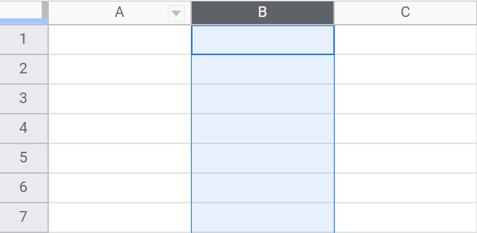
Column
Data going vertically (up and down) on a spreadsheet.
The column highlighted is column B.

Slide 5
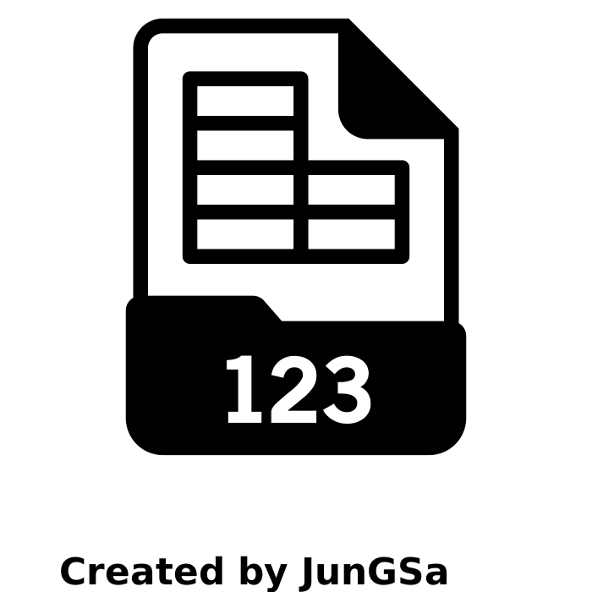
Data
Numbers, text or characters that, on their own, have no meaning.

Slide 6
Database
An organised collection of data.
Created by Larea
From Noun Project

Slide 7
Field
A table has a number of fields. These are the categories for each piece of data in the table.
For example,
Title
Author
ISBN

Slide 8
Flat file database
A flat file database is a database that contains a single table.

Slide 9
Foreign key
When you link to a source table’s primary key you use a foreign key.
A foreign key can be repeated because it is a link back to the primary key in the source table.

Slide 10
Information
Data that has been put into context to provide meaning.

Slide 11
Primary key
A primary key is a unique identifier for a collection of data in a database.
It cannot be repeated.

Slide 12
Record
A table contains a collection of records.
Each record contains the data for one object, person, or place.

Slide 13
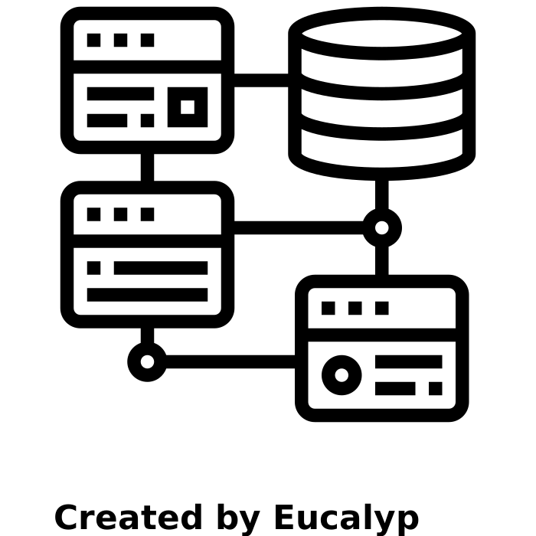
Relational database
A relational database contains more than one table.
The data in the tables are linked using relationships.

Slide 14
Row
Data going horizontally on a spreadsheet. Each horizontal line of cells is a row.
The example shows row 2 being highlighted.

Slide 15
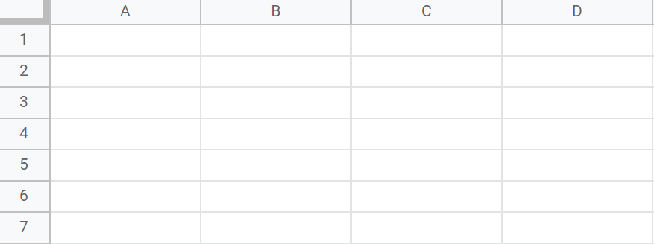
Spreadsheet
A piece of software that allows you to store data in columns and rows.
The data can then be analysed by using formulas and creating graphs.

Slide 16
Spreadsheet formula
A mathematical rule that can be applied to data. In a spreadsheet, a formula always begins with an equals ‘=’ sign.

Slide 17
Spreadsheet function
A predefined formula that can be performed on data in a spreadsheet.
An identifier, like sum, is used to call the function.

Slide 18
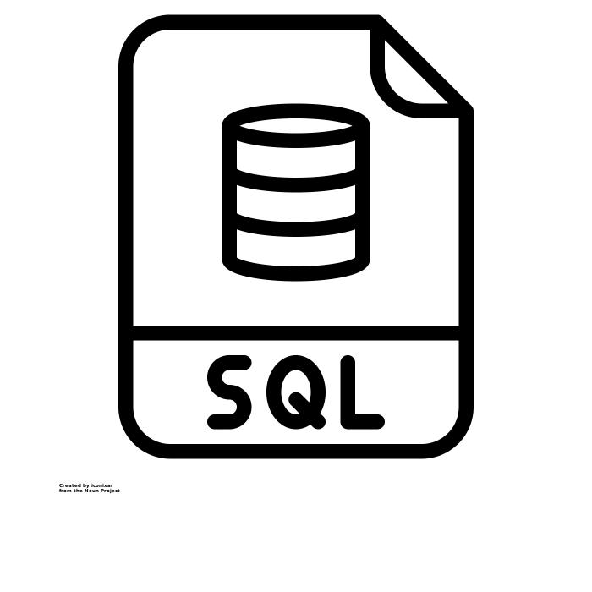
Structured Query Language (SQL)
A language used to communicate with a database.
You can use SQL to manipulate databases and retrieve records.

Slide 19
Table
A table holds a collection of records for a particular theme.
For example, the books in a library.

