Slide 1
Algorithms: Top tips
Live version
Notes:
Live version

Slide 2
Many of these top tips were suggested by educators during the weekly #CASchat on Twitter. They were then collated and built upon at the Hack the Curriculum event

Slide 3
Top tip 1
Primary
Secondary
An algorithm can be spoken, written or drawn so introduce a variety.
@hengehall #CASChat

Slide 4
Top Tip 2
Primary
Algorithms look different at Y1 than they do at Y6. Start simple and build complexity over time.
@hengehall #CASChat

Slide 5
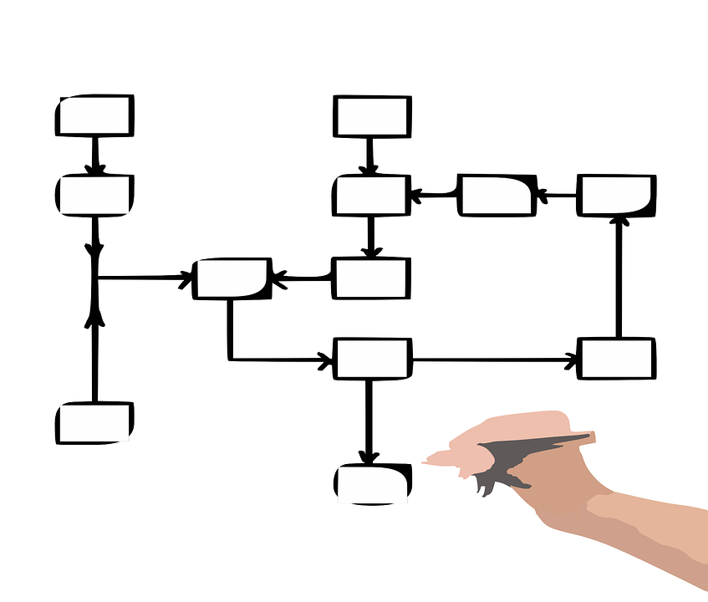
Top Tip 3
Primary
Secondary
Showing flowcharts, pseudo code and program code for the same algorithm can be helpful and asking students to move between these, e.g. can they write the code when given the flowchart.
@binarygenius #CASChat

Slide 6
Top Tip 4
Primary
Talk about the algorithm as a plan for the program, and make sure that this planning is a key part of programming (whether Bee-Bots using command cards, or Scratch in a form of pseudocode).

Slide 7
Top Tip 5
Secondary
When teaching standard algorithms, make sure that students know terminology such as “pass” in the context of bubble sort and “pivot” for quicksort. Use the vocabulary in explanations and require students to use it in their verbal and written explanations.
@binarygenius #CASChat

Slide 8
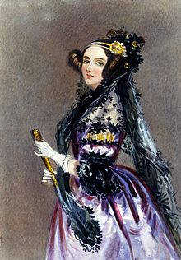
Top Tip 6
Primary
Secondary
Use a diverse range of role models that relate to algorithms in the real world. For example, Ada Lovelace wrote the first ever algorithm.

Slide 9
Top Tip 7
Primary
Secondary
Explain the difference between an algorithm and a program.
An algorithm is a way to solve a problem with a computer, written in a form that a human can understand.
A program is the execution of an algorithm in a specific programming language.

Slide 10
Top Tip 8
Primary
Secondary
Introduce concrete examples (unplugged) before moving on to abstract examples.
https://www.rodocodo.com/demystifying-coding-for-teachers-in-4-easy-steps/

Slide 11
Top Tip 9
Primary
Secondary
Use real-world contexts to teach about algorithms - and ensure students are familiar with these contexts (e.g. washing hands).
Link to Algorithms - examples presentation

Slide 12
Top Tip 10
Primary
Secondary
Revisit key terms and concepts over time in different contexts to consolidate knowledge.
Primary vocabulary
Secondary vocabulary

Slide 13
Top Tip 11
Primary
Secondary
Use cross-curricular links to consolidate familiarity of algorithms - e.g. how to use a dictionary in English or column addition in maths.

Slide 14
Top Tip 12
Primary
Secondary
When exploring algorithms through physical activities such as human robot, students will encounter the same problems as when writing code. Encountering these problems through play can help to alleviate some of the anxiety felt when coding for the ﬁrst time
@CASchat_uk #CASchat

Slide 15
Top Tip 13
Primary
With younger learners, you “need to make teaching algorithms much more concrete using physical resources rather than writing steps and breaking down a problem.”
@TsuiAllen #CASchat

Slide 16
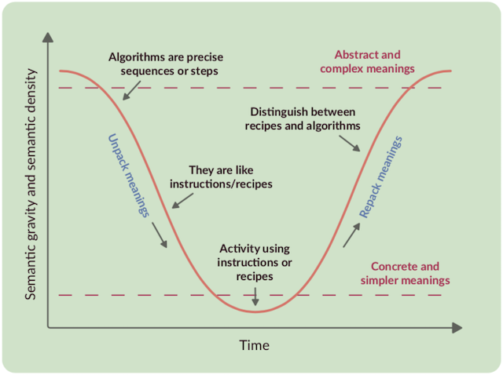
Top Tip 14
Primary
Secondary
Consider the semantic wave - ensure students make connections between the concrete examples and the abstract concept.
Read more at https://blog.teachcomputing.org/quick-read-6-semantic-waves/
Source: Teach Computing

