Slide 1
10 approaches for encouraging diversity in your computing classroom

Slide 2
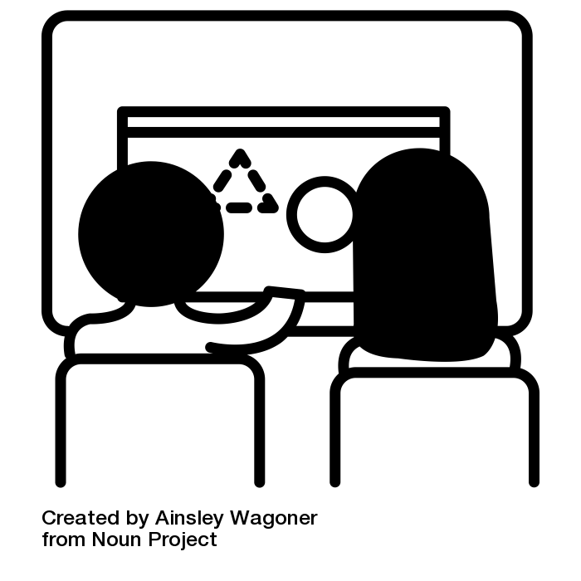
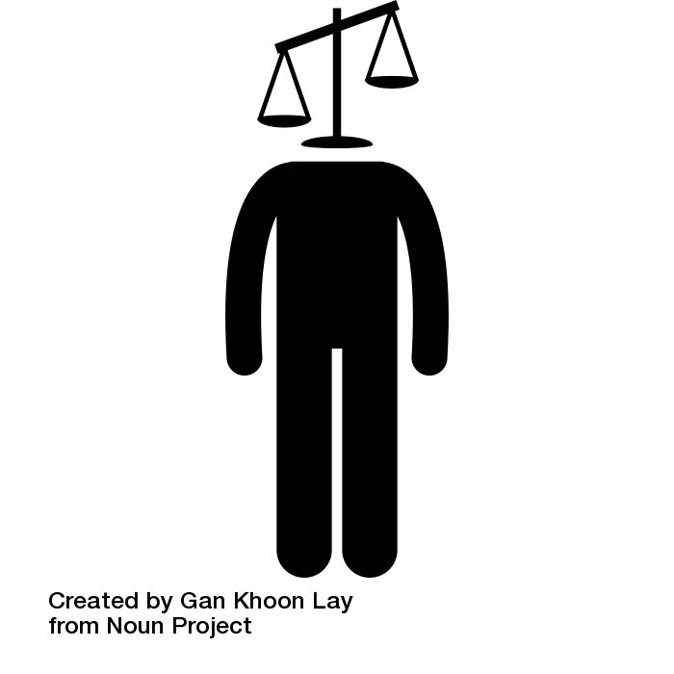
Pair programming
Accessible homework
Role models
Free and open source
A creative curriculum
Gender neutral language
Unconscious bias
No entry requirements
Culturally relevant
A broad curriculum

Slide 3
Use techniques, like paired-programming, to engage girls
Paired programming and collaborative working are known techniques to engage girls
Notes:
https://ncce.io/ks4-qr-pp
https://ncce.io/quickreads

Slide 4
Promote role models from diverse backgrounds, preferably alive!
Representation matters!
Refer to a diverse range of role models in your curriculum.
See also from Isaac:
ncce.io/alice_ashby
Notes:
https://bit.ly/RoleModelPoster

Slide 5
Deliver a creative curriculum which includes a variety of projects and contexts
Bring theory to life through creative projects, such as:
Podcasts
Videos
App creation
Music

Slide 6
Become aware of your unconscious bias
Discover your own biases and learn how to change them
Find out more on page 48 of Hello World: Issue 11
Notes:
https://ncce.io/tc05_16

Slide 7
Deliver culturally relevant pedagogy which addresses issues that are important to learners and their communities.
Read the report from the Raspberry Pi Foundation to learn more
Notes:
https://www.raspberrypi.org/blog/culturally-relevant-computing-curriculum-guidelines-for-teachers/

Slide 8
Provide accessible homework opportunities
Create paper based homeworks that don’t rely on technology
Provide free access to technology if it is required for the curriculum

Slide 9
Use free and open source tools and resources, e.g. library books, wiki books and free software
Free and/or open source tools:
GIMP
Inkscape
Blender
Scratch
Isaac CS

Slide 10
Cover a broad Computing curriculum not just computer science
Showing learners the breadth and depth of the curriculum will give them more opportunities to ‘see themselves’ in the subject

Slide 11
Do not enforce entry requirements for qualifications
With the right pedagogical approaches, all learners can achieve in computing
Don’t exclude based on prior attainment

Slide 12
Use gender neutral and culturally sensitive language in your lessons
For example:
Use they/them pronouns
‘A computer scientist … they need …’
Don’t assume learners all celebrate the same religious holidays

