Slide 1

Developing a new generation of
Curriculum Leaders
Notes:
A brief introduction outlining the purpose of the Tenderfoot project.

Slide 2


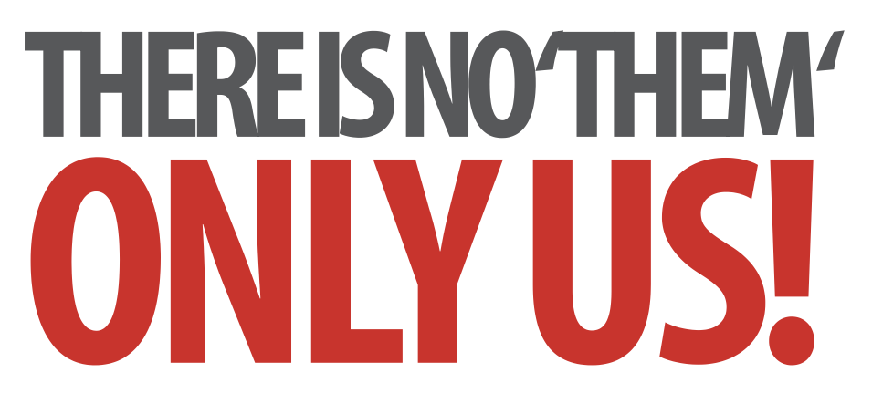
Laying Firm Foundations: A Conceptual Approach to Programming
Transitioning to Text
Notes:
Introductory slides that establish a common format to the start of a Master Teacher session. Please do stress the ethos at the start: there is no them – only us! If our subject is to develop all practising teachers have valuable contributions to make, regardless of prior experience. The CAS model recognises that good pedagogy is a process of discussion and development, facilitated through our Community of Practice.

Slide 3
Laying Firm Foundations: A Conceptual Approach to Programming
Transitioning to Text
Insert any specific notes
Start / End time
Toilets
Fire Drill / Exits
Notes:
Reminder to go through formalities at start. Placeholders for specific details

Slide 4
Transitioning To Text
Learning Outcomes
By the end of the session we hope you will:
Apply the key concepts required to write programs
Recognise the three key constructs in every program
Become familiar with flowcharts articulating the constructs
Have considered some challenges posed by text based coding
Have explored a couple of activities for introducing these programming concepts at KS3
Notes:
It is important to be explicit about the intended outcomes of the day for attendees.
Do not assume they will be aware of the purpose or target audience of the materials.
By stating the intentions, it helps avoid getting sidetracked into discussing the detail of individual classroom activities.
The primary aim is to educate teachers and illustrate the breadth and depth of Computer Science. The specific outcomes for teachers from this unit, are
Apply the key concepts required to write programs
Recognise the three key constructs in every program
Become familiar with flowcharts articulating the constructs
Have considered some challenges posed by text based coding
The purpose of Tenderfoot is to equip trainers with material and ideas to meet these outcomes and broaden the outlook of teachers new to Computing.
It hopes to provide a buffet of resources on which teachers can draw, to enrich their Key Stage 3 lessons, at the same time as meeting the key aim: providing greater depth of knowledge for teachers themselves.
Developing teachers is the focus, not providing activities for pupils.

Slide 5
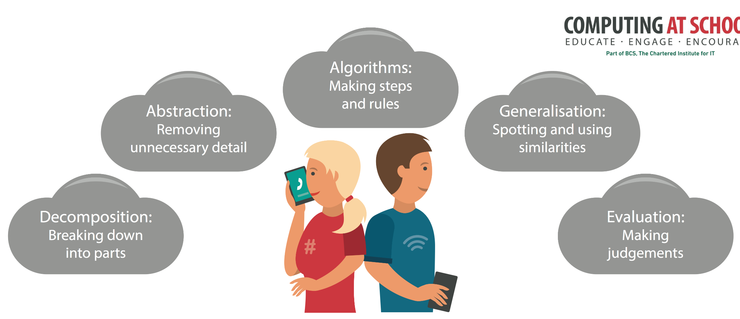
Computational thinking concepts are key
Notes:
Whatever the activity, there are some key concepts in Computer Science that occur again and again. CAS have produced a poster that highlights those key concepts - concepts that underpin computational thinking. Great for the classroom wall, so you can keep referring to them whenever the opportunity arises. We’ll be doing this throughout this session. The concepts are revealed on a click.

Slide 6

A Conceptual Approach to Programming
Transitioning to Text
Notes:
Once all students have some grounding in the concepts we can consider some of the barriers involved in transitioning to text based programming.
As before, we’ll try to emphasise 1 big idea, use practical activities to illustrate the 3 constructs and 4 concepts we want to bring out from all the activities, but text based programming offers up many potential pitfalls.
A staged approach can help avoid them … or at least help children over the biggest hurdle of all, commonly known as the ‘syntax barrier’.
First and foremost, the biggest barrier for most children is their inability to write / type accurately. Program environments are unforgiving. It must be one hundred percent accurate or it wont run. Different environments have different facilities to help with this, but an emphasis, right from the start on accuracy and attention to detail is essential.

Slide 7
A staged approach
Notes:
Many pupils will have some experience of creating html code. Exercises creating simple web pages in Notepad or Notepad++ can help instil the importance of syntactic accuracy.
Because html is a markup language, pupils will get immediate feedback on the accuracy of their code. It either displays as expected, or it doesn’t.
Moreover, there is no extra cognitive load involved in trying to think through the logic of algorithms involving our selection and iteration constructs. A simple html document is merely a set of display commands, executed sequentially.
Given the motivational context and the ease of creation in a plain text editor, they provide an ideal introduction to the rigour of text based coding. Simple html exercises will be included in a different Tenderfoot module.

Slide 8
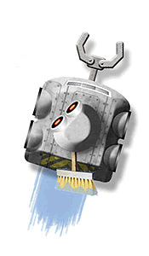
Learning by doing
Motivational contexts
General Public License (GPL) version available from
http://robomind.en.softonic.com/
Free
http://www.robomind.net/
Notes:
Given the extra cognitive demands raised by text based programs, finding motivational contexts is important.
Real robotics provides one example. Thanks to the Raspberry Pi legacy, there are now lots of cheap devices available on which to develop simple programs. If you have any Lego NXT Mindstorms kits at school, Enchanting (free http://enchanting.robotclub.ab.ca/About) allows you to program them via a Scratch interface, allowing an easy way in.
There is scope for a discussion hear to see what devices different schools use. There are no shortage of offerings that allow simple text programs to be written in a variety of languages, but few match the robustness (or cost!) of Lego Mindstorms.
Whatever robotics kit schools use (if any), the point is to highlight this area as highly motivational and point out that the exercises that follow using a simple simulator can provide good grounding to developing more complex work with real hardware..
RoboMind is a commercial offering. Earlier versions, with more limited functionality are available on a GPL license, eg free to download and use.
Developed at Amsterdam University, purpose built for education, version 2.6 can be downloaded from http://robomind.en.softonic.com/. A simple robot simulation, it provides an excellent way to transition to text based programming, and paves the way to further robotics exploration using industry standard languages.
The later commercial version also connects to Lego NXT.
We’ll use the free version for our activities.

Slide 9

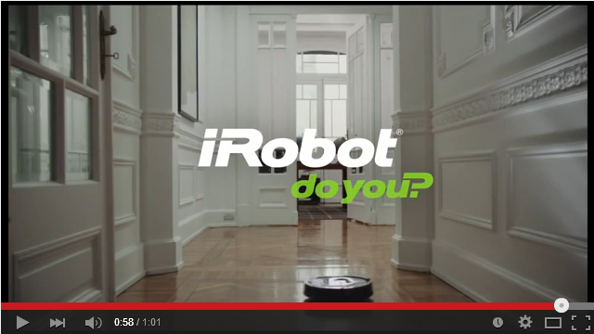
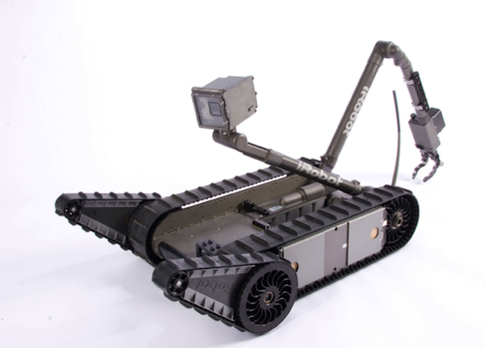
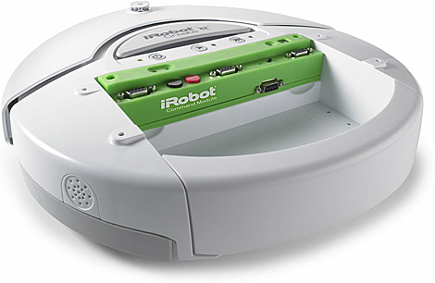
https://www.youtube.com/watch?v=mThf1LjWo1c
Notes:
Looking at robots in the real world can provide a good introduction to the topic.
iRobot are a company producing robotic devices ranging from hoovering (right) to military robots for tasks such as bomb disposal (left).
(click) The iRobot advertising campaign (2013) for the Roomba vacuum provides a good introductory video to engage interest. Several exist on YouTube, the link is to one of them. (click)

Slide 10
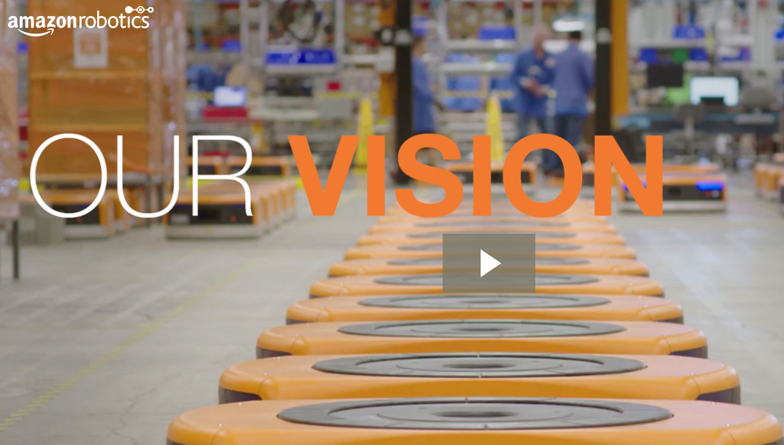
https://www.amazonrobotics.com/#/vision
Notes:
The Amazon Robotics website has a very good video about the people working there. Useful for demonstrating the type of careers Computing may lead to. Later we’ll see a video of their warehouse in action.

Slide 11
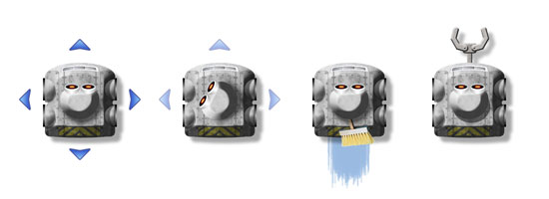
A Robot’s World
Move
Grab
Notes:
Robo is a small robot simulation. It can move forward, back, left and right. It has the facility to ‘see’, pick things up and paint lines.

Slide 12
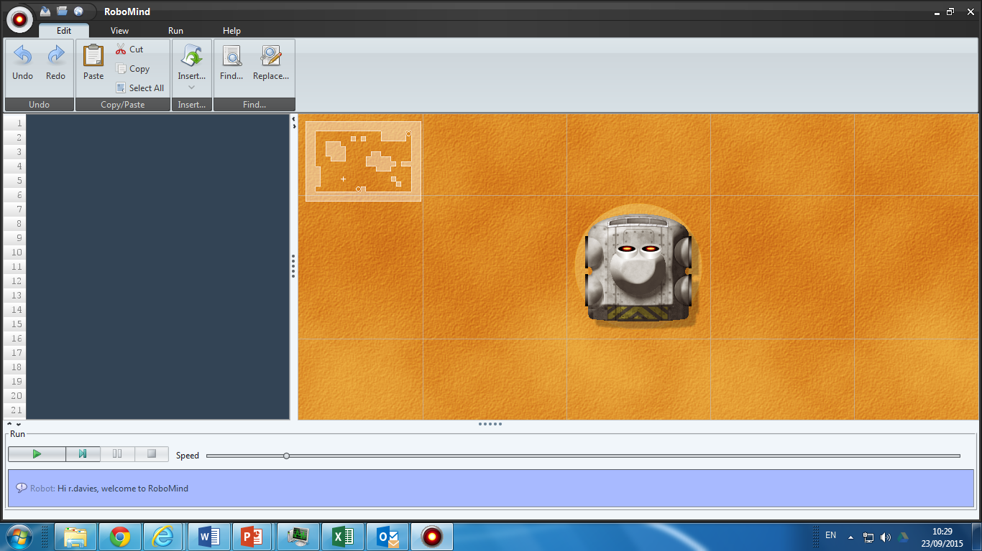
Notes:
With students at the computer we can explain the environment it operates in. It moves from tile to tile in it’s world – the highlighted area shows an overall map view of that world. (click)

Slide 13
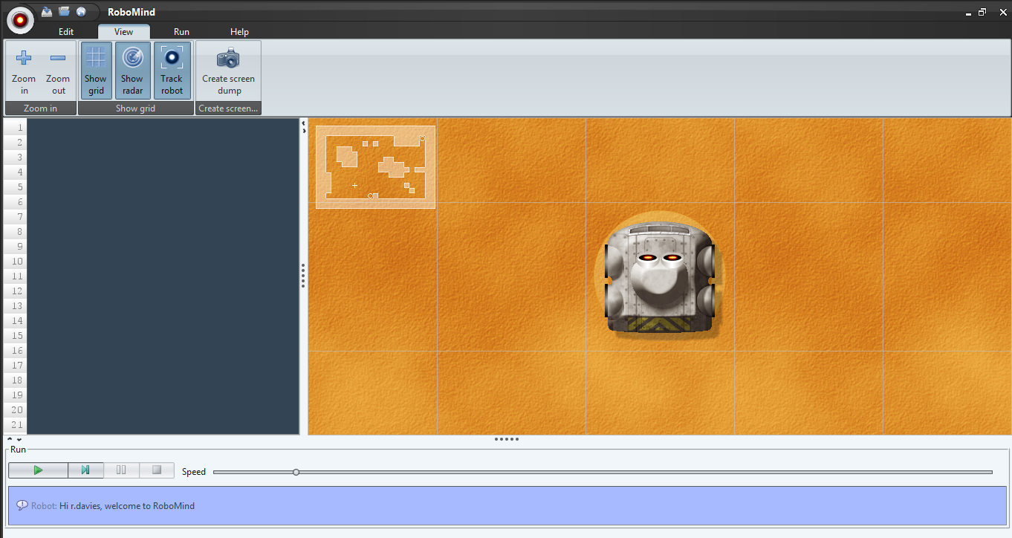
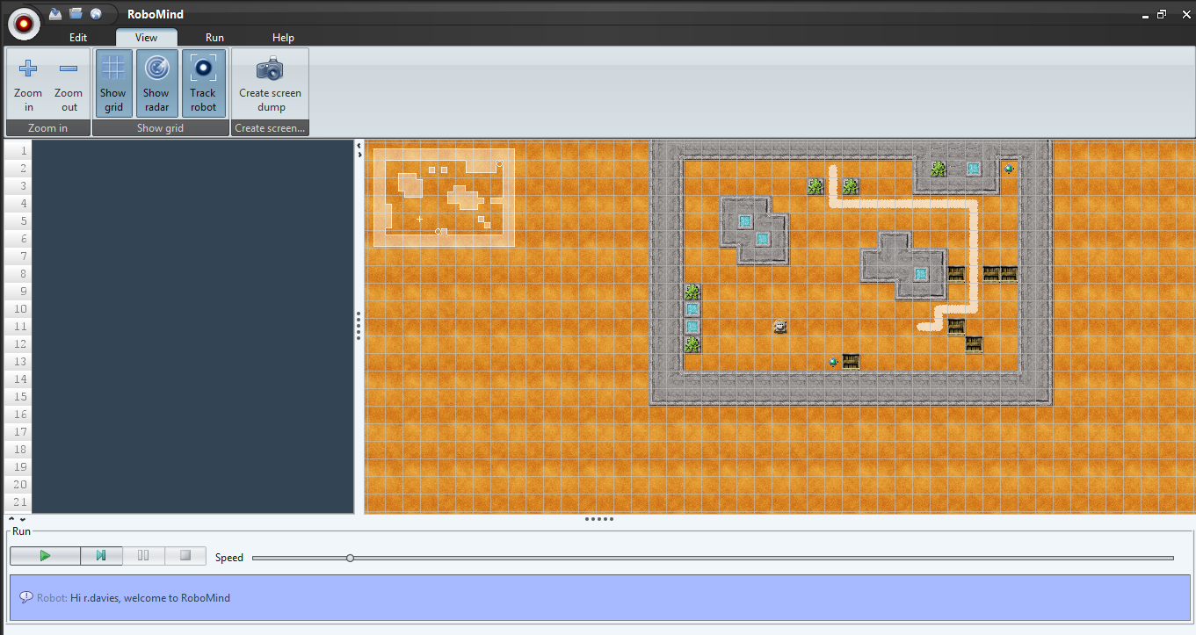
Notes:
From the View menu we can zoom in and out (click)

Slide 14
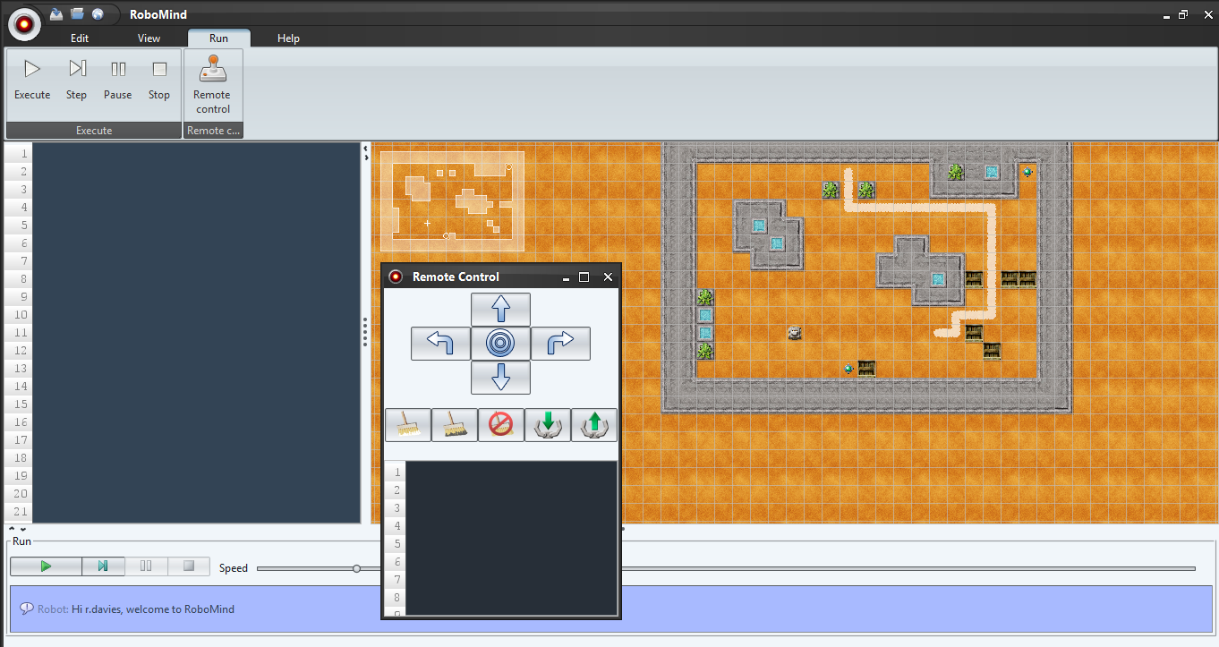
Notes:
From the Run menu, we have a Remote Control option. This is rather like a toy and it is useful for children to experiment with this to see how Robo moves and how their clicks are translated into text based commands.

Slide 15
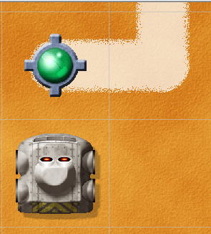
Quick Challenge
Using the Remote Control to pick up the 2 objects and place at either end of the line.

Slide 16
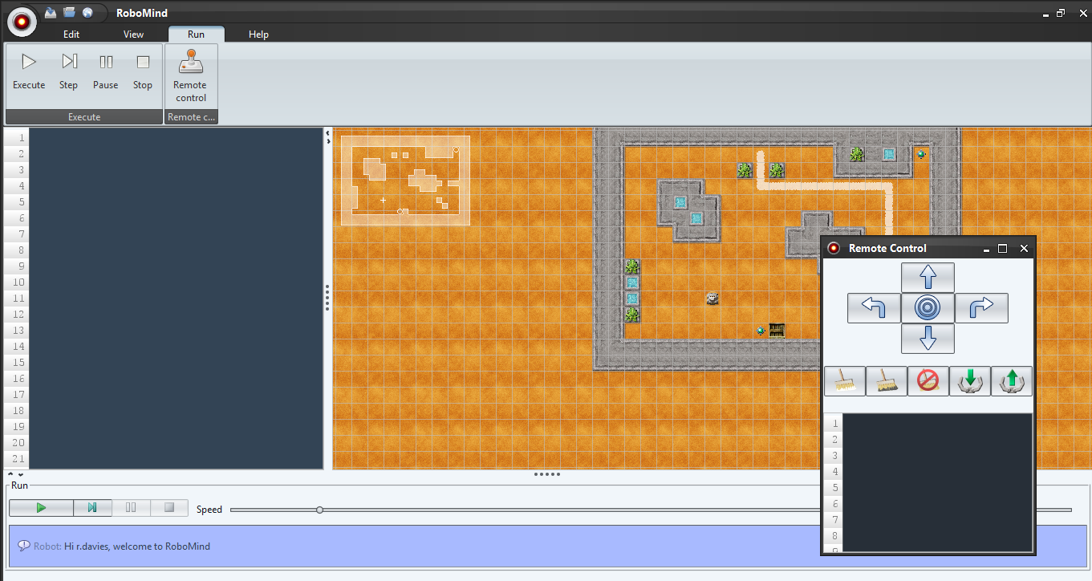
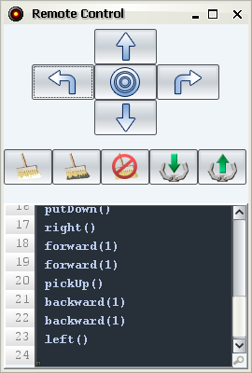
Copy and Paste your
code into the Editor.

Slide 17
Tidy up the code and
save it with a sensible filename.
Notes:
The Remote Control will generate a command for each step. We can tidy these up to, for example, backward (2)

Slide 18
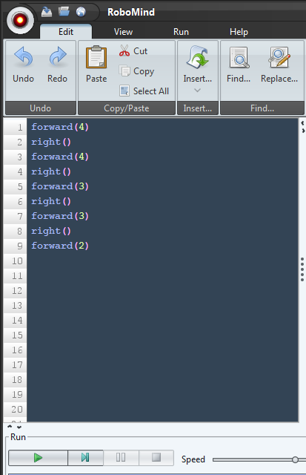
Restart RoboMind.
Open your file.
Run it.
Notes:
This ensures children can save and open files before embarking on a full program.

Slide 19
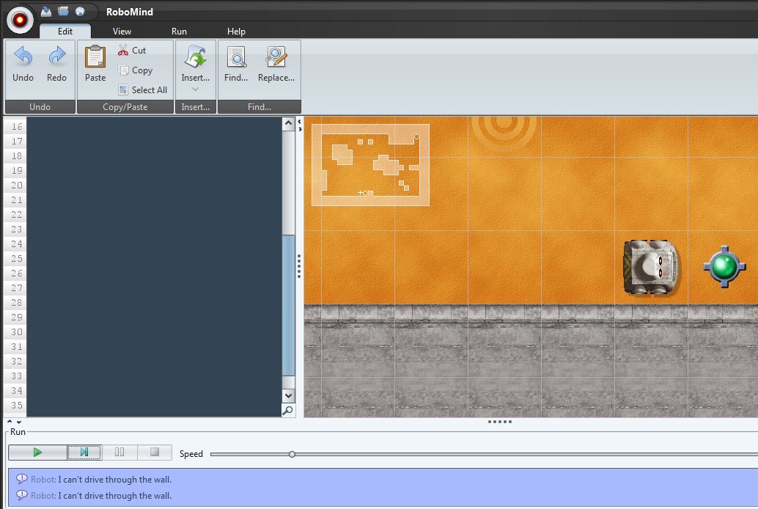
Writing Instructions
Each instruction on a separate line:
forward(1)
left()
forward(1)
right()
1. Write instructions
2. Click execute
3. See the result
Notes:
Click to illustrate sequence.

Slide 20


Efficiency Matters
forward(1)
right()
forward(1)
right()
forward(1)
right()
forward(1)
right()
Notes:
What can we say about the sequence of commands in the box (click) The two command sequence is repeatedly written 4 times. (click) This is an example where iteration would come in handy.

Slide 21
Efficiency Matters
Syntax:
repeat(number){Instructions}
forward(1)
right()
forward(1)
right()
forward(1)
right()
forward(1)
right()
repeat(4)
{
forward(1)
right()
}
Same square,
less work
Notes:
Syntax may be a new term – ensure they understand what it means.
We need to be absolutely clear about the ‘syntax’ for a repeat command (click). Emphasise the command and parameter( click), then the sequence of instructions to repeat within braces (click)
So this can be written (click) as shown. Notice how the braces are put on separate lines. Insisting on this layout is a key point to emphasise. It makes the code easier to read and debug.
There are 3 constructs in computer programs – this is an example of which? (click)

Slide 22

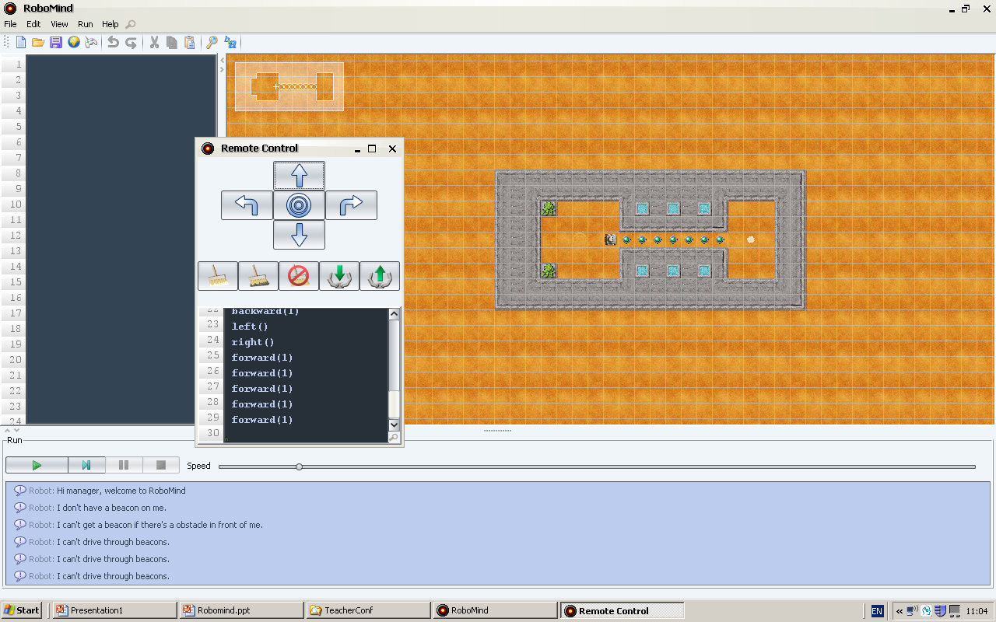
How does Robo get to the white spot?
Use a printed map and sketch
out the solution
Notes:
Print out the map and provide small wooden blocks for pupils to simulate Robo. (They may want to draw front /back/ left and right sides to remind them). Ask them to write down their solution.
(click) This is an exercise in decomposition. Work out a way to move one of the objects out of the way first. Jot the commands down.
Then do a similar thing for the second object, in a different column.
As they work through the actions they should become aware of a repeating sequence.

Slide 23
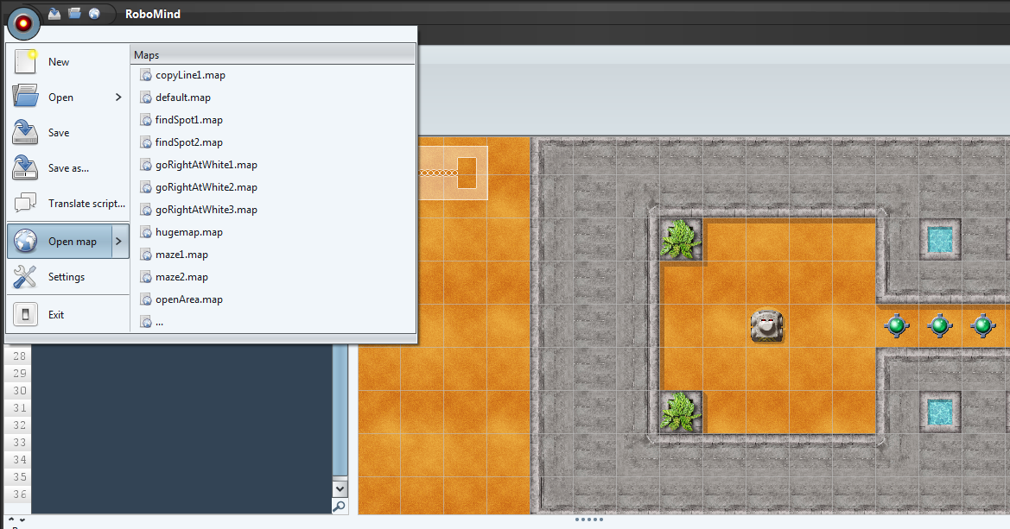
Repetition Practice
Load the Map – PassBeacons.map
Notes:
There are various ‘worlds’ included with the default installation of RoboMind. You can change Robo’s world by loading a different map file.

Slide 24


Repetition Practice
Write the program so Robo
stops on the white spot
Extension:
Modify your program to put
the beacons back before
you finish on the spot
Notes:
With the correct map and a solution already sketched out we can try the practical challenge.
The purpose is to establish that children can recognise and lay out a loop correctly. It is often good to be explicit about the purpose of the exercise. (click) Finding repeating patterns is an example of generalisation or pattern recognition.
(click) The extension is challenging but if they focus on trying to spot repeating patterns they may manage it!
A solution is included.

Slide 25


Points to ponder
What lies behind the syntax barrier? What facilities do ‘toy’ environments like RoboMind offer to help with the transition to text.
Can you suggest helpful tools in other languages?
Notes:
Again, a brief pause to encourage a short discussion whilst props are tidied up and the presenter gets ready for the next session.
Use this slide to prompt a discussion about approaches to teaching programming.
Try to draw out recognition of the challenge the syntax barrier poses.
Restricted environments, such as simple html markup, and RoboMind which has no variables, help focus on specifics and lower cognitive load.

Slide 26



Learning To Program
Don’t run before you can walk
Notes:
There are only three constructs for building programs. In the surface that seems simple. But the real power of programs comes once constructs are combined together or nested within each other.
Once we start combining constructs many children will struggle to appreciate what is happening, and even those who do, may struggle to articulate it. (click)
Don’t try to get children to run, before they can walk. Good programming requires a very solid grasp of these basic constructs. Children need endless exposure to the simple, ‘one level’ constructs before they are firmly embedded. Don’t move on to more complex challenges unless you are confident this is the case. Even if children create code that works, asking them to explain it will reveal the true thought processes involved.
Reading code snippets, saying it aloud is a good precursor to writing code. Explaining why code doesn’t work is a good measure of the ability to articulate their logical processes. Asking children to read code examples and predict what will happen gives teachers an immediate measure of understanding.
Much scaffolding is required when introducing compound constructs, and establishing careful ways to lay code out helps enormously.
We’ll model this by considering how to get Robo to walk, introducing flowcharts as a way to visualise program flow.

Slide 27
Teaching Robo
how to walk
Move
Grab
Paint
See
Notes:
Let’s teach Robo how to walk, paying particular attention to the structure of the code we build.
As well as moving and picking up/putting down, Robo can paint lines and also has some simple facilities to sense it’s surroundings – in other words to see. We’ll use both in the coming activities, but we’ll start by considering how it ‘sees’.

Slide 28
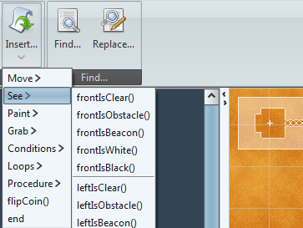
Notes:
Robo can see if the front, right or left is clear, white, black or contains an obstacle.
Notice we can list (and insert) all the commands Robo uses from the Insert menu. Encouraging the use of insert helps pupils avoid many of the syntax errors they would otherwise encounter.
By then editing and indenting, it helps them focus on structure, rather than syntax.
Teaching Robo to walk provides a simple context for introducing selection constructs. (click) Selection allows a program to do different things depending on the condition. Notice the Conditions sublist, also part of the Insert menu (click)

Slide 29
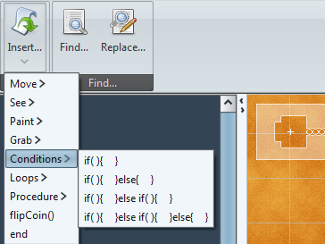
Notes:
There are 4 choices, for framing questions on which a decision can be made. We’ll start by considering how Robo might try to avoid an obstacle, using an IF – ELSE construct.
Can anyone suggest a way of combining a ‘see’ command, with the selection construct? (click

Slide 30
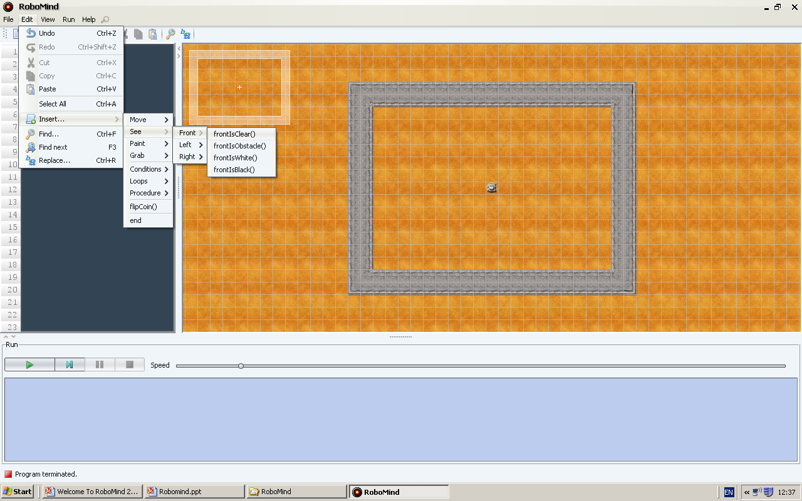
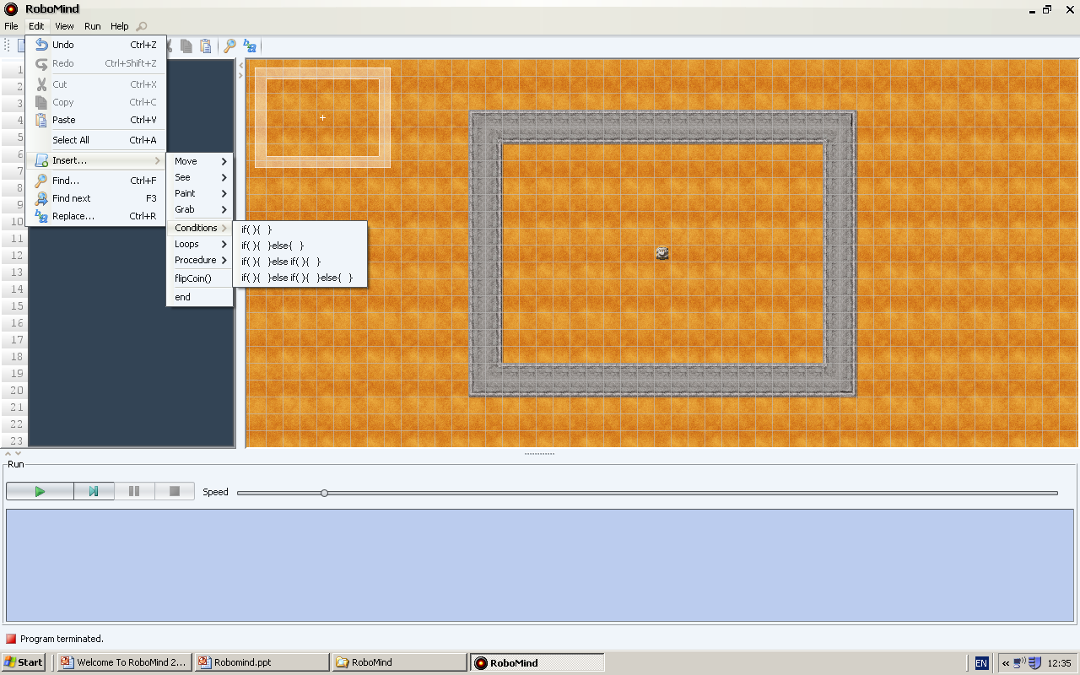
if( frontIsClear() )
{
forward(1)
}
else
{
right()
}
Notes:
When we insert the IF statement, there are a lot of brackets and braces which can cause confusion. Take some time explaining how to arrange this statement over more separate lines, to make it easier to comprehend.
The IF statement goes on the first line (click), and the condition (question) goes inside the brackets.
The braces (click) are arranged on separate lines.
This makes clear that the actions associated with each condition can be inserted between the pairs of braces. (click)
Insisting on this sort of detail in layout is the key to clear comprehension of code.

Slide 31
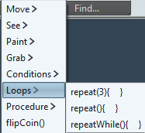
repeat()
{
if( frontIsClear() )
{
forward(1)
}
else
{
right()
}
}
What will happen
when this code runs?
Have a go!
How can we turn this
into a walk?
Notes:
Before anyone creates the code, ask them to predict what will happen.
Building a mental model of what to expect is an essential part of understanding code.
Reading comes before writing.
When the code is run, real learning starts to happen if the observed behavior contradicts the expectation.
At that point, the student has to reach into their mental toolkit and reason about what they are observing.
Take time to explain this rationale – you are equipping children to learn how to learn (click)
The code will move Robo 1 step forward if the way ahead is clear, otherwise turn right. It does not repeat. (click)
Combining constructs is challenging for children, but building a more complex structure in this way makes it easier to comprehend. We now need to repeat the whole ‘one step’ process by putting it inside a loop construct. (click) Which one?

Slide 32
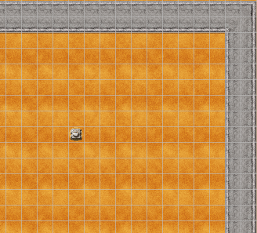
Start
Go forward
one step
repeat()
{
if( frontIsClear() )
{
forward(1)
}
else
{
right()
}
}
Is front
clear
?
Yes
No
Turn right
Notes:
If students struggle to grasp what is going on, another useful technique might be to develop a flow chart alongside reading the code, line by line from the screen.
A series of clicks takes you through the animation. Pause on click three, to emphasise that the step forward repeats many times until the way forward is no longer clear..

Slide 33
Decomposition Rules!
Key rule 1:
Put separate steps
on different lines.
Key rule 2:
Put brackets on separate lines and check they are in pairs.
Key rule 3:
Indent chunks of code for clarity.
Notes:
Decomposition applies at many levels.
Insist on children decomposing selection and iteration structures into separate parts. (click)
Then further decomposing to lay the brackets out on separate lines. (click)
Finally, use indentation to make the layout as clear as possible. This is particularly important when developing constructs that are nested within each other.

Slide 34
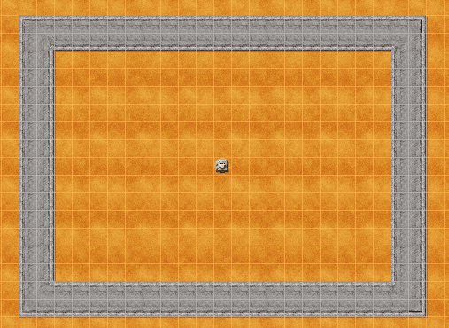
……paint a trail as you go
Let’s go walkabout
Notes:
Armed with the knowledge built so far, lets code Robo to go walkabout and paint a trail as it goes. Once implemented, another problem should become obvious … (click)

Slide 35
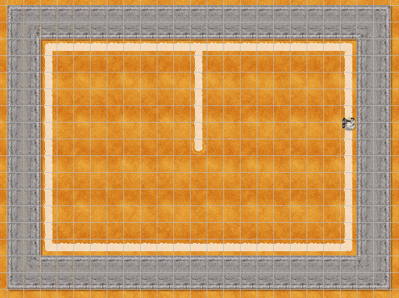
There was no ‘end’ to our flowchart
Start
Go forward
one step
Is front
clear
?
Yes
No
Turn right
Now what’s the problem?
Notes:
Clearly Robo will continue forever.
(click) Encourage students to study the flowchart
(click) There is no obvious end, or termination

Slide 36
Can you make Robo halt here?
Start
Go forward
one step
Is front
clear
?
Yes
No
Turn right
??
Notes:
Set an extra challenge to stop Robo in the top right corner
Ask what and where we might insert further commands into the flowchart. If the students are struggling (click) give a hint to indicate the position.
If they are still struggling, further hints and solution on the next slide.

Slide 37
What condition could we set here?
Start
Go forward
one step
Is front
clear
?
Yes
No
Turn right
No
Is front white?
Yes
End
Notes:
What condition could we set in the new decision box?
(click) adds the condition and end
(click) adds the iteration

Slide 38
What if we wanted to stop here?
Start
Go forward
one step
Is front
clear
?
Yes
No
Turn right
Where would the conditional go now?
Notes:
A good test of understanding might be to do class activities from the front asking what the impact would be of moving the conditional. Often the answers will reveal how little understanding children gain ‘first time round’.
Answer on next slide.

Slide 39
What if we wanted to stop here?
Start
Yes
Is front white?
End
Go forward
one step
No
Is front
clear
?
Yes
No
Turn right
Where would the conditional go now?
Notes:
In this case, we would want Robo to stop as soon as it senses white, so a check at the start of each iteration would make sense.
(click) reveals the position.
(click) adds the termination.

Slide 40
Challenge 1
1
2
3
4
5
6
7
8
9
10
11
12
13
14
15
16
17
paintWhite()
repeat()
{
if()
{
}
if(frontIsClear())
{
forward(1)
}
else
{
right()
}
}
IF what?
if()
{
}
Notes:
Even with a grasp of the logic behind the program flow, the challenge still remains to translate that logic into code.
Having correctly placed the selection construct, the condition must be determined. Again, ask the class (click)

Slide 41
Challenge 1
1
2
3
4
5
6
7
8
9
10
11
12
13
14
15
16
17
paintWhite()
repeat()
{
if(frontIsWhite())
{
}
if(frontIsClear())
{
forward(1)
}
else
{
right()
}
}
frontIsWhite()
Is anything missing?
Notes:
And again we can build up the code gradually. (click) shows correct placement.
(click) asks what remains to be done.

Slide 42
Challenge 1
1
2
3
4
5
6
7
8
9
10
11
12
13
14
15
16
17
paintWhite()
repeat()
{
if(frontIsWhite())
{
end
}
if(frontIsClear())
{
forward(1)
}
else
{
right()
}
}
end
Is anything missing?
Notes:
(click) gives answer and further (click) inserts in correct place.

Slide 43
Can you code both examples…
Start
Start
Yes
Is front white?
Go forward
one step
End
Go forward
one step
Is front
clear
?
No
Yes
Is front
clear
?
Yes
No
Turn right
No
Turn right
No
Is front white?
Yes
…to see the difference
End
Notes:
In this case, we would want Robo to stop as soon as it senses white, so a check at the start of each iteration would make sense.
(click) reveals the position.
(click) adds the termination.

Slide 44
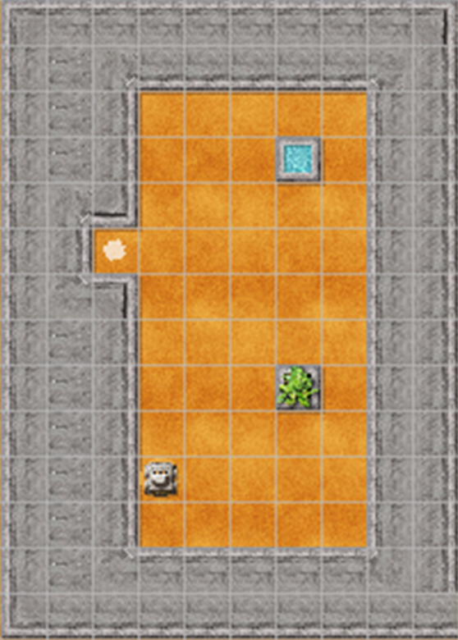
Robo’s World
Under the hood
An interlude for able students
Notes:
A repeating theme of this presentation is that it takes time, often a long time for children to recognise and apply basic constructs in their programs. But some ‘get it’ quickly. Having other ‘low maintenance’ challenges and tasks on hand for these students is an essential part of differentiation.
Investigating how Robo’s maps are constructed is itself a good exercise in computational thinking.

Slide 45
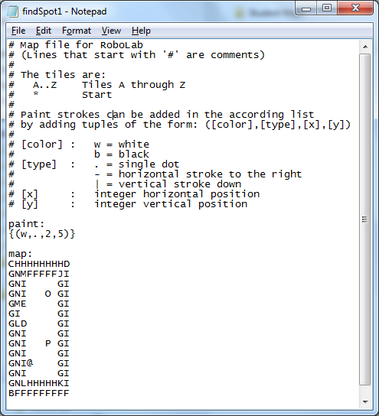
0 1 2 3 4 5 6 7 8 9
1
2
3
4
5
6
7
8
9
Notes:
We’ve taken the map file for granted. Load a map file and it displays a new world. But how does it do it?
We can get ‘under the hood’ of the file by opening it in Notepad. (click)
Here is a description of the world in another language. Let able students study it without any prompts.
Some elements are intuitive, but it will take systematic investigation to identify all the elements involved.
In particular, the syntax involving for adding paint strokes (click) requires them to understand how the x and y co-ordinates are specified.
These are numbered from zero from the top left (click)

Slide 46
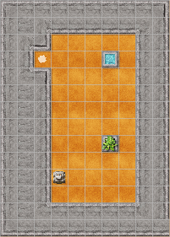
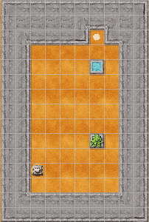
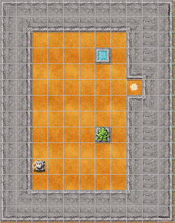
findSpot1
findSpot2
Notes:
The map shown is included in the RoboMind installation: FindSpot1. (click) There is a second similar map which we shall use in the next exercise: FindSpot2
As a challenge, students could study the maps and create two new variations (findSpot3 and 4) as shown.
Both are included in the resources as they will be used in the next exercise. Note the greater depth in the wall containing the spot.

Slide 47
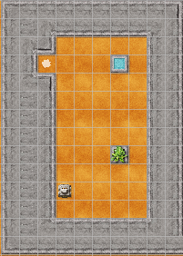
Challenge: Flowchart the solution
Notes:
As a group, you can challenge the students to flowchart the sequence for Robo to find and move onto the spot.
They may come up with a fixed set of commands (eg forward(5)), so emphasise the fact that we want to use something similar to the walkabout code, which used selection and iteration. (click).
That way we can generalise our code to find the spot wherever it is. As a challenge, Robo should find the spot, regardless of which map (findSpot1 or findSpot2) is used.
The following slide builds up the flowchart.

Slide 48
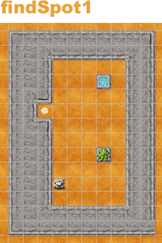




Repetition Again!
Start
Is left wall?
Yes
Go forward
one step
No
Turn left
Go forward
one step
End
Notes:
Use this to talk through the sequence of events. On the following slide we consider the loop in more detail.

Slide 49

Repetition Again!
Let’s program this first section.
What do we need?
A Loop!
But what else?
A Condition
So what instruction should we use?
Start
Is left wall?
Yes
Go forward
one step
Notes:
This is the first time we have formally introduced a different kind of loop. Up to now, the loops have been counter controlled loops, that is ‘For’ loops, or ‘Forever’ loops (in the absence of a number). This time we will use a ‘While’ loop; iterating whilst a condition remains true.

Slide 50
Repetition Again!
Condition controlled
loops
Syntax:
repeatWhile(condition)
{
Instructions
}
Start
Is left wall?
Yes
Go forward
one step
Notes:
Finally, we can highlight the syntax and layout we require in the code.

Slide 51


Two Types of Loop
Condition controlled
loops
Counter controlled
loops
Notes:
It’s worth emphasising the two types of loop. Another little chant for the class. ‘There are 2 kinds of loop – what are they?’ (click) ‘Counter controlled and condition controlled’ comes back the reply.
But it can still be a source of confusion.
Students may have used a Repeat – Until, or Forever – If in Wacky Races, and it is worth highlighting these constructs. Neither uses ‘while’ but both use a condition to control the number of iterations.

Slide 52
Program the solution
Notes:
The students can now program the solution …

Slide 53
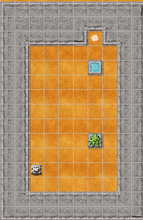
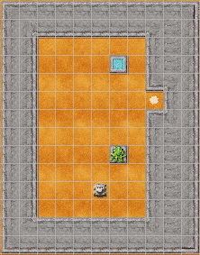
Program the solution
findSpot3
findSpot4
findSpot5
Notes:
… and once they succeed, get them to consider further generalising the code so it will work on the map findSpot3.
A further test would be to use findSpot4 (click) which should require no modification …
… and finally findSpot5 which requires considering a different starting position. This is quite tricky and should provoke a lot of thought and discussion.
The obvious solution is to program a starting routine that takes Robo forward until it reaches a wall, at which point it turns right, putting the wall on its left. The wall following routine can then be invoked. If this is the solution children find, consider findSpot6, which should get them to consider an obvious problem with wall following.

Slide 54
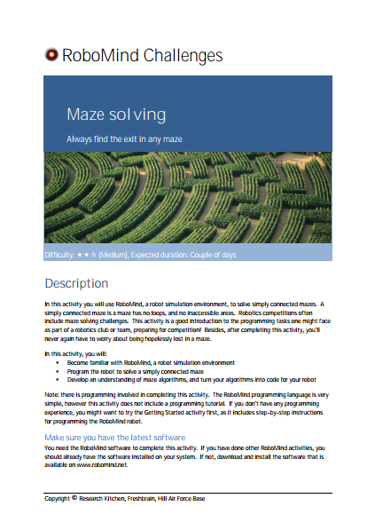

Two Big Challenges (1)
Walking a maze
Notes:
If the maze is simply connected (ie has no loops or inaccessible areas) your wall following algorithm can provide the basis for solving the maze. This is a ‘classic’ challenge and one that can leave a lasting impression on students. Unfortunately, too often, it is introduced without the necessary scaffolding. If your students have had the grounding we have just introduced, it shouldn’t present too much of a challenge.
The good folk at RoboMind have produced a nice handout about Maze Solving which you could use to encourage further research into maze solving algorithms (and types of mazes). For more able students, implementing Tremaux’s Algorithm would be a good challenge.

Slide 55

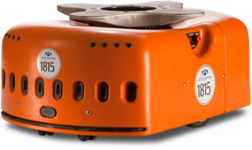
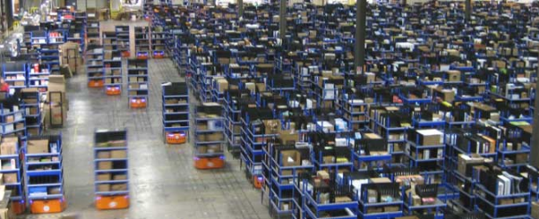
https://www.youtube.com/watch?v=6KRjuuEVEZs
Notes:
As mentioned earlier Amazon acquired the robotics company Kiva Systems, this year (2015). They produce the robots that are used in the automated warehouses.
Instead of the packers going to the shelves, the shelves come to the packers. The photo gives a sense of the scale involved. The Business Week video (3.30 mins) is well worth watching to give children a sense of how robots are used in the ‘real world’. They also look rather like the Robo!
After the video, ask pupils how the robots find their way around the warehouse. The complex software is obviously important, but the physical steering is accomplished by ‘line following’. You can see the tracks on the warehouse floor.

Slide 56
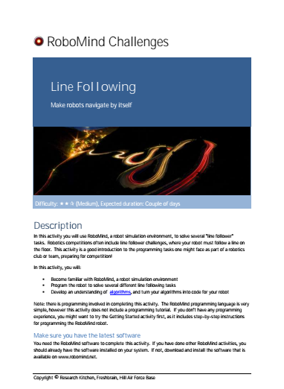
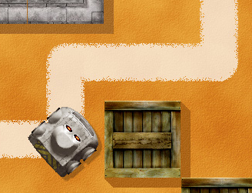
Two Big Challenges (2)
Walking the line
Notes:
The good folk at RoboMind have also produced a very good handout about Line Following. This includes a series of increasingly difficult challenges, from a simple line follower, to considering avoiding debris and walking grids.
To tackle the later challenges you would probably need to introduce procedures. A brief introduction, using our simple square example follows.

Slide 57

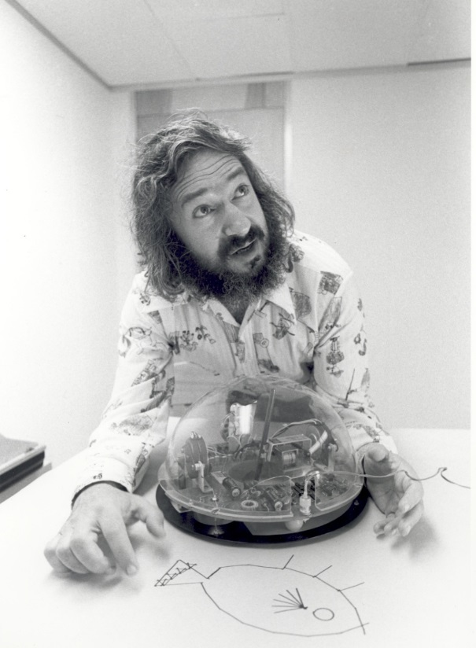

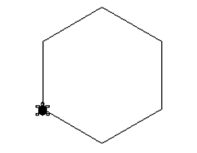
Seymour Papert
Notes:
In drawing simple shapes we are taking directly from the ideas of Seymour Papert and the sort of exploratory Logo activities he advocated in his book Mindstorms.
Drawing patterns and shapes is a very rich environment for early programming. The output is visual and the child can immediately see if their program works correctly. But it is not just the medium that is important, but the pedagogy too. You can get a flavour of this from this wonderful archive footage (click) starts video (2mins)

Slide 58
Thinking About Repetition
How might Robo
draw a window
like this?
Have a go!
Use the openArea map
Notes:
Asking how Robo might create a window like this, with 4 quadrants should provoke some discussion amongst those new to programming. If they are struggling encourage them to decompose, or subdivide the problem.
As Seymour Papert says though, students will learn best through doing. Encourage people to try, then discuss the solution on the next slide.

Slide 59
Thinking About Repetition
repeat(4)
{
repeat (4)
{
forward(1)
right()
}
}
What’s wrong?
Notes:
Many students will recognise that this is a repeat of a square.
Using the example above, point out the potential for confusion unless ‘nested loops’ are indented.
To reiterate - laying code out well is important for debugging.
(click)
What is wrong with this code? (click) for answer

Slide 60
Thinking About Repetition
repeat(4)
{
repeat (4)
{
forward(1)
right()
}
right()
}

Slide 61

Thinking A Bit More About Repetition
repeat(4)
{
repeat (4)
{
forward(1)
right()
}
right()
}
Notes:
It is best to avoid the complexity of nested iteration in early programming.
However encapsulating nested code in procedures makes it much easier to comprehend, since we can abstract away the unnecessary detail – in this case, by creating a procedure to draw a square, to remove the detail of the inner loop.

Slide 62
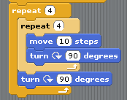
Thinking A Bit More About Repetition
repeat(4)
{
repeat (4)
{
forward(1)
right()
}
right()
}
Notes:
We can make a link with previous work in BYOB, which can help students understand a procedure definition.

Slide 63
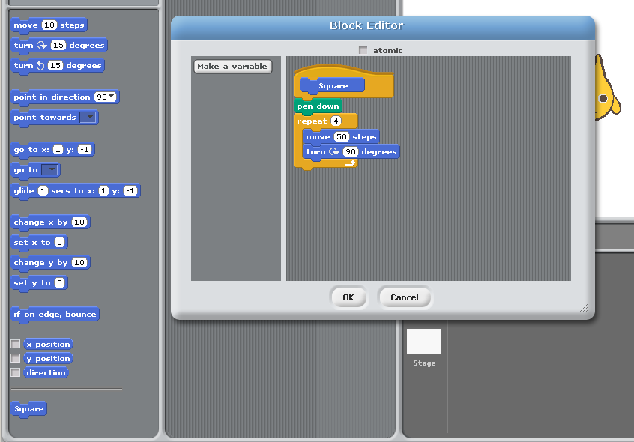
Notes:
In BYOB, we encapsulated the code to draw one square in it’s own block

Slide 64
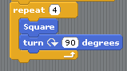
Thinking A Bit More About Repetition
repeat(4)
{
repeat (4)
{
forward(1)
right()
}
right()
}
square()
Notes:
By doing so, we made the code much easier to understand (click). We want to do the same thing in Robo’s code.

Slide 65
Two Stages
Define the procedure
Call it in your script
Notes:
As with BYOB, there are two stages, procedure definition, and once defined procedure calls

Slide 66
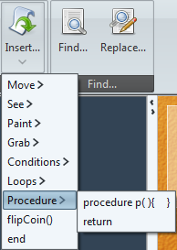
Two Stages
Define the procedure
procedure name( )
{
...instructions...
}
syntax: procedure p( ){ }
Notes:
To define can use the insert options to avoid syntax errors, but as before, we want to lay the code out on separate lines to make the structure more obvious (click).

Slide 67
Two Stages
Define the procedure
procedure square( )
{
repeat(4)
{
forward(1)
right()
}
}
Notes:
So here is the procedure definition

Slide 68
Two Stages
Define the procedure
Call it in your script
repeat(4)
{
square
right()
}
Notes:
To call the procedure we simply insert in our code, (click) just like in BYOB

Slide 69
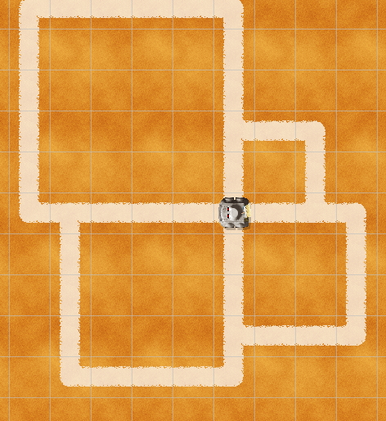
A Quick Challenge
We can save lines of
repetitive code by creating procedures and calling them many times.
Use 4 calls
of ‘square’
so Robo
produces this.
Notes:
The procedure we have defined draws a fixed size square, (click) but we can generalize the definition so it can be called with different values.
All squares have a similar set of commands, the only thing that differs is the length of the side.

Slide 70
A Quick Challenge
procedure square(width)
{
repeat(4)
{
forward(width)
right()
}
}
parameter
Notes:
Here’s the more general procedure definition. Notice the parameter included in the procedure header, and referenced in the body.
We can now call the procedure with different values as the parameter.

Slide 71


A Quick Challenge
procedure square(width)
{
repeat(4)
{
forward(width)
right()
}
}
parameter
VALUE
WIDTH
Notes:
A parameter is another new technical term. We can think of parameters as variables local to a procedure.
A box, named in the definition, into which we can put different values, when we call the procedure.

Slide 72
Points to ponder
Learning to program is challenging.
Can we decompose that challenge?
What different elements contribute to the cognitive load?
Notes:
A brief pause at the end to encourage another short discussion and reflection on the wider pedagogy involved.
Notice that when introducing text based languages we have focused entirely on the algorithmic constructs.
None of our Robo scripts has involved variables (until the last slides looking at procedures with parameters). In fact the free version of RoboMind doesn’t allow variables to be defined (except as parameters).
The cognitive load involved in getting to grips with programming is huge. Constructs, data structures and now syntax.
The key to handling complexity is to decompose the skillset into smaller parts, finding contexts that allow you to focus on a subset of the overall cognitive load.

Slide 73

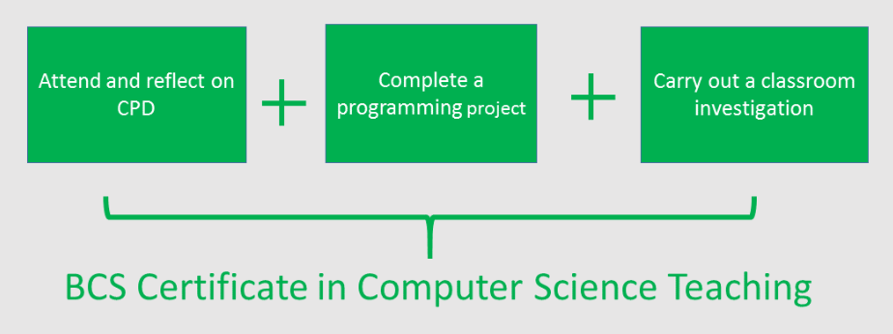

Class based research
Qualifications and Certifications
www.computingatschool.org.uk/certificate
Notes:
End with a reminder of the BCS Certificate in Computer Science Teaching – there are A5 hand-outs. One part of the evidence for the award is classroom research undertaken by the teacher. Maybe the points you’ve just discussed might form the basis of some action research?
(click)
The other two areas involve attending CPD – like this!
(click)
And completing a manageable programming project.
If that sounds a little daunting, remember you can opt for either an independent or guided route.
The latter means you’re supported by a mentor who can help guide you through.
It is a valued award, giving professional recognition accredited by the BCS, The Chartered Institute for IT.
More importantly, it’s designed to help you in the work you’re developing in school.
See the link for more information: http://www.computingatschool.org.uk/certificate

Slide 74

Computing is about
much more than
programming
Notes:
We can end by saying these 3 things.

Slide 75
Computing is about
much more than
programming
Computing is about developing a
way of thinking
Notes:
We can summarise by saying these 3 things.

Slide 76
Computing is about
much more than
programming
Computing is about developing a
way of thinking
Computing concepts provide ways to tackle many problem contexts
Notes:
We can summarise by saying these 3 things.

Slide 77
Join CAS
Not a member?
Thanks
Notes:
Promote CAS at end.

