Slide 1


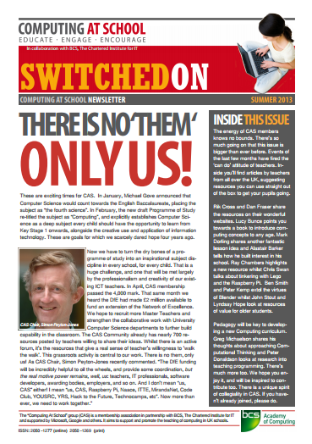
Theoretical Computers
Fun With Finite State Machines
Notes:
Introductory slides that establish a common format to the start of a Master Teacher session. The newsletter graphic is there to remind them to have them at sessions and promote them – and to stress the ethos at the start: there is no them – only us!

Slide 2
Theoretical Computers
Fun With Finite State Machines
Insert any specific notes
Start / End time
Toilets
Fire Drill / Exits
Notes:
Reminder to go through formalities at start. Placeholders for specific details

Slide 3
Theoretical Computers
Learning Outcomes
By the end of the session we hope you will:
Understand the purpose of state diagrams
Appreciate the concept of a finite-state machine
Be aware of formal languages and regular expressions
Be familiar with more advanced models of computation
Recognise the role of Turing machines in Computer Science
Have explored a range of activities for introducing CS concepts at KS3
Notes:
It is important to be explicit about the intended outcomes of the day for attendees.
Do not assume they will be aware of the purpose or target audience of the materials.
By stating the intentions, it helps avoid getting sidetracked into discussing the detail of individual classroom activities.
The primary aim is to educate teachers and illustrate the breadth and depth of Computer Science. The specific outcomes for teachers from this unit, are
To understand the purpose of state diagrams.
To appreciate the concept of a finite-state machine and provide examples.
Understand their place in language theory and regular expressions.
Be familiar with more advanced models of computation.
Recognise the importance of a Turing Machine in defining algorithms and identifying the limits of computation.
The purpose of Tenderfoot is to equip trainers with material and ideas to meet these outcomes and broaden the outlook of teachers new to Computing.
It hopes to provide a buffet of resources on which teachers can draw, to enrich their Key Stage 3 lessons, at the same time as meeting the key aim: providing greater depth of knowledge for teachers themselves.
Developing teachers is the focus, not providing activities for pupils.

Slide 4
The Big Picture
The State We Are In
Mind Your Language
Diagrams To Programs
Computing Without Computers
Notes:
Outline of the day.
In each area we’ll introduce specific classroom activities

Slide 5
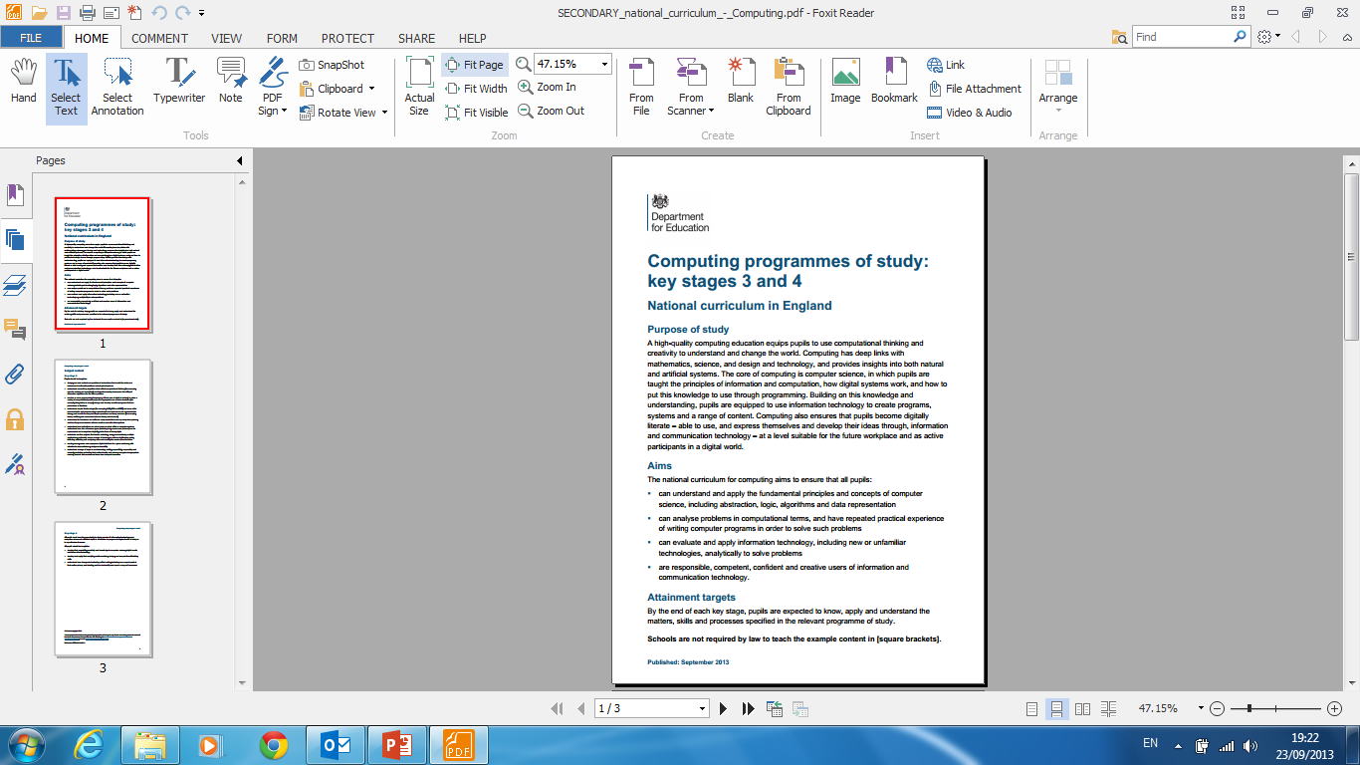
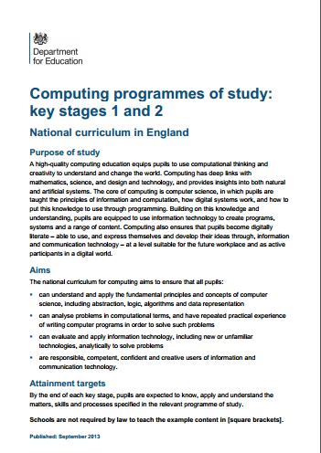
The Big Picture
The State We Are In
Mind Your Language
Diagrams To Programs
Computing Without Computers
Notes:
As usual with Tenderfoot units, we’ll start by setting the upcoming exercises in the context of the National Curriculum.
Much of the material we will cover will be unfamiliar to many ICT teachers, but the ideas we are introducing lie at the heart of Computer Science….

Slide 6
The Big Picture
Purpose of study
Computing has deep links with mathematics, science, and design
and technology, and provides
insights into both natural and
artificial systems.
The core of computing is computer science,
in which pupils are taught the principles of information and computation…
Notes:
…. and as the purpose of study makes clear, Computer Science lies at the heart of the new Computing curriculum.
We’ll see in this introduction how the ideas behind the notion of computation were forged in mathematical debates that took place before the second world war.

Slide 7
The Big Picture
Pupils should be taught to:
design, use and evaluate
computational abstractions that
model the state and behaviour of
real-world problems and physical systems
Notes:
In particular, we hope to illustrate how this particular phrase, from the KS3 curriculum can, in part be addressed.
This, more than any other sentence, seems to cause problems for those unfamiliar with the terminology of the discipline.
But, as with all the Tenderfoot units, we wish to stress that the National Curriculum isn’t everything. Homing in on the detail of a specific sentence risks missing the bigger picture – and this is a unit that focuses on some big ideas, in, we hope a fun sort of way.

Slide 8

✗
✗
Computational
Thinking
Thinking Like a
Computer Scientist
Notes:
The NC requirements are not definitive, a skeleton at best. Teachers teach what their knowledge, creativity and ambition allow. Our job is to find ways to develop childrens’ capacity to think like computer scientists.
We call this Computational Thinking…

Slide 9
Computational
Thinking
A high-quality computing education equips pupils to use computational thinking and creativity to understand
and change the world.
Notes:
Computational Thinking lies is the heart of the National Curriculum. Regardless of the detail, the over-arching aim is clear:
“A high-quality computing education equips pupils to use computational thinking and creativity to understand and change the world.”

Slide 10
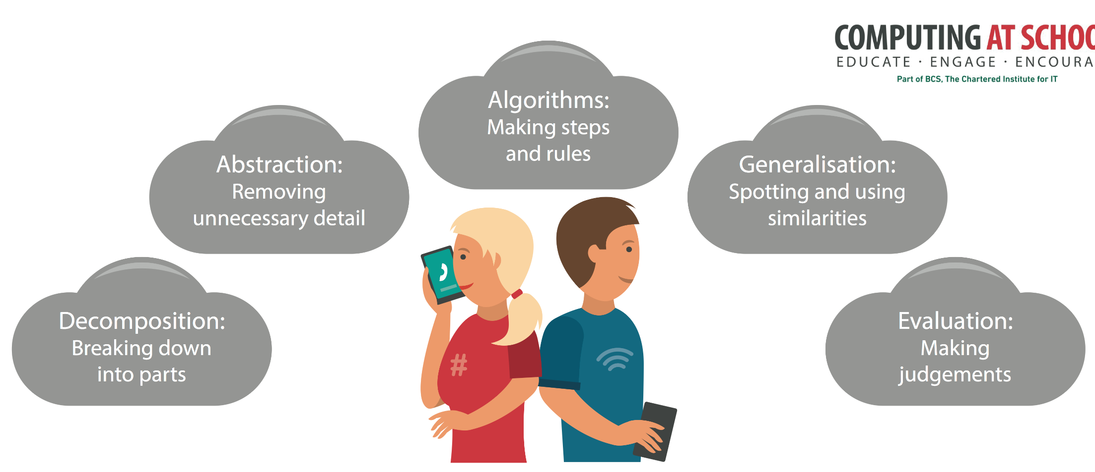
Concepts behind computational thinking are key to solving complex problems
Notes:
CAS have produced a poster that highlights the key concepts that underpin computational thinking – great for the classroom wall, so you can keep referring to them whenever the opportunity arises. We’ll be doing this throughout these sessions. They are … each will be revealed on a click.

Slide 11

What is a computer?
Input
Process
Output
A model of computation
Notes:
Open any gcse textbook and you will see something similar to the diagram above.
It is a convenient starting point for a discussion.
Ask the question; ‘What is a computer?’ You’ll receive a variety of answers.
Some will focus on a physical description – it has a screen and keyboard.
Others may try to be more specific – an electronic or digital machine perhaps.
Some might try to explain how a computer works, naming internal components perhaps.
Students usually start by describing hardware, but as computers become more ubiquitous, there are endless varieties.
Others might suggest that it is a machine that can be programmed to do different things.
This gets closer to an answer – it suggests software. But there are countless varieties of software – can they provide a definition?
(click)
What we need is a model – an abstraction that removes all the superfluous detail and tries to capture the essence of a computer.
This model is a good starting point – it captures the general behaviour of the hardware, taking input, doing something with it and displaying output.
But it also captures the software – programs also take data and do something to it before outputting the results.
We can call this a general model of how something is computed.

Slide 12


Loop until r = 0
r = a / b
a = b
b = r
if r = 0
print b
rocess
Input
Process
Output
A model of computation
Notes:
In this session we want to look in more detail at the process of computation.
(click)
We can express these as algorithms – the steps required to accomplish a particular task.
Realising algorithms in code is what software creation is all about, but we’re not concerned with coding in this session.
Nor are we concerned with how a computer executes code – that is the subject of the next Tenderfoot Unit: bits AND chips.
In this session we’re going to introduce some theoretical models of computation that were developed by early computer scientists to try to formalise the notion of an algorithm.

Slide 13
The big question for Computer Science
?
Input
Process
Output
Are there things a computer cannot solve?
Notes:
This may seem a bit obscure, but by finding ways of expressing algorithmic processes Computer Scientists could go on to ask some very big questions.
It’s a sort of common sense idea that as computers keep getting more powerful, there will come a time when every problem will be able to be solved by a computer.
Using models of computation, famous computer scientists have shown that there are things computers will never be able to solve, no matter how quick or powerful.

Slide 14
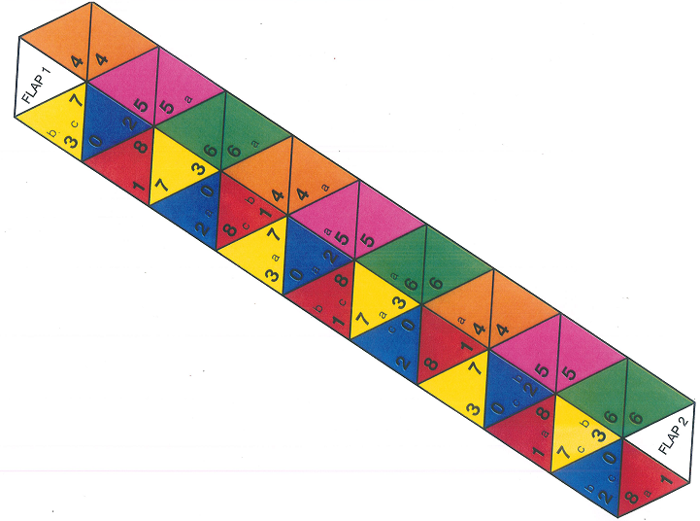
Theoretical Computers
The State We Are In
Notes:
This first session introduces students to some of the key ideas used in some models of computation.

Slide 15
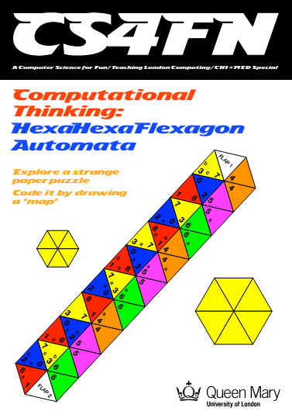
http://www.cs4fn.org/hexahexaflexagon/
Notes:
It is based on an exercise developed by Paul Curzon from cs4fn and involves students exploring the properties of a hexahexaflexagon.
There is a supporting booklet, which covers this activity and more, which can be freely downloaded from the link shown. It is also included in the resources.
A hexahexaflexagon is a curious hexagonal shape, made by folding a piece of paper, with an interesting history.

Slide 16

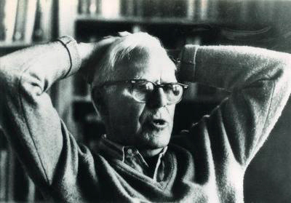
Arthur Stone
Bryant Tuckerman
Richard Feynman
John Tukey
1939
Princeton University
Flexagon Committee
1956
Martin Gardner
Notes:
Their discovery is credited to British mathematician, Arthur H Stone, studying at Princeton University in 1939. Finding his English paper didn’t fit his American folder, he tore a strip off and folded it up.
He formed the Princeton Flexagon Committee, along with his friends, Bryant Tuckerman, Richard Feynman and instructor John Tukey to explore their properties.
(click)
Some years later (1956), mathematician Martin Gardner popularised their work in articles he wrote for the magazine Scientific American.

Slide 17
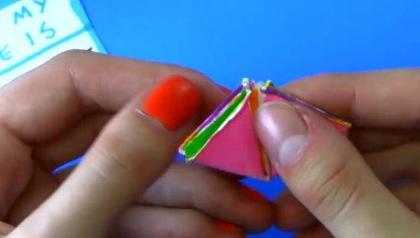
youtu.be/VIVIegSt81k
Vi Hart
1956
Martin Gardner
Notes:
In 2012, to celebrate Martin Gardner's birth, on 21 October, Vi Hart produced 3 wonderful videos telling the story of the hexaflexagon.
The first two at least (lasting 8 minutes) provide an excellent introduction before explaining the activity. https://youtu.be/VIVIegSt81k

Slide 18
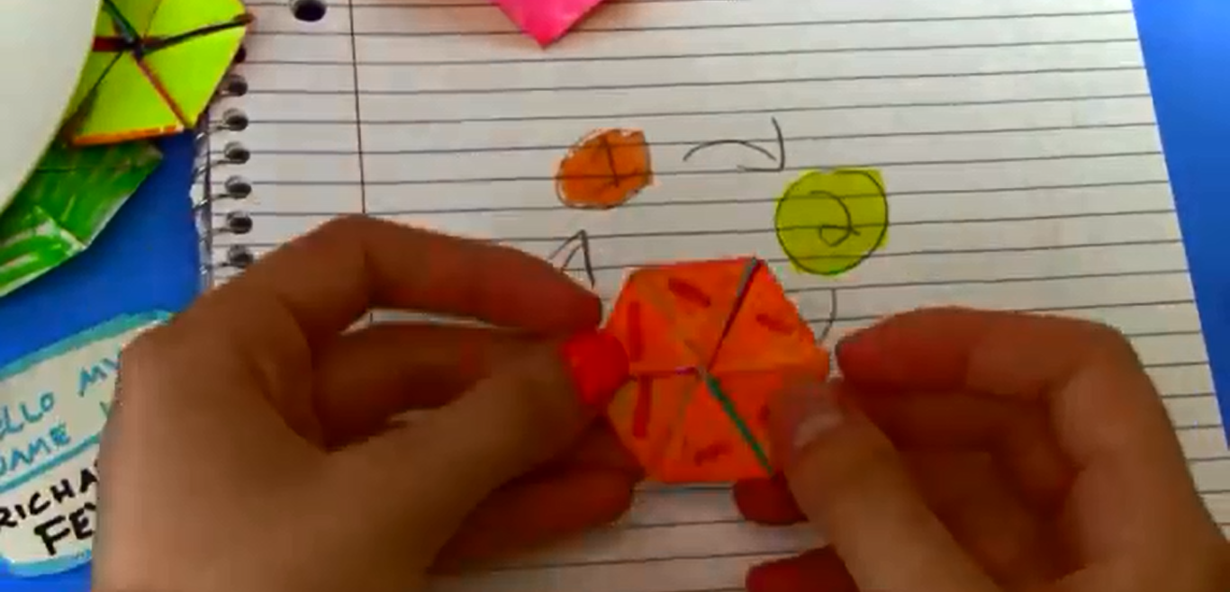
1
The Tuckerman Traverse
activity
Notes:
If you watched Vi Hart’s introduction you’ll know what the Tuckerman Traverse is already.
The challenge is for children to figure out a way to cycle through and display all the faces of a hexahexaflexagon, returning to their starting point.

Slide 19
HexaHexaFlexagons
youtu.be/gRg8cEK4Dms
Notes:
First we’ll need to make our hexahexaflexagons.
The resources include a template (as shown) that can be photocopied at A3 size.
Smaller hexahexaflexagons are harder to manipulate.
The shape is cut out, folded along its length and stuck back to back.
It’s strongly recommended this part is prepared in advance, as accurate folding and glueing is essential.
Students can work individually, in pairs or triplets depending on the number of flexagons you make available.

Slide 20
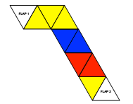
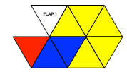

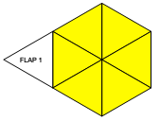
HexaHexaFlexagons
youtu.be/gRg8cEK4Dms
Step 2:
Step 1:
Do the same with the result. This brings three yellow triangles together.
Starting from the FLAP 1 end, fold the first pink triangle against its adjacent one, then green to green, orange against orange etc. down the strip. You should end up with a shorter strip.
Step 3:
Continue folding to
make a yellow
hexagon
Step 4:
FLAP 2 is tucked
under the hexagon,
FLAP 1 folded back and stuck.
Notes:
Give out the part complete flexagons.
The 4 steps revealed with clicks above should allow everyone to complete it.
Full instructions for folding a hexahexaflexagon are given in the cs4fn booklets.
The abbreviated steps, shown above should be sufficient for most (and is included as a handout)
If students struggle, encourage them to use the YouTube video link given on the slide and handout.

Slide 21
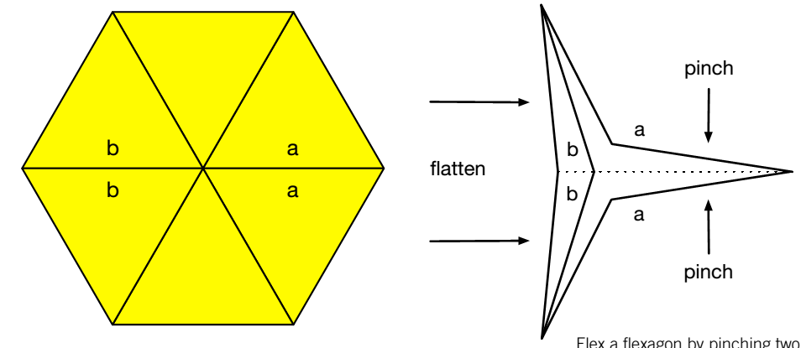
HexaHexaFlexagons
Pinch
Push
Pinch
Notes:
Flexing a hexahexaflexagon is a matter of pinching and flattening the opposite side.
There are a lot of letters and numbers on the flexagon, which will help the students exploration later.
Start with the yellow side facing you. If assembled correctly, the 3’s should be in a central ring and the lower case a’s and b’s together.
Always keep the flexagon facing the same way up initially.
By pinching and pushing, you’ll find it turns inside out.
Only some places can be pinched – these are indicated by the same lower case letters (a, b or c) being adjacent.
Once they get the hang of it encourage children to explore initially, to see what they can discover.
After a few minutes exploration, discuss the Tuckerman Traverse challenge with the class.
What do we need to find out before we can devise a sequence that reveals all the faces and ends on the same face as we first started?
Prompts are given on the next slide.

Slide 22
HexaHexaFlexagons
How many sides can you find?
How can we be sure we have found them all?
Let’s draw a diagram!
Notes:
Before students can attempt the Tuckerman Traverse, pose the question of how many faces it has.
(There are 9 sides)
Ensure the students keep the flexagon facing the same way up when exploring. Some faces have the same colour, but can be seen to be different by the positioning of the digits.
With the flexagon kept the same way up, each face is identified by the central ring of digits.
(click)
How can we be sure we have explored them all. (click)
A diagram is a good example of abstraction – removing any details that obscure our understanding.

Slide 23
HexaHexaFlexagon Graph
a
2
7
7
3
The start of a digraph
c
3
3
3
7
3
3
7
3
c
7
7
Let’s draw a diagram!
Notes:
Inspect all the details.
What are important?
The 3’s in the middle identify the side, so we can draw a node (click)
What happens when we pinch at a? (click)
We move to side 2.
Can we pinch anywhere and move back?
No, so the arrow is one way.
Diagrams like these are known as graphs.
The faces are indicated by nodes, and the transitions indicated by edges linking different faces.
A previous Tenderfoot Unit (Clever Stuff For Common Problems) introduced graphs as a powerful tool for representing a variety of problems.
In this example, the graph will represent the transitions between faces.
The edges have a letter assigned, indicating where to pinch, and the arrow indicates a direction.
Because the edges indicate one way transitions it is known as a directed graph or digraph for short.

Slide 24
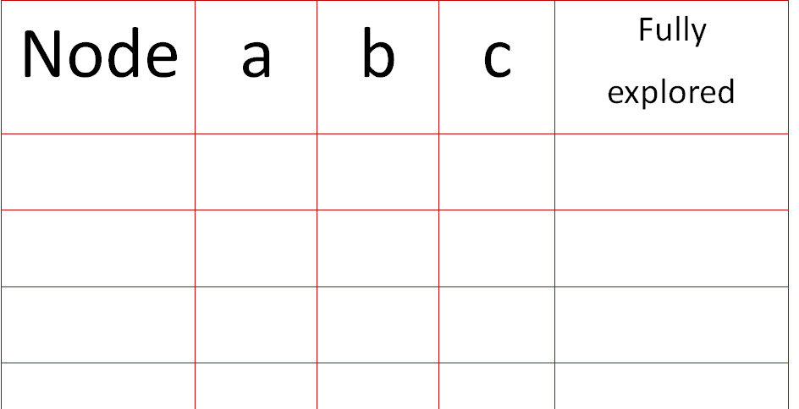
HexaHexaFlexagon Exploration
4
a
2
7
7
b
3
The start of a digraph
c
3
a
3
3
7
a
3
3
7
1
3
c
7
7
3
✓
✓
na
✓
2
✓
na
1
✓
na
Notes:
We need to be systematic in our exploration.
Working in pairs or small groups suggest they complete a table to record their results.
Give out the blank table in the resources and complete the first few lines together, as revealed in a series of clicks below.
As a class, start with face 3 facing, as shown.
Note that on side 3, only the a and b’s are together, so you can’t pinch at c. (click)
We record the Node (face) number, and note that pinch c is not applicable (na)
We can now tick when a side is pinched and also record when all options for each side have been fully explored.
As a group work through recording the first few moves, starting by pinching at a and revealing Node (blue face) 2. (click) This has already been recorded on our fledgling graph.
From Node 2, pinch options are only available for a and b, so c is marked na. (click)
Pinching at a, reveals Node (red face) 1.
Make sure students not only complete the table, but add the transition to their digraph. (click)
Again, pinch options are only available for a and b, so mark c as na. (click)
Pinching at a reveals Node (yellow face) 3 again (click)
This time, we can pinch at b, which takes us to Node (orange face) 4 (click) and we can now note that all pinch options for Node 3 have been explored.
Everyone should now be able to complete the remainder of their own exploration, and the associated digraph.
The completed digraph is shown on the next slide.

Slide 25
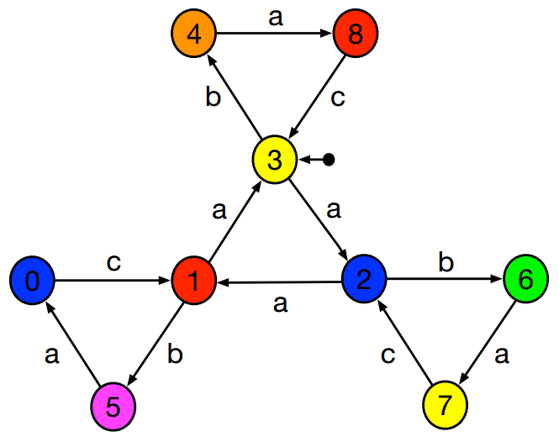
HexaHexaFlexagon Exploration
Can you now plan the Tuckerman Traverse?
Drawing an algorithm
Notes:
Here is the graph for a fully explored hexahexaflexagon.
We don’t need to use an actual hexahexaflexagon anymore as the graph accurately models its behaviour.
With this it is easy to plan a ‘Tuckerman Traverse’.
By abstracting away unnecessary detail, we’ve made the problem much easier to solve.
We need to indicate where to start (click), and then we can trace the inputs required to move between different states.
And we indicate an end state with a double ring.
A graph such as this, which indicates a set of states and the inputs required for each transition is known as a State Diagram. It is a diagram that expresses an algorithm.
The graph denotes a finite number of states (nodes).
It also indicates the actions (or inputs) required to move from one state to another (the letter to pinch).
All the possible actions (in this case the letters a, b and c) are known as the machines alphabet – the only acceptable inputs.
State Diagrams can also output things. To keep things simple, the only output in this case is displaying the colour and number of the face.
State Diagrams are extremely useful. They are a visual representation of a sequence (or potential sequence) of inputs/actions and can therefore be used to model many computational processes.

Slide 26

HexaHexaFlexagon Exploration
Is a full traversal of all faces possible?
7
1
8
7
1
8
c
a
c
3
3
3
7
8
1
b
3
3
7
8
b
1
3
c
a
c
7
1
8
7
1
8
Pinch
Taking it further
Notes:
Finite State Machines are extremely useful. They are a visual representation of a sequence (or potential sequence) of inputs/actions and can therefore be used to model many computational processes.
Before we look at other applications, there is an more difficult challenge involved with the hexahexaflexagon.
From the starting position shown, turn the flexagon over (click).
Notice there is a face with no numbers in the middle.
There are many more faces to explore flexing it this way up.
(click)
Is a full traversal of all sides possible?
To answer that, we need to decompose the problem into smaller explorations.
Decomposing a complex task into smaller parts is a key concept in computational thinking.
Can the group suggest some of the things we might need to investigate first?
Below are some suggestions to prompt a discussion.
Do any states on this side overlap with those we already know about?
If they do, how do we tell them apart?
Perhaps we will need a different abstraction to draw a graph?
If so, what symbols will we use?
We’ll leave this as an open ended challenge to explore as homework.

Slide 27
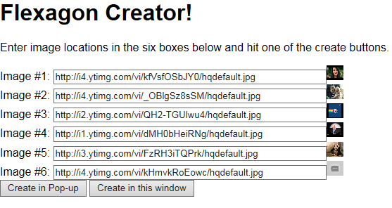
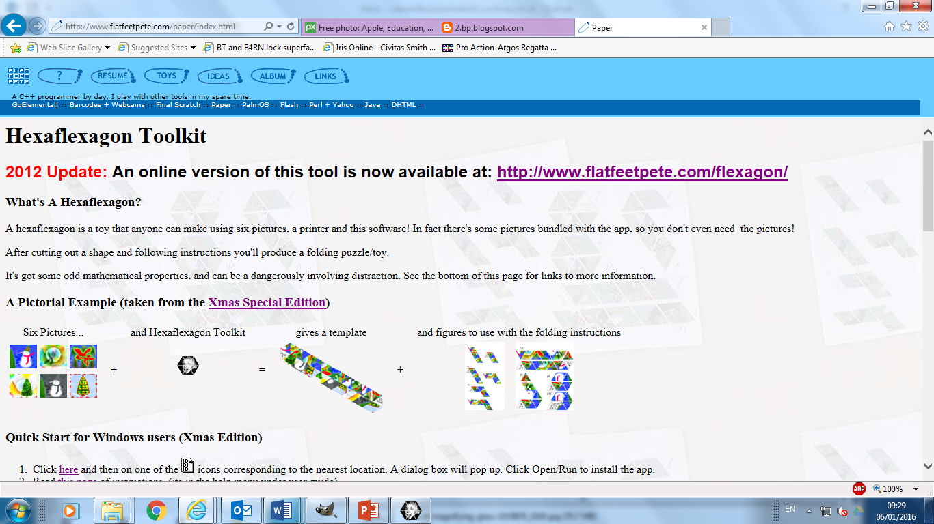
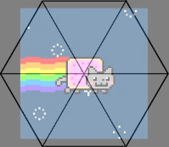
HexaHexaFlexagon Fun
www.flatfeetpete.com/flexagon
www.flatfeetpete.com/paper/index.html
Make your own flexagon
Notes:
Before we leave our investigation into flexegation it’s worth pointing out a simple utility that allows children to create their own hexahexaflexagon.
The lower link is to an application from Pete Bradshaw’s website that you can download and install locally.
(click)
Children supply six images which are cropped and stretched to fit the flexagon template. To avoid distortion, children can crop the images first to maintain the correct aspect ratio. They need an aspect ratio of 200:173
(click)
The upper link is to an online version, where you can supply the URL of six pictures. There is less control here, but it is easier to quickly create a hexahexaflexagon image.
The image is saved as a scaleable vector, which children can then manipulate to maximise the size they can print.
It offers a fun element at the end of the investigation.

Slide 28
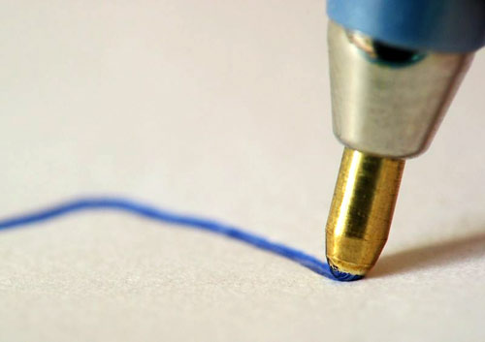
State Diagrams
Button clicked
State 1
State 2
Button clicked
Finite State Machines
Notes:
State Diagrams, as we have seen, can visually represent the behaviour of something that responds to input, has a set (finite) number of states, and can (if needed) output something too.
Things that display such behaviour are all around us. In computer science we call them Finite-State Machines.
Here, the behaviour of a ball point pen is represented by a state diagram.
The machine has two states, nib retracted and protruding.
It changes state in response to the input of a button being clicked.

Slide 29
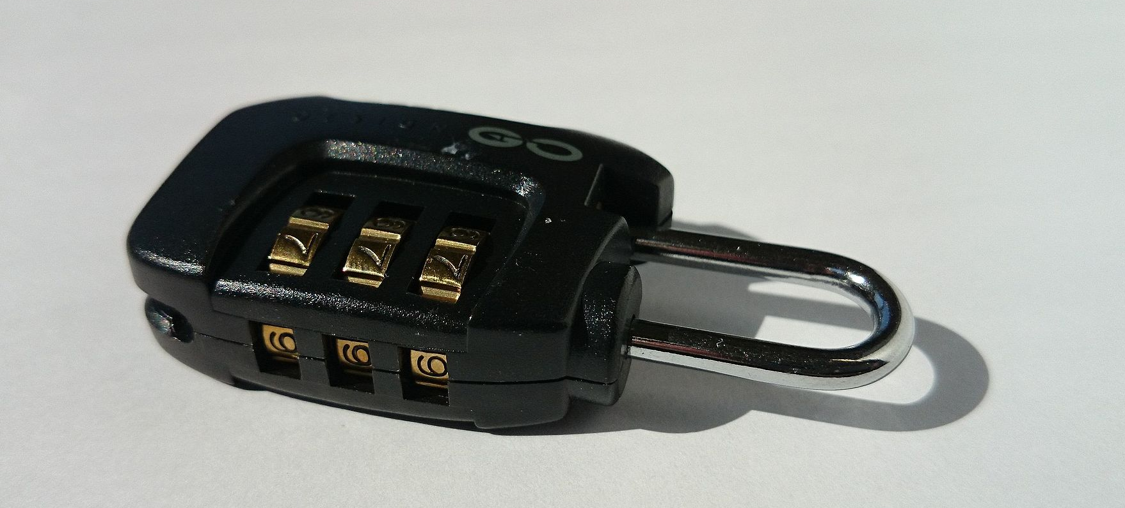
State Diagrams
<>2
Locked
Next Digit
Final Digit
Unlocked
3
2
6
<>3
<>6
Finite State Machines
Notes:
A combination lock might be considered a finite state machine.
Here, the 3 numbers have to be entered in the correct order.
If a 3 is not entered for the first digit, it remains in a locked state.
Once a 3 is entered, we can input the second digit and so on.
Only if the combination 326 is entered does the lock enter the unlocked state.
We indicate an ‘accepting’ state with a double ring.

Slide 30
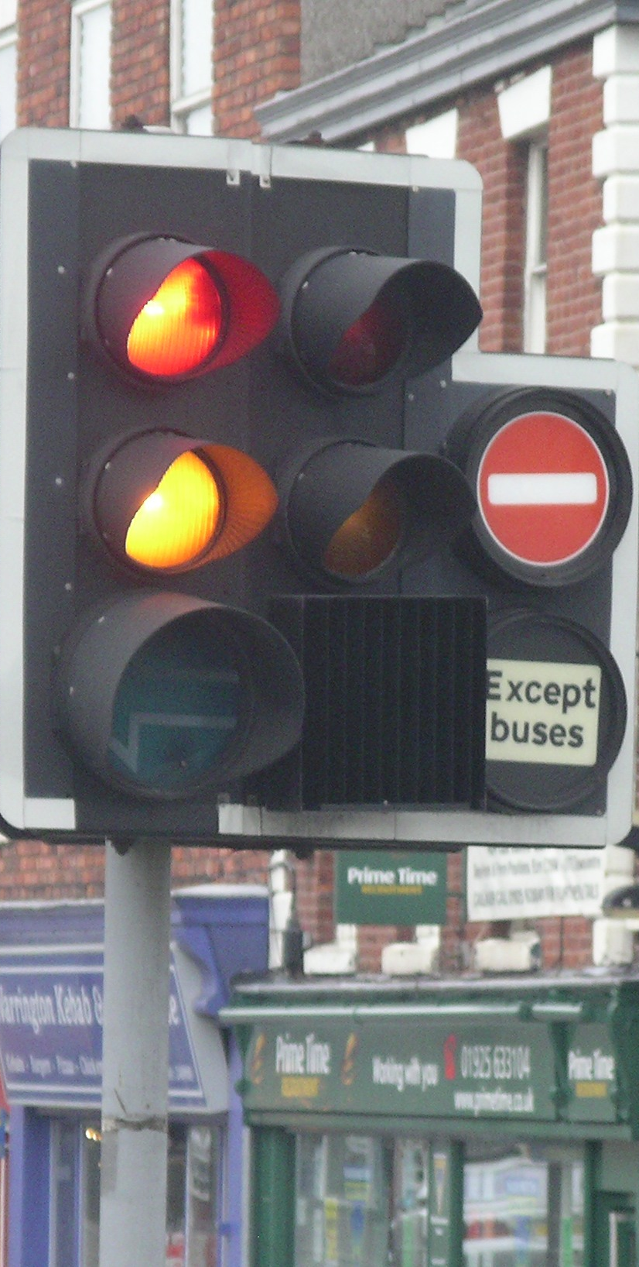
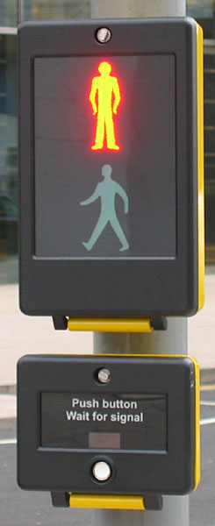
How many household finite state machines can you identify?
What is the biggest FSM you can think of?
Finite State Machines
Notes:
Traffic lights are another obvious example. (click)
A simple exercise might be to draw the state diagram for a pelican crossing.
(click)
Or homework could be to identify as many household objects that can be modelled through state diagrams.
There are lots of simple electrical or mechanical devices in a home that could fit this description.

Slide 31


Points to ponder
The National Curriculum makes no mention of finite-state machines.
What is the value in considering the National Curriculum when planning our teaching?
Notes:
A brief pause to encourage a short discussion whilst props are tidied up and the presenter gets ready for the next session.

Slide 32
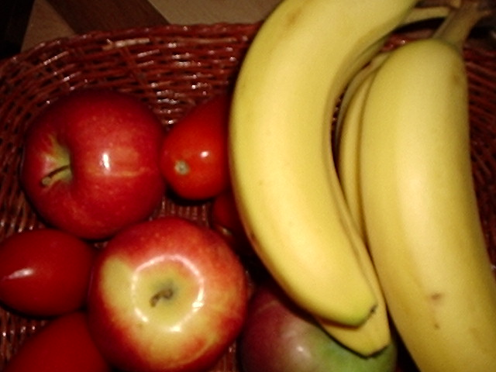
2
Fickle Fruit
activity
Notes:
The behaviour of many common situations can be modelled using a finite state machine.
A finite state machine is not really a mechanical entity, but an abstract set of instructions which a computer can be programmed to follow precisely.
This activity, from the MathManiaCS project is an entertaining introduction.

Slide 33
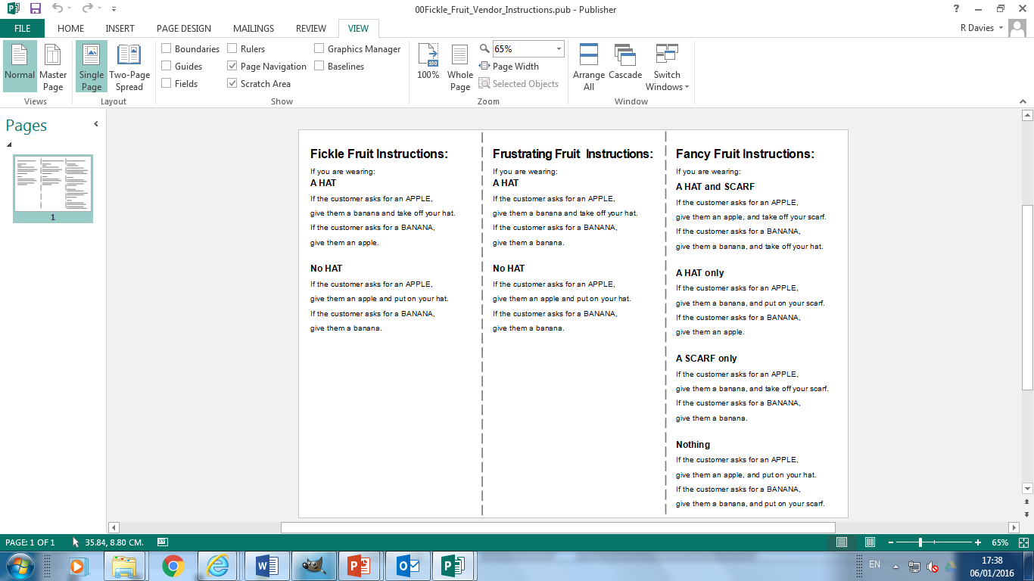
2
Fickle Fruit
activity
For each group will need:
A hat
A scarf
Several apples and bananas
Fruit vendor instruction cards
Notes:
Start the exercise as a class, with one volunteer at the front as a fruit vendor.
The vendor should wear a hat.
Give the volunteer the Fickle Fruit Instruction card.
No-one else should see it.
Instruct students to request (in an orderly fashion) either a banana or apple.
The vendor responds according to the instructions on the card.
Practise for a few minutes, and encourage students to keep some record of the behaviour they observe.
When they are familiar with the routine, split into smaller groups with one member elected as the fruit vendor.
They can take it in turns as the activity progresses.

Slide 34
2
Fickle Fruit
activity
Challenge:
Can the group place an order that will return 3 consecutive apples?
Two bananas then an apple?
A banana followed by two apples?
Notes:
In groups, with the fruit vendor in possession of the Fickle Fruit instruction card only (and starting with a hat on), issue the challenge above.
If they get the answer quickly (banana, banana, banana), ask them to repeat the exercise with the vendor starting without a hat.
Do they fully understand the vendors behaviour? (click)
Try the extra challenges, starting with the vendor in their current attire.
Bring this part of the activity to a close by asking the groups to predict the behaviour of the vendor and share any methods they have used to record the behaviour.
Has anyone drawn a state diagram?

Slide 35
Frustrating Fruit
Challenge:
Can the group place an order that will return 3 consecutive apples?
Notes:
Swap vendors and hand the new vendor the Frustrating Fruit instructions.
Allow them to start with or without the hat and issue the same original challenge.
Eventually, someone will realise that you cannot place an order for 3 consecutive apples.
Stop the exercise and ask if they are sure?
At this stage, we need an organised way of characterising the vendors behaviour.
The next slide demonstrates the creation of a state diagram.

Slide 36
Fickle Fruit State Diagram
b | a
b | b
a | b
HAT
NO HAT
a | a
Complete a state diagram for the Frustrating Fruit vendor
Notes:
Display the Fickle Fruit instructions. Ask students to identify the states.
(click)
There are two states for the vendor: Hat and No Hat.
Ask a student to read the first instruction if they are wearing a hat.
(click)
We can represent the transition with an arrow, but how do we record the input and output?
(click)
We’ll use ‘a’ and ‘b’ to represent apple and banana. We can write the input and output on the transition, using a pipe to separate them.
So a|b means we asked for an apple and received a banana.
Ask for a volunteer to suggest how we would represent a customer asking for a banana whilst in the Hat state.
(click)
Finally ask for completion of the transitions from the No Hat state.
(click) completes the diagram and sets the task to complete a similar diagram for the Frustrating Fruit vendor.
Give out copies of the Frustrating Fruit instructions and ask students to draw the diagram on the exercise sheet.
The next slide illustrates the answer.

Slide 37
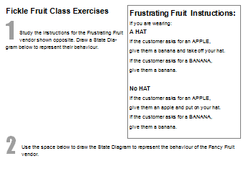
Frustrating Fruit State Diagram
b | b
b | b
a | b
HAT
NO HAT
a | a
Why can’t an order be placed for three consecutive apples?
Complete a state diagram for the Frustrating Fruit vendor
Notes:
Before displaying the answer, ask for volunteers to draw the state diagram.
A click will reveal the answer.
Can the students see (and explain) why a three apple order is impossible?
Before continuing, point out that a state diagram is completely deterministic. That means every state must have a transition for every possible input.
In this case, there are 2 states and 2 possible inputs, so four transitions.
How many transitions would there be if there were 3 states and 5 possible inputs? (15)

Slide 38

Fancy Fruit State Diagram
b | a
a | a
HAT & SCARF
HAT
a | b
b | b
a | a
b | b
a | b
SCARF
NONE
b | b
Do you notice anything about two of these states and transitions?
Notes:
The final exercise is more challenging.
The Fancy Fruit vendor has both a hat and a scarf.
Give out an instruction card to a vendor in each group and challenge the other students to complete the state diagram on the exercise sheet.
As they don’t know the possible states in advance, completing it in rough, as they perform the activity will be best.
A click will reveal the answer for them to check.
Another click poses a question.
The transitions outgoing from the Hat & Scarf state are identical to those from the None state.
When this happens we have an example of a redundant state.
The diagram can therefore be simplified, collapsing the two states into one as shown on the next click.

Slide 39
Fancy Fruit State Diagram
b | a
a | a
HAT/SCARF
or NONE
HAT
a | b
a | b
b | b
b | b
SCARF
Notes:
The simplified states and transitions.

Slide 40









Harold The Happy Robot
Either or
Either or
Inputs
Designing finite state machines
Notes:
Now we are familiar with state diagrams let’s try, as a group designing a FSM from a given specification.
Challenge the students to come up with a fsm to model the behavior of “Harold, the happy robot”.
Here is the story to tell about Harold:
(click)
At any time, Harold is either happy or sad.
(click)
He is also either charged or not-charged with electricity.
There are three types of inputs that Harold might get:
- electricity
“dance” request
music.
The rules that describe Harold’s behavior are fairly natural and shown on the next slide.
They are reproduced on Happy Robot Card, so each student can have a copy.

Slide 41

Harold The Happy Robot
Uncharged to charged.
If charged, no effect.
No effect on happiness
Sad to happy.
If happy, no effect.
No effect on electric charge.
If charged:
dance, become happy and uncharged.
If uncharged:
don’t dance, become sad if not already.
Input Rules
Notes:
The rules that describe Harold’s behavior are fairly natural:
(click)
Input of electricity cause him to go from not-charged to charged
It has no effect if already charged.
The electricity does not change whether he’s happy or sad.
(click)
Input of music causes him to become happy, if sad.
It has no effect if already happy.
The music does not change whether he’s charged or not-charged.
(click)
A “Please Dance!” request is the most complicated.
If he is already charged, he will dance and become happy, but also uncharged (since dancing uses up the charge).
If he is not charged, he will become unhappy if he wasn’t already (since he can’t fulfil your request).

Slide 42


Harold The Happy Robot
music
dance?
dance?|dancing
dance?|dancing
electricity
electricity
music
State Diagram
Notes:
Discuss how to draw a diagram to represent Harold’s behaviour.
There may be some confusion about states.
Deciding the states is the key starting point.
Is dancing part of any state or is it an output?
We’ll make it an output, in response to a dance request input.
So any “output” is associated with the transition, like the Fruit diagrams.
Guide them towards discovering that there are 4 states, and that “dancing” is not part of any state, in this model.
(click)
This reveals the 4 states.
Sad / Uncharged, Happy / Uncharged, Happy / Charged & Sad / Charged
Discuss the transitions from each one in turn. Clockwise from top left – use the questions for prompts
What input is needed to make Harold happy?
(click)
What makes him sad?
(click)
What makes him charged?
(click)
What discharges a happy Harold? ( a dance request, leading to dancing output)
(click)
By now the students should be able to add the correct inputs / outputs.
What makes a charged, happy Harold sad? (nothing, so no transition)
Does anything make a sad, but charged Harold happy?
(click)
What discharges a sad Harold?
(click)
A dance request, since he dances. Does it make him happy? (yes)
(click)
Does anything make him sad if he is charged? (no)
What transitions are missing?
(click)
A charge whilst sad.

Slide 43
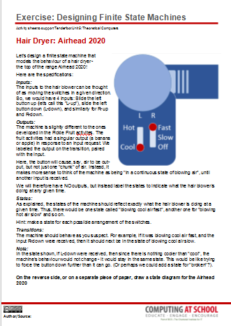
Airhead 2020
L R
Hot
Cool
Fast
Slow
Off
Designing finite state machines
Notes:
Once students have grasped the principles of designing Finite State Machines with State Transition Diagrams, they can start to investigate everyday appliances and try to develop their own diagrams.
The first challenge is a hair dryer. Give out the associated worksheet.
Before students start point out that there are no outputs on the transitions.
The transitions represent the input (L-up/down or R-up/down).
As the output is constant, it makes sense for the state to represent the output e.g. blowing cool air fast.
The solution is given on the next slide.
There are two conventions for representing FSM’s. Representing output on the state, as we did with the hexahexaflexagon, and are now doing with the hair dryer, is known as a Moore machine.
Representing output on the transition, as we did with the Fickle Fruit machines is known as a Mealy machine.
Whilst this detail is not needed at KS3, it does feature in A level courses.
A state transition diagram will use one or the other representation.
The choice of representation is usually dictated by the task it represents, but it is possible to express any Moore machine as a Mealy machine, and vice-versa.

Slide 44
Airhead 2020
L-up
COOL
FAST
HOT
FAST
L-down
R-up
R-down
R-up
R-down
COOL
SLOW
HOT
SLOW
L R
Hot
Cool
Fast
Slow
Off
R-up
R-down
R-up
R-down
OFF
(cool)
OFF
(hot)
L-up
L-down
R-down
R-down
Designing finite state machines
broken
Notes:
The FSM for the Hair Dryer is shown.
To check understanding, we could ask the students to add a broken state, as suggested on the worksheet.
Click to reveal the answer.
Where would another broken state be drawn to indicate a broken Left button?

Slide 45
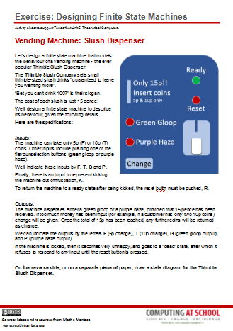
Thimble Slush Dispenser
Ready
Reset
Only 15p!!
Insert coins
5p & 10p only
Green Gloop
Purple Haze
Change
Designing finite state machines
Notes:
The Thimble Slush Dispenser is more challenging.
It could perhaps be set as homework.
Some discussion of how to represent output would be helpful.
As the output is a discrete drink, before returning to a ready state it is best represented on a transition – a Mealy machine.
The process of deciding on states can be difficult, and often requires intuition that comes from experience.
Be prepared with some good hints.

Slide 46
Thimble Slush Dispenser
READY
Ready
Reset
K
F
Only 15p!!
Insert coins
5p & 10p only
R
5p
IN
T
K
DEAD
F
Green Gloop
Purple Haze
10p
IN
K
T
K
F
T|F
15p
IN
G|GG
Change
P|PH
Designing finite state machines
F|F
T|T
Notes:
The solution to the Slush Dispenser is shown.
Note that this is a Mealy machine, that is the output is shown on the transition.
To check understanding of the transitions, clicks highlight those showing output.
These can be prompts for questions.
Note the ‘pipe’ symbol separates the input from the output, so in our machine in the 15p state, if we press (input) G, we will get Green Gloop (GG) out.

Slide 47
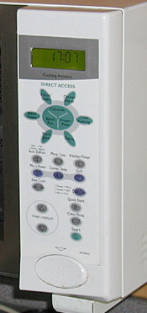
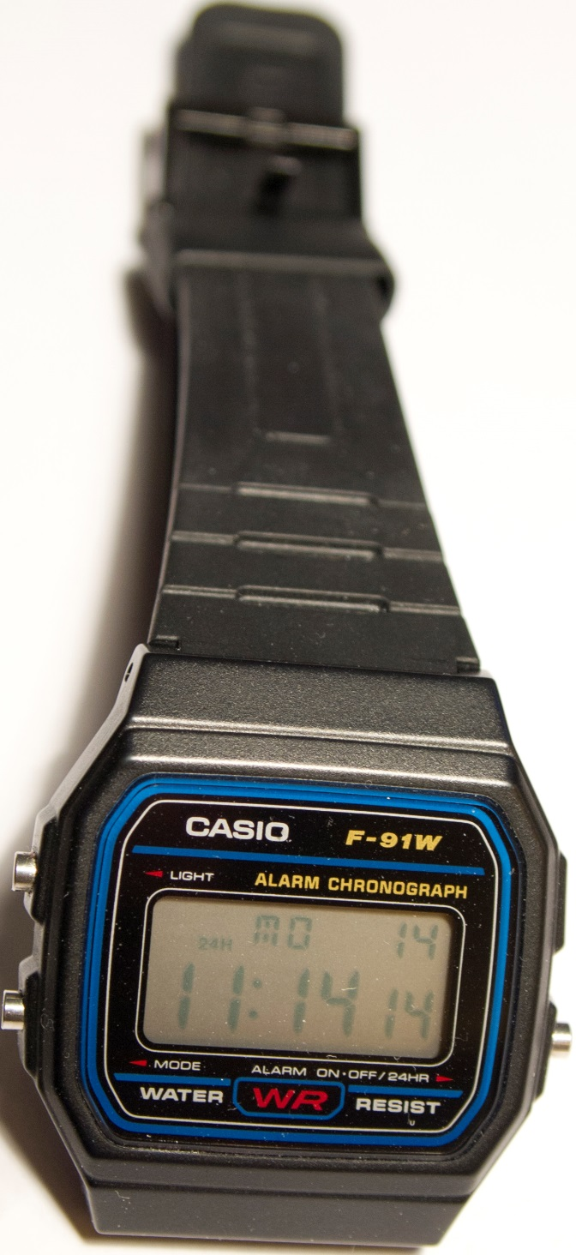
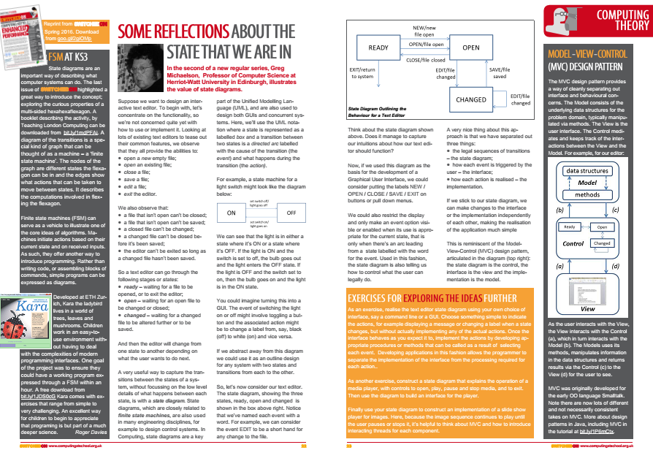
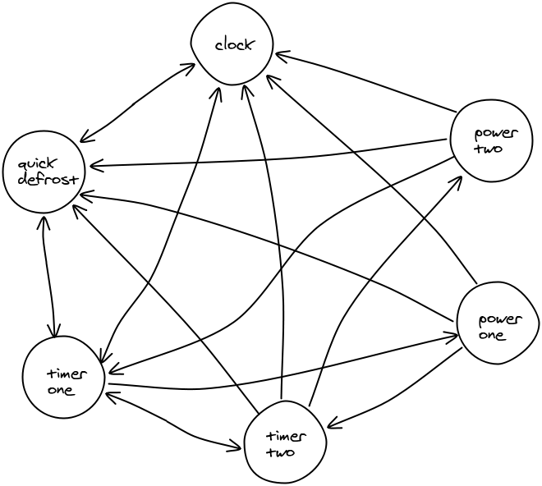
Interface Design
www.cs4fn.org/humanerror/microwaveracing.php
Finite State Machines
Notes:
FSM’s can be very useful for modelling the design of interfaces.
Another homework might develop diagrams for setting the time or alarm on a digital watch for example.
(click)
By modelling the interface, design errors can quickly be identified.
If the FSM that describes a device is very complicated it is a warning that the interface will be difficult to navigate
Look at the microwave interface diagram – if Power 1 is set, the user can’t set Timer 1 without going through other buttons. Timer 1 should be set first.
Once you know the sequence it isn’t a problem, but the designer should really allow for the fact that people might set the power first.
This is another huge growth area in Computer Science: HCI or Human Computer Interaction.
Cs4fn host a 2 minute video of people setting microwaves that makes the point nicely, pointing out the implications for interfaces in more serious settings, such as hospitals. Link on slide.
(click)
Finally, a reprint of an article from SwitchedON, the CAS magazine, encourages teachers and students to look at how software interfaces can be expressed as a FSM.
It highlights the importance of the concept for software developers in separating the processing requirements from the interface behaviour.
The article includes suggestions for further exercises.

Slide 48
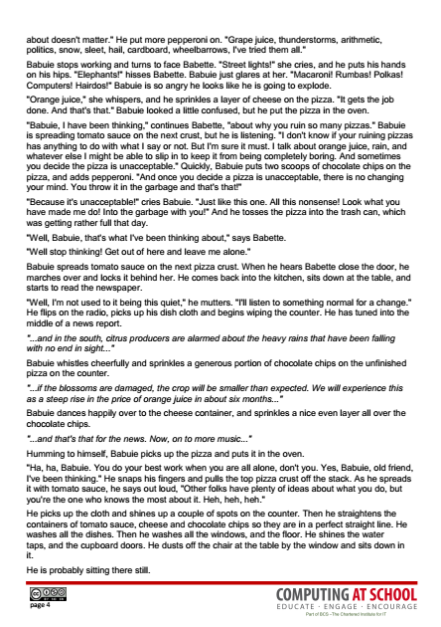
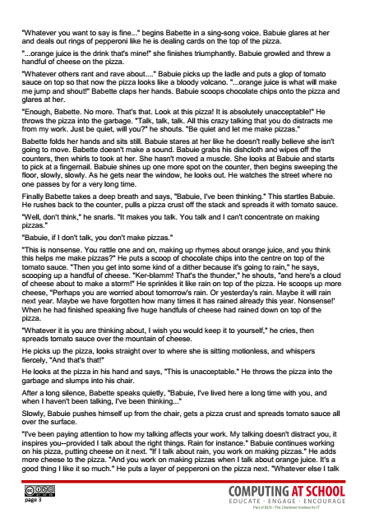
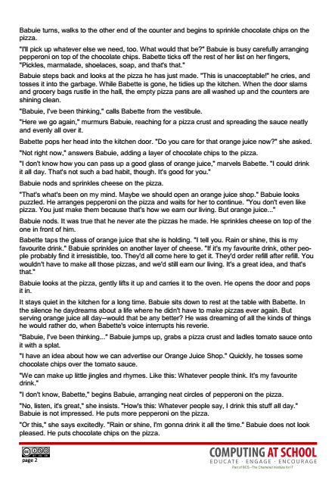
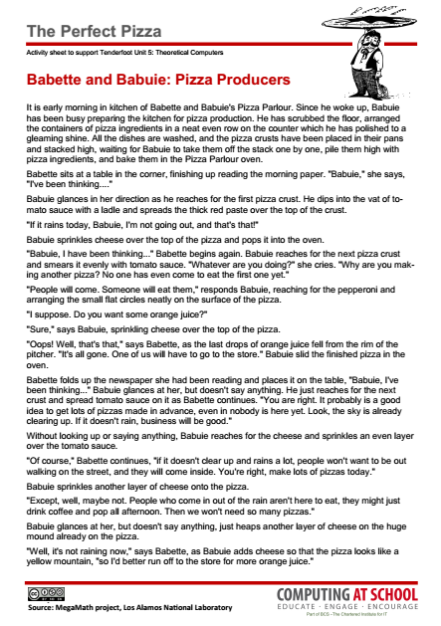
The Perfect Pizza
Finite State Machines
Notes:
One final, if challenging, exercise is also included in the resources.
It comes from the now defunct MegaMath website, a project hosted by Los Alamos National Laboratory in the late 1990’s.
The Perfect Pizza is a story in which the behaviour of the Babuie, the pizza maker can be explained by a Finite State Machine.
It could be set as an extension exercise.
Reading the story could be done as a homework, or read aloud in class, embellished with students acting out parts.
These questions can be used to prompt discussion:
What part of Babette's behavior seems to influence Babuie?
If Babuie's behaviour can be described in terms of a finite state machine, what are the "letters" of its "alphabet”?
What strategies do you use to try and figure what Babuie's finite state machine is?
Students will need time to chew this over and explore possibilities.

Slide 49
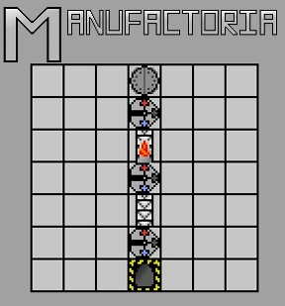
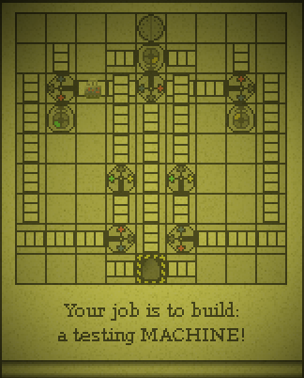
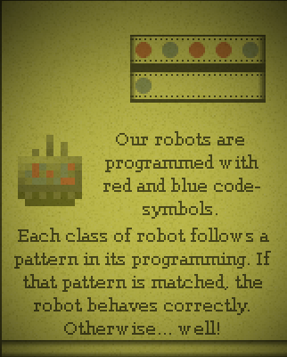
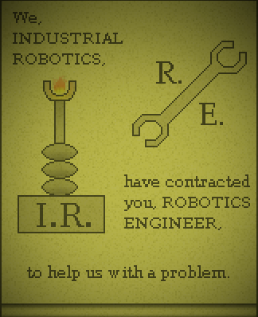
Finite State Machines
goo.gl/B28pKZ
Notes:
And as a last pointer, Manufactoria is a very challenging game based on Finite State Machines.
Probably one for teachers, rather than students!

Slide 50

Points to ponder
How many examples does a key stage 3 pupil need to be able to generalise
‘finite state machine’ (FSM)
Notes:
Again, a brief pause to encourage a short discussion whilst props are tidied up and the presenter gets ready for the next session.

Slide 51

Theoretical Computers
Mind Your Language
Notes:
This session looks at how finite state machines can be used to define language checkers, their use in computer systems and introduces the notion of formal and natural languages.

Slide 52
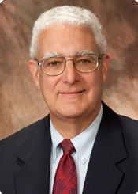
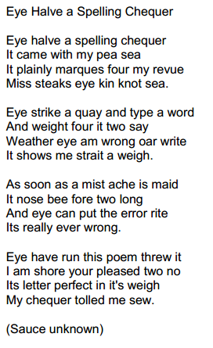
www.bios.niu.edu/zar/poem.shtml
Jerrold
Zar
Spellcheck is smart, but sometimes stupid
Notes:
Have you ever wondered how a spell check works … and why it sometimes doesn’t!
Many people will have come across the famous poem illustrated.
Written to highlight the limitations of spell check, it has ‘gone viral’.
Many versions playfully suggest the ‘sauce’ is unknown
(click)
It was, in fact, written by Professor Jerrold H. Zar, at Northern Illinois University, in 1992. The link provides details, and the original is included in the resources.
A good introductory exercise for students is to read and translate the poem into the words conveying correct meaning.
The simpler version (shown) is also included which is easier.
The key point is, of course, that a Spell Check utility, whilst helpful, cannot be relied upon totally.

Slide 53
Is that boat for sail?
I got a teddy bare for my birthday
Look over their, there playing football
In the library, reading allowed is not aloud
Spellcheck is smart, but sometimes stupid
Notes:
The following homophones (words that sound the same, but are spelt differently) are taken from the British Council resources for learning English.
They all highlight some of the problems for spellcheckers – encourage students to articulate what the problem is.
Each revealed on a click.

Slide 54
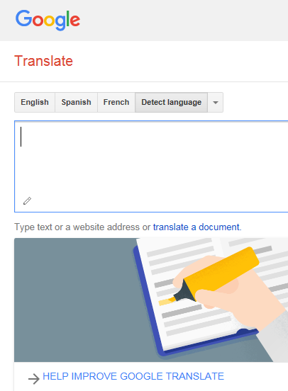
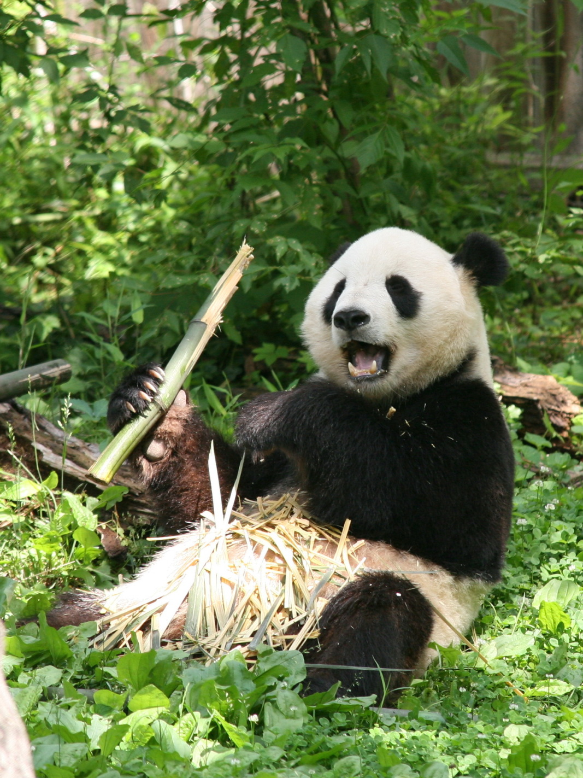
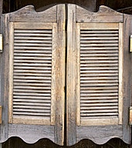

Natural Languages
Eats shoots and leaves
Spellcheck is smart, but sometimes stupid
Notes:
One of the reasons spellcheckers can be stupid is that natural languages, such as English are full of ambiguity.
The sentence above may well refer to panda’s, but it could equally have another meaning (click)
… an incident in a saloon bar for instance.
(click)
The phrase is the title of a well known book on English grammar, but there is more to natural languages than just spelling and grammatical rules.
Meaning is often dependent on context, which is why online translation services are notorious for getting things wrong too.

Slide 55


Formal Languages
Natural Languages
www.cs4fn.org/linguistics/klingon.html
Notes:
Natural languages evolve. Formal languages, by contrast are designed.
Programming languages are like this, which means they have to adhere to strictly defined rules.
This makes it possible to accurately translate them into the machine code used by a computer.
If the syntax and grammar aren’t perfect, the translator rejects them.
(click)
We tend to take language for granted, but linguistics is an important area for computer scientists as they strive, not only to define more intuitive programming languages, but translation and grammar checking services too.
As ever, CS4Fn have a nice introductory article to point children towards.

Slide 56
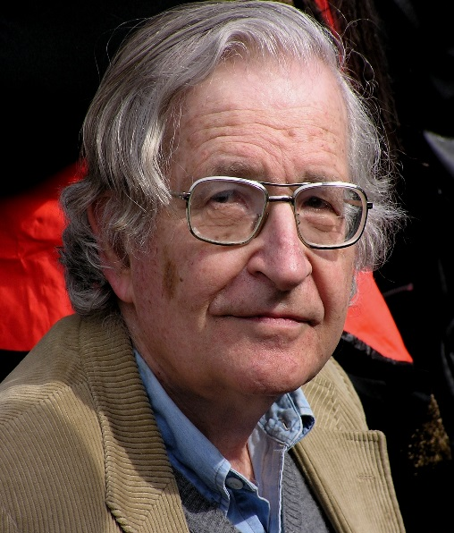
The structure of language
A language is a sequence of ‘atoms’.
Grammar: rules defining sequences.
Expressed in terms of symbols.
Simple example:
Noam Chomsky
Sentence → a Noun Phrase (NP) followed by a Verb Phrase (VP)
Noun Phrase → an Article (A) followed by a Noun (N) OR Proper Noun (PN)
Verb Phrase → a Verb (V) OR a Verb followed by Noun Phrase
Article → ‘a’ OR ‘the’
Noun → ‘cat’ OR ‘child’ OR ‘sun’
Proper Noun → ‘Peter’ OR ‘Janet’
Verb → ‘sees’ OR ‘likes’
Notes:
In the 1950’s, Noam Chomsky, the famous linguist, philosopher and social critic laid the foundations for analysing languages.
He defined a language as a sequence of ‘atoms’.
Taking English as an example, a sentence is made up of a sequence of words.
Words are made up of a sequence or string of letters.
The letters are the languages’ alphabet – from which more complex sequences can be built.
Not all possible sequences are valid words.
(click)
Grammar is the rules defining how the atoms can be combined and structured.
These are expressed as symbols.
(click)
We’ll use a simple subset of English as an example.
Here a sentence is defined as a combination of a Noun Phrase ‘symbol’ followed by a Verb Phrase ‘symbol’.
All subsequent symbols are defined until we get down to actual words in the language.

Slide 57
The structure of language
S::- NP VP
NP::- A N | PN
VP::- V | V NP
A::- a | the
N::- cat | child | sun
PN::- Peter | Janet
V::- sees | likes
The cat sees Janet
Sentence S → a Noun Phrase (NP) followed by a Verb Phrase (VP)
Noun Phrase NP → an Article (A) followed by a Noun (N) OR Proper Noun (PN)
Verb Phrase VP → a Verb (V) OR a Verb followed by Noun Phrase
Article A → ‘a’ OR ‘the’
Noun N → ‘cat’ OR ‘child’ OR ‘sun’
Proper Noun PN → ‘Peter’ OR ‘Janet’
Verb V → ‘sees’ OR ‘likes’
Parse Tree
Notes:
The box shows a more symbolic representation of the rules.
Note the pipe to represent alternatives (OR).
The symbolic representation is known as Backus-Naur Form. Developed by John Backus and Peter Naur to define Algol, it is now the main technique for defining formal languages.
(click)
Let’s now evaluate whether a sentence is valid in our language.
To do this we will develop what is known as a Parse Tree, breaking the sentence down into defined symbols.

Slide 58



The structure of language
S::- NP VP
NP::- A N | PN
VP::- V | V NP
A::- a | the
N::- cat | child | sun
PN::- Peter | Janet
V::- sees | likes
The cat sees Janet
S
NP
VP
A
N
V
NP
the
cat
sees
PN
Parse Tree
Janet
Notes:
A sentence is composed of a Noun Phrase followed a Verb Phrase (click)
Do we have a valid Noun Phrase? Yes, an Article (the) followed by a Noun (cat) (click)
What about the Verb Phrase? This is a Verb followed by a Noun Phrase (click)
But do we have a Noun Phrase at the end? Yes, because it is a Proper Noun (click)
This is known as a derivation.
Essentially it is an exercise in decomposition and pattern recognition - fundamental concepts in computational thinking.

Slide 59
The structure of language
S::- NP VP
NP::- A N | PN
VP::- V | V NP
A::- a | the
N::- cat | child | sun
PN::- Peter | Janet
V::- sees | likes
a child likes the sun
the child likes Peter
the sun sees the child
a cat sees
Peter sees sun
cat likes sun
Notes:
As a group try these other sentences.
Which are valid? Prove it through derivation.
The first four are valid. Note that meaning is irrelevant, it is the rules which matter.
It’s more difficult to articulate why the last two are rejected.

Slide 60
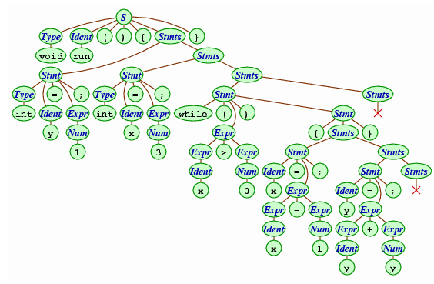
The structure of language
Parse Tree
www.cburch.com/cs/150/reading/grammar/index.html
Notes:
Languages can be very complex.
Here is an example parsing a small statement in Java.
The Java grammar has hundreds of rules but compilers can use those rules to dissect each statement into various symbols, which themselves decompose into defined atoms.
The image is taken from a good introductory article, given in the link.

Slide 61
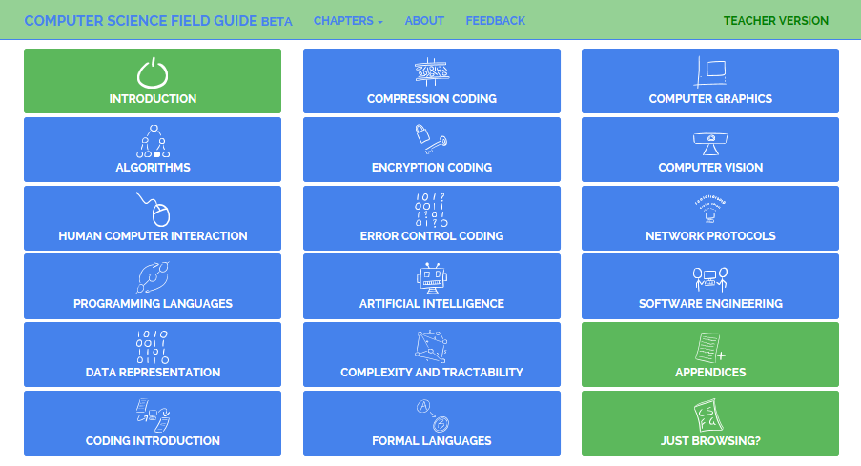

www.csfieldguide.org.nz/
Parse Tree
Notes:
Our friends from CS Unplugged in New Zealand are producing a Computer Science Field Guide to support their curriculum changes.
There is a student version, and a teacher guide with supplementary material.
The section on Formal Languages is well worth reading to appreciate the importance and depth of this area and stimulate further ideas.

Slide 62
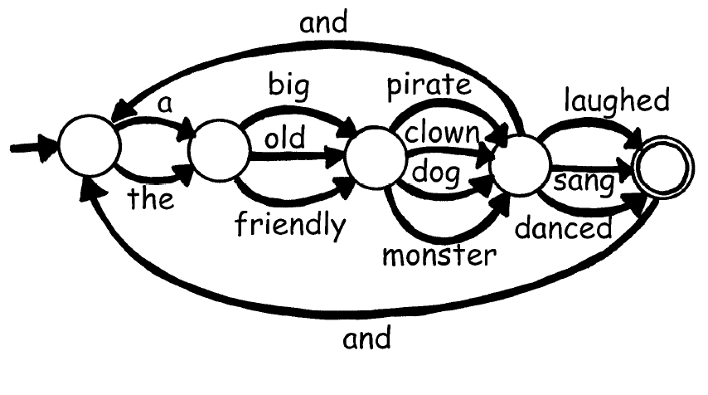
Finite State Machines
Parse Tree
a big clown sang and the friendly monster danced
a friendly monster and a big dog
a friendly pirate laughed and danced
a big clown and the old dog sang
Notes:
Defining languages in this way is very flexible.
Finite state machines can be designed to check for valid sentences, as this example shows.
Would “a big clown sang and the friendly monster danced” be a valid sentence in this language? (yes)
How about “a big clown and the old dog sang” (yes)
How about ““a friendly pirate laughed and danced” (no)
And “a friendly monster and a big dog” (no – highlight it must finish in the accepting state)
Although natural languages aren’t the best example, since they are far too large and context sensitive, they allow children to appreciate the idea involved.
However, wherever sequences of strings need to be validated, finite state machines are powerful tools for defining and checking patterns.
For example, small languages can be defined to restrict input into text boxes.
Or to ensure e-mail addresses, number plates, dates etc. conform to a valid format.

Slide 63
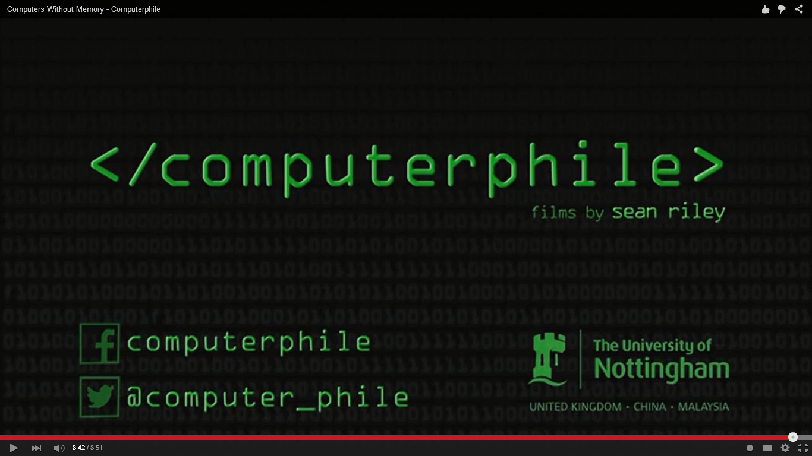
Sir, why are you teaching us this?
https://youtu.be/vhiiia1_hC4
Notes:
Before looking at the next set of activities it’s also worth mentioning Computerphile.
Computer Science will be unfamiliar territory for many ICT teachers and this is a wonderful reference source.
A You Tube channel, it is the sister of Numberphile and has over 250 short videos on all manner of computing topics.
This 8 minute video is an excellent explanation of link between Finite State Machines, languages and computer science.
There are several related videos which you may want to recommend teachers watch, on Turing Machines and the Chomsky hierarchy.
They all provide greater depth to help answer the perennial question, “Why are we doing this?”
Some of these links will be highlighted later.

Slide 64
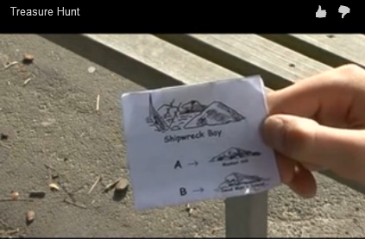

Treasure Hunt
csunplugged.org/videos/#Finite_State_Automata
Notes:
If you haven’t familiarised students with the idea of a Finite State Machine, the Treasure Hunt activity described here is another introductory exercise.
As our main activity will take place outside, this exercise makes a good starter. It is explained well in the 2 minute video given in the link: http://csunplugged.org/videos/#Finite_State_Automata

Slide 65



Treasure Hunt
Notes:
Seven children are needed to represent each place, spread around a playground or school field.
Each is given their relevant place card (kept secret) and a location label to display e.g. Pirates Island.
The rest of the group go to the starting point in turn (with a short delay between each child). In this demonstration we’ll say that is Pirate Island.
They can ask to take Ship A or Ship B. We’ll assume they pick A. (click)
The child looks at the instructions and tells them the destination of Ship A - in this case Shipwreck Bay.
Arriving a Shipwreck Bay, the child requests Ship A or B again. Let’s assume Ship A is requested again. (click)
This directs them back to Pirate Island, where they will this time request Ship B. (click)
Only to be directed to Dead Mans Island to be informed that no-one leaves alive!

Slide 66
Treasure Hunt
The quickest route?
Notes:
Each of the explorers is trying to get to Treasure Island.
They are each given a blank map, on which to record their findings.
Fast finishers can be asked to start again and find another route.
Eventually, most will find a way. (click)
At this point gather the group and ask which is the quickest route?
Unless they have a complete map, this should generate debate.
Can anyone describe a slow route?
The complete map is shown overleaf, and can be photocopied and distributed at the end if desired.

Slide 67
Treasure Hunt
The quickest route?
B
B
B
A
A
A
B
A
A
A
B
B
Notes:
With the complete map the quickest route is easy to work out.
It can be described as a sequence of A’s and B’s (BBAB)
The slowest route will generate more debate, as we can keep repeating circuits if we wished.
For example AAA, AAAAAA and AAAAAAAAA all return to the same starting point.

Slide 68
Finite Stata Automata
B
B
B
A
A
A
B
A
A
A
B
B
Notes:
The Treasure Hunt can be described as a Finite State Machine.
It has a starting state – Pirate Island (click)
Making choices moves you to other states and the end state is indicated with a double circle.
Notice this Finite State Machine has no outputs.
You win if you end up at the end or ‘accepting’ state.
Such machines are known as acceptors or Finite State Automata (FSA) since the output is indicated by where you finish.
Ending anywhere else is rejected.
Children can now describe the rules for getting to Treasure Island.
It’s not easy, but they should be able to articulate that:
The final steps are BAB
The first steps can be either B, AA or ABA.

Slide 69



3
Eating Your Own Words!
activity
Y
U
M
M
M
Y
Notes:
In this next exercise, students act out the operation of a FSA that has been drawn out in the playground.
The ideas comes from the now defunct MegaMath project, developed in part by Mike Fellows, instrumental in the later CS Unplugged material.

Slide 70
3
Eating Your Own Words!
activity
Essentials:
Pavement chalks
Strips of paper
Marker pens
Lots of sweets (at least 2 or 3 per student)
Y
U
M
M
M
Y
Notes:
Students receive (or make) ‘tickets’ – a string of letters that serve as inputs to the machine.
The tickets tell them which lines to follow and which states to pass through.
If they end up in an accept state they receive a sweet.
This means that what was printed on their ticket was recognized by the machine as a word in its language.
The FSA needs to be drawn out in advance.

Slide 71
Finite State Automata
b
a
a
b
S
a
b
b
a
Machine 1
Notes:
This is a very easy FSA for children to understand.
Only use it if you feel the following slide is too difficult for your students.
Instructions on the next slide.

Slide 72
Finite State Automata
a
b
b
a
a
b
S
b
a
b
a
Machine 2
Notes:
Draw the FSA above on the playground using pavement chalks.
If you feel this is too difficult for your children and easier machine is given on the previous slide, but it should be a good starting point for Key Stage 3 students.
The states should be large enough for one child to stand in.
Place a container with lots of small sweets in the accepting state (the double circle). This is the accepting state.
Use an area large enough for the children to gather around the drawing and be able to see what is happening.
It is ideal if the drawing can remain for several days so other students have a chance to speculate about what it is, and the students "in the know" have a chance to demonstrate how it works at break / lunch.

Slide 73












Instructions
abbaaabb
abbaaabb
Machine 2
Notes:
Give out the instructions and explain the situation.
The machine understands its own language, not ours.
It’s language is a bit silly, as it is made up of just two letters a and b.
There are lots of words in it’s language, made up of just these two letters, but not all combinations of ‘a’ and ‘b’ are words it recognises.
Start with short words of less than 8 letters. You may wish to give students the first few (including at least one that is accepted and one that passes through the accepting state but then fails) as a walk through.
Invite a student to try a word by walking through the machine.
Read off the letters in the word to the other students then show how a word is tested in the machine:
The student holds the ticket with the word on it and stands in the circle marked S. Ask, "What is the first letter of your word?"
Show the student how to walk down the line and stop in the next state (cross out the letter used).
Then ask, "What is the next letter of your word?" and so on until the end of the word is reached.
We process the letters on the ticket from left to right.
(click)
Once explained students form an orderly queue. (click)
The teacher is best positioned between the Start and Accepting states.
(click)
The students task is to write a word made up only of ‘a’s and ‘b’s.
Taking each letter in turn from their word, follow the arrows.
If they end up finishing in the accepting state, they get a sweet.
They do not get a sweet if they are passing through the accepting state before the word is complete.
When they finish tracing their word, they return and join the end of the queue for another go.
Continue until they all catch on how to make a word that is accepted.
For those who catch on quickly, ask them to try words over 14 letters long.
Make a list, as they go of words the machine accepts, and words that it does not accept.
Do not show them a diagram of the FSA before they start, the instructions are given in a handout that can be distributed.

Slide 74
Debrief
Accepted
Not Accepted
Patterns
If I use a word like aaba, I pass the sweets but I can't have one. Why?
What strategies did you use for words to try?
Can you see patterns for words in the lists?
Notes:
Back in the classroom, make a list of words accepted and not accepted.
Make sure everyone contributes.
Use the 3 questions (revealed on clicks) to promote discussion.
For the third question, add another column and note the patterns children spot.
Finally try to get children to articulate how spotting patterns helps with choosing new words to try.
Through pattern recognition, children generalise the rules of the machine, which can then be applied to choosing new words.
If they struggle with the patterns, further prompts are on the next slide.

Slide 75
Debrief
Accepted
bab
abab
abbab
abbbbbab
abbbbbbbbbab
3 key rules:
End with only one ‘b’
Starting with ‘a’, can have any number of ‘b’s
Starting with ‘b’, can have any number of ‘a’s
Notes:
The words shown are all accepted by this FSM.
There is one similarity between them all?
Children may point out they all end in ‘ab’, but is this true of every acceptable word? Once they spot a pattern they need to check it against the machine, we could also have ‘bb’ (click - they all end in one ‘b’)
By spotting a pattern in some of the words children should be able to articulate a second key rule. (click)
What if a word starts with ‘b’?
If children can’t see the answer encourage them to trace through the FSM until someone suggests it. (click)

Slide 76
Shortcuts for long words
Accepted
bab
abab
abbab
abbbbbab
abbbbbbbbbab
The longest word the machine will accept?
ab*ab
ba*b
zero or more ‘b’s
Notes:
When making a list of accepted words hopefully some children came up with very long words which didn’t fit in your box.
If not, we can pose the question now; what is the longest word in this machines language?
Clearly we can’t write an infinite number of words, or a word with an infinite number of letters, so we need a shortcut for writing ‘any number of’ ‘a’s or ‘b’s.
Invite suggestions and encourage them to develop their own shorthand.
Children may be familiar with the use of wild cards, but if not, now is the time to introduce them. (click)
Note that an asterix represents ‘zero or more’ of the previous character.
Can the children express a rule for words beginning with a ‘b’?
(click)
Notice how the second rule allows for ‘bb’ as well as any number of ‘a’s in between.

Slide 77
Extension
a
b
a,c
a
c
b
b
a
S
c
b
c
b
a
c
Machine 3
Notes:
To reinforce understanding, you could
extend the FSA exercise by moving the Accepting State
adding a second Accepting State
asking students to choose words that involve the use of a wild card.
The exercise can be repeated with a more complex machine as shown.
This FSA introduces a 3 letter alphabet, and offers more challenge.
It can be approached as a paper exercise, and is included in the photocopiable resources.

Slide 78
Expressing rules
b
b
a
ab
babaa
aaababa
aababbb
Odd number of ‘a’s
a
b
a
ab
abab
ababab
abababab
b
a
Alternating
sequence of ‘ab’s
a
b
a
a
At least one ‘b’
ab
abaa
baba
bbbaaab
b
b
Notes:
Generalising from specific instances to broader rules takes practice.
Three simple FSAs are displayed on clicks.
Challenge the students to express the rules for words that end in the Accepting State.
The first click reveals sample accepting words (as a hint), then the rule.
Ask if any of these be expressed using wildcards like we suggested before?
It’s not easy. Students might think the middle example could be written (ab)*, but that would allow for no letters as well as ab.
We really need a few more shortcut tools for expressing some other rules.
Thankfully there are a recognised set of shortcuts which are used to write general or ‘regular expressions’ (‘regex’ for short).
Its worth noting that any regular expression can be expressed as a finite state machine.
The next activity introduces the idea.

Slide 79

4
activity
Reverse
Pictionary
Notes:
This exercise, developed by Linda Pettigrew, develops familiarity with FSAs.
It also encourages students to design their own notations for regular languages, and is a motivator for learning a precise notation.

Slide 80




4
activity
Reverse
Pictionary
Notes:
Split the class in half and ask them to pair up.
Give each pair in one half a copy of the FSM-A1 diagram, and those in the other half a copy FSM-B1.
(click)
Give each pair a Language Sheet as well. They will be writing in the top half only.
Each half should not see the FSM the other half have.
Give the pairs five minutes to come up with a description of the words their FSM will accept.
Encourage them to think about ways to describe repeating sequences.
They may be familiar with some symbols used in regular expressions, such as *, but they can use anything they decide.
But they also need to list the meaning of any symbols they use.
You may need to help get the students started. For example, since * represents zero or more instances of a character, perhaps we should have a symbol to mean ‘one or more’ instances (a + perhaps).
We could then write he+p.
The whole phrase itself can be repeated, with a hyphen, so how might we represent the repetition of a string rather than a character, and so on.
When they are happy with their description and definitions, each pair completes the Language Description box.
(click)

Slide 81
Notes:
Pairs then swap descriptions with a pair in the other half.
Each pair now complete the bottom half of the sheet.
Having read the description they entering 6 strings they think would be accepted, and 6 they think would be rejected.

Slide 82
Notes:
Finally, the sheets are gathered in and redistributed back to the original half.
They do not have to return to the original pair.
Each pair now acts as a ‘computer’ taking each input string provided at the bottom and confirming it conforms to the FSM.
If a string is accepted / rejected incorrectly, the pair have to work out where the error arose.

Slide 83
Regular Expressions
FSM-A2
e
o
m
e
w
1
2
3
4
el
FSM-B2
squ
2
ir
3
ch
-
1
4
Notes:
Once students are familiar with the activity, it can be repeated with two further FSMs (or more).
Follow up discussion can investigate whether some descriptions were longer than needed, or confusing, and whether the language of the FSM was captured in the description.
This provides a constructivist approach to introducing the notation of regular expressions whilst emphasising the point that any language expressed by a FSM can be represented as a regular expression.

Slide 84


Regular Expressions
www.cs4fn.org/regularexpressions/knitters.php
Notes:
CS4Fn has a very good article introducing regular expressions by looking at knitting patterns.
It introduces all the key notation for writing regular expressions.

Slide 85


Regular Expressions
Mr McDuff’s breakfast:
o(m | r | s)*t(p | j)
o = a bowl of oatmeal
m = a splash of milk
r = a handful of raisins
s = a spoonful of sugar
t = a piece of toast
p = peanut butter
j = jam
Notes:
Another child friendly activity you could use to introduce further regex notation is ‘Mr McDuff’s Breakfast’, another idea from the MegaMath project.
This can be acted out to a class.
Mr McDuff likes his breakfast.
His choices are summarised in the items listed.
Mr McDuff likes variety. Students should try to summarise the rules of his eating habits.
Make several breakfasts in front of the class until someone can explain that:
Mr McDuff always has a bowl of oatmeal and a piece of toast.
He sometimes has milk or raisins or sugar on his oatmeal. He may have it plain. If he has sugar, he may have several spoons, similarly with handfuls of raisins or splashes of milk.
His toast will always have either jam or peanut butter.
We can summarise all his breakfasts in the regular expression.
Note the ‘pipe’ symbol (|) here signifies OR, not a distinction between input and output, as in a FSM
Three key symbols to emphasise:
* Represents zero or more of the preceding element
| represents alternatives (or)
( ) enclose multiple items to which a symbol applies.
Armed with this knowledge, can the children come up with a regular expression for their own breakfast?
They should include anything they drink as well as eat.

Slide 86


Regular Expressions
regexone.com/
Notes:
RegexOne is a good website for teachers to learn the basics of writing Regular Expressions.
It’s a little dry, and not recommended for children.
However, students would benefit from some experience of writing regular expressions.
In themselves they are good pattern matching exercises, an essential element in computational thinking.
But practical exercises can also illustrate the sort of ‘real world’ tasks in which Regular Expressions (and Finite State Machines) might be used.

Slide 87




Regular Expressions
Notes:
An easy way to start is by finding matching text.
Applications such as spreadsheets are able to handle regular expressions, and so can some word processors.
The Find / Replace tool in Microsoft Word uses them provided the ‘Use wildcards’ option is enabled in the Advanced Find.

Slide 88

Regular Expressions
goo.gl/I9XCoq
Notes:
Graham Mayor has an excellent tutorial on his website with activities that would be very relevant for students.
The link is given on the slide.
It introduces the components of regular expressions and suggests various activities, such as reversing surname and forenames in a list of names, formatting quotations an so on.
It is a good way of introducing computing theory alongside developing practical editing skills.

Slide 89




Regular Expressions
Notes:
Most programming languages have built in support for regular expressions. Although there will be minor differences in dialect, they all use the same basic symbol set.
Rubular is a website that checks Regex written for the programming language Ruby.
The symbols are summarised on the website.
(click)
You can enter a series of test strings, against which you can test any regular expression.
(click)
When you enter an expression the matches are highlighted.
(click)
The best feature though, is that once you have created test strings you can create a permanent link, which can be shared with your students.
This makes it easy to develop a series of exercises for use in class.
(click)
The Computer Science Field Guide, from New Zealand provides a couple of exercises to get you started.
We’ve included these in the resources which can be used with teachers as an introductory activity.

Slide 90
Points to ponder
What cross-curriculum benefits might accrue from studying finite-state machines and regular expressions?
Could it impact on literacy?
Notes:
Again, a brief pause to encourage a short discussion whilst props are tidied up and the presenter gets ready for the next session.

Slide 91

Theoretical Computers
From Diagrams
To Programs
Notes:
We’ve made the link between Finite State Machines and regular expressions.
And we’ve seen how they can be used to define valid input strings.
In this next section we’ll look at introducing programming through Finite State Machines.

Slide 92

Kara
The Programmable Ladybird
5
activity
Notes:
Kara is a programmable ladybird.
In this activity we’ll use Kara as a vehicle for introducing children to another way of thinking about algorithms and introducing programming.
(click)
Kara was born in the research done by Raimond Reichert at ETH, Zurich (a leading STEM University) in the years1999-2003
He was looking at ways that theoretical computers could be used to introduce the fundamental concepts of Computer Science and was an early advocate of making computer science a part of general school education.

Slide 93
“Programming practiced as an educational exercise … is best learned in a toy environment, designed to illustrate selected concepts in the simplest possible setting.”
5
activity
Notes:
It’s worth starting by quoting him.

Slide 94
“The fundamental concepts of programming may be intellectually demanding, but they are not complex in the sense of requiring mastery of lots of details.”
5
activity
Notes:
He goes on to say.

Slide 95
“Instead of using a programming language, we use a simpler model … finite state machines.”
5
activity
Notes:
So that is the thinking behind Kara and it has certain advantages.
He goes on to say…

Slide 96

“It is easy to represent them in a graphical manner. Paths of execution are defined statically as paths in a directed graph; no other control structures are needed.”
5
activity
Notes:
Children don’t have to be introduced to the three constructs of sequence, selection and iteration before they start programming.
They can define a program by creating a state diagram, and they can quickly produce diagrams that can do fairly powerful things.

Slide 97

Introducing Kara
swisseduc.ch/compscience/karatojava/kara/
5
activity
Notes:
Kara is free to download and requires no installation.
It comes with a handy 7 page manual which you can distribute to children.
Both are included in the resources.
The slides that follow are a practical introduction designed to be followed by the class.

Slide 98


Introducing Kara
Notes:
When you run it, Kara’s world opens.
It is a very simple world, consisting of a grid of squares.
Each square can have leaves, mushrooms or trees in them, but we’ll start by just putting Kara in there.
Drag Kara from the right into her world.
(click)

Slide 99



Introducing Kara
Notes:
Notice the Programming button.
(click)
This opens a second window where we can build our Finite State Machine.
It already has an end state added in the diagram.
Down the left hand side are controls to let you create, edit and delete states.
(click)
Create a new state, named S1.

Slide 100


Introducing Kara
Notes:
The new state appears in your diagram.
(click)
If you hover the mouse over the state, with the MIDDLE highlighted, you can move it.
Move it into the centre of the diagram and make it the Start State, by selecting that option on the left.
(click)

Slide 101


Introducing Kara
Notes:
It should look something like this.
(click)
With the mouse over the EDGE of the state, we can draw our transitions.
Initially, just draw a line, back to itself, as shown.
(click)

Slide 102

Introducing Kara
Notes:
In the lower half of the window, the transition has been recorded.
Note the tab, which indicates which state we have selected.
Notice the ‘Next State’, which indicates we remain in S1.
Experiment with changing that to Stop. The diagram will redraw.
For the moment, leave it as shown, returning to S1 and consider the ‘Kara Executes’ column.
The red cross indicates Kara currently does nothing on the transition.
(click)
Look at the options on the left.
These allow Kara to move forward, turn left and right, pick up or put down an object.
Let’s add a move forward command to the transition definition. Simply drag it across.
(click)

Slide 103


Introducing Kara
Notes:
If we execute this Finite State Machine, what do you think Kara will do?
(She will move forward one square, return to S1, move forward again, return to S1 and so on, moving forward continually.)
(click)
Returning to Kara’s world we can run the program using the controls shown.
Experiment with these and the Speed of execution slider.
(click)
There are only 3 constructs in programming: Sequence, Selection and Repetition.
We’ve written our first program, expressed as a Finite State Machine, which implements a continuous loop.

Slide 104



Introducing Kara
Notes:
Let’s make Kara’s world a little more exciting by adding a mushroom!
We want Kara to continue moving forward until she bumps into a mushroom. Then she should stop.
How might we express this in the FSM?
The discussion should draw out the need for a transition to the Stop state, but also the need to test for a mushroom at S1.
We need to add a sensor, the input from which will determine which transition to take.
(click)
With S1 selected, activate the Edit State option.
(click)
And add a mushroom sensor to this state and tick.

Slide 105



Introducing Kara
Notes:
When you return to the Programming window, notice how the sensor has been added to the state definition.
(click)
We can now set different actions in answer to the condition by selecting the Yes or No option, and adding a second statement moving Kara to the Stop state.
Thinking again about our programming constructs, we’ve now implemented an IF statement, or selection.

Slide 106


Introducing Kara
Notes:
The state diagram will update,
And when the program is executed Kara should stop at the mushroom.

Slide 107

Introducing Kara
Edit S1
Add a Tree sensor
Assign the correct actions to each condition
Notes:
Finally, let’s add a tree into Kara’s path.
When Kara detects a tree, we want her to go round it, before continuing on her way.
Check the students can recount the steps involved. They are revealed on a click.

Slide 108


Introducing Kara
Notes:
With two sensors there are four possible combinations.
In this case, we don’t need to consider what would happen if Kara sensed both a tree and a mushroom in front because only one element can be on one square.
However, students will need to consider all combinations when trees are detected to the side, whilst mushrooms are in front.
Similarly with leaves, which are detected underneath Kara.
These are encountered in the tasks, and can be linked to work with students developing truth tables.
(click)
Notice here how we have a sequence of actions triggered by a condition, the third of our key programming constructs.

Slide 109
Introducing Kara
Notes:
Finally, once you are happy with your program you can save it using the usual icon.
This will save you Finite State Machine as a file with a .kara extension.
(click)
Note that it will not save the world you have configured.
To do that, you will need to use the same icon in Kara’s world.
These are saved as files with a .world extension

Slide 110



Exercises
Notes:
Kara comes with a series of graded exercises built in.
(click)
The drop down list reveals what is available.
The easy challenges should be accessible to KS3 children, whilst the harder challenges provide plenty of scope for differentiation and extension work.

Slide 111



Exercises
Notes:
As well as the explanation of the task, each challenge comes with several preconfigured worlds to try your solution.
Notice that a world can be constrained to just a few tiles, rather than the whole grid.
(click)
Solutions and hints to the easy challenges are provided in the resources but it is worth teachers trying to solve as many as possible for themselves so they can appreciate the issues students will encounter.

Slide 112

Points to ponder
Does the use of state diagrams and finite-state machines offer an alternative approach for introducing programming?
Notes:
Again, a brief pause to encourage a short discussion whilst props are tidied up and the presenter gets ready for the next session.

Slide 113






Class based research
Why?
www.computingatschool.org.uk
Notes:
Before we embark on the last activity, use the following slides to prompt a discussion about the value of classroom research both to support continuing professional development and to inform the wider teaching community.
Use the terms “teacher enquiry”, “action research”, “reflective practitioner” and “practitioner research”.
Teaching computer programming is a relatively new activity.
Many teachers are experiencing it for the first time.
Those with experience can offer valuable support, advice and information to other colleagues.
There are lots of opportunities for colleagues, old and new to contribute to an emerging pedagogy.
(click)
Inform them of the Teacher Enquiry in Computing Education project. It provides a forum and focus for research in the field of computing.
It can be accessed from the home page of the CAS website, under the link to projects: http://www.computingatschool.org.uk/

Slide 114
Class based research
What?
Find out
from colleagues in English which aspects of this topic would support their pupils’ development.
Notes:
Research an area in which you have ready access to the data but be aware of researcher bias and local ethical considerations.
Don’t try to prove something you believe – always think that you are “bringing a better understanding” of the situation – it helps avoid bias.
Emphasise the key words such as “find out”, “evaluate” and “compare” to spark ideas
Each of the following slides gives an example of a possible focus for research.

Slide 115
Class based research
What?
Evaluate
the use of finite-state machines as a vehicle to introduce programming.
.
Notes:
Focus your research on something you are trying out. Start by creating a question. Develop sub-questions that bring more detail or further focus your research.

Slide 116
Class based research
What?
Compare
school data of the pupils performance in English and how well they engage with work on language structure and regular expressions.
Notes:
There is a lot of data in school; devise an analysis that will enhance your job and provide interesting perspectives.

Slide 117
Class based research
What?
Design, implement and evaluate
a single lesson taught by different teachers.
Notes:
Evaluating a unit of work you develop has obvious practical benefits.

Slide 118


Class based research
How?
Notes:
Briefly tell the audience of different methods. Choose one of the examples from the previous slide and discuss which methods might be used:
Questionnaire (including online) and Survey
Interview
Focus group (and online forum, wiki)
Scrutiny of documents including pupils’ work and blogs
Scrutiny of numerical data
Observation
Less common but very effective:
Analysis of professional conversations (in meetings, by email, through forum)
Analysis of pupil interactions/engagement in VLEs, forum, etc.
Discourse analysis
Content analysis
(click)
Remember – all research has ethical considerations
Remind them of the school’s requirement/permissions/information to pupils and parents – the idea of informed consent and freedom to withdraw their data from the research process.
If working on a University course then you will be governed by their ethics policy.
If completing the BCS Certificate then there is an explicit ethical requirement.

Slide 119


Class based research
Qualifications and Certifications
www.computingatschool.org.uk/certificate
Notes:
End with a reminder of the BCS Certificate in Computer Science Teaching – there are A5 hand-outs. One part of the evidence for the award is classroom research undertaken by the teacher.
(click)
The other two areas involve attending CPD – like today!
(click)
And completing a manageable programming project.
If that sounds a little daunting, remember you can opt for either an independent or guided route.
The latter means you’re supported by a mentor who can help guide you through.
It is a valued award, giving professional recognition accredited by the BCS, The Chartered Institute for IT.
More importantly, it’s designed to help you in the work you’re developing in school.
See the link for more information: http://www.computingatschool.org.uk/certificate

Slide 120

Theoretical Computers
Computing
Without
Computers
Notes:
This final section introduces the most complete, and widely recognised model of computation: the Turing Machine.

Slide 121
Input
Process
Output
Models of computation
Notes:
We started this unit by asking what a computer is, and what it means to compute.
Our starting point was a general model of how something is computed: taking some input, doing something to it before outputting the results of that process.

Slide 122
Loop until r = 0
r = a / b
a = b
b = r
if r = 0
print b
rocess
Input
Process
Output
Models of computation
Notes:
We went on to introduce the notion of Finite State Automata, as mechanisms for expressing a computational process.
In the course of the activities we’ve used Finite State Automata to describe the behaviour of a flexagon, using it to illustrate an algorithm to display every side.
We’ve seen how they can be used to validate inputs, and derive regular expressions and we’ve looked at ways to describe simple programs as state transition diagrams.
Whilst programming Kara we noted how we could express logical relationships, such as AND in the state transitions.
In computer science, we can think of Finite State Automata as abstract models that help convey a computational process.

Slide 123


Finite State Machines
Combinational Logic
Saucer
C
Cup
S
C
Ready
S
Models of computation
Notes:
Wikipedia has a good article on Automata Theory, with a diagram that puts combinational logic and FSA at the heart of the theory.
We can demonstrate many simple processes in terms of logical constructs (AND, Or and NOT) – we see that when looking at the behaviour of specific circuits, for example, within a computer. We call that combinational logic.
Finite State Machines are seen as a more powerful abstraction – the next layer up if you like in our models of computation.
But we also noted earlier that there are things Finite State Machines cannot do.
You can’t devise a Finite State Machine to check if a phrase using brackets always has a closing bracket to match every opening bracket.
Similarly no Finite State Machine can check if a word is a palindrome (spelt the same backwards).
These sort of problems rely on pairing up.
We can write Finite State Machines that pair up specific numbers of items, but we can’t write a general machine for any number of symbols.
Consider a FSM that tries to pair up cups and saucers.
(click)
We might start in a Ready state.
(click)
The first input is a saucer, so we move to a Saucer state.
(click)
The next input is a cup, which pairs up with the saucer, so we return to the Ready state.
(click)
This time the input is a cup, so we need a new state to indicate an extra cup.
(click)
With the next input a saucer, we return to the Ready state again.

Slide 124
Finite State Machines
Combinational Logic
Two
Saucers
S
Saucer
Three
Saucers
S
Four
Saucers
S
C
Cup
S
C
Ready
S
Models of computation
Notes:
So far, so good. Our FSM seems to be handling the inputs.
Next up is a saucer which returns us to the saucer state.
(click)
But now we have a second saucer, so we need a state to represent two saucers.
(click)
The next input is also a saucer, so now we need a 3 saucer state,
And a 4 saucer state when the next input is also a saucer.
Can you see the problem?

Slide 125
Push Down Automata
Finite State Machines
Combinational Logic
Two
Saucers
S
Saucer
Saucer
Surplus
Three
Saucers
S
Four
Saucers
S
C
Cup
Cup
Surplus
S
C
Ready
S
Models of computation
Notes:
The name gives it away really.
A FINITE state machine cannot have an INFINITE number of states to handle an indeterminate number of inputs.
It can’t ‘keep count’. It has no memory of what has gone before. - it only knows what state it is in.
(click)
For this reason, more flexible models, known as Push Down Automata were conceived.
In essence these are Finite State Machines connected to a form of memory known as a stack.
Now we can just have two states for our Cups and Saucers machine, recognising a surplus of either.
(click)
Each time a cup comes in, we simply remove a saucer from the top of the stack.
When the stack is empty, we return to the Ready state.

Slide 126

Turing Machines
Push Down Automata
Finite State Machines
Combinational Logic
Memory
youtu.be/224plb3bCog
Input
Process
Output
Models of computation
Notes:
Think back to our original model of a computer – the Input, Process, Output diagram.
(click)
A Push Down Automaton can be thought of as this, with some form of memory attached to allow it to ‘keep count’.
As we’ve just seen, that memory is a ‘stack’ which limits what it can do. It can only retrieve things from the top of the stack.
(click)
A more general model, which allows access to any element of memory is known as a Turing Machine … and it has a remarkable history.
(click)
In computer science, the different levels are known as the ‘Chomsky hierarchy’.
There’s more to it than we have considered here, but if you’d like to delve deeper, Computerphile is the place to start.
The link is on the slide.
If you are likely to be teaching A level at any point all the related Computerphile videos are worth watching.

Slide 127

Turing Machines
Push Down Automata
Finite State Machines
Combinational Logic
Memory
Input
Process
Output
Models of computation
Notes:
The Turing Machine was conceived in the 1930’s by Alan Turing, a mathematical genius best known for his role in breaking the Enigma codes in the Second World War.
Whilst grappling with whether it was possible to determine in advance if a mathematical problem was solvable, various mathematicians tried to develop a formal definition of an algorithm. Several ideas were developed independently.
Despite the differences, there was nothing to choose between them – they were all shown to be equivalent to each other – an incredible coming together of ideas.
Alan Turing conceived of the idea of computing machine, which was the most intuitive.
He based it on the idea of a human ‘computer’ – someone who did calculations in a series of steps, using a scratch pad to jot down parts of the working out.
It is remarkable for two reasons.
First, he had the idea long before any electronic computers had ever been built.
Second, his model has been shown to be as powerful as any computer built since!
By powerful, we don’t mean fast, we mean it can compute anything any modern computer can compute.
This is the heart of Computer Science.
Just as Finite State Machine’s can describe Regular Expressions, Turing Machines can describe more general computations.
Having a model of computation allows us to reason about what sort of problems are computable, and what are not.
Put another way, if something can be computed, a Turing Machine can be designed to do it.

Slide 128


Memory
youtu.be/gROuKl82BTk
Input
Process
Output
A Turing Machine
Notes:
So what did Turing envisage?
Actually, it is pretty simple. Here is a picture of a model Turing Machine at Harvard University.
It consists of just two things:
A very long tape that can move in either direction, and a mechanism in the middle that can look at the bit of tape beneath it, read what is on it, erase and write other symbols on it if needed.
(click)
In a short, 5 minute video produced by the BCS, Kate Russell explains the place of the Turing Machine in the development of Alan Turing’s ideas.
This is a video to share with students.

Slide 129

An infinite tape
Infinite running time
Memory
Input
Process
Output
A Turing Machine
Notes:
We can simplify a Turing Machine to a schematic: a tape and a read/write head.
Superficially, it seems very different from our model of a computer in the left hand corner.
But let’s consider the parts.
The tape can have symbols written on it, either before the machine starts, or when it is running.
So we have some means of inputting information.
The symbols on the tape whilst it is running are a store, just like memory in a modern computer.
When the machine stops what is left on the tape can be considered the output.
What it does whilst it is running is determined by the behaviour of the Read / Write head.
This can be described as a Finite State Machine. It acts like the computer processor.
In fact we can think of modern computer processors as Finite State Machines, albeit very complicated ones.
They contain billions of logic gates which combine to put a machine in a particular state on every tick of its clock.
It may seem incredible to children that such a simple machine can do anything a powerful modern computer can, so it is worth stressing two important caveats:
(click)
It has as much memory as it needs (the tape goes on for ever)
It has a much running time as it needs.
The second of these caveats is important to stress to children.
Turing machines are slow – very slow!
At KS3, the implications of a Turing Machine for investigating the limits of computation aren’t really important.
What is, is to make the point that in order to understand how computers compute, we can abstract away the specific details of modern computers to focus on the essential process.
We can make this point by demonstrating how a simple machine like this can do some simple computation.
To do that in a fun way, we’ll fall back on our traditional prop of bribing children with sweets.

Slide 130


6
activity
The Chocaholic Turing Machine
www.cs4fn.org/magazine/magazine14.php
Notes:
This activity comes from CS4Fn, and was first outlined in their special issue to celebrate the centenary of Alan Turing’s birth.
The whole magazine is well worth reading if you wish to know more about his life and work.

Slide 131







6
activity
The Chocaholic Turing Machine
Notes:
Split the class into small groups. Three or four may work best initially.
Once familiar with the process you may wish to try pairs.
You will need a large supply of chocolate buttons, both white and dark.
Alternatively, you can use counters of two colours, but it isn’t as much fun.
A minimum of 7 dark and 15 white buttons are needed for each group to implement the example.
More will be needed if other numbers are tried.
You also need six different coloured lollies per group. These do not have to be edible and could be made of coloured card.
Our example uses Red, Orange, Violet, Blue, Green and Pink

Slide 132

Notes:
The activity, and an introductory article have been reproduced in the resources. Encourage students to read the article first.
We will walk through the activity in the next few slides.
(click)
The chocolates represent the starting tape of the Turing Machine.
Children should arrange their opening chocolates in a line on the table, as shown.

Slide 133
A Subtracting Machine
4
minus
3
Notes:
We are going to implement a subtracting machine.
The dark chocolates represent the two numbers we have input.
So we are going to perform the calculation 4 minus 3.
Representing numbers in this way is known as the unary number system.
Our tape distinguishes between the two numbers by having some white chocolates between them.
Later we’ll ask the students to set up their own subtraction using different numbers.
It will work so long as the first number is larger than the second.

Slide 134

A Subtracting Machine
Current Lolly
Notes:
Each group also needs the rules for the Subtraction Machine.
(click)
One person should be assigned the job of holding the Current Lolly.
We start holding the Red Lolly

Slide 135

A Subtracting Machine
Current Lolly
What happens next?
Head
Notes:
Starting from the leftmost chocolate, students implement the rules
(click)
In this case the Current Lolly is RED, and the Current Chocolate WHITE so what happens?

Slide 136
A Subtracting Machine
Current Lolly
Notes:
The Chocolate remains WHITE,
The Lolly remains RED
The Head moves right one place.
What happens next?

Slide 137
A Subtracting Machine
Current Lolly
Notes:
Again, the Chocolate remains WHITE,
The Lolly remains RED
The Head moves right one place.
This will happen on the next cycle too.

Slide 138
A Subtracting Machine
Current Lolly
Notes:
Again, the Chocolate remains WHITE,
The Lolly remains RED
The Head moves right one place.
Now what happens?

Slide 139

A Subtracting Machine
Current Lolly
Notes:
In this case the chocolate is DARK so it remains DARK.
But the Lolly changes to ORANGE
And the Head moves right
Because the lolly has changed, we now need to look at the rules for an ORANGE lolly.
What happens next?

Slide 140
A Subtracting Machine
Current Lolly
What is the pattern of chocolates when the process has finished?
Notes:
The chocolate is DARK, so remains DARK
The Lolly is ORANGE so remains ORANGE
And the Head moves right.
You might wonder if anything is ever going to change, but it will.
When a chocolate changes colour, remove the one from the tape and EAT IT!
Replace it with the correct colour from your supplies.
If working in groups, the children should take turns to move the head so they get an equal chance of eating a chocolate!
The next slide reveals the answer.

Slide 141

A Subtracting Machine
Current Lolly
The final two steps
Notes:
On click the final steps are acted out, but ask the students to predict it first.
(click)
The Lolly is VIOLET, the chocolate WHITE, so they remain so and the Head moves left.
Now the chocolate is DARK so what happens?
(click)
It changes to WHITE, there is no new Lolly and the process stops

Slide 142
A Subtracting Machine
4
minus
3
What is left on the tape?
Notes:
The final output is displayed on the tape.
One dark chocolate represents the result of the calculation.
Students can try other numbers to satisfy themselves that it works.

Slide 143
A Subtracting Machine
Can you write the rules as a Finite State Machine?
W | W →
D | D →
ORANGE
RED
Notes:
We’ve said that the tape (or chocolates on the table) represent a computers memory and the rules represent the processor running a program.
A final challenge might be to ask the students to express the rules in the form of a FSM.
If we take the first rule we might represent it like this (click)
The state is RED.
The transition needs to represent what is under the head.
(click)
So the first rule is if white, remain white and move right, and stay in a RED state.
It also has to represent the status of the tape after any action and the direction of travel.
(click)
So here is the first rule, written in this way.
See if students can add the second rule.
A click will reveal it.
The next slide gives the complete FSM.

Slide 144
A Subtracting Machine
STOP
W | W ←
D | W ←
W | W ←
BLUE
VIOLET
D | D →
D | D ←
W | W →
D | D →
W | W ←
RED
D | D →
ORANGE
W | W →
PINK
D | W →
GREEN
W | W →

Slide 145
Taking It Further
Can you write the rules for a Turing Machine to add one to any number of dark chocolates?
STOP
D | D →
W | W →
W | W →
START
D | D →
S1
W | D →
S2
W | W ←
S3
D | D ←
Notes:
A final challenge, for able students might be to try to devise a set of rules (or FSM) to increment a unary number by one.
They can use the same conventions as before, dark chocolates bounded by white chocolates to represent the starting number.
A click will reveal a solution, which can be worked through as a class example if you prefer.
To check understanding, one more transition is needed to trap a faulty layout – can anyone spot it?

Slide 146




Taking It Further
Notes:
It is also worth mentioning a version of Kara, designed to implement Turing Machines.
Turing Kara is rather more challenging than Kara.
However, for very able students, it may provide good extension challenges.
A potential source of confusion is a representation of a tape as a grid.
(click)
This can be avoided.
Like Kara, it comes with a set of exercises and the first two are accessible to able students at this age.
(click)
Each challenge comes with its own worlds.
They restrict the ‘tape’ to a short sequence which avoids a lot of potential confusion.
(click)
It also introduces ‘bounding symbols (#), and uses 3 symbols on the tape, a 1 and 0, but also a blank square.

Slide 147





goo.gl/ouz9Du
Taking It Further
goo.gl/bvFpbO
goo.gl/DRCEM8
Notes:
Finally, two more pointers, specifically for teachers.
Firstly, Rob Mullins from the Cambridge Computer Lab provides detailed instructions for anyone who wants to use a Raspberry Pi to build a Turing Machine with LED’s with an interface developed in Python.
(click)
Secondly, On the centenary of Alan Turing's birth, Google provided a wonderful doodle that consists of 12 brain teasing puzzles.
The second link is to an excellent explanatory article, if you can’t figure out what to do.

Slide 148
Alan Turing’s Genius
A Universal Machine
Notes:
Alan Turing demonstrating that anything that could be computed, could be computed by a Turing Machine.
Through this computer scientists could explore what was computable, and what wasn’t.
Unlike the common sense idea that computers will, one day, be able to do anything, computer science can demonstrate there are things computers will never be able to do.
This is the significance of ‘the halting problem’, something you may have heard about, which is introduced at A Level.
If a program is running and seems to be stuck, how do we know whether it is just taking a long time to perform a calculation or is stuck in an infinite loop? One of these will eventually halt, having performed the calculation, the other will go on for ever.
Turing proved that computers can’t inspect every program and say, conclusively if they will run to completion.
The insight has immediate implication for programs written to check software, but also provides an example of an uncomputable problem.
It proves there are things that cannot be computed.
If this seems a little obscure Turing also offered a more fundamental insight.
In a Turing Machine, the data is put on the tape.
The particular purpose of the machine is encapsulated in the Finite State Machine that processes that data, like our subtracting machine.
But Turing went on to show how the instructions for the machine could also be encoded as symbols on the tape.
By running up and down the tape, the machine could read an instruction, then find the data and do something to it, before going to read the next instruction, and so on.
He called this the Universal Machine.

Slide 149
Alan Turing’s Genius
Memory
Input
Process
Output
A Universal Machine
Notes:
So we can conclude where we started.
Turing envisaged a general purpose machine that could be programmed by putting different instructions in memory
He envisaged software before any software had been written.
But he also showed that because any Turing Machine could have the instructions of any computational sequence put on its tape, all computers were equivalent to each other in what they could and could not do.
Any machine could ‘emulate’ any other.
(click)
In a sense, it is the ultimate ‘computational abstraction’.
A theoretical model of a computer that describes all modern computers…
…developed before any computer had ever been built.

Slide 150

Alan Turing’s Genius
Notes:
This plaque is in Sackville Park, Manchester.
Following his code breaking exploits in the war Turing went on to play a key role in designing the early computers.
He laid the foundations for the field of Artificial Intelligence, something we look at in another Tenderfoot Unit.
At the time of his death he was exploring computational patterns occurring in nature, a field that is really just developing now.
Quite simply he was ahead of his time.
He died young, a result of being hounded because he was gay.
Turing was the father of Computer Science, but his life and death provide many other lessons for children today.

Slide 151
Computing is about
much more than
programming
Notes:
We can summarise by saying these 3 things.

Slide 152
Computing is about
much more than
programming
Computing is about developing a
way of thinking
Notes:
We can summarise by saying these 3 things.

Slide 153
Computing is about
much more than
programming
Computing is about developing a
way of thinking
Computing concepts provide insight into many other contexts
Notes:
We can summarise by saying these 3 things.

Slide 154
Join CAS
Not a member?
Thanks
Notes:
Promote CAS at end.

