Slide 1
Teachers’ perspectives on strategies to teach Computing
Sue Sentance
King’s College London & CAS
Andrew Csizmadia,
Newman University

Slide 2
Context (in brief)
1417 teachers completed the CAS National Survey in Feburary 2014
Teachers were asked if the optionally wanted to complete more lengthy questions (If they said no, we didn’t ask them)
The questions were:
What are good techniques/strategies you have found for helping students to understand programming?
Describe any good techniques/strategies you use for helping students to understand other aspects of Computing?
What difficulties, if any, have you experienced teaching programming?
What difficulties, if any, have you experienced teaching other aspects of Computing?
357 teachers gave answers. For the purposes of this we are ignoring questions 3 and 4.

Slide 3
Findings – Contextualisation of Learning
“Scale it back to basics and use real-life examples for the activities e.g. making tea. Use lots of visual aids to help pupils and online resources to help scaffold activities.”
Teachers talk about relating computing content to other aspects of the curriculum
Teachers give examples of both relating what is being learned in computing to other subjects taught at school and also to concepts from home (so relating to real-life).
Case 233, secondary teacher, confidence 7

Slide 4
Findings – Collaborative Working
“Decomposing sample problems together as a class then team-coding …they can use peers for discussion of specific problems. …”
Collaborative strategies to be promoted include:
team work
peer mentor
paired programming
collaboration
(Kafai & Burke, 2014)
Positive motivational impact on:
individuals
groups
whole class
Case 12, secondary teacher, confidence 9

Slide 5
Findings – Computational Thinking
“Organise the learning so that the pupils develop their programming skills using decomposition and abstraction. ….”
Computational thinking concepts and processes to be prompted include:
logic (algorithmic) thinking
decomposition
problem solving
abstraction
(Brennan & Resnick, 2012; Curzon et al., 2014).
Case 265, secondary teacher, confidence 10

Slide 6
Findings –Programming Pedagogy
Closely related to the theme of computational thinking are the strategies that teachers use to help their students understand program code.
Other strategies described included:
“scaffolding” as the student is given part of a program to extend
giving students programs to debug
paired programming
Typing in code to give more chance that the program would work, but involving debugging errors caused by transcription errors
“… giving code on paper not electronically, so they have to type it in, think about what they are typing and fix the errors that occur when trying to compile the program … “
Case 113, secondary teacher, confidence 7

Slide 7
Findings – Kinaesthetic Activities
“For example I use clear plastic drinking cups as memory locations and label them as variables or when demonstrating an algorithm like bubble sort add data (on pieces of paper).”
A significant proportion of teachers mentioned supporting students’ understanding by using physical, or unplugged-style activities in the classroom.
Activities are designed to promote both collaboration and computational thinking skills.
Teachers’ impression were that students actually physically being engaged in the activity was conducive to the students’ learning.
Case 229, secondary teacher, confidence 9

Slide 8
Methodology

Slide 9
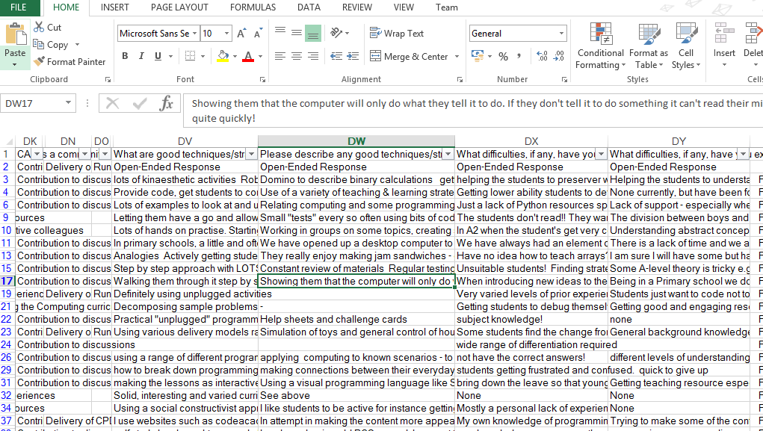
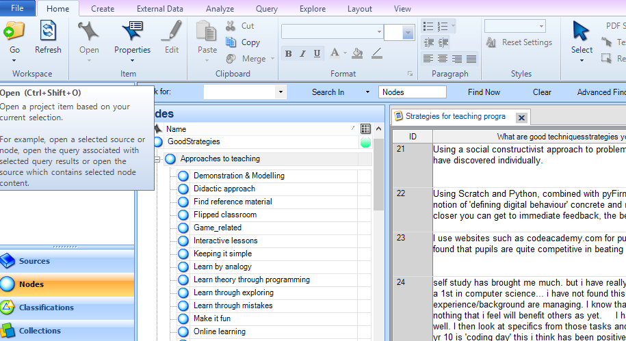
Methodology – how to deal with qualitative data
Free text open-ended questions (in electronic format)
Data imported into qualitative data analysis software (QDA Miner Lite is free)

Slide 10
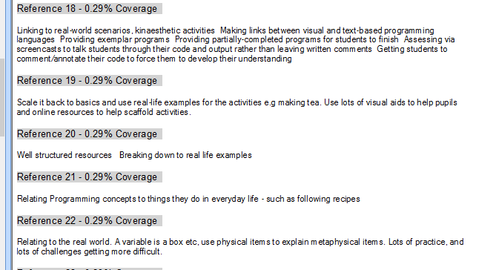
Initial coding exercise
For each response, allocate one or more “categories of response” or code to that response, e.g. unplugged, assessment, group work, etc.
Each response may be tagged with more than one code if appropriate
On first pass, build up suggested list of codes
Review coding system to assimilate codes that seem to fit the data
(You may determine your list of codes without going through all the responses)
Tagging as “real-life activites”

Slide 11
Verification of coding
Go through the data again and allocate one or more codes to your response
Ideally two people should do this so that that the allocation of codes is verified, and you both agree on what the codes “mean” in terms of the language used by the respondents.
This gives you some simple statistics on what codes are coming up more frequently

Slide 12
What we did
We looked at the most common codes then were able to see what types of responses came up very infrequently and leave those out.
We were able to group them into the five categories we talk about in our paper (described earlier):
Contextualisation of learning
Collaborative working
Computational thinking
Code tracing and scaffolding
Learning away from the computer

Slide 13
Writing up for a paper
To write up this type of analysis, find some exemplar quotes that illustrate the sort of sentiment that is within the similar answers.
We had some interesting responses that were very individual views – not relevant to us as we had over 300 teachers and needed to see what “most” or “many” teachers said – so we didn’t report them. If you have long interviews with only 4 or 5 people, you can then look at the individual responses in more depth.
Papers that are likely to be accepted have a clear message. In our case we tried to group the strategies into 5 separate/defined areas to create a memorable and citable message (but they are not as clear as they could be – this is real data after all).

Slide 14
Questions?

