Slide 1

Developing a new generation of
Curriculum Leaders
Notes:
A brief introduction outlining the purpose of the Tenderfoot project.

Slide 2


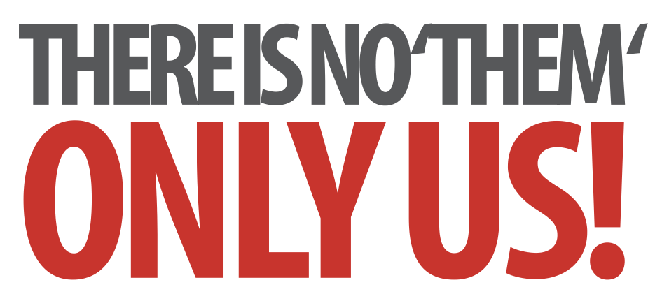
Laying Firm Foundations: A Conceptual Approach to Programming
Structured Programs
Notes:
Introductory slides that establish a common format to the start of a Master Teacher session. Please do stress the ethos at the start: there is no them – only us! If our subject is to develop all practising teachers have valuable contributions to make, regardless of prior experience. The CAS model recognises that good pedagogy is a process of discussion and development, facilitated through our Community of Practice.

Slide 3
Laying Firm Foundations: A Conceptual Approach to Programming
Structured Programs
Insert any specific notes
Start / End time
Toilets
Fire Drill / Exits
Notes:
Reminder to go through formalities at start. Placeholders for specific details

Slide 4
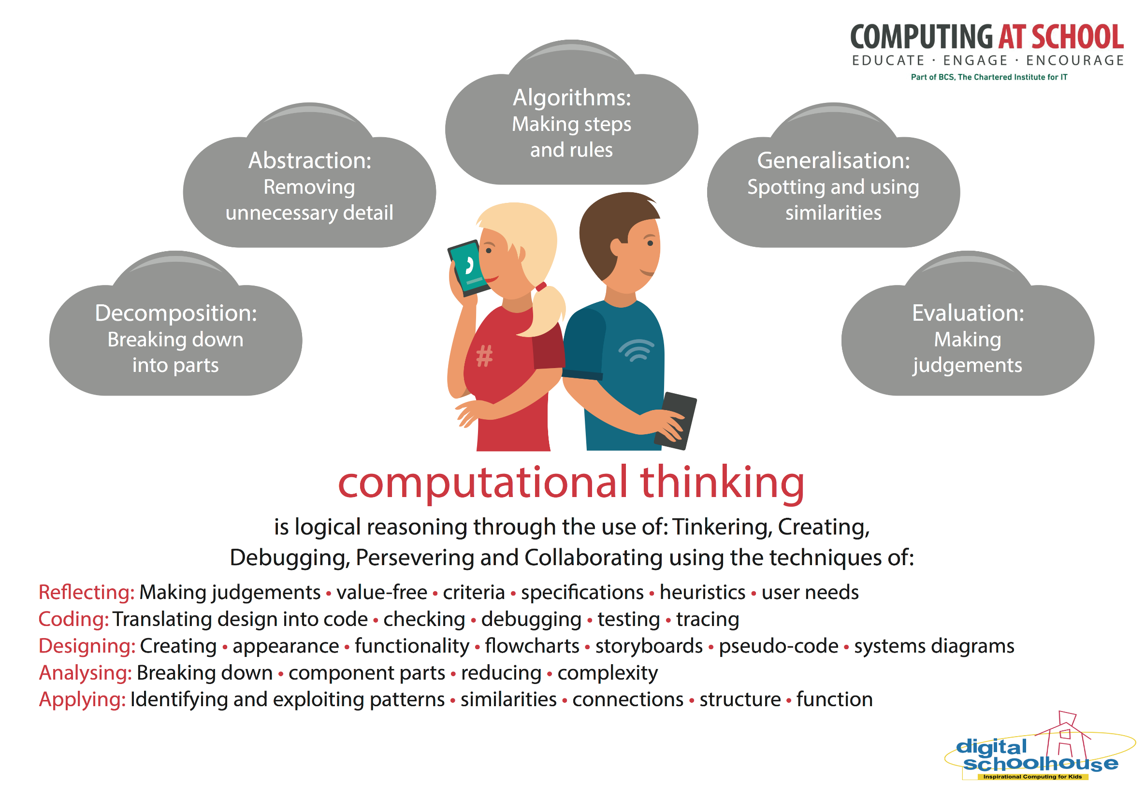
Computational thinking concepts are key
Notes:
Whatever the activity, there are some key concepts in Computer Science that occur again and again. CAS have produced a poster that highlights those key concepts - concepts that underpin computational thinking. Great for the classroom wall, so you can keep referring to them whenever the opportunity arises. We’ll be doing this throughout this session. The concepts are revealed on a click.

Slide 5
Structured Programs
Learning Outcomes
By the end of the session we hope you will:
Be familiar with the key concepts required to write programs
Recognise the three key constructs used in every algorithm
Appreciate the centrality of a variable
Be familiar with functions and procedures
Recognise their role in structured programming
Have explored a couple of activities for introducing these programming concepts at KS3
Notes:
It is important to be explicit about the intended outcomes of the day for attendees.
Do not assume they will be aware of the purpose or target audience of the materials.
By stating the intentions, it helps avoid getting sidetracked into discussing the detail of individual classroom activities.
The primary aim is to educate teachers and illustrate the breadth and depth of Computer Science. The specific outcomes for teachers from this unit, are
Be familiar with the key concepts required to write programs
Recognise the three key constructs used in every algorithm
Appreciate the centrality of a variable
Be familiar with functions and procedures
Recognise their role in structured programming
The purpose of Tenderfoot is to equip trainers with material and ideas to meet these outcomes and broaden the outlook of teachers new to Computing.
It hopes to provide a buffet of resources on which teachers can draw, to enrich their Key Stage 3 lessons, at the same time as meeting the key aim: providing greater depth of knowledge for teachers themselves.
Developing teachers is the focus, not providing activities for pupils.

Slide 6

Structured Programs
A Conceptual Approach to Programming
Notes:
In this second session we want to take the ideas of structured programming further.

Slide 7


Structured Programs
A Conceptual Approach to Programming
1 idea
2 activities
3 constructs
4 concepts
Notes:
Let’s just recap. The focus of the first session was concepts and continuity. What we want to do is constantly reinforce 1 big idea – that this is about developing Computational Thinking (click). We’ve developed one programming activity so far, involving only simple sequencing to illustrate the 4 central concepts.
Before we look at a second activity, lets consider the 3 constructs for creating algorithms, and another central idea that goes hand in hand with algorithms, that of data structures.

Slide 8
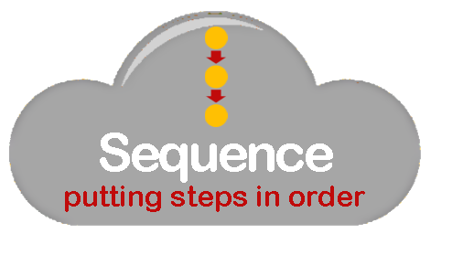
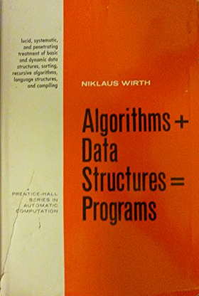



= Programs
Algorithms + Data Structures
Niklaus Wirth
Notes:
Algorithms + Data Structures = Programs is an old, but well known book written by Computer Scientist Nicklaus Wirth.
Amongst many other achievements, Wirth developed the programming language Pascal.
The title summarises the challenge facing programmers. They need to develop algorithms which manipulate data.
We’ve mentioned the 3 key constructs for building algorithms. What are they? (click for reminder of sequence, selection and iteration)
So far we haven’t considered how data is held in a program, that is, the Data Structures in Nicklaus Wirths equation.

Slide 9

= Programs
Algorithms + Data Structures
Notes:
We’ll start with a simple, but absolutely key concept: the notion of a variable. This is the idea that any data we wish to hold in a program must be put into a named ‘container’. This is the simplest data structure, on which many more can be built. It is therefore a key idea for students to grasp.
Children don’t intuitively ‘get this’ – it is an abstract concept, and how we introduce it can have a huge bearing on children’s understand.

Slide 10
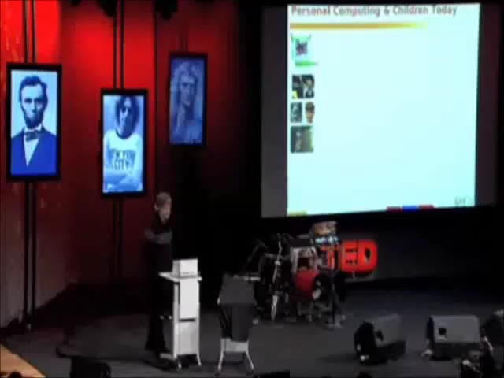
= Programs
https://www.ted.com/talks/alan_kay_shares_a_powerful_idea_about_ideas
Algorithms + Data Structures
Notes:
Here’s a clip of Alan Kay (pioneer of the early laptops, developer of object oriented programming, designer of Squeak, a visual language and much much more) speaking at a TED Conference in 2007.
If you want to watch the whole talk, about the power of programming to inspire thinking and foster curiosity, you can find it at the link at the top (click) https://www.ted.com/talks/alan_kay_shares_a_powerful_idea_about_ideas

Slide 11
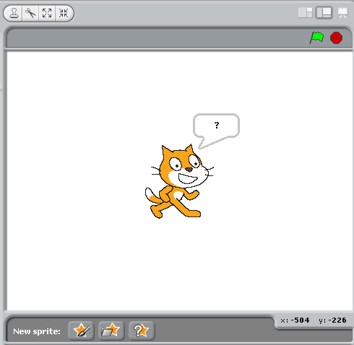
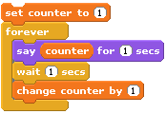
What will the cat say?
Notes:
So we want children to discover the properties of variables through practical challenges. They will learn by doing. By doing and observing they will build up their own mental model of how variables work. But before doing so it is worth introducing the name of the concept and pointing out the drawer in BYOB or Scratch that allows variables to be created.
Ask students to predict what the Cat will say. Some may expect it to say ‘counter’ if they have never come across the notion of a variable. Others may intuitively see what will happen but not have the language to explain. Introduce the term variable to them.
Ask the students to read the code on the screen line by line. If the answers are imprecise, model the language required eg ‘A value of 1 is assigned to the variable called counter’, ‘The contents of the variable called counter (which is currently 1) are displayed in the speech bubble for 1 second.’ etc
The following animation makes the behaviour clear (click)

Slide 12
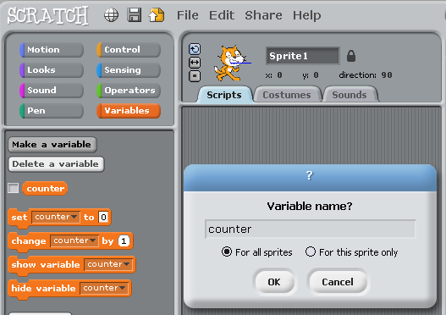
Key Concept: Variable
Notes:
Before we animate the code, point out how a variable can be created and named in BYOB or Scratch, and once created, where they appear..

Slide 13

Variables
VALUE
NAME
Notes:
Conceptually, it is useful to thing of a variable as a container, with a label, into which a value can be placed. The value can change, as we will see, but the container will only ever contain one entity.

Slide 14
Variables
1
COUNTER
Notes:
So let’s step through the code.
The container is labelled (named) as counter. (click)
The value 1 is placed in it.

Slide 15
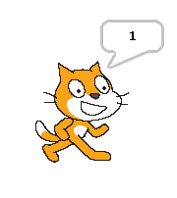
Variables
1
COUNTER
Notes:
The value inside the container is inspected and ‘spoken’ for 1 second.
The program then waits for 1 second.

Slide 16
Variables
1
2
COUNTER
Notes:
The value in counter is incremented by 1, so it now contains the value 2.
The animation takes the value out and changes it to emphasise that it is only 1 held in the box.

Slide 17
Variables
2
3
2
COUNTER
Notes:
The program loops round and repeats the sequence, saying the value 2, waiting, incrementing counter to the value 3.

Slide 18
Variables
3
4
3
COUNTER
Notes:
The same sequence, this time saying 3 and incrementing to 4.
It can be useful to have a couple of childen acting this out in front of the class with a box and a mini whiteboard slate, on which they can rub out the old and write the new values on, before putting it back in the box.

Slide 19
Variables
4
5
4
COUNTER
Notes:
The same sequence again. If the children think they have ‘got it’ ask them to chant the steps, before enacting in the animation. It is surprising how often they get it wrong!

Slide 20
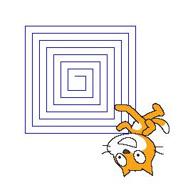
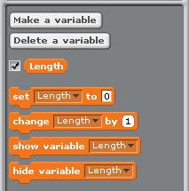
Variable Challenge
1
activity
Draw a squiral
Extra challenge!
Can you use another VARIABLE so the colour of the sides changes on every turn
Notes:
Some children will get this very quickly, but for many, repeated exposure to the concept is needed. Drawing a Squiral provides a good lesson to practise applying the concept – with plenty of extension challenge for those who grasp the concept, along with some powerful visuals.
Start by discussing how it might be drawn (from the centre outwards, using a similar loop and variable as we did in the counter example).

Slide 21


Investigation
If that was easy:
Stop the squiral when the sprite touches the edge.
Amend the code so the sprite comes back, drawing a second squiral inside the first one.
Can you generalise your code so the ‘gap’ between the lines in the
squiral can be varied.
Notes:
For the more able, start by asking pupils to investigate the impact of changing the amount the variable is incremented on each step. They can then control the ‘gap between the lines.
Returning within the squiral involves recognising how far to move, before redrawing a decrementing squiral.
The final challenge involves creating a gap variable, and refactoring the move at the edge, to reflect half the value of the gap. This is a good example of how code can be refactored, spotting the pattern between the gap and the move, to make it more general.

Slide 22



Structured Programs
A Conceptual Approach to Programming
1 idea
2 programs
3 constructs
4 concepts
Notes:
Let’s just recap again. The focus of this session is concepts and continuity. Many of the tools and techniques introduced wont be new to pupils, but once in secondary school we need to put what they know already into the context of our 4 key concepts and constantly reinforce that these are at the heart of developing Computational Thinking (click).
We know that programs are built up of algorithms acting on data structures. (click)
We know the key to handling complexity lies in decomposing big problems into smaller ones, and that once a small program is created, the detail can be abstracted away by developing functions or procedures.
So complex programs are built by assembling smaller blocks of code.
Let’s now look at a more challenging activity to illustrate these key concepts and build on the ideas of decomposition and abstraction.
(click) Welcome to Wacky Races!

Slide 23

2
activity
© Hanna Barbera Productions
Notes:
Welcome to Wacky Races!
The next slide shows a finished program running. As it runs, point out the start and finish line, and how the six sprites line up to start when the Reset button is pressed.
The race is random and the outcome will differ each time.

Slide 24
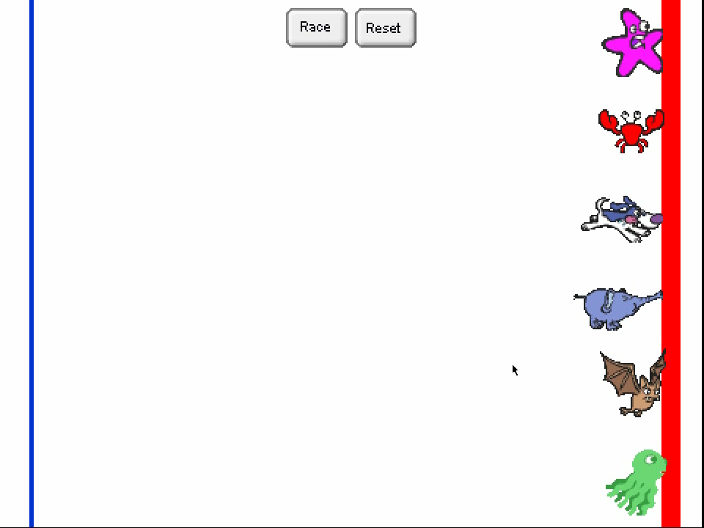
Notes:
The video should start automatically.

Slide 25
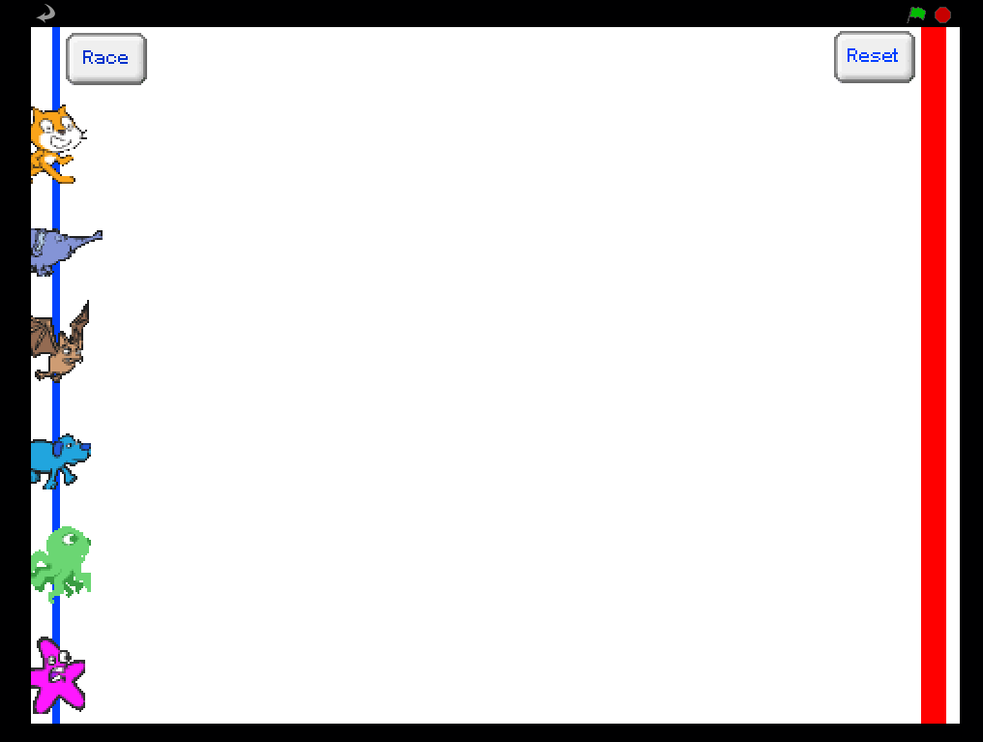
Notes:
Discuss how we might break down the task.
The aim would be to draw out 3 or 4 distinct areas that could be developed independently eg Race Setup, Actual Race and the Finish.
Each can then be further decomposed. Consider each in turn.

Slide 26
Game Setup
STEP 1: Create a ‘racetrack’ with start and finish line.
STEP 2: Select and resize six sprites with at least 2 costumes to allow for animation.
STEP 3: Work out how to get them all to line up on the starting line.

Slide 27
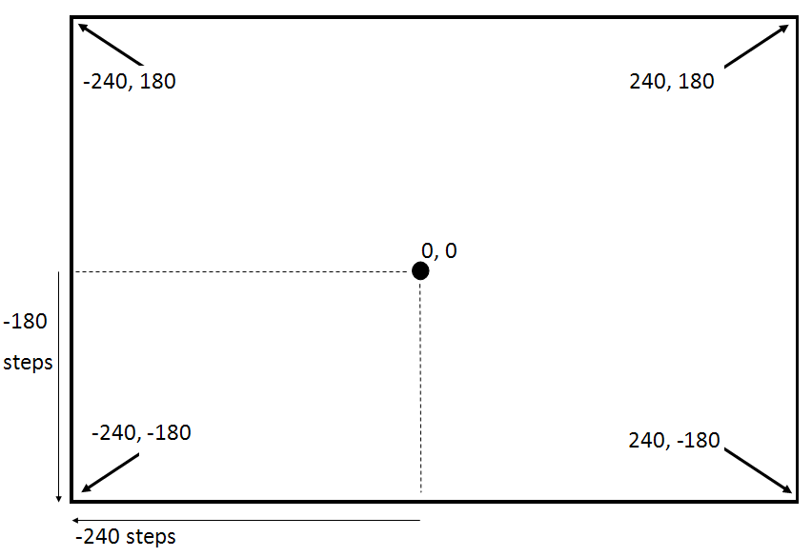
The Scratch/BYOB Screen
Notes:
It’s worth noting the co-ordinates used on the screen, so the six sprites can be spaced equidistant.

Slide 28
Main Race
STEP 4: Get one sprite to race across the screen
STEP 4a: And stop on the finish line.
STEP 5: Apply to all six sprites - but they must race at a random speed.
STEP 6: Work out how to get them all to start racing together.
What constructs might we use here?
Notes:
Again we can decompose the Main Race. We can consider using a loop to repeat a move command, changing the costume each time to create the animation, and a selection statement (IF touching) to stop when it touches the red line.

Slide 29
Finishing Touches
STEP 7: Get the sprites to announce their position on the finish line.
STEP 8: Work out how to reset the game so that, when you click a reset button, all the sprites line up on the start line ready to race again.
How might we keep track of the position?
Notes:
Some form of counter variable would help keep track of position, incrementing by 1 each time a sprite finishes.

Slide 30
Code Management
LineUp
Race
Extensions
Notes:
Now that we have decomposed the problem, we can think about naming our own procedures to encapsulate the code. The race breaks down neatly into the commands to Line Up, which can be called by clicking on the Reset Button, and the commands to Race.
If we want to extend the functionality, we can develop new procedures to accomplish particular tasks.

Slide 31
Extensions
Award points to each racer. 6 points for a win, down to 1 for last place.
Keep a record of Total Points for each racer, so we can run several races.
Add a third button, Final Score. When clicked it will display the total score for each sprite …
… and announce the winner!
Notes:
Three possible extensions are suggested, for those who make quick progress. The last one is challenging but doesn’t require any more knowledge of structures than we have covered.

Slide 32
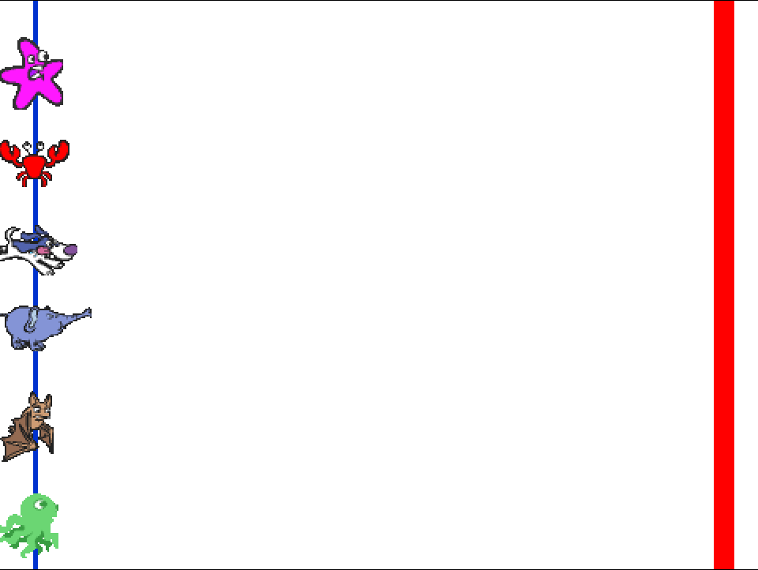
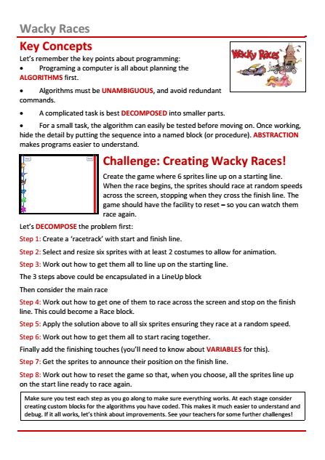
A step too far?
Scaffolding a part complete project
Notes:
There is an Activity handout for reference, to help tackle the challenges.
However, it is often difficult for children to code from a blank canvas. If you feel creating Wacky Races from scratch would be a ‘step too far’ you could provide a partial implementation and set challenges to modify the existing code. Several incomplete versions of the program are included in the resources.
Race01: provides the background start / finish lines and has sprites in place so pupils can investigate their starting position, prior to writing the code to line them up.
Race02: models the code to return a sprite to the start, and displays the co-ordinates to make it clearer.
Race03: develops the code for one sprite to race.
Race04: models the encapsulation of the race sequence into a block
Race05: displays the use of a position variable to allow the sprite to announce its place at the end of a race.
Race06: introduces buttons and broadcasts

Slide 33
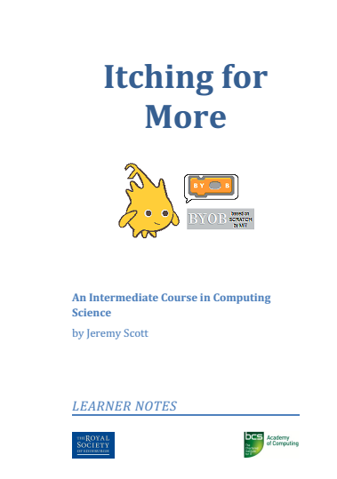
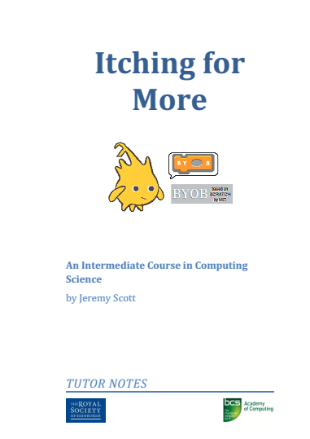
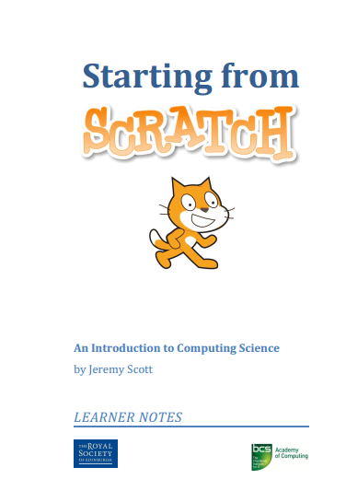
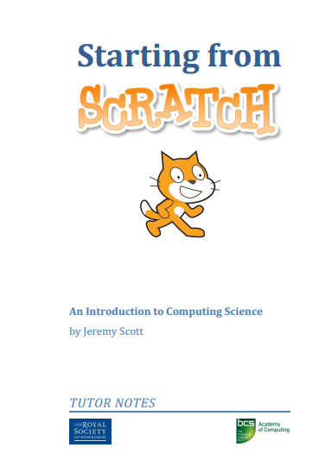
Other Projects
goo.gl/XCQARR
Scaffolding a part complete project
Notes:
There are lots of excellent resources to support the development of programming using Scratch / BYOB.
The best, with comprehensive notes for students and tutors, supported by screencasts, and supporting programs is probably Jeremy Scott’s material. Starting From Scratch provides an introduction for absolute beginners. (click)
The material in Itching For More is best pitched for KS3 pupils developing the ideas and concepts we’ve outlined here.
Produced for The Royal Society in Edinburgh, the material is part of a bigger resource that also includes material for developing projects in App Inventor. All resources can be obtained from https://goo.gl/XCQARR

Slide 34
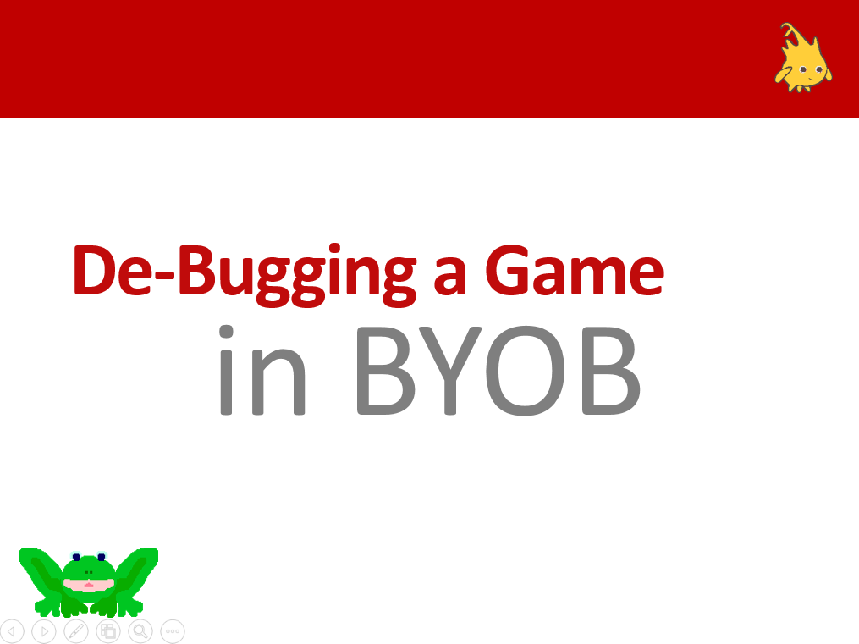
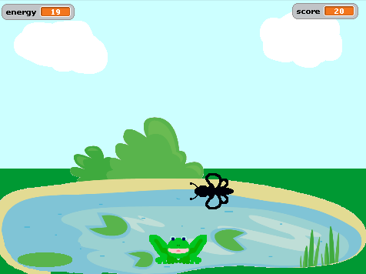
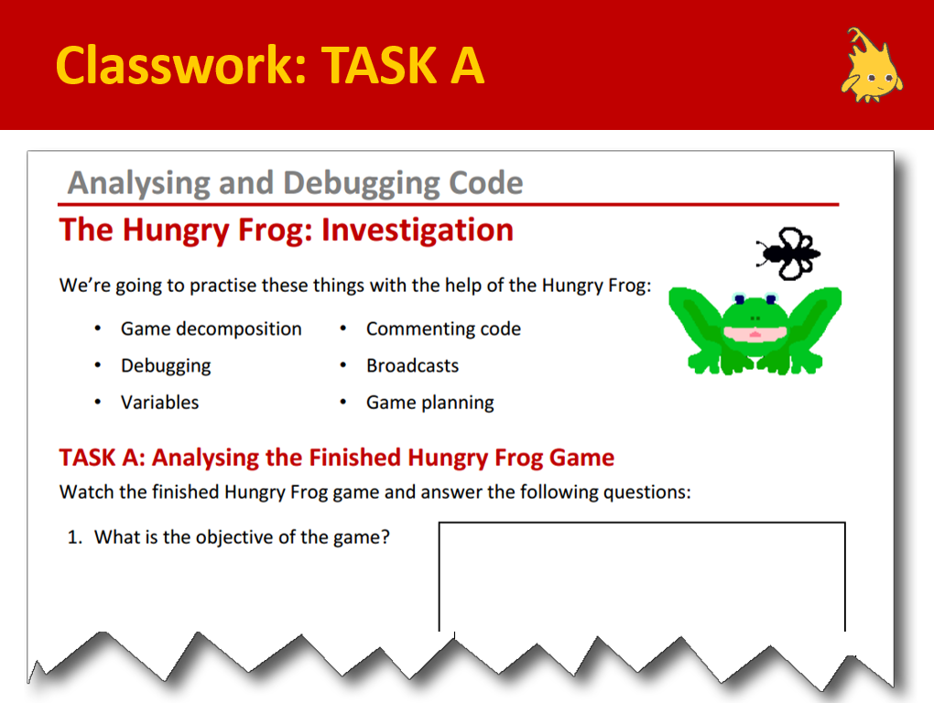
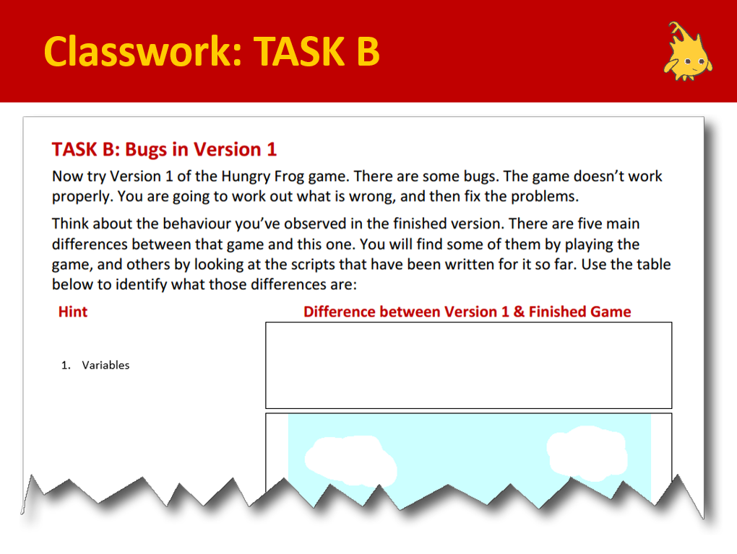
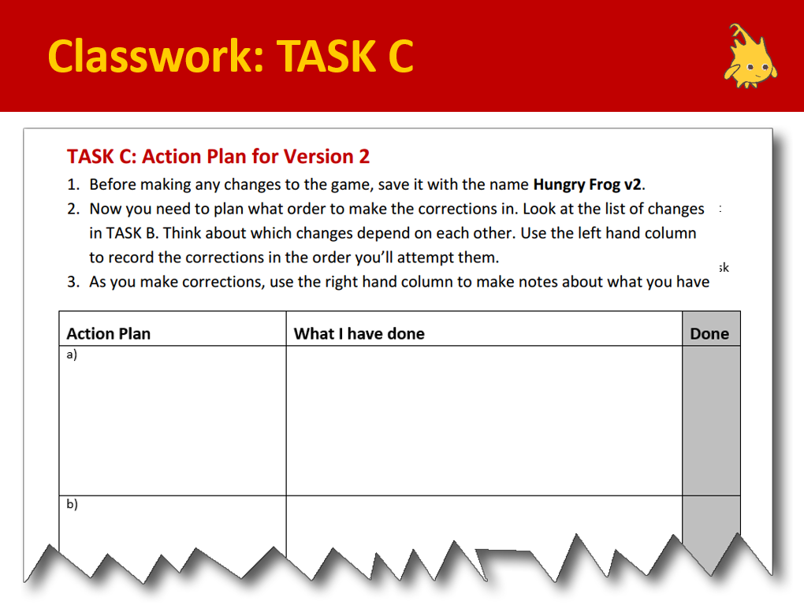
Other Projects
Scaffolding a part complete project
Notes:
Included in the resources are some ready to go classroom materials based around one of the projects in ‘Itching For More’: The Hungry Frog
This project requires some media files (included).
The activity focuses on students investigating a working game and answering a series of structured questions. (Task A)
It then involves students analysing a part working game and comparing it to the previous example to identify the errors.
The focus is on observing behaviour, then reading the code.
Finally, Task C plans how to fix it. It includes a teacher presentation, two activity sheets and a homework.

Slide 35
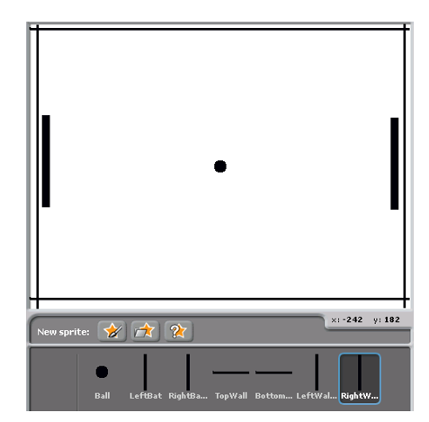
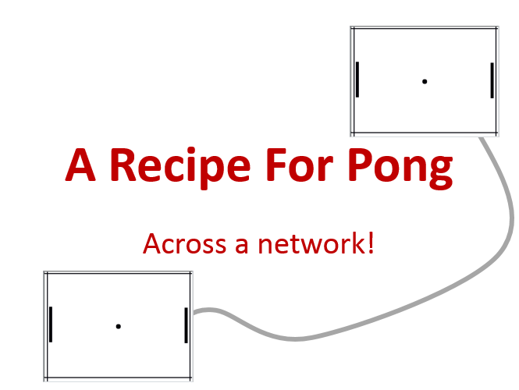
Other Projects
To engage the very able, without introducing new concepts
A simple game with a twist
Notes:
Finally, there are instructions and scripts included to demonstrate how to play the classic game, Pong across two machines.
One big challenge for Computing teachers is providing challenges for able students that don’t require extra support. This is an excellent project to get able students thinking, and having a sense of doing something special…
… and it doesn’t involve any extra knowledge, apart from how to enable the sharing of sprites across machines.

Slide 36


Points to ponder
Scaffolding projects, reading code and paired programming are all techniques to aid learning.
How do we know what works?
How can we contribute to subject pedagogy?
Notes:
A brief pause to encourage a short discussion before the session ends.
Use this slide to prompt a discussion about approaches to teaching programming.
Paired programming is a popular approach for developing pupil capability. Do teachers have other ideas? If so, how can we evaluate them? This is a fertile area for action research …. A core element of the BCS Certificate.

Slide 37

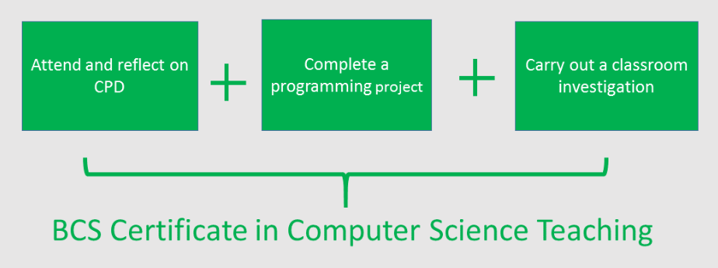

Class based research
Qualifications and Certifications
www.computingatschool.org.uk/certificate
Notes:
End with a reminder of the BCS Certificate in Computer Science Teaching – there are A5 hand-outs. One part of the evidence for the award is classroom research undertaken by the teacher. Maybe the points you’ve just discussed might form the basis of some action research?
(click)
The other two areas involve attending CPD – like this!
(click)
And completing a manageable programming project.
If that sounds a little daunting, remember you can opt for either an independent or guided route.
The latter means you’re supported by a mentor who can help guide you through.
It is a valued award, giving professional recognition accredited by the BCS, The Chartered Institute for IT.
More importantly, it’s designed to help you in the work you’re developing in school.
See the link for more information: http://www.computingatschool.org.uk/certificate

Slide 38
Teaching children to program is about
applying key concepts from Computational Thinking
Concepts are transferable to other problem solving contexts
Notes:
We started by emphasising that teaching programming requires a conceptual approach. These concepts can be easily transferred from one programming language to another.
Let’s quickly recap what is in our intellectual toolkit

Slide 39
Teaching children to
program is about
applying key concepts
from Computational
Thinking
Concepts are transferable to other problem solving contexts
Notes:
The programming language we use is secondary, the concepts are key. They give us a special way of looking at problems. If you can think like a Computer Scientist you have an approach that allows transition to more complex programming environments.

Slide 40

Computing is about
much more than
programming
Notes:
We can end by saying these 3 things.

Slide 41
Computing is about
much more than
programming
Computing is about developing a
way of thinking
Notes:
We can summarise by saying these 3 things.

Slide 42
Computing is about
much more than
programming
Computing is about developing a
way of thinking
Computing concepts provide ways to tackle many problem contexts
Notes:
We can summarise by saying these 3 things.

Slide 43
Join CAS
Not a member?
Thanks
Notes:
Promote CAS at end.

