Slide 1
KS 5 – Computer Architecture Unplugged
Making the new GCE fun
Christine Swan – Master Teacher
The Stourport High School & Vith Form College
cswan@shs.worcs.sch.uk
@chris_swan

Slide 2
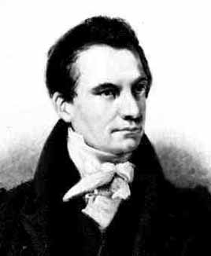

Slide 3
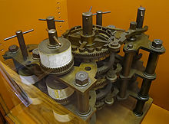

Slide 4
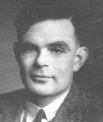

Slide 5
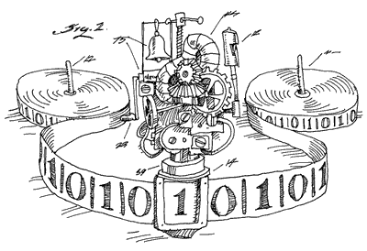

Slide 6
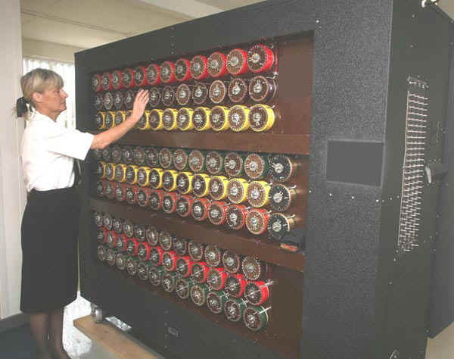

Slide 7
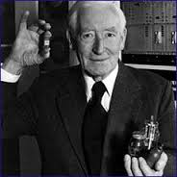

Slide 8
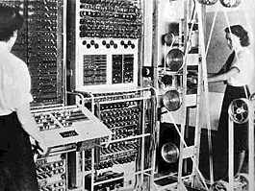

Slide 10
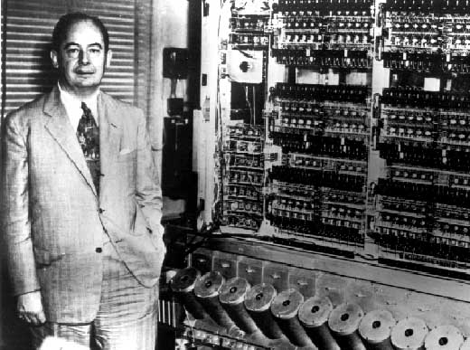

Slide 11
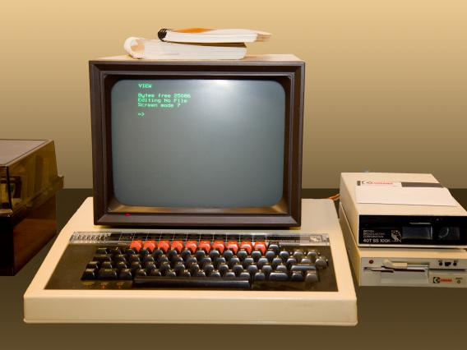

Slide 12
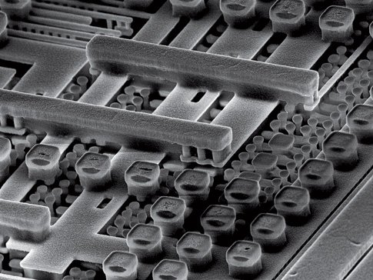

Slide 13
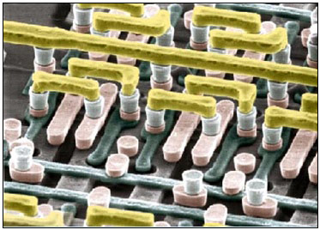

Slide 14
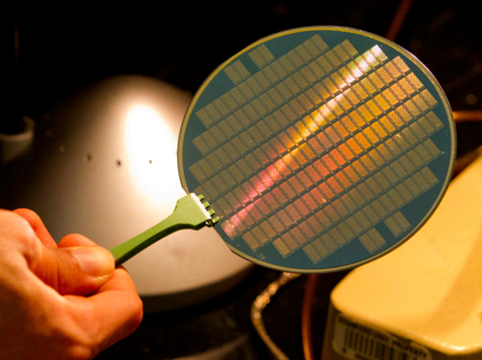

Slide 15
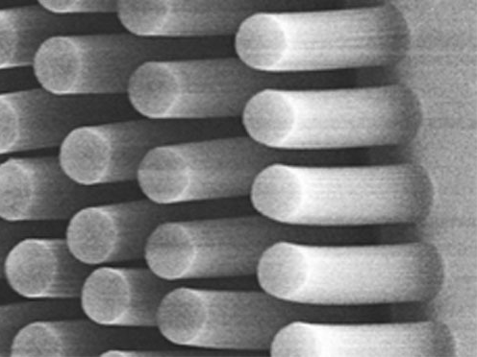

Slide 16
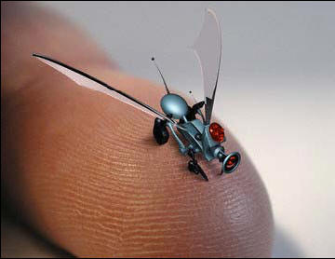

Slide 17
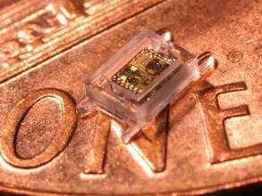

Slide 18
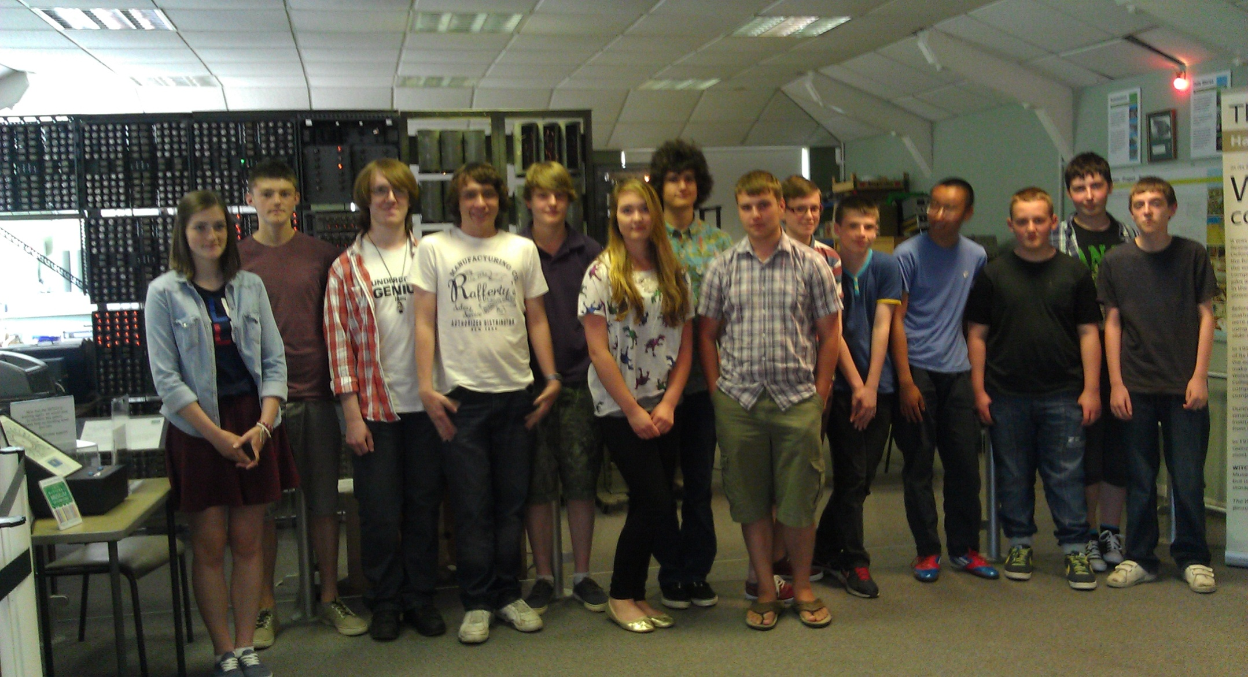

Slide 19
Introducing the new A Level
In the topic of computer architecture, there are few changes:
Not just the Von Neumann architecture
Harvard and contemporary architecture now included

Slide 20
What is staying the same
Von Neumann architecture
ALU, memory unit, control unit, CIR, PC, MAR, MDR, ACC
Fetch Decode Execute cycle
RISC and CISC processors
Parallel and multicore processors
Pipelining
GPU
Effect of no. of cores, clock speed and cache memory
Control, address and data buses

Slide 21
How do we take an abstract model of the CPU and make it accessible and memorable for our students?

Slide 22
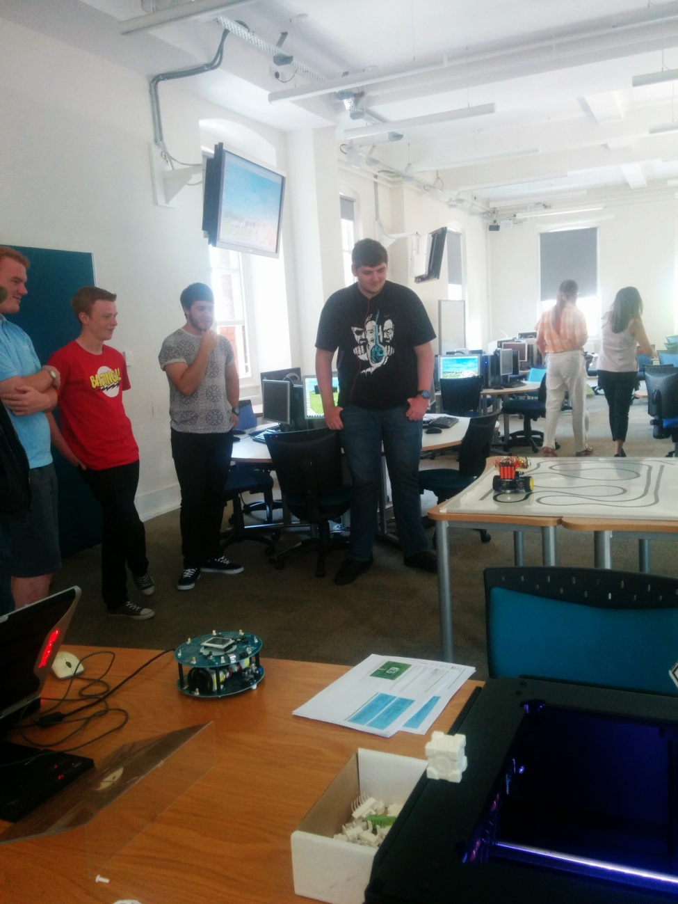
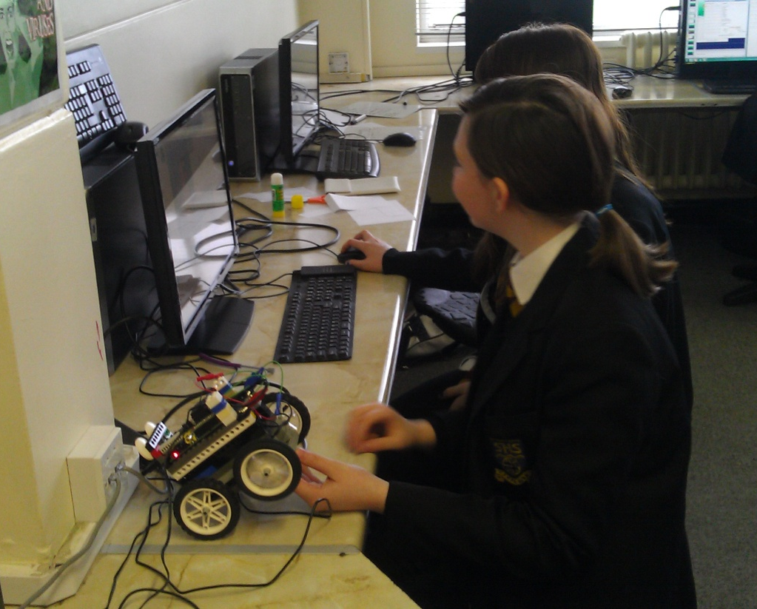

Slide 23
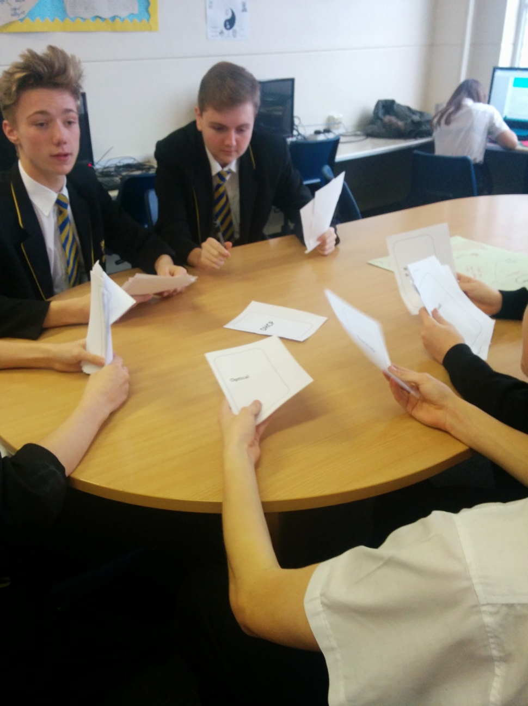
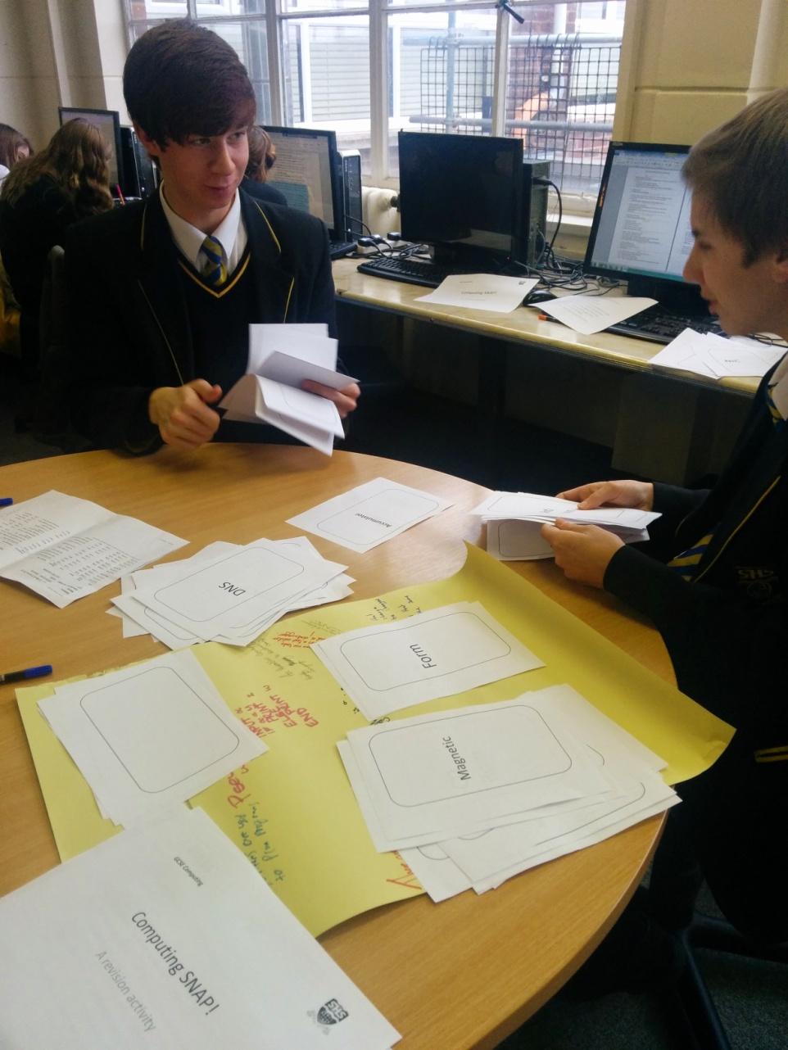

Slide 25
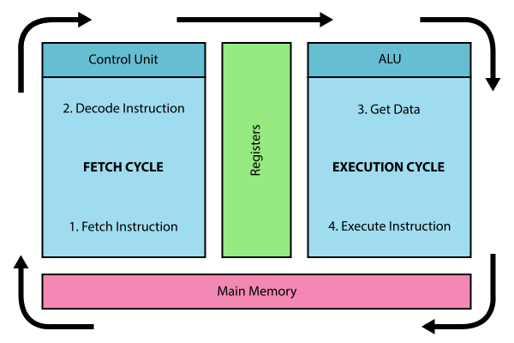

Slide 26
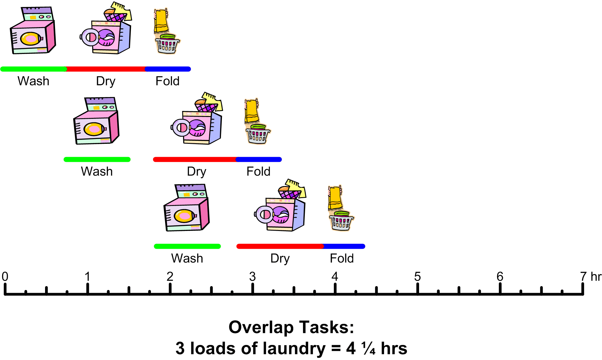

Slide 27
https://www.youtube.com/watch?v=-P28LKWTzrI

Slide 28
Unplugged activities
Fetch Decode Execute board game
CPU poems
SNAP
Acting out the Fetch Decode Execute cycle
“Whose Line of Code is it anyway?” LMC assembly language card game

Slide 29
Unplugged activities
CPU jigsaw
Animated fetch decode execute cycle
Model making e.g. Lego, plasticene, junk

Slide 30
The Fetch Decode Execute Game
Roll a dice to translate and “execute” the number of steps

Slide 31
SNAP!

Slide 32
Fetch Decode Execute “play”

Slide 33
RISC or CISC?
Give students a simple expression or problem:
X = Y+Z-A
Ask students what operations a CPU would need to support to solve it.
Present them with the LMC instruction set and explain instructions needed to copy data into registers and manage program flow
Then give a slightly more challenging problem:
X = Y³ /Z²
They should see that we can break down this expression into more simple operations in stages (rather than having a specific instruction to do this – it is too specific)
How about rendering pixels on a screen?
Playing a sound?

Slide 34
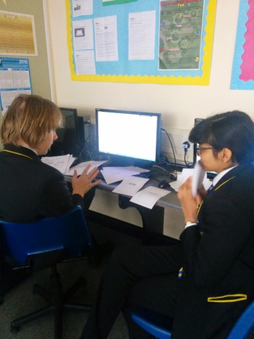
LMC game

Slide 35
CPU jigsaw – can be adapted for Harvard and contemporary CPUs (with cache and multiple cores)

Slide 36
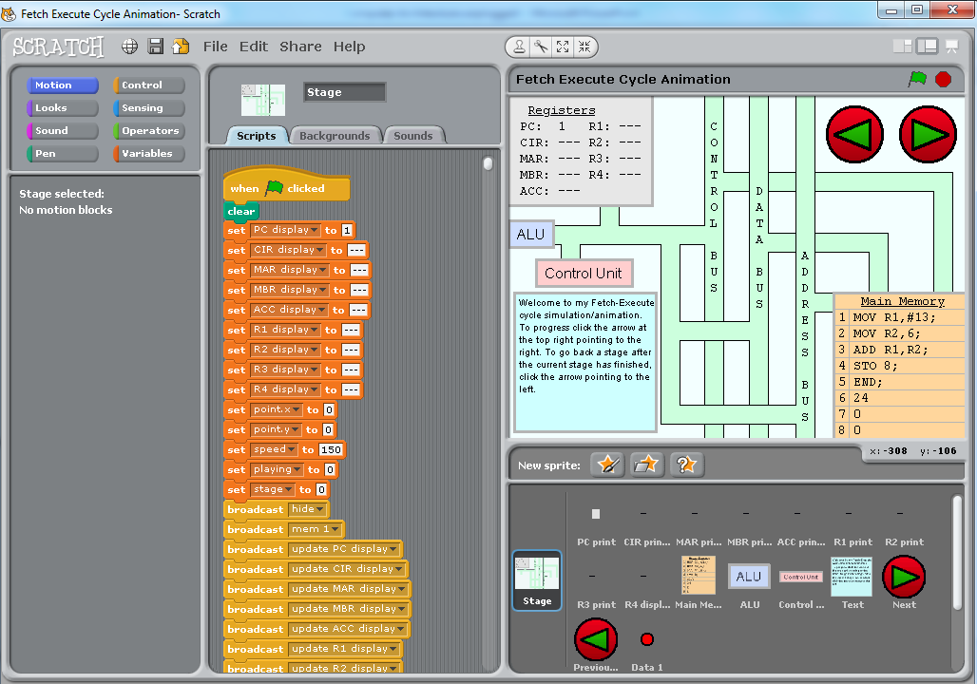
Scratch Animation

Slide 37
Suggestions of further sources
Guide to modern microprocessors
IEEE Spectrum Computing page
The Register - Hardware -always an interesting read
Raspberry Pi
Adafruit - the wonderful world of hardware

