Slide 1
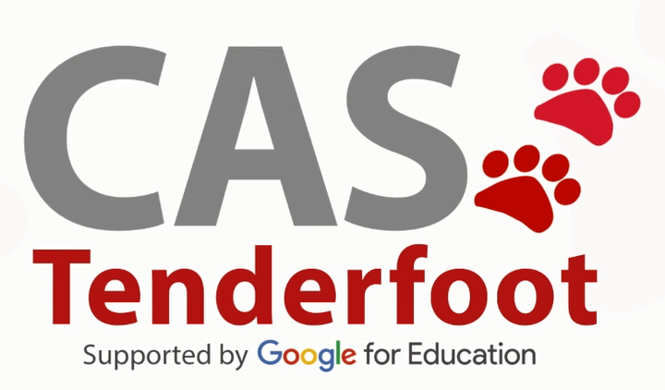
Developing a new generation of
Curriculum Leaders
Notes:
A brief introduction outlining the purpose of the Tenderfoot project.

Slide 2

Why
What
When
How
Notes:
A chance to explain what the Tenderfoot project entails – hide if not required.
Why? The need to develop a deeper appreciation of Computer Science amongst non-specialists secondary teachers.
What? Currently seven full Units are completed, packaged as 30+ separate sessions to support Master Teachers and others hosting local CPD. Four further Units are scoped and awaiting further development.
When? The seven completed Units will be online by the start of the academic year 2017 – 18.
How? The CAS model is that of local face to face sessions through which we build trust and a genuine community of practice. Some may develop the material into online delivery but the key aim is to help sustain the fabric of the CAS Community, developing through the Regional Centre initiatives.

Slide 3
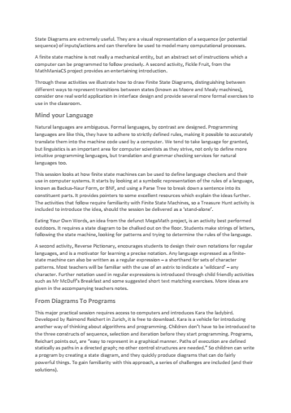
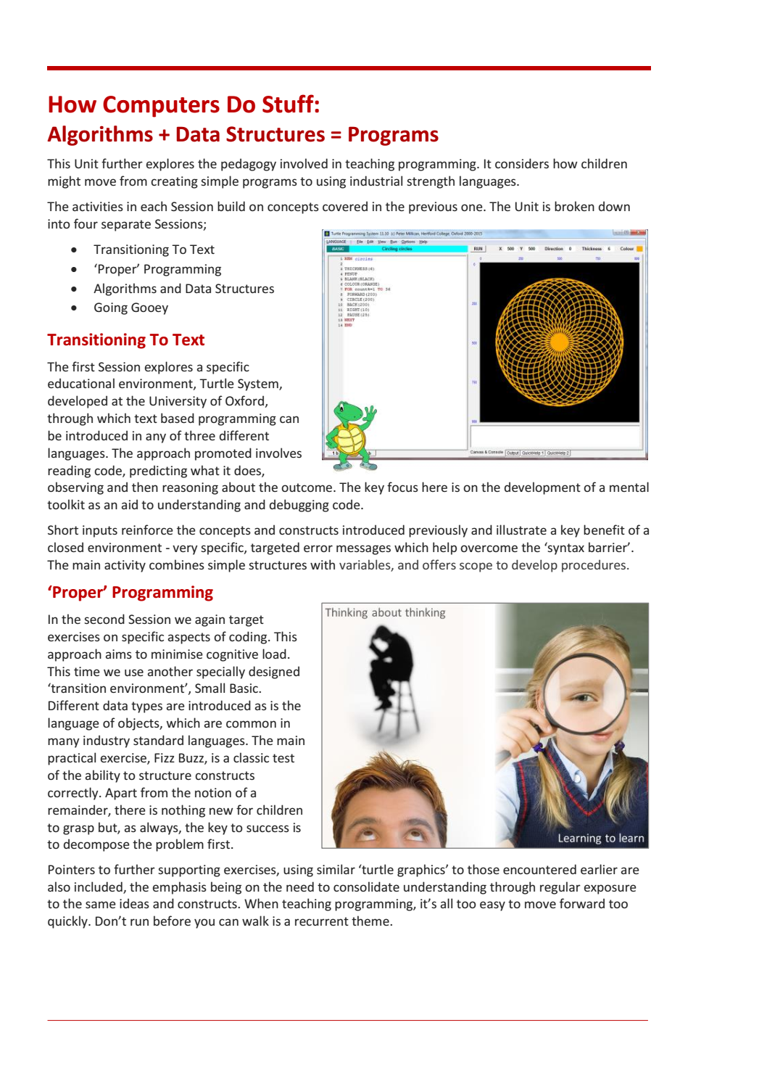
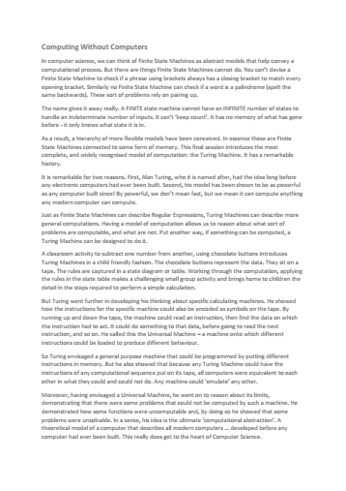
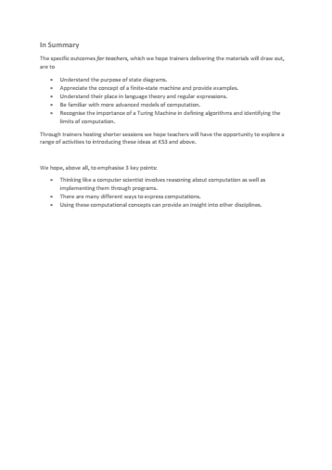
Each
Unit
Notes:
It is important that attendees understand the structure of the supporting resources and their target audience.
A short summary of the content of each Unit can be downloaded and distributed in advance.
A full day Unit is fast paced, aimed at experienced curriculum leaders and potential Tenderfoot trainers.

Slide 4

Each
Unit
Notes:
Each Unit includes a full Trainer Presentation, which follows these introductory slides.

Slide 5
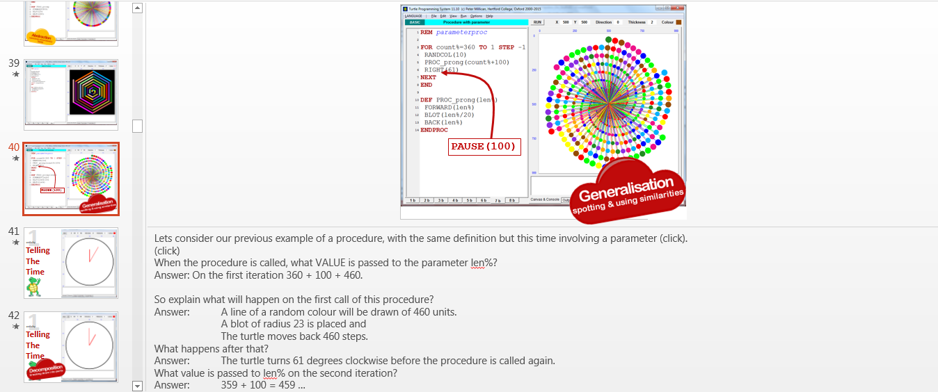
Notes:
The slides include very detailed notes outlining the supporting narrative. Please read them carefully if preparing a presentation.

Slide 6
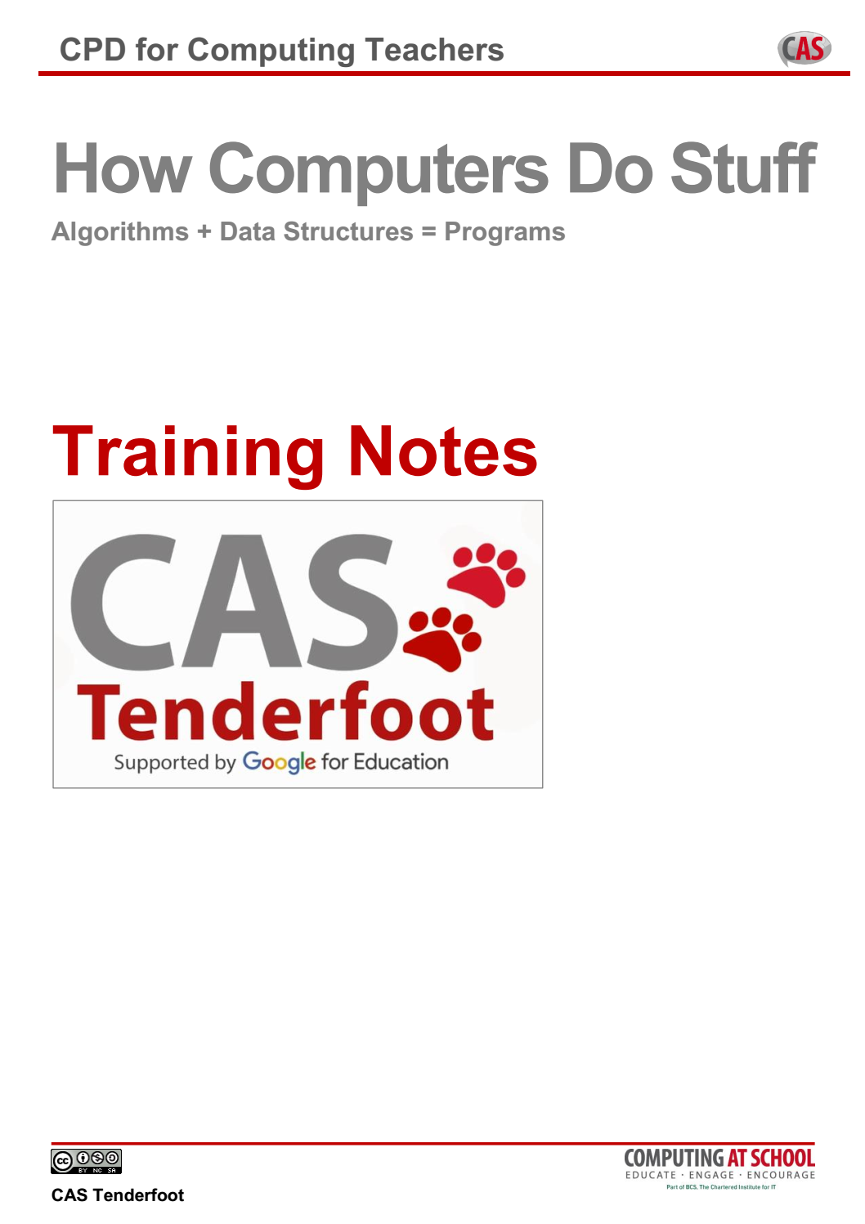
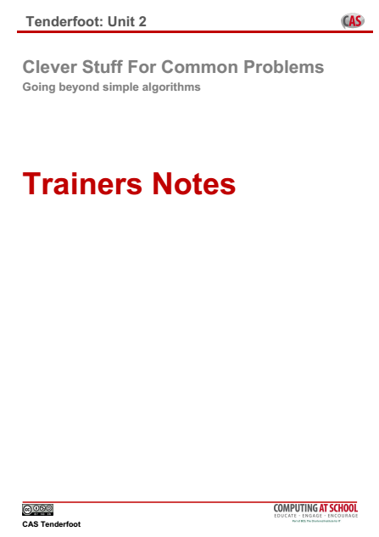
Each
Unit
Notes:
Trainers Notes are provided to help with advanced preparation.
These can be distributed at the start of a full day session.
The contents are explained in the following slides.

Slide 7
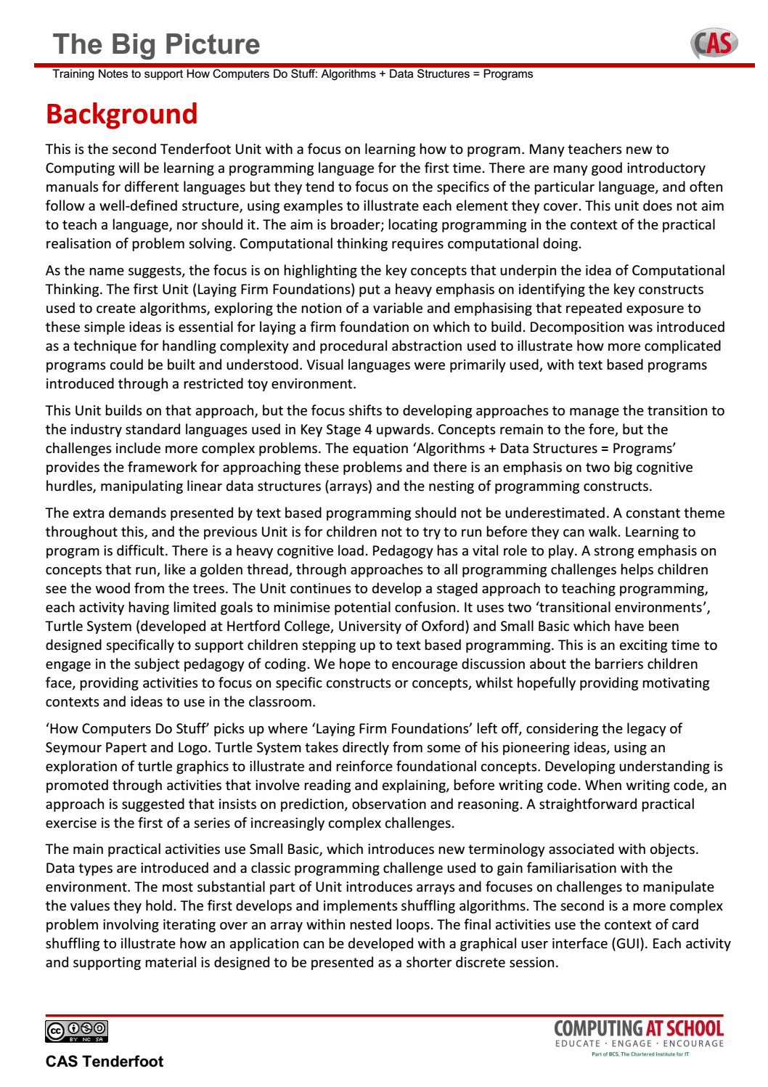
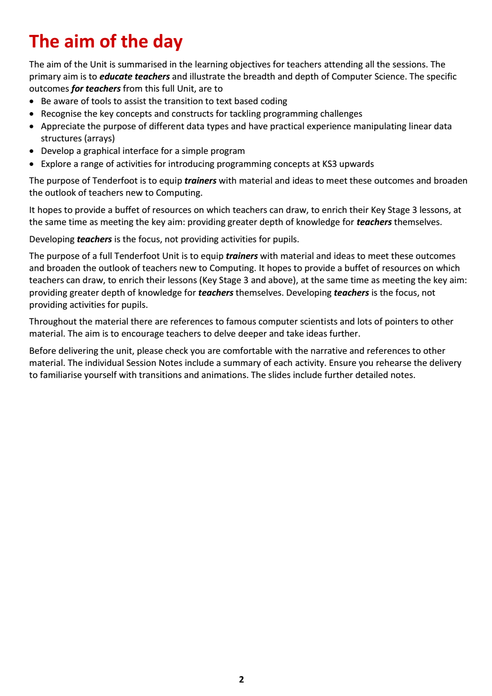
Notes:
The first page sets the subject matter in context, outlines the ‘big picture’ and identifies the learning objectives for teachers new to Computing.
It is worth emphasizing that the purpose of the material is to raise the awareness of teachers to the breadth and depth of the subject, not simply to provide another source of fun activities for classroom use.

Slide 8
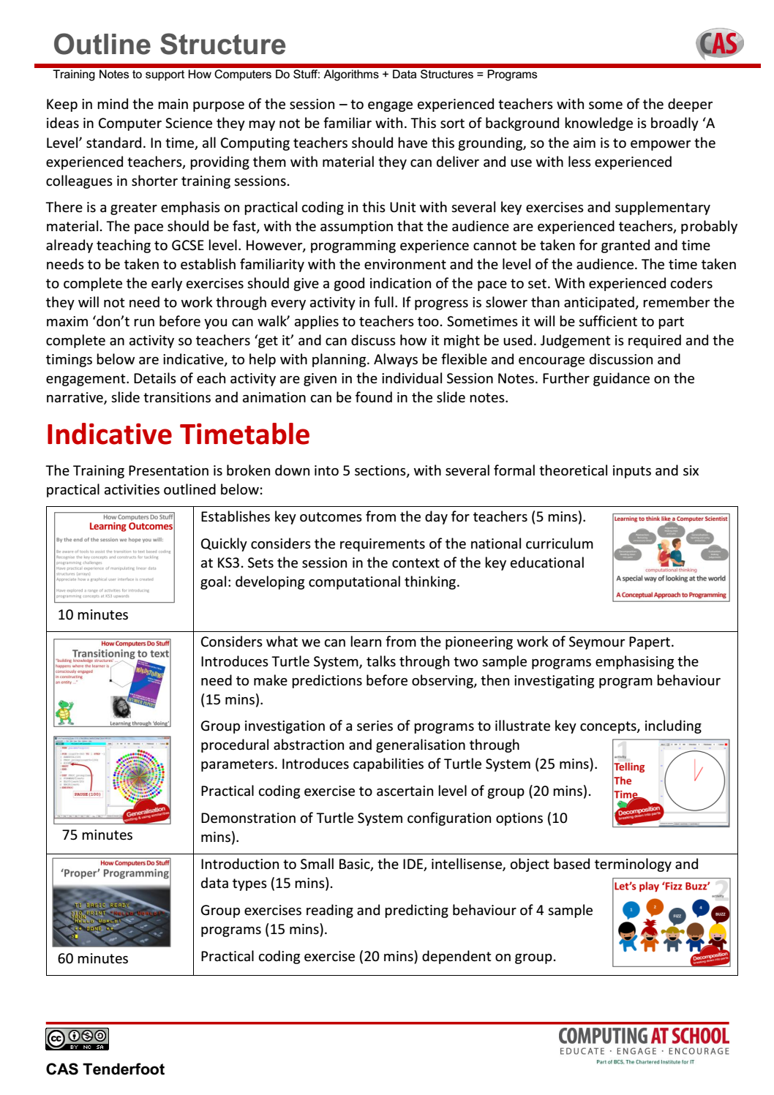
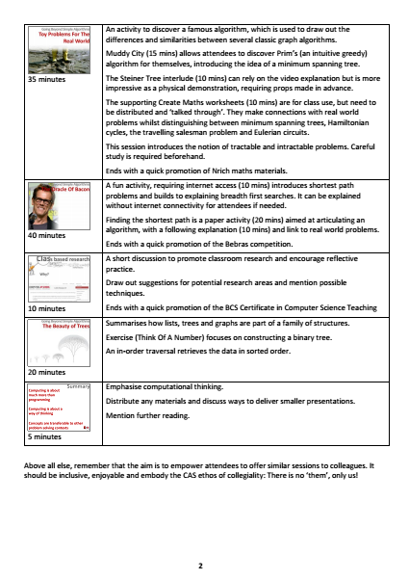
Notes:
An indicative timetable for a full day Unit is included.
A lot of ground is covered, so keeping to time can be challenging!

Slide 9
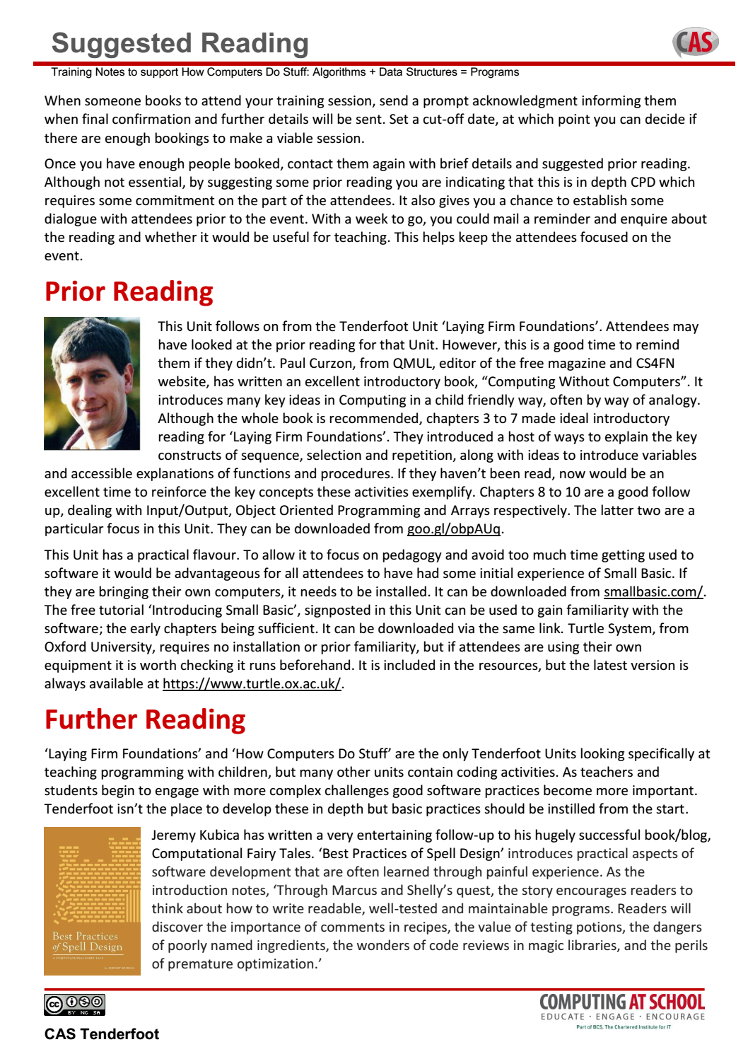
Notes:
Pointers are provided to good CPD practice. Making contact and establishing a dialogue prior to the event is important. Suggesting simple reading or watching a video allows the opportunity to follow up with a reminder.
The ultimate aim is to encourage teachers to dig deeper, so suggested further reading is also included.

Slide 10
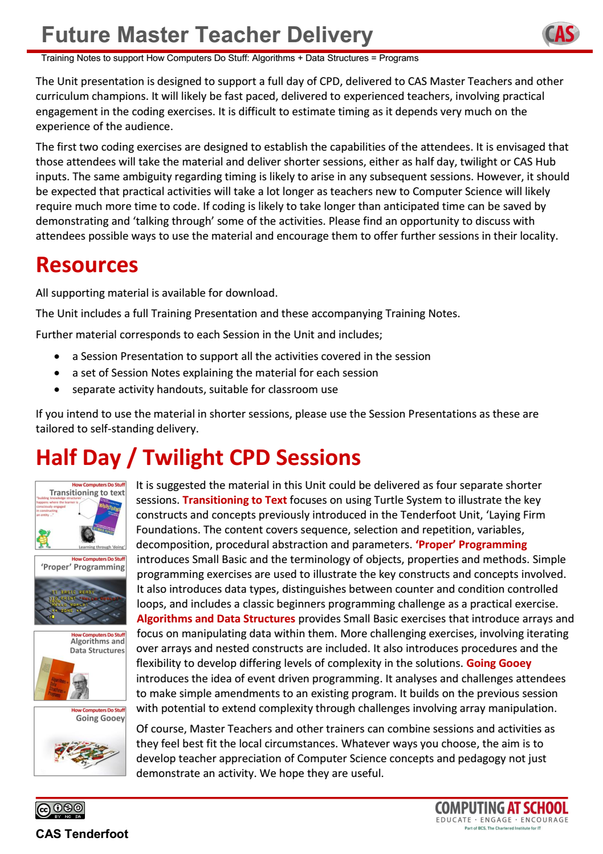
Notes:
The Unit is subdivided into sessions. This allows you to take the material and offer shorter sessions to fit local circumstances.
A summary of the sessions and indicative timings is included to facilitate planning.

Slide 11
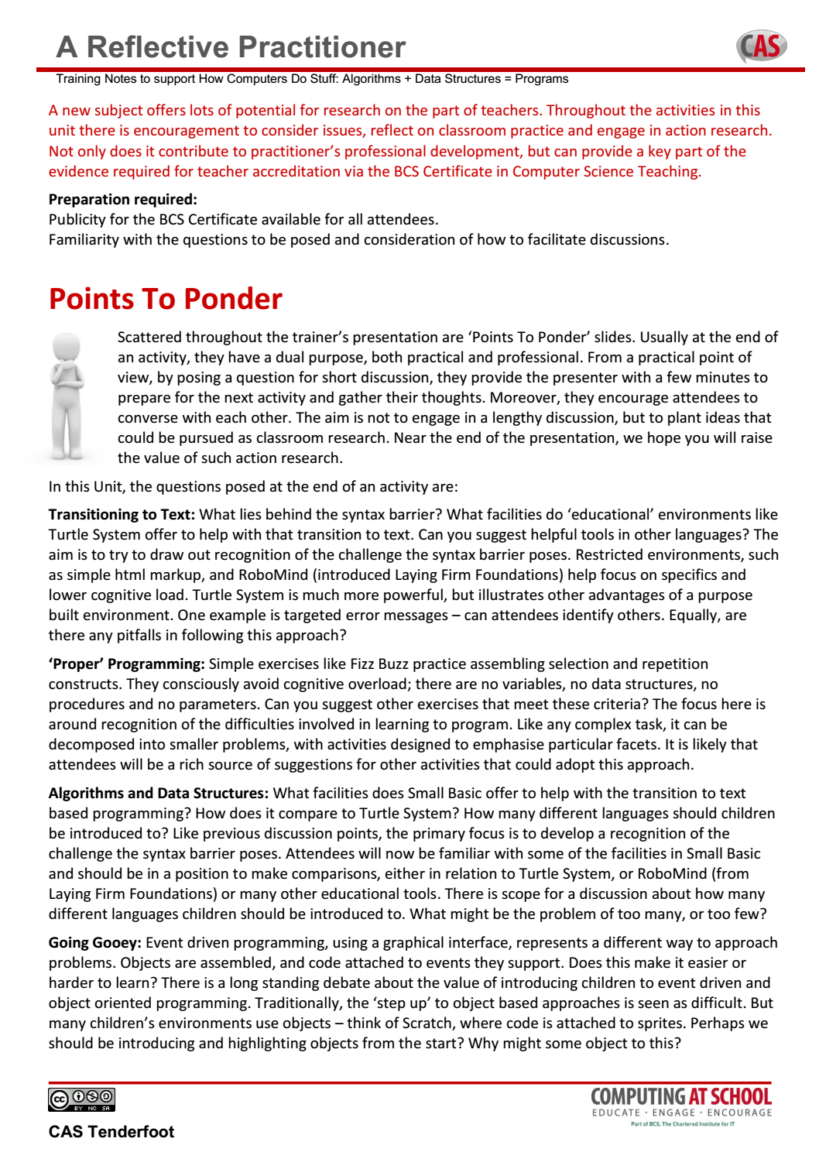
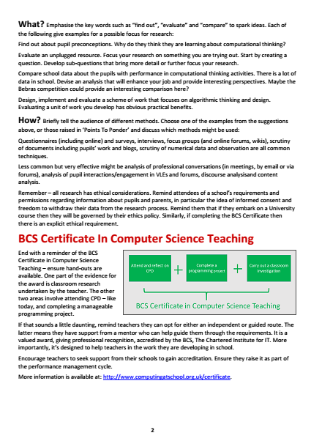
Notes:
Finally, there is a summary of the key points in the presentation where we hope Trainers will facilitate discussion and debate.
A key element in the CPD is to encourage reflective practice, promote action research and encourage teachers to consider the BCS Certificate in CS Teaching.

Slide 12
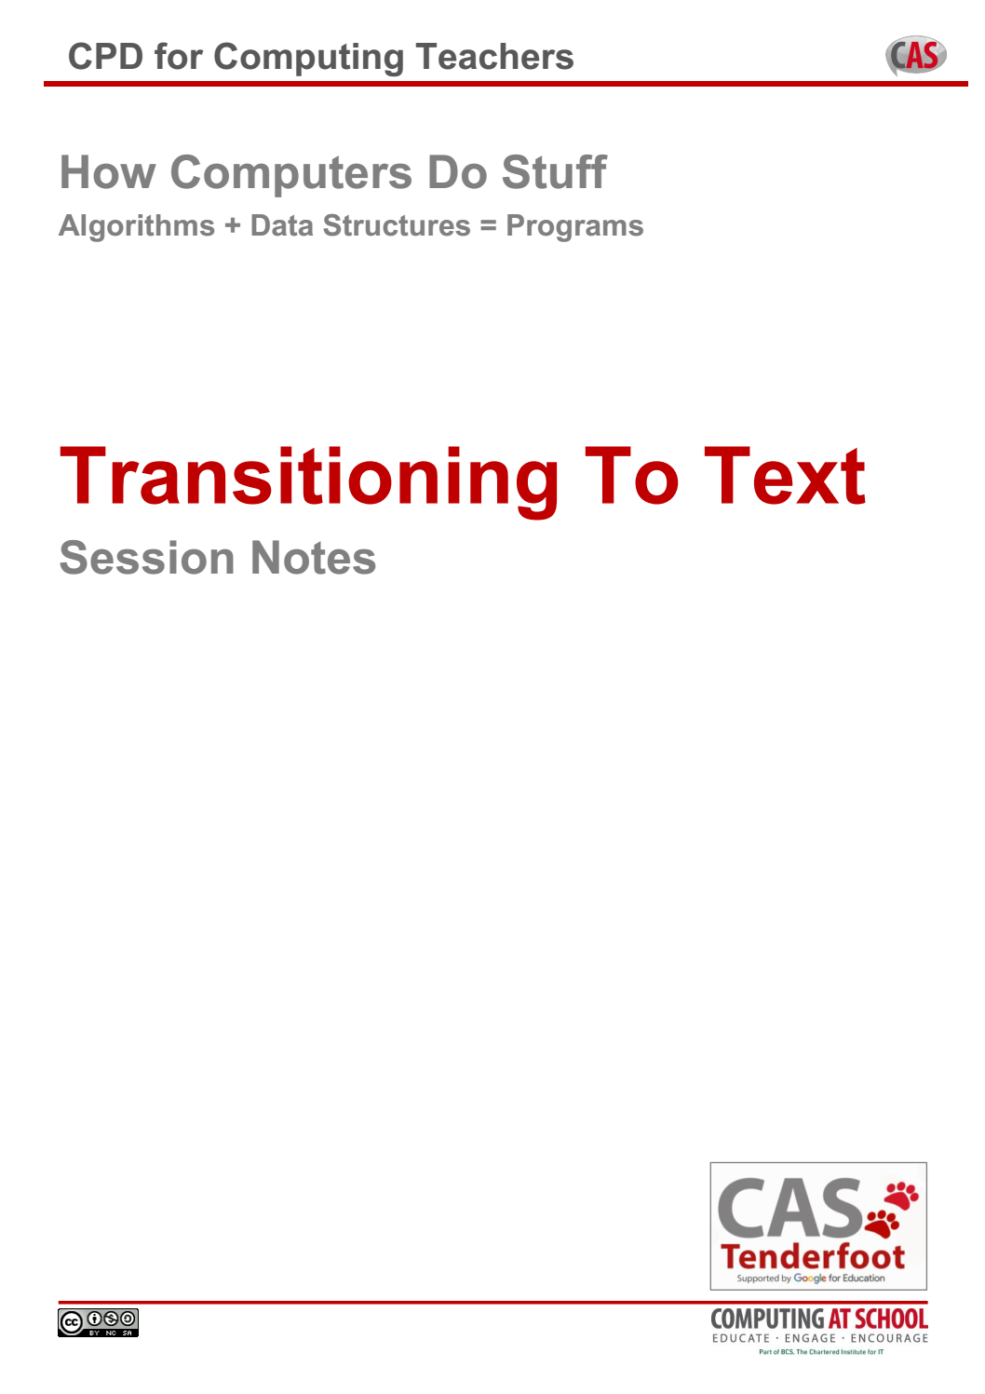
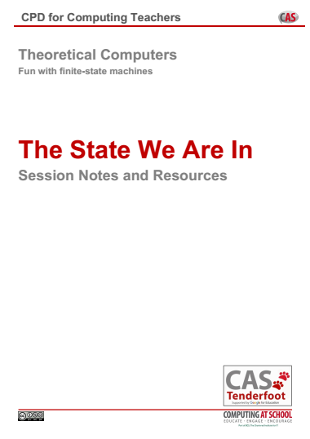
Each
Session

Slide 13


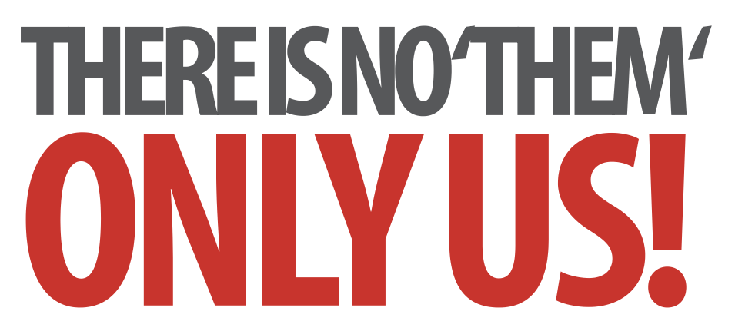
How Computers Do Stuff
Algorithms + Data Structures = Programs
Notes:
Introductory slides that establish a common format to the start of a Master Teacher session. Please do stress the ethos at the start: there is no them – only us! If our subject is to develop all practising teachers have valuable contributions to make, regardless of prior experience. The CAS model recognises that good pedagogy is a process of discussion and development, facilitated through our Community of Practice.

Slide 14
How Computers Do Stuff
Algorithms + Data Structures = Programs
Insert any specific notes
Start / End time
Toilets
Fire Drill / Exits
Notes:
Reminder to go through formalities at start. Placeholders for specific details

Slide 15
How Computers Do Stuff
Learning Outcomes
By the end of the session we hope you will:
Be aware of tools to assist the transition to text based coding
Recognise the key concepts and constructs for tackling programming challenges
Have practical experience of manipulating linear data structures (arrays)
Appreciate how a graphical user interface is created
Have explored a range of activities for introducing programming concepts at KS3 upwards
Notes:
It is important to be explicit about the intended outcomes of the day for attendees.
Do not assume they will be aware of the purpose or target audience of the materials.
By stating the intentions, it helps avoid getting sidetracked into discussing the detail of individual classroom activities.
The primary aim is to educate teachers and illustrate the breadth and depth of Computer Science. The specific outcomes for teachers from this unit, are
Be aware of tools to assist the transition to text based coding
Recognise the key concepts and constructs for tackling programming challenges
Appreciate different data types and have practical experience of manipulating linear data structures (arrays)
Developed a graphical interface for a simple program
Have explored a range of activities for introducing programming concepts at KS3 upwards
The purpose of Tenderfoot is to equip trainers with material and ideas to meet these outcomes and broaden the outlook of teachers new to Computing.
It hopes to provide a buffet of resources on which teachers can draw, to enrich their Key Stage 3 lessons, at the same time as meeting the key aim: providing greater depth of knowledge for teachers themselves.
Developing teachers is the focus, not providing activities for pupils.

Slide 16
The Big Picture
Transitioning To Text
‘Proper’ Programming
Algorithms and Data Structures
Going Gooey
Notes:
Here’s the outline of the day: This Unit is a natural follow on from the Tenderfoot Unit ‘Laying Firm Foundations’. That considered the bigger picture (why teach programming at all ?) and the fact that students come from primary schools with very different experiences and exposure to Computing. It ended by introducing some of the issues with text based programming, arguing that restricted ‘toy environments’ can help reduce the cognitive load involved.
In this Unit, our starting point is addressing issues raised by text based programming, before offering some practical challenges that get children using ‘real’ programming environments. The day starts by putting this in the context of the National Curriculum and, more broadly, the need to develop Computational Thinking.

Slide 17
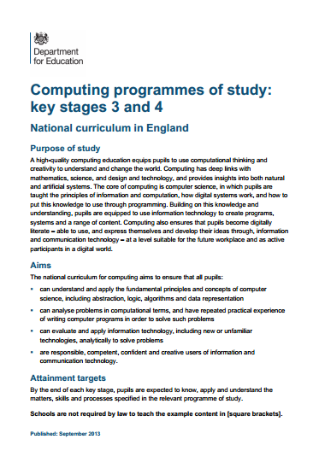
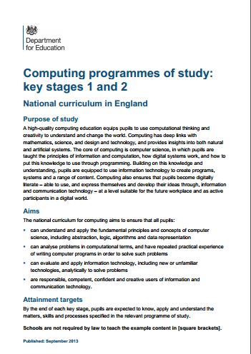
The Big Picture
Transitioning To Text
‘Proper’ Programming
Algorithms and Data Structures
Going Gooey
Notes:
So lets start by briefly reiterating the big picture. The starting point for most teachers new to Computing will, inevitably be the National Curriculum … and secondary teachers need to be aware that this will take time to embed. A key message from Part 1 was not to try to run before children could walk. Learning to program is a difficult – it requires a firm grasp of several concepts and involves a combination of many skills.

Slide 18
The Big Picture
Key Stage 3
Pupils should be taught to:
use two or more programming
languages, at least one of which is
textual, to solve a variety of
computational problems
make appropriate use of data
structures [e.g lists, tables or arrays]
design and develop modular programs that use
procedures or functions
Notes:
Whilst much of the NC is very slim on detail, when it comes to programming it is fairly explicit and provides a clear developmental structure. Part 1 of thus Unit focused on much of the prior foundational knowledge required, today looks at the specifics outlined as goals for KS3.
Here you find the first mention of text based programming languages, data structures and modular programs.
Theses requirements will shape the activities to come but before we do that we need to take a step back, appreciate the bigger picture.

Slide 19
The Big Picture
Key Stage 3
Pupils should be taught to:
use two or more programming
languages, at least one of which is
textual, to solve a variety of
computational problems
make appropriate use of data
structures [e.g lists, tables or arrays]
design and develop modular programs that use
procedures or functions
WHY?
Notes:
So before plunging into the detail, lets first distinguish the wood from the trees.
The bigger question is WHY? – why teach programming at all?

Slide 20
The Big Picture
Purpose Of Study
A high-quality computing education
equips pupils to use computational
thinking and creativity to
understand and change the world.
Notes:
Computational Thinking is made explicit in the Purpose of Study that introduces both the primary and secondary programmes of study …

Slide 21
The Big Picture
Purpose Of Study
A high-quality computing education
equips pupils to use computational
thinking and creativity to
understand and change the world.
The core of computing is computer
science, in which pupils are taught
the principles of information and
computation, how digital systems work, and how to put this knowledge to use through programming.
Notes:
It goes on to say how this can be applied through programming.

Slide 22
Computing is about
much more than
programming
Notes:
We can summarise by saying these 3 things.

Slide 23
Computing is about
much more than
programming
Computing is about a
way of thinking
Notes:
We can summarise by saying these 3 things.

Slide 24
Computing is about
much more than
programming
Computing is about a
way of thinking
Computational thinking is developed through computational doing
Notes:
We can summarise by saying these 3 things.

Slide 25
Teaching children to
program is about
applying key concepts
from Computational
Thinking
Computational thinking is developed through computational doing
Notes:
So teaching programming involves a conceptual approach. These concepts can be easily transferred from one programming language to another, but also to approaching problems on other, non programming contexts.

Slide 26
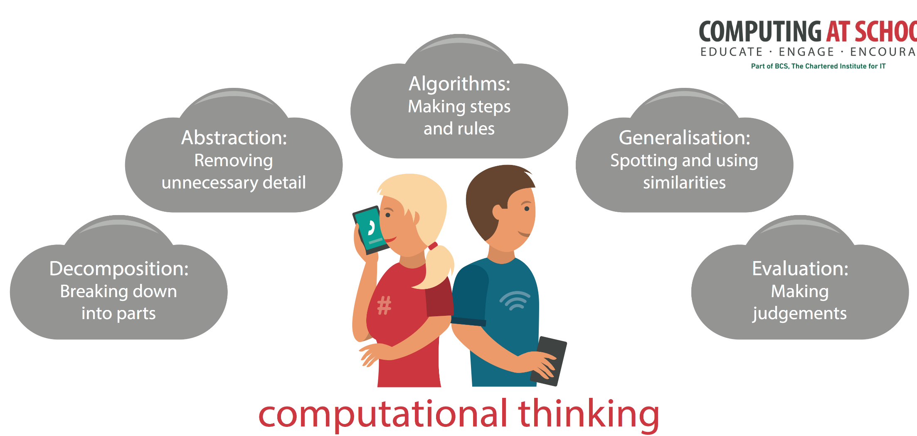
A special way of looking at the world
Notes:
A simple way to get this across is to suggest to children that thinking like a computer scientist is a special way of looking at the world. Very soon, they will be seeing algorithms everywhere. They will be breaking problems down, spotting patterns and recognising this weird thing called abstraction, again and again and again.
Many CAS members offer CPD in particular programming languages. Regardless of the language, the concepts should be the same. The language is secondary, the concepts are key – hence the name of this session.

Slide 27
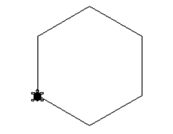
How Computers Do Stuff
Transitioning to text
The big picture
Transitioning to text
‘Proper’ programming
Algorithms and data structures
Going gooey
Notes:
As before, we’ll try to emphasise the big idea of computational thinking throughout, focus on one or two practical activities to illustrate the 3 constructs and 4 concepts we want to bring out from all the activities, but let’s start by reiterating the lessons we can learn from one of the ‘fathers’ of computational thinking.

Slide 28

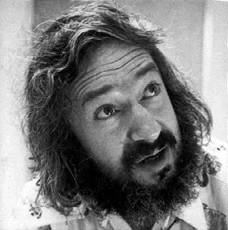
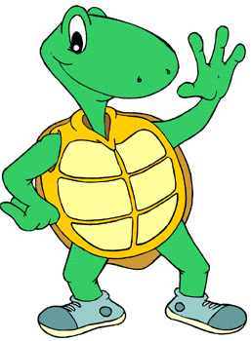
“building knowledge structures’ … happens where the learner is
consciously engaged
in constructing
an entity …”
Learning through ‘doing’
Notes:
We need to acknowledge the legacy of Seymour Papert, Logo, turtle graphics and his ideas about pedagogy. (click)
At it’s heart is the notion of constructionism: that children construct their mental models in the course of building things. By mentally predicting then observing outcomes their knowledge is refined. They learn through doing.
We’ll use an environment developed by Peter Millican (Oxford University) called Turtle System, designed specifically to support introductory programming through exploration of graphics.

Slide 29
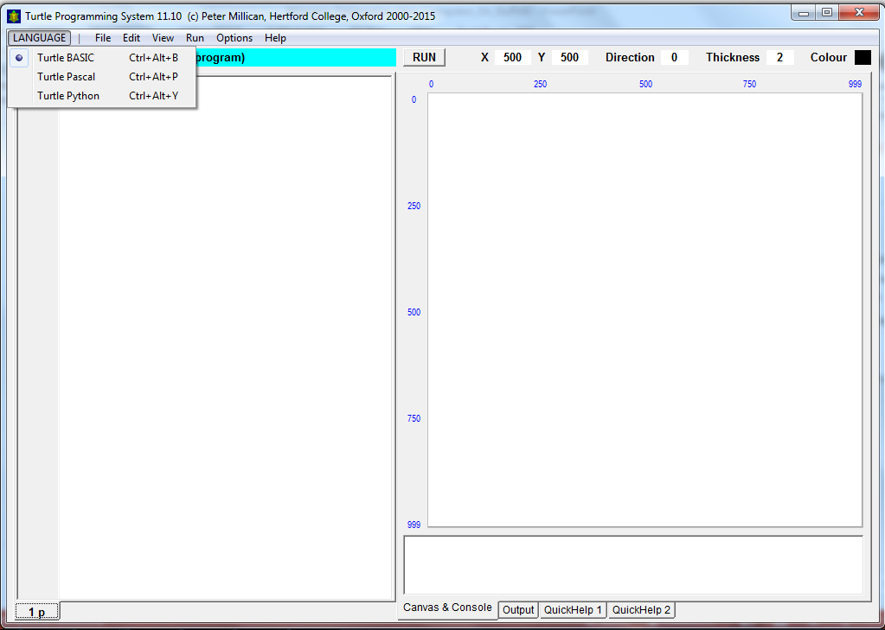
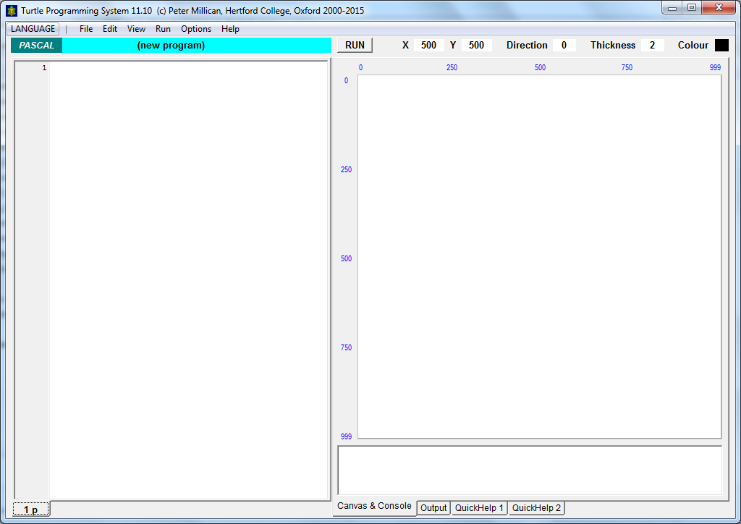
http://www.turtle.ox.ac.uk/
Notes:
That said, before allowing children to explore and create, there is much value in discussing programs as a class, to model ways that will help hone their investigatory powers.
Here is Turtle System. Free to download and no installation – it runs as a standalone executable (Windows only currently).
Have students load the system. (click)
The software (v11) is included in the resources, but check the link for later versions.
Notice it supports programs written in three ‘real’ programming languages. We’ll use Basic for our examples.
Programs are loaded (or written) in the left window, whilst the output is observed on the canvas on the right, when the run button is clicked.

Slide 30
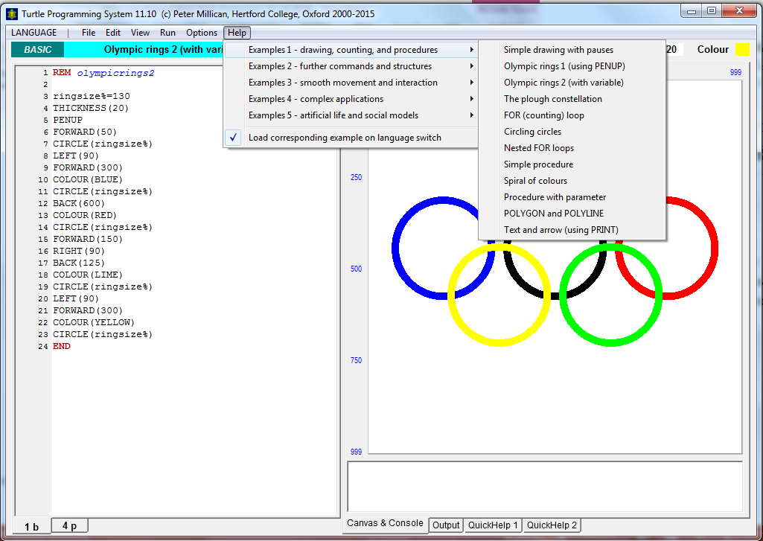
Notes:
The package comes with many example programs to study (click) and the option to compare the same program in all three languages.
We can use the examples as whole class exercises to get children to read the code, predict what will happen and demonstrate simple ways to investigate the behaviour.

Slide 31
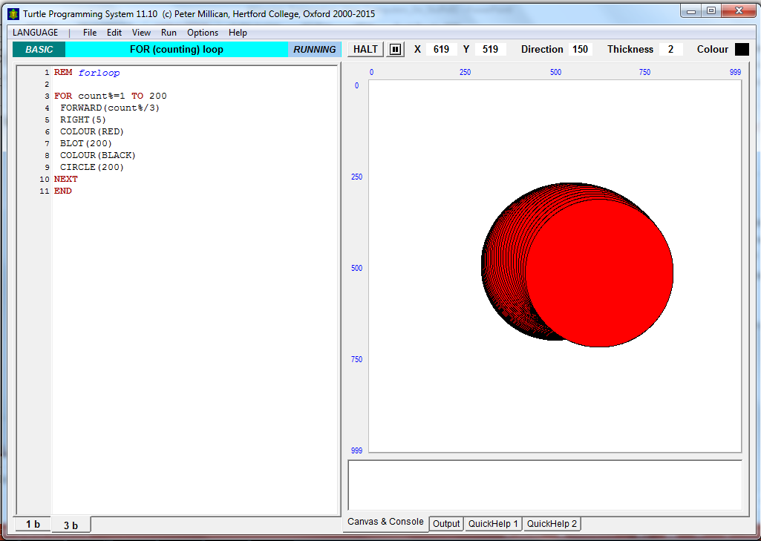
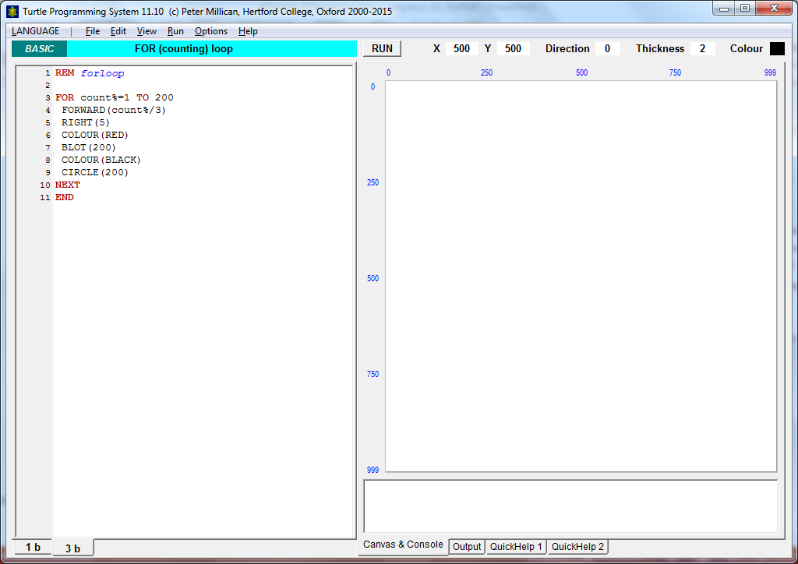
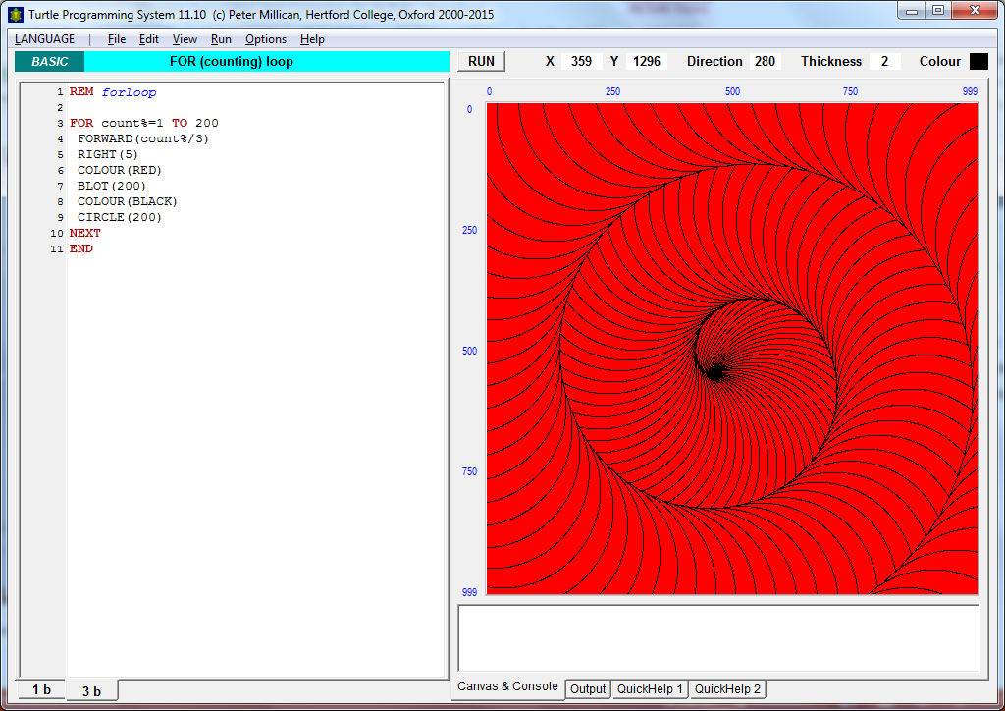
Notes:
Display this code to the class. What will happen when this program is run?
(click)
A red circle outlined in black is repeatedly drawn, (click) spiralling outward in ever increasing steps.
Here we can see the power involved in exploring code that develops patterns.

Slide 32
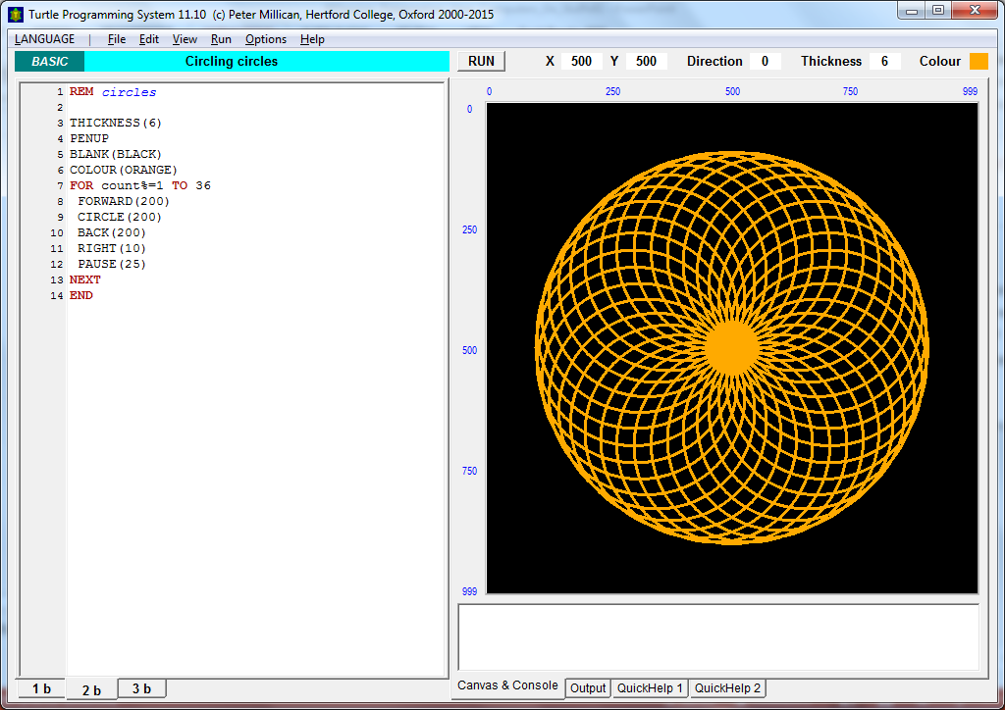
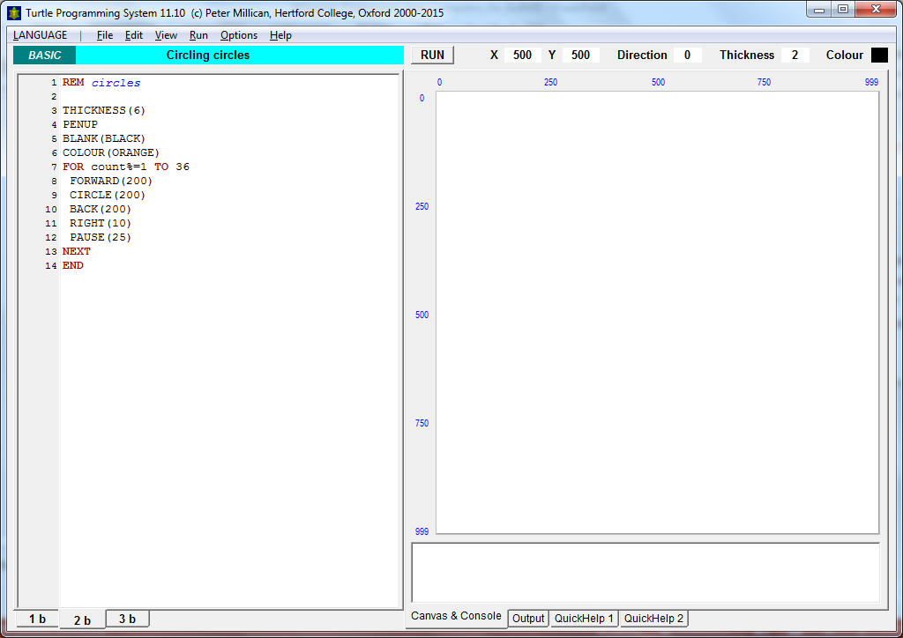
Notes:
What will this one create? (click)
The effect is even more pronounced if you observe the program running. You will see the shape building as the loop executes. Encourage students to predict, as a class, then run it and observe.

Slide 33


Thinking about thinking
Learning to learn
Notes:
It needs to be spelt out to students why you insist on a prediction, before observing the code running.
When you READ code, you are putting yourself in the position of the computer. You are trying to think about how the computer thinks. You are thinking about thinking.
(click)
When you OBSERVE the code running, unless you already have a mental model of what you expect, there is little gained form the experience. If you have a mental model – or prediction, then the observation confirms you were right, or contradicts it.
If your prediction is wrong, so you have to reach for an intellectual toolkit to reason about why it was wrong. You need to debug. You need to employ logical deduction. You need to observe and experiment. In employing these techniques you are honing your ability to systematically investigate. You are learning to learn.
Put this way, children will embrace the approach, as they appreciate it’s value in improving their capacity to learn. A wrong prediction is something to celebrate – real learning takes place when your mental model is challenged.
In more general terms; when your programs don’t work, that is no reason to become disheartened. It is something to celebrate – an opportunity to debug and to learn! (click)

Slide 34
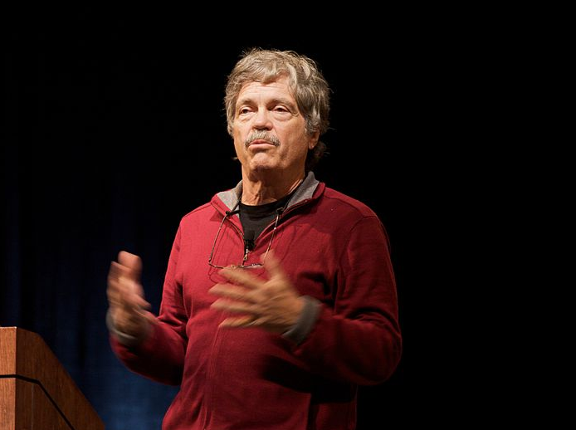
“If you don’t fail at least ninety percent of the time, you are not aiming high enough.”
Alan Kay
Notes:
Alan Kay, who was featured earlier, once famously said: ‘If you don’t aim for 90% failure, you aren’t aiming high enough.’

Slide 35
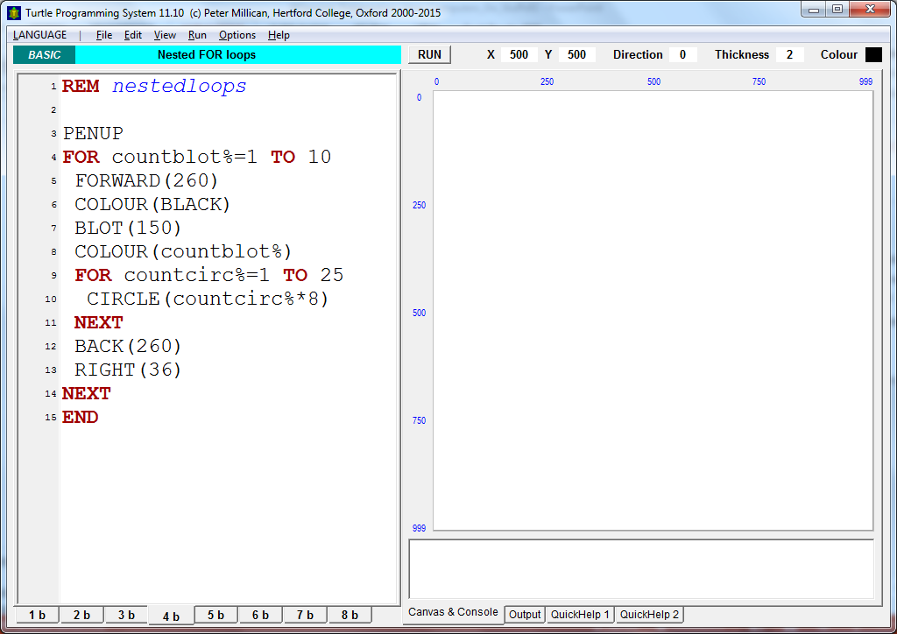
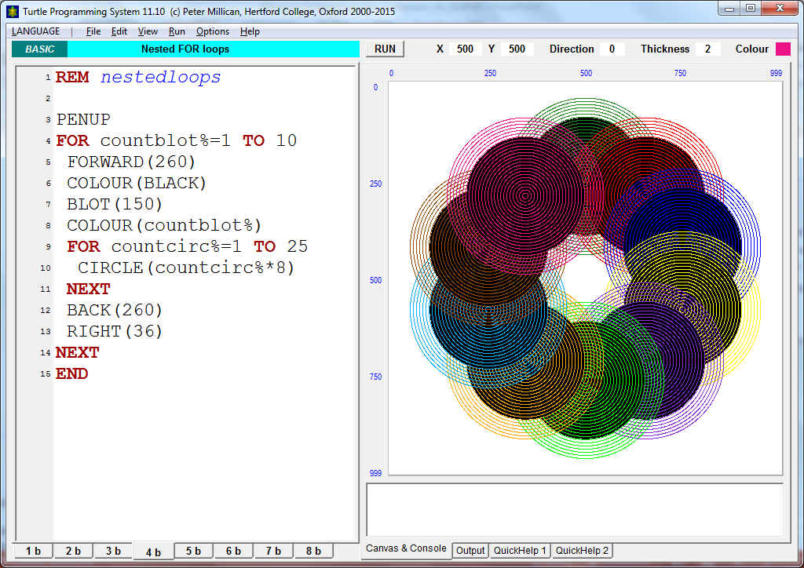
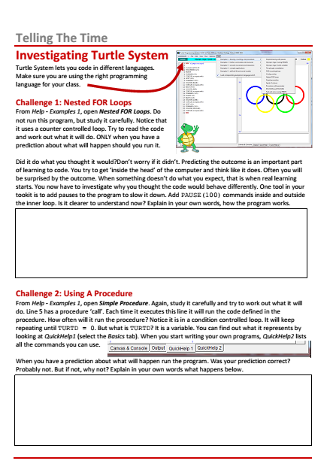
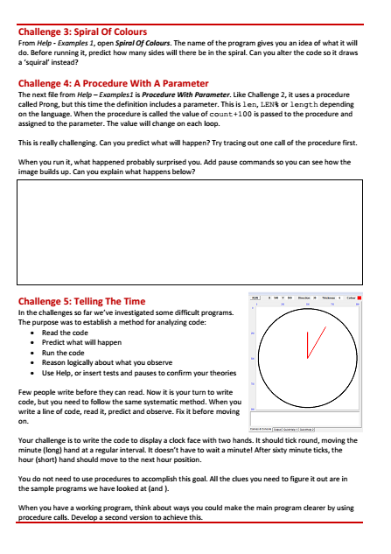
Notes:
The series of exercises that follow focus on developing students ability to read, predict and analyse code before embarking on a practical exercise of their own.
You can work through them as a class exercise or an activity sheet is included for pupils self study.

Slide 36


PAUSE(100)
Notes:
In Part 1, we highlighted the cognitive challenge of nesting constructs inside each other.
Here is an example of the use of two repetition constructs. With clear visual output we can begin to appreciate how nested constructs execute.
Adding a pause both within, and outside the inner loop, and observing what happens should make the stages of execution clear.

Slide 37
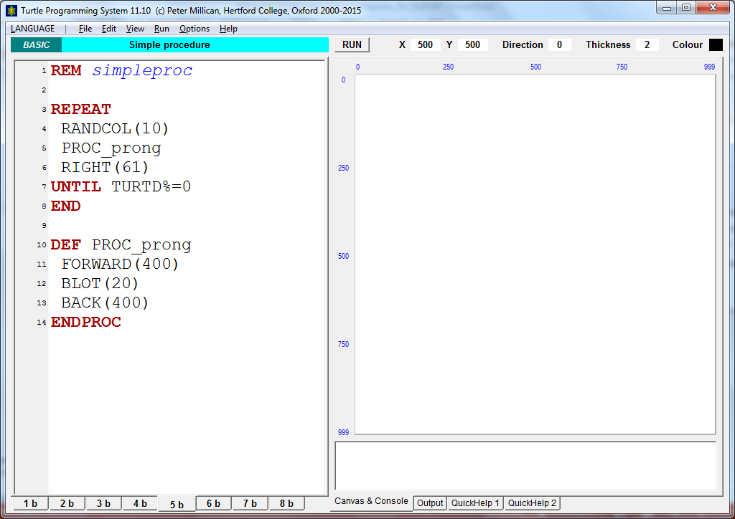


Notes:
From Help – Examples1, open Simple Procedure. This uses another repetition structure – a condition controlled loop.
We also highlighted in Part 1, the power of procedural abstraction. By defining procedures we can hide the detail involved within a procedure definition. This make complex code much easier to manage and understand.
Here is an example of a procedure definition in Basic. Notice in this case the definition comes at the end of the program. The procedure is called in the main program above (click)
Look at the code carefully. When does the loop end? (click)
When the variable TURTD% = 0. But where is the variable set, or changed? (click)
The tabs at the bottom give access to the help. Select QuickHelp1(click)

Slide 38
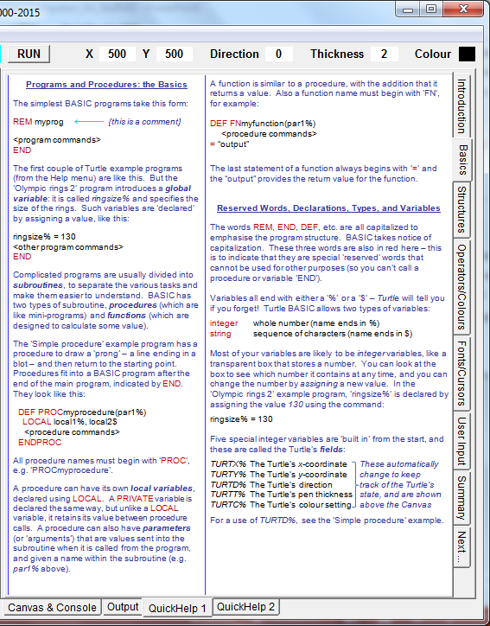
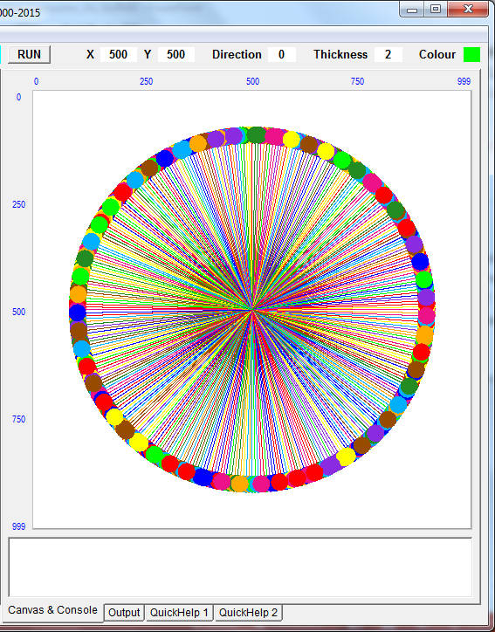
Notes:
Down the right hand side are various tabs. The Basic tab explains that the TURT.. variables are built in.
Having pointed this out, let the students predict what will happen BEFORE running the program and observing what actually happens.
Was their initial prediction correct? Probably not. But if not, why not?
(click)
One of the advantages of a purpose built beginners environment is that by having a small, restricted command set, help is much more accessible. Encourage students to begin to use Help to investigate, and then write programs. QuickHelp2 lists all the commands on the left.
Suggest students study the next example, Spiral of Colours, which is reminiscent of our earlier squiral. Ensure they predict what will happen before having their mental model confirmed or challenged when they run the program (click)

Slide 39
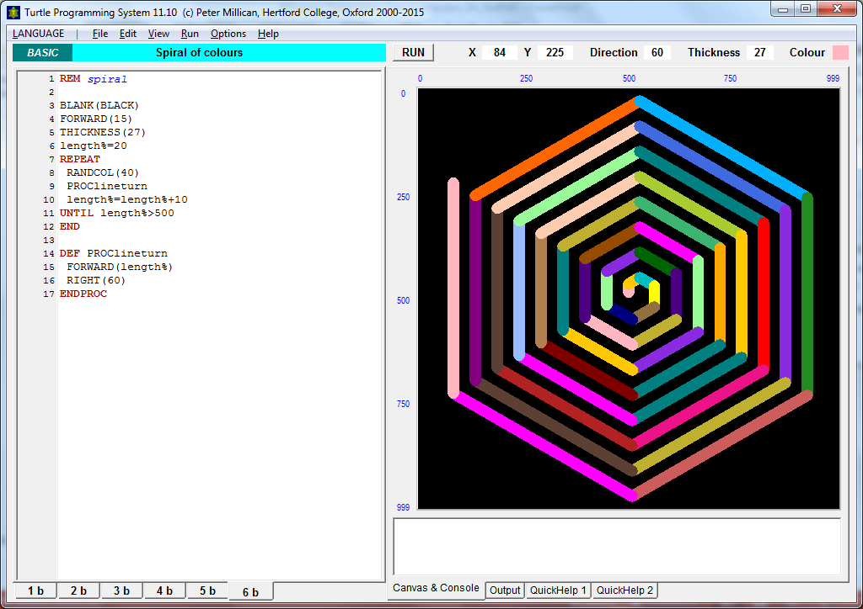
Notes:
Was their prediction right?
As a question and answer activity, ask the students to explain each line of code. If a student translation of a line is vague, ask others to sharpen it. If it is still not precise, model the correct the answer. Turn it into a collective challenge to hone the precision of the code reading.

Slide 40
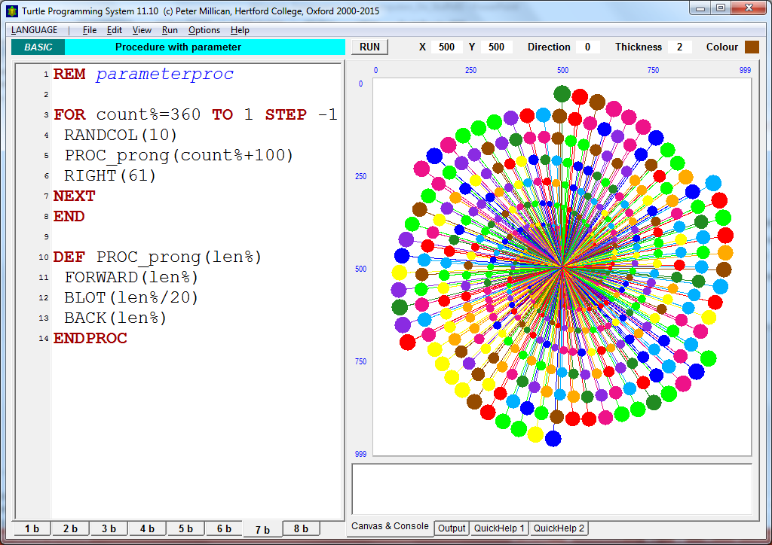
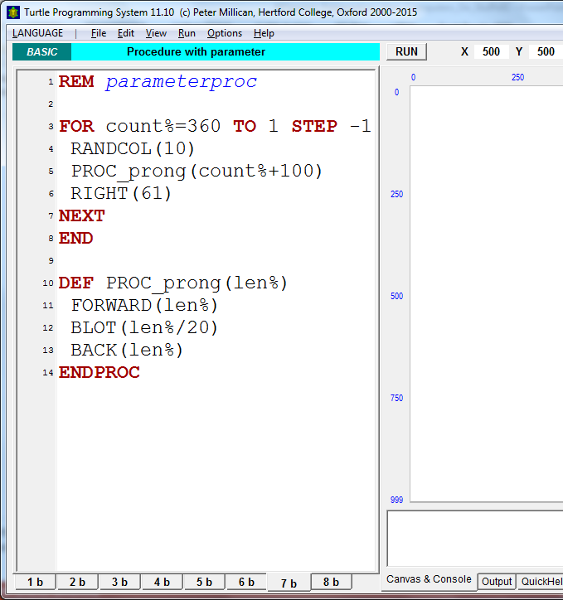

parameter
PAUSE(100)
Notes:
Lets consider our previous example of a procedure, with the same definition but this time involving a parameter (click).
(click)
When the procedure is called, what VALUE is passed to the parameter len%?
Answer: On the first iteration 360 + 100 + 460.
So explain what will happen on the first call of this procedure?
Answer: A line of a random colour will be drawn of 460 units.
A blot of radius 23 is placed and
The turtle moves back 460 steps.
What happens after that?
Answer: The turtle turns 61 degrees clockwise before the procedure is called again.
What value is passed to len% on the second iteration?
Answer: 359 + 100 = 459 …
… an so on until you are confident the group has grasped it.
Now get them to predict what will happen when the program is run.
Even though many will follow the way the procedure calls work, they will still be surprised at the result. (click)
So encourage a further discussion to try to explain what they have just observed. As a starting prompt, ask why there are 6 lines spiralling into the centre, rather than the one suggested in the code.
Answer: There isn’t. The reason lies in how far the turtle turns before being called again (61 degrees). If this isn’t understood you could get a protractor and draw it out, or add appropriate pause statements, so the execution is slowed down. (click) What this is, in effect, is a Catherine Wheel effect.

Slide 41
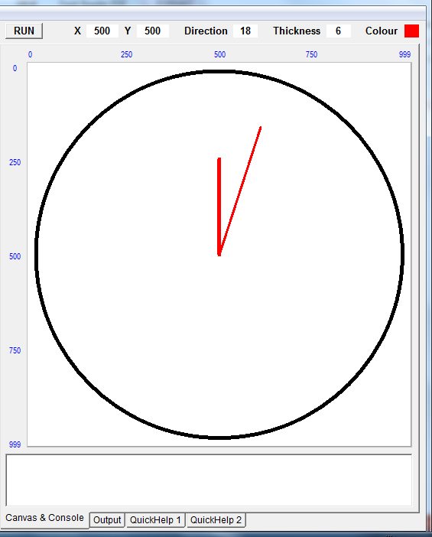
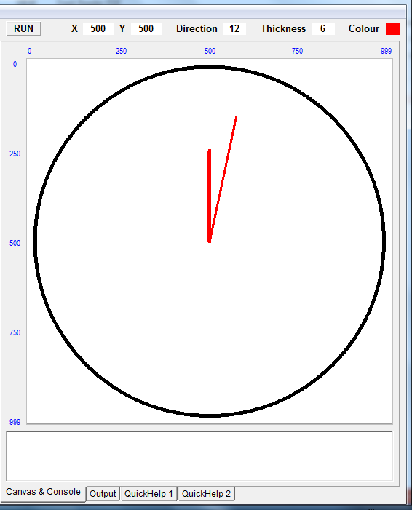
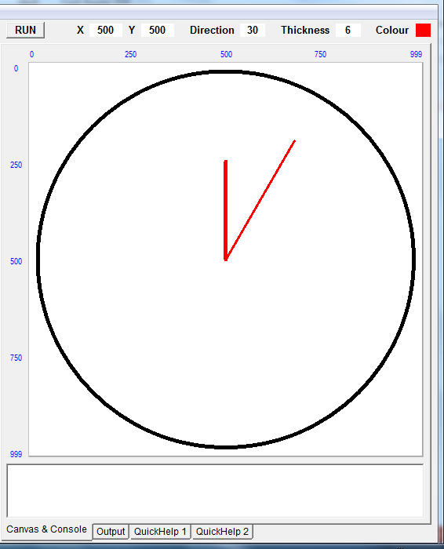
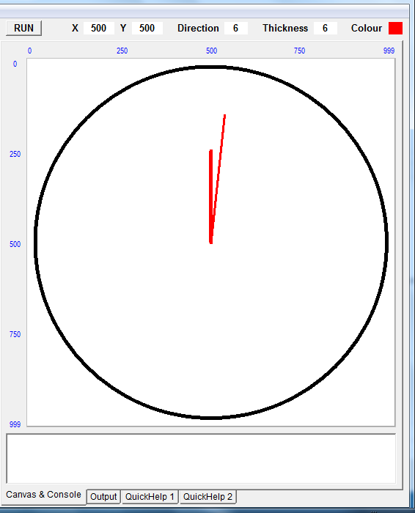
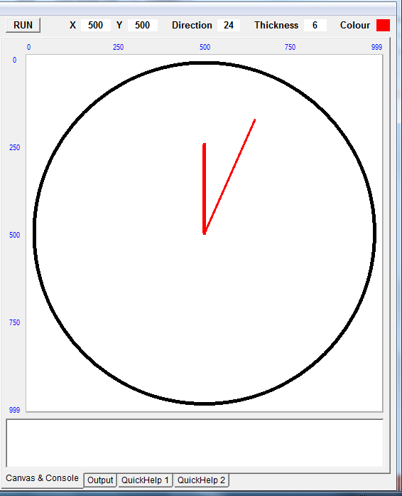
1
activity
Telling The Time
Notes:
We’ve looked at a variety of short programs. Students should have access to these from the Examples1 menu under the Help option. We’ll look in a minute at how you can configure Turtle System to make example programs available.
The example programs will give them all the commands they require to tackle the following task. Write a program to display an analogue clock, whose minute hand ticks round. (click to demonstrate).

Slide 42
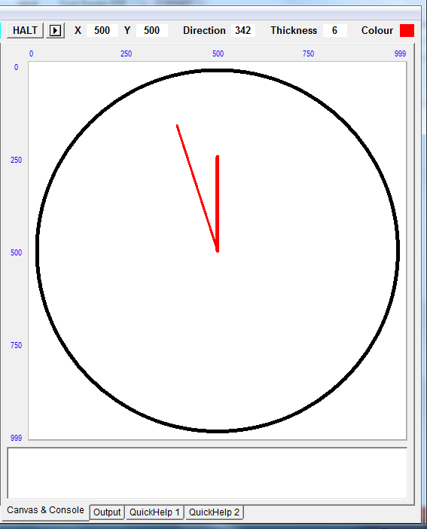




1
activity
Telling The Time
Notes:
It isn’t complex, and does not require the use of parameters. We’ve introduced them, so teachers new to programming are familiar with to them, but they are another cognitive burden for beginner programmers.
At the risk of too much repetition, getting to grips with programming requires repeated exposure to the same concepts in a variety of contexts.
So this challenge represents a students first attempt to write their own text based program.
The expectation is they will use Help to identify the commands they need and generally work in a more independent fashion.
But the key to a successful program will be to plan it first. (click) In other words decompose the problem.
It’s worth doing this as a group activity.

Slide 43




The syntax
barrier
Notes:
As their first attempt at writing a text based program, students will inevitably hit the syntax barrier.
One of the great strengths of Turtle System, is that error messages are very precisely targeted, telling showing what the problem is and showing exactly where to find the probem. Here it makes it clear which line and what procedure call is the problem.
(click)
In this example it makes clear Basic’s rules for naming variables and
(click)
Here there is no value attached to thickness and
(click)
The colour isn’t a recognised name. Notice in each case that the source of the error is underlined.

Slide 44

Teacher configuration
Notes:
Turtle System comes with many program examples. We’ve looked at a few and they are very useful teaching aids.
However, you may not want students to have access to them all.
For example, a solution to the Clock challenge is given in the second set of examples.
You may also want to add your own to the Examples for them to investigate.
Other features too, might be worth controlling, such as restricting which language you want students to view.
(click)
Teachers can do all of this via the Power Users Menu.
It is worth familiarising yourselves with this so you can configure a version of Turtle for the students, and have a separate version for teachers.

Slide 45



Teacher configuration
Notes:
Once the Power User Menu is available, the options under Help allow you to Save all the Help examples to the Turtle System folder. (click). Each language folder created, has all the example files in it (click).
This can then be modified, adding programs, or removing others.

Slide 46



Teacher configuration
Notes:
You don’t need to remove files even. The examples will list files, only whilst in alphabetic sequence.
Notice file D_theplough. By renaming it, (click) the alphabetic sequence only runs A to C.
(click)
Now by selecting the option for the Help menu to reflect the file structure … and answering OK to the confirmation
(click)
The restricted menu is now available.
This is a very useful feature that allows quick reconfiguration and reinstatement.
Note that if you wish to save your own programs into these folders to add to the menu, you must use the .tgx option in the Save As dialogue.

Slide 47



Teacher configuration
Notes:
You may wish to make other changes to the configuration, perhaps removing the Language Menu, so children can’t change the language accidentally, and disabling the Power Users Options.
(click)
When you are finished making your choices, save them to an options file (click).

Slide 48


Teacher configuration
Notes:
Now when students open Turtle System (click), they can apply the settings from the options file.

Slide 49
Learning to think like a Computer Scientist
A special way of looking at the world
Notes:
With any programming environment there are lots of important elements that need to be mastered to make best use of it. When teaching it is easy to get bogged down in these details.
Teachers and students need to keep ‘coming up for air’. Get into the habit of pausing, taking a few deep breaths and refocusing on the key concepts

Slide 50


Points to ponder
What lies behind the syntax barrier?
What facilities do ‘educational’ environments like Turtle System offer to help with the transition to text.
Can you suggest helpful tools in other languages?
Notes:
A brief pause to encourage a short discussion whilst props are tidied up and the presenter gets ready for the next session.
Use this slide to prompt a discussion about approaches to teaching programming.
Try to draw out recognition of the challenge the syntax barrier poses.
Restricted environments, such as simple html markup, and RoboMind (introduced in Part 1) help focus on specifics and lower cognitive load. Turtle System is much more powerful, but illustrates other advantages of a purpose built environment. One example is targeted error messages – can attendees identify others.
Are there any pitfalls?

Slide 51

How Computers Do Stuff
‘Proper’ Programming
Notes:
Now that students have had some experience of writing text based code we can begin to try to draw everything together.
As before, we’ll try to emphasise the 1 big idea, focusing on practical activities to illustrate the 3 constructs and 4 concepts we want to bring out from all the activities.
We’ll take the same approach of targeting the exercises to minimise cognitive load and we’ll use another specially designed ‘transition environment’.

Slide 52


Code Editor
IntelliSense Help
Integrated Development Environment (IDE)
Notes:
Small Basic gives pupils a feel of an industry standard IDE and has been designed to help transition to Visual Basic.NET. It has a code editor where children construct their programs (click), but one key reason for using it is the ‘IntelliSense’ which is a real help now that syntax becomes more complex.
We can also begin to introduce the language of objects, that is common in many programming languages.

Slide 53
The Title property of the TextWindow object is set to Welcome Program.
Learning to read before trying to write
Notes:
As before, work to ensure students can read code, before trying to write it is essential.
Comments start with an apostrophe, and are highlighted in green. (click)
Precision in describing each statement is important. Ask students to read the line highlighted before (click) modelling the answer.
(click)
If we execute that line

Slide 54

Learning to read before trying to write
Notes:
If we execute the code, a text window opens, with the title property set.
All examples are included in the resources: 01Welcome.sb

Slide 55
Objects, Properties and Methods The Basic Rules
Properties are ‘things’ that objects have.
We use ‘dot’ notation to refer to them
ObjectName.PropertyName = PropertyValue
and assign them values.
Notes:
New terminology needs to be outlined at the start, with a particular distinction drawn between properties and methods.

Slide 56
Objects, Properties and Methods The Basic Rules
ObjectName.PropertyName = PropertyValue
Think of a property as a built in variable belonging to an object.
Notes:
New terminology needs to be outlined at the start, with a particular distinction drawn between properties and methods.

Slide 57
Objects, Properties and Methods The Basic Rules
ObjectName.PropertyName = PropertyValue
Think of a property as a built in variable belonging to an object.
Methods are ‘things’ that objects can do.
We use ‘dot’ notation to invoke the method.
ObjectName.MethodName(MethodInputs)
Think of a method as a built in procedure belonging to an object.
Noun
Verb
Notes:
New terminology needs to be outlined at the start, with a particular distinction drawn between properties and methods.
Don’t underestimate the extra cognitive load for some students with this new terminology (click) and try to draw an association with concepts they are familiar with from previous work.
(click)
Compare and contrast properties and methods. (click)
(click)
Perhaps look for associations they can make with other concepts they are familiar with, such as Nouns and Verbs

Slide 58

objects
properties
methods
Notes:
Intellisense lists the objects (and key words) based on what you type and when selected
(click)
the properties and methods associated with the object are displayed and can be selected.
This is a huge help in minimising syntax errors.

Slide 59


Saving a Program: Keep in folders
Notes:
When you save a program, a Small Basic project file is created. This is your source code.
(click)
When you run your program, a further 3 files are created.
SmallBasicLibrary.dll is called a run-time library. It contains files that help your program run.
The Welcome file (marked Application if you list the details) is the compiled version which runs and
Welcome.pdb is a database file with information needed by your program.
Three files with the same name can be a source of initial confusion, so it is worth pointing this out. It can be introduced as a quick investigation for pupils.
The main point, with the potential to generate so many files if several programs are written, is to keep each one in a separate folder.

Slide 60










Basics in Small Basic
Notes:
Before we start, let’s use Small basic to introduce another key idea.
We know that programs are combinations of algorithms and data structures.
We know that algorithms are combinations of three constructs: sequence, selection and iteration.
And we know that a single entity of data can be stored in a variable.
But there are different types of data that can be stored and depending on the data type, different things to be done.
So to add to our list of classroom chants: There are 4 primitive data types. They are?
And the answer should come back (click)
Character, Boolean, Integer and Float
Notice the ‘char’ data type can be any letter, symbol or digit. This can cause problems for children in distinguishing between a number (made up of digits) and the use of a digit as a character. Actually, we usually think of combinations of characters as a particular data type (click) known as a string (of characters). Thinking of the use of digits in strings, phone numbers and vehicle registration plates are often good examples to distinguish from integers or floats. You do maths on real numbers.
We came across the notion of different variables types in Turtle System, but didn’t need to emphasise it. Older versions of Basic insisted on numeric variable names ending in %, whilst string variables ended in $.

Slide 61
02DataTypes.sb
Basics in Small Basic
What happens here?
NumberBananas = 32
NumberApples = 22
TextWindow.WriteLine("Pieces of fruit total " + NumberBananas + NumberApples)
Pieces of fruit total 3222
TextWindow.WriteLine("Pieces of fruit total " + (NumberBananas + NumberApples))
Notes:
We can make the point about different data types behaving differently by predicting what will happen here.
Once children have created their mental model, get them to open and run the code: 02DataTypes.sb
The result will probably surprise them. Small Basic does not insist on specifying data types, but will determine the Data Type by evaluating the value assigned to it. So both variables are integers.
But… in order to display anything on the screen, it has to be converted to a string of characters first.
So the + in the input to the WriteLine method has the effect of concatenating 3 strings.
By uncommenting the last line of the code (click) we can compare the effect of bracketing the two numbers together. Now the calculation of adding the two numbers together is executed before the conversion to a string of characters to be displayed.

Slide 62

03SimpleMaths.sb
Basics in Small Basic
Read the code and predict the outcome.
variable
function
parameters
Notes:
A simple program to demonstrate floor division and modulo. When reading the code, insist on precision in the explanation.
Use the sample line (click) as an example to model the language required.
“Two parameters, the starting number 28, and the divisor 5 ” (click)
“are passed to the built in maths function, remainder” (click)
“and the result is assigned to the variable LeftOver” (click)
Notice how, when trying to describe a complex statement, it is often best to read it from right to left.

Slide 63
04BlastOff.sb
Basics in Small Basic
What happens here?
For LoopCounter = 10 To 0 Step -1
TextWindow.WriteLine(LoopCounter)
EndFor
TextWindow.WriteLine("Blastoff!!")
Learning to read before trying to write
Notes:
Ask students to predict what will happen here. Once they recognise the pattern they nearly always fail to notice it will print a zero before BlastOff.
Possibly trace it on the board.
There are two types of loop, which is this an example of?
(click)
The example gives them the syntax for a counter controlled loop.

Slide 64
04BlastOff.sb
Basics in Small Basic
What happens here?
Counter = 10
While (counter >= 0)
TextWindow.WriteLine(Counter)
Counter = Counter - 1
EndWhile
TextWindow.WriteLine("Blastoff!!")
Learning to read before trying to write
Notes:
Here is the same code written using a condition controlled loop.
Having pointed out the printing of zero on the last example, will this print the zero or not?
Both examples are given in 04BlastOff.sb for students to study.
Out by one errors in loops are one of the most common programming mistakes.

Slide 65

2
Let’s play ‘Fizz Buzz’
activity
2
4
1
BUZZ
FIZZ
Notes:
The first practical coding exercise is a classic test of the ability to structure constructs correctly.
There is nothing new for children to grasp but, as always, the key to success is to (click) decompose the problem first. If children attempt to write the entire thing, they will probably get lost.
Initially the upper bound could be set in the program to say 50 and the students encouraged to use a For loop. They have the example syntax but should be encouraged to read the intellisense help. They will need to use it for the extension tasks.
The solution will require the use of math.remainder.
The key ‘gotcha’ revolves around numbers that are divisible by both 3 and 5, when the output should be ‘Fizz Buzz’
For those who master this quickly, an extension would be for the user to be prompted for input of the upper bound first.
A second obvious improvement would be to introduce some form of pause so you could see the early numbers, rather than have them scroll straight past when it runs.
The aim of these would be to encourage the students to explore the help to find the relevant commands. Solutions are given in the resources.

Slide 66




Learning To Program
Don’t run before you can walk
Notes:
There is a very succinct guide that comes with Small Basic.
It provides a good introduction to many of the capabilities and gives plenty of ideas for simple programs to reinforce the basic ideas.
At the risk of repetition, moving on too quickly is probably the biggest pitfall facing inexperienced teachers.
(click)
One chapter that would pay dividends would be to explore some of the shape investigations in the chapter on turtle graphics, which should be a familiar area by now.
The preceding chapter on manipulating shapes in the graphics window would also be good preparation for the final task.

Slide 67
Points to ponder
Simple exercises like Fizz Buzz practice assembling selection and repetition constructs.
They consciously avoid cognitive overload: there are no variables, no data structures, no procedures, no parameters.
Can you suggest other exercises that meet these criteria?
Notes:
Before the next activity, have a brief pause to encourage a short discussion whilst props are tidied up and the presenter gets ready for the next session.
Use this slide to prompt a discussion about approaches to teaching programming.
The focus is around recognition of the difficulties involved in learning to program. Like any complex task, it can be decomposed into smaller problems, with activities designed to emphasise particular facets. Can attendees suggest other activities that adopt a similar approach?

Slide 68


How Computers Do Stuff
Algorithms and Data Structures
Niklaus Wirth
Notes:
Algorithms + Data Structures = Programs is an old, but well known book written by Computer Scientist Nicklaus Wirth. Amongst many other achievements, Wirth developed the programming language Pascal.
The title summarises the challenge facing programmers. They need to develop algorithms which manipulate data. We’ve mentioned the 3 key constructs for building algorithms but so far we haven’t considered how data is held in a program, beyond using individual variables.
This final session considers the Data Structures in Nicklaus Wirths equation

Slide 69

Notes:
So far, our conceptual model for programming has highlighted the ‘Big 3’ constructs used to create algorithms, and the notion of a variable as a container to hold a data value.
We introduced the idea of primitive data types earlier, before pointing out that the commonly used string type variable is really made up of a combination of characters.
It is a compound data structure.
There are many different data structures that allow you to store combinations of values. Different languages have different ones built in.
We’re going to introduce a compound structure, which Small Basic calls an Array. To keep things simple we can think of this as a list of values.

Slide 70
Arrays in Small Basic
Student
Array Names
Score
Array Indexes
Student[1]
Student[2]
Student[3]
.
.
Student[200]
Score[1]
Score[2]
Score[3]
.
.
Score[500]
Notes:
Imagine we wanted to store a list of 200 student names, or a set of 500 scores. Rather than creating an individual variable for each student, or each score, we can use arrays. (click)
Each array has a name, and the individual items are referenced by their place in it (click) – known as the array index.
An array is a simple concept; a collection of related data which avoids the problem of managing many individual variable names. Nonetheless many children will have difficulty manipulating the data in them correctly.

Slide 71

A simple subroutine
Read the code line by line
What does it do?
Notes:
Here is an example of a subroutine called ManyIntegers. The subroutine is defined at the top (click)
and called in the main program (click).
The code is included in the resources. Students could run it to observe what it does, but it is better to read the code and predict its behaviour before running it.
So what does it do? It prompts the user to input the number of items required, then creates an array with integers incrementing from 1 to the number required.
It is a useful technique for filling an array with a series of integers.
(click)
The key point is to highlight the use of the LoopCounter to identify the index position in the array.

Slide 72

3
Investigating Shuffles
activity
Notes:
This activity is a substantial one that brings together many of the elements we have highlighted in the two parts to this Unit.
Following Seymour Papert, the best way for children to internalise the concept of an array is through practical activity. We’ll look at something all children are familiar with, challenging them to write a program to implement a shuffle.

Slide 73

A Shuffle Algorithm
Using an array as a data structure containing initially 9 (N) integers in ascending order.
Write an algorithm to shuffle the values into a random order.
Use the printed array to test your
Shuffle.
Notes:
There are many ways to shuffle cards, or other lists of items. This is a good group activity that gets them thinking about the stages involved in a shuffle. There are no right answers, but the challenge is to articulate their method as an algorithm.
Using just 9 values initially, we can use integers 1 through 9 to represent them in an array. There is a printed array that can be used with playing cards with values 1-9. This will help them articulate the steps involved – or dry run their algorithm (or that of their neighbours) to test it.
If they are stuck for ideas, see the next slide.

Slide 74

A Shuffle Algorithm: 3 ideas
Take any two values at random, and swap them. Repeat a thousand times.
The Knuth Shuffle is explained here
http://en.wikipedia.org/wiki/Fisher%E2%80%93Yates_shuffle
Riffle the ‘deck’. Split in two and interleave.
Notes:
Here are three possible shuffle algorithms. The first is the easiest to implement.
Implementing the Knuth, or Fisher Yates shuffle is more challenging. A series of slides are included for you to use or study.
There are some interesting properties associated with riffle shuffles, which we will explore in a later exercise. Implementing a riffle shuffle is a good exercise for more able children.

Slide 75
Coding A Shuffle
Before coding your shuffle, consider a swap.
Predict what this code will do:
A = 5
B = 3
A = B
B = A
textwindow.writeline(A)
textwindow.writeline(B)
Notes:
Before we attempt to code a shuffle subroutine, ensure children understand the problem of swapping variables.
When run the output will be 3 and 3. We need a third variable to avoid the second value being overwritten.

Slide 76
Coding A Shuffle
To swap values we must use a temporary variable:
A = 5
B = 3
Temp = A
A = B
B = Temp
Notes:
This is the easiest way for children to understand, but for the very able children you may wish to point out that there is a VERY clever way to swap 2 values without a third variable. It is fiendishly clever, uses addition and subtraction and is well worth them trying to find the solution. Do not reveal the answer!
Answer: A = A + B ; B = A – B ; A = A - B

Slide 77

Coding A Shuffle
Now we know how to swap items, we
can define that as a subroutine…
… and call it in our main shuffle.
Challenge:
Use an array containing 52 integers in order.
Produce a subroutine that shuffles
the values into a random order.
Notes:
By first defining a swap subroutine, we can keep the shuffle code clear of clutter and focus solely on the manipulation of the array. (click)
So the first challenge is to code a working shuffle. We can use an array of 52 integers initially, just to simulate the 52 different cards in a deck. (click)
We’ve mentioned the idea of spotting similarities before. Do we need to code this from scratch?
Students should recognise that they can use their ManyInteger subroutine in this new program.
An example for a simple shuffle is included SimpleShuffle.sb for reference.

Slide 78
Coding a Knuth Shuffle
Pick one item from the array at random.
Swap that item with the last item.
Randomly pick one item from the remaining list.
Swap it with the item on the bottom of the remaining list.
Repeatedly remove one item from the remaining list and swap it with the item on the bottom of the remaining list.
Notes:
These slides are included as a walk through of the Knuth shuffle.
Coding a Knuth shuffle is a good exercise for more able students and for staff learning about array manipulation.

Slide 79
Coding a Knuth Shuffle
1 2 3 4 5
Remaining List underlined
1 2 5 4 3
Remaining list underlined
1 4 5 2 3
Remaining list underlined
Select one at random
Swap with last position
Now pick another from the remaining list
and swap with the last position in the remaining list
… and so on until no items remain
Notes:
The key to understanding this shuffle is identifying the remaining list.
It is this that makes it an improvement on a random swap.

Slide 80
Coding a Knuth Shuffle
Variables needed:
TempValue: temporary variable used for swapping
LoopCounter: loop counter variable
ItemPicked: variable giving item picked in remaining list
Remaining: loop variable giving number of items in remaining list
NumberOfItems: variable giving number of initial items
Notes:
If this is to be used as an exercise, and the students are struggling, identifying the variables required can help.

Slide 81
Coding a Knuth Shuffle
Sub KnuthShuffle
'Work through remaining values
'Start at NumberOfItems
swap one value on each loop
'After each step, Remaining is decreased by 1
For Remaining = NumberOfItems to 2 Step -1
'Pick item at random
ItemPicked = Math.GetRandomNumber(Remaining)
'Swap picked item with bottom item
TempValue = NumberList[Remaining]
NumberList[Remaining] = NumberList[ItemPicked]
NumberList[ItemPicked] = TempValue
EndFor
EndSub
Notes:
The final code is included for reference.
Note the swap is included, rather than defined as a separate subroutine.
Note also the use of Step to control how you iterate over the array. This is important in our next challenge.

Slide 82
Learning To Program
Don’t run before you can walk
Notes:
Manipulating arrays isn’t easy. Children need repeated exposure to simple examples. Shuffling allows for solutions of varying complexity. It is easier than sorting. Sorting algorithms often rely on the use of nested constructs which are often a step too far for many children.

Slide 83

4
One Hundred Doors
activity
Notes:
In this activity we pose a classic problem and look at a way to solve it by designing a program that involves nested constructs. It is a difficult challenge, aimed at teachers, to illustrate the extra cognitive load involved, but may be appropriate for able students. An activity sheet is included.

Slide 84
Hundred Doors Puzzle
100 doors in a row are all initially closed.
We want to pass along the row, opening and closing doors.
How can we represent the state of the doors?
Doors
Doors[1] closed
Doors[2] closed
Doors[3] closed
.
.
Doors[100] closed
Notes:
A famous puzzle, reputedly used as an interview question at Google involves 100 doors. We want to keep track of which are open and which are closed.
The problem lends itself to an array, which we’ll call doors.
(click)
The state of each door can be set to closed initially

Slide 85


Hundred Doors Puzzle
Notes:
A counter controlled loop can be used to reference each index position, setting the value to closed (click).

Slide 86
Hundred Doors Puzzle
You make 100 passes by the doors.
On the first pass, visit every door.
If the door is closed, open it; if open, close it.
The second time you only visit every 2nd door.
The third time,
only every
3rd door …
… until the 100th
pass visits only
the 100th door.
Notes:
Here’s the problem. (click)
Every visit to a door involves toggling it ie changing it from open to closed, or vice versa.
On the second pass the doors 2, 4, 6, 8 etc are visited
On the third, it is doors 3, 6, 9, 12 etc.

Slide 87
Hundred Doors Puzzle
What is the state of the doors after the last pass. Which are open, which are closed?
Let’s decompose the problem.
Notes:
Discuss how we might approach this. We clearly need to decompose the problem.
The discussion should make it clear that this is a difficult challenge.
It is aimed at teachers, but may be appropriate for able students.
A good solution would involve a nested loop.

Slide 88

Hundred Doors Puzzle: WARNING!
This is a difficult challenge
involving nested constructs!
Can you write a program
to solve the puzzle?
Can you see a pattern in
the answer?
The next slide contains
a coded solution!
Notes:
An activity sheet could be used. The code is also included in the resources; DoorsSolution.sb
It will be discussed on the next slide.
If time is limited, the solution can be discussed as a group, rather than setting it as a practical activity.

Slide 89

Hundred Doors Puzzle: Solution
Notes:
If time is limited, here is a solution to discuss as a group.
It could be treated as a reading task, or could be dry run with a smaller number of cards (doors) with open / closed on alternate sides so people appreciate how it works.
There are 2 key elements for understanding the program.
Line 16 uses the incremented value of the start variable to control the step.
Lines 17 to 21 toggle the door value.
(click)
We’ve focused on decomposing the problem, but can we make it simpler to understand with abstraction?

Slide 90

Hundred Doors Puzzle: Subroutine
Notes:
Here we have defined a subroutine (Small Basic’s term for a named block of code) for toggling the value of a door.
Notice how, by abstracting away the detail from the main code, it makes that easier to understand. (click)
The subroutine is called at Line 26

Slide 91
Points to ponder
What facilities does Small Basic offer to help with the transition to text based programming.
How does it compare to Turtle System?
How many different languages should children be introduced to?
Notes:
Before the last, substantial activity, have a brief pause to encourage a short discussion whilst props are tidied up and the presenter gets ready for the next session.
Use this slide to prompt a discussion about approaches to teaching programming.
Like previous discussion points, the focus is recognition of the challenge the syntax barrier poses.
Attendees will now be familiar with some of the facilities in Small Basic and should be in a position to make comparisons, particularly in relation to Turtle System, or RoboMind from Part 1. There is scope for discussion about how many different languages children should be introduced to. What might be the problem of too many, or too few?

Slide 92

How Computers Do Stuff
Going Gooey
Notes:
The final coding challenge introduces a GUI (pronounced gooey), or graphical user interface.

Slide 93



http://social.technet.microsoft.com/wiki/contents/articles/16299.small-basic-curriculum.aspx
Notes:
Learning the particulars of any language carries a significant overhead.
As prompted in the Points to Ponder, there is scope for debate about whether a school should focus on 1 language or provide exposure to many.
The purpose of these training materials is to suggest possible environments to use, but inevitably, we can’t, and shouldn’t provide a crash course in any.
Once pupils gain some familiarity with Small Basic you can encourage them to investigate the Microsoft Small Basic curriculum. A series of 1 hour lessons introducing different features. These are very useful for introducing specific functionality, such as the graphics window.
To give a sense of how powerful Small Basic is, we’ll take our shuffle routine and produce a graphical user interface (GUI) for the program.

Slide 94

Let’s consider displaying your code in
a graphics window.
5
Card Shuffler!
activity
Notes:
Creating a graphical display is reasonably simple, but involves several details.
It is easiest to start with reference to an existing program.

Slide 95


A Graphical User Interface
Let’s consider displaying your code in
a graphics window.
Amending existing code
can be an effective
learning technique.
Notes:
Studying and amending code is another effective learning technique and allows us to focus on the structure of the code.
(click)
The code for this is provided Graphic_Shuffle_Investigation.sb. It will also require the card images included in the resources.
There is an activity sheet in the resources – the slides that follow introduce the challenges and talk through some solutions.

Slide 96

A Graphical User Interface
Graphics window
Notes:
Creating a graphics window is straightforward.
Note the use of a FilePath variable, which will allow you later in the program to create a string pointing to the subdirectory of the card images.

Slide 97

A Graphical User Interface
Image: \CardsSmall\53.png
Notes:
Line 43 demonstrates how the FilePath variable is concatenated with the filename of the card back image.
How are 52 of them displayed in a row.

Slide 98

A Graphical User Interface
What about these GUI elements?
Notes:
Can you find the code to display the other graphical elements?
It is in the Clear subroutine, so is redrawn each time that is called. (click)
Notice the buttons added at the end.

Slide 99



A Graphical User Interface
Control Objects
Notes:
The buttons are examples of control objects. These allow a GUI to be controlled via button clicks and other common features.
But ours don’t work. Why not? (click)
The relevant code on Line 27 is commented out. (click) When it is activated, a button click will ‘raise an event’ causing the Click subroutine to be called.
What does this do?

Slide 100

A Graphical User Interface
Challenge1:
Refactor the code, so it displays the original Deck in order, before a Shuffle.
Notes:
Once the buttons are activated we are able to display the cards in shuffled order.
But why can’t we display them in the original order when the deck is created?
Each image has a number as a filename. If you look at these images, when an array of integers from 1 to 52 is created, the cards mapped to these numbers would display as (click) when first created.
This is a simple task, that involves recognising that Shuffle is called in the main program, not just on a button click. Commenting this out, or removing it will solve the problem.

Slide 101
A Graphical User Interface
Challenge 2:
Tidying up the code
The shuffle subroutine is a mess!
Use your own shuffle algorithm
Remove the display code
Notes:
To encourage further study of the code, we can tidy up the shuffle subroutine.
Firstly, it uses a Knuth shuffle, which is unlikely to be the students shuffle implantation.
The first challenge is to put their own shuffle algorithm into the subroutine.
There is no swap subroutine here, so they will have to include that as well, if they used one.
Secondly, the shuffle subroutine includes the code to display the cards face down.
This has nothing to do with shuffling and should be factored out into it’s own subroutine.
This is a common mistake and needs emphasising. Subroutines should be developed for each separate task.

Slide 102
A Graphical User Interface
Challenge 3:
Can we sort the Deck back into order?
Encapsulate this in a subroutine CardSort
Add a fourth button Sort, which invokes this subroutine.
Notes:
Implementing any sorting algorithm is well beyond most KS3 pupils, but it is included as a good challenge for teachers or able students.
But there is also a simple way to produce the cards in order, and that is to recreate the array.
Calling ManyIntegers will achieve this aim and so this challenging task can be achieved more easily with some simple refactoring.
The real challenge is then to work out how to create and display a fourth button which calls CardSort when it is clicked.

Slide 103
Card Descriptions
Challenge 4:
We represent a deck of cards by the numbers 1 to 52.
Write the code to input a CardNumber
It will then print the description of the card e.g. “King of Hearts”
Encapsulate this in a subroutine CardName
Notes:
This final challenge is quite hard, and offered as an extension.
It does not need to be incorporated in the GUI, but that could be an extra extension for very able students.
The following slide provides a hint and teaching aid.

Slide 104
Card Descriptions
Think about
Math.Floor
Math.Remainder
Hearts Diamonds Clubs Spades
1 14 27 40
2 15 28 41
3 16 29 42
4 17 30 43
5 18 31 44
6 19 32 45
7 20 33 46
8 21 34 47
9 22 35 48
10 23 36 49
11 24 37 50
12 25 38 51
13 26 39 52
Card
2
3
4
5
6
7
8
9
10
J
Q
K
A
Notes:
Think about the numbers of the card image files.
They are listed in a table: 1 to 13 represent Hearts, 14-26 Diamonds and so on.
(click)
The cards named 1, 14, 27 and 40 are all two’s of a particular suit.
Can you think of a way of extracting the suit and value from the filename?

Slide 105



Arrays and Graphics
Notes:
The Small Basic Introductory Guide is very good.
Chapter 10 focuses on arrays.
The later examples introduce a two dimensional array to represent a grid in a graphics window.
Finally, it uses a counter controlled loop to introduce some very effective animation.
As a homework for teachers it is well worth working through and could provide the basis for several coding challenges.
How about creating a chess board, for example?

Slide 106
6
Perfect Riffles
activity
Notes:
This is a final optional activity designed to reveal a surprising insight.

Slide 107


Investigating A Perfect Riffle Shuffle
Split a set of 8 ordered cards into 2 halves
Class Activity
Graphics from NCETM
Notes:
Riffle shuffles interleave the top and bottom halves of a deck.
This activity is also used in the introduction to Tenderfoot Unit 2: Clever Stuff For Common Problems, so use here is optional, if time allows.
Hand out the investigation template and cards.
Explain the basic premise of a riffle shuffle, interleaving the bottom and top halves of a deck.

Slide 108

Investigating A Perfect Riffle Shuffle
Interleaved with the top and bottom card remaining in place
Out-shuffle
Graphics from NCETM
Notes:
An explanation of an out-shuffle, leaving the top and bottom cards in place. Click to reveal.

Slide 109

Investigating A Perfect Riffle Shuffle
Using 8 cards, starting in order, perform 3 out-shuffles.
What do you notice?
After 1st out-shuffle
After 2nd out-shuffle
After 3rd out-shuffle
Graphics from NCETM
Notes:
Once children have done it, click to reveal the result of each subsequent shuffle

Slide 110

Investigating A Perfect Riffle Shuffle
Interleaved with the top and bottom card moved in
In-shuffle
Graphics from NCETM
Notes:
Explanation of an in-shuffle, moving the top and bottom cards ‘in’. Click to reveal.

Slide 111

Investigating A Perfect Riffle Shuffle
Will they ever return to the starting position?
Using 8 cards, now start performing consecutive in-shuffles.
What do you notice?
After 1st in-shuffle
After 2nd in-shuffle
After 3rd in-shuffle
Graphics from NCETM
Notes:
Now try it with in-shuffles. Click to reveal the result of each subsequent shuffle. The order hasn’t returned after 3 shuffles, so encourage them to keep investigating. They should find it takes another 3 in-shuffles.

Slide 112
Investigating A Full Deck
Can you code both ‘in’ and ‘out’ riffle shuffle sub routines?
Refactor your GUI code to accommodate them.
How many consecutive ‘in’ or ‘out’ shuffles are needed to return a full deck to it’s original order?
Notes:
A final challenge might be to develop each in and out-shuffle as a separate subroutine. The GUI Shuffle application could be refactored to accommodate them and a series of investigations embarked on. As well as returning to the original order, experiments could be undertaken to see if you could control the position of the top card. What sequence of moves would be required to move it down the pack to the 2nd, 3rd, 4th or any other position?
Such perfect shuffles lie at the heart of some magician routines for manipulating cards.

Slide 113
Points to ponder
Event driven programming, using a graphical interface, represents a different way to approach problems.
Objects are assembled, and code attached to events they support.
Does this make it easier or harder?
Notes:
Before the last, substantial activity, have a brief pause to encourage a short discussion whilst props are tidied up and the presenter gets ready for the next session.
Use this slide to prompt a discussion about approaches to teaching programming.
There is a long standing debate about the value of introducing children to event driven and object oriented programming. Traditionally, the ‘step up’ to object based approaches is seen as difficult. But many children’s environments use objects – think of Scratch, where code is attached to sprites. Perhaps we should be introducing and highlighting objects from the start? Why might some object to this?

Slide 114






Class based research
Why?
www.computingatschool.org.uk
Notes:
To round off the session, use the following slides to prompt a discussion about the value of classroom research both to support continuing professional development and to inform the wider teaching community.
Use the terms “teacher enquiry”, “action research”, “reflective practitioner” and “practitioner research”.
Teaching computer programming is a relatively new activity.
Many teachers are experiencing it for the first time.
Those with experience can offer valuable support, advice and information to other colleagues.
There are lots of opportunities for colleagues, old and new to contribute to an emerging pedagogy.
(click)
Inform them of the Teacher Enquiry in Computing Education project. It provides a forum and focus for research in the field of computing.
It can be accessed from the home page of the CAS website, under the link to projects: http://www.computingatschool.org.uk/

Slide 115
Class based research
What?
Find out
about pupils preconceptions of why they are learning computer programming
Notes:
Research an area in which you have ready access to the data but be aware of researcher bias and local ethical considerations.
Don’t try to prove something you believe – always think that you are “bringing a better understanding” of the situation – it helps avoid bias.
Emphasise the key words such as “find out”, “evaluate” and “compare” to spark ideas
Each of the following slides gives an example of a possible focus for research.

Slide 116
Class based research
What?
Evaluate
the use of a regular starter based on tracing (dry running) or reading code.
Notes:
Focus your research on something you are trying out. Start by creating a question. Develop sub-questions that bring more detail or further focus your research.

Slide 117
Class based research
What?
Compare
school data about the pupils with their performance in programming sessions.
Notes:
There is a lot of data in school; devise an analysis that will enhance your job and provide interesting perspectives.

Slide 118
Class based research
What?
Design, implement and evaluate
a module to support primary transition.
Notes:
Evaluating a unit of work you develop has obvious practical benefits.

Slide 119


Class based research
How?
Notes:
Briefly tell the audience of different methods. Choose one of the examples from the previous slide and discuss which methods might be used:
Questionnaire (including online) and Survey
Interview
Focus group (and online forum, wiki)
Scrutiny of documents including pupils’ work and blogs
Scrutiny of numerical data
Observation
Less common but very effective:
Analysis of professional conversations (in meetings, by email, through forum)
Analysis of pupil interactions/engagement in VLEs, forum, etc.
Discourse analysis
Content analysis
(click)
Remember – all research has ethical considerations
Remind them of the school’s requirement/permissions/information to pupils and parents – the idea of informed consent and freedom to withdraw their data from the research process.
If working on a University course then you will be governed by their ethics policy.
If completing the BCS Certificate then there is an explicit ethical requirement.

Slide 120


Class based research
Qualifications and Certifications
www.computingatschool.org.uk/certificate
Notes:
End with a reminder of the BCS Certificate in Computer Science Teaching – there are A5 hand-outs. One part of the evidence for the award is classroom research undertaken by the teacher.
(click)
The other two areas involve attending CPD – like today!
(click)
And completing a manageable programming project.
If that sounds a little daunting, remember you can opt for either an independent or guided route.
The latter means you’re supported by a mentor who can help guide you through.
It is a valued award, giving professional recognition accredited by the BCS, The Chartered Institute for IT.
More importantly, it’s designed to help you in the work you’re developing in school.
See the link for more information: http://www.computingatschool.org.uk/certificate

Slide 121
Summary
Computing is about
much more than
programming
Computing is
about a way of thinking
Computational thinking is developed through computational doing
Notes:
We can summarise by recapping the 3 points made at the start.

Slide 122
Summary
Computing is about
much more than
programming
Computing is
about a way of thinking
Computational thinking is developed through computational doing
Notes:
We can summarise by recapping the 3 points made at the start.

Slide 123
Summary
Computing is about
much more than
programming
Computing is
about a way of thinking
Computational thinking is developed through computational doing
Notes:
We can summarise by recapping the 3 points made at the start.

Slide 124


Computational
Thinking
A special way of looking at the world
Notes:
Finish by summarising the key point.
Computational thinking involves a number of key concepts that occur again and again. These inform the way we look at the world. Make sure you have the Tenderfoot posters displayed in your classroom, so you can continually make reference to the concepts when they arise.

Slide 125
Join CAS
Not a member?
Thanks
Notes:
Promote CAS at end.

