Slide 1



WELCOME

Slide 2

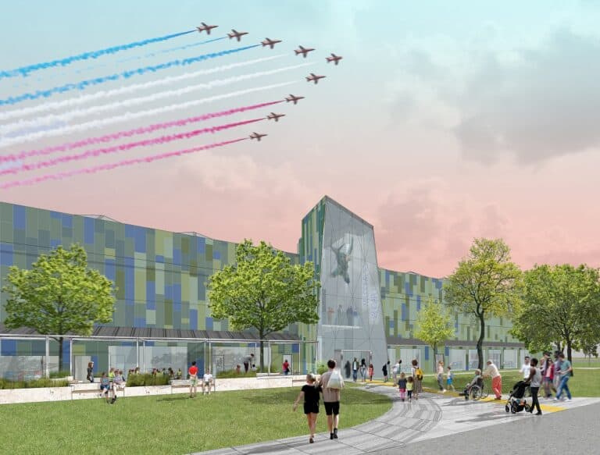
Museum Purpose
Our purpose is to share the story of the Royal Air Force, past, present and future – using the stories of its people and our collections in order to engage, inspire and encourage learning.
The Royal Air Force Museum is a National Museum, a Government non-departmental public body (NDPB) and a registered charity.
Our collection is central to everything we are and do and comprises around 1.3m objects which we hold in trust for the people of the UK.
We are an educational charity and whether visitors are engaging with our displays, taking part in discussion and debate, studying our archive, holding a corporate event in our spaces, having fun at events and in our playground, or enjoying a rest in our café, there are opportunities for learning and inspiration in every pore of our Museum.
Our vision is to inspire everyone with the RAF story - the people who shape it and its place in our lives.

Slide 3
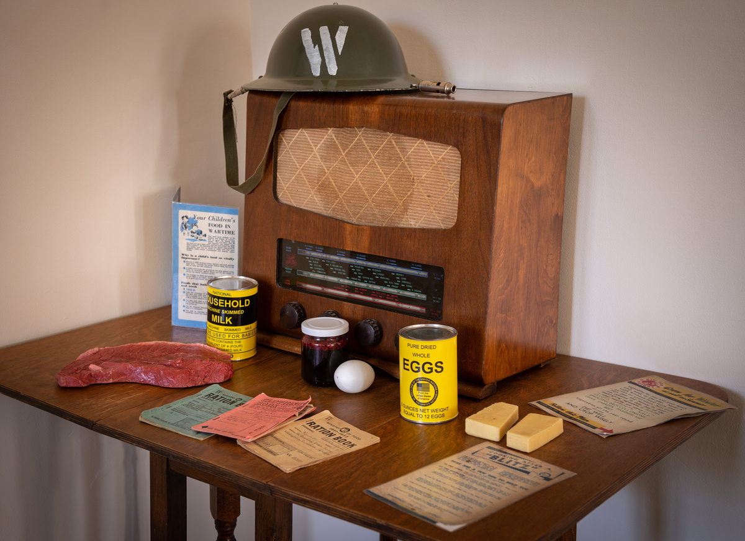
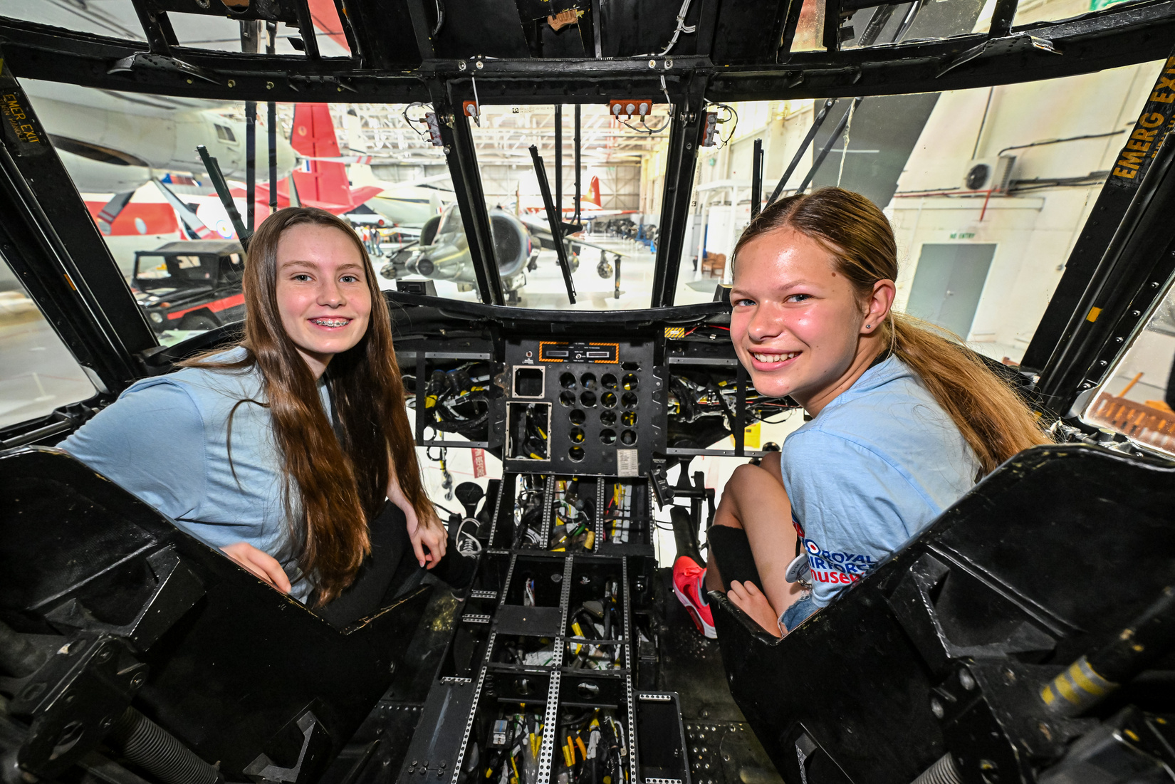
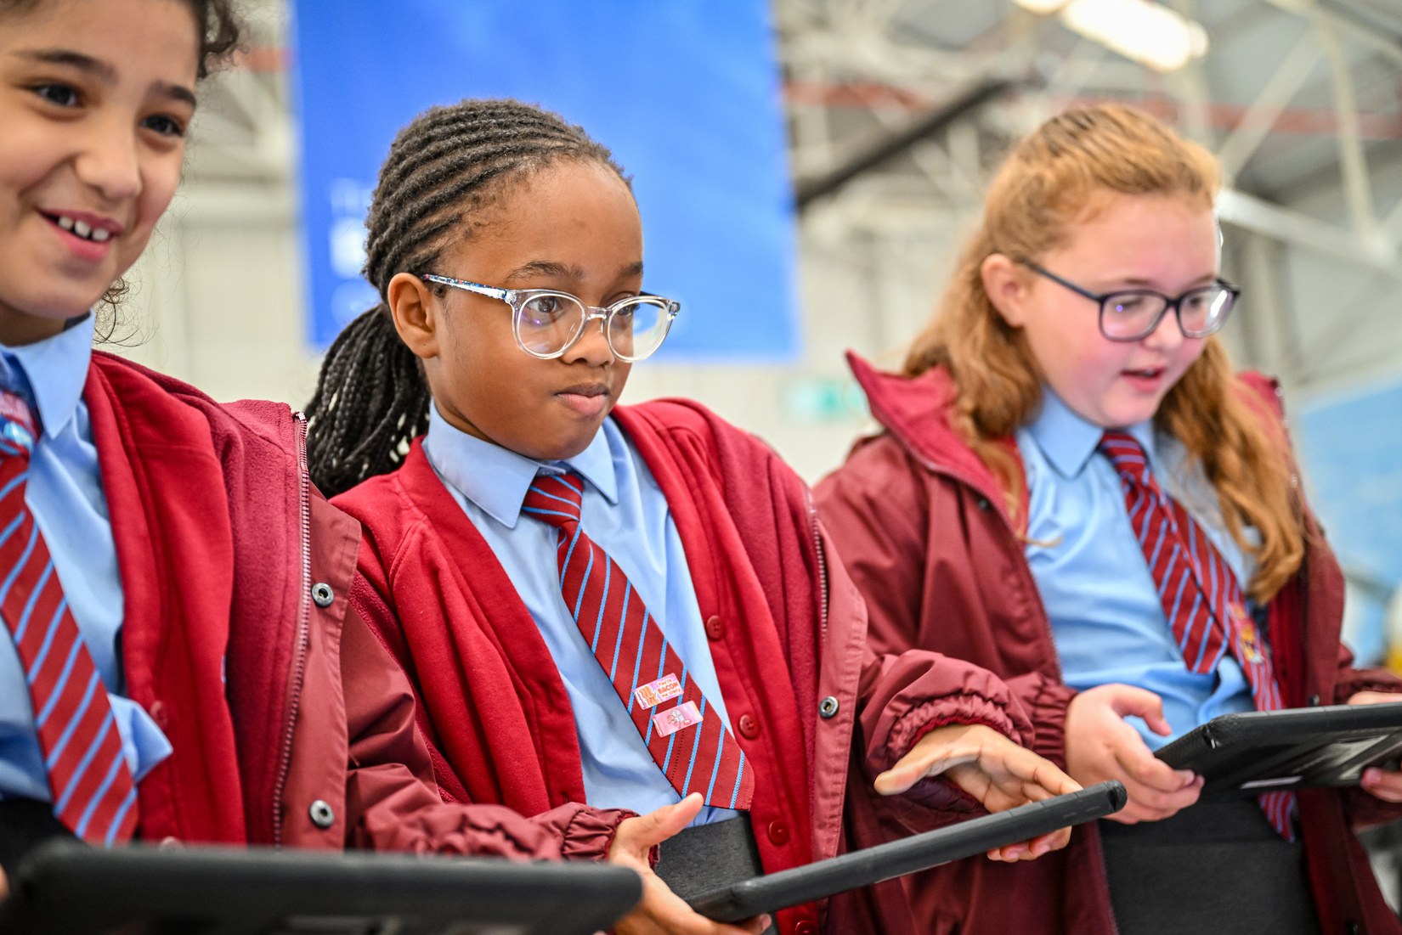
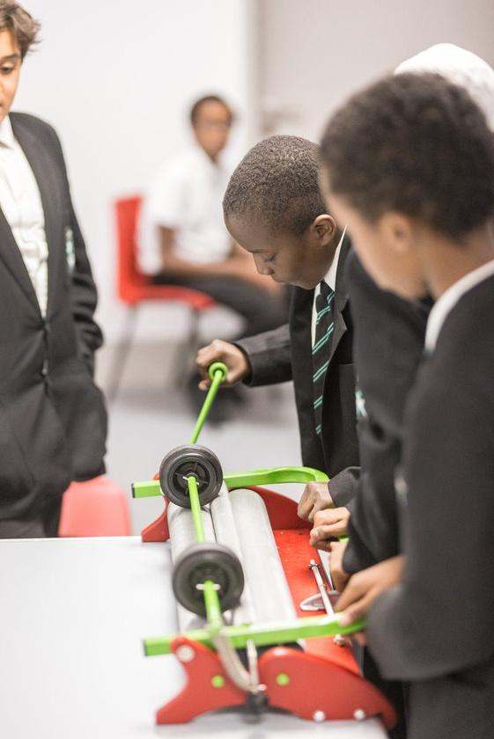
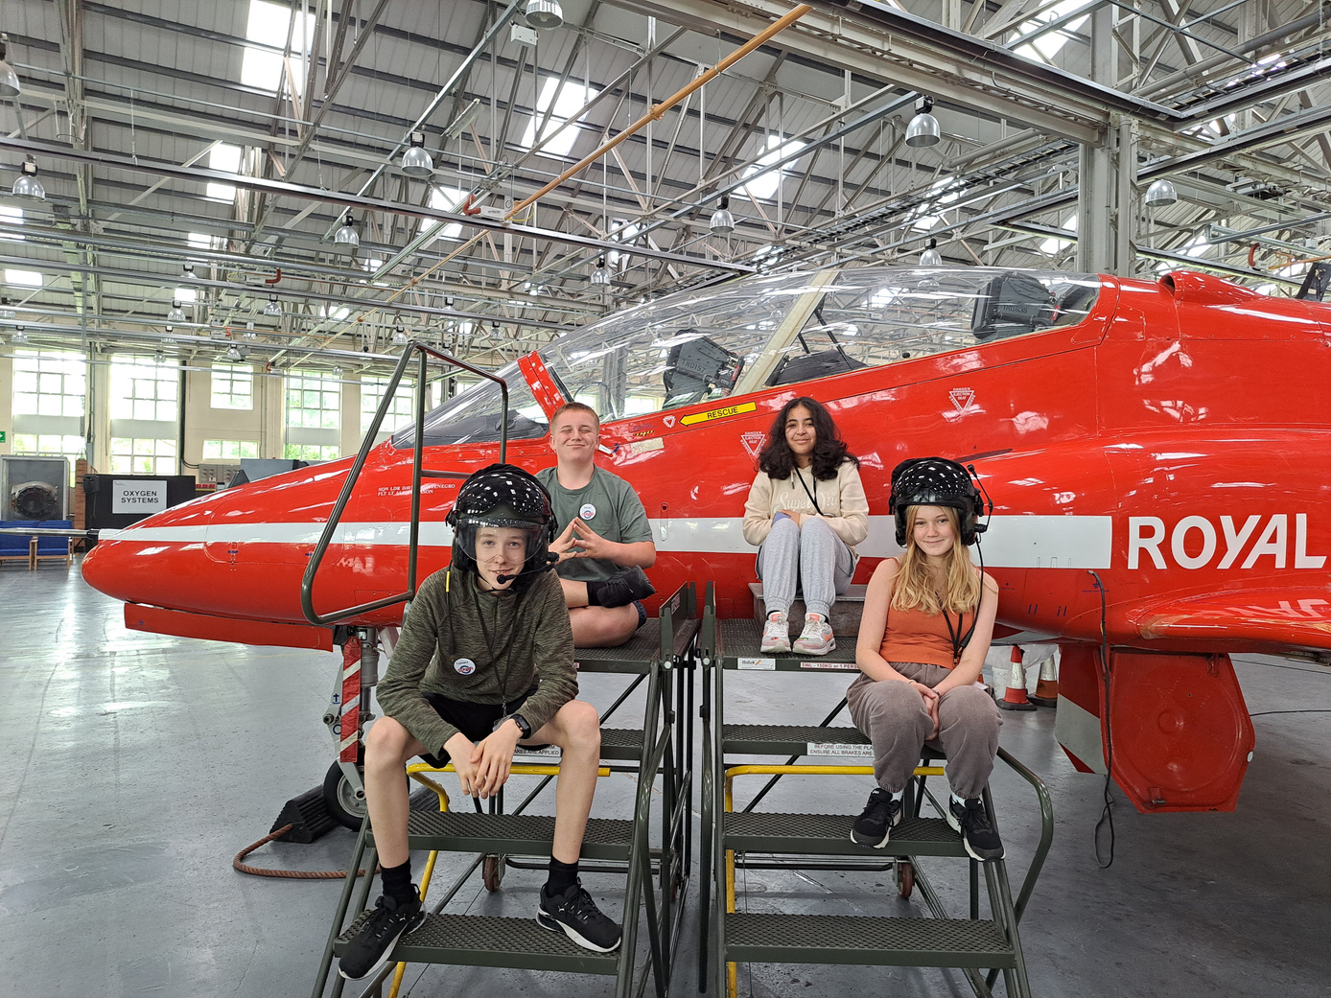
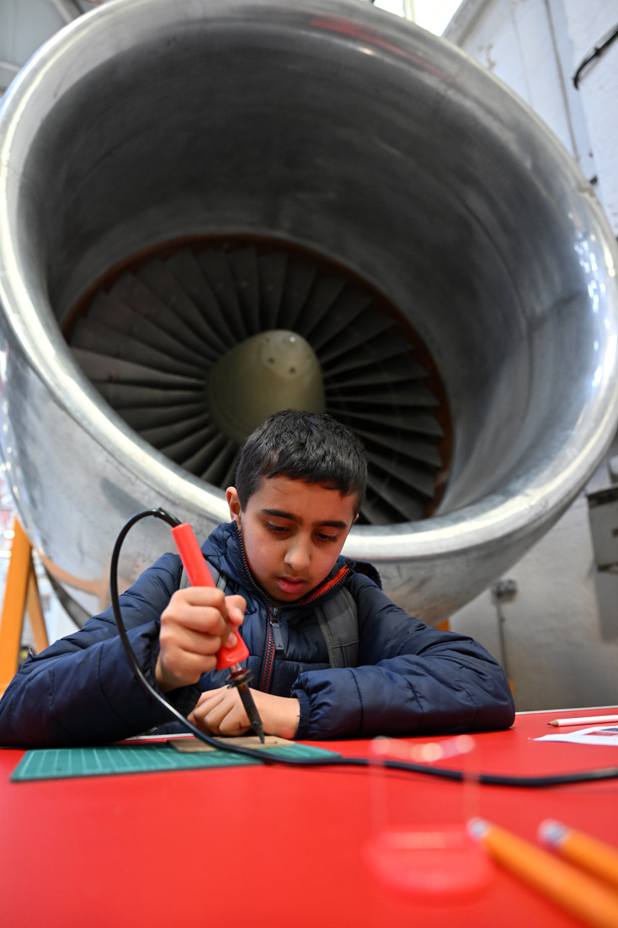
Learning and Engagement Team

Slide 4
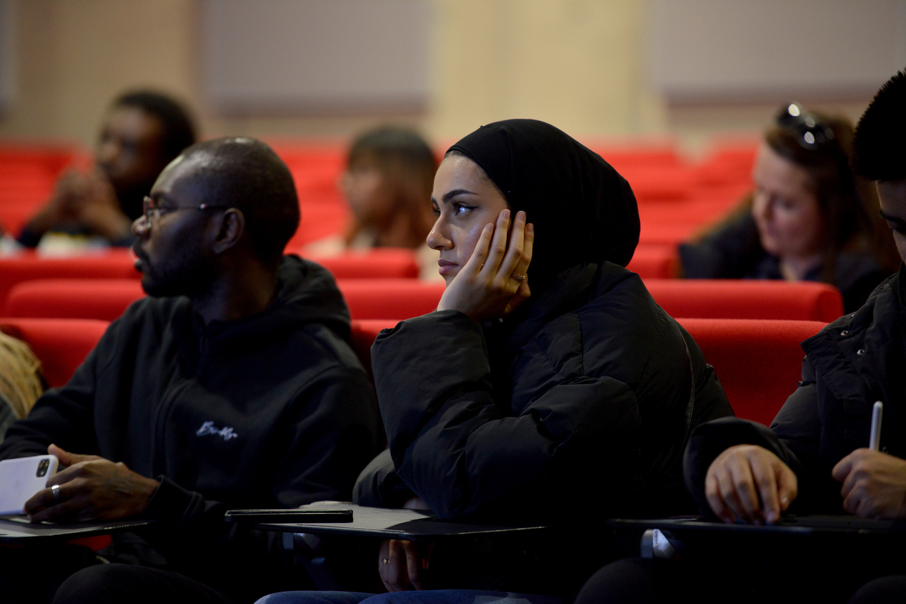
Work Experience
  The RAF Museum’s work experience programme is available at both public museum sites – in North London and the West Midlands.
  It is open to students in Year 10 and above.
  Our programme aims to break down barriers into museums and showcase the huge variety of careers and opportunities that are available within this sector.

Slide 5
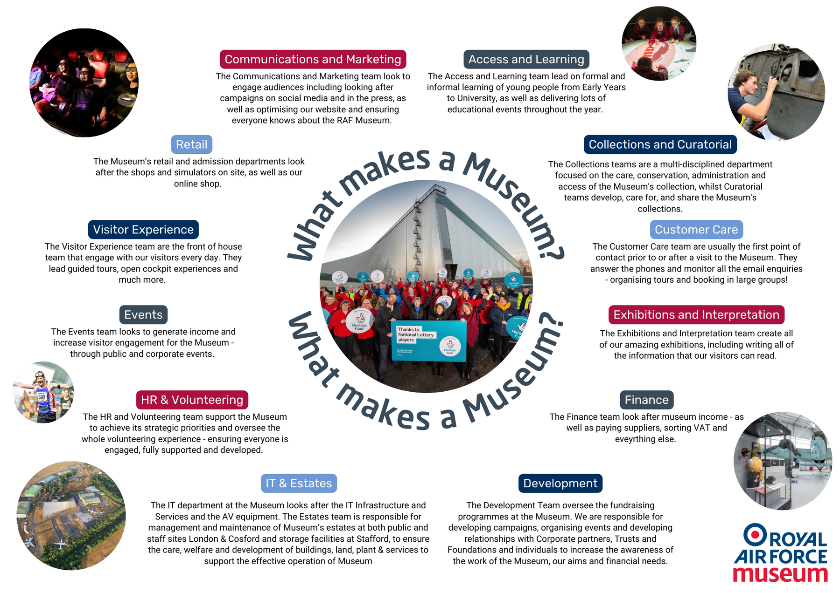

Slide 6
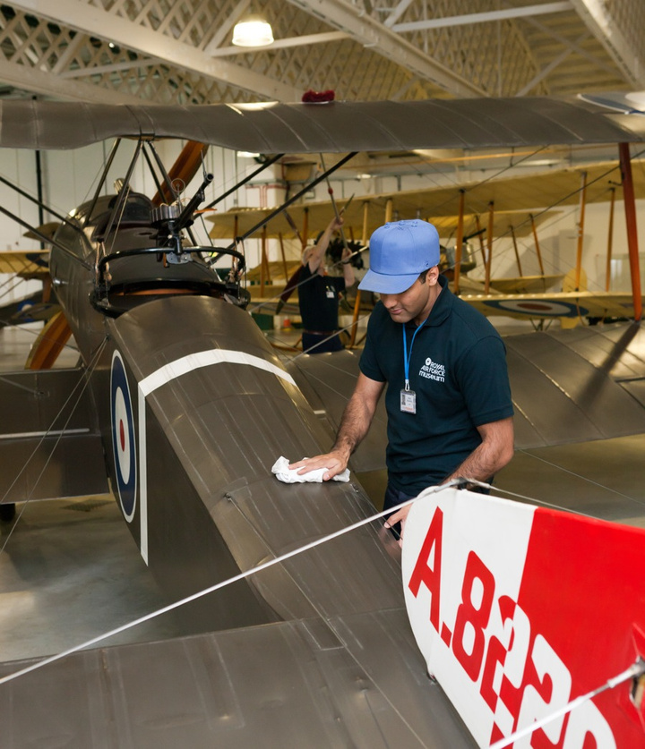

workexperience@rafmuseum.org

Slide 7





Slide 8

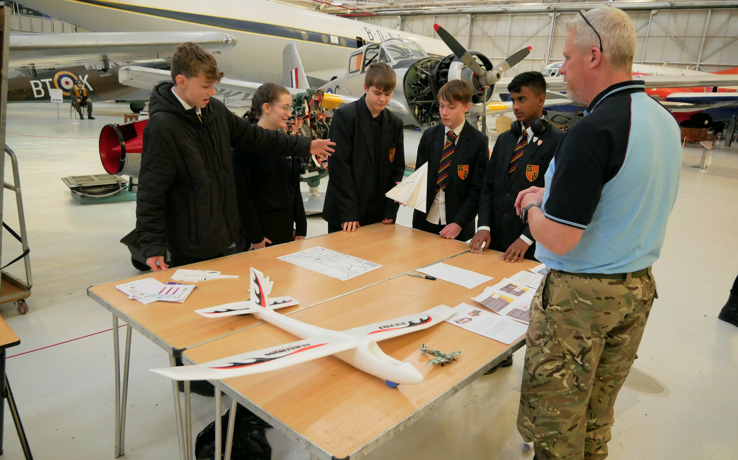
KS3 Glider Challenge
Students learn about the theory of flight and compete in teams to build and fly a glider!
All schools receive a resource pack, including a lesson plan aligned to the national curriculum.
Teachers cover the prep for the challenge at school before bringing their team to take part at RAF Museum Midlands, either on-site or online.

Slide 9
learning-midlands@rafmuseum.org

Slide 10

Youth Advisory Panel
We are looking for 16 to 24-year-olds to support our Midlands Development Programme by joining our Youth Advisory Panel!
The panel will help shape our museum into an engaging and relevant space for young people. They will:
  Produce exhibitions and input into design plans
  Gain experience at a national museum
  Enrich their CVs

Slide 11
midlandsyouthpanel@rafmuseum.org

Slide 12

Summer Time Advanced Aerospace Residency (STAAR) programme
STAAR is an Immersive STEM residential for Year 9 (Scottish S3) Students, showcasing an interest or aptitude in STEM subjects.
This fully funded, hands-on residential camp takes place on the grounds of RAF Cosford and the RAF Museum Midlands, providing an immersive experience facilitated by industry professionals.

Slide 13
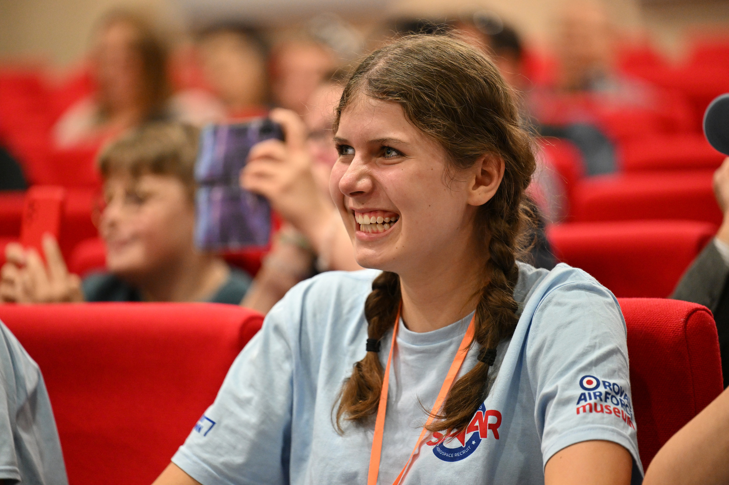
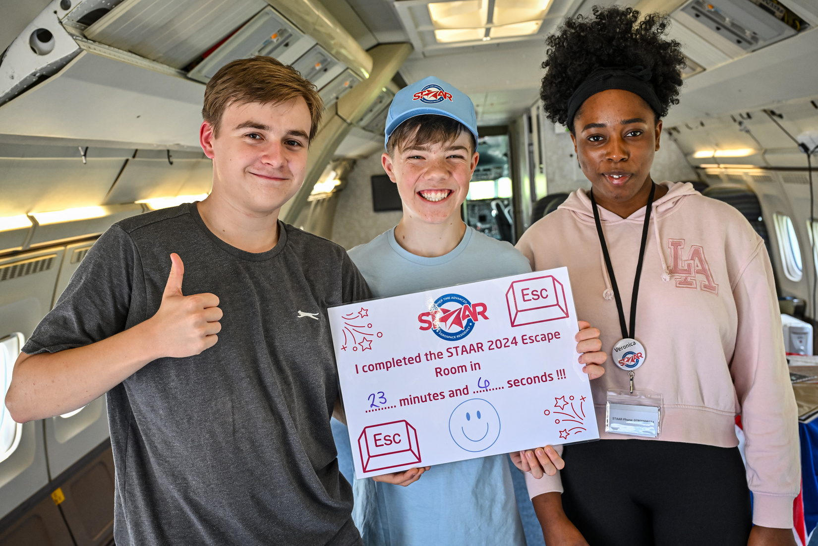
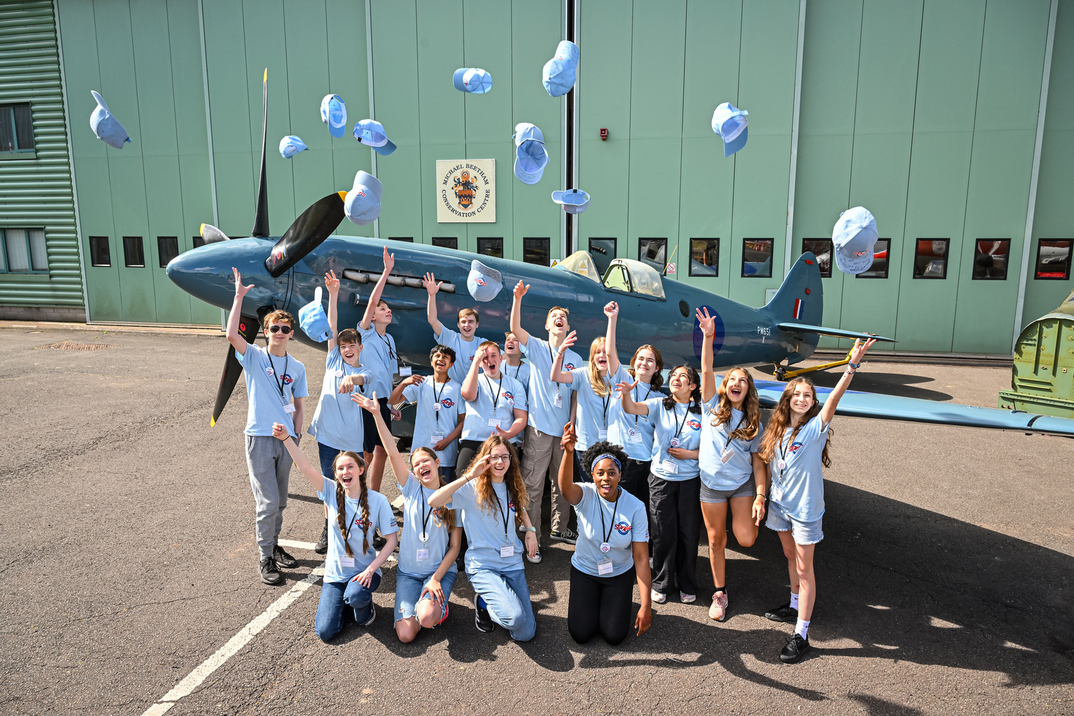
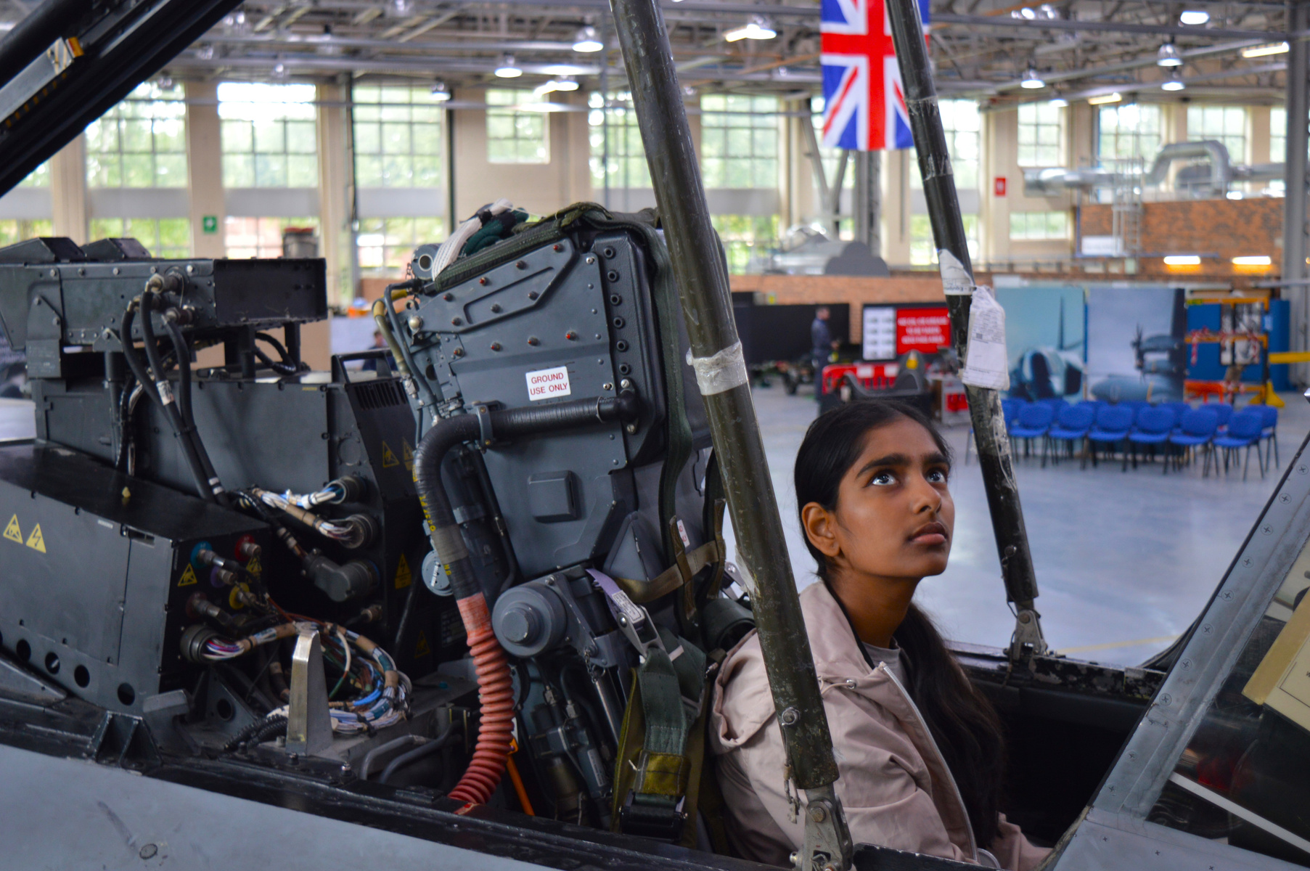

Slide 14

The application process for STAAR 2025 is set to open in early 2025. The residential will take place in July 2025.
Email STAAR@rafmuseum.org to be notified when applications open.
www.rafmuseum.org.uk/STAAR

Slide 15



Follow our social media channels for updates and offers throughout the year!
@rafmlearning

Slide 16

Q&A

