Slide 1

Developing a new generation of
Curriculum Leaders
Notes:
A brief introduction outlining the purpose of the Tenderfoot project.

Slide 2

Why
What
When
How
Notes:
A chance to explain what the Tenderfoot project entails – hide if not required.
Why? The need to develop a deeper appreciation of Computer Science amongst non-specialists secondary teachers.
What? Currently seven full Units are completed, packaged as 30+ separate sessions to support Master Teachers and others hosting local CPD. Four further Units are scoped and awaiting further development.
When? The seven completed Units will be online by the start of the academic year 2017 – 18.
How? The CAS model is that of local face to face sessions through which we build trust and a genuine community of practice. Some may develop the material into online delivery but the key aim is to help sustain the fabric of the CAS Community, developing through the Regional Centre initiatives.

Slide 3

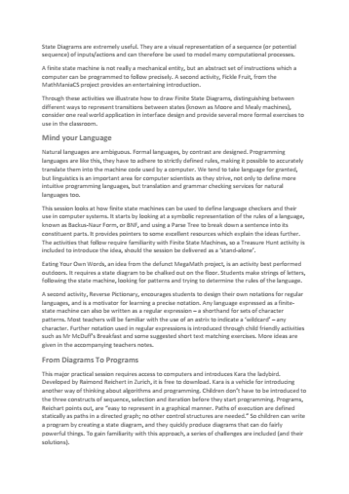
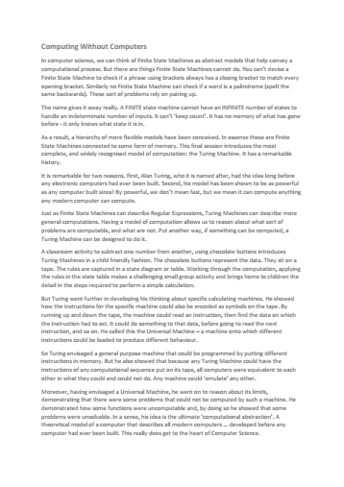

Each
Unit
Notes:
It is important that attendees understand the structure of the supporting resources and their target audience.
A short summary of the content of each Unit can be downloaded and distributed in advance.
A full day Unit is fast paced, aimed at experienced curriculum leaders and potential Tenderfoot trainers.

Slide 4

Each
Unit
Notes:
Each Unit includes a full Trainer Presentation, which follows these introductory slides.

Slide 5
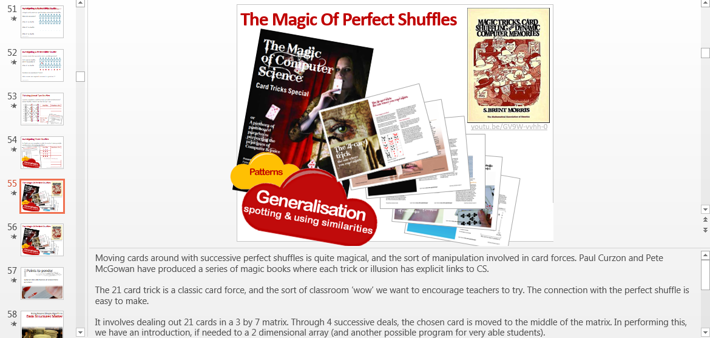
Notes:
The slides include very detailed notes outlining the supporting narrative. Please read them carefully if preparing a presentation.

Slide 6


Each
Unit
Notes:
Training Notes are provided to help with advanced preparation.
These can be distributed at the start of a full day session.
The contents are explained in the following slides.

Slide 7

Notes:
The first page sets the subject matter in context, outlines the ‘big picture’ and identifies the learning objectives for teachers new to Computing.
It is worth emphasizing that the purpose of the material is to raise the awareness of teachers to the breadth and depth of the subject, not simply to provide another source of fun activities for classroom use.

Slide 8
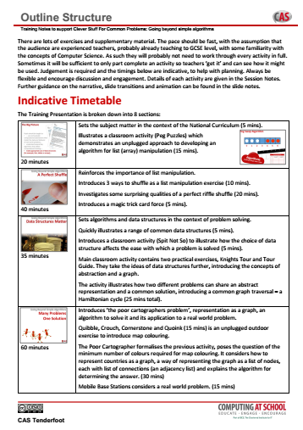

Notes:
An indicative timetable for a full day Unit is included.
A lot of ground is covered, so keeping to time can be challenging!

Slide 9
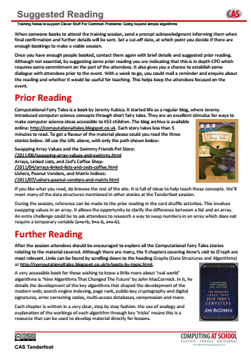
Notes:
Pointers are provided to good CPD practice. Making contact and establishing a dialogue prior to the event is important. Suggesting simple reading or watching a video allows the opportunity to follow up with a reminder.
The ultimate aim is to encourage teachers to dig deeper, so suggested further reading is also included.

Slide 10

Notes:
The Unit is subdivided into sessions. This allows you to take the material and offer shorter sessions to fit local circumstances.
A summary of the sessions and indicative timings is included to facilitate planning.

Slide 11


Notes:
Finally, there is a summary of the key points in the presentation where we hope Trainers will facilitate discussion and debate.
A key element in the CPD is to encourage reflective practice, promote action research and encourage teachers to consider the BCS Certificate in CS Teaching.

Slide 12
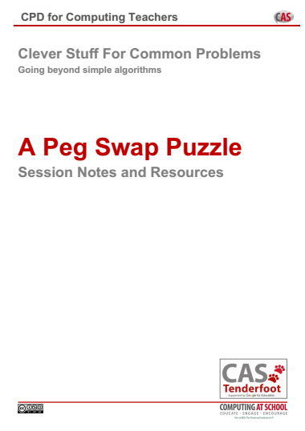

Each
Session

Slide 13



Clever Stuff For Common Problems
Going Beyond Simple Algorithms
Notes:
Introductory slides that establish a common format to the start of a Master Teacher session. Please do stress the ethos at the start: there is no them – only us! If our subject is to develop all practising teachers have valuable contributions to make, regardless of prior experience. The CAS model recognises that good pedagogy is a process of discussion and development, facilitated through our Community of Practice.

Slide 14
Clever Stuff For Common Problems
Going Beyond Simple Algorithms
Insert any specific notes
Start / End time
Toilets
Fire Drill / Exits
Notes:
Reminder to go through formalities at start. Placeholders for specific details

Slide 15
Clever Stuff For Common Problems
Learning Outcomes
By the end of the session we hope you will:
Recognise linear structures (lists) are part of a broader family Appreciate the value of data structures for problem solving
Have become familiar with graph theory and related terms
Be aware that many problems can be represented as graphs
Be familiar with a range of graph traversal algorithms
Recognise their role in solving many every day problems
Have explored a range of activities for introducing these CS concepts at KS3
Notes:
It is important to be explicit about the intended outcomes of the day for attendees.
Do not assume they will be aware of the purpose or target audience of the materials.
By stating the intentions, it helps avoid getting sidetracked into discussing the detail of individual classroom activities.
The primary aim is to educate teachers and illustrate the breadth and depth of Computer Science. The specific outcomes for teachers from this unit, are
Recognise linear structures (lists) are part of a more general group and introduce several strategies to introduce them at KS3
Appreciate the value of data structures for problem solving
Become familiar with graph theory and related terms
Be aware that many problems can be represented as graphs
Be familiar with a range of graph traversal algorithms
Recognise their role in solving many every day problems
The purpose of Tenderfoot is to equip trainers with material and ideas to meet these outcomes and broaden the outlook of teachers new to Computing.
It hopes to provide a buffet of resources on which teachers can draw, to enrich their Key Stage 3 lessons, at the same time as meeting the key aim: providing greater depth of knowledge for teachers themselves.
Developing teachers is the focus, not providing activities for pupils.

Slide 16
The Big Picture / Peg Swap Puzzle
A Perfect Shuffle
Data Structures Matter
Many Problems One Solution
Toy Problems for the Real World
The Oracle of Bacon
The Beauty Of Trees
Notes:
Quick outline of the day. Stress the fact there is a lot to cover!
We’ll start by considering the National Curriculum and a warm up activity.
Before reflecting on ways to make connections in computer science.
The main purpose is to consider the importance of Data Structures for solving problems,
And illustrate the way a solution to one problem can provide a solution to others, before looking at some fun exercises to illustrate real world problems.
We’ll end with a recap about data structures and a quick exercise that can be used to demonstrate some of the magic of algorithms and data structures.

Slide 17
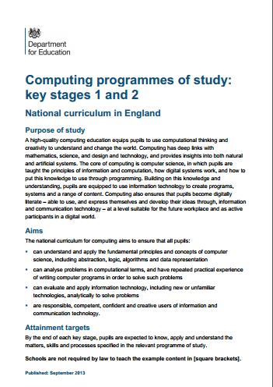
The Big Picture
A Perfect Shuffle
Data Structures Matter
Many Problems One Solution
Toy Problems for the Real World
The Oracle of Bacon
The Beauty Of Trees
Notes:
So lets start by setting the day in context of new national curriculum

Slide 18
The Big Picture
Pupils should be taught to:
use logical reasoning to
explain how some simple
algorithms work and to detect
and correct errors in algorithms
Notes:
We can look at some of the specific statements in the National Curriculum to highlight where the sort of things we will cover might fit. At Key Stage 2 there is one simple requirement specified.

Slide 19

The Big Picture
Pupils should be taught to:
… use and evaluate
computational abstractions that
model the state and behavior
of real-world problems…
understand several key
algorithms that reflect
computational thinking …
make appropriate use of data structures
[for example, lists, tables or arrays]…
Notes:
At Key Stage 3 things get a little more wordy.
Here are three partial statements taken from the Program of Study. Don’t dwell on these, simply highlight them.
Each subsequent slide highlights the next phrase (click)

Slide 20
The Big Picture
Pupils should be taught to:
… use and evaluate
computational abstractions that
model the state and behavior
of real-world problems…
understand several key
algorithms that reflect
computational thinking …
make appropriate use of data structures
[for example, lists, tables or arrays]…
Notes:
Each subsequent slide highlights the next phrase (click)

Slide 21
The Big Picture
Pupils should be taught to:
… use and evaluate
computational abstractions that
model the state and behavior
of real-world problems…
understand several key
algorithms that reflect
computational thinking …
make appropriate use of data structures
[for example, lists, tables or arrays]…
Notes:
At Key Stage 3 things get a little more wordy.
Here are three partial statements taken from the Program of Study. Don’t dwell on these, simply highlight them.
Each subsequent slide highlights the next phrase (click)

Slide 22
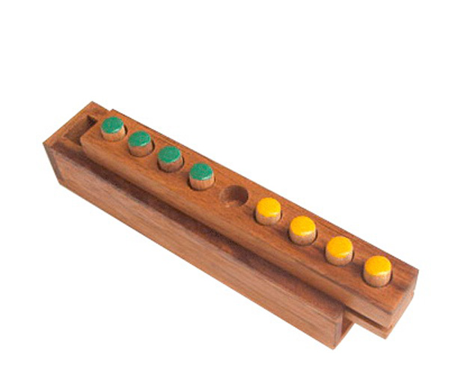
Peg Swap Puzzles: Leapfrog
Pupils should be taught to:
… use and evaluate
computational abstractions that
model the state and behavior
of real-world problems…
understand several key
algorithms that reflect
computational thinking …
make appropriate use of data structures
[for example, lists, tables or arrays]…
0
activity
Notes:
It’s likely that the most complex structures a child will manipulate in programs at KS3 will be a list or array.
This, in itself is often a difficult conceptual step.
Before introducing programming challenges, children generally benefit from being exposed to the concept in other ways.
Peg switch puzzles can be a kinaesthetic way into investigating data structures such as arrays

Slide 23
Peg Swap Puzzles: Leapfrog
0
activity
Notes:
Here’s a simple warm up activity. A peg puzzle like this can be made simply with wood and small sections of dowel in two colours.
The aim is to swap the pegs, moving each colour alternately.
There are two types of move (click)
Into an adjacent space or (click)

Slide 24
Peg Swap Puzzles: Leapfrog
0
activity
Notes:
Jumping over an one opposing colour into a space.

Slide 25
Peg Swap Puzzles: Leapfrog
Move either:
Into an adjacent empty space (forward or back) or
Jump over 1 opposing peg into a space (forward or back)
Can you find a way to swap the pegs?
Notes:
These are the only two moves allowed. (click)
The first challenge for students is to find a way to solve the problem.

Slide 26


Peg Swap Puzzles: Leapfrog
Notes:
Once some have found a solution, introduce a competitive element as an extension, whilst others are still trying to solve it.
What is the minimum number of moves to complete a swap?
Children should begin to see a pattern required to complete this efficiently. (click)
Pattern recognition like this is a key concept underpinning Computational Thinking. Once students appreciate a pattern, they should be able to extend their reasoning and tackle a larger, similar problem.

Slide 27
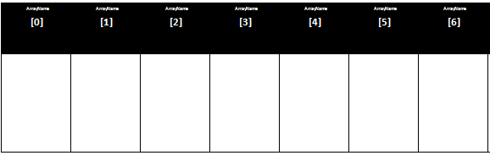

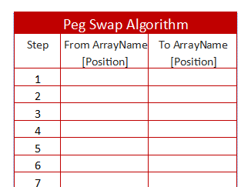
Peg Swap Puzzle
0 1 2 3 4 5 6
Notes:
Once all the children have figured out how to solve the smaller puzzle, ask them explain their solution using the slide on the board.
Invite them to come up and explain. They may point to pegs initially, but it will become apparent that they need to refer to particular pegs and spaces.
Discuss possible ways to do this before suggesting (if the children don’t) numbering each space (click).
Once we can identify the spaces, do we need to identify the pegs as well?
We can articulate an algorithm by recording the move, rather than the peg eg space 4 to space 3. (click)
Hand out an array sheet and counters to help them visualise and record their algorithm.

Slide 28
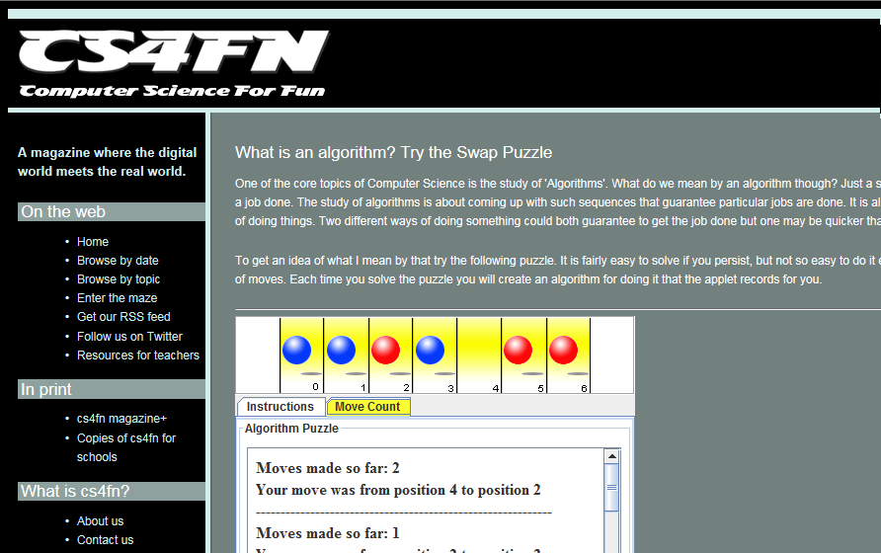
Peg Swap Algorithm
http://www.cs4fn.org/algorithms/swappuzzle
Notes:
If children struggle to record the steps there is an applet on the cs4fn website which will record and count the moves as you do them.
This can also be useful for a homework extension, perhaps using a larger 9 space board.
The point of this warm up exercise is to emphasise that we can introduce difficult programming concepts through simple problem solving activities. Often, working things through by hand is an important precursor to any coding.

Slide 29

✗
✗
Computational
Thinking
Notes:
So to conclude our introduction, the National Curriculum requirements are not definitive, they are a skeleton at best.
Teachers teach what their knowledge, creativity and ambition allow.
Our job is to find ways to develop children’s capacity to think like computer scientists.
We call this Computational Thinking.
It lies at the heart of the National Curriculum.
Once you start to slice and dice a curriculum, it is very easy to focus on the trees, and lose sight of the wood, the big picture.

Slide 30
Computational
Thinking
A high-quality computing education equips pupils to use computational thinking and creativity to understand
and change the world…
Notes:
Regardless of the detail, our over-arching aim is: “A high-quality computing education equips pupils to use computational thinking and creativity to understand and change the world.”

Slide 31
Computational
Thinking
The core of computing is computer science, in which pupils are taught the principles of information
and computation...
Notes:
And at it’s core is Computer Science, a science that has grown out of grappling with the problems posed by the explosive development of information and communications technology.

Slide 32
Computing is about
much more than
programming
Notes:
We can summarise by saying these 3 things.

Slide 33
Computing is about
much more than
programming
Computing is about a
way of thinking
Notes:
We can summarise by saying these 3 things.

Slide 34
Computing is about
much more than
programming
Computing is about a
way of thinking
Concepts are transferable to other problem solving contexts
Notes:
We can summarise by saying these 3 things.

Slide 35
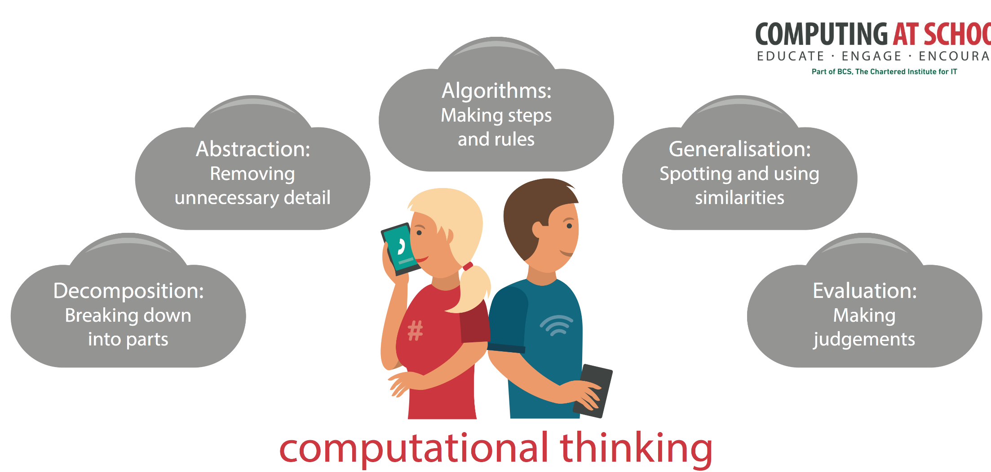
Concepts are transferable to other problem solving contexts
Notes:
CAS have produced a poster that highlights these concepts – great for the classroom wall, so you can keep referring to them whenever the opportunity arises. We’ll be doing this throughout these sessions. They are … each will be revealed on a click.

Slide 36

Going Beyond Simple Algorithms
A Perfect Shuffle
Notes:
This next activity continues the theme of manipulating arrays.
Children need repeated exposure to the same ideas in a variety of contexts before they sink in.

Slide 37
1
A Shuffle Algorithm
activity
Notes:
This activity uses a similar array template to Leapfrog and starts by asking children to design an algorithms to shuffle cards.
Each pair, or small group will need the cards Ace through to 8 in on particular suit.

Slide 38
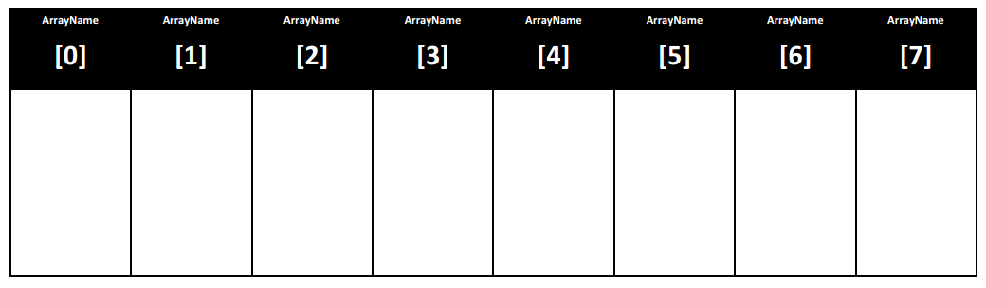
A Shuffle Algorithm
Using an array as a data structure containing initially 8 (N) integers in ascending order.
Write an algorithm to shuffle the values into a random order.
Use the printed array to test your
Shuffle.
Notes:
There are many ways to shuffle cards, or other lists of items. This is a good group activity that gets them thinking about the stages involved in a shuffle. There are no right answers, but the challenge is to articulate their method as an algorithm.
Using just 8 values initially, we can use integers 0 through 7 to represent them in an array. There is a printed array that can be used with playing cards with values 1-8. This will help them articulate the steps involved – or dry run their algorithm (or that of their neighbours) to test it.
If they are stuck for ideas, see the next slide.

Slide 39
A Shuffle Algorithm: 3 ideas
1
Take any two values at random, and swap them. Repeat a thousand times.
The Knuth Shuffle is explained here
http://en.wikipedia.org/wiki/Fisher%E2%80%93Yates_shuffle
2
Notes:
Here are three possible shuffle algorithms. The first is the easiest to implement.
(click)
Implementing the Knuth, or Fisher Yates shuffle is much more challenging. A couple of slides are included for you to use or study, and as an example for children of how to write their algorithm.
It is named after the famous computer scientist, Donald Knuth, author of the multi volume “The Art of Computer Programming”.

Slide 40
Coding a Knuth Shuffle
Pick one item from the array at random.
Swap that item with the last item.
Randomly pick one item from the remaining list.
Swap it with the item at the end of the remaining list.
Repeatedly remove one item from the remaining list and swap it with the item on the bottom of the remaining list.
Notes:
These slides are included as a walk through of the Knuth shuffle.
The algorithm is built up by two clicks, a diagram follows on the next slide.
Articulating (and coding) a Knuth shuffle is a good exercise for more able students and for staff learning about array manipulation.

Slide 41
Coding a Knuth Shuffle
1 2 3 4 5
Remaining list underlined
1 2 5 4 3
Remaining list underlined
1 4 5 2 3
Remaining list underlined
Select one at random
Swap with last position
Now pick another from the remaining list
and swap with the last position in the remaining list
… and so on until no items remain
Notes:
The key to understanding this shuffle is identifying the remaining list.
It is this that makes it an improvement on a random swap.

Slide 42

A Shuffle Algorithm: 3 ideas
1
Take any two values at random, and swap them. Repeat a thousand times.
The Knuth Shuffle is explained here
http://en.wikipedia.org/wiki/Fisher%E2%80%93Yates_shuffle
Riffle the ‘deck’. Split in two and interleave.
2
3
Notes:
It is the third idea, a riffle shuffle we want to focus on. This is very challenging, but makes an interesting activity as most children will be familiar with how it works. Implementing a riffle shuffle is a good exercise for more able children.
There are also some interesting properties associated with riffle shuffles, which we will explore.

Slide 43
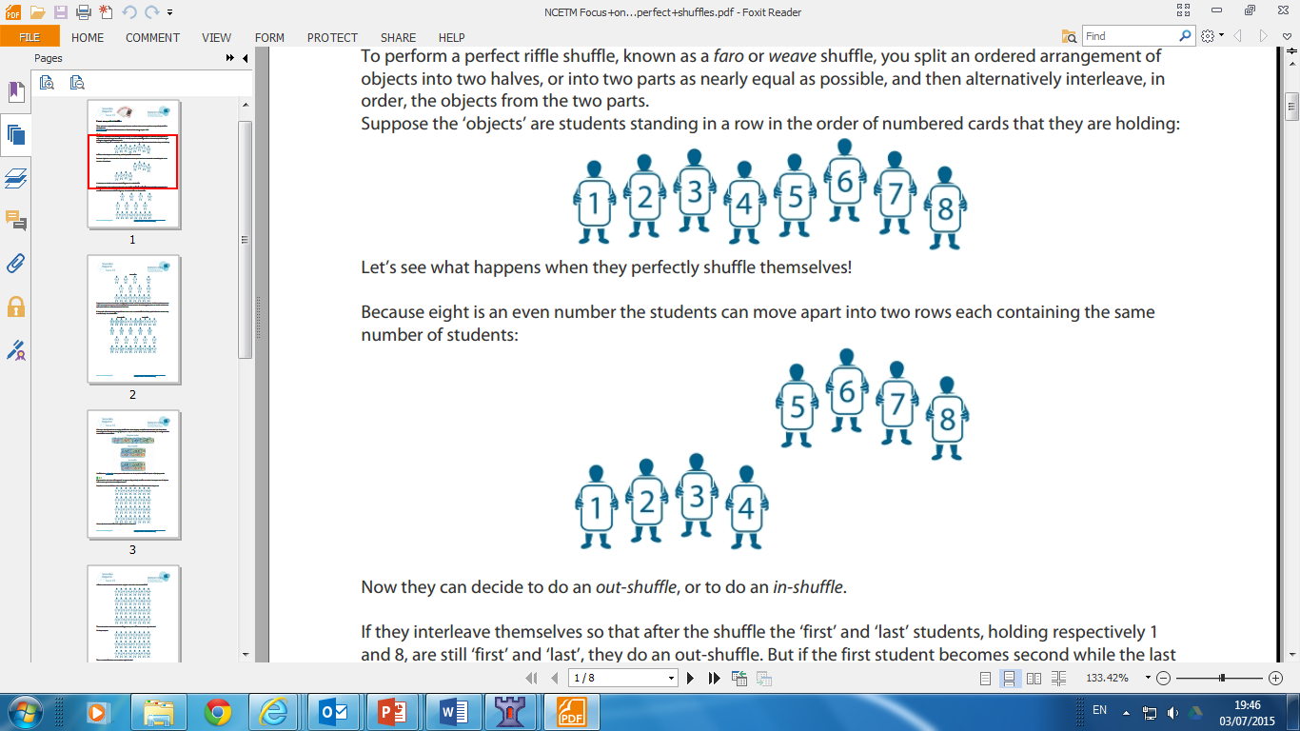
Investigating A Perfect Riffle Shuffle
Split a set of 8 ordered cards into 2 halves
Graphics from NCETM
Notes:
This is a pattern matching activity designed to reveal a surprising insight.

Slide 44
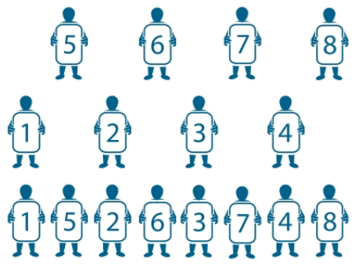
Investigating A Perfect Riffle Shuffle
Interleaved with the top and bottom card remaining in place
Out-shuffle
Graphics from NCETM
Notes:
An explanation of an out-shuffle, leaving the top and bottom cards in place. Click to reveal.

Slide 45
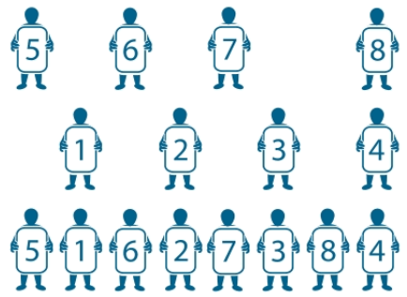
Investigating A Perfect Riffle Shuffle
Interleaved with the top and bottom card moved in
In-shuffle
Graphics from NCETM
Notes:
Explanation of an in-shuffle, moving the top and bottom cards ‘in’. Click to reveal.

Slide 46
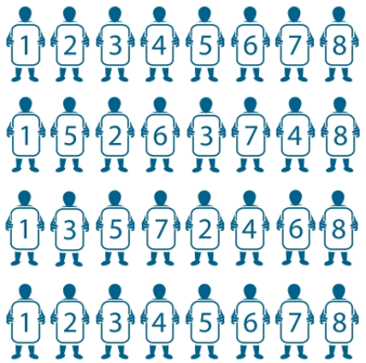
Investigating A Perfect Riffle Shuffle
Using 8 cards, starting in order, perform 3 out-shuffles.
What do you notice?
After 1st out-shuffle
After 2nd out-shuffle
After 3rd out-shuffle
Graphics from NCETM
Notes:
Once children have done it, click to reveal the result of each subsequent shuffle.
There is a certain wonderment in finding that the cards have returned to their original position.

Slide 47
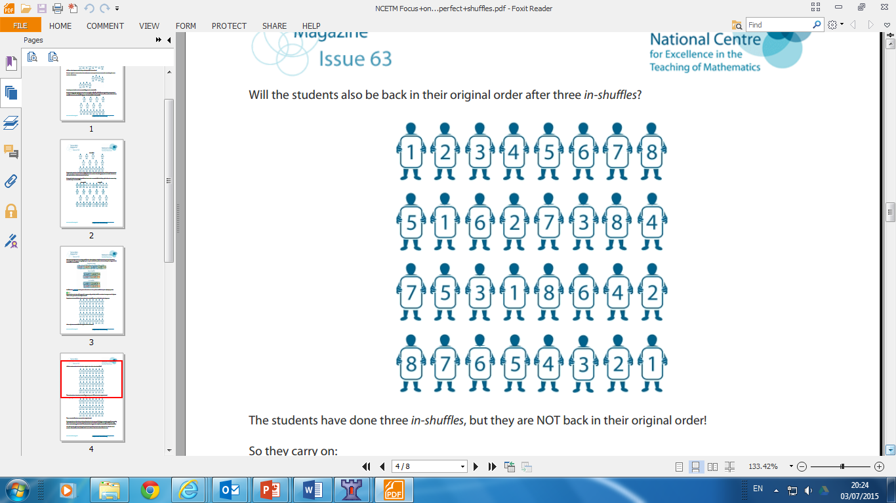
Investigating A Perfect Riffle Shuffle
Will they ever return to the starting position?
Using 8 cards, now start performing consecutive in-shuffles.
What do you notice?
After 1st in-shuffle
After 2nd in-shuffle
After 3rd in-shuffle
Graphics from NCETM
Notes:
Now try it with in-shuffles. Click to reveal the result of each subsequent shuffle. The order hasn’t returned after 3 shuffles, so encourage them to keep investigating. They should find it takes another 3 in-shuffles.

Slide 48
Investigating A Perfect Riffle Shuffle
Can you move the top card to each possible position?
Here, one in-shuffle,
gets it to position 1
After 1st in-shuffle
0 1 2 3 4 5 6 7
Positions are numbered from 0
What moves are required to move it to position 2?
Graphics from NCETM
Notes:
Leave the pupils to experiment with the question. If some find it quickly, ask them to see if any other moves would move the card to position 2.
The answer is In-shuffle, followed by Out-shuffle.

Slide 49
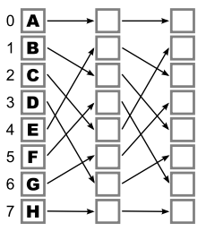
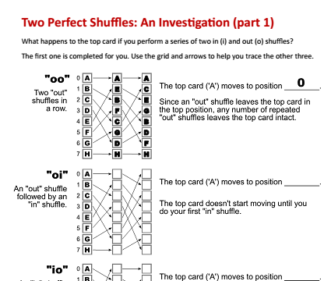
Thinking About Two Shuffles
Can you complete a table for each possible combination of in/out-shuffles? Here’s the first for out - out
A
E
B
F
C
G
D
H
A
C
E
G
B
D
F
H
Shuffles | Position of A
O O | O
O I | 1
I O | 2
I I | 3
Need help?
Use the sheet
Ideas and worksheets from Gary Kacmarcik: cse4K12.org
Notes:
Combining two shuffles is an exercise that can be set as class or homework. The object is to familiarise children with array index positions whilst being able to trace cumulative changes.
It isn’t easy but the exercise sheet gives a clear steer, with children only having to follow directions to derive the answer.

Slide 50
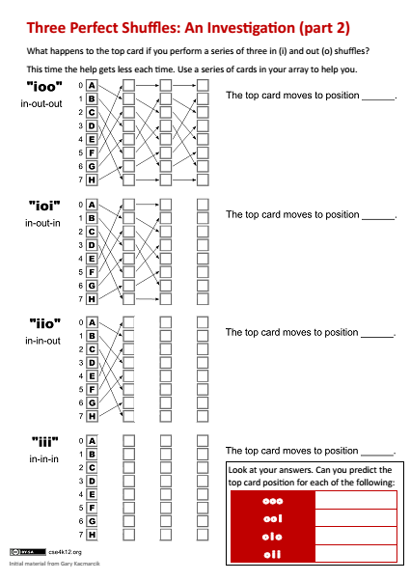
Investigating Three Shuffles
To finish can you complete a table for each of these possible combinations of 3 in/out-shuffles?
Shuffles | Position of A
I O O | 4
I O I | 5
I I O | 6
I I I | 7
O O O
O O I
O I O
0 I I
Now try to predict the following
Ideas and worksheets from Gary Kacmarcik: cse4K12.org
Notes:
The second part of the investigation gets more complicated with less and less help available. Nonetheless, once completed, or even part way through, it should become apparent to the pupils that the pattern of In(I) Out(O) shuffles required is given by the binary number of the position to move to eg to move to position 6 (binary 110) requires I I O
Again, we are looking to develop the idea of pattern matching, and from that generalising so we can predict outcomes, based on what we have observed.

Slide 51
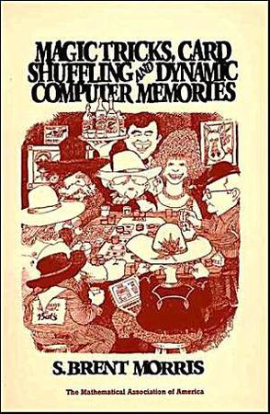
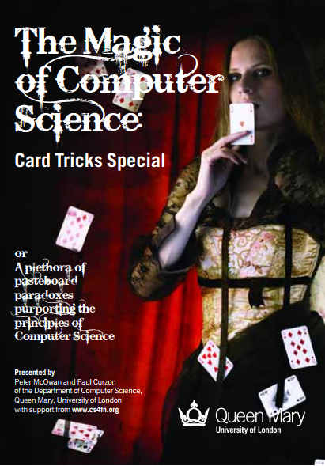
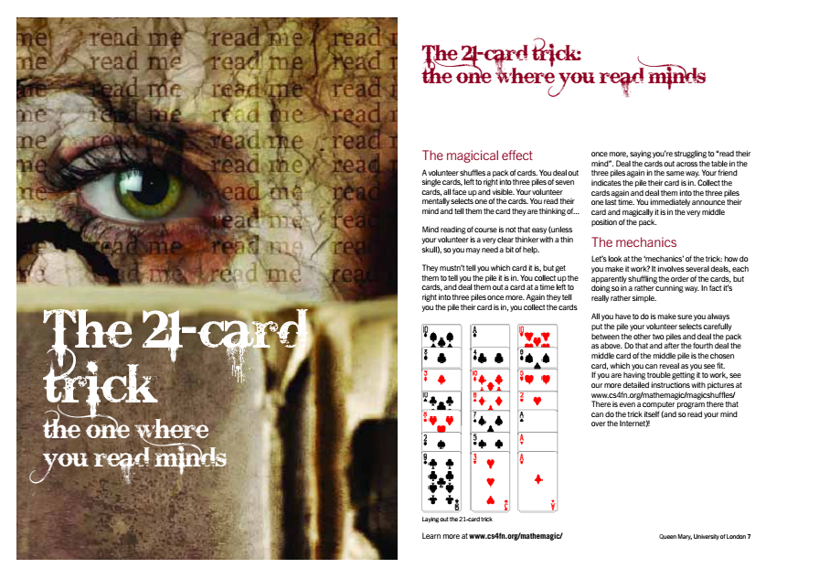
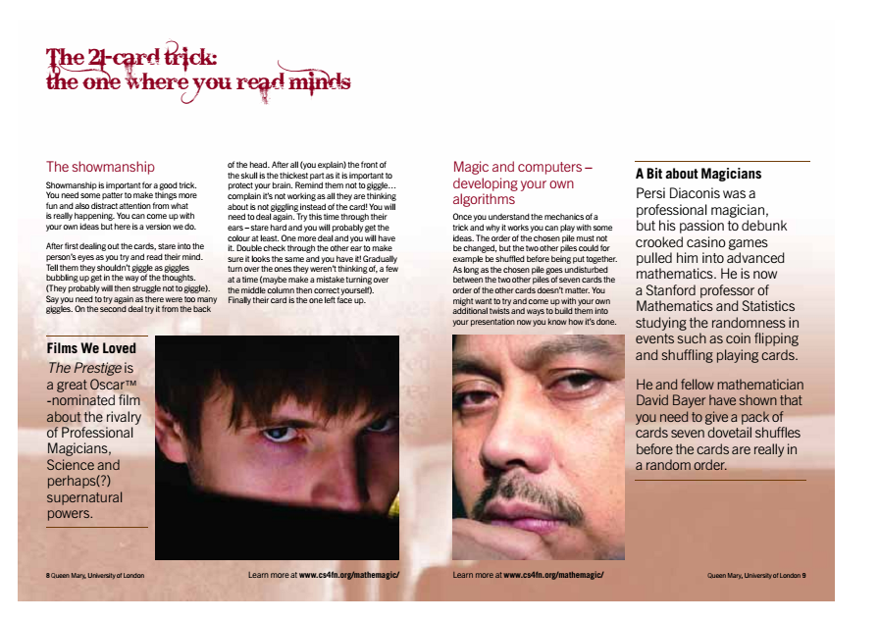
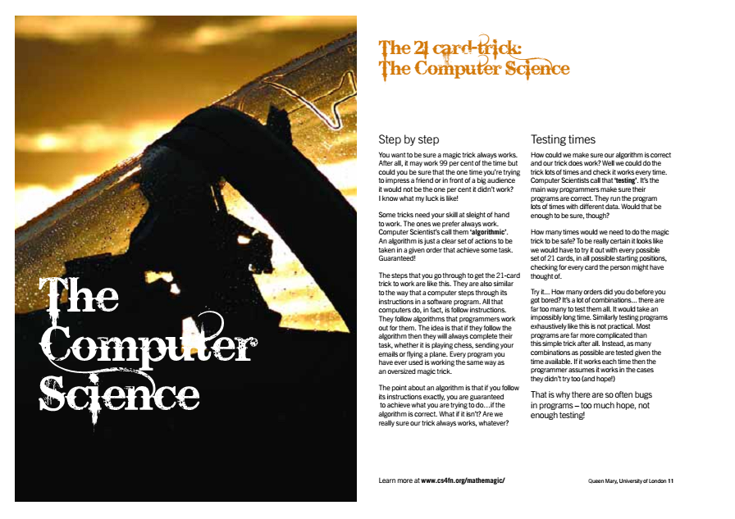
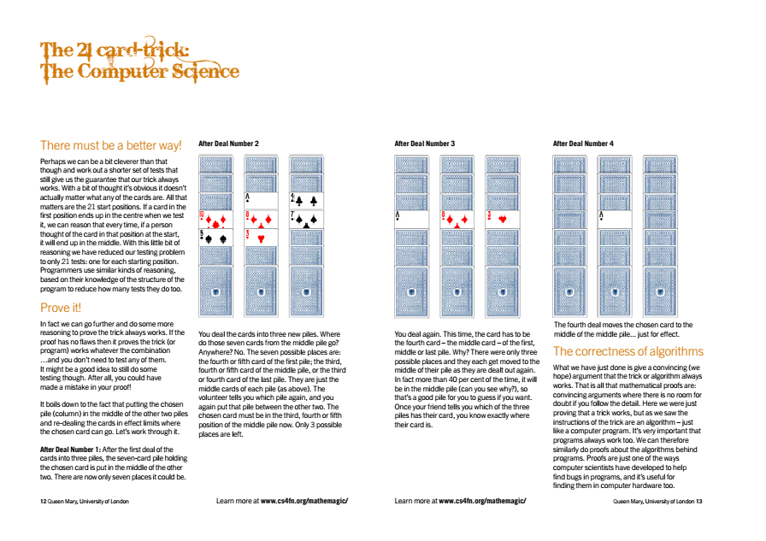
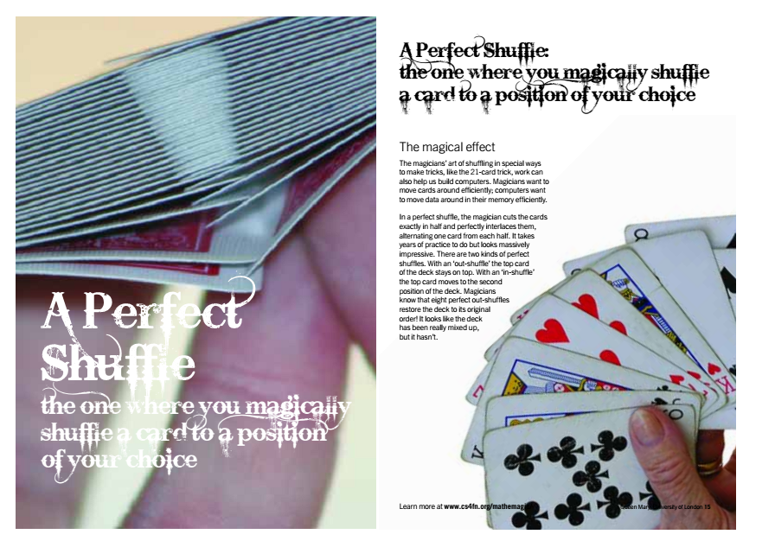
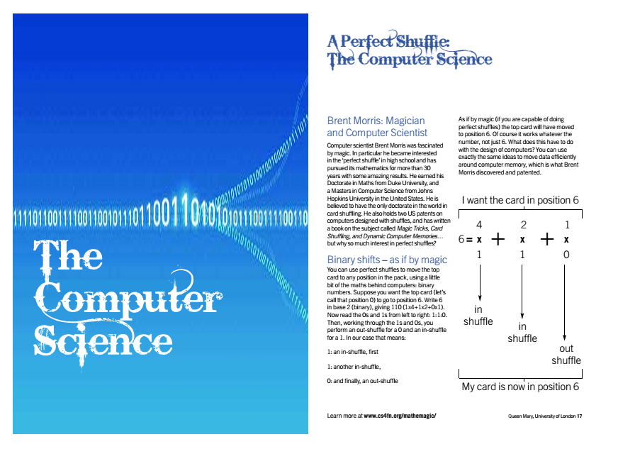
The Magic Of Perfect Shuffles
youtu.be/GV9W-vvhh-0
Notes:
Moving cards around with successive perfect shuffles is quite magical, and the sort of manipulation involved in card forces. Paul Curzon and Pete McGowan have produced a series of magic books where each trick or illusion has explicit links to CS.
The 21 card trick is a classic card force, and the sort of classroom ‘wow’ we want to encourage teachers to try. The connection with the perfect shuffle is easy to make.
It involves dealing out 21 cards in a 3 by 7 matrix. Through 4 successive deals, the chosen card is moved to the middle of the matrix. In performing this, we have an introduction, if needed to a 2 dimensional array (and another possible program for very able students).
What we are trying to do here is reveal the links between seemingly disparate ideas in CS. Manipulating arrays makes a connection with binary, unexpected patterns emerge that are surprising and stimulate a desire to delve deeper.
If teachers wish to understand more about the maths involved, or indeed the link between perfect shuffles and clever methods to move data in memory, the lecture cited, by Brent Morris is a valuable use of 50 minutes.
The first volume of their magic books (there are 3) is a card trick special. All the ‘self working’ card tricks are good examples of algorithms – following a set a defined steps to achieve the same result each time. They would make an excellent subject for a Hub meeting, with attendees volunteering to do a trick each. The magic book is included in the resources.

Slide 52


Points to ponder
What are the affordances of kinaesthetic activities?
Notes:
Throughout the presentation ‘Points To Ponder’ slides offer an opportunity to pause and pose a question.
The aim is not to engage in a lengthy discussion, but to plant ideas that could be pursued as classroom research.
Near the end, we’ll raise the value of such action research.

Slide 53
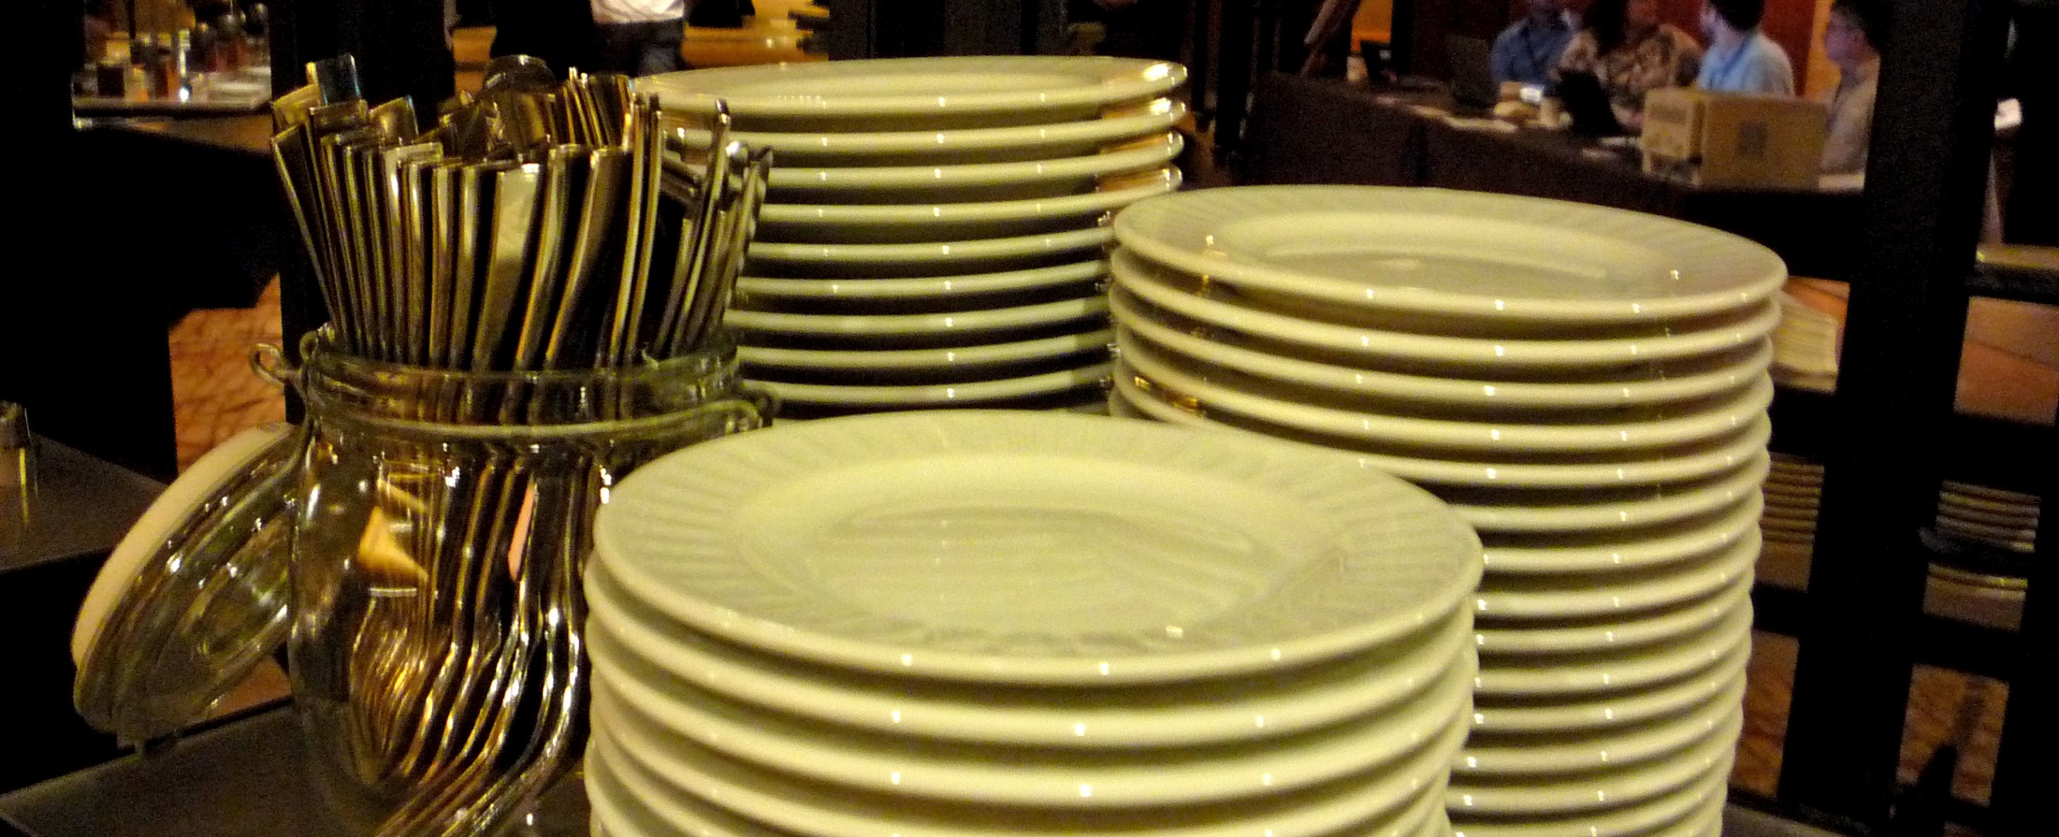
Going Beyond Simple Algorithms
Data Structures Matter

Slide 54
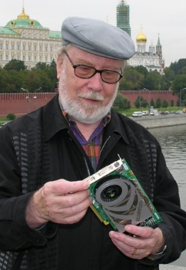
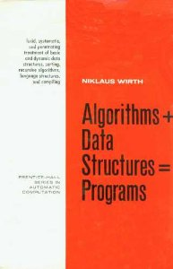
Niklaus Wirth
Notes:
Niklaus Wirth, a computer scientist who developed, amongst other things the programming language Pascal, wrote a famous book in 1975 entitled Algorithms + Data Structures = Programs

Slide 55



Notes:
Most students are familiar now with the term Algorithm.
We do a good job in making clear the key constructs from which algorithms are built (click)
Those of Sequence, selection and repetition

Slide 56
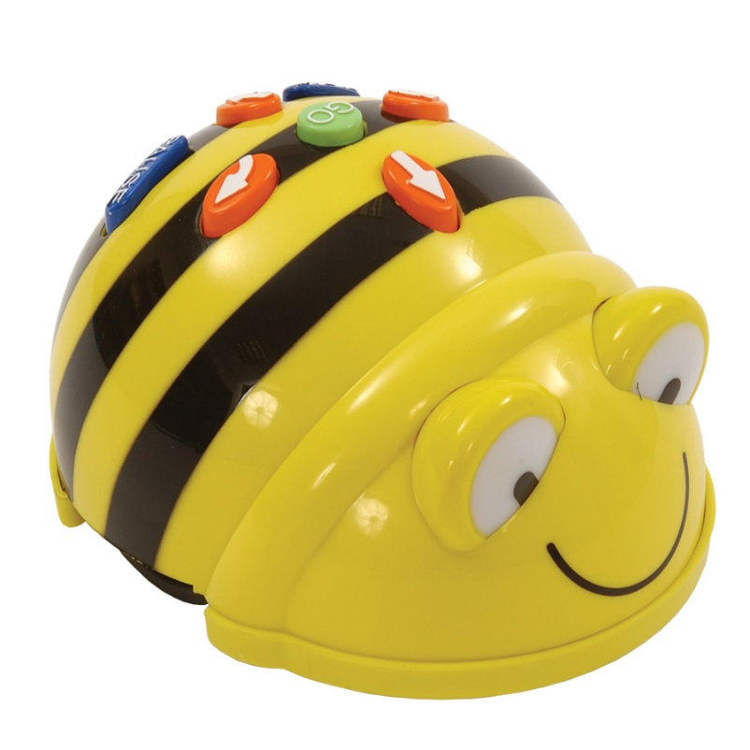
Notes:
And children get familiar with constructing algorithms from a very early age, using things like BeeBots in primary schools.

Slide 57
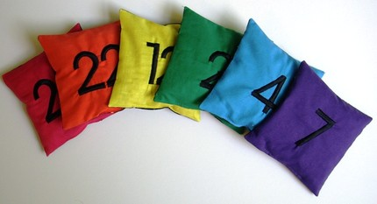
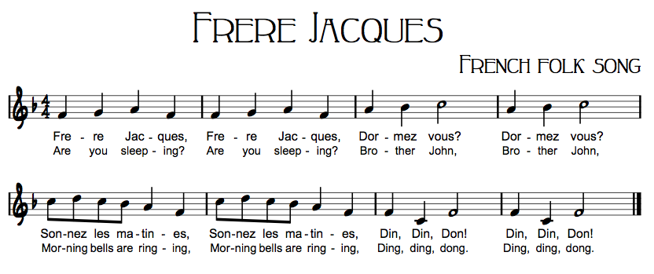
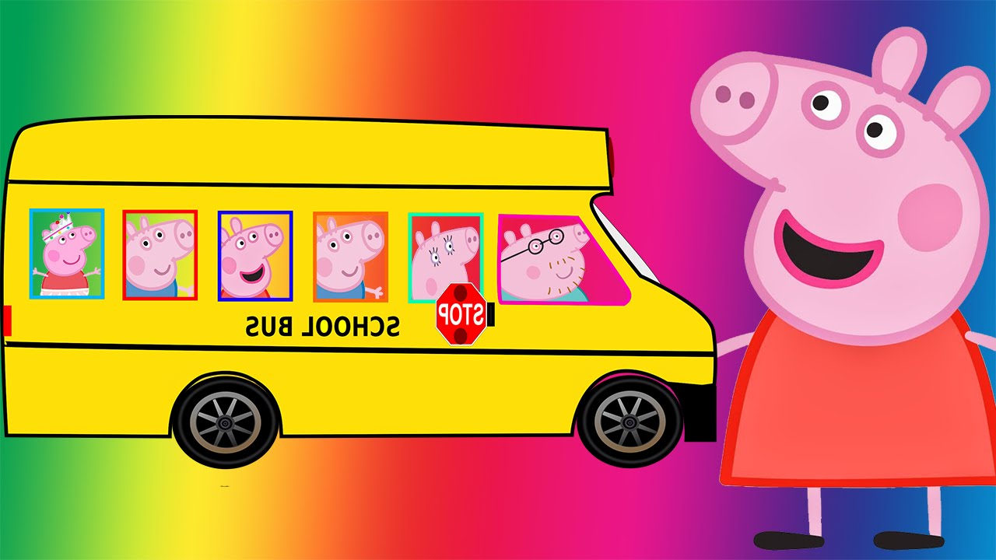
Notes:
But it’s not just through programming that they encounter these constructs, they occur again and again in the primary curriculum.
Think of number sequencing activities (click), repetition in rhymes like the wheels on the bus (click), indeed there are many computational concepts that can be exemplified in musical scores and singing rounds (click) …

Slide 58
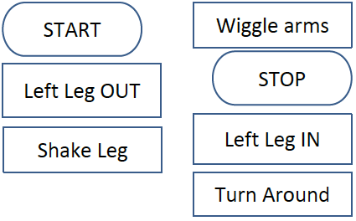
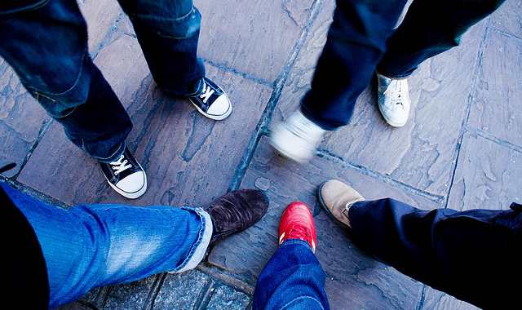
Notes:
… or even dance activities.
Maybe the Hokey Cokey really is what it is all about?

Slide 59

Notes:
But what consideration is given to data structures in primary schools?
The answer is probably very little but there are endless possibilities.

Slide 60
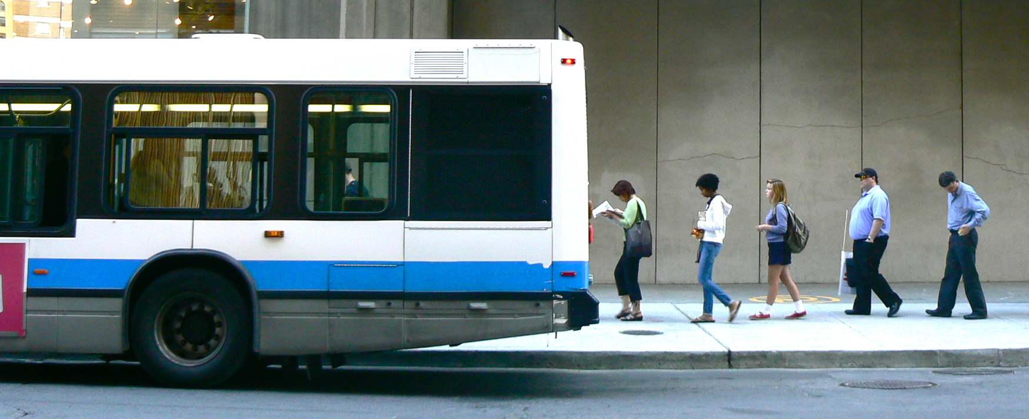
Notes:
We could consider the behaviour of a queue (click)

Slide 61
Notes:
… and compare it to that of a stack perhaps. (click)

Slide 62
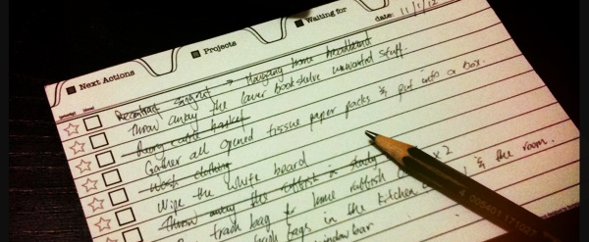
Notes:
Or a to do list… (click)

Slide 63
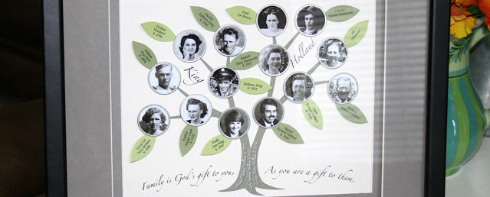
Notes:
Or a family tree… (click)

Slide 64
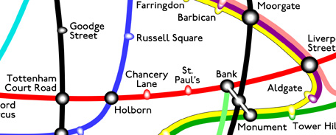
Notes:
Or a map… No computing session is complete without a picture of the obligatory tube map! This is a detail from one of many representations collated by Maxwell Roberts http://www.tubemapcentral.com/.

Slide 65
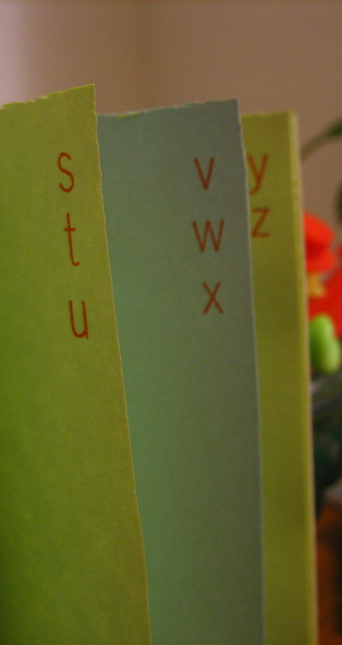
Doing things well depends on the way we order information not just the algorithm
Notes:
Doing things well requires more than a clever algorithm, it depends on the way we structure data. We intuitively organise addresses for example, into alphabetical order of names … (click)

Slide 66
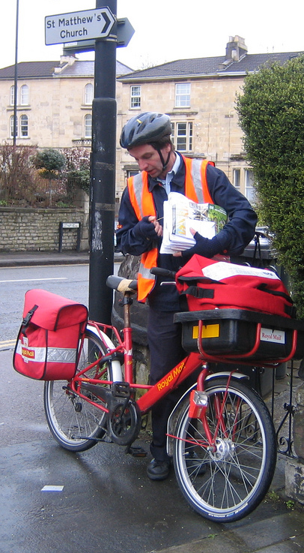
What sort of order depends on the task
Doing things well depends on the way we order information not just the algorithm
Notes:
… but for a postman the addresses are sorted into delivery order.
The data structures are suited to the task.

Slide 67
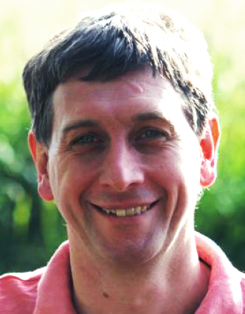
Let’s play Spit Not So!
2
activity
Notes:
So Data Structures matter and to make the point to children, let’s play a quick game called Spit Not So. (click)
This activity was devised by Paul Curzon, the driving force behind CS4Fn, and we’ll be looking at several of the activities from that wonderful website during the day.

Slide 68
NOT
FAT
SPIT
SO
FOP
IN
IF
PAN
AS
Let’s play Spit Not So!
2
Split into pairs
Take turns to pick up a word
First to hold 3 words containing
the same letter wins
activity
Notes:
Split group into pairs. Each pair has a set of 9 cards spread randomly between them.
Explain the rules (click).
Play as many games as possible in a few minutes, keeping score.
Stop the activity. Ask those who are winning in each pair to put their hands up.
Explain that you are going to give those currently losing a helping hand.
Select all those who are losing and gather them around your desk.
Hand each a copy of the Top Secret aid.
Insist on them keeping their instructions secret.
Start the scoring again and give them several more minutes to play some more.
Stop the groups again and ask if the Top Secret aid has changed their fortunes, before discussing. (click)

Slide 69
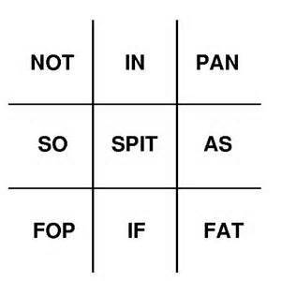
NOT
FAT
SPIT
SO
FOP
IN
IF
PAN
AS
Let’s play Spit Not So!
2
Top Secret!
activity
Notes:
Ask the children to explain why the Top Secret aid helped them.
The aid arranges the words in a grid. Words with the same letter form a line, either vertically, horizontally or diagonally.
By recording the words they take, and their opponents, using X and O, children can now play Spit Not So as if it was a game of noughts and crosses.
Most children know how to force at least a stalemate in noughts and crosses.
So the way we structure data has a very big bearing on how successful we might be.

Slide 70
computation +
information =
solutions
Notes:
So Data Structures are important, and we can engage with them, explore their properties and familiarise ourselves with potential applications without necessarily worrying about implementing them in code.
We shouldn’t underestimate the challenges facing children when learning to code. Keeping things simple is a key watchword. At Key Stage 3, repeated exposure to single variables and simple lists or arrays is probably about right.
(click)
But by introducing more complex data structures, we can begin to open their eyes to some of the clever solutions to everyday problems that have developed thanks to Computer Science.
Greg Michaelson, CAS member and a professor of Computer Science at Herriot watt University puts it nicely when he rewrite’s Wirth’s formulation in more general terms.
Let’s look at some ‘toy problems’ and use them to illustrate some of the key concepts underlying computational thinking.

Slide 71


The Knights Tour
3
activity
http://teachinglondoncomputing.org
Notes:
The Knights Tour is a puzzle.
Solving puzzles can be a very effective way of developing computational thinking, since it is all about problem solving.
(click)
It was developed by Paul Curzon, from Queen Mary College, University of London, as part of the resources for the Teaching London Computing initiative and has recently been reproduced as a cs4fn booklet.
These resources aren’t restricted to London’s teachers, but are available for download from their website. http://teachinglondoncomputing.org

Slide 72
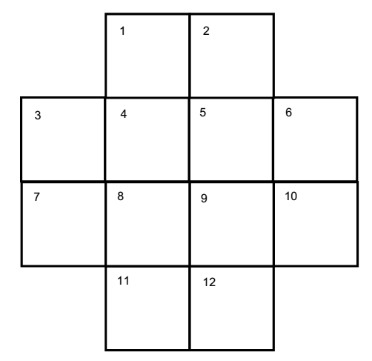

The Knights Tour
Notes:
Give each person a ‘chess board’ and Knight piece.
Place the Knight on square 1
Check everyone is familiar with the way a Knight can move:
From here, the piece could move 3 possible ways (click)
To square 7 (click)
Or to square 9 by either of two routes. (click)
Or to square 6.

Slide 73
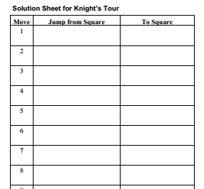
The Knights Tour
Find a series of moves to visit every
square once,
ending at the
start position
Notes:
The challenge is to work out a series of moves so the knight visits each square once (and once only) and ends up back at it’s original position. (click)
There are sheets available to help you record your moves.
You could perhaps offer a small prize for the first to solve it.
There are many solutions, so if a child solves it quickly, challenge them to find as many different ways as possible.
It isn’t easy, so allow perhaps 15 minutes for this activity and then stop everyone.
Establish if anyone / how many did succeed and discuss how hard they found it.

Slide 74

Tour Guide
A hotel guide wishes to arrange a tour of various London attractions for guests. They have a bus map showing the services that connect different places.
Can you plan a route that visits each attractions and returns them to the hotel?
Notes:
If the Knights Tour was a little challenging, helping a Tour Guide plan an outing might be easier.
Ask a child to give out the maps as the students will solve this one very quickly.

Slide 75
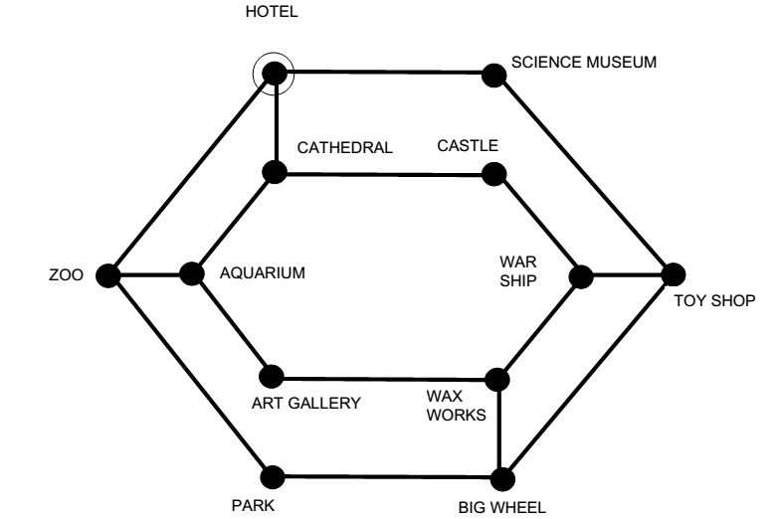
Tour Guide
Notes:
If projecting onto an interactive whiteboard children can come and outline their solutions, or simply read the order of attractions to visit.
There are many solutions, one is highlighted (click).
Solving the problem isn’t the point of the exercise. Discuss why it was much easier to solve this.
Answers may include the fact that you can trace a trail, having a map makes it easy to see etc.
In essence, the way the problem is represented makes it easy to solve.

Slide 76

Tour Graph
Nodes
Edges
Notes:
The map or diagram is an example of a structure computer scientists call a graph. (click)
A graph consists of a series of nodes connected by edges (sometimes called vertex and arc) and they are remarkably useful for representing a range of contexts and problems.
(click)
Deriving a graph from a problem statement is a good example of representational abstraction.
The graph captures all the relevant information required to solve the problem, and removes any superfluous detail.

Slide 77
The Knights Tour
Could a graph help to represent the
Knights Tour
problem?
What details
can we abstract away?
Notes:
Discuss with the group whether we could employ a graph to represent the Knights Tour.
Do we need to know which squares, for example, are adjacent to each other?

Slide 78
The Knights Tour
7
9
1
6
Notes:
All we really need to know, to solve this problem is which squares the Knight can reach from any location. (click)
A node can represent each square, linked by an edge to every other square the Knight can reach, so node 1 is connected to node 7 … (click)
… and to node 9 and node 6.
Armed with that knowledge, give out plenty of rough paper and challenge the students to complete the graph representation.
Answer on the next slide.

Slide 79
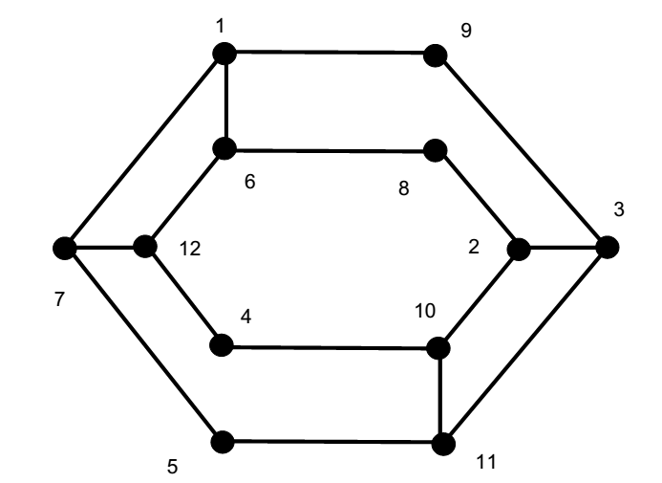
The Knights Tour Graph
Hotel
Science Museum
Cathedral
Castle
Toy Shop
Aquarium
Warship
Zoo
Wax Works
Art Gallery
Park
Big Wheel
Notes:
Here is the graph for the Knights Tour for students to check theirs against.
They may have a different layout, but arranging it in this way should make something obvious. Do they notice anything about the graph?
(click)
It is identical to the London Tour Guide problem!

Slide 80
The Knights Tour Graph
Problem Specification:
From start point
Visit each location once
Return to start
Hotel
Science Museum
Cathedral
Castle
Toy Shop
Aquarium
Warship
Zoo
Wax Works
Art Gallery
Park
Big Wheel
Notes:
By writing the specification of the problem in general terms, we can begin to see similarities.
(click)
Once we see the similarities in problems, we can apply a general solution to both. This notion of generalisation, of recognising patterns is another central concept in Computational Thinking.

Slide 81


Graph Traversal
Problem Specification:
From start point
Visit each location once
Return to start
Toy Shop
Notes:
The solution to both these problems, visiting every node and returning to complete a circuit is known as a Hamiltonian Cycle.
It is named after the Irish physicist and Mathematician, William Rowan Hamilton (1805-1865), who devised a puzzle to visit every corner of a dodecahedron. (click)

Slide 82

Graph Traversal
Problem Specification:
From start point
Visit each location once
Return to start
Toy Shop
Notes:
The twelve sides of the dodecahedron can be represented as a graph and a cycle traced through it.
Tracing a route through a graph can make good homework exercises, but the difficulty depends on the size of the graph. Determining whether a graph contains a Hamiltonian Cycle is one of a class of very hard problems for computers.
Visiting every node of a graph is just one of several common operations which collectively can be called graph traversals.
As you might expect various algorithms have been developed to perform different types of traversals.
We’ll explore some of these later, but developing an efficient way of finding some types of traversal remains one of the ‘holy grails’ of computer science.
The key point for us though, is to stress that by abstracting away details and recognising similarities we have the potential to use a general algorithm to solve a particular problem.

Slide 83
Points to ponder
There are many ways to illustrate abstraction…
… and many types.
How can we move from
examples to applying it as a
computational technique?
Toy Shop
Notes:
Again, a brief pause to encourage a short discussion whilst props are tidied up and the presenter gets ready for the next session.

Slide 84




Going Beyond Simple Algorithms
Many Problems
One Solution
Notes:
We’ve seen how a graph can be used as a map to help solve traversal type problems.
The next set of activities demonstrate what a flexible tool a graph can be for representing a variety of problems.

Slide 85




Quibble,
Crouch, Cornerstone and Quoink!
4
activity
Notes:
If the weather is fine, Quibble, Crouch, Cornerstone and Quoink provides a wonderful outdoor, collaborative exercise.
You’ll need a set of pavement chalks.
Introduce the activity as an exercise in computational thinking.
The idea was taken from the now defunct MegaMath project. MegaMath was a project of the Computer Research and Applications Group at Los Alamos National Laboratory. One of the driving forces was Mike Fellows, who went on to help develop the CS Unplugged materials.
If the weather isn’t on your side, a similar indoor puzzle follows.

Slide 86






Quibble
Quoink
Crouch
Cornerstone
Confused
Notes:
Each child in turn draws an area to stand in. (click)
Each area should be connected to at least one of the existing areas (click)
Encourage them to draw shapes that connect to more than one other area if possible (without getting too ridiculous!).
Gradually build up the map, with each child standing in their area (click)
Until every child is standing on the map (click)
(click)
Each child starts in a confused state. Model the stance. This indicates they don’t know what to do.
The challenge is to arrange themselves into one of four positions:
Quibble. Model the position, standing on one leg (they can swap legs if they are tired!)
Crouch, squatting,
Cornerstone, standing straight, hand on hip and clenched first salute or
Quoink, jiggling about and waving their arms above their heads.
The only rule is that they must not adopt the same position as any of their neighbours that their shape connects with.
If they don’t know what to do, or can’t find a position to satisfy the rule, they stay in a confused state.
The challenge, as a group is to see how long it takes until no-one is still confused.
If silly positions are potentially too disruptive, each child can be issued with cards bearing the position names which they simply hold aloft.
If the group find a solution quickly, remove one of the positions and see if they can find a solution with just three different positions.
Back in the classroom you can discuss the success (or otherwise) of their efforts. If you have a camera, a snapshot of the ‘map’ might be useful to display on the board.

Slide 87




Quibble, Crouch and Cornerstone Only
Quibble
Crouch
Cornerstone
Back in the classroom you can discuss the success, or otherwise and approaches taken.
Notes:
If the students manage to solve their puzzle quickly, remove one of the positions and ask them to try to solve it using only three.
This will prove more challenging.
A final extension, if needed, might be to create a map by drawing closed loops, overlaid on each other (click) as shown. The discrete areas of a map created this way can always be filled with just two positions.
(click)
This ‘closed loop’ map will provide a starting point for a class investigation.
But first, back in the classroom you can discuss the success, or otherwise of the approaches taken.
The aim of the discussion is to try to get the children to formulate their approach, or algorithm for solving the problem.
Don’t worry if they struggle at this stage, but the goal is always to promote the idea that they should be striving to articulate a precise series of steps, avoiding any ambiguity.

Slide 88


The Poor Cartographers Problem
Ideas and materials from CS Unplugged: http://csunplugged.org/graph-colouring/
and CS Inside: http://csi.dcs.gla.ac.uk/
Notes:
The activity you have just undertaken is an outdoor variation of ‘The Poor Cartographers Problem’.
Imagine a hard up map maker tasked with colouring in different countries.
Countries sharing a border can’t be the same colour.
Given a map, what is the minimum number of colours required to colour it in?

Slide 89

The Poor Cartographers Problem
Ideas and materials from CS Unplugged: http://csunplugged.org/graph-colouring/
and CS Inside: http://csi.dcs.gla.ac.uk/
Notes:
Here is a simple one to start with.
Do it as a group, on the board and try to draw out the steps required.
Essentially, we want children to discover the ‘has to be’ rule, and identify ways to check existing colours before adding another.
In this case, the map can be coloured using just two colours.
We can also use it to clarify the point about countries meeting at a point, which does not constitute a shared border.

Slide 90


The Poor Cartographers Problem
Notes:
We mentioned earlier that any map drawn using overlaid closed shapes can be coloured using just two colours.
Here is an example through which we can emphasise the ‘has to be’ rule.
Starting from the top left, as a class work through shading it in.
When everyone has the idea, reveal the answer (click).

Slide 91

The Poor Cartographers Problem
Can you design a map that requires five colours?
Notes:
Give out the two maps shown to ensure students have understood.
The top map requires three colours, and the bottom one four.
(click)
An extension task might be to ask students to design their own map that requires five colours to complete.
Whilst they may think they have a solution, all maps drawn on a flat surface require only four colours.
As an aside, it can be pointed out that the conjecture that any map can be coloured using only four colours was formulated in 1852, but it was not proved until 1976. Computer science is full of unsolved problems, and knowing that the four-color theorem was proved after more than 120 years of research is encouragement for those Computer Scientists looking for solutions to hard problems today.

Slide 92
The Poor Cartographers Problem
Notes:
Let’s consider some of the problems we might face tackling a harder problem, such as the map of Europe.
What we need is an algorithm
What strategies might we adopt?
Would we start with any specific country e.g. the one with the most borders?
How do we know which country has the most borders anyway in a large map?
(click)
What we need to do is abstract away the unnecessary detail

Slide 93

The Poor Cartographers Problem
2
5
1
4
3
6
Notes:
How might we represent this simple map? As a graph of course! But what are the nodes and what are the edges?
(click)
The nodes can represent the countries. But what do the edges represent? Deciding what to include in an abstraction is the key task.
Encourage suggestions before insisting that we’ll use edges to represent the borders between countries.
So which other nodes will country 1 be connected to? (click) Answer is 2 and 3.
Country 2 borders 1, but also 3, 4 and 5 (click) so we add those connections.
(click) and so on until the graph is a complete representation of the map.

Slide 94
The Poor Cartographers Problem
2
5
1
4
3
6
1 – 2,3
2 – 1,3,4,5
3 – 1,2,4,6
4 – 2,3,5,6
5 – 2,4,6
6 – 3,4,5
Notes:
So now for the algorithm. Algorithms go hand in hand with data structures. (click)
It might be good to develop a class chant: “When I say algorithms you say?” and back comes “Data Structures”
We have a data structure, a graph, which is an abstract representation of the map.
But how can a computer process this?
Although we wouldn’t expect children at KS3 to implement the algorithm that follows, it is useful to show them that we can represent the graph in a form that they are familiar with.
(click)
Lets make a list of the nodes.
And for each node, let’s make a list of the connections (click)

Slide 95
The Poor Cartographers Problem
2
5
Stage 1
Determine the best order to colour
Stage 2
Assign colours
1
4
3
6
1 – 2,3
2 – 1,3,4,5
3 – 1,2,4,6
4 – 2,3,5,6
5 – 2,4,6
6 – 3,4,5
Notes:
We now have a list of lists.
We’ve taken a representational abstraction and put it in a form a computer can work with.
We have, to coin a phrase, a ‘computational abstraction’’
The algorithm is in two stages: Stage 1 determines the best order to colour the nodes and (click)
Stage 2 assigns a legal colour.

Slide 96
The Poor Cartographers Problem
2
5
Repeatedly:
Remove node with
least connections
Store in a list
Remove connection
from other nodes
1
4
Stage
1
3
6
1 – 2,3
2 – 1,3,4,5
3 – 1,2,4,6
4 – 2,3,5,6
5 – 2,4,6
6 – 3,4,5
Notes:
Let’s work through stage 1, step by step.
Which is the node with the least connections? (click)
Answer : Node 1

Slide 97
The Poor Cartographers Problem
2
5
Repeatedly:
Remove node with
least connections
Store in a list
Remove connection
from other nodes
1
4
3
6
1 – 2,3
2 – 1,3,4,5
3 – 1,2,4,6
4 – 2,3,5,6
5 – 2,4,6
6 – 3,4,5
1 – 2,3
Notes:
Store the node in another list.

Slide 98
The Poor Cartographers Problem
2
5
Repeatedly:
Remove node with
least connections
Store in a list
Remove connection
from other nodes
1
4
3
6
1 – 2,3
2 – 1,3,4,5
3 – 1,2,4,6
4 – 2,3,5,6
5 – 2,4,6
6 – 3,4,5
1 – 2,3
Notes:
Remove the connection from the other nodes. (click to see)

Slide 99
The Poor Cartographers Problem
2
5
Repeatedly:
Remove node with
least connections
Store in a list
Remove connection
from other nodes
1
4
3
6
1 – 2,3
2 – 3,4,5
3 – 2,4,6
4 – 2,3,5,6
5 – 2,4,6
6 – 3,4,5
1
Notes:
We keep repeating the process, so which node is removed next?
Actually, any of 2, 3, 5 or 6 could be taken, so we’ll take 5 as an example. (click)

Slide 100
The Poor Cartographers Problem
2
5
Repeatedly:
Remove node with
least connections
Store in a list
Remove connection
from other nodes
1
4
3
6
1 – 2,3
2 – 3,4,5
3 – 2,4,6
4 – 2,3,5,6
5 – 2,4,6
6 – 3,4,5
1
5 – 2,4,6
Notes:
Click to take animation further

Slide 101
The Poor Cartographers Problem
2
5
Repeatedly:
Remove node with
least connections
Store in a list
Remove connection
from other nodes
1
4
3
6
1 – 2,3
2 – 3,4,5
3 – 2,4,6
4 – 2,3,5,6
5 – 2,4,6
6 – 3,4,5
1
5 – 2,4,6
Notes:
Click to take animation further

Slide 102
The Poor Cartographers Problem
2
5
Repeatedly:
Remove node with
least connections
Store in a list
Remove connection
from other nodes
1
4
3
6
1 – 2,3
2 – 3,4
3 – 2,4,6
4 – 2,3, 6
5 – 2,4,6
6 – 3,4
1
5
Notes:
Which should we take next?
Either 2 or 6. We’ll take 2 (click)

Slide 103
The Poor Cartographers Problem
2
5
Repeatedly:
Remove node with
least connections
Store in a list
Remove connection
from other nodes
1
4
3
6
1 – 2,3
2 – 3,4
3 – 2,4,6
4 – 2,3, 6
5 – 2,4,6
6 – 3,4
1
5
2 – 3,4
Notes:
Two is stored and (click)

Slide 104
The Poor Cartographers Problem
2
5
Repeatedly:
Remove node with
least connections
Store in a list
Remove connection
from other nodes
1
4
3
6
1 – 2,3
2 – 3,4
3 – 4,6
4 – 3, 6
5 – 2,4,6
6 – 3,4
1
5
2
Notes:
The nodes removed (click)

Slide 105
The Poor Cartographers Problem
2
5
Repeatedly:
Remove node with
least connections
Store in a list
Remove connection
from other nodes
1
4
3
6
1 – 2,3
2 – 3,4
3 – 4,6
4 – 3, 6
5 – 2,4,6
6 – 3,4
1
5
2
Notes:
We could take any again, so this time I’ll take 3 (click)

Slide 106
The Poor Cartographers Problem
2
5
Repeatedly:
Remove node with
least connections
Store in a list
Remove connection
from other nodes
1
4
3
6
1 – 2,3
2 – 3,4
3 – 4,6
4 – 3, 6
5 – 2,4,6
6 – 3,4
1
5
2
3 – 4,6
Notes:
Stored in the list (click)

Slide 107
The Poor Cartographers Problem
2
5
Repeatedly:
Remove node with
least connections
Store in a list
Remove connection
from other nodes
1
4
3
6
1 – 2,3
2 – 3,4
3 – 4,6
4 – 6
5 – 2,4,6
6 – 4
1
5
2
3
Notes:
Connections removed

Slide 108
The Poor Cartographers Problem
2
5
Repeatedly:
Remove node with
least connections
Store in a list
Remove connection
from other nodes
1
4
3
6
1 – 2,3
2 – 3,4
3 – 4,6
4 – 6
5 – 2,4,6
6 – 4
1
5
2
3
4 – 6
Notes:
We’ll remove 4 this time, then finally 6

Slide 109
The Poor Cartographers Problem
2
5
Repeatedly:
Remove node with
least connections
Store in a list
Remove connection
from other nodes
1
4
Stage
1
3
6
1 – 2,3
2 – 3,4
3 – 4,6
4 – 6
5 – 2,4,6
6 –
1
5
2
3
4
6
Notes:
And stage 1 is complete.

Slide 110
The Poor Cartographers Problem
2
5
Repeatedly:
Replace nodes in reverse order
Assign a legal colour to node
1
4
Stage
2
3
6
1
5
2
3
4
6
Notes:
Stage 2 involves assigning colours to nodes in reverse order to the list compiled. So (click)

Slide 111
The Poor Cartographers Problem
2
5
Repeatedly:
Replace nodes in reverse order
Assign a legal colour to node
1
4
3
6
6 – 3,4,5
4 – 2,3,5,6
3 – 1,2,4,6
2 – 1,3,4,5
5 – 2,4,6
1 – 2,3
1
5
2
3
4
6
Notes:
Node 6 is placed at the top of the list

Slide 112
The Poor Cartographers Problem
2
5
Repeatedly:
Replace nodes in reverse order
Assign a legal colour to node
1
4
3
6
Red
6 – 3,4,5
4 – 2,3,5,6
3 – 1,2,4,6
2 – 1,3,4,5
5 – 2,4,6
1 – 2,3
1
5
2
3
4
Notes:
As it is the first node to be coloured, any colour will do. Lets say red (click)

Slide 113
The Poor Cartographers Problem
2
5
Repeatedly:
Replace nodes in reverse order
Assign a legal colour to node
1
4
3
6
Red
6 – 3,4,5
4 – 2,3,5,6
3 – 1,2,4,6
2 – 1,3,4,5
5 – 2,4,6
1 – 2,3
1
5
2
3
4
Notes:
Node 6 is placed at the top of the list

Slide 114
The Poor Cartographers Problem
2
5
Repeatedly:
Replace nodes in reverse order
Assign a legal colour to node
1
4
3
6
Red
Green
6 – 3,4,5
4 – 2,3,5,6
3 – 1,2,4,6
2 – 1,3,4,5
5 – 2,4,6
1 – 2,3
1
5
2
3
Notes:
The node 4 can have any colour (click) so long as it isn’t the same as any node in it’s list, that is already assigned.
We can’t use red, so lets use green (click)

Slide 115
The Poor Cartographers Problem
2
5
Repeatedly:
Replace nodes in reverse order
Assign a legal colour to node
1
4
3
6
Red
Green
6 – 3,4,5
4 – 2,3,5,6
3 – 1,2,4,6
2 – 1,3,4,5
5 – 2,4,6
1 – 2,3
1
5
2
3
Notes:
Node 3 as added next

Slide 116
The Poor Cartographers Problem
2
5
Repeatedly:
Replace nodes in reverse order
Assign a legal colour to node
1
4
3
6
Red
Green
Blue
6 – 3,4,5
4 – 2,3,5,6
3 – 1,2,4,6
2 – 1,3,4,5
5 – 2,4,6
1 – 2,3
1
5
2
Notes:
Node 3 cannot have red, or green, so lets give it blue

Slide 117
The Poor Cartographers Problem
2
5
Repeatedly:
Replace nodes in reverse order
Assign a legal colour to node
1
4
3
6
Red
Green
Blue
6 – 3,4,5
4 – 2,3,5,6
3 – 1,2,4,6
2 – 1,3,4,5
5 – 2,4,6
1 – 2,3
1
5
2
Notes:
Node 2 is added next

Slide 118
The Poor Cartographers Problem
2
5
Repeatedly:
Replace nodes in reverse order
Assign a legal colour to node
1
4
3
6
Red
Green
Blue
Red
6 – 3,4,5
4 – 2,3,5,6
3 – 1,2,4,6
2 – 1,3,4,5
5 – 2,4,6
1 – 2,3
1
5
Notes:
Node 2 cannot have green, or blue, but it can have red (click)

Slide 119
The Poor Cartographers Problem
2
5
Repeatedly:
Replace nodes in reverse order
Assign a legal colour to node
1
4
3
6
Red
Green
Blue
Red
6 – 3,4,5
4 – 2,3,5,6
3 – 1,2,4,6
2 – 1,3,4,5
5 – 2,4,6
1 – 2,3
1
5
Notes:
Node 5 is added next

Slide 120
The Poor Cartographers Problem
2
5
Repeatedly:
Replace nodes in reverse order
Assign a legal colour to node
1
4
3
6
Red
Green
Blue
Red
Blue
6 – 3,4,5
4 – 2,3,5,6
3 – 1,2,4,6
2 – 1,3,4,5
5 – 2,4,6
1 – 2,3
1
Notes:
What colour is assigned to Node 5? (click) Blue, as Red and Green are bordering, but not Blue.

Slide 121
The Poor Cartographers Problem
2
5
Repeatedly:
Replace nodes in reverse order
Assign a legal colour to node
1
4
3
6
Red
Green
Blue
Red
Blue
Green
6 – 3,4,5
4 – 2,3,5,6
3 – 1,2,4,6
2 – 1,3,4,5
5 – 2,4,6
1 – 2,3
Notes:
Finally, what colour will be assigned to Node 1? (click) Green

Slide 122

The Poor Cartographers Problem
Repeatedly:
Replace nodes in reverse order
Assign a legal colour to node
Red
Green
Blue
Red
Blue
Green
6 – 3,4,5
4 – 2,3,5,6
3 – 1,2,4,6
2 – 1,3,4,5
5 – 2,4,6
1 – 2,3
Notes:
The combination of an algorithm and a data structure have made it possible to compute the best way to colour a map

Slide 123
The Poor Cartographers Problem
2
5
1
4
3
6
Notes:
But no one of it would have been possible if we hadn’t been able to develop an abstract representation of the problem in the first place.

Slide 124


The Mobile Phone Mast Problem
Notes:
So far we have considered puzzles and ‘toy problems’ to try to highlight some of the key ideas to help solve problems using computational thinking.
It’s time to look at some real world problems.

Slide 125
The Mobile Phone Mast Problem
How can we ensure adequate coverage without interference?
Frequency1
Frequency 1
Frequency 2
Frequency 1
Frequency 1
Notes:
Mobile phone use has exploded over the last twenty years. To satisfy demand, network operators have built ever increasing numbers of base station transmitters / receivers.
The problem they face will be familiar to anyone who has a wireless doorbell. Where many devices use wireless communication, to avoid interfering with each other, they must use different frequencies.
Small devices work in the unregulated frequency ranges. They usually avoid interference by having several frequencies they can potentially operate on.
Telecommunications is a much more serious matter. Telecoms operators must operate within a regulated range. Each operator must purchase the right to transmit on a particular frequency.
Each base station has a transmission range as shown on the schematic. Base stations transmitting on the same frequency cannot overlap without causing interference.
To cover the gap illustrated, an extra station, working on a different frequency is required (click).
Each telecoms provider will want to maximise mobile phone reception, but minimise the number of frequencies it has to purchase.

Slide 126
The Mobile Phone Mast Problem
 | 1 | 2 | 3 | 4 | 5 | 6
1 | - | 35 | 245 | 12 | 400 | 112
2 | 35 | - | 175 | 47 | 149 | 233
3 | 245 | 175 | - | 111 | 365 | 411
4 | 12 | 47 | 111 | - | 65 | 350
5 | 400 | 149 | 365 | 65 | - | 211
6 | 112 | 233 | 411 | 350 | 211 | -
How can we ensure adequate coverage without interference?
Notes:
The table in the slide shows six base stations owned by a telecoms provider.
The figures indicate the distance between each mast.
Masts that are within 150 miles of each other must operate on different frequencies.
Each frequency costs £50,000 to purchase.
How can we go about calculating how many frequencies the operator needs to buy?
In the discussion the students will hopefully recognise that we might be able to construct a graph to represent the problem

Slide 127
The Mobile Phone Mast Problem
 | 1 | 2 | 3 | 4 | 5 | 6
1 | - | 35 | 245 | 12 | 400 | 112
2 | 35 | - | 175 | 47 | 149 | 233
3 | 245 | 175 | - | 111 | 365 | 411
4 | 12 | 47 | 111 | - | 65 | 350
5 | 400 | 149 | 365 | 65 | - | 211
6 | 112 | 233 | 411 | 350 | 211 | -
Notes:
In the discussion the students will hopefully recognise that we might be able to construct a graph to represent the problem.
What sort of problem is it though? Do we want to traverse the graph, like we did with the Tour Guide, or is it a map colouring problem?
Establish with the students that it is a map colouring problem.
We already know how to solve these, so we have generalised the problem (click)

Slide 128


The Map Colouring Problem
 | 1 | 2 | 3 | 4 | 5 | 6
1 | - | 35 | 245 | 12 | 400 | 112
2 | 35 | - | 175 | 47 | 149 | 233
3 | 245 | 175 | - | 111 | 365 | 411
4 | 12 | 47 | 111 | - | 65 | 350
5 | 400 | 149 | 365 | 65 | - | 211
6 | 112 | 233 | 411 | 350 | 211 | -
Notes:
But what would we put as nodes and edges?
(click)
The nodes seem obvious, each base station, but the edges need some thought.
We don’t need to know about the base stations that are over 150 miles apart. That is unnecessary detail.
All we need to represent is the base stations that are within 150 miles. (click highlights the relevant edges)
Armed with this knowledge, it should be possible to draw the graph, and apply the same algorithm as before.
The worksheet shown is included in the resources.

Slide 129

Computational Abstractions
'If you can't solve a particular problem, find an easier one that you can solve.'
Notes:
The quote is from George Polya, who wrote a very influential book ‘How To Solve It’.
We may have algorithms for solving particular classes of problems, but recognising a problem as similar to another is part of the art of computer science.
The ability of students to make sensible judgements and recognise general features of problems, depends on the depth of the intellectual toolkit they develop.
That in turn will be based on familiarity with some of these concepts that occur again and again, such as abstraction and generalisation.
Combining abstraction with algorithms or automating the algorithm through computer programs, (a computational abstraction) is a powerful tool.

Slide 130
Points to ponder
Can we teach problem solving?
Notes:
There is no set of rigid rules for solving problems.
Recognising that a problem is identical to another is partly experience.
Deciding what to include in an abstraction, for example, is a judgement.
So what are we teaching? Are we just exposing children to lots of examples in the hope ‘something rubs off’?

Slide 131

Going Beyond Simple Algorithms
Toy Problems For The Real World
Notes:
We’ve introduced a lot of concepts underpinning computational thinking.
We’ve also demonstrated the flexibility of graphs for representing a variety of problems.
The next set of activities introduces more ‘toy’ activities which have relevance to a wide range of real world problems.

Slide 132

5
http://csunplugged.org/
Muddy City
activity
Notes:
The last exercise went through a detailed algorithm for minimising colours in a map.
We wouldn’t expect children at KS3 to discover such a complex algorithm through their own investigations.
However, there are some simple explorations children can do, which allow them to discover famous algorithms that are used today.
The Muddy City activity from our friends at CS Unplugged does just that.

Slide 133

The Muddy City Problem
Notes:
Once upon a time there was a city that had no roads. Getting around the city was particularly difficult after rainstorms because the ground became very muddy—cars got stuck in the mud and people got their boots dirty.
The mayor of the city decided that some of the streets must be paved, but didn’t want to spend more money than necessary because the city also wanted to build a swimming pool. The mayor therefore specified two conditions:
Enough streets must be paved so that it was possible for everyone to travel from their house to anyone else’s house by a route consisting only of paved roads, possibly via other houses
the paving should be accomplished at a minimum total cost.
The diagram indicates the number of paving stones needed to connect each house. The bridge requires a paving slab.
What is the smallest number of paving stones needed to ensure the residents from any house can get to any other house.
This is a good group task. Give groups 10 minutes or so to come up with an answer.

Slide 134


The Muddy City Problem
What is the smallest number of paving stones to ensure every house is connected?
23 paving slabs are needed
What strategy did you adopt?
Notes:
Ask the group for their answers and see if there is any discrepancy.
The answer is 23 slabs (revealed on a click).
Hopefully some will have got that answer.
Ask the groups to indicate their solution on the map. There are several so after one solution is demonstrated, ask if anyone has a different solution.
Two solutions are shown (on click) as exemplars, but the key question is to articulate the strategy to solve it.
There are endless possibilities but intuitively, students will probably come up with selecting the shortest connection first, then working out from that point. Allow time for students to articulate and discuss alternatives.
Two possible approaches generally follow. Either, selecting the lowest connector from the two houses they have just connected, or selecting the lowest next connection anywhere in the city.
Both of these are known as ‘greedy’ algorithms – they always take the best option available.
One is demonstrated on the next few slides.

Slide 135
The Muddy City Problem
Notes:
First, establish that the muddy city can be represented as a graph.

Slide 136
The Muddy City Problem
5
3
3
3
4
2
5
3
4
4
2
4
4
3
2
3
3
2
4
4
Notes:
Each edge on the graph has a weight corresponding to the number of paving slabs required.

Slide 137
The Muddy City Problem
5
3
3
3
4
2
5
3
4
4
2
4
4
3
2
3
3
2
4
4
Notes:
The graph is an abstraction of the city, hiding unnecessary detail but contains all the relevant information to solve the problem.

Slide 138
The Muddy City Problem
5
3
3
3
4
2
5
3
4
4
2
4
4
3
2
3
3
2
4
4
Notes:
Finding the shortest distance to connect all nodes is known as a minimum connector problem.
The optimal solution is a Minimum Spanning Tree. (click)
The lowest connection is our starting point.
We start by identifying the shortest link to make a connection.
There are several possible candidates, and we can choose at random.
(click)
We’ll choose the one highlighted.

Slide 139
The Muddy City Problem
5
3
3
3
3
3
4
2
5
3
3
4
4
2
4
4
3
3
2
3
3
2
4
4
Notes:
We now identify the shortest connection from either node that will add another node to our map.
Again, there are several to choose from, as shown.
(click)
We’ll take the option in the top right.

Slide 140
The Muddy City Problem
5
3
3
3
4
2
5
3
4
4
2
4
4
3
2
3
3
2
4
4
Notes:
With the three nodes connected, which node will be added next?
(click)
The shortest connection is the 2 on the right.

Slide 141
The Muddy City Problem
5
3
3
3
3
4
2
5
3
4
4
2
4
4
3
2
3
3
2
4
4
Notes:
At this point, you could invite children to point to possible connections; there are 4 possibilities.
(click)
We’ll choose the one shown.

Slide 142
The Muddy City Problem
5
3
3
3
3
3
4
2
5
3
4
4
2
4
4
3
2
3
3
2
4
4
Notes:
Again there are two options to choose from on the next step, but check pupils understand why two other edges weighted 3 are not options.
(click)
We’ll choose the top left.

Slide 143
The Muddy City Problem
5
3
3
3
3
3
4
2
5
3
4
4
2
4
4
3
2
3
3
3
2
4
4
Notes:
This time there is only the one option.

Slide 144
The Muddy City Problem
5
3
3
3
3
3
4
2
5
3
4
4
2
4
4
3
2
3
3
3
2
2
4
4
Notes:
Again, this time there is only the one option.

Slide 145
The Muddy City Problem
5
3
3
3
3
3
4
2
5
3
4
4
2
4
4
3
2
3
3
3
3
2
2
4
4
Notes:
Again, there is only the one option.

Slide 146
The Muddy City Problem
5
3
3
3
3
3
4
2
5
3
4
4
2
4
4
3
2
2
3
3
3
3
2
2
4
4
Notes:
And finally the last connection is made.
A further animation of a greedy algorithm is included on subsequent slides if reinforcement is needed.
This is currently hidden.

Slide 147

A Greedy Algorithm
B
A
C
H
J
I
G
F
D
E
Finding a minimum spanning tree.
Notes:
We can walk through another greedy algorithm, using a different graph if more reinforcement is needed.
Finding the shortest distance to connect all nodes is known as a minimum connector problem.
The optimal solution is a Minimum Spanning Tree. (click)
The lowest connection is our starting point.

Slide 148
A Greedy Algorithm
B
A
C
C
H
J
J
I
G
F
D
E
Pick the lowest connection as a starting point.
If there are several, pick any at random.
Notes:
If there are several contenders as the starting point, pick any at random. We’ll use J-C (click)

Slide 149
A Greedy Algorithm
B
B
A
C
C
H
J
J
I
G
F
D
E
Consider all connection from C or J that add another house.
We’ll choose the link to B.
Notes:
There are 5 connections going from our starting nodes to unconnected houses.
They have distances of (clockwise from the top) 5, 4, 5, 2 and 2.
A greedy algorithm will pick the lowest.
Either of the connections with a distance of 2 will do. We’ll choose J-B (click)

Slide 150
A Greedy Algorithm
B
B
A
C
C
H
J
J
I
I
G
F
D
E
Which will be added next?
J – I is the shortest.
Notes:
Ask students which connection will be added next.
It will be the other connection with a distance of 2, J-I (click)

Slide 151
A Greedy Algorithm
B
B
A
C
C
H
J
J
I
I
G
F
D
D
E
Which connections should we consider next?
We’ll choose C - D.
Notes:
What next?
The connections that add a new house to the path are (clockwise from top): A-B (4), C-D (4), J-D (5), I-E (4), I-F (6) and B-H (5).
We can choose any with a distance of 4, so let’s choose C-D (click)

Slide 152
A Greedy Algorithm
B
B
A
C
C
H
J
J
I
I
G
F
D
D
E
E
Which connections should we consider next?
We’ll choose D - E.
Notes:
Ask the students which connections should be considered next.
Which will be selected?
D-E as it has the smallest distance and adds a new node to the tree. (click)

Slide 153
A Greedy Algorithm
B
B
A
A
C
C
H
J
J
I
I
G
F
D
D
E
E
Which connections should we consider next?
A – B is the shortest.
Notes:
Ask the students which connections should be considered next.
Which will be selected?
A-B as it has the smallest distance and adds a new node to the tree. (click)

Slide 154
A Greedy Algorithm
B
B
A
A
C
C
H
H
J
J
I
I
G
F
D
D
E
E
Which connections should we consider next?
A – H is the shortest.
Notes:
Ask the students which connections should be considered next.
Which will be selected?
A-H as it has the smallest distance and adds a new node to the tree. (click)

Slide 155
A Greedy Algorithm
B
B
A
A
C
C
H
H
J
J
I
I
G
G
F
F
D
D
E
E
Can you complete the connections?
F – H is next.
Followed by F – G.
Notes:
Ask the students to complete the minimum spanning tree.
Which will be selected next?
F-H as it has the smallest distance and adds a new node to the tree. (click)

Slide 156
A Greedy Algorithm
B
B
A
A
C
C
H
H
J
J
I
I
G
G
F
F
D
D
E
E
Another solution.
Notes:
The solution we have is an optimal solution, but not the only one.
If we had picked a different connection when we had a choice between two of equal value, we may have got a different result, with the same distance.
For instance (click), we could have had I – E connected, instead of C – D.

Slide 157



A Greedy Algorithm : Prim’s Algorithm
Vojtěch Jarník
1897 - 1970
Robert Prim
1921 -
Edsger Dijkstra
1930 - 2002
Notes:
The algorithm we have described is known as Prims Algorithm.
Developed initially by a Czech mathematician, Vojtěch Jarník in 1930, it was also discovered independently by computer scientists (click) Robert Prim (1957) and Edsger Dijkstra (1959).

Slide 158
Kruskal’s Algorithm
Edge | ab | ae | bc | be | cd | ed | ec
Weight | 3 | 1 | 5 | 4 | 2 | 7 | 6
1
a
e
3
4
6
7
5
2
b
c
d
Notes:
Prim’s algorithm is not the only one for finding a Minimum Spanning Tree.
Another well known one, often discovered intuitively by children tackling something like the Muddy City problem is Kruskal’s Algorithm, designed by American computer scientist Joseph Kruskal in 1956.
Can you spot the difference between this approach and Prim’s?
(click)
As with Prim’s we select the shortest edge.

Slide 159
Kruskal’s Algorithm
Edge | ab | ae | bc | be | cd | ed | ec
Weight | 3 | 1 | 5 | 4 | 2 | 7 | 6
1
a
e
3
4
6
7
5
2
b
c
d
Notes:
The connection between A and E is made,
Which edge is selected next? (click)
CD
Kruskals algorithm takes the shortest connection, regardless of whether it joins the existing path.

Slide 160
Kruskal’s Algorithm
Edge | ab | ae | bc | be | cd | ed | ec
Weight | 3 | 1 | 5 | 4 | 2 | 7 | 6
1
a
e
3
4
6
7
5
2
b
c
d
Notes:
The connection between C and D is made,
Which edge is selected next? (click)
AB

Slide 161
Kruskal’s Algorithm
Edge | ab | ae | bc | be | cd | ed | ec
Weight | 3 | 1 | 5 | 4 | 2 | 7 | 6
1
a
e
✗
3
4
6
7
5
2
b
c
d
Notes:
The connection between A and B is made,
Which edge is selected next? (click)
BE is the next shortest, but that creates a cycle.
(click)
So BC is selected

Slide 162
Kruskal’s Algorithm
Edge | ab | ae | bc | be | cd | ed | ec
Weight | 3 | 1 | 5 | 4 | 2 | 7 | 6
1
a
e
✓
3
4
6
7
5
2
b
c
d
Notes:
The connection between B and C is made, and the tree is complete.

Slide 163
A Quick Interlude: Steiner Trees
3 meters
What is the smallest distance required to connect these four points?
1 meter
1 meter
1 meter
Notes:
Minimum Spanning Trees provide the shortest connection utilising existing points.
(click)
In this case, if each point is 1 meter apart, a Minimum Spanning Tree would be 3 meters.

Slide 164
A Quick Interlude: Steiner Trees
2.83 meters
What is the smallest distance required to connect these four points?
Notes:
However, if we introduce new points as intersections, we can improve on this.
(click)
This configuration would be 2.83 meters.
The extra point is called a Steiner point, after the mathematician Jacob Steiner (1976 – 1863).
But can we do better?

Slide 165


A Quick Interlude: Steiner Trees
2.73 meters
What is the smallest distance required to connect these four points?
Notes:
Two Steiner points makes an even better solution.
(click)
Clearly introducing Steiner points can lead to even more efficient solutions than those computed by Prims or Kruskals algorithm.
But because we can introduce as many arbitrary Steiner points as we like, it is a very difficult problem to compute.
(click)
CS Unplugged have another good outdoor activity, Ice Roads which introduces an investigation into Steiner Trees, which could make a good set of extension activities.

Slide 166


A Quick Interlude: Steiner Trees
What is the smallest distance required to connect these four points?
https://www.youtube.com/watch?v=dAyDi1aa40E
Notes:
There is an excellent explanation, and a wonderful demonstration of how nature can find solutions for things computers find hard by SingingBanana, one of the contributors to the NumberPhile series of videos on YouTube. https://www.youtube.com/watch?v=dAyDi1aa40E
(click)
Soap bubbles will naturally form a Steiner Tree between points, and this can provide an excellent class demonstration.

Slide 167


Working For Efficiency
http://www.cre8atemaths.org.uk/
Notes:
Lots of real world activities involve trying to compute the most efficient solution to a variety of tasks.
Prims and Kruskals algorithms are widely used to solve many real life Minimum Spanning Tree (MST) problems. Network cabling or other utility routing problems reduce to MST problems for example.
Knowing they have discovered a real algorithm, used in the real world can be very motivational for children.
(click)
Create Maths was a project that ran from 2007 to 2010, for maths teachers in Yorkshire and Humberside. They produced a nice set of simple exercises, suitable for KS3 to do real world graph problems. Ideal computational thinking homeworks.

Slide 168


Working For Efficiency
http://www.csfieldguide.org.nz/en/chapters/complexity-tractability.html
Notes:
There are many different types of problems that can be investigated through graphs.
They often appear similar, but can be subtly different.
In Muddy City, the challenge was to find the shortest tree that connected all nodes.
Previously, in the Knights Tour, we tried to find a Hamiltonian Cycle, that is a tour that visited every node once, and returned to the starting point.
Is this delivery exercise the same as either of those?
Not quite. In this case we are not just looking for a Hamiltonian Cycle, but for the shortest cycle. This is famously known as the Travelling Salesman Problem. It is famous because there is no known algorithm that can solve it in a reasonable amount of time, for even a small number of locations.
It is a common misconception that as computers get faster and faster, they will eventually be able to solve any problem such as this by ‘brute force’, that is, trying every combination. But even with 8 locations, all connected, a fast computer might take around 5 minutes to check every possible combination of routes. That might not seem ‘impossible’, but if the number of locations increased to 10, the time required would increase to 5 hours, and with just 20 locations, nearly 200 million years! If this seems ridiculous, take a look at the link to the New Zealand CS Field Guide shown on the slide. It explains the concept of intractability well and which has a nice interactive to show how such problems quickly becomes intractable.
(click)
Nonetheless, knowing they have just discovered Prims algorithm, and it took over a hundred years to prove the graph colouring theory, there is no harm in children having a go. Although no-one has yet found an algorithm for the Travelling Salesman Problem, neither has it been proved that one cannot exist. And with small graphs, as shown, it should be possible to get ‘good’ solutions, even if we can’t prove they are optimal.
Again, the focus here is on developing a greedy strategy. The website http://www.math.uwaterloo.ca/tsp/games/index.html has two games for children to explore on this theme, the second introducing a competitive element between two players. Well worth investigating.

Slide 169


Working For Efficiency
Notes:
Is a problem such as planning a paper round like any of the previous problems? Can we use a previous strategy to solve this?
Sadly we can’t. In this case, we need a solution that visits every edge once, rather than every node, and returns to the starting point.
These tours are known as Eulerian Circuits, named after the mathematician Leonhard Euler (1707 -1783) and his first statement of this classic problem, the Bridges of Konigsberg.
(click)
Edge traceable graphs make great ‘pencil puzzles’. Students try to trace a route along all the lines without taking their pencil off the paper.
Like Hamiltonian Cycles, finding an Eulierian Circuit is a very difficult problem for a computer. But being able to say whether a graph contains an edge traceable circuit is much easier. It involves an investigation of the properties of the graph.
(click)
Encourage children to study the number of connections at each node. Can they spot the pattern?
Investigations of this sort are ideal for developing the ability to generalise: observing specific examples, spotting similarities and developing a general hypothesis that can be applied to all similar problems.

Slide 170

http://nrich.maths.org
Notes:
The sort of activities and algorithms we’ve touched on tend to fall under the heading of Discrete (or Decision) Maths.
At A Level, this is taught as a Maths module, and many of the ideas lie at the heart of Computer Science. But there is no reason not to introduce the ideas earlier.
The Nrich Maths project has lots of wonderful activities that would make excellent introductions to Computational Thinking in KS3.
It is searchable by age and Topics.

Slide 171



Notes:
Selecting topics gives a menu of broad topics including Decision Maths
(click)
Selecting that gives an idea of how many resources are available.
To get an idea we’ll select Networks/Graph Theory

Slide 172


Notes:
There are many age appropriate activities, and the search can be refined by Key Stage.
The challenges are also graded by difficulty within the Stage.

Slide 173



Enriching Maths With Graphs
Notes:
Every activity has hints to get children going, solutions and teachers resources.
(click)
The teachers notes, in particular, are very useful, providing links to extensions and clear explanations as to the purpose of the exercise.
Many relate directly to the problems we’ve looked at today (click)

Slide 174

Enriching Maths With Graphs
http://nrich.maths.org/11821
Notes:
Here are a few others which could be included in a scheme of work around this topic.
Who’s Who is an excellent homework activity based on interpreting a graph.
http://nrich.maths.org/11821

Slide 175

Enriching Maths With Graphs
http://nrich.maths.org/7030
Notes:
The Colouring Curves Game might make a good starter activity for introducing graph colouring.
http://nrich.maths.org/7030

Slide 176

Enriching Maths With Graphs
http://nrich.maths.org/2318
http://www.beaver-comp.org.uk/
Notes:
Paw Prints would make a starter activity to introduce Eulerian Circuits.
http://nrich.maths.org/2318

Slide 177
Points to ponder
Can Computing provide a different perspective on maths?
Can it help develop mathematical understanding?
Notes:
This particular question is very pertinent given the current primacy of performance tables and pressures in many schools to cut curriculum time for other subjects.

Slide 178

Going Beyond Simple Algorithms
The Oracle Of Bacon
6
activity
Notes:
We started the day looking at lists (or arrays). We’ve gone on to explore graphs and mentioned things such as Minimum Spanning and Steiner Trees.
In this penultimate exercise we’ll look at a fun activity that can be used to introduce another ‘classic’ algorithm.

Slide 179


Six Degrees Of Kevin Bacon
Alexandra Daddario
was in
The Squid and the Whale
(2005)
Alexandra Bacon Number
with
Jesse Eisenberg
2
was in
Beyond All Boundaries
(2009)
with
Kevin Bacon
Notes:
Twenty years ago, inspired by "six degrees of separation," the theory that nobody is more than six relationships away from any other person in the world, a game was dreamed up by movie buff Brian Turtle, called Six Degrees Of Kevin Bacon.
The game involves trying to connect any movie star to the actor Kevin Bacon, linking them by other actors who have appeared in the same film.
Here is an example (click) using Alexandra Daddario, who played Annabeth in Percy Jackson films.
She therefore has a Bacon Number of 2

Slide 180

Bacon Number | Total
0 | 1
1 | 3045
2 | 355179
3 | 1257575
4 | 315923
5 | 26238
6 | 3105
7 | 372
8 | 55
9 | 9
10 | 1
Average Bacon Number: 3.09
Notes:
The internet movie database lists nearly 3 million actors and actresses, and about 2 million movies.
The chart shows the distribution of the statistics for ‘Bacon numbers’. (Note the chart will be out of date as it is updated regularly)
Finding a movie star with a Bacon number of 4 or over is challenging!

Slide 181

Can you find a movie star with a bacon number > 3
Notes:
Such was the popularity of the game, Google have built Bacon number functionality into its search engine.
Here’s a fun class challenge! The star children search for must have appeared in a movie, not TV or music videos.

Slide 182



https://oracleofbacon.org
Notes:
It’s not just Google who calculate a movie star’s Bacon Number. There is a dedicated website, called The Oracle of Bacon which does the same thing and more.
Here is the link between Daniel Radcliffe and Kevin Bacon, like we did in Google. (click)
Ask if anyone notices anything about this. (click)
Although we have the same Bacon Number, the connections are different to those given in Google.
Invite suggestions as to why this might be the case.
The answer lies in understanding how a Bacon Number is calculated.

Slide 183
https://oracleofbacon.org
Leven Rambin
How does it know?
Russell Crowe
Douglas Smith
Katelyn Mager
Jennifer Connelly
Logan Lerman
Noah
Alexandra Daddario
Emma Watson
Percy Jackson:
Sea of Monsters
Notes:
So how does it do it?
All 3 million actors and actresses on the internet movie database are linked in a gigantic graph. Each node is a movie star.
Each edge between two nodes is the film they both appeared in. So Alexandra Daddario is linked to Logan Lerman (Percy Jackson) through the film Sea of Monsters.
(click)
She is also linked to Douglas Smith, Katelyn Mager, Leven Rambin and every other actor/actress in that film.
(click)
And of course, it is not just Alexandra who is linked to each start, but they are all linked to each other.
(click)
But Logan Lerman also starred in Noah with Russell Crowe, Jennifer Connelly and Emma Watson.
(click)
So they are all linked together too (click), as they are to the cast of other films they starred in.

Slide 184


Kevin Bacon
Notes:
In reality, the graph is far more complicated than the example we just gave, and would look more like this, with Kevin Bacon at the centre.
(the different colours represent people in the same film clustered together).
(click) So a very large graph is the structure that holds all the data, but what about the algorithm to link a movie star

Slide 185

Notes:
Let’s try to work out an algorithm.
As a whole class activity, imagine the red node is Kevin Bacon. The yellow node is an movie star entered on the website.
We need to find the shortest path between the two. Give out the graph for students to try to find the smallest number of connections to link the two.
If they think they have found it, invite them to connect the path on the board.
If they are struggling, announce you have found a link using eight steps – can they beat that?
(They should, the shortest is 7 and the answer is given on the following slide)

Slide 186

Finding The Shortest Path
Notes:
What lessons can we learn from this? Encourage a class discussion.
The best solution may not always be the most obvious. The shortest path starts by moving away from the destination for example.
Ask how they got their answer. Did they develop a systematic approach?
We are looking for them to articulate an algorithm that checks possible routes and is general enough to apply to any situation.

Slide 187
Finding The Shortest Path
Notes:
Once students have articulated a possible approach, use this slide to consider if it could be applied to the general situation of finding the shortest path for any Movie Star to Kevin Bacon. Different sample starting positions are highlighted on (click)

Slide 188

https://oracleofbacon.org
Notes:
We can generalise the problem even further.
The Oracle of Bacon allows you to calculate not just a star’s Bacon number, but their degree of separation from any other movie star. (click) So here we can check the degree of separation of Alexandra Daddario from Daniel Radcliffe (Harry Potter). .. (click)
… and she has a Daniel Radcliffe Number of 2.

Slide 189
Finding The Shortest Path
1
1
1
1
Notes:
Let’s use a slightly simpler graph to demonstrate the approach.
Starting with the yellow node, we identify every node connected to it (click)

Slide 190
Finding The Shortest Path
1
1
2
1
2
2
2
1
Notes:
Now we take each Node with a value of 1 in turn. Again we identify every node connected to it, and label them with a value of 2. (click)
Would we label the final node (with the dashed line) to 2?
We wouldn’t because it already has a value of 1, so we know we can reach it in one step.
So we only label the node with two if it does not already contain a value.

Slide 191
Finding The Shortest Path
2
2
2
1
2
1
1
2
2
2
1
Notes:
Notice here, the first connection already has a value assigned, so no connection is recorded.
Each subsequent connected node is labelled with a value of 2, apart from the final (dashed line) which again connects to a node with a lower value, so is ignored.

Slide 192
Finding The Shortest Path
2
2
2
2
2
1
2
1
1
2
2
2
1
Notes:
From the next node, the first connection is ignored for the same reason as before. (click)
We also don’t make the connection back to the node at the bottom right for the same reason as before, and the next value 1 node makes no further connections.
This explains how Google and The Oracle of Bacon can get the same Bacon Number but with different links – it all depends which connection is first made, and which one is ignored.

Slide 193
Finding The Shortest Path
3
2
3
2
3
3
3
2
2
3
2
1
3
2
1
1
3
2
2
2
1
Notes:
The links to the third node are next established. (click through sequence, pausing to ask pupils to predict which connections will be made if required).

Slide 194
Finding The Shortest Path
Breadth
First
Search
3
2
3
2
3
3
3
2
2
3
2
1
3
2
1
1
3
2
2
2
1
Notes:
At this point, having found the destination, we can identify a shortest path.
There may be others that are just as short, but no path can be shorter.
An algorithm like this is known as a Breadth First Search of a graph because it searches every node one step away from the start, before it tries any further away.

Slide 195


http://oracleofbacon.org/onecenter.php
Breadth
First
Search
Notes:
Is Kevin Bacon at the centre of the Hollywood universe?
Using the link shown calculates the average Bacon Number.
Ask students how this might be done.
It involves calculating every star’s Bacon number, then working out the average. The table shows the distribution. Kevin Bacon is, on average 3.009 degrees of separation from every other star.
Challenge the pupils to find a star who has a lower average number (click)
Here for example is Jude Law, with an average 3.003.
Who can find the best ‘centre’ of the movie universe?

Slide 196
Breadth
First
Search
Notes:
Before leaving The Oracle of Bacon, read the explanation of how the site works.
It may be too technical for many, but for interested students it gives an idea of the size of the graph structures that power applications such as these, as well as ways in which you could link this work to other aspects of computing.
Note in particular, the details about caching requests to speed up the ability to answer future similar queries. Calculating the shortest path to every movie star would take a long time!
Breadth first searches lie at the heart of shortest path algorithms.

Slide 197



Notes:
Shortest path algorithms lie behind many common applications, such as Sat Nav’s and route finding software.
It’s worth encouraging students to think about how the graph behind something like Google maps or AA route finder would be constructed.
Every intersection of every tiny road is in there, and the sheer size of graphs like this, make searching for shortest paths a demanding task.

Slide 198


http://research.microsoft.com/apps/video/?id=146561
Simon Peyton-Jones
Notes:
Shortest path algorithms have become much more efficient over the last 50 years. If they hadn’t many route finding tasks just wouldn’t be able to run on devices such as Smartphones which have far less memory than most PC’s.
The search for more efficient ways of doing things is the focus of another Tenderfoot unit: Doing Stuff and Doing It Well, but you might like to watch the Chair of CAS, Simon Peyton-Jones talking about recent developments in route finding algorithms.
Simon is addressing schoolchildren, and the talk lasts about 30 minutes.

Slide 199


www.beaver-comp.org.uk
Simon Peyton-Jones
Notes:
One final source of excellent short questions is the annual Bebras Computational Thinking Challenge.
Held in November, and free to enter, it ought to be an annual part of every Computing departments calendar.
After the competition, the questions are published as a booklet. Past questions make excellent homework challenges. Last years booklet is included in the resources, and the teacher notes point out some particularly relevant questions involving graphs and trees.
(click)
Questions are submitted by panels from all contributing countries and graded by age.
They span the entire school age.
Kits and Castors are primary pupils. Juniors spans Yr6 and 7, Intermediate, Yrs 8 and 9, Seniors 10 and 11, Elite being post 16.

Slide 200
What is the least number of logs needed for the new dam?
Notes:
Here’s two quick exemplar problems from the Bebras competition last year.
This first one was aimed at KS3.
It’s a simple shortest path problem, which pupils can probably do in their head.

Slide 201

How many different ways are there to connect S and R
with the least possible number of connectors?
Notes:
The second is harder, aimed at post 16 students.
The handout gives the answer, and the approach.

Slide 202






Class based research
Why?
www.computingatschool.org.uk
Notes:
Before we embark on the last activity, use the following slides to prompt a discussion about the value of classroom research both to support continuing professional development and to inform the wider teaching community.
Use the terms “teacher enquiry”, “action research”, “reflective practitioner” and “practitioner research”.
Teaching computer programming is a relatively new activity.
Many teachers are experiencing it for the first time.
Those with experience can offer valuable support, advice and information to other colleagues.
There are lots of opportunities for colleagues, old and new to contribute to an emerging pedagogy.
(click)
Inform them of the Teacher Enquiry in Computing Education project. It provides a forum and focus for research in the field of computing.
It can be accessed from the home page of the CAS website, under the link to projects: http://www.computingatschool.org.uk/

Slide 203
Class based research
What?
Find out
about pupil preconceptions.
Why do they think they are learning about computational thinking?
Notes:
Research an area in which you have ready access to the data but be aware of researcher bias and local ethical considerations.
Don’t try to prove something you believe – always think that you are “bringing a better understanding” of the situation – it helps avoid bias.
Emphasise the key words such as “find out”, “evaluate” and “compare” to spark ideas
Each of the following slides gives an example of a possible focus for research.

Slide 204
Class based research
What?
Evaluate
an unplugged resource.
Notes:
Focus your research on something you are trying out. Start by creating a question. Develop sub-questions that bring more detail or further focus your research.

Slide 205
Class based research
What?
Compare
school data about the pupils with performance in computational thinking activities.
Notes:
There is a lot of data in school; devise an analysis that will enhance your job and provide interesting perspectives.
Maybe the Bebras competition could provide an interesting comparison here?

Slide 206
Class based research
What?
Design, implement and evaluate
a scheme of work that focuses on algorithmic thinking and design
Notes:
Evaluating a unit of work you develop has obvious practical benefits.

Slide 207


Class based research
How?
Notes:
Briefly tell the audience of different methods. Choose one of the examples from the previous slide and discuss which methods might be used:
Questionnaire (including online) and Survey
Interview
Focus group (and online forum, wiki)
Scrutiny of documents including pupils’ work and blogs
Scrutiny of numerical data
Observation
Less common but very effective:
Analysis of professional conversations (in meetings, by email, through forum)
Analysis of pupil interactions/engagement in VLEs, forum, etc.
Discourse analysis
Content analysis
(click)
Remember – all research has ethical considerations
Remind them of the school’s requirement/permissions/information to pupils and parents – the idea of informed consent and freedom to withdraw their data from the research process.
If working on a University course then you will be governed by their ethics policy.
If completing the BCS Certificate then there is an explicit ethical requirement.

Slide 208


Class based research
Qualifications and Certifications
www.computingatschool.org.uk/certificate
Notes:
End with a reminder of the BCS Certificate in Computer Science Teaching – there are A5 hand-outs. One part of the evidence for the award is classroom research undertaken by the teacher.
(click)
The other two areas involve attending CPD – like today!
(click)
And completing a manageable programming project.
If that sounds a little daunting, remember you can opt for either an independent or guided route.
The latter means you’re supported by a mentor who can help guide you through.
It is a valued award, giving professional recognition accredited by the BCS, The Chartered Institute for IT.
More importantly, it’s designed to help you in the work you’re developing in school.
See the link for more information: http://www.computingatschool.org.uk/certificate

Slide 209

Going Beyond Simple Algorithms
The Beauty of Trees
Notes:
We started the day looking at lists (or arrays). We’ve gone on to explore graphs and mentioned things such as Minimum Spanning and Steiner Trees.
In this final session we’ll recap how they ‘fit together’ and demonstrate a class activity that can demonstrate a certain beauty about a particular type of tree – a binary tree.

Slide 210
Niklaus Wirth
Notes:
We started by mentioning Niklaus Wirth’s book from 1975 entitled Algorithms + Data Structures = Programs

Slide 211
computation +
information =
solutions
Notes:
A better way to think of it might be that computation acting on information leads to solutions to problems.

Slide 212
Notes:
We’ve noted that most students are familiar now with the term algorithm and the key constructs from which algorithms are built, sequence, selection and repetition.

Slide 213


Notes:
In the course of this unit we have looked at several general data structures for holding information, namely (click) lists, graphs and trees.
Let’s just recap to see how they fit together as a family.

Slide 214

Tree structure
Linear structure: List
Notes:
Consider the development of a rail network.
Initially we may have only one station. A single entity, such as a station can be stored as a named variable (click)
Once we connect two stations, a compound data structure makes sense. They are similar items. A list would fine.
And a list would continue to be appropriate whilst extra stations were added to this one line.
(click)
A linear structure could also cope with new stations inserted, rather than appended.
(click)
But what happens when branch lines are added?

Slide 215
Graph structure
Tree structure
Notes:
This sort of arrangement is better thought of as a tree – with different paths or lines branching off.
Trees can have many branches, but there is only ever one path to a leaf (or terminal) node. There is a certain beauty in trees as we shall discover later.
As the network grows, branching paths are no longer adequate for representing the railway…
(click)
… and we need to be thinking in terms of graphs.
We often introduce algorithmic constructs to children away from the computer. Developing familiarity with these makes the challenge of coding algorithms easier.
Similarly, developing an appreciation of the role of data structures away from the computer helps develop an appreciation of how clever algorithms can be applied to common problems.
So Trees and Lists can be thought of as particular subsets of the more general graph structure.

Slide 216
Special Trees: A Binary Tree
Root
Notes:
A binary tree is a particular subset of the more general tree structure – and there is a certain beauty kin them.
Firstly it is a rooted tree, which is a node from which the tree springs.
Somewhat confusingly, in computing, binary trees are usually drawn upside down. The root is at the top.
The root node has two and only two child nodes (click), hence the term binary tree.
Each child node is referred to as the left and right
Each subsequent node also has two child nodes though it is possible that every node may not be used.
(click)

Slide 217
Special Trees: A Binary Tree
Root
Terminal nodes
Notes:
Formally though, in a binary tree every node has two child nodes, apart from terminal nodes, which have no children.

Slide 218

Special Trees: A Binary Tree
Think of
a Number!
7
activity
54,36,75,17,24,62,88,83,56,48
Notes:
You can play do this as a class activity with a child at the board drawing the binary tree as it grows or you can have each child creating their own tree on paper.
The activity involves children picking numbers at random and can go on as long as you want.
For simplicity, it is probably worth having limits, say between 1 and 100, and avoiding duplicate values.
To demonstrate, we’ll use ten numbers, selected at random, though, for the purpose of the animation, I’ve had to select those numbers in advance (click).
I hope everyone agrees they are a random set!

Slide 219
Think of a number!
54
54
Notes:
So here is the first number, 54.
A child will draw the root node and put the number in.

Slide 220
Think of a number!
36
54
36
Notes:
Because 36 is less than 54, it become the left child node (click)

Slide 221
Think of a number!
75
54
36
75
Notes:
And because 75 is greater than 54, it become the right child node (click)

Slide 222
Think of a number!
17
54
36
75
17
Notes:
So where does 17 go?
(click) to the left of 36.

Slide 223
Think of a number!
24
54
36
75
17
24
Notes:
How about 24?
(click)
Less than 36, but more than 17.

Slide 224
Think of a number!
62
54
36
75
17
62
24
Notes:
Next up is 62.

Slide 225
Think of a number!
88
54
36
75
17
62
88
24
Notes:
Next up is 88

Slide 226
Think of a number!
83
54
36
75
17
62
88
24
83
Notes:
Next up is 83

Slide 227
Think of a number!
56
54
36
75
17
62
88
24
56
83
Notes:
Next up is 56

Slide 228
Think of a number!
48
54
36
75
17
48
62
88
24
56
83
54,36,75,17,24,62,88,83,56,48
Notes:
Finally 48, in our example.
(click)
Here is the original list, just to prove we haven’t cheated.
Obviously we could go on and on.

Slide 229
The magic of trees!
54
36
75
17
48
62
88
24
56
83
Notes:
In a binary tree, each node has two child nodes apart from terminal nodes.
Every node containing a value should have two children, so we can add empty terminal nodes. (click)
Has that satisfied the criteria that every node with a value is a parent node with two childen? No, we need to add a few more terminal nodes. (click)

Slide 230

From the root:
Draw anti clockwise
The second time you meet a number
Add it to a list
54
36
75
17
48
62
88
24
56
83
Notes:
Now we have our random numbers, let’s walk around the structure, following the algorithm shown.
Give each student a sheet to record the results.
If they are struggling, the hidden slide (next) builds up the answer. It can be used for a whole class as a child traces the route on a whiteboard. The following slides walk through the process, visiting each node in turn. Use (or hide) whichever is most suitable.

Slide 231


The magic of trees!
54
17
A Tree Sort
36
24
17
36
24
48
48
54
75
56
62
62
56
75
88
83
83
88
Notes:
Now we have our random numbers, let’s walk around the structure.

Slide 232
The magic of trees!
54
17
36
17
Notes:
Now we have our random numbers, let’s walk around the structure.
Clicks take you through a sequence highlighting each time you meet a node.
At that point the value is added to the ‘Met Once’ column.
The second time the node is met, the value is added to the final list.
Further visits to any nodes are ignored.
This slide takes you to node value 24.
If you feel that is enough for a group to work independently, hide the following three slides.
Equally, if you prefer no animation, there is a hidden slide preceding this which can be used.
By following this algorithm we can retrieve an ordered list without having to sort the values first.

Slide 233
The magic of trees!
54
17
36
24
17
36
24
48
48
Notes:
This slide takes the animation up to the return to the root node.

Slide 234
The magic of trees!
54
17
36
24
17
36
24
48
48
54
75
56
62
62
56
Notes:
The animation up to the second visit of Node 75

Slide 235
The magic of trees!
54
17
A Tree Sort
36
24
17
36
24
48
48
54
75
56
62
62
56
75
88
83
83
88
Notes:
The final section of the animation completing the traversal.
By following this algorithm we can retrieve an ordered list without having to sort the values first.

Slide 236
Clever Stuff For Common Problems
Going Beyond Simple Algorithms
Notes:
That concludes the activities for this unit.
The purpose was to highlight a few puzzles that could be used to introduce algorithms to solve everyday problems. To do so, we needed to appreciate that there are many data structures that work hand in hand with algorithms. We wouldn’t expect students at KS3 to attempt to code any of these, but introducing the algorithms and associated data structures in an ‘unplugged’ way will undoubtedly strengthen their capability to grasp the concepts behind manipulating simple arrays.

Slide 237
Summary
Computing is about
much more than
programming
Notes:
We can summarise by saying these 3 things.

Slide 238
Summary
Computing is about
much more than
programming
Computing is about a
way of thinking
Notes:
We can summarise by saying these 3 things.

Slide 239
Summary
Computing is about
much more than
programming
Computing is about a
way of thinking
Concepts are transferable to other problem solving contexts
Notes:
We can summarise by saying these 3 things.

Slide 240

Computational
Thinking
A special way of looking at the world
Notes:
Throughout the activities, the emphasis has been on computational thinking.
Computational thinking involves a number of key concepts that occur again and again. These inform the way we look at the world. Make sure you have the Tenderfoot posters displayed in your classroom, so you can continually make reference to the concepts when they arise.

Slide 241
Join CAS
Not a member?
Thanks
Notes:
Promote CAS at end.

