Slide 1

Developing a new generation of
Curriculum Leaders
Notes:
A brief introduction outlining the purpose of the Tenderfoot project.

Slide 2

Why
What
When
How
Notes:
A chance to explain what the Tenderfoot project entails – hide if not required.
Why? The need to develop a deeper appreciation of Computer Science amongst non-specialists secondary teachers.
What? Currently seven full Units are completed, packaged as 30+ separate sessions to support Master Teachers and others hosting local CPD. Four further Units are scoped and awaiting further development.
When? The seven completed Units will be online by the start of the academic year 2017 – 18.
How? The CAS model is that of local face to face sessions through which we build trust and a genuine community of practice. Some may develop the material into online delivery but the key aim is to help sustain the fabric of the CAS Community, developing through the Regional Centre initiatives.

Slide 3
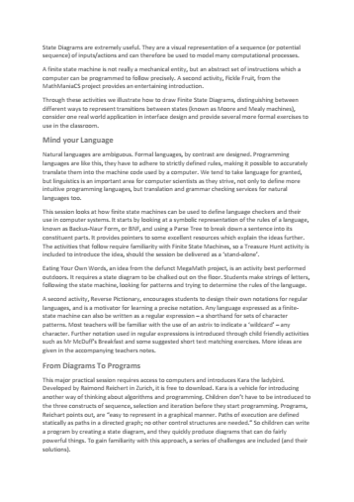
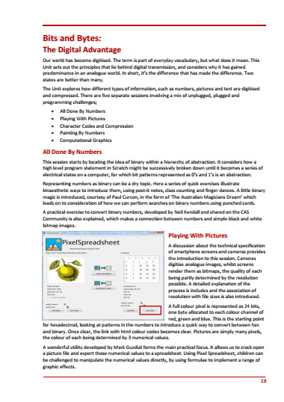
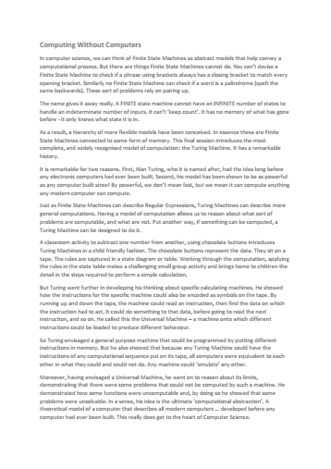
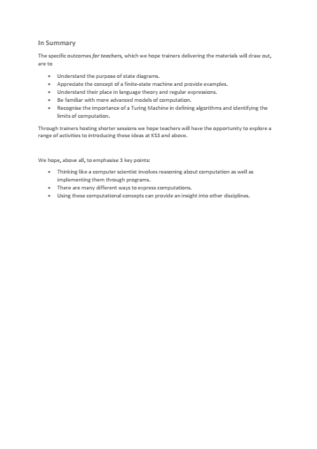
Each
Unit
Notes:
It is important that attendees understand the structure of the supporting resources and their target audience.
A short summary of the content of each Unit can be downloaded and distributed in advance.
A full day Unit is fast paced, aimed at experienced curriculum leaders and potential Tenderfoot trainers.

Slide 4

Each
Unit
Notes:
Each Unit includes a full Trainer Presentation, which follows these introductory slides.

Slide 5
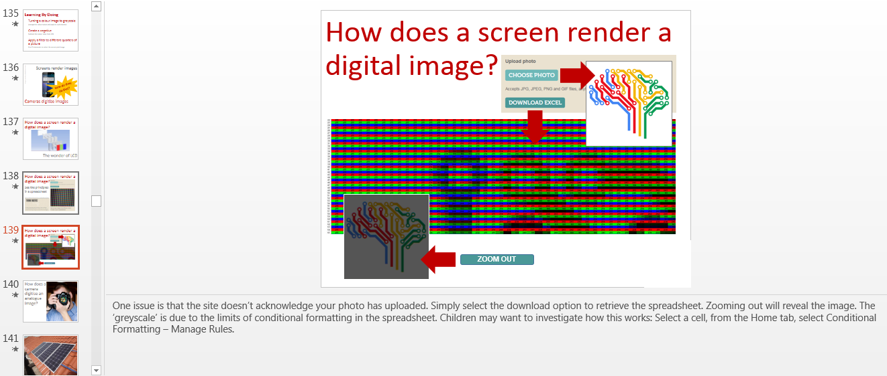
Notes:
The slides include very detailed notes outlining the supporting narrative. Please read them carefully if preparing a presentation.

Slide 6


Each
Unit
Notes:
Training Notes are provided to help with advanced preparation.
These can be distributed at the start of a full day session.
The contents are explained in the following slides.

Slide 7
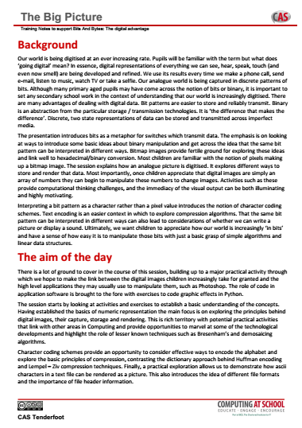
Notes:
The first page sets the subject matter in context, outlines the ‘big picture’ and identifies the learning objectives for teachers new to Computing.
It is worth emphasizing that the purpose of the material is to raise the awareness of teachers to the breadth and depth of the subject, not simply to provide another source of fun activities for classroom use.

Slide 8
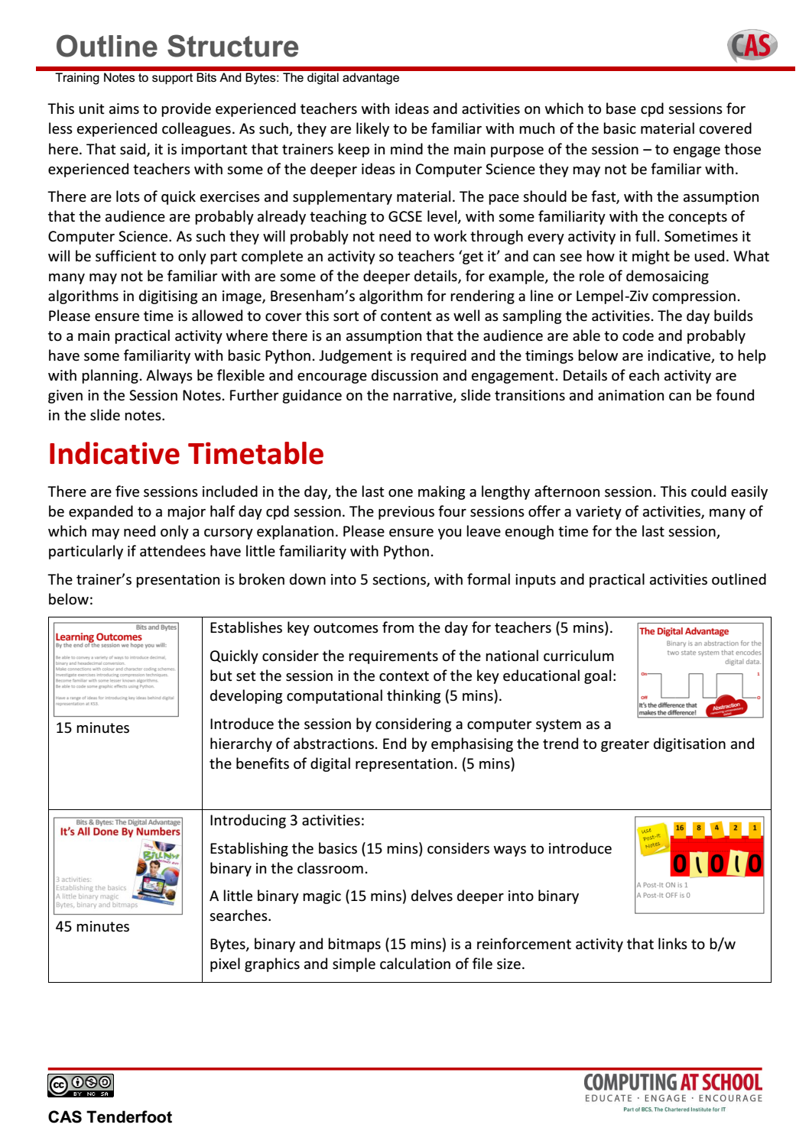
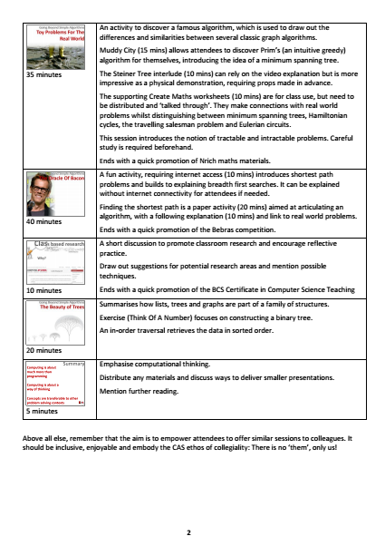
Notes:
An indicative timetable for a full day Unit is included.
A lot of ground is covered, so keeping to time can be challenging!

Slide 9
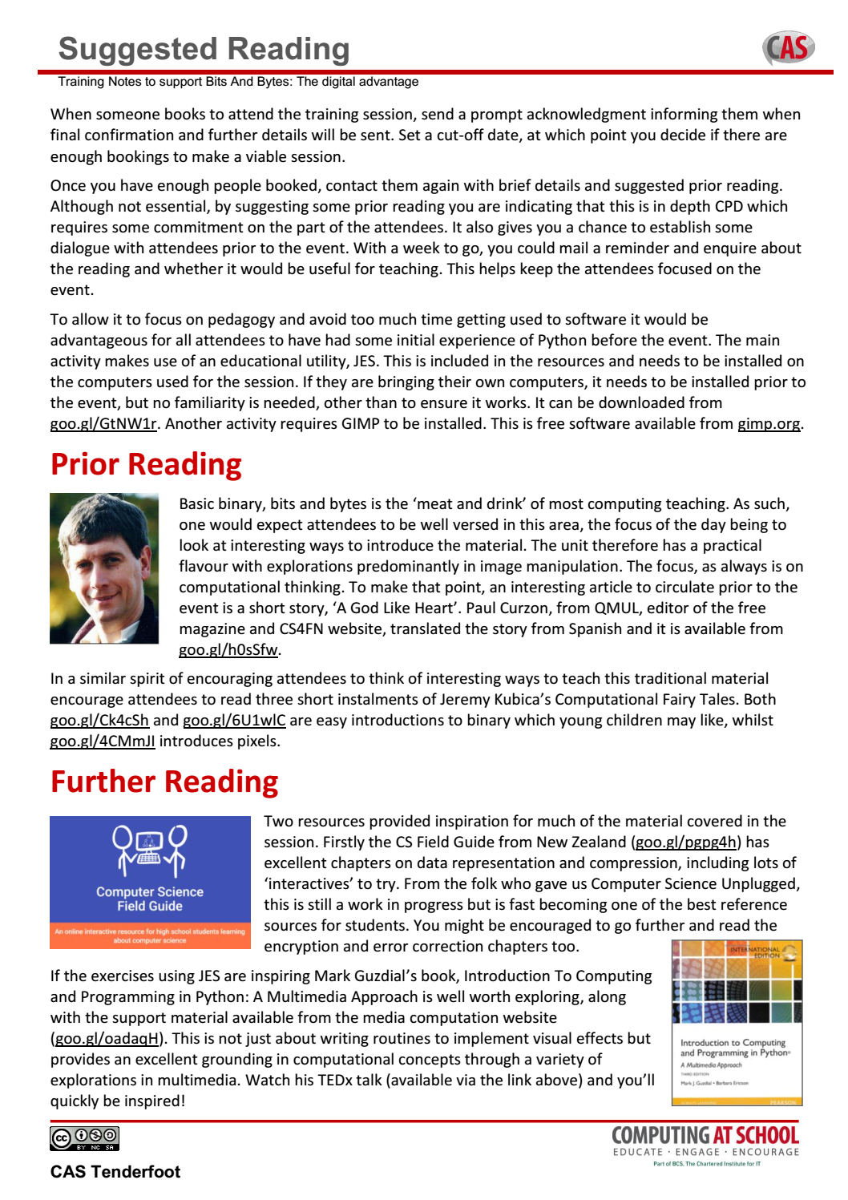
Notes:
Pointers are provided to good CPD practice. Making contact and establishing a dialogue prior to the event is important. Suggesting simple reading or watching a video allows the opportunity to follow up with a reminder.
The ultimate aim is to encourage teachers to dig deeper, so suggested further reading is also included.

Slide 10

Notes:
The Unit is subdivided into sessions. This allows you to take the material and offer shorter sessions to fit local circumstances.
A summary of the sessions and indicative timings is included to facilitate planning.

Slide 11
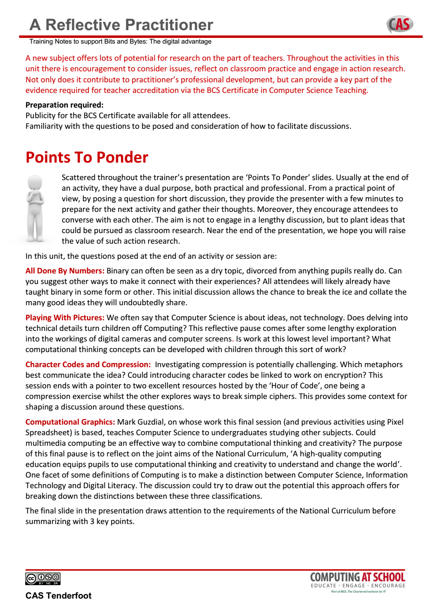
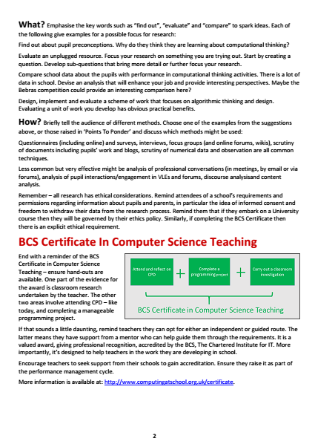
Notes:
Finally, there is a summary of the key points in the presentation where we hope Trainers will facilitate discussion and debate.
A key element in the CPD is to encourage reflective practice, promote action research and encourage teachers to consider the BCS Certificate in CS Teaching.

Slide 12
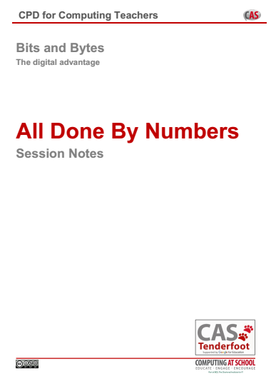
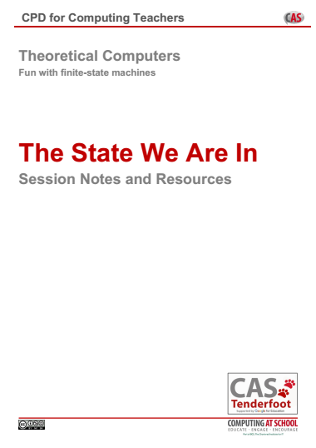
Each
Session

Slide 13


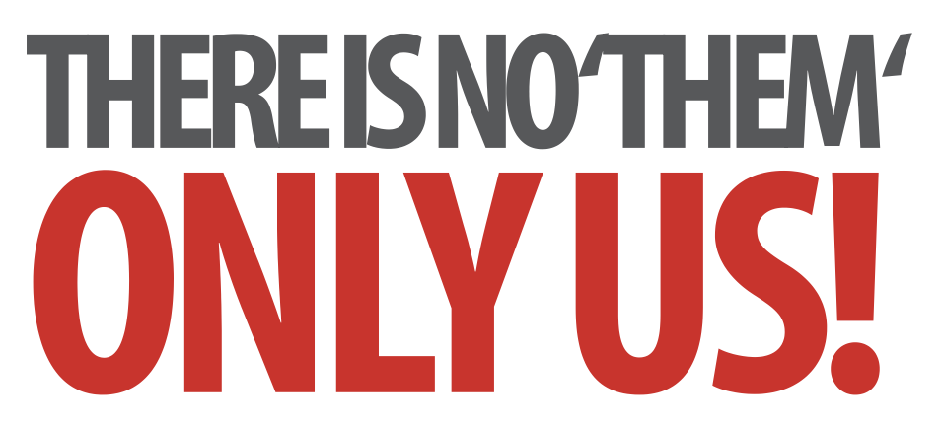
Bits and Bytes
The Digital Advantage
Notes:
Introductory slides that establish a common format to the start of a Master Teacher session. Please do stress the ethos at the start: there is no them – only us! If our subject is to develop all practising teachers have valuable contributions to make, regardless of prior experience. The CAS model recognises that good pedagogy is a process of discussion and development, facilitated through our Community of Practice.

Slide 14
Bits and Bytes
The Digital Advantage
Insert any specific notes
Start / End time
Toilets
Fire Drill / Exits
Notes:
Reminder to go through formalities at start. Placeholders for specific details

Slide 15
Bits and Bytes
Learning Outcomes
By the end of this Unit we hope you will:
Be able to convey a variety of ways to introduce decimal, binary and hexadecimal conversion.
Make connections with colour and character coding schemes.
Investigate exercises introducing compression techniques.
Become familiar with some lesser known algorithms.
Be able to code some graphic effects using Python.
Have a range of ideas for introducing key ideas behind digital representation at KS3.
Notes:
It is important to be explicit about the intended outcomes of the day for attendees.
Do not assume they will be aware of the purpose or target audience of the materials.
By stating the intentions, it helps avoid getting sidetracked into discussing the detail of individual classroom activities.
The primary aim is to educate teachers and illustrate the breadth and depth of Computer Science. The specific outcomes for teachers from this unit, are
Be able to convey a variety of ways to introduce decimal, binary and hexadecimal conversion.
Make connections with colour and character coding schemes.
Investigate exercises introducing compression techniques.
Become familiar with some lesser known algorithms.
Be able to code some graphic effects using Python.
And leave with a range of ideas for introducing key ideas behind digital representation at KS3
The purpose of Tenderfoot is to equip trainers with material and ideas to meet these outcomes and broaden the outlook of teachers new to Computing.
It hopes to provide a buffet of resources on which teachers can draw, to enrich their Key Stage 3 lessons, at the same time as meeting the key aim: providing greater depth of knowledge for teachers themselves.
Developing teachers is the focus, not providing activities for pupils.

Slide 16
The Big Picture
It’s All Done By Numbers
Playing With Pictures
Character Codes and Compression
Painting By Numbers
Computational Graphics
Notes:
Outline of the day.
In each area we’ll introduce specific classroom activities.

Slide 17
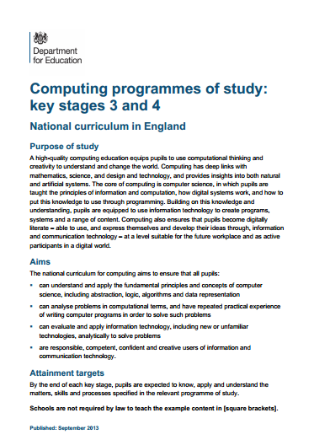
The Big Picture
It’s All Done By Numbers
Playing With Pictures
Character Codes and Compression
Painting By Numbers
Computational Graphics
Notes:
Outline of the day

Slide 18
The Big Picture
Pupils should be taught to:
understand the hardware and
software components that make up
computer systems…
understand how data of various
types can be represented and
manipulated digitally, in the form
of binary digits
understand and use binary digits, such as to be able
to convert between binary and decimal and perform
simple binary addition
Notes:
A brief look at the NC requirements. At this point, it is worth pointing out that we won’t have time to deal with sound, but will focus on numbers, text and pictures.

Slide 19
The Big Picture
✗
Pupils should be taught to:
understand the hardware and
software components that make up
computer systems…
understand how data of various
types can be represented and
manipulated digitally, in the form
of binary digits
understand and use binary digits, such as to be able
to convert between binary and decimal and perform
simple binary addition
Notes:
The NC requirements are not definitive, a skeleton at best. Teachers teach what their knowledge, creativity and ambition allow. Our job is to find ways to develop children’s capacity to think like computer scientists.

Slide 20

✗
✗
Computational
Thinking
Thinking Like a
Computer Scientist
Notes:
We call this Computational Thinking. It lies at the heart of the National Curriculum. Our job is to find ways to develop children’s capacity to use key ideas from computer science to solve problems

Slide 21
Computational
Thinking
A high-quality computing education equips pupils to use computational thinking and creativity to understand and change the world.
Notes:
Regardless of the detail, our over-arching aim is: “A high-quality computing education equips pupils to use computational thinking and creativity to understand and change the world.” Stress the focus on computational thinking.

Slide 22
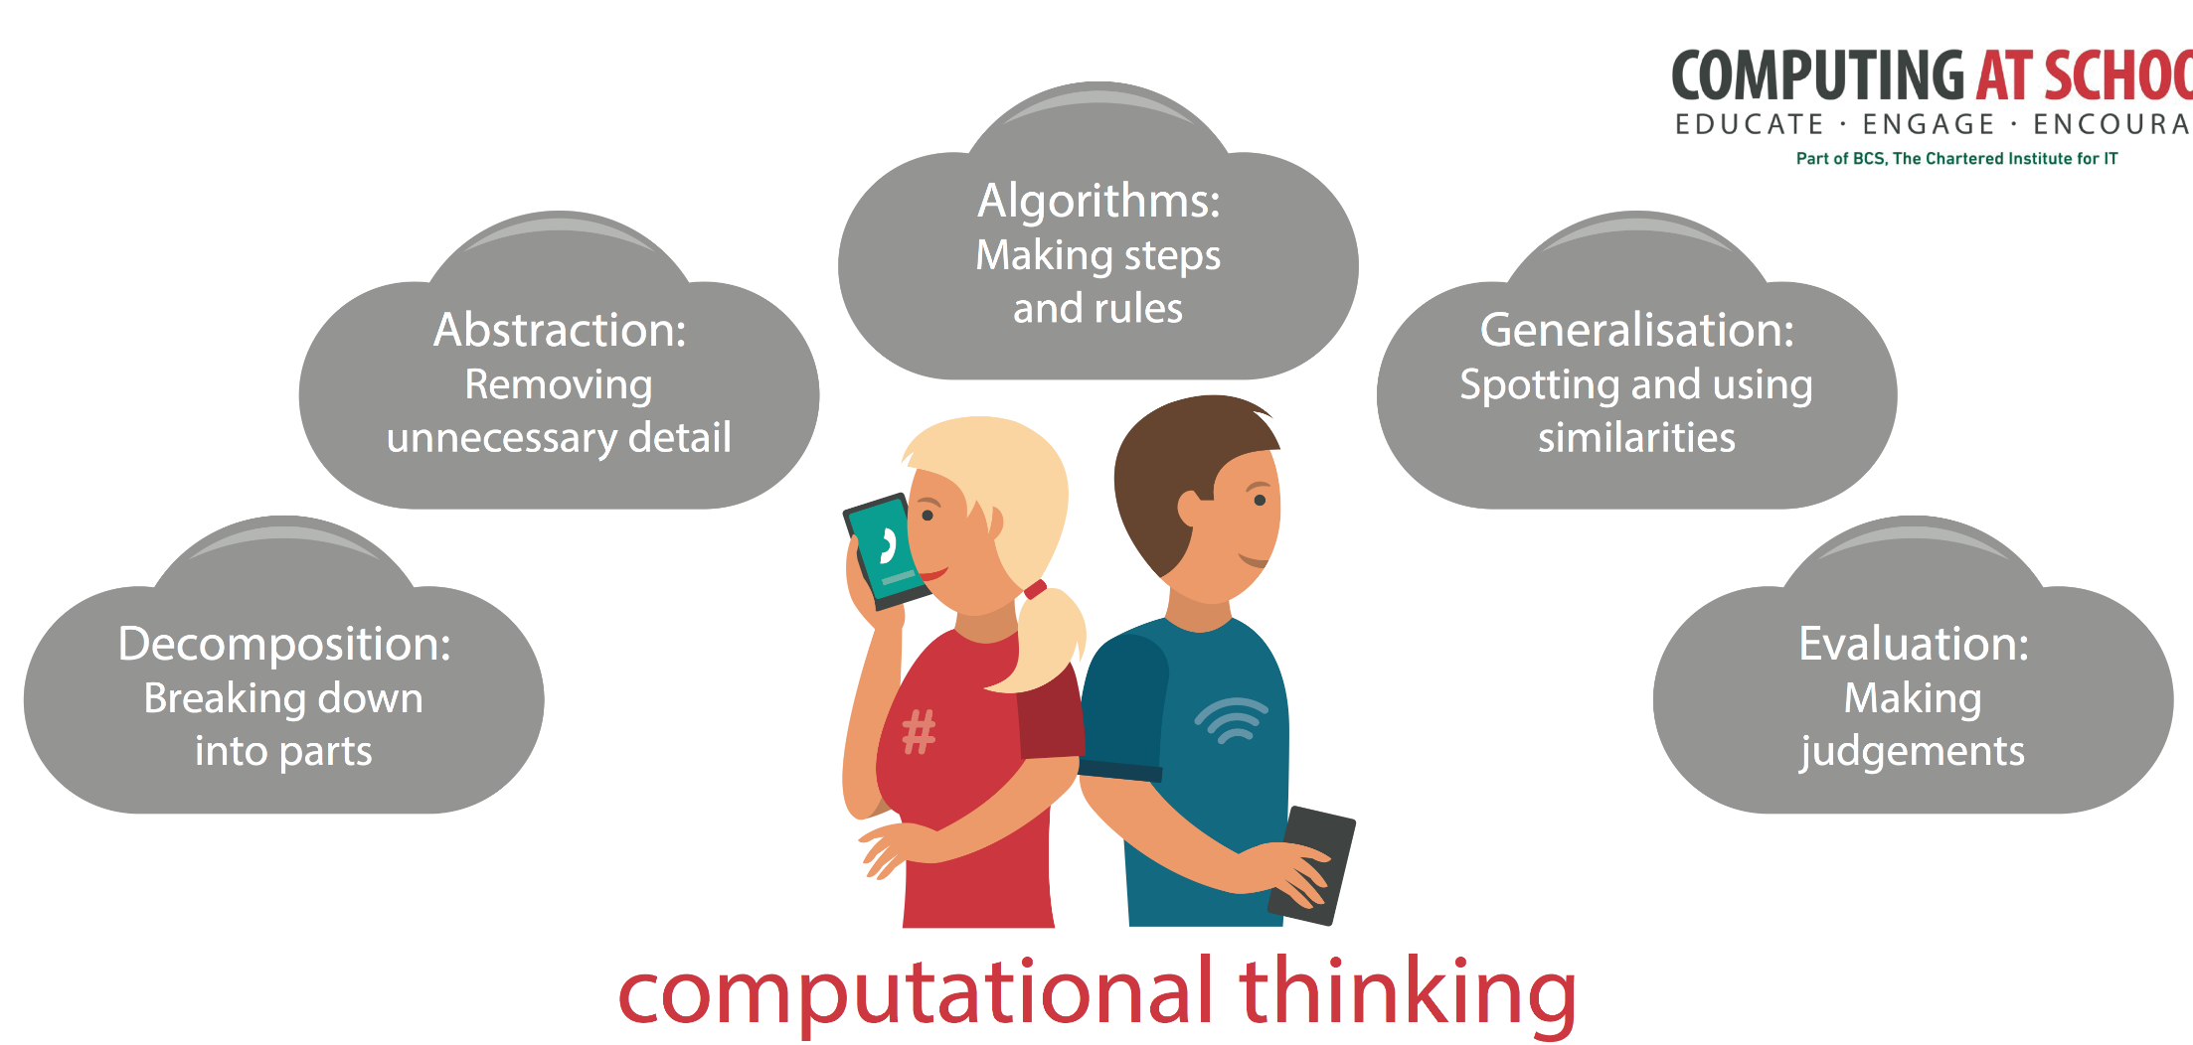
A special way of looking at the world
Notes:
Computational thinking is a particular way of looking at the world. It involves a number of key concepts that occur again and again. CAS have produced a poster that highlights these concepts – great for the classroom wall, so you can keep referring to them whenever the opportunity arises. We’ll be doing this throughout these sessions. They are … each will be revealed on a click.

Slide 23
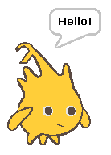
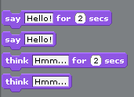

Consider A Scratch Function
Set timer to 0
Take XY position of sprite
Draw bubble above XY
Put text ‘Hello’ in bubble
Delete bubble when timer = 200
Notes:
Consider the idea of abstraction. We use abstraction all the time. Think of a simple function in Scratch. The block hides a lot of mechanical detail – it is an abstraction of the steps required. Abstraction is about the correct level of detail for the problem being solved. In the example our aim is programing the sprite to say things for set periods of time. The ‘mechanical detail’ is hidden as it’s not pertinent to the problem at this level.

Slide 24
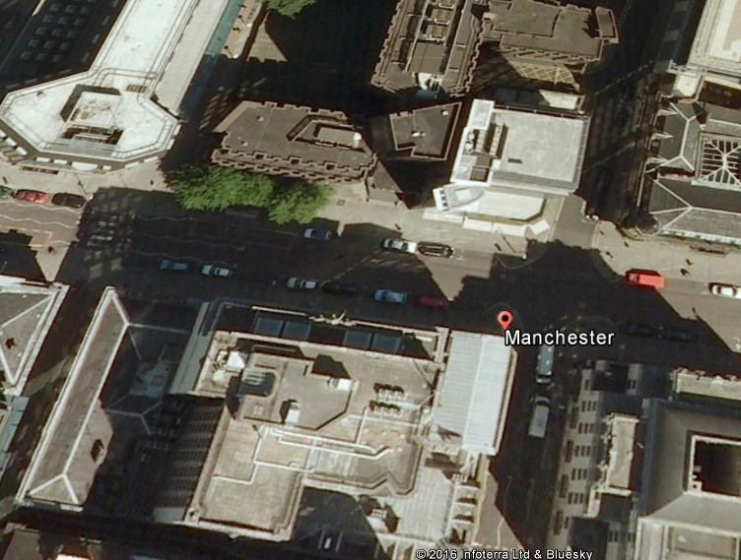
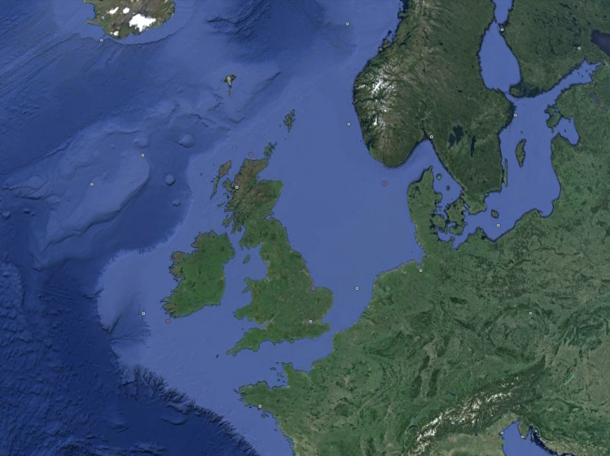
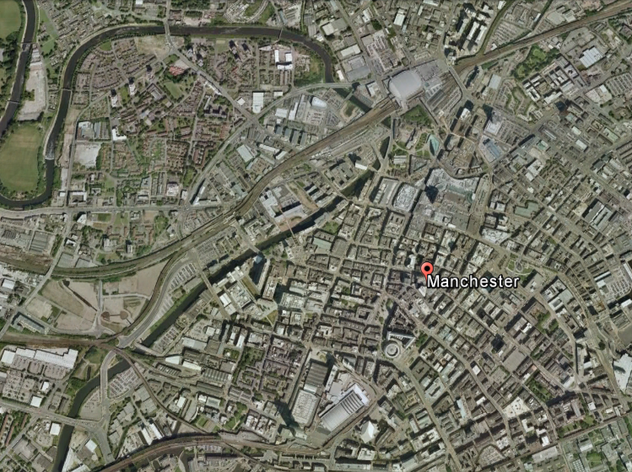
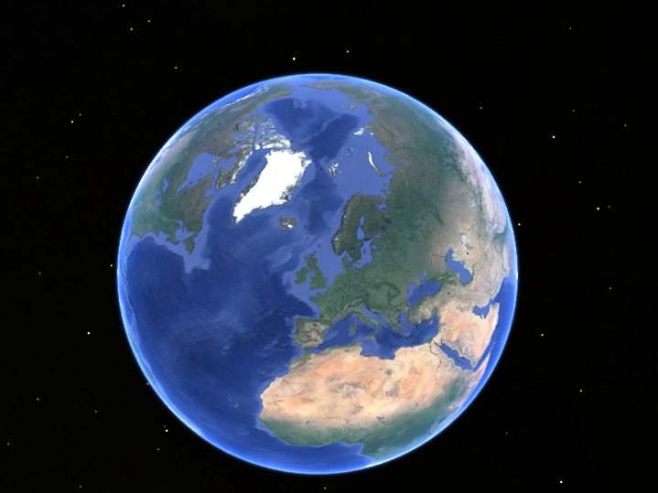
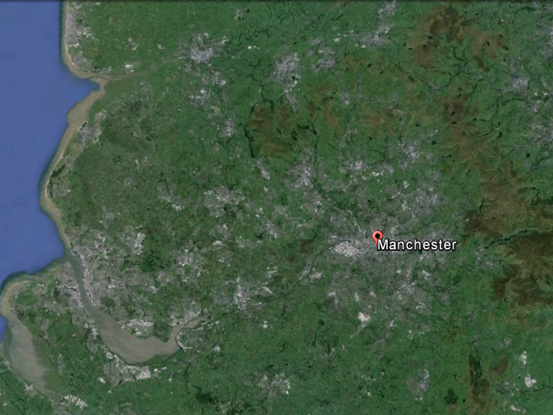
Notes:
We can think of computer systems as a series of abstractions, rather like our view in Google Earth.
To appreciate the world, much detail is hidden.
(click)
But as we zoom in, views at different levels progressively reveal more detail.
The details of which building are on what street in Manchester might be important to a taxi driver, but to an airline pilot, a higher level of abstraction might be more appropriate.

Slide 25
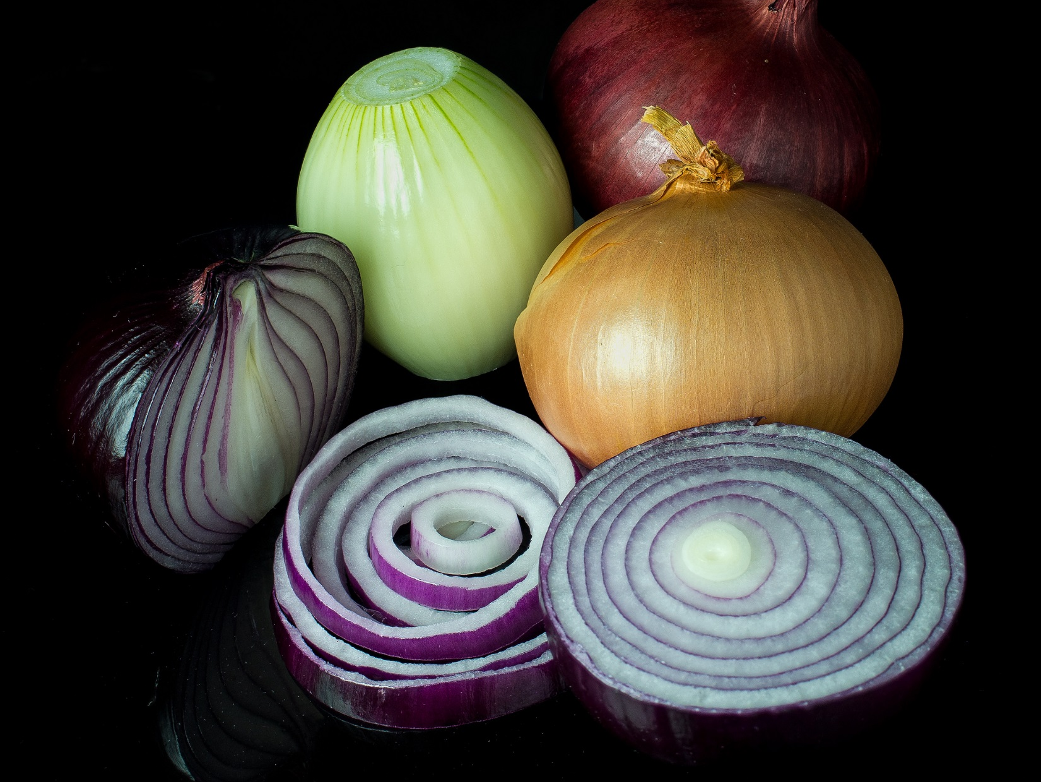
Image CC, courtesy of Colin: goo.gl/y6GOK7
Notes:
Another analogy might be with an onion. You can keep peeling away the layers to expose more underlying detail below.

Slide 26
Human Ideas
Applications Layer
Operating System Layer
Programming Layer
Translation Layer
Layers of Abstraction
Low Level Language
Notes:
At the level of software, we have a hierarchy of abstraction, starting with a users original ideas, communicated via an application, the application interacting with the operating system, both probably written in a high level programming language, translated into a low level code that can be run on the specific machine.

Slide 27
Machine Code
Machine Architecture
Finite State Machine
Logic Gates
Digital Data
Physics!
Layers of Abstraction
Notes:
Similarly, at a hardware level we can look at the machine code, implemented on a particular machine architecture, whose processing can be expressed conceptually as a ‘finite state machine’, implemented through circuits built of logic gates which manipulate the flow of bits. We can go lower and look at how those bits are actually implemented physically – the flow of electrons, but we’re then into the realms of physics.

Slide 28
The Digital Advantage
Binary is an abstraction for the two state system that encodes digital data.
On
1
Off
O
It’s the difference that
makes the difference!
Notes:
Not all early computers were digital, but digital representation triumphed because it allowed unambiguous transmission of data over imperfect media. An ‘on’ or voltage high, might not be quite 5 volts, and an ‘off’ might not be quite 0 volts, but the difference between the two states meant they could still be clearly recognised. It was the difference, the clarity of distinction that made the difference between digital and other types of early data encoding.

Slide 29

Bits & Bytes: The Digital Advantage
It’s All Done By Numbers
3 activities:
Establishing the basics
Binary magic
Bytes, binary and bitmaps
Notes:
The link between switches, on’s and off’s and binary is well made in an entertaining clip from Bill Nye, The Science Guy: a long running American TV series in the 1990’s. A great introduction for pupils, the clip comes from Episode 18, Season 4, Apl 25 1997. At the time of writing, 31 of he 100 episode run are available on iTunes. Hopefully, the Computer episode, although dated, will be made available shortly.
A short 4 minute video from CS Unplugged (00Binary_Counting)is included for teachers unfamiliar with binary numbers.

Slide 30

Establishing the basics
1
activity
What do you notice about these cards?
Notes:
A starter to introduce binary place value. Each pupil / attendee should have a set of cards.
You may get a variety of responses to the question – all possibly valid. The point is to try to draw out from the audience whether they can see any patterns.
An online version is available to use if you prefer.
http://www.mrmaynard.com/activities/binarycards/

Slide 31
By turning some over we can make different numbers.
What number is this?
Notes:
Establishing that we can make different numbers by adding the values on the cards.

Slide 32
And this?

Slide 33
With your own cards, make the numbers 6, 15 and 21.

Slide 34
Class Activity
Layout your cards face down. This represents 0. Now try flipping cards so you count upwards: 1, 2, 3, 4, 5 etc.
Notes:
Once pupils are familiar with this you can ask how many they can count to.

Slide 35
1 0 1 1
When a binary card isn’t showing it is represented by a 0.
A card showing is a 1.
Eleven in decimal is 1011 in binary.
Notes:
The link is established between a 1, representing a card who’s value counts, and a 0 for a card face down.

Slide 36

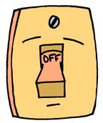
1 1 0 1 1
When a binary card isn’t showing it is represented by a 0.
A card showing is a 1.
Eleven in decimal is 1011 in binary.
Notes:
A link can now be made between the 1’s and 0’s representing switches (On and Off)

Slide 37
What value does this switch represent?
Notes:
And understanding of place value checked.

Slide 38
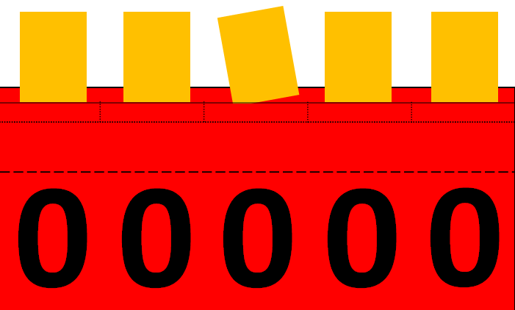
1 1 0 1 1
So what value is this binary pattern?
Notes:
It takes time to reinforce these ideas, so distribute to pairs of pupils the Super Switching Binary Machine.

Slide 39
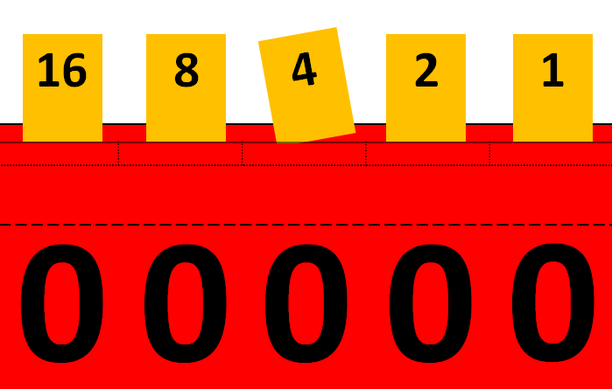

Use
Post-It
Notes
In pairs:
The super switching binary machine
Notes:
Children first insert the place value cards, as a reminder. Then distribute Post-It notes.
The super switching binary machine requires some folding and preparation. An easier version, with place values included can be used and printed directly to card, without the need for further preparation. Both versions are included in the resources.

Slide 40

Use
Post-It
Notes
1
1
A Post-It ON is 1
A Post-It OFF is 0
Notes:
By physically putting post-it’s on the machine, it reinforces the notion of 1/0 equating to On/Off. What number would this represent?
Once set up, try to make this a quickfire activity. See next slide.

Slide 41
As quick as you can….
….. hold up in the air
What is the smallest number you can represent?
What is the largest?
Add 7 + 4
3 + 10
7 - 3
Use
Post-It
Notes
What is the largest number you can count to, using just your fingers?
Notes:
Here we can quickly assess understanding. The last 3 introduce pupils to the notion of doing simple addition / subtraction in their head, but representing the answer in binary.
The final challenge should stimulate them to work out the binary place values for further columns. Have children look at the pattern again of the place value cards in the machine if need be. Don’t tell them the values – the aim is to recognise the pattern.

Slide 42
Bits and Bytes
1 bit on it’s own can represent 2 things (or states). 0 and 1
Grouped together they can represent many things or states.
8 bits together allow 256 different states. The numbers 0 up to 255.
8 bits are termed 1 byte.
4 bits are known as a nibble.
Notes:
Once children understand place values beyond those in the immediate activity we can establish the units of measurement.

Slide 43
Bits and Bytes
1 kilometre = 1000 metres
1 kilogram = 1000 grams
1 kilobyte = 1024 bytes
Why 1024?
1 kilobyte?
Notes:
When bytes are grouped together, why don’t they follow the normal decimal system convention of a ‘kilo’ representing 1000?
The answer lies with binary – our two state system, rather than the decimal 10 state system. If you lift the flap on the binary switching machine where the column value cards sit, you’ll see the values written in a different way.

Slide 44


Bits and Bytes
2⁹
2⁸
2⁷
2⁶
2⁵
2⁴
2³
2²
2¹
2⁰
2 x 2 x 2
2 x 2
Notes:
Start by explaining that 4 is 2 squared, and 8 is 2 cubed. Ask the students to predict what 2 is, expressed in powers of 2. Even if they aren’t familiar with the maths, they should be able to see a pattern, and so also be able to predict 2 to the power 0 (which does cause some difficulty). Going the other way, we can predict 2 to the power 4 and then see the series expand further.

Slide 45
Bits and Bytes
512
256
128
64
32
16
8
4
2
1
2⁹
2⁸
2⁷
2⁶
2⁵
2⁴
2³
2²
2¹
2⁰
?
So 2¹⁰ =
1024
Notes:
Now with the pattern of powers established – increasing by one each time, can the students put the values above them, starting with 2 to the power 5. They may want to try doing 2x2x2x2x2. If so, point out that it is easier to think of it as $2^{4}$ x 2 ie the value doubles. Even if the pupils don’t grasp the maths, point out that by recognising the patterns they are thinking computationally.

Slide 46
Bits and Bytes
1 kilobyte = 1024 bytes
1024 kilobytes =
1024 megabytes =
1024 gigabytes =
1024 terabytes =
1 megabyte
1 gigabyte
1 terabyte
1 petabyte
Challenge: Find out how the series continues.
Extra challenge: Tell me why I am wrong!
Notes:
Children may be familiar with terms like megabytes and gigabytes, so encourage a little research into the series. Wikipedia will explain why, strictly speaking, we should be using terms like kibibyte and mebibyte, which can lead to an interesting discussion about many ambiguous terms now in use in technology.

Slide 47
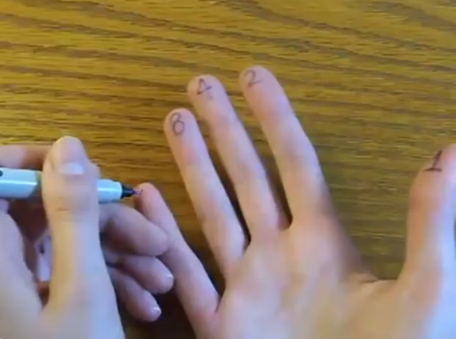
The Binary Hand Dance
Vi Hart
youtu.be/OCYZTg3jahU
Notes:
There are other kinaesthetic ways to introduce binary. Vi Hart’s binary hand dance is a wonderful 3 minute video that provides fun reinforcement. Another way might be to have 4 to 6 children sat in a line on chairs, with a sign showing 0. They act as binary values. As the class chant a count, the correct pupils should stand up, holding aloft a 1 (the reverse side of the 0 sign).

Slide 48
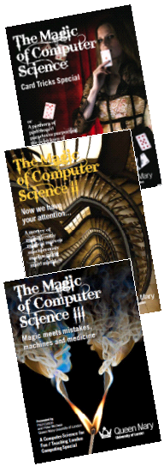
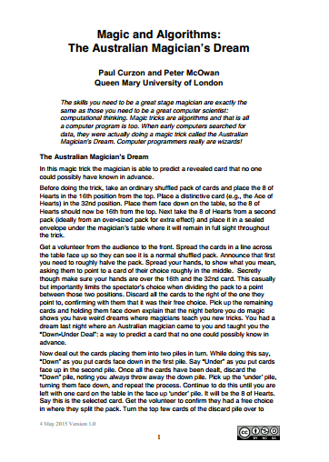
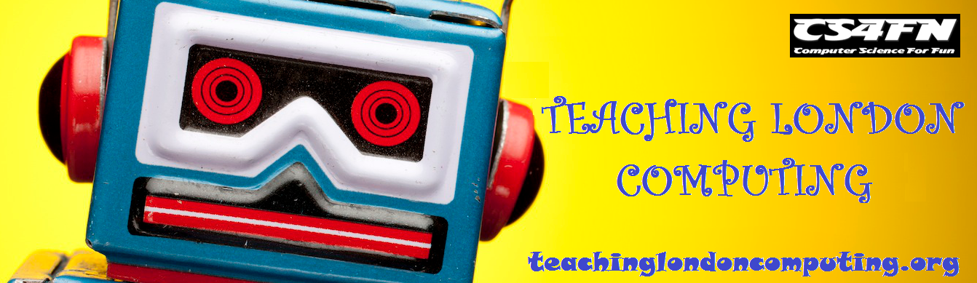
2
A Little Binary Magic
activity
Notes:
Paul Curzon and Peter McOwan have produced 3 volumes of wonderful magic tricks to help illuminate CT concepts. Well worth becoming familiar with some of them to expand your teaching repertoire. One great booklet, produced under the auspices of Teaching London Computing is ‘The Australians Magicians Dream’. This outlines a very effective magic trick and goes on to explain the links to binary and CT concepts. The booklet is included in the resources. A sequence of slides demonstrate the trick, with an explanation of how it works.

Slide 49
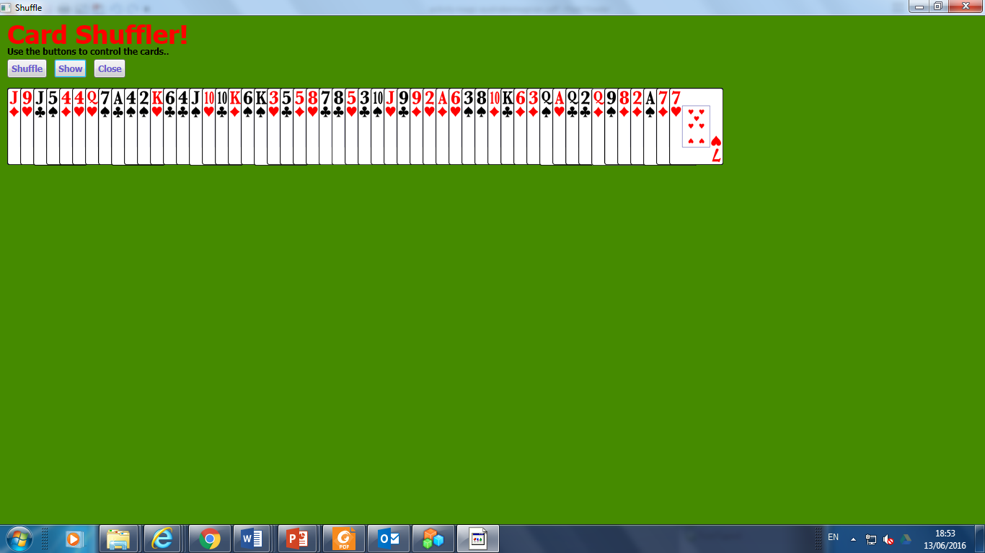




Australian Magician’s Dream
A deck of cards is spread on a table.
Under the table is a sealed envelope.

Slide 50

Australian Magician’s Dream
A spectator is invited to split the deck.
Ask them to choose somewhere near the middle, between the magicians hands.

Slide 51

Australian Magician’s Dream
The lower half are discarded.
The top half gathered up and
placed face down.

Slide 52


Australian Magician’s Dream
Down
Under
Dealt into two piles ‘Down’ (face down) and ‘Under’ (face up) from the top.

Slide 53







Australian Magician’s Dream
Down
Under
Dealt into two piles ‘Down’ (face down) and ‘Under’ (face up) from the top.

Slide 54
Australian Magician’s Dream
Down
Under
Discard the ‘Down’ pile.
Take the Under pile and repeat the process.

Slide 55
Australian Magician’s Dream
Down
Under
Discard the ‘Down’ pile.
Take the Under pile and repeat the process.

Slide 56
Australian Magician’s Dream
Down
Under
Continue until only 1 card remains face up.

Slide 57

Australian Magician’s Dream
Down
Under
Open the envelope to reveal the same card!

Slide 58
Australian Magician’s Dream
How does it work?

Slide 59
Australian Magician’s Dream
16th
32nd
How does it work?

Slide 60
Australian Magician’s Dream
1
2
3
4
5
6
7
8
9
10
11
12
13
14
15
16
17
18
19
20
21
22
23
24
25
26
27
28
92
30
31
How does it work?
Notes:
The deck is prepared in advance, with the 8 of Hearts in position 16. A similar card is placed in the envelope.
Because the participant will split the deck below card 32, at most there will be 31 cards being dealt out.
(click)
Those with a dot will be in the first ‘Down’ discarded pile.

Slide 61
Australian Magician’s Dream
1
2
3
4
5
6
7
8
9
10
11
12
13
14
15
16
17
18
19
20
21
22
23
24
25
26
27
28
29
30
31
How does it work?
Notes:
Those with a dot will be in the first ‘Down’ discarded pile.

Slide 62
Australian Magician’s Dream
1
2
3
4
5
6
7
8
9
10
11
12
13
14
15
16
17
18
19
20
21
22
23
24
25
26
27
28
29
30
31
2
4
6
8
10
12
14
16
18
20
22
24
26
28
30
How does it work?
Notes:
Those with a dot will be in the first ‘Down’ discarded pile, leaving the cards shown.
(click)
Again, every card whose position is an odd number will be discarded on the next pass.

Slide 63
Australian Magician’s Dream
1
2
3
4
5
6
7
8
9
10
11
12
13
14
15
16
17
18
19
20
21
22
23
24
25
26
27
28
29
30
31
2
4
6
8
10
12
14
16
18
20
22
24
26
28
30
4
8
12
16
20
24
28
How does it work?
Notes:
Those with a dot will be in the next ‘Down’ discarded pile, leaving the cards shown.
(click)
Again, every card whose position is an odd number will be discarded on the next pass.

Slide 64
Australian Magician’s Dream
1
2
3
4
5
6
7
8
9
10
11
12
13
14
15
16
17
18
19
20
21
22
23
24
25
26
27
28
29
30
31
2
4
6
8
10
12
14
16
18
20
22
24
26
28
30
4
8
12
16
20
24
28
8
16
24
How does it work?
Notes:
Those with a dot will be in the next ‘Down’ discarded pile, leaving the cards shown.
(click)
Again, every card whose position is an odd number will be discarded on the next pass, leaving the 16th card as the only one remaining.
The trick will always work, provided the number of cards selected is over 16, but less than 32. If 32 had been selected, it would have remained in the final line, leaving another deal, in which card 16 would have been discarded.

Slide 65

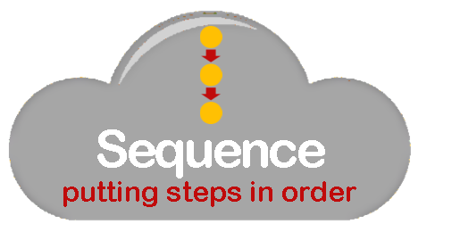

Australian Magician’s Dream
1. Place the chosen card in position 16 2. Discard roughly the bottom half of the pack 3. Repeat 4 times: Repeat until no cards left: Discard a card Keep a card 4. Reveal the card is the one predicted.
Notes:
We can express the trick as an algorithm.
The rules are expressed using two of the three constructs, sequence and repetition, from which all algorithms can be built.

Slide 66
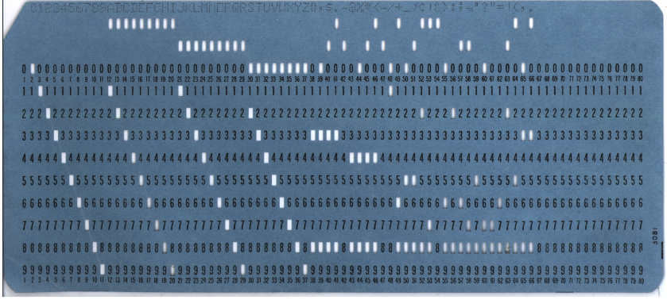
Search Algorithm
Punched Card Searching
1. Place the chosen card in position 16 2. Discard roughly the bottom half of the pack 3. Repeat 4 times: Repeat until no cards left: Discard a card Keep a card 4. Reveal the card is the one predicted.
Notes:
The trick is actually a search algorithm.
It was used to search for a particular value in the days when data was stored on punched cards.
The card shown is an example of a punched card, used on the early Eniac computer.

Slide 67
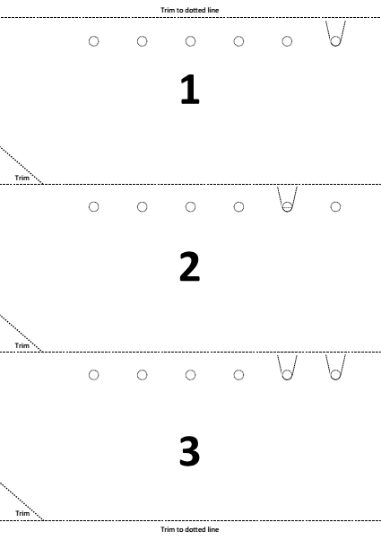
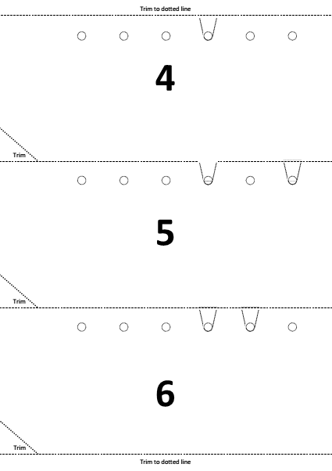
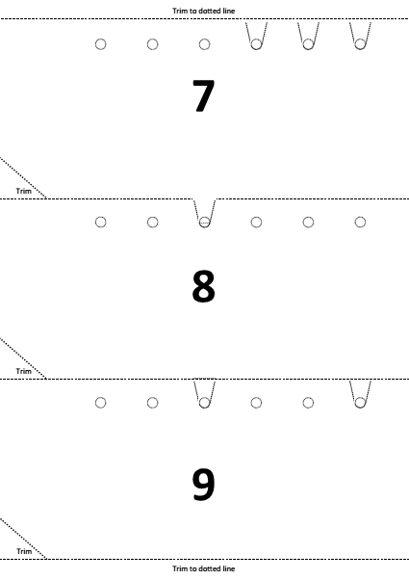
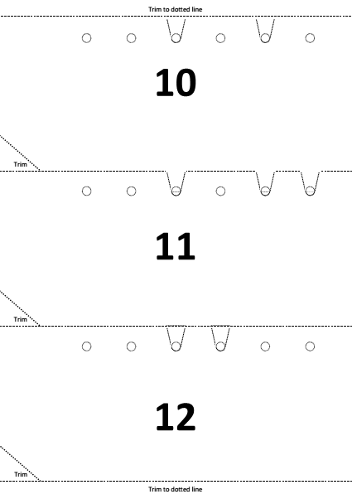
Search Algorithm
Punched Card Searching
Notes:
We can make our own simplified version of punched cards. The template is in the resources. Although it takes some time to prepare, the effect is worth it! Accuracy in creating the cards is key. There are templates for cards up to the value 63, though you will want to only use up to 31 to demonstrate the similarity with the magic trick.

Slide 68
Search Algorithm
Punched Card Searching
32 16 8 4 2 1
0 0 0 1 1 1
Notes:
The cards use slots and holes to represent 1 and 0.
Each card has holes and slots made to represent the binary equivalent of the number on the card, as shown in this example.
Each column represents a binary value column
(click)
A slot represents a binary 1, a hole a zero; the example of 7 is shown.

Slide 69

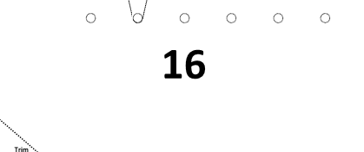

Search Algorithm
Punched Card Searching
0 1 0 0 0 0
Notes:
Like the magic trick, the cards should be kept in order initially.
(click)
If we pass a needle and thread (or skewer) through the rightmost column, what will happen?
All the odd number cards will fall to the floor. These all have slots in that column.
It is the equivalent of our ‘Down-Under’ dealing. We have discarded all the odd numbered cards.
We can then continue, passing the needle through the second hole of the remaining cards, thus removing 2, 6, 10, 14, 18, 22, 26 and 30. The procedure can be repeated for each column until only the 16 remains.

Slide 70
Search Algorithm
Punched Card Searching
0 0 0 1 1 1
Notes:
Any number can be searched for in this fashion. The search will work with cards shuffled into any order.
If we wished to search for seven, binary 000111, pass the needle through each column in turn starting from the rightmost one. But this time retrieve the cards that fall and use those for the next pass.
Whether you use the retained or retrieved cards is given by the binary value of the number. So 7 will use the retrieved cards for each of the next two passes, then the retained cards for successive passes until it is the ony one remaining.

Slide 71
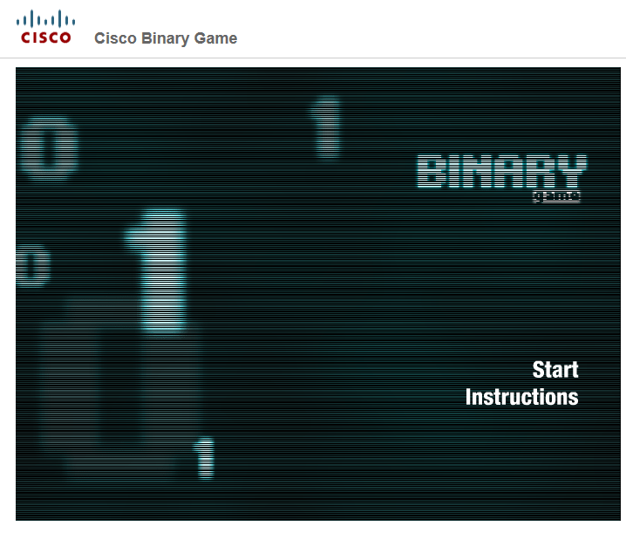
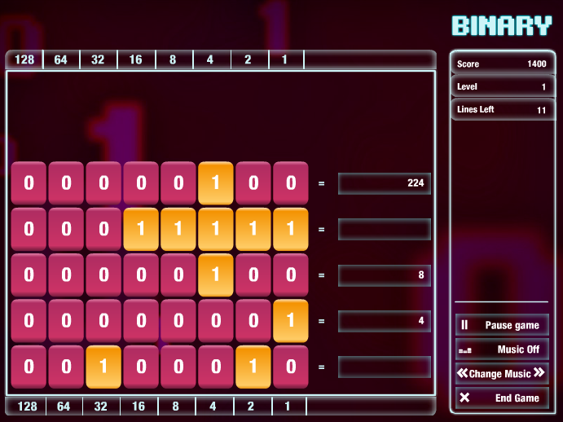
goo.gl/AI2AtX
Notes:
Finally a couple of games worth introducing. Cisco’s Binary Game is fast paced, for practising binary / decimal conversion. Children love it! See http://goo.gl/AI2AtX

Slide 72
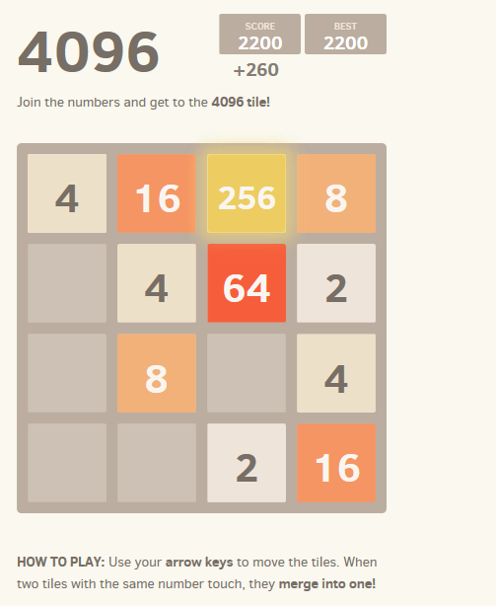
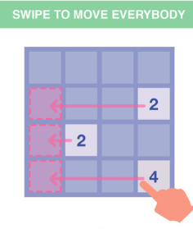

goo.gl/BlFTRp
youtu.be/4p-9-nK-mwY
Notes:
The 4096 game is slightly less obvious, but is very popular! It helps reinforce the sequence of binary place values. Your goal is to combine the tiles until you reach the number 4096. A task that can be much harder than it seems. It is available online (http://goo.gl/BlFTRp) or via iTunes, along with other variants.
If you feel the need for more reinforcement of basic conversion take a look at the Binary Octopus video: https://youtu.be/4p-9-nK-mwY

Slide 73
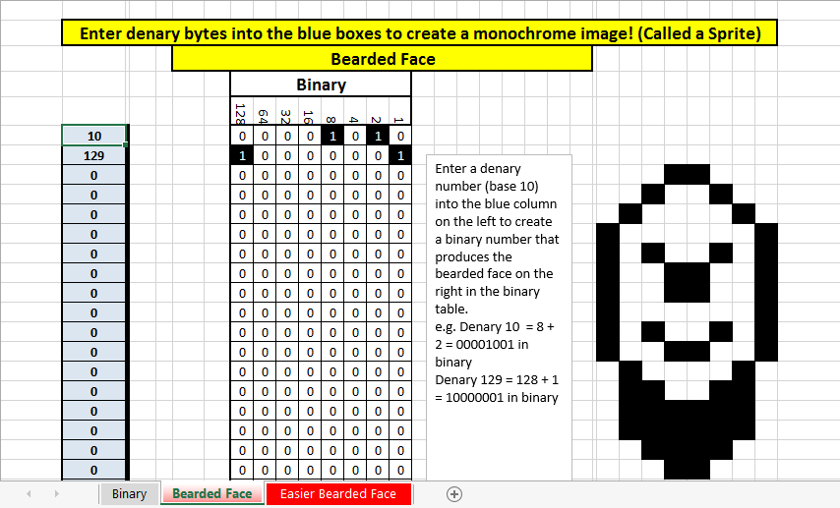
Bytes, Binary and Bitmaps
3
activity
Idea and resources from Neil Kendall and Keith Wyles
Notes:
Another popular CAS resource, shared by Neil Kendall allows the teacher to introduce the idea of binary numbers being interpreted as black or white pixel values. Keith Wyles produced a simpler version (shown) which may be more suitable with students to start with.
Both are included in the resources, we use the harder examples in the presentation.

Slide 74
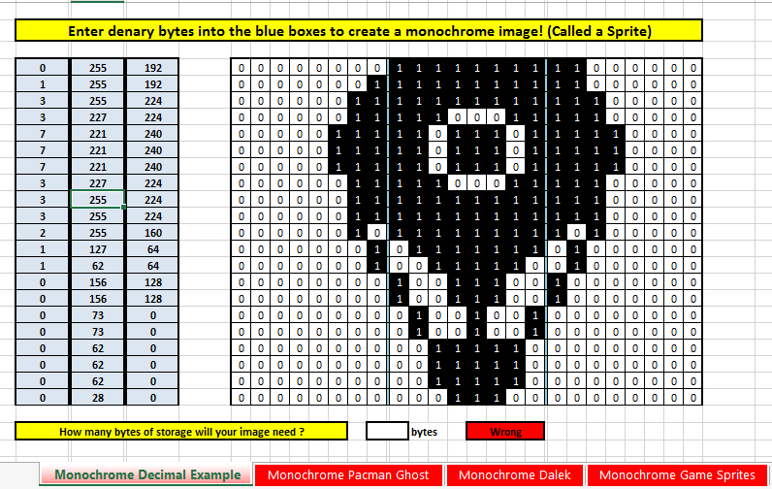
Bytes, Binary and Bitmaps
A practical activity to
develop simple images
Pupils enter 3 numbers (between 0
and 255) per row.
Each is rendered as the 3,
8 bit binary equivalents.
3
activity
Idea and resources from Neil Kendall
Notes:
The challenge is to render simple pictures. It allows pupils to visualise decimal to binary conversions, and gives the opportunity to introduce bytes as a measurement of file size.

Slide 75
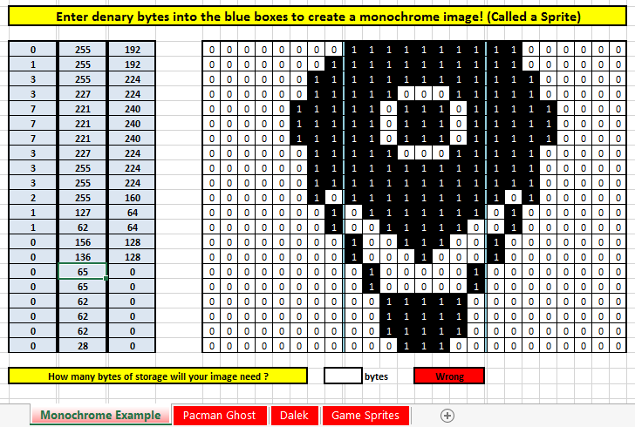
Bytes, Binary and Bitmaps
128 + 64 = 192
128 | 64 | 32 | 16 | 8 | 4 | 2 | 1
1 | 1 | 0 | 0 | 0 | 0 | 0 | 0
Idea and resources from Neil Kendall
Notes:
This activity needs careful explanation. Ensure the students have the correct tab selected, so they see what is displayed. Ensure they read the yellow explanation at the top and highlight the top row of the blue box. Take each of the values in turn, and highlight how the binary equivalent represents 8 monochrome pixels. Take the remaining two values in turn, paying attention to the final one, to ensure pupils see the link between 192 and 11000000.

Slide 76
Bytes, Binary and Bitmaps
Idea and resources from Neil Kendall
Notes:
Finally, point out the challenge to work out the number of bytes required for the whole image.

Slide 77
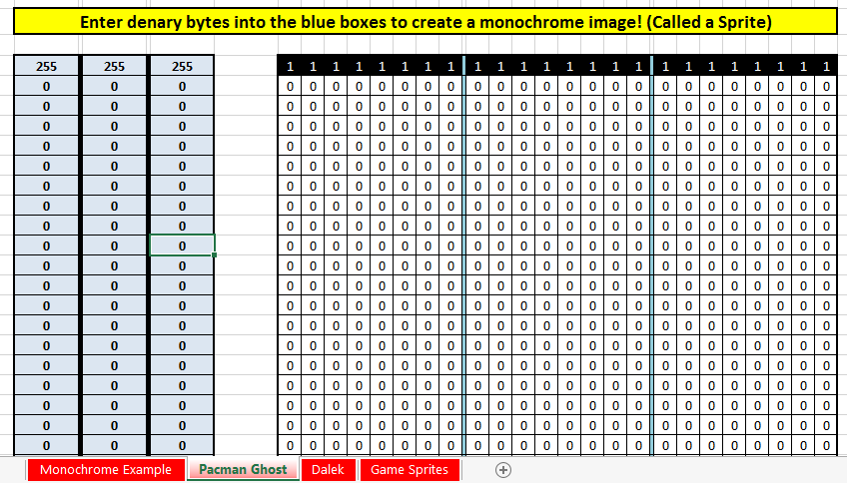
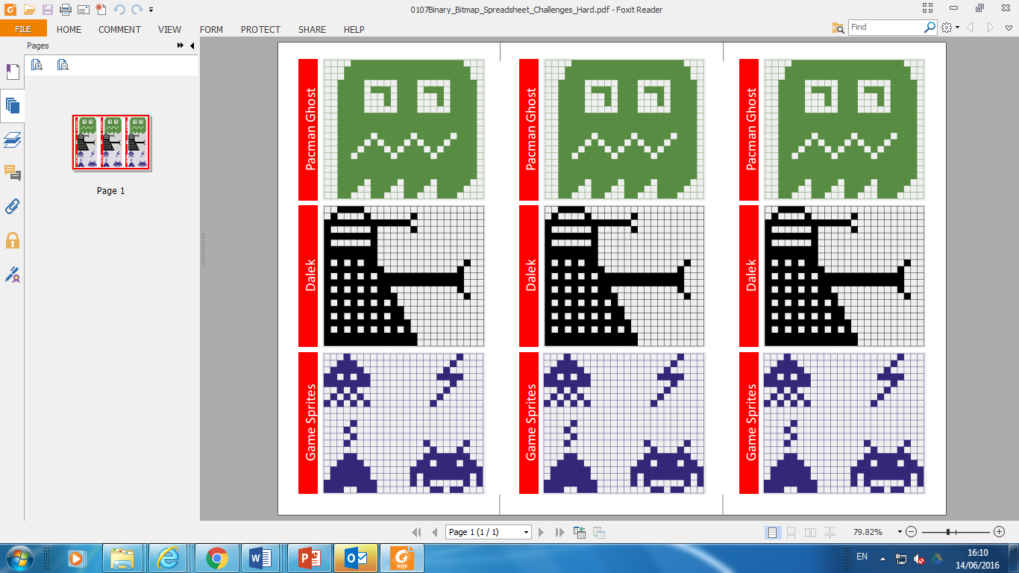
Bytes, Binary and Bitmaps
Idea and resources from Neil Kendall
Notes:
If children need further explanation, move to the Pacman Ghost tab. Here the top row is coloured black as a result of the three 255 values entered. Have the children alter these numbers and observe the result.
(click) The task sheet gives the three images to construct, though choosing one will probably be a long enough activity.

Slide 78
Bytes, Binary and Bitmaps
128 64 32 16 8 4 2 1
128 64 32 16 8 4 2 1
128 64 32 16 8 4 2 1
Idea and resources from Neil Kendall
Notes:
If children need further explanation, move to the Pacman Ghost tab. Here the top row is coloured black as a result of the three 255 values entered. Have the children alter these numbers and observe the result.
(click) The task sheet gives the three images to construct, though choosing one will probably be a long enough activity.

Slide 79


Points to ponder
Binary can often be seen as a dry topic, divorced from anything pupils really do.
Can you suggest other ways to make it connect with their experiences?
Notes:
A brief pause to encourage a short discussion whilst props are tidied up and the presenter gets ready for the next session.
Use this slide to prompt a discussion about approaches to introducing and teaching binary.
All attendees will likely already have taught binary in some form or other. This initial discussion allows the chance to break the ice and collate the many good ideas they will undoubtedly share.

Slide 80
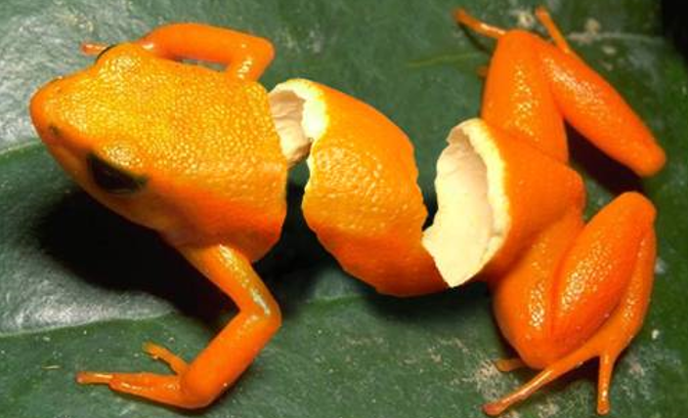
Bits & Bytes: The Digital Advantage
Playing With Pictures
goo.gl/Q92bnR
How do they do that?
Notes:
Graphic design can be stunning and provoke a lot of interest from children into just ‘how do they do that?’ An interesting article with links to good galleries of examples can be found at goo.gl/Q92bnR .

Slide 81
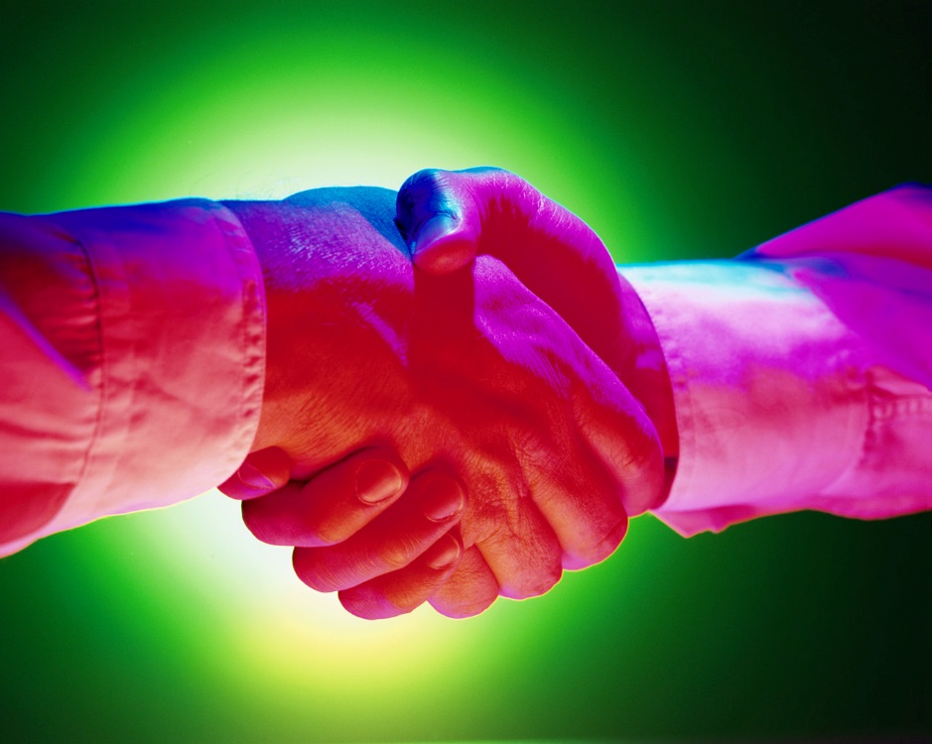
How do they do that?
Can you
decompose into the steps required?
Notes:
If we take a simple picture, with just a grasp of the basics, children should be able to create similar effects. Let them think about the steps required to create this image.

Slide 82
Selecting
Enhancing
Layering
Feathering
Notes:
This picture has been built up using 4 basic techniques. Firstly the handshake has been selected and cut from the original photograph. The image has been enhanced through applying a tint to different areas and it has been layered on top of a background, again created from a green rectangle with a circle removed and the edge feathered.

Slide 83

Notes:
Mastering these simple techniques allows for artistic creativity. The theory of how digital pictures are stored sits very well with creative image manipulation. We don’t need to throw the IT baby out with the bathwater… … but we do need children to understand the basics of digitisation and digital rendering..

Slide 84

Lets talk phones!
Notes:
In this session we start by outlining the basics, introduce hexadecimal and html codes before looking at an activity to manipulate pixel values. Phones are a good starting point for children – a subject dear to their hearts.

Slide 85


Which has the best screen?
Notes:
The next 3 slides are designed to get pupils considering how to evaluate a screen. The Galaxy here has the biggest, but is it the best? Ascerttain whether pupils know how the measurement is derived (across the diagonal).

Slide 86
Which has the best screen?
Notes:
The Lumia has the biggest number here, but what does PPI stand for? (Pixels per inch)

Slide 87
Which has the best screen?
Notes:
Only here do we have the actual resolution of the display.

Slide 88

Which has the best camera?
Notes:
We can also distinguish between the resolution of the display, and the resolution of images captured. We need to unpick what ‘megapixels’ are, and how often these aren’t a precise measurement, rather an indication.

Slide 89

How many
pixels?
9,980,928
Notes:
The number of pixels in an image can be derived from multiplying the resolution figures. In this case, we have a 10 megapixel camera.

Slide 90

Screens render images
Image courtesy of Intel Free Press
Cameras digitize images
Notes:
Image source: https://www.flickr.com/photos/intelfreepress/

Slide 91




Screens render images
4
Cameras digitize images
activity
Notes:
A short activity, based on one first developed by CSInside for children to try to digitize images at different resolutions is included.
The class is split into two groups on either side of the room. One half receive the Star picture, the other half the face. They need to keep the image hidden from the other side.
The activity can work on two levels. As a simple activity, children should digitise an image and swap it with someone on the other side who has a similar resolution grid. When everyone has rendered the coded image they receive results for the group can be compared. This makes the simple point that the higher the resolution, the clearer the representation. This can lead to a discussion of how to best digitise an image. Is it always best to code a 1 where black appears, even if it is a tiny proportion of the pixel? Perhaps there are better rules to adopt? Should it be 1 if only a tiny bit of black is in the square? Let them decide the rule, but insist it is applied consistently. This is the challenge posed by ‘subpixel’ rendering. The process is known as rasterization. In graphics software digitising a line / curve etc. is usually achieved using a variant of Bresenham’s algorithm. There is a nice online demonstration of rasterization at http://goo.gl/BxXJqe. Where shades of grey are possible, these too an be employed to represent part of a pixel (anti-aliasing), but this often leads to a blurred effect.
A more complex adaptation is to swap digitised images randomly. In this case the recipient will receive one of three possibilities:
an image digitised at the same resolution as they intend to render.
an image digitised at a lower resolution than their rendering grid or
an image digitised at a higher resolution than they can render.
The first two present no further challenges – the child has no choice in how they render the data. The point can be made that an image cannot be displayed at a higher resolution than it was digitised. In the third case though, children are presented with the challenge of how to render clusters of 4 pixels. This is worthy of a class discussion. There are no simple correct answers, other than a consistent approach being called for. However, it can be used to highlight real challenges in computer graphics, often referred to as LOD (Level of Detail) or mipmapping. As a figure, for example moves into the distance in a game, the pixel representation of it has to be reduced, presenting a similar challenge to the one we are considering.

Slide 92

Thinking
About
Files
The more pixels,
the greater the resolution.
The greater the resolution, the better the image.
The better the image, the bigger the file!
Notes:
Once resolution is understood, we can introduce the idea of different files sizes. By zooming in on the eye, children can begin to appreciate the number of pixels involved – this tiny image snippet has over 450 pixels!

Slide 93

Notes:
Ask children which would be a bigger file – one picture, or an entire novel?
Lets estimate about 12 words per line. About 7 or 8 letters on average in a word, and about 40 lines per page. That’s around 90 bytes (characters) per line, so 3,600 bytes per page. A thousand pages would be 3,600,000 bytes – around 3.5 MB.
An uncompressed 10 megapixel picture, using 3 bytes per pixel would be about 8 or 9 times bigger. Of course, both pictures and text are usually compressed – we’ll look at that later.

Slide 94


Image courtesy of Wikipedia
Notes:
In simple form, a moving image can be considered like a ‘flick book’ – a series of images. Multimedia files will include sound as well.
Image source: https://en.wikipedia.org/wiki/Horse#/media/File:Muybridge_race_horse_animated.gif

Slide 95
Text = small
Picture = big
Multimedia
= huge
Notes:
At this point, pupils may well ask how video can be streamed. It would be a good time to mention that transmission of sound, pictures and video would not be possible without clever compression algorithms. Most common media files are compressed…

Slide 96


http://windirstat.info
Notes:
WinDirStat is a free utility that displays files visually by size and type. It can be very useful for children to begin to appreciate varying file sizes associated with different media. Notice here the two big files highlighted, both of which are videos.

Slide 97


Understanding Colour
Notes:
When an image is rendered, each pixel is lit by a combination of 3 colours; red, green and blue (RGB). RGB is an additive colour model, that is the light is added to a black screen. By contrast, when a picture is printed on white paper, light has to be removed to reneder the correct colours. Three translucent colours, Cyan, Magenta and Yellow (CMYK – the K represents black) are combined in this subtractive colour model.

Slide 98


Full Colour Bitmaps
Each pixel is made of RGB values in the range 0-255
Examples
Notes:
Given this explanation of full colour representation, ask how many bits (or bytes) are required to store each pixel value. 1 byte will be needed for each colour (because 255 is represented in binary as 1111 1111), so 3 bytes (or 24 bits) are required. In actual fact, a 4th byte usually stores a value for transparency as well.

Slide 99
Full Colour Bitmaps
How would each pixel be represented in a computers memory?
Red Value |  |  |  |  |  |  |  | Green Value |  |  |  |  |  |  |  | Blue Value
128 | 64 | 32 | 16 | 8 | 4 | 2 | 1 | 128 | 64 | 32 | 16 | 8 | 4 | 2 | 1 | 128 | 64 | 32 | 16 | 8 | 4 | 2 | 1
Examples
Notes:
You can use this slide as a class teaching tool, with children being asked to fill in the binary values.
The following 3 slides have answers for each example

Slide 100
Full Colour Bitmaps
How would each pixel be represented in a computers memory?
Red Value |  |  |  |  |  |  |  | Green Value |  |  |  |  |  |  |  | Blue Value
128 | 64 | 32 | 16 | 8 | 4 | 2 | 1 | 128 | 64 | 32 | 16 | 8 | 4 | 2 | 1 | 128 | 64 | 32 | 16 | 8 | 4 | 2 | 1
0 | 0 | 1 | 0 | 0 | 0 | 1 | 0 | 1 | 0 | 1 | 1 | 0 | 0 | 1 | 0 | 0 | 1 | 0 | 0 | 1 | 1 | 0 | 0

Slide 101
Full Colour Bitmaps
How would each pixel be represented in a computers memory?
Red Value |  |  |  |  |  |  |  | Green Value |  |  |  |  |  |  |  | Blue Value
128 | 64 | 32 | 16 | 8 | 4 | 2 | 1 | 128 | 64 | 32 | 16 | 8 | 4 | 2 | 1 | 128 | 64 | 32 | 16 | 8 | 4 | 2 | 1
1 | 0 | 0 | 1 | 1 | 0 | 0 | 1 | 0 | 0 | 0 | 0 | 0 | 0 | 0 | 0 | 0 | 0 | 0 | 0 | 0 | 0 | 0 | 0

Slide 102
Full Colour Bitmaps
How would each pixel be represented in a computers memory?
Red Value |  |  |  |  |  |  |  | Green Value |  |  |  |  |  |  |  | Blue Value
128 | 64 | 32 | 16 | 8 | 4 | 2 | 1 | 128 | 64 | 32 | 16 | 8 | 4 | 2 | 1 | 128 | 64 | 32 | 16 | 8 | 4 | 2 | 1
0 | 0 | 1 | 1 | 0 | 0 | 1 | 1 | 0 | 1 | 1 | 0 | 0 | 1 | 1 | 0 | 0 | 1 | 1 | 0 | 0 | 1 | 1 | 0

Slide 103
Hexadecimal Numbers
Binary use two digits
0 and 1
We use the decimal system because we have ten digits on our hands.
0 1 2 3 4 5 6 7 8 and 9
What might we use if we had 16 fingers?
Notes:
Encourage children to come up with any sensible ideas. We want to encourage an understanding of place values. The key point is we only have ten numeric digits in our language, so we need to agree a set of symbols to represent digits equating to 10, 11, 12, 13, 14 and 15. Clearly in base16, 10 means something very different to 10 in base10.

Slide 104
Decimal, Binary & Hex
Decimal | Binary | Hexadecimal
0 | 0000 | 0
1 | 0001 | 1
2 | 0010 | 2
3 | 0011 | 3
4 | 0100 | 4
5 | 0101 | 5
6 | 0110 | 6
7 | 0111 | 7
8 | 1000 | 8
9 | 1001 | 9
10 | 1010 | A
11 | 1011 | B
12 | 1100 | C
13 | 1101 | D
14 | 1110 | E
15 | 1111 | F
16 | 10000 | 10
17 | 10001 | 11
Let’s compare all 3 ways of writing numbers

Slide 105
Decimal, Binary & Hex
Decimal | Binary | Hexadecimal
0 | 0000 | 0
1 | 0001 | 1
2 | 0010 | 2
3 | 0011 | 3
4 | 0100 | 4
5 | 0101 | 5
6 | 0110 | 6
7 | 0111 | 7
8 | 1000 | 8
9 | 1001 | 9
10 | 1010 | A
11 | 1011 | B
12 | 1100 | C
13 | 1101 | D
14 | 1110 | E
15 | 1111 | F
16 | 10000 | 10
17 | 10001 | 11
How many digits do these numbers have?

Slide 106
Decimal, Binary & Hex
Decimal | Binary | Hexadecimal
0 | 0000 | 0
1 | 0001 | 1
2 | 0010 | 2
3 | 0011 | 3
4 | 0100 | 4
5 | 0101 | 5
6 | 0110 | 6
7 | 0111 | 7
8 | 1000 | 8
9 | 1001 | 9
10 | 1010 | A
11 | 1011 | B
12 | 1100 | C
13 | 1101 | D
14 | 1110 | E
15 | 1111 | F
16 | 10000 | 10
17 | 10001 | 11
What about these?

Slide 107
Decimal, Binary & Hex
Decimal | Binary | Hexadecimal
0 | 0000 | 0
1 | 0001 | 1
2 | 0010 | 2
3 | 0011 | 3
4 | 0100 | 4
5 | 0101 | 5
6 | 0110 | 6
7 | 0111 | 7
8 | 1000 | 8
9 | 1001 | 9
10 | 1010 | A
11 | 1011 | B
12 | 1100 | C
13 | 1101 | D
14 | 1110 | E
15 | 1111 | F
16 | 10000 | 10
17 | 10001 | 11
And these?
Notes:
Each hexadecimal digit equates to 4 binary digits – try to encourage children to spot this. The next few slides should make it clear.

Slide 108
Thinking About Place Value
Try these conversions. Two are given to help you get started.
Decimal Value |  |  |  |  |  |  |  | Binary Value |  |  |  |  |  |  |  | Hexadecimal Value
 |  | 100 | 10 | 1 |  |  |  | 128 | 64 | 32 | 16 | 8 | 4 | 2 | 1 |  |  |  | 16 | 1
 |  |  |  | 1 |  |  |  |  |  |  |  | 0 | 0 | 0 | 1 |  |  |  |  | 1
 |  |  |  | 2 |  |  |  |  |  |  |  | 0 | 0 | 1 | 0 |  |  |  |  | 2
 |  |  | 1 | 5 |  |  |  |  |  |  |  | 1 | 1 | 1 | 1 |  |  |  |  | F
 |  |  | 1 | 6 |  |  |  |  |  |  | 1 | 0 | 0 | 0 | 0 |  |  |  | 1 | 0
 |  |  | 3 | 1 |  |  |  |  |  |  | 1 | 1 | 1 | 1 | 1 |  |  |  | 1 | F
 |  |  | 3 | 2 |  |  |  |  |  | 1 | 0 | 0 | 0 | 0 | 0 |  |  |  | 2 | 0
 |  |  | 6 | 4 |  |  |  |  | 1 | 0 | 0 | 0 | 0 | 0 | 0 |  |  |  | 4 | 0
 |  | 2 | 5 | 5 |  |  |  | 1 | 1 | 1 | 1 | 1 | 1 | 1 | 1 |  |  |  | F | F
Examples
Notes:
First some practice converting to binary and hexadecimal.

Slide 109
Thinking About Place Value
Can you see a pattern between the highlighted bits?
Decimal Value |  |  |  |  |  |  |  | Binary Value |  |  |  |  |  |  |  | Hexadecimal Value
 |  | 100 | 10 | 1 |  |  |  | 128 | 64 | 32 | 16 | 8 | 4 | 2 | 1 |  |  |  | 16 | 1
 |  |  |  | 1 |  |  |  |  |  |  |  | 0 | 0 | 0 | 1 |  |  |  |  | 1
 |  |  |  | 2 |  |  |  |  |  |  |  | 0 | 0 | 1 | 0 |  |  |  |  | 2
 |  |  | 1 | 5 |  |  |  |  |  |  |  | 1 | 1 | 1 | 1 |  |  |  |  | F
 |  |  | 1 | 6 |  |  |  |  |  |  | 1 | 0 | 0 | 0 | 0 |  |  |  | 1 | 0
 |  |  | 3 | 1 |  |  |  |  |  |  | 1 | 1 | 1 | 1 | 1 |  |  |  | 1 | F
 |  |  | 3 | 2 |  |  |  |  |  | 1 | 0 | 0 | 0 | 0 | 0 |  |  |  | 2 | 0
 |  |  | 6 | 4 |  |  |  |  | 1 | 0 | 0 | 0 | 0 | 0 | 0 |  |  |  | 4 | 0
 |  | 2 | 5 | 5 |  |  |  | 1 | 1 | 1 | 1 | 1 | 1 | 1 | 1 |  |  |  | F | F
Examples
Notes:
The zero in hex equates to the zero in the first 4 bits of the binary number

Slide 110
Thinking About Place Value
Can you see a pattern between the highlighted bits?
Decimal Value |  |  |  |  |  |  |  | Binary Value |  |  |  |  |  |  |  | Hexadecimal Value
 |  | 100 | 10 | 1 |  |  |  | 128 | 64 | 32 | 16 | 8 | 4 | 2 | 1 |  |  |  | 16 | 1
 |  |  |  | 1 |  |  |  |  |  |  |  | 0 | 0 | 0 | 1 |  |  |  |  | 1
 |  |  |  | 2 |  |  |  |  |  |  |  | 0 | 0 | 1 | 0 |  |  |  |  | 2
 |  |  | 1 | 5 |  |  |  |  |  |  |  | 1 | 1 | 1 | 1 |  |  |  |  | F
 |  |  | 1 | 6 |  |  |  |  |  |  | 1 | 0 | 0 | 0 | 0 |  |  |  | 1 | 0
 |  |  | 3 | 1 |  |  |  |  |  |  | 1 | 1 | 1 | 1 | 1 |  |  |  | 1 | F
 |  |  | 3 | 2 |  |  |  |  |  | 1 | 0 | 0 | 0 | 0 | 0 |  |  |  | 2 | 0
 |  |  | 6 | 4 |  |  |  |  | 1 | 0 | 0 | 0 | 0 | 0 | 0 |  |  |  | 4 | 0
 |  | 2 | 5 | 5 |  |  |  | 1 | 1 | 1 | 1 | 1 | 1 | 1 | 1 |  |  |  | F | F
Examples
Notes:
It is the same every time it occurs.

Slide 111
Thinking About Place Value
Can you see a pattern between the highlighted bits?
Decimal Value |  |  |  |  |  |  |  | Binary Value |  |  |  |  |  |  |  | Hexadecimal Value
 |  | 100 | 10 | 1 |  |  |  | 128 | 64 | 32 | 16 | 8 | 4 | 2 | 1 |  |  |  | 16 | 1
 |  |  |  | 1 |  |  |  |  |  |  |  | 0 | 0 | 0 | 1 |  |  |  |  | 1
 |  |  |  | 2 |  |  |  |  |  |  |  | 0 | 0 | 1 | 0 |  |  |  |  | 2
 |  |  | 1 | 5 |  |  |  |  |  |  |  | 1 | 1 | 1 | 1 |  |  |  |  | F
 |  |  | 1 | 6 |  |  |  |  |  |  | 1 | 0 | 0 | 0 | 0 |  |  |  | 1 | 0
 |  |  | 3 | 1 |  |  |  |  |  |  | 1 | 1 | 1 | 1 | 1 |  |  |  | 1 | F
 |  |  | 3 | 2 |  |  |  |  |  | 1 | 0 | 0 | 0 | 0 | 0 |  |  |  | 2 | 0
 |  |  | 6 | 4 |  |  |  |  | 1 | 0 | 0 | 0 | 0 | 0 | 0 |  |  |  | 4 | 0
 |  | 2 | 5 | 5 |  |  |  | 1 | 1 | 1 | 1 | 1 | 1 | 1 | 1 |  |  |  | F | F
Examples
Notes:
Here, the F digit in hex equates to 15 in binary

Slide 112
Thinking About Place Value
Can you see a pattern between the highlighted bits?
Decimal Value |  |  |  |  |  |  |  | Binary Value |  |  |  |  |  |  |  | Hexadecimal Value
 |  | 100 | 10 | 1 |  |  |  | 128 | 64 | 32 | 16 | 8 | 4 | 2 | 1 |  |  |  | 16 | 1
 |  |  |  | 1 |  |  |  |  |  |  |  | 0 | 0 | 0 | 1 |  |  |  |  | 1
 |  |  |  | 2 |  |  |  |  |  |  |  | 0 | 0 | 1 | 0 |  |  |  |  | 2
 |  |  | 1 | 5 |  |  |  |  |  |  |  | 1 | 1 | 1 | 1 |  |  |  |  | F
 |  |  | 1 | 6 |  |  |  |  |  |  | 1 | 0 | 0 | 0 | 0 |  |  |  | 1 | 0
 |  |  | 3 | 1 |  |  |  |  |  |  | 1 | 1 | 1 | 1 | 1 |  |  |  | 1 | F
 |  |  | 3 | 2 |  |  |  |  |  | 1 | 0 | 0 | 0 | 0 | 0 |  |  |  | 2 | 0
 |  |  | 6 | 4 |  |  |  |  | 1 | 0 | 0 | 0 | 0 | 0 | 0 |  |  |  | 4 | 0
 |  | 2 | 5 | 5 |  |  |  | 1 | 1 | 1 | 1 | 1 | 1 | 1 | 1 |  |  |  | F | F
Examples
Notes:
And it is the same every time.

Slide 113
Thinking About Place Value
Can you see a pattern between the highlighted bits?
Decimal Value |  |  |  |  |  |  |  | Binary Value |  |  |  |  |  |  |  | Hexadecimal Value
 |  | 100 | 10 | 1 |  |  |  | 128 | 64 | 32 | 16 | 8 | 4 | 2 | 1 |  |  |  | 16 | 1
 |  |  |  | 1 |  |  |  |  |  |  |  | 0 | 0 | 0 | 1 |  |  |  |  | 1
 |  |  |  | 2 |  |  |  |  |  |  |  | 0 | 0 | 1 | 0 |  |  |  |  | 2
 |  |  | 1 | 5 |  |  |  |  |  |  |  | 1 | 1 | 1 | 1 |  |  |  |  | F
 |  |  | 1 | 6 |  |  |  |  |  |  | 1 | 0 | 0 | 0 | 0 |  |  |  | 1 | 0
 |  |  | 3 | 1 |  |  |  |  |  |  | 1 | 1 | 1 | 1 | 1 |  |  |  | 1 | F
 |  |  | 3 | 2 |  |  |  |  |  | 1 | 0 | 0 | 0 | 0 | 0 |  |  |  | 2 | 0
 |  |  | 6 | 4 |  |  |  |  | 1 | 0 | 0 | 0 | 0 | 0 | 0 |  |  |  | 4 | 0
 |  | 2 | 5 | 5 |  |  |  | 1 | 1 | 1 | 1 | 1 | 1 | 1 | 1 |  |  |  | F | F
Examples
Notes:
Now consider what happens when we get to bigger numbers. Notice that each 1 in the binary ‘16’ column signifies 1 lot of 16 in hex.

Slide 114
Thinking About Place Value
Can you see a pattern between the highlighted bits?
Decimal Value |  |  |  |  |  |  |  | Binary Value |  |  |  |  |  |  |  | Hexadecimal Value
 |  | 100 | 10 | 1 |  |  |  | 128 | 64 | 32 | 16 | 8 | 4 | 2 | 1 |  |  |  | 16 | 1
 |  |  |  | 1 |  |  |  |  |  |  |  | 0 | 0 | 0 | 1 |  |  |  |  | 1
 |  |  |  | 2 |  |  |  |  |  |  |  | 0 | 0 | 1 | 0 |  |  |  |  | 2
 |  |  | 1 | 5 |  |  |  |  |  |  |  | 1 | 1 | 1 | 1 |  |  |  |  | F
 |  |  | 1 | 6 |  |  |  |  |  |  | 1 | 0 | 0 | 0 | 0 |  |  |  | 1 | 0
 |  |  | 3 | 1 |  |  |  |  |  |  | 1 | 1 | 1 | 1 | 1 |  |  |  | 1 | F
 |  |  | 3 | 2 |  |  |  |  |  | 1 | 0 | 0 | 0 | 0 | 0 |  |  |  | 2 | 0
 |  |  | 6 | 4 |  |  |  |  | 1 | 0 | 0 | 0 | 0 | 0 | 0 |  |  |  | 4 | 0
 |  | 2 | 5 | 5 |  |  |  | 1 | 1 | 1 | 1 | 1 | 1 | 1 | 1 |  |  |  | F | F
Examples
Notes:
It is the same here.

Slide 115
Thinking About Place Value
Can you see a pattern between the highlighted bits?
Decimal Value |  |  |  |  |  |  |  | Binary Value |  |  |  |  |  |  |  | Hexadecimal Value
 |  | 100 | 10 | 1 |  |  |  | 128 | 64 | 32 | 16 | 8 | 4 | 2 | 1 |  |  |  | 16 | 1
 |  |  |  | 1 |  |  |  |  |  |  |  | 0 | 0 | 0 | 1 |  |  |  |  | 1
 |  |  |  | 2 |  |  |  |  |  |  |  | 0 | 0 | 1 | 0 |  |  |  |  | 2
 |  |  | 1 | 5 |  |  |  |  |  |  |  | 1 | 1 | 1 | 1 |  |  |  |  | F
 |  |  | 1 | 6 |  |  |  |  |  |  | 1 | 0 | 0 | 0 | 0 |  |  |  | 1 | 0
 |  |  | 3 | 1 |  |  |  |  |  |  | 1 | 1 | 1 | 1 | 1 |  |  |  | 1 | F
 |  |  | 3 | 2 |  |  |  |  |  | 1 | 0 | 0 | 0 | 0 | 0 |  |  |  | 2 | 0
 |  |  | 6 | 4 |  |  |  |  | 1 | 0 | 0 | 0 | 0 | 0 | 0 |  |  |  | 4 | 0
 |  | 2 | 5 | 5 |  |  |  | 1 | 1 | 1 | 1 | 1 | 1 | 1 | 1 |  |  |  | F | F
Examples
Notes:
The 10 in binary, is 2 in hex.

Slide 116
Thinking About Place Value
Can you see a pattern between the highlighted bits?
Decimal Value |  |  |  |  |  |  |  | Binary Value |  |  |  |  |  |  |  | Hexadecimal Value
 |  | 100 | 10 | 1 |  |  |  | 128 | 64 | 32 | 16 | 8 | 4 | 2 | 1 |  |  |  | 16 | 1
 |  |  |  | 1 |  |  |  |  |  |  |  | 0 | 0 | 0 | 1 |  |  |  |  | 1
 |  |  |  | 2 |  |  |  |  |  |  |  | 0 | 0 | 1 | 0 |  |  |  |  | 2
 |  |  | 1 | 5 |  |  |  |  |  |  |  | 1 | 1 | 1 | 1 |  |  |  |  | F
 |  |  | 1 | 6 |  |  |  |  |  |  | 1 | 0 | 0 | 0 | 0 |  |  |  | 1 | 0
 |  |  | 3 | 1 |  |  |  |  |  |  | 1 | 1 | 1 | 1 | 1 |  |  |  | 1 | F
 |  |  | 3 | 2 |  |  |  |  |  | 1 | 0 | 0 | 0 | 0 | 0 |  |  |  | 2 | 0
 |  |  | 6 | 4 |  |  |  |  | 1 | 0 | 0 | 0 | 0 | 0 | 0 |  |  |  | 4 | 0
 |  | 2 | 5 | 5 |  |  |  | 1 | 1 | 1 | 1 | 1 | 1 | 1 | 1 |  |  |  | F | F
Examples
Notes:
And 100 is 4 in hex. Regardless of the column headings, by treating each nibble as a binary number, we can easily convert it to the hexadecimal equivalent.

Slide 117
Thinking About Place Value
Can you see a pattern between the highlighted bits?
Decimal Value |  |  |  |  |  |  |  | Binary Value |  |  |  |  |  |  |  | Hexadecimal Value
 |  | 100 | 10 | 1 |  |  |  | 128 | 64 | 32 | 16 | 8 | 4 | 2 | 1 |  |  |  | 16 | 1
 |  |  |  | 1 |  |  |  |  |  |  |  | 0 | 0 | 0 | 1 |  |  |  |  | 1
 |  |  |  | 2 |  |  |  |  |  |  |  | 0 | 0 | 1 | 0 |  |  |  |  | 2
 |  |  | 1 | 5 |  |  |  |  |  |  |  | 1 | 1 | 1 | 1 |  |  |  |  | F
 |  |  | 1 | 6 |  |  |  |  |  |  | 1 | 0 | 0 | 0 | 0 |  |  |  | 1 | 0
 |  |  | 3 | 1 |  |  |  |  |  |  | 1 | 1 | 1 | 1 | 1 |  |  |  | 1 | F
 |  |  | 3 | 2 |  |  |  |  |  | 1 | 0 | 0 | 0 | 0 | 0 |  |  |  | 2 | 0
 |  |  | 6 | 4 |  |  |  |  | 1 | 0 | 0 | 0 | 0 | 0 | 0 |  |  |  | 4 | 0
 |  | 2 | 5 | 5 |  |  |  | 1 | 1 | 1 | 1 | 1 | 1 | 1 | 1 |  |  |  | F | F
Examples
Notes:
So the final number 1111 is 15 in binary, which equates to F in hex.

Slide 118
Full Colour Bitmaps
Let’s look again at our last pixel example
Red Value |  |  |  |  |  |  |  | Green Value |  |  |  |  |  |  |  | Blue Value
128 | 64 | 32 | 16 | 8 | 4 | 2 | 1 | 128 | 64 | 32 | 16 | 8 | 4 | 2 | 1 | 128 | 64 | 32 | 16 | 8 | 4 | 2 | 1
0 | 0 | 1 | 1 | 0 | 0 | 1 | 1 | 0 | 1 | 1 | 0 | 0 | 1 | 1 | 0 | 0 | 1 | 1 | 0 | 0 | 1 | 1 | 0
We can easily convert this to hexadecimal by converting each nibble in turn, and treating it as a 4 bit binary number
Notes:
Our blue binary pixel value is very long and not easy to remember. Hexadecimal provides a convenient shorthand for long binary numbers. Lets convert it nibble by nibble. See the next slide.

Slide 119
Full Colour Bitmaps
Let’s look again at our last pixel example
Red Value |  |  |  |  |  |  |  | Green Value |  |  |  |  |  |  |  | Blue Value
8 | 4 | 2 | 1 | 8 | 4 | 2 | 1 | 8 | 4 | 2 | 1 | 8 | 4 | 2 | 1 | 8 | 4 | 2 | 1 | 8 | 4 | 2 | 1
0 | 0 | 1 | 1 | 0 | 0 | 1 | 1 | 0 | 1 | 1 | 0 | 0 | 1 | 1 | 0 | 0 | 1 | 1 | 0 | 0 | 1 | 1 | 0
3
3
6
6
6
6
Notes:
Notice how the column values have been changed to make it easy to convert each nibble. 336666 is the hexadecimal equivalent of 001100110110011010010110.

Slide 120


Convert the RGB value to hex
http://www.colorpicker.com/
Notes:
Using an online colour picker, we can easily find the RGB value. Once the students have converted it, reveal the value in the box – this is the hex equivalent, which is also the html colour code.

Slide 121


Crossbin Puzzles
Similar to crossword puzzles:
the clues are hexadecimal
the answers are binary numbers.
Once complete, fill the '1' squares to see a small image.
Notes:
Two good homework exercises from Gary Kacmarcik to practice hex / binary conversion.

Slide 122



Further Reinforcement
goo.gl/Q5OzeV
Ideas and resources from Tim Eaglestone
Notes:
Repeated exposure to simple binary representation and conversion is important for laying a solid foundation. Tarzia is free software from Hermitech Laboratory (http://goo.gl/Q5OzeV). It is good for making matching games that pairs or tables of students can complete. CAS Master Teacher, Tim Eaglestone has shared examples of two formats, a domino type game and a jigsaw/shape type pattern for matching. They are included in the resources. They include binary and hexadecimal conversion. Why not download the software and have a go preparing some of your own?

Slide 123


Pictures Are Just Numbers
goo.gl/Gv9Drk
Lets ‘get under the hood’ of ordinary images.
Mark Guzdial
5
activity
Notes:
Pixel spreadsheet is a utility developed by Mark Guzdial at Georgia Tech, which extracts the RGB pixel values from an image file and converts them into a spreadsheet. We can use the spreadsheet’s functionality to alter the values, before saving as an image file.

Slide 124


Notes:
We load an image using a standard file browser interface.

Slide 125

Notes:
Note the image file details – it is only a small image 100 pixels by 100, but that is still 10,000 pixels, whose RGB values are output on a separate row for each pixel. Encourage the children to use small image files supplied.

Slide 126
Notes:
The button converts the image file to a spreadsheet…

Slide 127

Notes:
… which should be saved

Slide 128

 | 0 | 1 | 2 | 3
0
1
2
Notes:
Note the column values, the first two indicating the x and y co-ordinates of the pixel, followed by the RGB values. The grid allows you to explain how co-ordinates are numbered from the top left corner.

Slide 129

Hold shift down,
Scroll to bottom,
Select last cell,
Perform operation
(usually fill down)
Save with a new
filename and close
Notes:
Here we are setting the green value to zero. As there are 10000 rows, using fill down is the easiest way to copy the value.

Slide 130

Notes:
We can now load the saved spreadsheet and convert to an image…

Slide 131

Notes:
… which can then be saved. The thumbnail shows the changed image.

Slide 132

Notes:
Notice we can swap colour channels simply by renaming them. The order they appear doesn’t matter, it is the name of the column that is important.

Slide 133

Notes:
When it loads, the colour values will still be listed in the correct order. Try to get children to predict what the result of the change will be.

Slide 134

Learning By Doing
www.youtube.com/watch?v=xo6oatm6lKw
Notes:
There are 5 short supporting videos. These take you through the basic operations. Three challenges are given on the next slide, which are quite challenging. The videos will provide answers if students are stuck. The first is linked in the slide, but all are available from https://goo.gl/B7iWP9 .

Slide 135
Learning By Doing
Turning a colour image to greyscale
Average the colour values and apply to each channel.
Create a negative
Subtract the colour value from 255
Apply a filter to different quarters of a picture
Use IF statements to select the correct pixel range.

Slide 136
Screens render images
Image courtesy of Intel Free Press
How do they do that?
Cameras digitize images
Notes:
We’ve established that bitmap pictures are stored as a list of numbers, representing the RGB values of each pixel – but how do screens render these as images? And how do cameras digitize the image as a series of numbers in the first place? A quick look at the technologies we take for granted.
Image source: https://www.flickr.com/photos/intelfreepress/

Slide 137

How does a screen render a digital image?
The wonder of LCD
Notes:
The image is hyperlinked to an excellent 2 minute video explaining how LCD screens work.
https://www.youtube.com/watch?v=0B79dGR19Tg
Another good video for classroom use (4 minutes) can be found at https://www.youtube.com/watch?v=8ZIq5jpiY4M

Slide 138



How does a screen render a digital image?
See the principles in a spreadsheet
http://www.think-maths.co.uk/spreadsheet
Image converting code by Andrew Taylor. Website assembled by Rick Steckles and Alison Hover. Phone-screen microscopic image courtesy of Jamie Gallagher.
Notes:
The Think Maths website, initiated by Matt Parker, has a wonderful utility, whereby you upload an image and download a spreadsheet with RGB values in each cell. See next slide.

Slide 139



How does a screen render a digital image?
ZOOM OUT
Notes:
One issue is that the site doesn’t acknowledge your photo has uploaded. Simply select the download option to retrieve the spreadsheet. Zooming out will reveal the image. The ‘greyscale’ is due to the limits of conditional formatting in the spreadsheet. Children may want to investigate how this works: Select a cell, from the Home tab, select Conditional Formatting – Manage Rules.

Slide 140

How does a camera digitise an analogue image?
Notes:
It’s one thing demonstrating that a picture can be rendered from a series of numbers, but inquisitive children will want to know how the image is digitised in the first place.
Photo from https://www.flickr.com/photos/fun3/ Sebastian Vandray

Slide 141

Notes:
The technology is essentially the same as that used in solar panels. When sunlight falls on a panel it is converted into an electrical current.
Image from https://www.flickr.com/photos/marufish/

Slide 142

Charged Coupled Device Array
Voltage converted to a number
Notes:
Inside a camera is an array of charged Coupled Devices. As light hits each of them, they generate a small voltage that can be measured. The number can then be stored. The analogue image is converted to a set of digital data.
Image attribution: Michael Miller https://www.flickr.com/photos/12150723@N06/

Slide 143

Demosaicing
Algorithms
Bayer Filter
http://goo.gl/0kuWAF
Notes:
Each CCD has a filter to collect only one particular colour, R, G or B. A Bayer Filter has twice as many green filters as red and blue. Each pixel has only one colour measurement, but the camera computer runs a demosaicing algorithm to average the values around that pixel to create a full colour value for each pixel.

Slide 144
Points to ponder
We often say that Computer Science is about ideas, not technology.
Does delving into technical details turn children off Computing?
Notes:
A brief pause to encourage a short discussion whilst props are tidied up and the presenter gets ready for the next session.
Use this slide to prompt a discussion about the value or otherwise of exploring ‘techie stuff’.

Slide 145

Bits & Bytes: The Digital Advantage
Character Codes and Compression
Notes:
Graphic design can be stunning and provoke a lot of interest from children into just ‘how do they do that?’ An interesting article with links to good galleries of examples can be found at goo.gl/Q92bnR .

Slide 146

A Festive Problem
Tom is trapped on the top floor of a department store. It’s just before Christmas and he wants to get home. What can he do?
Across the street he can see someone working late into the night. How could he attract her attention?
Notes:
A rather silly story as an introduction.

Slide 147
A Festive Problem
He has a brilliant idea he can use the Xmas tree lights to send her a message! He finds all the trees and plugs them in so he can turn them on and off.
He uses a simple binary code, which he knows the woman across the street is sure to understand.

Slide 148
A Festive Problem
Can you work it out?
Notes:
help im trapped

Slide 149
Design Your Own Code
We know we can represent numbers as binary codes, and pictures can be stored as numbers.
What if we want to write text?
Can we devise a
character code?
Group Discussion
Notes:
This is a good source of discussion for students. They could be challenged to come up with their own character coding scheme in small groups. The prompts on the next slide help steer the discussion if they are struggling.

Slide 150

Things To Consider
Are there any codes that already exist?
Group Discussion
Notes:
Morse Code is an obvious example of a character code that could translate directly to 1/0 representation. However, students should note that also requires spaces between letters and words to be translated. Without the ‘pause’ there is a problem with codes of different lengths. A fixed number of bits per character would solve this. A second point students might raise is the limited character set. Upper case letters and digits only.

Slide 151

Things To Consider
What symbols do we need to encode?
Group Discussion
Notes:
This should generate a variety of suggestions. Build an ad-hoc list on the board. Ask if there is a more systematic way to think about this. A study of a computer keyboard might provide a good approach to ensure all punctuation symbols are accounted for.

Slide 152

Things To Consider
How many bits do we need to assign for each character?
Group Discussion
Notes:
Depending on the investigation so far, students should have around 100 symbols to encode. The largest 7 bit binary number is 127, so a standard English alphabet character set should be able to be encoded in 7 bits. But what about supporting other alphabets? Ascii originated as the standard character set for those using the English alphabet using 7 bits, but as other character sets needed to be encoded, Unicode (using 16 bits) was developed. Use the image for children to spot characters not in the English character set.

Slide 153

Decoding A Message
48656C6C6F20576F726C6421
6
activity
Instructions, images and ideas from D J Dates: goo.gl/2r3QYe
Notes:
Through discussion children should be aware of the need for a common standard. This simple decoding activity introduces standard ascii code, with each character taking 1 byte. The decoder wheel comes from DJ Dates (http://goo.gl/2r3QYe). Print the templates onto card and children can cut out and make their own decoding wheel. For ease of translation, and as an extra challenge, each byte on the slide is expressed in hexadecimal, so each two hex digits are the equivalent of a binary byte.

Slide 154


Decoding A Message
48656C6C6F20576F726C6421
6
activity
Idea and images from @frostini2010: goo.gl/ewGO4a
Notes:
An alternative approach might be to look the values up using a standard decimal ascii table, having decoded the values to decimal using the simple technique shown. Thanks to @frostini2010: goo.gl/ewGO4a for the idea.

Slide 155


Decoding A Message
48656C6C6F20576F726C6421
6
goo.gl/h4ZlYo
activity
Notes:
Or use an ascii table with the binary values to lookup directly. Both tables, to print out are included in the resources.
The easiest alternative for less able pupils would be to use an online hex to ascii convertor, such as that at goo.gl/h4ZlYo. The message is Hello World!

Slide 156

Unicode and Ascii
Try this in Word:
Alt + 065
Alt + 14789
http://goo.gl/viOId4
Notes:
Once students have been introduced to ascii tables and their limited character set highlighted, they can be compared to Unicode.
The online tables can be quite confusing (hence the limited version supplied for the last exercise). As noted earlier, Unicode (using 16 bits) allows for a far greater range of characters. A quick activity to highlight this on Windows machines is to hold the left Alt key and tap Unicode numbers on the number pad before releasing the Alt key (ensure that Num Lock is on). This sends the relevant character to the screen—try it in Word. E.g Alt + 065 gives A and Alt+14789 gives 㧅. The link gives examples of other widely used Alt – codes: http://goo.gl/viOId4.

Slide 157


Analysing A Message
48656C6C6F20576F726C6421
How many bytes does the message take up?
Notes:
If children think it is 11 (or 10) bytes check they include a byte for both the space and exclamation mark. Once translated, type the message into Notepad and save the file. Look at the file properties to confirm the size of the message as 12 bytes.

Slide 158

Analysing A Message
48656C6C6F20576F726C6421
Open in a Hex Editor to confirm. http://en.webhex.net/
Notes:
Hex Editors allow you to see the binary (expressed in hexadecimal) contents of a file.

Slide 159

Analysing A Message
48656C6C6F20576F726C6421
Notes:
Spend a little time explaining what the Hex Editor is displaying. Point out the contents of the file are displayed on the right…

Slide 160
Analysing A Message
48656C6C6F20576F726C6421
Notes:
… and the Hex value for each character in sequence. Tools such as these allow us to look ‘under the hood’, rather like the Pixel Spreadsheet used earlier. We’ll investigate files a bit more later.

Slide 161


Analysing A Message
Open the test file provided
Notes:
We can use the test file provided for a bit more analysis.

Slide 162
Analysing A Message
Open the test file provided

Slide 163
Analysing A Message
Which letters are used most?
Notes:
The statistics will show the frequency of each character.

Slide 164


Analysing A Message
Which letters are used most?
Notes:
Clearly, some characters are more commonly used than others. The Table View is clearest.
Instead of using the same size codes for each letter, some compression techniques (such as Huffman encoding) allocate shorter bit patterns to more common letters, thus saving space.

Slide 165

Simple Encryption
https://hourofcode.com/encryption
Notes:
An excellent, engaging encryption activity is hosted by the Hour of Code initiative. The interface is very intuitive. The activity starts with simple ceasar ciphers but progresses to looking at random substitution ciphers. These require the use of frequency analysis to begin to tackle the challenge. Teachers Notes are available and a nice introductory video. There are several texts to decipher. Challenging the group to be the first to extract a message can make for a competitive lesson!

Slide 166
Shrinking A Message
7
activity
Notes:
The following activity introduces a common method of compression.

Slide 167
Shrinking A Message
Text files can be easily compressed.
Two approaches:
Huffman compression uses shorter bit patterns for common characters.
Lempel-Ziv (LZ) compression looks for repeating character sets.
Let’s look at the latter approach.
Notes:
Lempel Ziv compression is the basic technique behind many common compression methods, such as zip. Named after the originators Abraham Lempel and Jacob Ziv.
Huffman compression now features on some gcse specifications and is well explained by a resource shared on the CAS Community by James Franklin of Axied. You can find it here: http://community.computingatschool.org.uk/resources/4565

Slide 168
Shrinking A Message
How many bytes is this message?
Discuss ways to shrink the size.
I am Sam,
Sam I am.
That Sam-I-am! That Sam-I-am!
I do not like that Sam-I-am!
Group Discussion
Ideas and resources from CS Field Guide: http://www.csfieldguide.org.nz Chapter 7
Notes:
This is the start of a child’s rhyme. It is 75 bytes (not including new line characters). Clearly parts are repetition – so how might we shrink it? The following slides will give an explanation, but allow a discussion first, and encourage children to be precise in their explanations.

Slide 169

Shrinking A Message
The compressed message
I am Sam,
Sam I am.
That Sam-I-am! That Sam-I-am!
I do not like that Sam-I-am!
Notes:
The graphic is a visual representation of the compressed message. Provided children complete the links to the boxes in order, they should be able to decompress the message. The following sequence gets them going, but once the first few links have been established this could be done as a class exercise on the board.

Slide 170

Shrinking A Message
The compressed message
I am Sam,
Sam I am.
That Sam-I-am! That Sam-I-am!
I do not like that Sam-I-am!

Slide 171

Shrinking A Message
The compressed message
I am Sam,
Sam I am.
That Sam-I-am! That Sam-I-am!
I do not like that Sam-I-am!
Notes:
Once the children get the idea, allow them to complete the sequence on the board, circling the source for each box contents.

Slide 172

Shrinking A Message
The compressed message
I am Sam,
Sam I am.
That Sam-I-am! That Sam-I-am!
I do not like that Sam-I-am!
Notes:
Once the children get the idea, allow them to complete the sequence on the board, circling the source for each box contents.

Slide 173

Shrinking A Message
The compressed message
I am Sam,
Sam I am.
That Sam-I-am! That Sam-I-am!
I do not like that Sam-I-am!
Notes:
Once the children get the idea, allow them to complete the sequence on the board, circling the source for each box contents.

Slide 174

Shrinking A Message
The compressed message
I am Sam,
Sam I am.
That Sam-I-am! That Sam-I-am!
I do not like that Sam-I-am!
Notes:
Once the children get the idea, allow them to complete the sequence on the board, circling the source for each box contents.

Slide 175

Shrinking A Message
The compressed message
I am Sam,
Sam I am.
That Sam-I-am! That Sam-I-am!
I do not like that Sam-I-am!
Notes:
This is the last help screen.

Slide 176
Shrinking A Message
The compressed message
I am Sam,
Sam I am.
That Sam-I-am! That Sam-I-am!
I do not like that Sam-I-am!
Notes:
The method being used is the basis of Ziv-Lemple compression

Slide 177

Shrinking A Message
De-compress the message on the worksheet.
Resources
From CS Inside
Zipping It Up
Notes:
The worksheet is included in the resources.

Slide 178
Shrinking A Message
Pease porridge hot,
Pease porridge cold,
Pease porridge in the pot,
Nine days old.
Some like it hot,
Some like it cold,
Some like it in the pot,
Nine days old.

Slide 179
Shrinking A Message
Another compressed representation
Each character is copied until the instruction to insert. (9, 15) means copy from original position 9 to 15
l
d
h
o
How much wood could a(9,15)hop…
c
o
u
a
p
How much wood
c
w
o
o
d
------------------
Notes:
This representation demonstrates how numbers can be used to indicate the position and quantity of text to insert. This is how the compressed file would be stored, using pointers in place of repetitive text. The second exercise uses this technique, and children usually find this more challenging. However, for a computer following an algorithm, this would not present any difficulty.

Slide 180

Shrinking A Message
Can you decompress the whole sentence using the same approach?
Notes:
Give out the second exercise, so children can try this individually, or in groups.

Slide 181
Shrinking A Message
Compression algorithm: Stage 1
Scan from start to finish for repeated text
if fragment has already appeared:
check repeat is as big as possible
underline repeated section
draw box around original section
draw line between the sections
Ignore repeats of two characters or less
A
D
I
L
L
A
R
A
D
O
L
L
A
R
Notes:
A final exercise that provides a challenge to compress text, following a basic algorithm

Slide 182

A
D
I
L
L
A
R
A
D
O
L
L
A
R
Compression algorithm: Stage 2
Replace the repeated text block with pointers to original positions.
Each pointer takes one space (even if the number is 10 or larger)
A D I L L A R 1 3 O 5 8
How small can you
compress the example
in the worksheet?
Notes:
Give out final exercise.

Slide 183

Shrinking A Message
https://hourofcode.com/textcomp
Notes:
Another excellent, engaging activity is hosted by the Hour of Code initiative, this time focused on compression. There are several texts to compress and the interface is very intuitive, using symbols to represent character strings. Teachers Notes are available and a nice introductory video. A key point to emphasise to children is how one compressed text string can be included within another definition of a repeating set. Challenging the group to get the best compression ration makes for a competitive lesson!

Slide 184
Points to ponder
Investigating compression is potentially challenging. Which metaphors best communicate the idea?
Could introducing character codes be linked to work on encryption?
Notes:
A brief pause to encourage a short discussion whilst props are tidied up and the presenter gets ready for the next session.
Use this slide to prompt a discussion about other ways to convey compression and provoke thoughts on links to other areas students could explore.

Slide 185


8
Bits & Bytes: The Digital Advantage
Painting By Numbers
activity
Notes:
In this section we will use GIMP – a free graphics editor very similar in capabilities to Photoshop. We’ll use it to illustrate file formats, structure and contents and explore how to writing a picture using a text file. Finally, we’ll look at compressing images.

Slide 186
Portable Bitmap Format
8
activity
NETPBM format:
several file formats that allow a bitmap to be written in plain text.
They use file extensions
.pbm, .pgm and .ppm
Notes:
IN the following slides, we will open plain text files (.txt) and save with a new extension. We can then render them using GIMP.

Slide 187


Portable Bitmap .pbm
P1
# This is an example of a comment
6 10
0 0 0 0 1 0
0 0 0 0 1 0
0 0 0 0 1 0
0 0 0 0 1 0
0 0 0 0 1 0
0 0 0 0 1 0
1 0 0 0 1 0
0 1 1 1 0 0
0 0 0 0 0 0
0 0 0 0 0 0
File Format: .pbm
Black/white only
Notes:
Using Notepad, open the file sample_letter from the Text Files folder.
Notice the layout of the characters highlighted. These represent pixel values 0 for white, 1 for black.
In Notepad, save the file with a .pbm extension. GIMP, and some other image editors, will now be able to render the pixel information.

Slide 188

Notes:
Open the file in GIMP and zoom in. It is only 60 pixels so very small.

Slide 189
Portable Bitmap .pbm
P1
# This is an example of a comment
6 10
0 0 0 0 1 0
0 0 0 0 1 0
0 0 0 0 1 0
0 0 0 0 1 0
0 0 0 0 1 0
0 0 0 0 1 0
1 0 0 0 1 0
0 1 1 1 0 0
0 0 0 0 0 0
0 0 0 0 0 0
File Format: .pbm
Black/white only
Notes:
As well as the pixel values, there is other information at the top. Ask pupils what they think this is for. The image editor will ignore comments when rendering the file. The other details make up the file header – essential information for rendering the picture to the right dimensions – 6 pixels per row, and 10 rows. P1 is header detail that tells the computer to render each ascii value (1 and 0) as black and white. You’ll find more about the file specification (and example files) at http://people.sc.fsu.edu/~jburkardt/data/pbma/pbma.html . Notice that the pixel values do not need to be arranged as they are displayed, as the rendering information (6 by 10) is contained in the file header. To make the point, ask pupils to open diamond_v1 and predict what will be displayed. Then ask them to predict diamond_v2. It is the same data, and will render the same because of the header information.

Slide 190

Notes:
Open feep_sample in Notepad, and study it. Notice it has different header information. P2 specifies different ways to interpret the data that follows. Ask pupils to study it and predict what will be displayed. Notice it has an extra number, 15 in the file header – what might that be related to? Only display the rendered image once they have made predictions. Save the file, but this time with a file extension .pgm. This will render as a grayscale image, with 16 values of gray. Pupils should experiment by changing the maximum gray value, and also changing the file extension to pbm and observe what happens.

Slide 191


Notes:
Finally, pupils should open six_coloured_pixels, study it before saving with the extension .ppm. They could use a colour picker utility to predict how it would render.

Slide 192


Design on paper
Write in Notepad
Render in GIMP
Notes:
Following the exploration of the different file types, a class activity could be to write their own picture. They need not work with as many pixels as given, a 10 by 10 grid is challenging enough for some. The more able could attempt full colour images, whilst the easiest would be simple black and white images, like the simple binary images attempted earlier. The key point here, is that previously the pixels were rendered according to a number, whilst here, the image is rendered according to ascii character values in Notepad.
File header information is also introduced. A further investigation of file sizes using, say Paint will reveal that image files are larger than just the sum of the pixel values. The extra size is due to the information stored in the file header.

Slide 193

Compressing Pictures
9
activity
Notes:
This introduces the idea of run length encoding. It reinforces the point that all data is a collection of bit patterns. How those are interpreted determines what is displayed.

Slide 194
Compressing Pictures
LZ compression looked for repeated patterns in the text.
The same approach can be applied to pictures too.
Often a picture will have a continuous run of the same colour pixels. Why store each value repeatedly?
Notes:
This introduces the idea of run length encoding. It reinforces the point that all data is a collection of bit patterns. How those are interpreted determines what is displayed.

Slide 195

Run Length Encoding
In a black and white image, do we need to store B and W?
Notes:
Display the example of run length encoding and ensure pupils understand how it works. Then ask whether it could be reduced further. Is there any need to store B & W. Could we just store the ‘run’ size? If we did, how would we know which was first? A protocol would be required, usually starting with a white run. See next slide for example.

Slide 196

Run Length Encoding
goo.gl/bvMxDS
Notes:
The same example, with no reference to W or B. But notice how each row starts with a 0 run of white pixels. The link (http://goo.gl/bvMxDS) is to an online interactive you (or pupils) can use to build a picture and generate the run length coding. Notice it gives the comparison between the size using standard bitmap representation and the run length encoding. Could it be reduced further? Yes – the final value isn’t required, so long as we know the length of the row.

Slide 197


Run Length Encoding
How much space has been saved?
6, 4
3, 3, 4, 3
2, 2, 6, 4
1, 1, 3, 2, 1, 4, 1, 2
1, 1, 2, 5, 1, 3, 1, 1
0, 1, 2, 7, 1, 2, 1
0, 1, 2, 8, 3
0, 2, 2, 8, 2
0, 2, 3, 7, 3
0, 3, 4, 4, 4
0, 3, 4, 4, 1, 1, 2
1, 2, 4, 4, 1, 1, 1, 1
1, 1, 5, 3, 4, 1
2, 2, 4, 1, 3, 2
3, 3, 4, 3
6, 4
Notes:
This example tests whether students can apply the idea. It is available as a written exercise, the slide being an opportunity to go through it as a class. Note that rows 6 to 11 MUST start with a 0 run of white. Note also that the final run isn’t included, but for this, the header would need to store the row length once.
The uncompressed file would require 256 bits. The run length version would require 86 numbers to be stored – saving around 2/3rd of the space. This is the simple explanation, adequate at KS3.
However, some students may point out that this is flawed. Can a number be stored in 1 bit? As the biggest number required is 8 (1000 in binary), 4 bits per number are required, so the total file size would be 344 bits – an increase of nearly 40%! Compression algorithms might not always result in a smaller file size! If students have pointed this out, encourage them to think about the sort of files that would compress well, and those that would not. A plain white image would be a ‘best case’. What would be a worst case?

Slide 198


Lossless and Lossy Compression
goo.gl/GEBfUU
Notes:
An image compressed by run length encoding can be restored to it’s original detail. It is an example of Lossless compression. Lossy compression techniques on the other hand, rely on the removal of detail to shrink a file. Image compression methods such as JPEG take advantage of patterns in the image to reduce the space needed to represent it, without impacting the image unnecessarily.
In the example, the uncompressed image on the left is compared to two compressed versions. Both have reduced the file to a third of its size. The middle one uses JPEG lossy techniques – the difference is imperceptible. The right hand version achieves the size reduction by reducing the colour depth. Instead of 24 bits per pixel, it uses 8 bits, thus reducing the number of colours it can represent to 256. Reducing the number of bits (the colour depth) is sufficiently crude that we don't really regard it as a compression method, but just a low quality representation. Image compression methods like JPEG and PNG are designed to take advantage of the patterns in an image to get a good reduction in file size without losing more quality than necessary.
The example comes from an excellent chapter in the CS Field Guide which comes as recommended further reading (http://goo.gl/GEBfUU).

Slide 199

Lossless and Lossy Compression
goo.gl/OfB0tI
Notes:
For those who are time pressed, CS4Fn also has a couple of good articles which would make good homework reading for children. The link (http://goo.gl/OfB0tI) takes you to an accessible explanation of JPEG. Having read the article, follow the link at the bottom to a further explanation of MPEG, for movie compression.

Slide 200

A Different Logic
Can you render this image from the data given?

Slide 201

A Different Logic
Start with the largest number

Slide 202

A Different Logic
Which two columns can now be completed?

Slide 203

A Different Logic
Now which row can we complete? Why?

Slide 204

A Different Logic
What is the next step?
Why?

Slide 205

A Different Logic
What stages are left to complete?
There are lots of ways data can represent a picture.
Software to render an image must understands the file format.

Slide 206

A Different Logic
Two final challenges are presented on the Painting Logical Pictures worksheet.

Slide 207


A Different Logic
Want more?
Try these…
http://goo.gl/tJOqb9
http://goo.gl/ZfPQCI

Slide 208






Class based research
Why?
www.computingatschool.org.uk
Notes:
Before we embark on the last activity, use the following slides to prompt a discussion about the value of classroom research both to support continuing professional development and to inform the wider teaching community.
Use the terms “teacher enquiry”, “action research”, “reflective practitioner” and “practitioner research”.
Teaching computer programming is a relatively new activity.
Many teachers are experiencing it for the first time.
Those with experience can offer valuable support, advice and information to other colleagues.
There are lots of opportunities for colleagues, old and new to contribute to an emerging pedagogy.
(click)
Inform them of the Teacher Enquiry in Computing Education project. It provides a forum and focus for research in the field of computing.
It can be accessed from the home page of the CAS website, under the link to projects: http://www.computingatschool.org.uk/

Slide 209
Class based research
What?
Find out
when pupils have met binary or hexadecimal before and if they see this helping in other areas of mathematics
Notes:
Research an area in which you have ready access to the data but be aware of researcher bias and local ethical considerations.
Don’t try to prove something you believe – always think that you are “bringing a better understanding” of the situation – it helps avoid bias.
Emphasise the key words such as “find out”, “evaluate” and “compare” to spark ideas
Each of the following slides gives an example of a possible focus for research.

Slide 210
Class based research
What?
Evaluate
the use of an unplugged activity you’ve used to explain binary representation of images.
Notes:
Focus your research on something you are trying out. Start by creating a question. Develop sub-questions that bring more detail or further focus your research.

Slide 211
Class based research
What?
Compare
school data about pupils performance in mathematics and how well they ‘like’ this area of computing.
Notes:
There is a lot of data in school; devise an analysis that will enhance your job and provide interesting perspectives.
Maybe the Bebras competition could provide an interesting comparison here?

Slide 212
Class based research
What?
Design, implement and evaluate
a sequence of lessons taught by different teachers
Notes:
Evaluating a unit of work you develop has obvious practical benefits.

Slide 213


Class based research
How?
Notes:
Briefly tell the audience of different methods. Choose one of the examples from the previous slide and discuss which methods might be used:
Questionnaire (including online) and Survey
Interview
Focus group (and online forum, wiki)
Scrutiny of documents including pupils’ work and blogs
Scrutiny of numerical data
Observation
Less common but very effective:
Analysis of professional conversations (in meetings, by email, through forum)
Analysis of pupil interactions/engagement in VLEs, forum, etc.
Discourse analysis
Content analysis
(click)
Remember – all research has ethical considerations
Remind them of the school’s requirement/permissions/information to pupils and parents – the idea of informed consent and freedom to withdraw their data from the research process.
If working on a University course then you will be governed by their ethics policy.
If completing the BCS Certificate then there is an explicit ethical requirement.

Slide 214


Class based research
Qualifications and Certifications
www.computingatschool.org.uk/certificate
Notes:
End with a reminder of the BCS Certificate in Computer Science Teaching – there are A5 hand-outs. One part of the evidence for the award is classroom research undertaken by the teacher.
(click)
The other two areas involve attending CPD – like today!
(click)
And completing a manageable programming project.
If that sounds a little daunting, remember you can opt for either an independent or guided route.
The latter means you’re supported by a mentor who can help guide you through.
It is a valued award, giving professional recognition accredited by the BCS, The Chartered Institute for IT.
More importantly, it’s designed to help you in the work you’re developing in school.
See the link for more information: http://www.computingatschool.org.uk/certificate

Slide 215

Bits & Bytes: The Digital Advantage
Computational Graphics
Notes:
This final section introduces a major activity to manipulate images via code.

Slide 216


Bits & Bytes: The Digital Advantage
Computational Graphics
10
activity
http://goo.gl/GtNW1r
Notes:
We’ll use a Python environment developed by Mark Guzdial, who we met earlier through his Pixel Spreadsheet utility.
One of the great things about the JES interpreter is that it allows you to define procedures that produce great visual effects. Being able to see a visual outcome is a well known way of assisting in the debugging process. Don’t worry of your efforts don’t work first time. Persevere. Most of the exercises below don’t require very complex coding, and you’ll soon get used to the syntax. That said, if you are new to coding, these may prove challenging!

Slide 217


goo.gl/hWaWrD
Program Editor
Real Time Jython Interpreter
Notes:
JES v4 is included in the resources, but can be downloaded from goo.gl/GtNW1r. This is the teacher’s page for Mark Guzdial’s Media Computation course, pioneered at Georgia Tech, and includes links to other supporting material. At the time of writing JES v5 was in development. Details can be found at goo.gl/hWaWrD.
The interpreter is shown. If the Help panel opens on the right, close it. It can always be opened when needed.
Understanding the two windows is key. Procedures can be defined in the upper Program Area, whilst real time code is written and executed in the lower Interpreter.

Slide 218



Opening An Image
Notes:
Once launched, the basic operations for selecting an image file and extracting the raw data is always the same. The picture tool allows you to interrogate the picture. This can be useful should you wish to select, for example, a range of pixels in your code. You can establish the range using the picture tool.

Slide 219

Interrogating An Image
Notes:
Individual values can be obtained using the getPixel function.

Slide 220

Interrogating An Image
Any picture variable can be examined using the picture tool.
Notes:
And the values of individual pixels can be set directly.

Slide 221



Slide 222


x y r g b
Notes:
A pixel object has 5 attributes, it’s x and y positions and the Red, Green and Blue colour channel values.

Slide 223



Notes:
The list, pixels, is therefore a large array or list of pixel objects.
Each pixel is identified by its list index position – in this case pixel position 1600.
Most image manipulation involves opening a picture, extracting the pixel data into an array, then iterating over that array making changes as required.
As such, it is an ideal medium for reinforcing simple algorithms, acting on the sort of linear data structures children should already have some experience of by the end of KS3.

Slide 224


Emphasise the Big Picture
Notes:
Most of the exercises that follow help reinforce the ‘big 3’ constructs that lie at the heart of all algorithms.
Even when the focus is on the particulars of syntax, always take time to draw back and emphasise the bigger picture. Note here, how we refer to repetition as iteration. In many of our examples we will be using loops (repetition) to iterate over a long list.

Slide 225


Coding Visual Effects
Notes:
The best way to code effects is to define procedures in the Program Editor.
You can save and later modify these. If you want to use a procedure in the interpreter, open it in the Editor, then Load it into the Interpreter. Here we have a procedure called decreaseRed(picture) defined (def) in the Editor. Once it is loaded into the program (Load Program button) we can call the procedure just by its name.
The explore(picture) command will display the picture, but not give you the same interrogation tools that openPictureTool(picture) does

Slide 226



The Power of Iteration
Notes:
Here a procedure defined in the Program Editor, and loaded into the program.
A useful exercise would be to ask students to read the code and predict what will happen when the procedure is called.
It clearly turns an image into a negative – something we should be familiar with from the Pixel Spreadsheet exercises.

Slide 227

Concepts Are Key
Notes:
Again, take time to reinforce key concepts as students study code.
Can they decompose the decreaseRed( ) procedure and explain precisely how it works.

Slide 228
Concepts Are Key
Notes:
Once defined, we can abstract away the detail of how the procedure works.
Simply calling it by name makes the main sequence of code easier to understand.

Slide 229

Concepts Are Key
Notes:
We can generalise the procedure too.
(click)
Ask how the two definitions differ.
(click
By introducing a parameter, we can call the same routine with different values, varying its intensity.

Slide 230
Duplicating Procedures
Once one colour is defined,
copy and modify to create
def decreaseBlue(picture, amountInPercent)
def decreaseGreen(picture, amountInPercent)
Save As decreaseColours.py
Notes:
Once we have a procedure for changing one colour, we can copy and modify it in the Program Editor.
With 3 definitions in the same program we can save it with a new name.
Once it is loaded, we can call any of the three procedures.

Slide 231

Combining Procedures
Save As makeSunset.py
def makeSunset(picture):
decreaseBlue(picture, amountInPercent)
decreaseGreen(picture, amountInPercent)
Notes:
We can also combine procedures to make more complex ones.
Here we define a makeSunset( ) procedure combining calls to decreaseBlue( ) and decreaseGreen( ).
What is missing in the definition?
makeSunset needs to have an amountInPercent parameter to pass to the calls of decreaseBlue( ) and decreaseGreen( )

Slide 232

Combining Procedures
Notes:
When the alterations are made, and the procedure called, we should get a nice dusk effect.

Slide 233


Building cool algorithms
Notes:
Some of the algorithms that follow are challenging. Don’t attempt to code them in the session, but discuss the principles behind them.
The teachers notes that accompany this presentation provides a guide to help attendees code them later.
The first example is straightforward – posterizing an image.

Slide 234
Building cool algorithms
loop through the pixels:
get the RGB values
map values to smaller range
if < 64 set to 31
if > 63 and < 128 set to 95
if > 127 and < 192 set to 159
if > 191 and < 256 make 223
Posterizing An Image
Notes:
The pdeudocode illustrates the mapping required to reduce the number of colours in the image.

Slide 235
Building cool algorithms
def posterize(picture):
#loop through the pixels
for p in getPixels(picture):
#get the RGB values
red = getRed(p)
green = getGreen(p)
blue = getBlue(p)
#check and set red values
if(red < 64):
setRed(p, 31)
if(red > 63 and red < 128):
setRed(p, 95)
if(red > 127 and red < 192):
setRed(p, 159)
if(red > 191 and red < 256):
setRed(p, 223)
Posterizing An Image
Notes:
A part solution is shown.

Slide 236

Building cool algorithms
Black and White
Posterizing
Notes:
We can extend the idea to make a black and white posterized image.
The key here is calculating a variable luminance, which is then compared to a threshold value.

Slide 237

Building cool algorithms
Black and White
Posterizing
Notes:
Experiment with the threshold value to achieve a good image.

Slide 238


Building cool algorithms
Black and White
Posterizing
Notes:
Here the threshold has been increased to 128.

Slide 239


Building cool algorithms
Turn to grayscale
For each pixel in turn:
Increase red slightly
Decrease blue
Sepia Tinting
Notes:
Colour tints are easy to implement. Here’s an outline of an algorithm to give a photo an antique look. Click to reveal the effect.

Slide 240

Building cool algorithms
Blurring
Average from four sides compute new colour
Notes:
Choose a simple picture to try this blurring effect.
Blurring a picture involves an algorithm rather like that used to create a digital image—a demosaicing algorithm.
Essentially, for each pixel, a new value is calculated by taking the R, G & B values and averaging them with the same values from the 4 adjoining pixels, as shown.
See the teacher notes for further decomposition.

Slide 241

Building cool algorithms
Edge Detection
Notes:
Edge detection is an interesting challenge, with potentially stunning effects.

Slide 242

Building cool algorithms
If the difference in brightness
of the pixel below and to the right > 10:
Copy a black pixel
Else:
Copy a white pixel
Edge Detection
Notes:
Again, it relies on comparison with neighbouring pixels.
The teacher notes contain a more detailed explanagtion.

Slide 243
Building cool algorithms
Edge Detection

Slide 244

Building cool algorithms
Notes:
By experimenting with the edge detection algorithm, other subtle effects can be developed.

Slide 245

Building cool algorithms
Notes:
Merging two photographs presents further logical challenges, but encourage people to think about the steps involved.
In this case, the overlapping pixels of each image are halved in value.
A more subtle algorithm would feather the two images.

Slide 246


Building cool algorithms
Red Eye
Removal
Notes:
Red eye removal requires a bit more thought. We can extract a range of pixels to test, but what do we test against?
The red pupils are not a solid colour, so we need to test their ‘closeness’ or ‘distance’ from red.
Thankfully, JES has a built in function for calculating distance.
For those interested, the formula for calculating this is shown.

Slide 247

Building cool algorithms
Red Eye
Removal

Slide 248


Building cool algorithms
Notes:
We can use the same ‘distance’ technique to do ‘green screen’ techniques – I this case copying only pixels that aren’t nearly red to an existing image of the same size.
Note the limitation - the white background element remains.

Slide 249



Cool algorithms
Douglas Blank
Bryn Mawr, Philadelphia
Notes:
We’ll end by showcasing an idea from Douglas Blank, Computer Scientist at Bryn Mawr College, Philadelphia posted on his website.
He collected a series of images from an MRI scan.
A simple idea, easily achieved with most image manipulation packages was to create an animated gif.

Slide 250

Cool algorithms
for pixel in getPixels(newimage):
if distance(pixel)to(black)) > 50:
# not black
copy pixel to new canvas
Douglas Blank
Bryn Mawr, Philadelphia
Notes:
Douglas then copied the lighter areas of each scan, effectively overlaying them, to create this image.
The pseudocode is straightforward.
A more startling effect came when he copied only 3 quadrants of each image, offsetting each on by a few pixels…

Slide 251
Cool algorithms
for pixel in getPixels(newimage):
if distance(pixel)to(black)) > 50:
# not black
if getX and getY(pixel)< thresholds:
copy pixel to new canvas offset by 3
Douglas Blank
Bryn Mawr, Philadelphia
http://bubo.brynmawr.edu/~dblank/brain/
Notes:
Here’s the code.
Can you predict the outcome?

Slide 252

Cool algorithms

Slide 253



Media Computation
goo.gl/4QsS9T
Notes:
These ideas and materials were taken from Mark Guzdials book.
It covers more than just images, exploring ways to manipulate sound and video too.
For further inspiration, watch his TED talk here: goo.gl/4QsS9T

Slide 254
Points to ponder
Could exploring multimedia computing such as this be an effective way to combine computational thinking and creativity?
Notes:
A brief pause to encourage a short discussion whilst props are tidied up and the presenter gets ready for the next session.
Mark Guzdial teaches Computer Science to undergraduates studying other subjects. Could multimedia computing be an effective way to combine computational thinking and creativity? The following slide draws attention to that aspect of the National Curriculum.

Slide 255
Computational
Thinking
A high-quality computing education equips pupils to use computational thinking and creativity to understand and change the world.
Notes:
We can finish by reflecting on where we started.
Regardless of the detail, our over-arching aim is: “A high-quality computing education equips pupils to use computational thinking and creativity to understand and change the world.”

Slide 256
Computing is about
much more than
programming
Notes:
We can summarise by saying these 3 things.

Slide 257
Computing is about
much more than
programming
Computing is about developing a
way of thinking
Notes:
We can summarise by saying these 3 things.

Slide 258
Computing is about
much more than
programming
Computing is about developing a
way of thinking
Computing concepts provide insight into many other contexts
Notes:
We can summarise by saying these 3 things.

Slide 259
Join CAS
Not a member?
Thanks
Notes:
Promote CAS at end.

