Slide 1
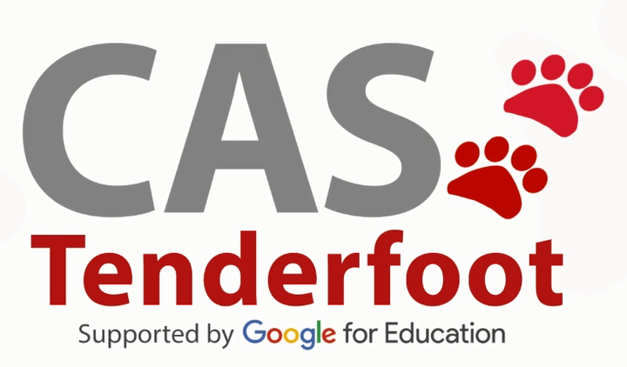
Developing a new generation of
Curriculum Leaders
Notes:
A brief introduction outlining the purpose of the Tenderfoot project.

Slide 2


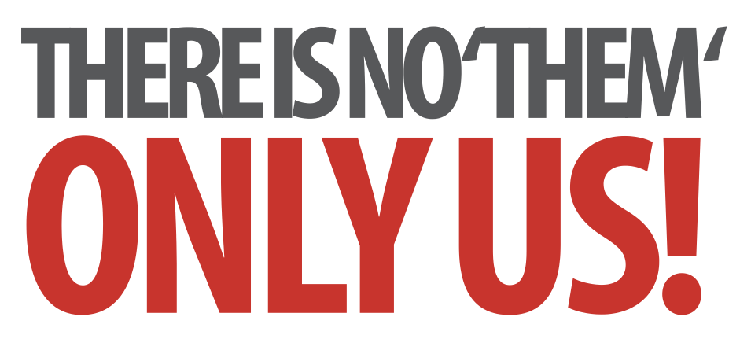
Laying Firm Foundations: A Conceptual Approach to Programming
Concepts and Continuity
Notes:
Introductory slides that establish a common format to the start of a Master Teacher session. Please do stress the ethos at the start: there is no them – only us! If our subject is to develop all practising teachers have valuable contributions to make, regardless of prior experience. The CAS model recognises that good pedagogy is a process of discussion and development, facilitated through our Community of Practice.

Slide 3
Laying Firm Foundations: A Conceptual Approach to Programming
Concepts and Continuity
Insert any specific notes
Start / End time
Toilets
Fire Drill / Exits
Notes:
Reminder to go through formalities at start. Placeholders for specific details

Slide 4
Concepts and Continuity
Learning Outcomes
By the end of the session we hope you will:
Understand the key concepts required to write programs
Recognise the three key constructs in every program
Become familiar with functions and procedures
Recognise their role in structured programming
Have explored a couple of activities for introducing these programming concepts at KS3
Notes:
It is important to be explicit about the intended outcomes of the day for attendees.
Do not assume they will be aware of the purpose or target audience of the materials.
By stating the intentions, it helps avoid getting sidetracked into discussing the detail of individual classroom activities.
The primary aim is to educate teachers and illustrate the breadth and depth of Computer Science. The specific outcomes for teachers from this unit, are
Understand the key concepts required to write programs
Recognise the three key constructs in every program
Become familiar with functions and procedures
Recognise their role in structured programming
The purpose of Tenderfoot is to equip trainers with material and ideas to meet these outcomes and broaden the outlook of teachers new to Computing.
It hopes to provide a buffet of resources on which teachers can draw, to enrich their Key Stage 3 lessons, at the same time as meeting the key aim: providing greater depth of knowledge for teachers themselves.
Developing teachers is the focus, not providing activities for pupils.

Slide 5
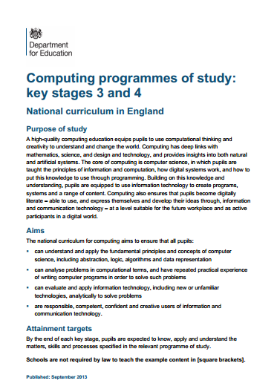
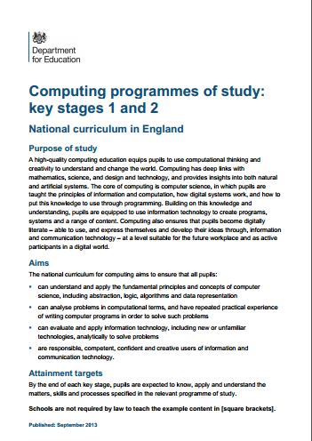
The Big Picture
Notes:
Lets start with the big picture. The starting point for most teachers new to Computing will, inevitably be the National Curriculum … and secondary teachers need to be aware that this will take time to embed. It’s therefore important that they are aware of expectations in the primary curriculum, which are only likely to be partially met in the near future.

Slide 6
The Big Picture
Key Stage 1
Pupils should be taught to:
understand what algorithms are;
how they are implemented as
programs on digital devices; and
that programs execute by following
precise and unambiguous instructions
create and debug simple programs
use logical reasoning to predict the behaviour of simple programs
Notes:
So starting with primary schools, it is clear that implementing algorithms as simple programs is an expectation right from KS1. Notice the third statement – using reasoning to predict the behaviour of programs. Even at this early age there is an indication about the pedagogy

Slide 7
The Big Picture
Key Stage 2
Pupils should be taught to:
design, write and debug
programs …
solve problems by decomposing
them into smaller parts
use sequence, selection, and
repetition in programs
work with variables …
use logical reasoning … to detect and correct errors in algorithms and programs
Notes:
At KS2 some of the key concepts underpinning programming are made explicit – decomposition; sequence, selection and iteration; variables; debugging by thinking logically. These lie at the heart of the mental toolkit we wish to develop in children throughout their time in school.

Slide 8
The Big Picture
WHY?
Key Stage 3
Pupils should be taught to:
use two or more programming
languages, at least one of which is
textual, to solve a variety of
computational problems
make appropriate use of data
structures [e.g lists, tables or arrays]
design and develop modular programs that use
procedures or functions
Notes:
And so on to KS3 where there is the first mention of text based programming languages, data structures and modular programs.
Whilst much of the NC is very slim on detail, when it comes to programming it is explicit and provides a clear developmental structure. That’s very good for us, and something that will shape the activities to come but before we do that we need to take a step back, appreciate the bigger picture and try to distinguish the wood from the trees.
(click)
The bigger question must surely be WHY? – why teach programming at all?

Slide 9
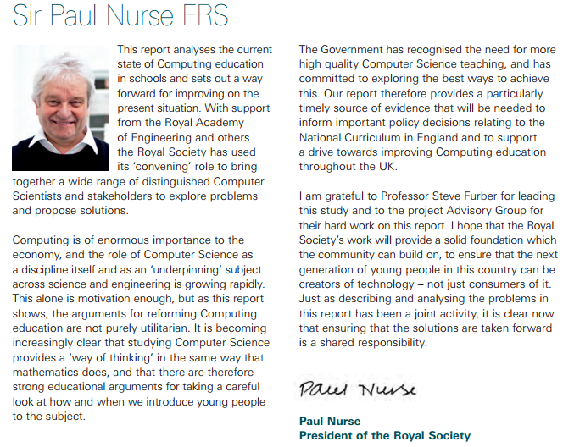
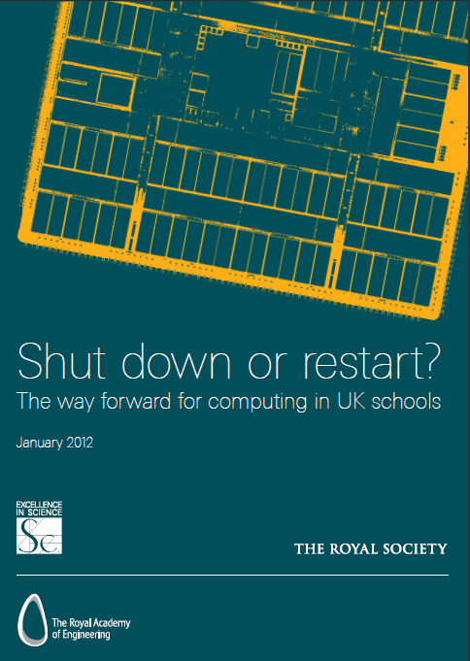
The Big Picture
“It is becoming increasingly clear that studying Computer Science provides a ‘way of thinking’ in the same way that mathematics does …. there are strong educational arguments for looking at how we introduce the subject.”
Notes:
In 2012, a very influential study, by the Royal Society made the case for a new Computing curriculum. Eminent biologist, and nobel prize winner, Sir Paul Nurse wrote the introduction and in it he said …

Slide 10

Learning to think like a Computer Scientist
“It is becoming increasingly clear that studying Computer Science provides a ‘way of thinking’ in the same way that mathematics does …. there are strong educational arguments for looking at how we introduce the subject.”
Notes:
Developing that ‘way of thinking’, which we commonly refer to as Computational Thinking is our rationale.

Slide 11
Learning to think like a Computer Scientist
Purpose Of Study
A high-quality computing education
equips pupils to use computational
thinking and creativity to
understand and change the world.
Notes:
Computational Thinking is made explicit in the Purpose of Study that introduces both the primary and secondary programmes of study …

Slide 12
Learning to think like a Computer Scientist
Purpose Of Study
A high-quality computing education
equips pupils to use computational
thinking and creativity to
understand and change the world.
The core of computing is computer
science, in which pupils are taught
the principles of information and
computation, how digital systems work, and how to put this knowledge to use through programming.
Notes:
It goes on to say how this can be applied through programming.

Slide 13
Computing is about
much more than
programming
Notes:
We can summarise by saying these 3 things.

Slide 14
Computing is about
much more than
programming
Computing is about a
way of thinking
Notes:
We can summarise by saying these 3 things.

Slide 15
Computing is about
much more than
programming
Computing is about a
way of thinking
Computational thinking is developed through computational doing
Notes:
We can summarise by saying these 3 things.

Slide 16
Teaching children to
program is about
applying key concepts
from Computational
Thinking
Concepts are transferable to other problem solving contexts
Notes:
So teaching programming involves a conceptual approach. These concepts can be easily transferred from one programming language to another, but also to approaching problems on other, non programming contexts.

Slide 17
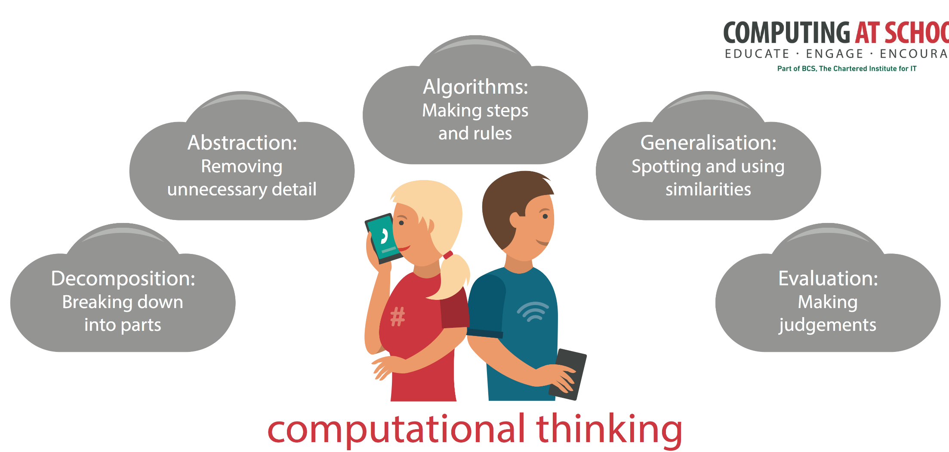
Teaching children to
program is about
applying key concepts
from Computational
Thinking
Concepts are transferable to other problem solving contexts
Notes:
CAS have produced a poster that highlights these concepts – great for the classroom wall, so you can keep referring to them whenever the opportunity arises. We’ll be doing this throughout these sessions. They are … each will be revealed on a click.

Slide 18
Learning to think like a Computer Scientist
A special way of looking at the world
A Conceptual Approach to Programming
Notes:
A simple way to get this across is to suggest to children that thinking like a computer scientist is a special way of looking at the world. Very soon, they will be seeing algorithms everywhere. They will be breaking problems down, spotting patterns and recognising this weird thing called abstraction, again and again and again.
Many CAS members offer CPD in particular programming languages. Regardless of the language, the concepts should be the same. The language is secondary, the concepts are key – hence the name of this session (title appears on click).

Slide 19
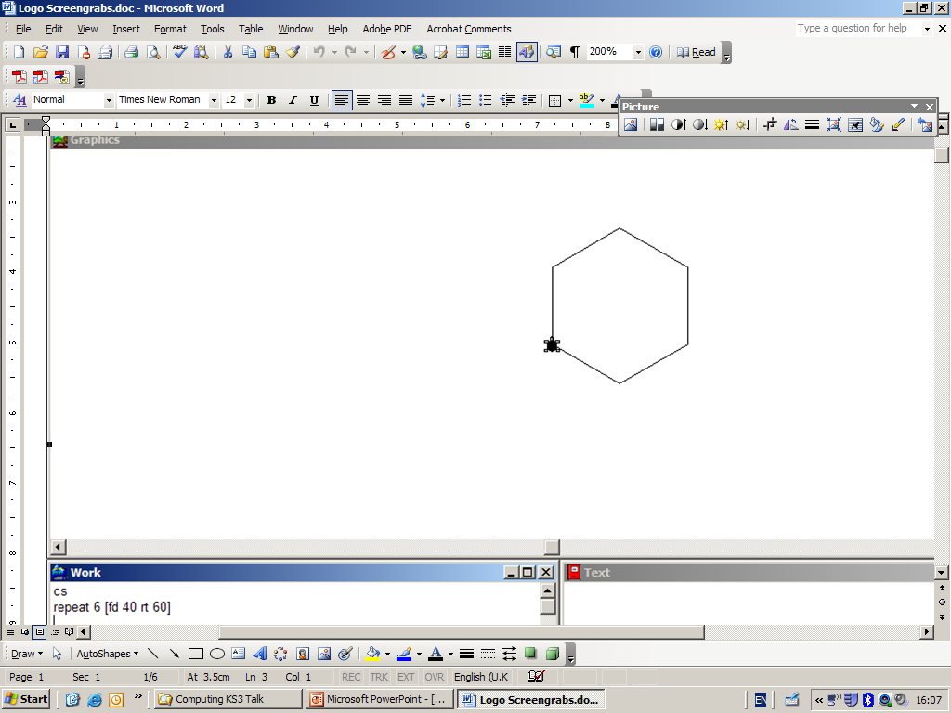
Concepts and continuity
A Conceptual Approach to Programming
Notes:
So let’s start by outlining the key concepts and looking at how we can ensure continuity from primary.

Slide 20
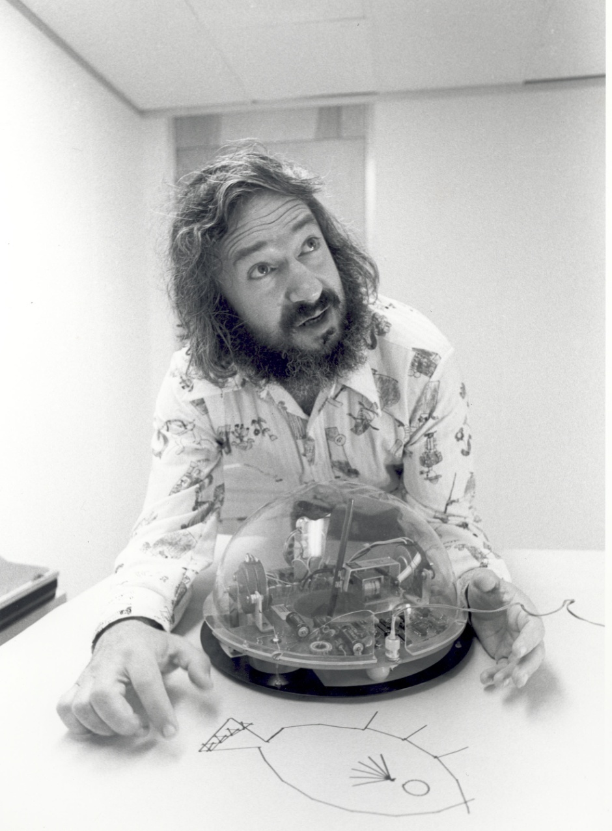
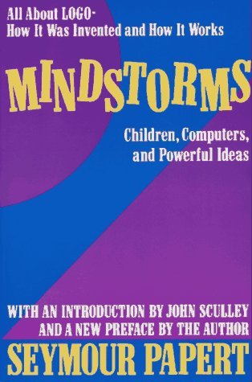
History lesson
Seymour Papert 1967
Notes:
We’ll start with a quick history lesson. What do you think of when you see this image? If your answer wasn’t LOGO, you’re clearly not from a certain generation. Logo was the first educational programming language, developed in the 1960’s and 70’s by this man (click), Seymour Papert. Logo was used to write programs for floor turtles, like the one shown. It was the forerunner of many of the devices we see in Primary schools today, such as BeeBots.
Papert worked at the Massechusettes Institute of Technology (MIT) and wrote a seminal book (click), Mindstorms: Children, Computing and Powerful Ideas. Many of these ideas shape our approach to teaching today.

Slide 21

Seymour Papert 1967
Notes:
The name Mindstorms might be familiar from the programmable Lego kits. Seymour Papert was involved in the early development of these. Mindstorms (the book) appeared in 1980 when educational software was just beginning… … and yet Papert could already see some of the dangers inherent in ‘drill and skill’ approaches.

Slide 22
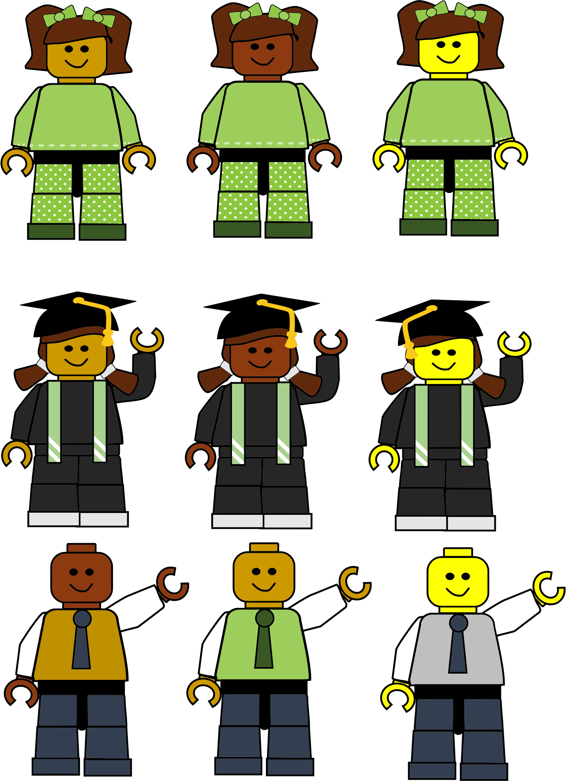
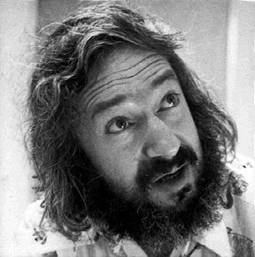
“In many schools today, the phrase ‘computer-aided instruction’ means the computer is being used to program the child....
Notes:
It’s quite remarkable the insights Papert had. In the 1960’s people laughed when he suggested computers could be instruments for children’s learning, yet now we find ourselves standing on the shoulders of this educational giant. Quote extends over 2 slides.

Slide 23
…in my vision, the child programs the computer and, in doing so
comes into contact with some of the deepest ideas from science, maths, and the art of intellectual
model building.”

Slide 24
“building knowledge structures’ … happens where the learner is
consciously engaged
in constructing
an entity …”
Learning through ‘doing’
Notes:
He goes on to say (quote again). In essence what he is arguing is (click) that children learn by doing – something that should inform our approach today. Children cannot be taught didactically to program, but need to be presented with challenges through which they develop their own understanding.

Slide 25
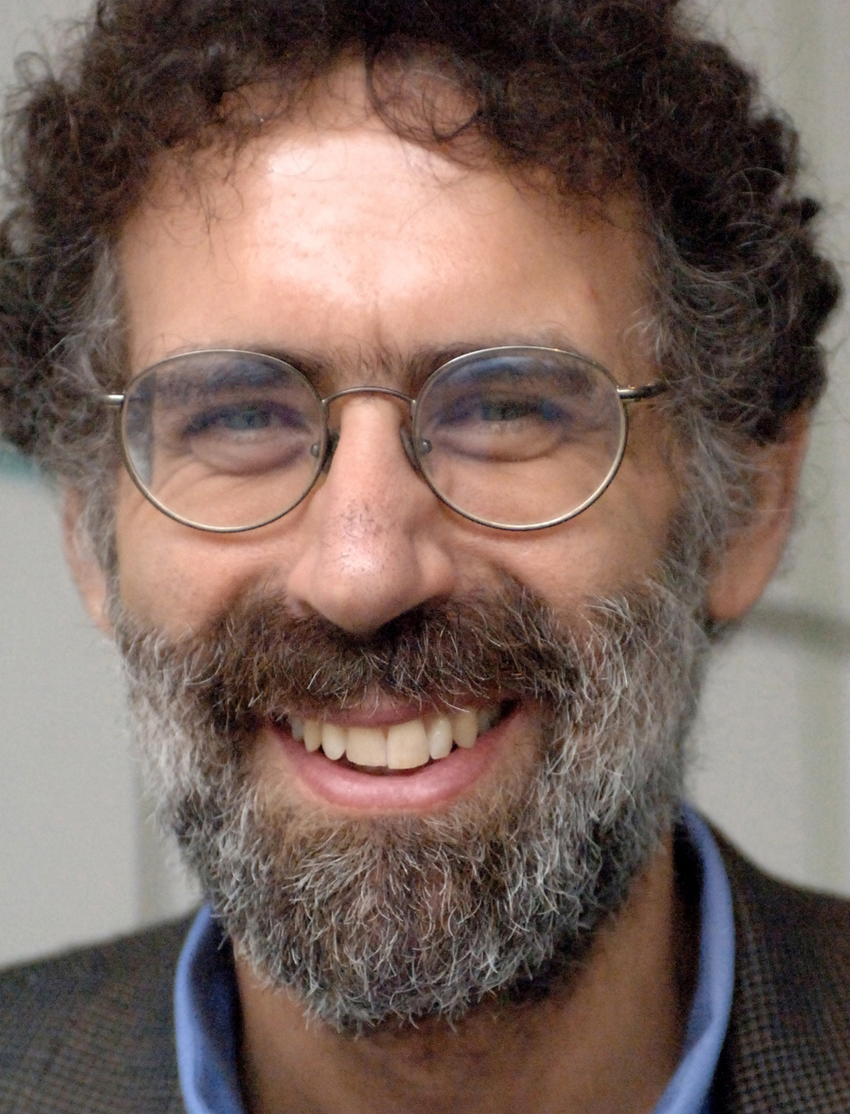
Learning through ‘doing’
Notes:
This man was a doctoral student of Seymour Papert’s. He too was involved in the development of Lego Mindstorms (click). Both appreciated how Lego helped develop creative play and how constructing things helped shape children’s ‘knowledge structures’. Does anyone know who he is and what he is famous for today? (Answer: Mitch Resnick created Scratch)

Slide 26
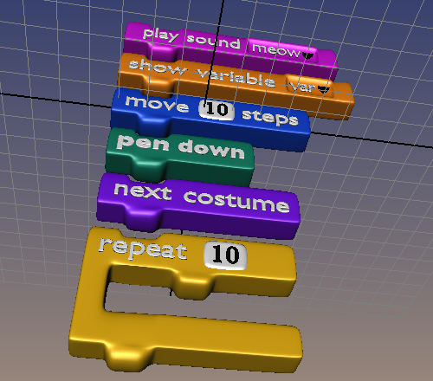
Learning through ‘doing’
Notes:
Mitch Resnick, ‘Papert Professor of Learning Research’ and Director of the Lifelong Kindergarten Group at MIT developed Scratch, launched in 2003. Next slide has a video (1min 20secs) explaining why.

Slide 27
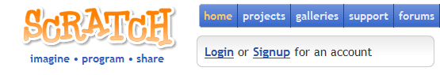

Notes:
Scratch has been a game changer in education. There will be few Primary children who haven’t had some form of contact with it. It has a very low floor of entry. It is a visual language, which removes the need to type commands. You can see the analogy with Lego in the way sequences can be snapped together.

Slide 28
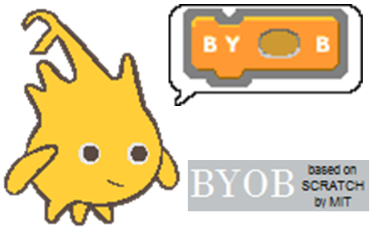
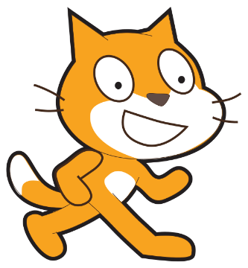


http://byob.berkeley.edu/
Visual languages are educational tools
Notes:
Scratch has spawned many variants – which have often extended it’s capabilities. One such variant (click), used to teach undergraduates at the University of Berkeley in California was BYOB (Build Your Own Blocks). This provides a seamless transition for pupils who already have some experience of Scratch, but is far more powerful.
(click) Don’t dismiss visual languages as ‘toy’ languages. They have a long history of pedagogical development and are the starting point for grasping computational concepts. Once grasped, they make the transition to text based coding much easier.
Its worth noting that both Scratch and BYOB now run ‘in the cloud’. These versions are Scratch 2 and Snap! (click). This has certain advantages, primarily no installation and being accessible from any computer online. But they also have disadvantages for schools with unreliable or limited connectivity. It is also another User ID for students to remember and any media they wish to use has to be uploaded to the cloud first.
At the time of writing, Snap! didn’t support multiple instruments which is essential for an upcoming project. We’ll therefore be using a local installation of BYOB in these examples. This situation will change with time and you may wish to use the online versions. Both are freely available from the URL: Home page - http://byob.berkeley.edu and BYOB page - goo.gl/biqgp3

Slide 29
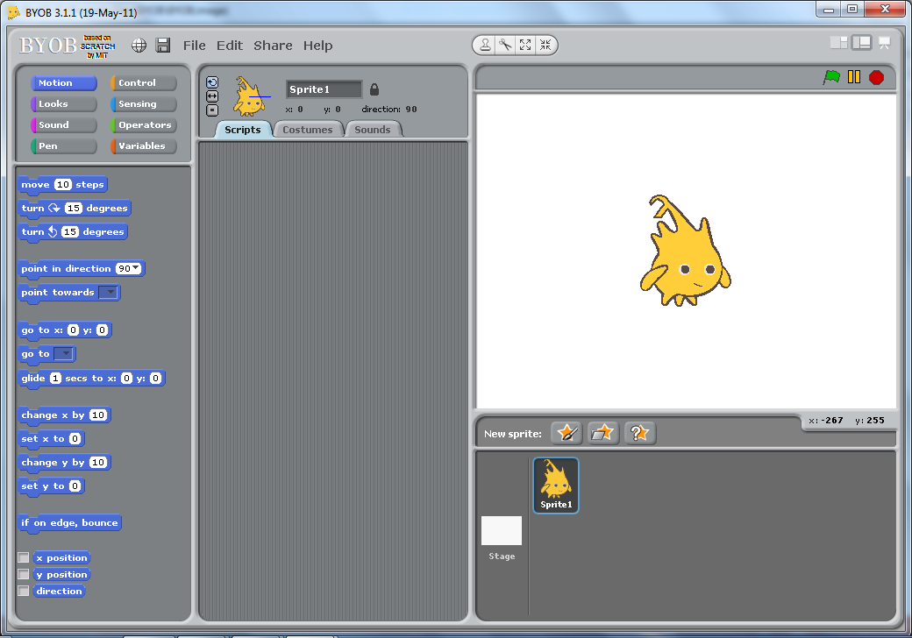
The BYOB ‘IDE’
Integrated Development Environment
Notes:
Before we start, ensure everyone can open BYOB. Use this to to stress the similarity with Scratch – 3 slides simply show different drawers of commands which are just the same as Scratch.

Slide 30
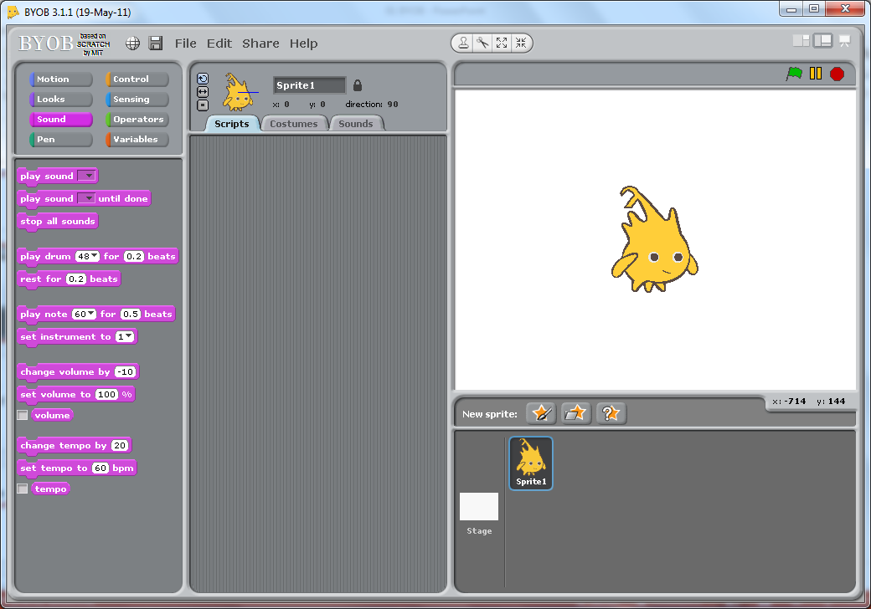
The BYOB ‘IDE’
Integrated Development Environment

Slide 31
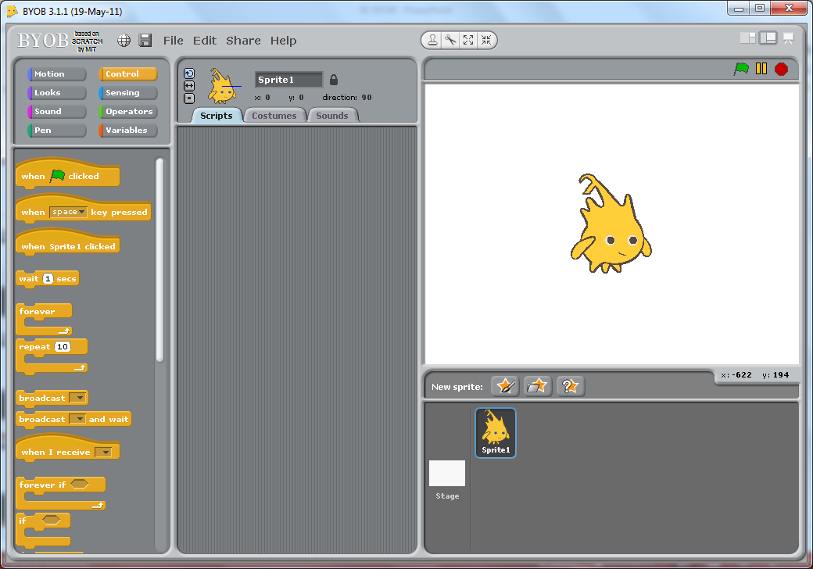
The BYOB ‘IDE’
Integrated Development Environment

Slide 32
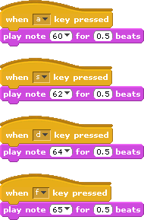
Lets make some music!
Notes:
Ensure your audience are familiar with dragging blocks to create scripts. Point out the ‘hat’ blocks which sit on top of scripts and act as the trigger to execute the commands. Here we program different keys on the keyboard to act as triggers to play notes.

Slide 33

A Conceptual Approach to Programming
Concepts and
Continuity
1 idea
2 activities
3 constructs
4 concepts
Notes:
We’ve talked a lot in the introduction. The focus of this session is concepts and continuity. What we want to do is constantly reinforce 1 big idea – that this is about developing Computational Thinking (click).
We’ll suggest two activities, involving 3 key constructs to illustrate 4 central concepts.

Slide 34
Learning through ‘doing’
Paired programming?
Notes:
One final point - just like children learning to walk, you, or your audience will learn through doing. Nobody can ‘tell’ a child how to walk – they learn by falling over … again and again and again.
So it is with programming, but a challenge facing teachers is managing that within a class. A parent may pick a child up, but you can’t be picking 30 children up all the time. There are many ideas being shared by teachers in this regard – one very effective method is to develop paired programming. Working in pairs allows discussion and develops the ability to articulate your thoughts. So one person constructs the program from the instructions of another.

Slide 35
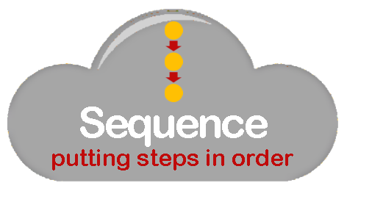


The ‘Big Three’
Notes:
We’re going to give children a couple of programming projects. Programming need not be intimidating- on fact it is based on just three simple ideas, or constructs. We could call them the ‘big 3’:
(click)
Sequence – the challenge of arranging instructions into the correct order.
Selection – allowing a program to branch down a different route IF a certain condition is met and
Repetition –sometimes referred to as Iteration Allowing us to repeat sequences of commands by looping back.
It’s useful to repeat these constructs regularly and often. Perhaps get the children to chant them back in response to a prompt; “There are only 3 constructs in programming. They are?” Response in a loud voice, all together; “Sequence, Selection and Repetition” It’s worth noting too, that when introducing programming this probably represents the order of complexity of the constructs. Children generally find conditional IF statements easier than loops.
Throughout any coding project, take the opportunity to highlight code and ask what construct(s) are exemplified.

Slide 36





Notes:
We’ve mentioned the focus on concepts, so lets get them upfront right from the start. Obviously there will be a focus on algorithms as a sequence of instructions, but we also want to highlight (click) the idea of decomposition, breaking a complex problem into smaller parts as a way of managing complexity. Generalisation (click) may be a new term for many, but in many computing contexts for young children, this amounts to trying to spot patterns. Finally (click), at the heart of Computational Thinking is the notion of Abstraction, which we’ll highlight as it arises.
Throughout the projects we want to take every opportunity to highlight examples of both the key constructs and the core concepts.

Slide 37

Making Music
with BYOB
Notes:
With all that said, lets look at making some music with BYOB.

Slide 38
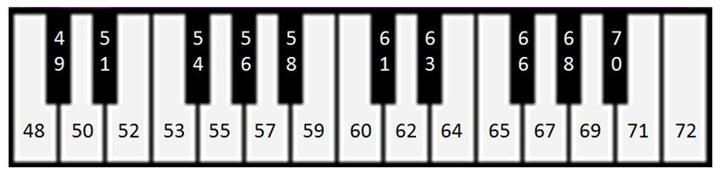
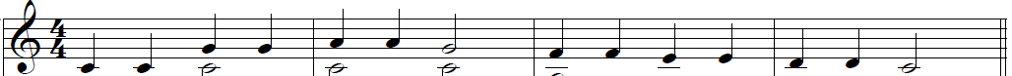
Understanding notes
C D E F G A B C D E F G A B C
67 67 69 69 67 65 65 64 64 62 62 60
60 60
C C G G A A G F F E E D D C
Notes:
Children don’t need to understand musical notation to do these activities. In fact, learning to read music is an exercise in pattern recognition itself. We do need to start by explaining notes. Start by making a link to keys on a piano. The numbers on the piano keys equate to the BYOB pitch number. (click) The letters of the notes appear below the piano keys
The numbers in a BYOB ‘play’ command indicate the key or pitch to play. The default number (60) represents the middle key on the piano. White piano keys are represented by the letters A to G, which repeat in sets of 8 (or octaves). We wont be worrying about the black notes at the moment. (click)
The musical score is a way of writing instructions to play a sequence of notes. Each line and each space between the lines indicates a different white piano key. If we tell pupils that the first note represents middle C, we can work out the letter of each further note. (click removes the arrow) Go through this on the screen, counting up each space and line to the G, then the A to make this clear.
Finally, having worked out the notes, we can convert these to the pitches (numbers) used in the ‘Play Note’ command in BYOB. (click illustrates first two notes) Having been given the first two 60’s, work through the rest with the group to ensure they understand how to convert. The higher up the score the notes are, the higher the number. (click to reveal answer)
(click brings concept graphic) In essence what we are doing is translating one language (a musical score) to a sequence of instructions for the computer. The rules for converting one to another have to be expressed unambiguously (an example of an algorithm).
The musical score itself can itself be seen as an algorithm – an unambiguous sequence of steps to produce a tune.

Slide 39
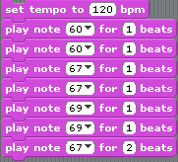
Save as LittleStar01
Too slow?
Change tempo
60 60 67 67 69 69 67 65 65 64 64 62 62 60
Notes:
Having translated the score to numeric notes, we can implement the algorithms in BYOB, using a sequence of play note commands. The first seven notes are given on the screen. At this point we can point out that the different look of a musical note indicates the length of time to play it for (click). In this case all the notes are 1 beat (a crotchet) apart from notes 7 and 14 which are two beats (a minim).
If it sounds too slow, do not change the number of beats for a note, but change the tempo of the beats (click).
Armed with this knowledge, pupils can finish creating the script for the whole line. (click) A clear example of Sequencing.
(click) At this point it’s worth ensuring pupils can save their script, locate it and reload it into BYOB. They will probably recognise the tune so suggest a naming convention that allows for versions eg LittleStar01

Slide 40
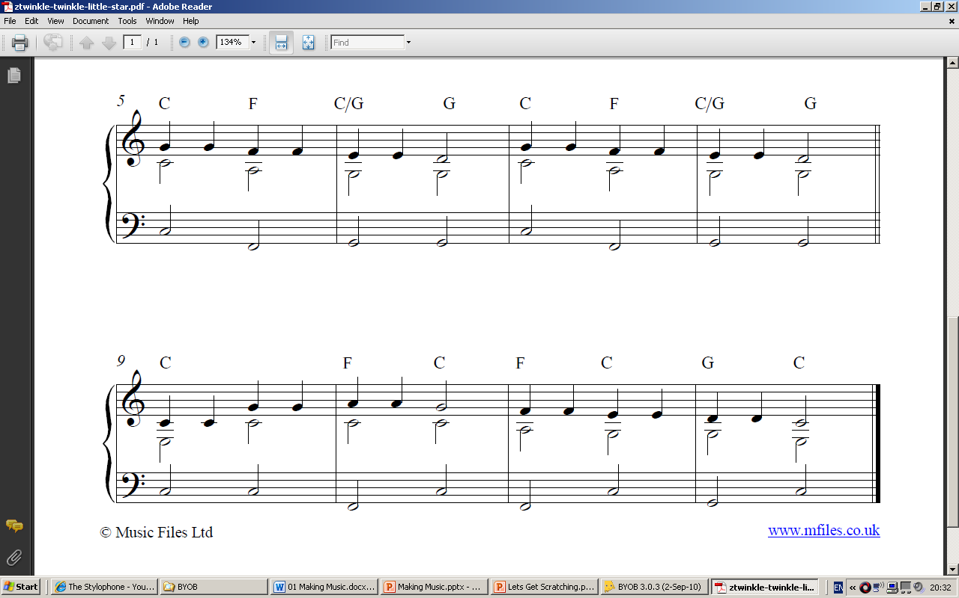
60 60 67 67 69 69 67 65 65 64 64 62 62 60
C D E F G A B C D E F G A B C
Notes:
With the remainder of the score on the screen, the challenge is to continue with the translation and scripting of the sequence.

Slide 41
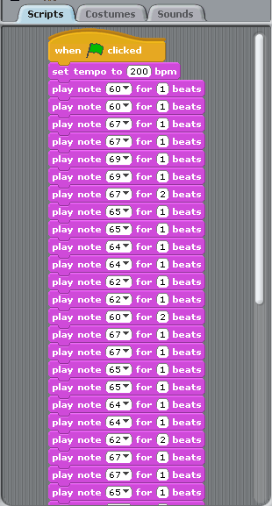
LittleStar01
60 60 67 67 69 69 67 65 65 64 64 62 62 60
C D E F G A B C D E F G A B C
Notes:
The start of the long sequence can be illustrated on screen if they are struggling.

Slide 42
Can we spot a repeating pattern?
Twinkle twinkle little star
how I wonder what you are
Up above the earth so high
like a diamond in the sky
Twinkle twinkle little star
how I wonder what you are
Notes:
The words of the rhyme should make it obvious to all that part of it is repeated (click)

Slide 43
60 60 67 67 69 69 67 65 65 64 64 62 62 60
67 67 65 65 64 64 62 67 67 65 65 64 64 62
60 60 67 67 69 69 67 65 65 64 64 62 62 60
C D E F G A B C D E F G A B C
Notes:
With the fully translated score, can the pupils spot the repeating musical sequence displayed?
The last line is the same as the first, just as the words are. If they don’t see this initially, perhaps ask them to listen to the tune and see if they can spot the pattern.

Slide 44
60 60 67 67 69 69 67 65 65 64 64 62 62 60
67 67 65 65 64 64 62 67 67 65 65 64 64 62
60 60 67 67 69 69 67 65 65 64 64 62 62 60
C D E F G A B C D E F G A B C
Notes:
This is a good example of the concept of pattern recognition. If we can spot this, we can reuse the original sequence (initially just by copying it), rather than creating it all again. Later we can look at better ways to reuse the code, but worth highlighting the concept now.

Slide 45
Can we spot another repeating tune?
Twinkle twinkle little star
how I wonder what you are
Up above the earth so high
like a diamond in the sky
Twinkle twinkle little star
how I wonder what you are
67 67 65 65 64 64 62 67 67 65 65 64 64 62
Notes:
If they haven’t noticed already, see if they can spot another part of the tune that repeats. (click)
It is worth pointing this out: the tune repeats, even if the words are different. (click reveals the score)

Slide 46
The trouble with a long script?
Twinkle twinkle little star
how I wonder what you are
Up above the earth so high
like a diamond in the sky
Twinkle twinkle little star
how I wonder what you are
Notes:
As pupils code their tune, it should become obvious that a long script (spaghetti code) makes it very difficult to spot mistakes.
Far better to break the song down into smaller sections and test each as it is developed.
This is, of course, and example of decomposition (click).

Slide 47
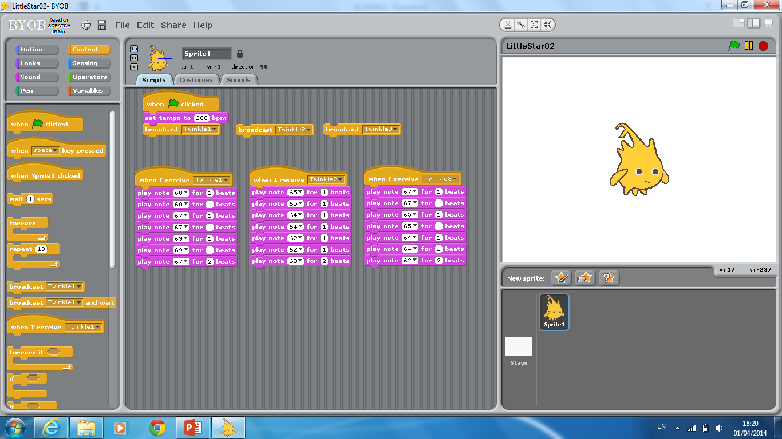
The trouble with a long script?
Refactor your composition
and save as LittleStar02
Twinkle twinkle little star
how I wonder what you are
Up above the earth so high
like a diamond in the sky
Twinkle twinkle little star
how I wonder what you are
Notes:
The rhyme can be coded using just these 3 sequences of seven commands. Highlight the use of message broadcasts to control program flow. This will be essential later on.
Discuss the benefits of this approach with students: Easier to test and debug, easier to check each section has the same number of beats etc.
Students should refactor their TwinkleStar code to ensure familiarity with the use of broadcasts and save it as, perhaps LittleStar02.

Slide 48
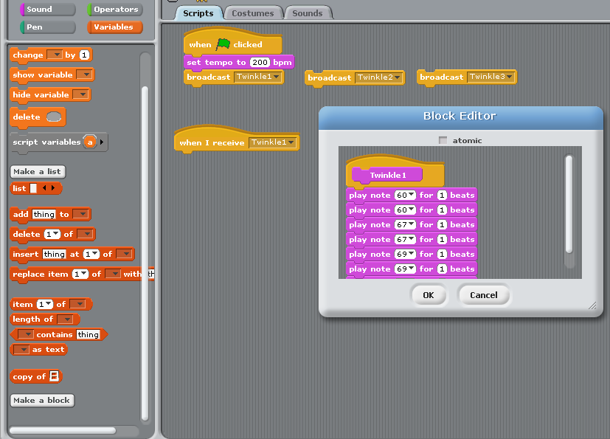
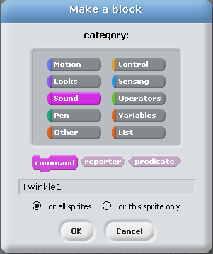
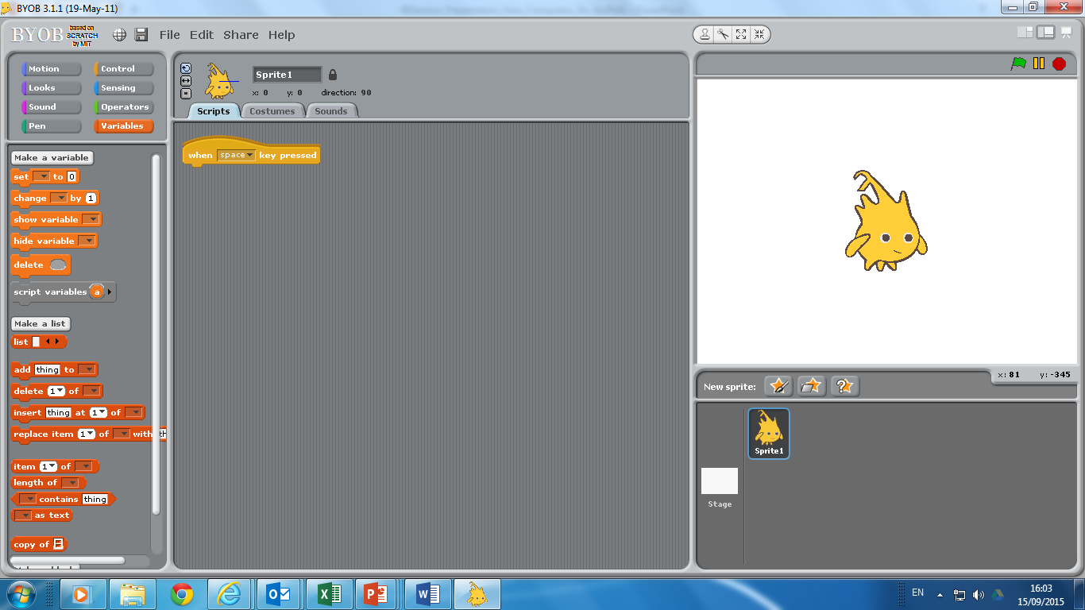
‘Songline’ blocks …
Notes:
Having refactored their code into manageable chunks, it is only a small conceptual step to encapsulate that code in a block of its own. We’ll call them songline blocks. The animation demonstrates how to define and name a new command block, ensuring it is placed in the correct category drawer (Sound).

Slide 49
‘Songline’ blocks …
Notes:
Once defined, we can drag the relevant code from the script window (click).

Slide 50
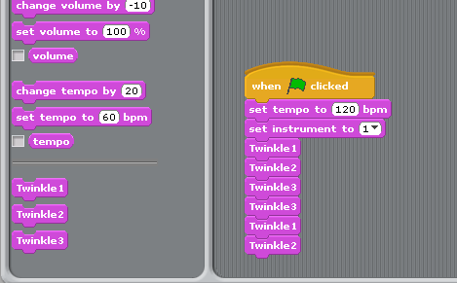

‘Songline’ blocks … make code clearer
Notes:
The rhyme can now be built from a higher level sequence of 3 songline blocks.
Hiding the detail of each songline within a named procedure is a good example of abstraction: the complexity of the song detail is hidden, making the code clearer.
In this sense procedural abstraction and decomposition can be viewed as two sides of the same coin.

Slide 51
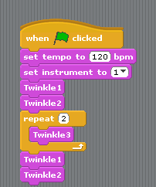
‘Songline’ blocks … make code clearer
Notes:
We can, of course, improve this sequence slightly by recognising the repetition of Twinkle3! (click)

Slide 52
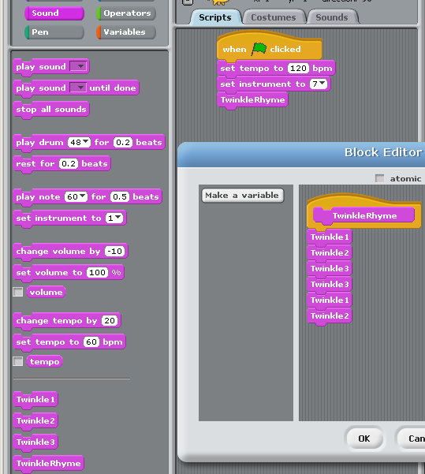
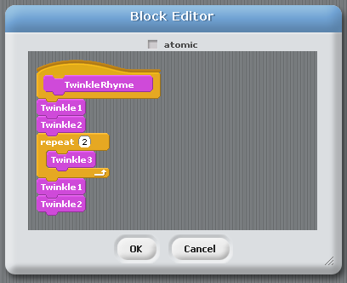
Higher level abstraction … a song block!
Notes:
Once we have encapsulated the sequences into procedures (or blocks), we can encapsulate those blocks in higher level blocks too.
There is no end to this process, so complex code can be built up by decomposing a problem into smaller parts, which themselves can be broken into smaller parts until we get to a manageable problem.
This can be coded and tested. Once we know it works, we can hide the detail of how it works in a named procedure, or block.
These small blocks can be assembled to produce more complex sequences, which can then be tested and further encapsulated. Decomposition and abstraction lie at the heart of how we manage the inherent complexity of difficult problems.
To play our tune, we now only need to ‘call’ or use one block, ‘TwinkleRhyme’.
But what’s the point of developing such a high level block?

Slide 53
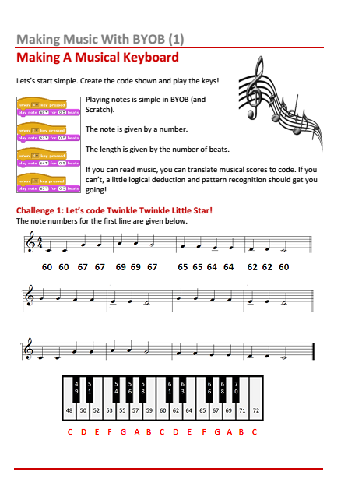
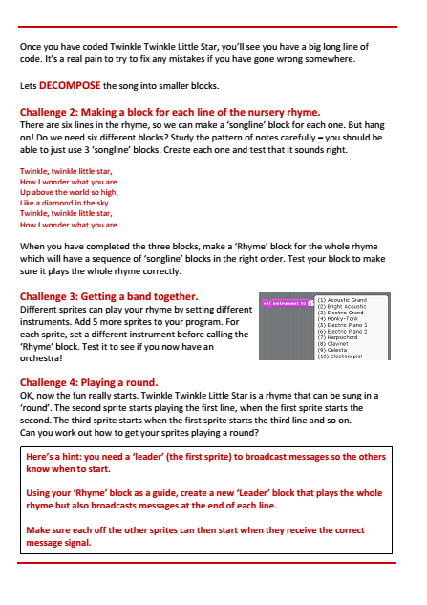
The steps so far …
Stage 1: Translate the music into BYOB commands. This means working out the Note Number and Beats for each note on the music.
Stage 2: Create the commands for each line of the song. Test them to make sure they sound correct.
Stage 3: Check that the total number of beats played for each line is the same. If not, your round won’t work.
Stage 4: Create ‘songline’ blocks for each line. If
a line is the same as a previous one, you don’t
need to make a new block.
Notes:
With a high level block like TwinkleRhyme, we can tackle more complex problems, such as playing a round. There is an activity sheet for children and it is best to set this as a challenge to grapple with.
This slide outline the steps so far (click for each step). The following slide outlines the further steps required. Although they are summarised here, decomposing the problem would make a good class discussion.

Slide 54
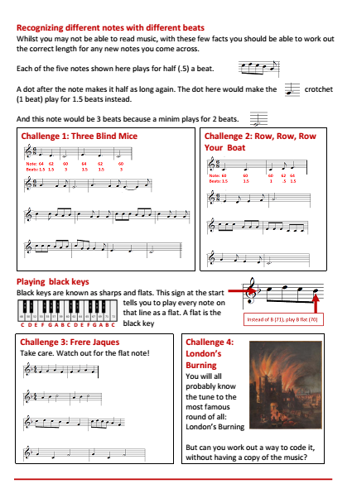
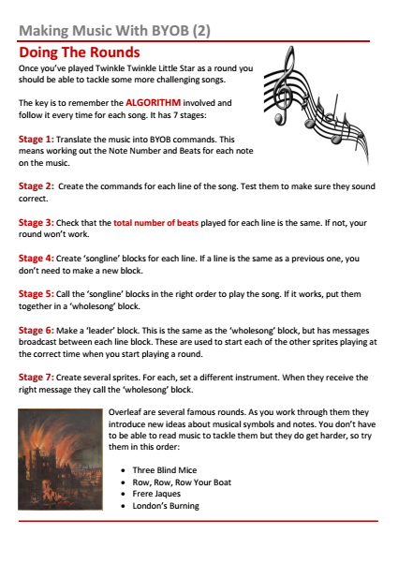
A complex problem … playing a round
Stage 5: Call the ‘songline’ blocks in the right order to play the song. If it works, put them together in a ‘wholesong’ block.
Stage 6: Make a ‘leader’ block. This is the same as the ‘wholesong’ block, but has messages broadcast between each line block. These are used to start each of the other sprites playing at the correct time when you start playing a round.
Stage 7: Create several sprites. For each, set a different instrument. When they receive the right message they call the ‘wholesong’ block.
Notes:
With a high level block like TwinkleRhyme, we can tackle more complex problems, such as playing a round.
This slide outlines the further steps required to create a round. In order to hear the round it is essential to have different instruments for each sprite.
Once successful, a follow up activity sheet introduces 4 other more challenging rounds to create.
For those who struggle, the key technique is outlined on the next couple of slides.

Slide 55
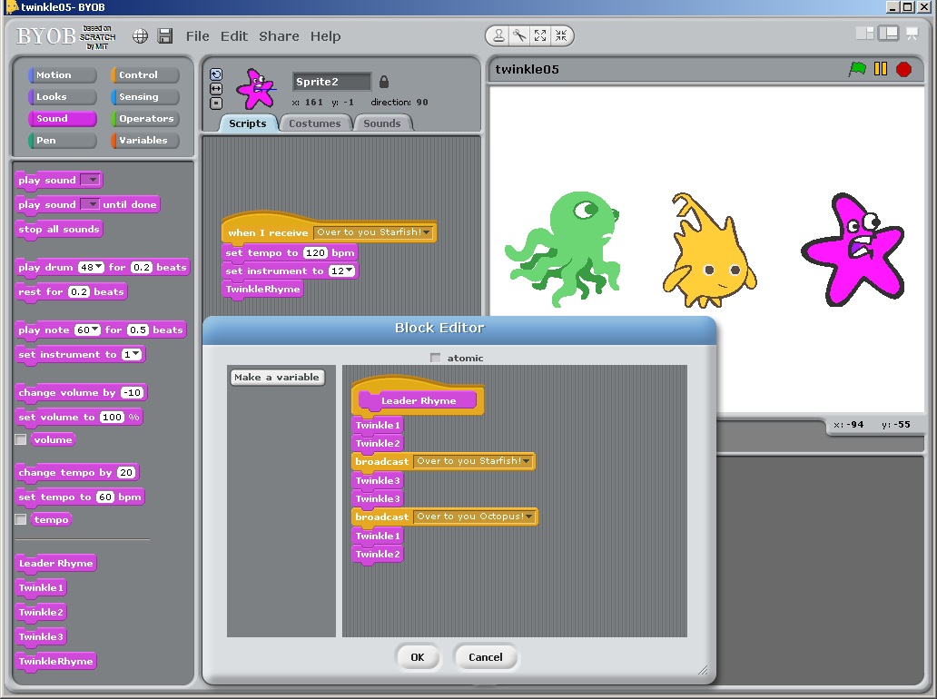
A complex problem … playing a round
Notes:
The Leader block includes message broadcasts.

Slide 56
A complex problem … playing a round
Notes:
The angler fish sprite is the leader. After two lines of Twinkle Twinkle it broadcasts a message.
The starfish sprite is scripted to call the whole song block on receiving this message, so starts playing (with a different instrument) as the leader starts the third line.

Slide 57
In summary …
To tackle complex problems we DECOMPOSE them into smaller steps.
Each small challenge can be defined as a block and tested.
Once working we can ABSTRACT away the detail. We just use the block without having to worry about
how it works.
This makes DEBUGGING much easier.

Slide 58
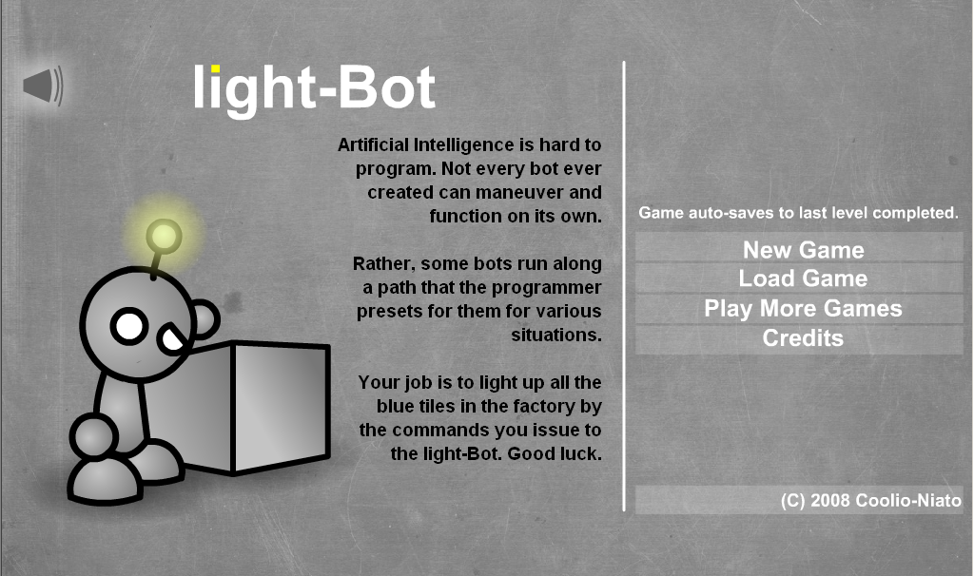
In summary …
http://armorgames.com/play/2205/light-bot
Notes:
Before moving on, it’s worth mentioning light-Bot. This is a wonderful game that helps reinforce the idea of defining functions and calling them multiple times. It is available to play free online via Armor Games, including the very challenging light-Bot 2. or… (click)

Slide 59
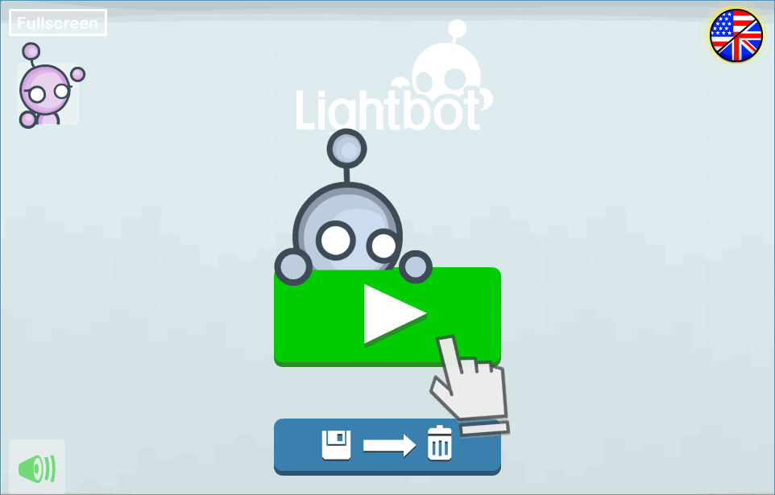
In summary …
http://lightbot.com/hoc2014.html
Notes:
The Hour of Code initiative has a set of problems available as a free app, or online flash game.

Slide 60
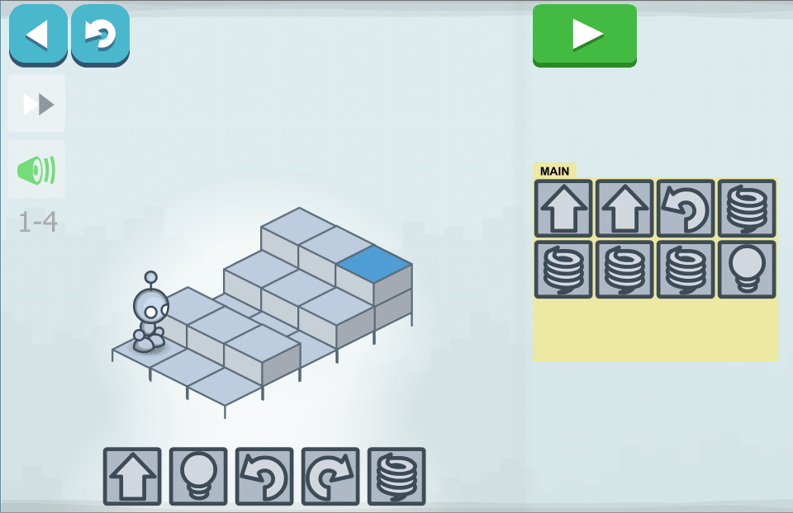
In summary …
http://lightbot.com/hoc2014.html
Notes:
It has simple challenges to allow children to build basic sequences from 5 command blocks. (The last is a jump command)

Slide 61
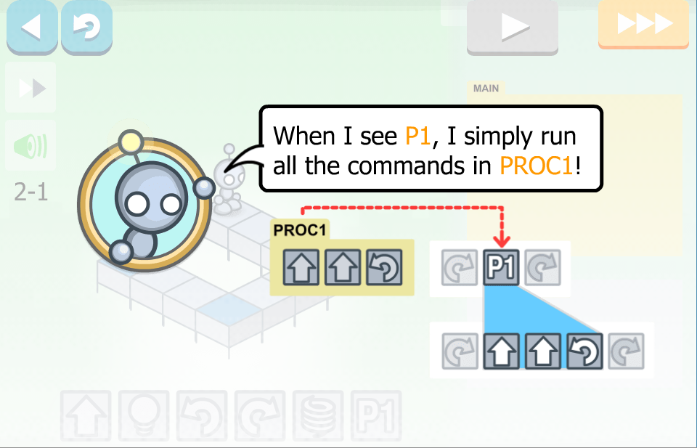
In summary …
http://lightbot.com/hoc2014.html
Notes:
Very quickly, the number of spaces in the Main program are not enough to solve the challenge, and a procedure call is introduced.

Slide 62
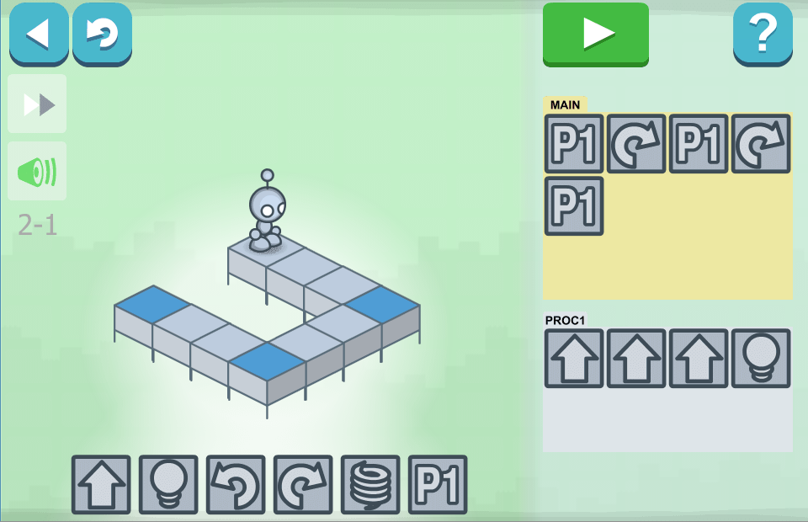
In summary …
http://lightbot.com/hoc2014.html
Notes:
Here’s the first simple example, involving 3 calls of the procedure. Talk through it.
It does get more challenging, but one word of warning. At the higher level, procedure calls are used recursively. What that means is a procedure can include a call to itself in the definition, in order to create loops. There is an example here (click for next slide).

Slide 63
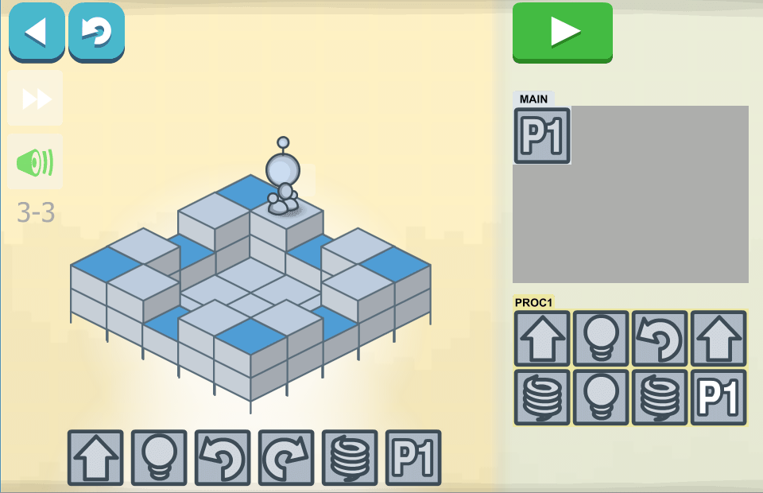
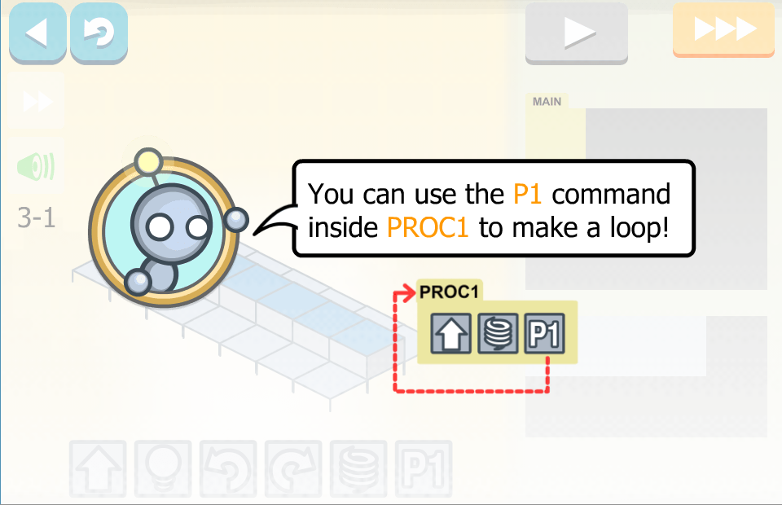
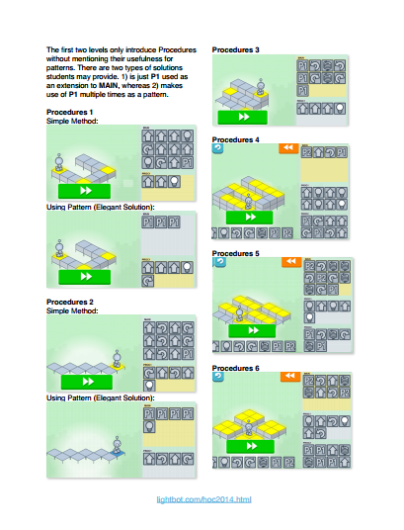
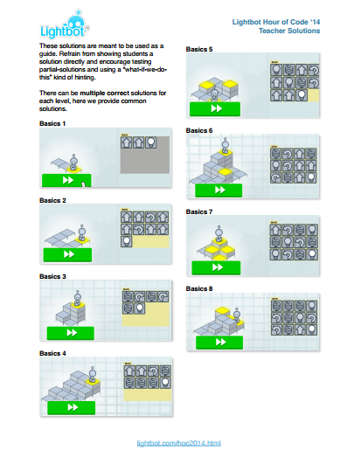
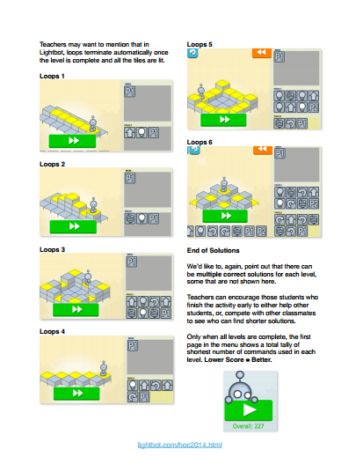
In summary …
http://lightbot.com/hoc2014.html
Notes:
Notice the procedure includes a call to itself in the definition. The result of this would be an infinite loop. (click)
Here you’ll see that the procedure is called. The last step of its execution is to call itself again… and again … and again.
When to introduce recursion in teaching programming is a subject of much debate and for young children can become a source of confusion. Can you see a simpler way to solve this level?
To avoid this potential confusion it may be best to stick to Levels 1 and 2 in the Hour of Code material. (click)
If you are pressed for time, we’ve included the solutions in the resources.

Slide 64


Points to ponder
Visual languages have proved a ‘game changer’.
Why do children seem to grasp a visual language better?
Is a different pedagogy required to introduce them?
Notes:
A brief pause to encourage a short discussion before ending the session.
Use this slide to prompt a discussion about approaches to teaching programming.
Visual languages, in particular Scratch, have become game changers. They have a low floor of entry allowing young children to express their computational thinking. But many children still founder on the transition to text. Why?

Slide 65



Class based research
Qualifications and Certifications
www.computingatschool.org.uk/certificate
Notes:
End with a reminder of the BCS Certificate in Computer Science Teaching – there are A5 hand-outs. One part of the evidence for the award is classroom research undertaken by the teacher. Maybe the points you’ve just discussed might form the basis of some action research?
(click)
The other two areas involve attending CPD – like this!
(click)
And completing a manageable programming project.
If that sounds a little daunting, remember you can opt for either an independent or guided route.
The latter means you’re supported by a mentor who can help guide you through.
It is a valued award, giving professional recognition accredited by the BCS, The Chartered Institute for IT.
More importantly, it’s designed to help you in the work you’re developing in school.
See the link for more information: http://www.computingatschool.org.uk/certificate

Slide 66

Computing is about
much more than
programming
Notes:
We can end by saying these 3 things.

Slide 67
Computing is about
much more than
programming
Computing is about developing a
way of thinking
Notes:
We can summarise by saying these 3 things.

Slide 68
Computing is about
much more than
programming
Computing is about developing a
way of thinking
Concepts are transferable to other problem solving contexts
Notes:
We can summarise by saying these 3 things.

Slide 69
Join CAS
Not a member?
Thanks
Notes:
Promote CAS at end.

