Slide 1

Simulating Our World
Complex Investigations
Notes:
Although we are dealing principally with ‘ideas’ models, we will often want to quantify the emergent behaviour we observe.
In this section we will take another simple StarLogo model and look at some of the tools that can help do that.
We’ll also introduce a similar modelling environment that uses text based code and analyse a more complex model.

Slide 2


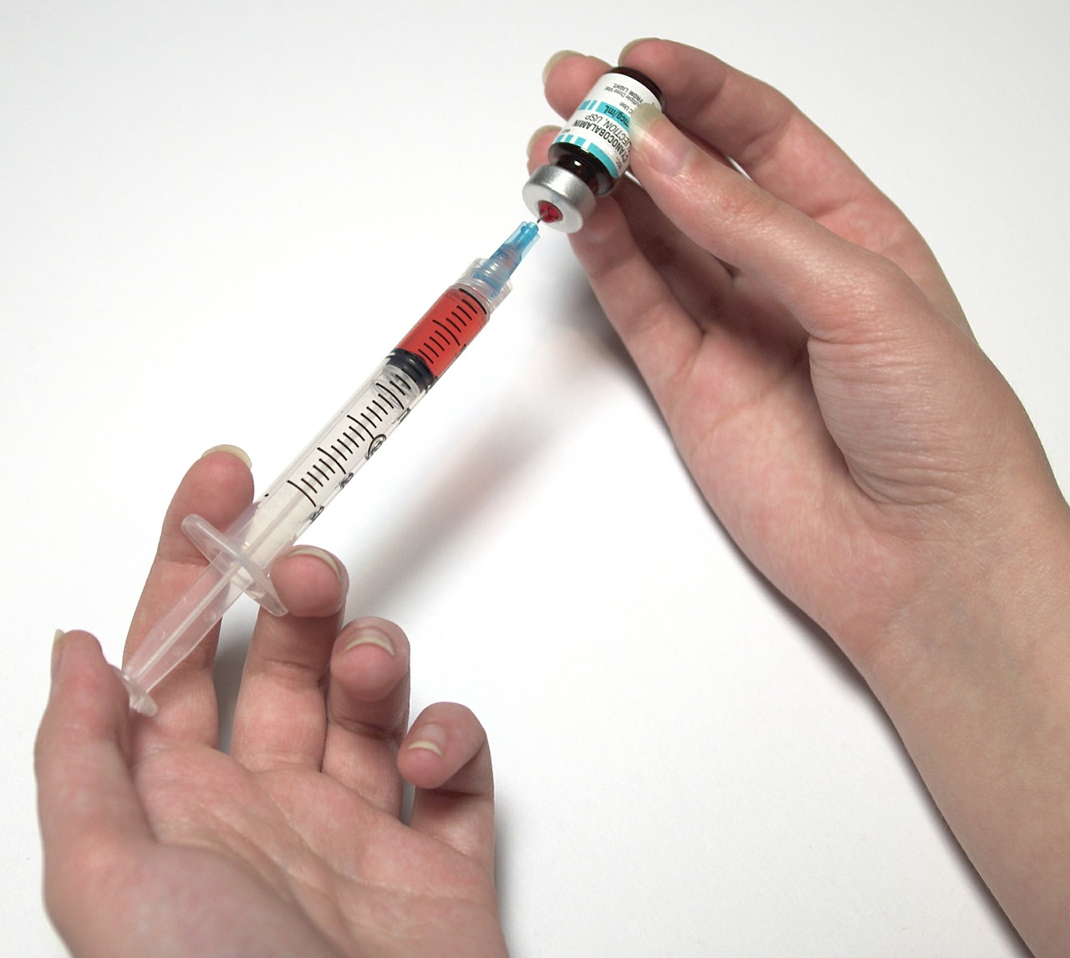
Pandemic Panic!
5
activity
Notes:
We’ll start by looking at a way to model the spread of an epidemic.
There have been several pandemic alerts in recent years involving humans; the ebola outbreak, swine flu, zika virus or avian flu for example.
There are many other examples in the natural world, particularly agricultural concerns. Think of Foot and Mouth, ‘Mad Cow’ disease or the current concern about TB.
In all these cases, the very genuine concerns arise from modelling scenarios based on an understanding of how the particular infections spread.
We’ll use another exemplar model from the curriculum materials provided by the Scheller Teacher Education Partnership as our starting point.
It is a simple model, but very effective for getting over the ideas of how a pandemic can quickly emerge (or be stopped).

Slide 3
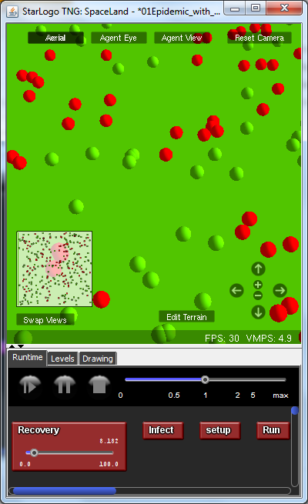
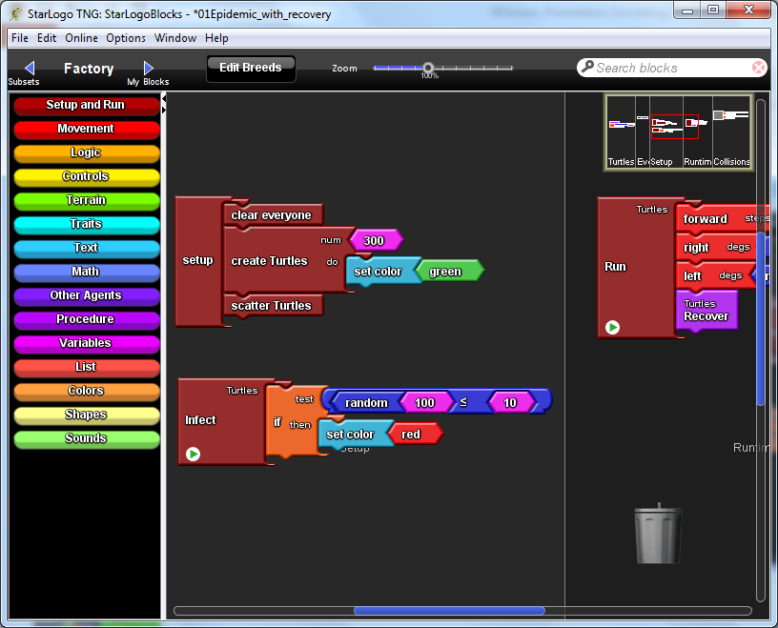
Pandemic Panic!
01Epidemic_with_recovery.sltng
Create The Population
Seed The Infection, Set Recovery
Spread Infection On Contact
Notes:
Open the model 01Epidemic_with_recovery
As usual we have Setup and Run buttons, but you’ll notice we also have a third button, and a slider.
The model is initialised as the diagram shows.
Try setting the Recovery slider to about 8 in the first instance and watch the model.
We use red spheres to represent infected agents.
When they collide with green agents the infection is passed on.
But observe the infected agents – at some point they change back to green.
They have recovered.
It would be nice if we could plot the number of infected agents, and observe the effect of altering the recovery rate.
We’ll do that later, but first let’s investigate how the model works.

Slide 4
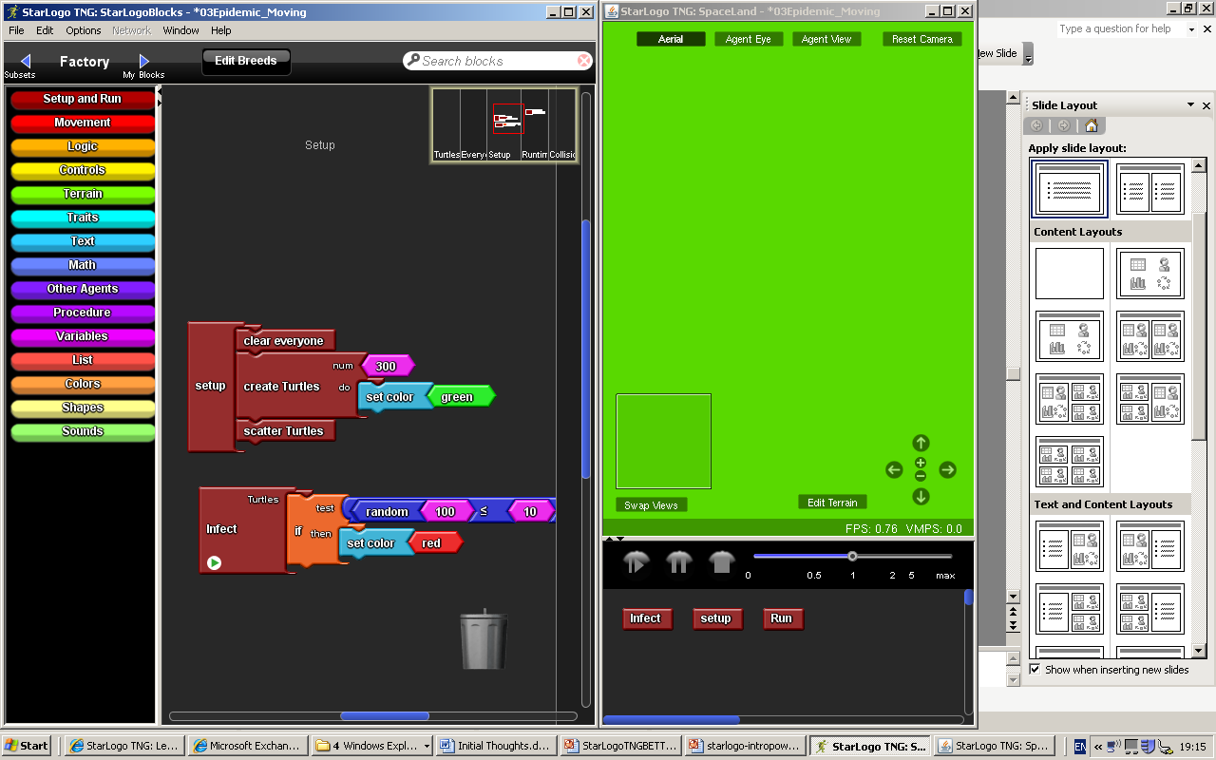
Create The Population
Seed The Infection
Notes:
The model is quite simple – we should already be familiar with all the commands used.
Again, reading the code and explaining it can be a good class exercise.
The Setup procedure creates and scatters our ‘turtles’.
We’ve edited the breed, so it uses a sphere for the image, and we set those to green.
(click)
To seed the infection we generate a random number for each agent, and if it is less than or equal to 10, we set it’s colour to red, indicating it is infected.
So roughly 10% of the population will start infected – though the exact number is unknown.

Slide 5
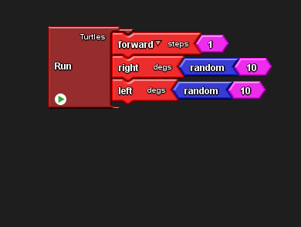
Make The Population Mobile
Notes:
Our Run button instigates a familiar wiggle walk.

Slide 6
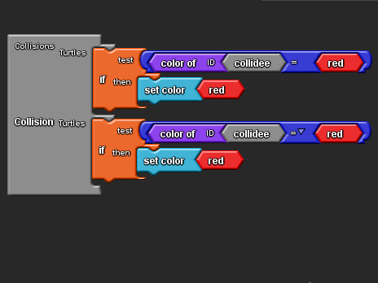

Spread Infection On Contact
Notes:
Note the code for a collision.
Can anyone explain the top conditional statement?
If the agent that bumps into the turtle is red, set this turtle to red, so passing on the infection.
But why do we have a second conditional?
Because we need to consider the collision from the perspective of both agents.
So in each conditional, a different turtle is the collidee.
(click)
With just this simple code, we have the basis for a model.
Children may be able to build this unaided, or it could be supplied and they could be challenged to say why it is flawed, and asked to improve it.
Either way, the important point to stress is that evaluation is an essential part of computational thinking.
Identifying flaws and making judgements about what and how to improve their code is important.
The video on the next slide demonstrates the problem.

Slide 7
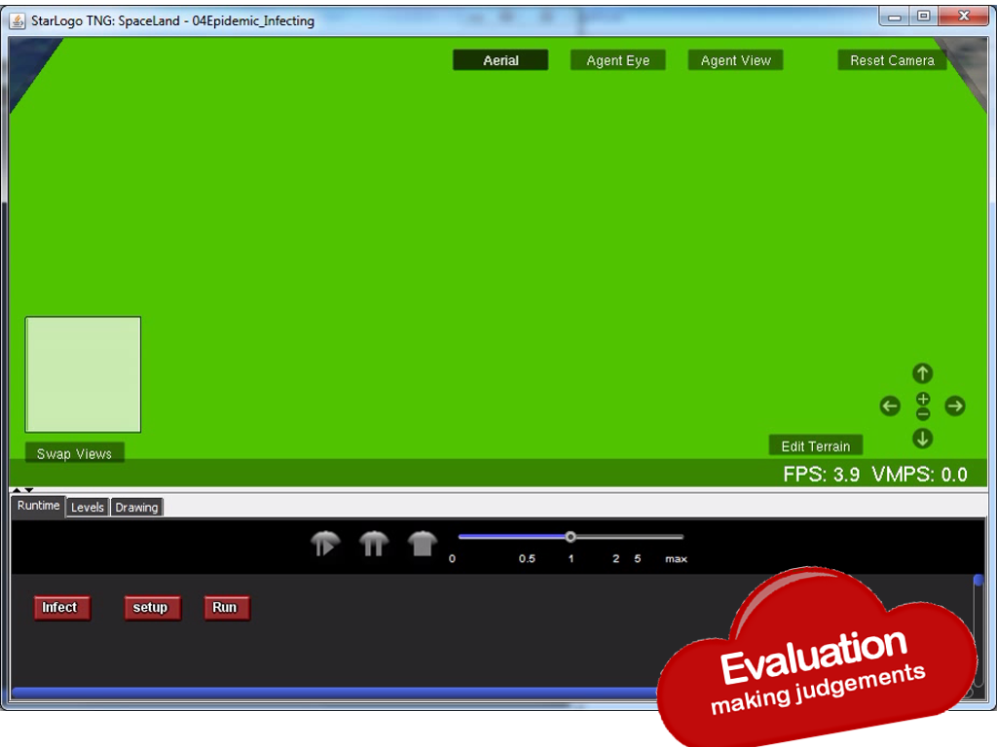
Notes:
On click, a video will play of the model as it currently stands.
Ask students what is wrong.

Slide 8
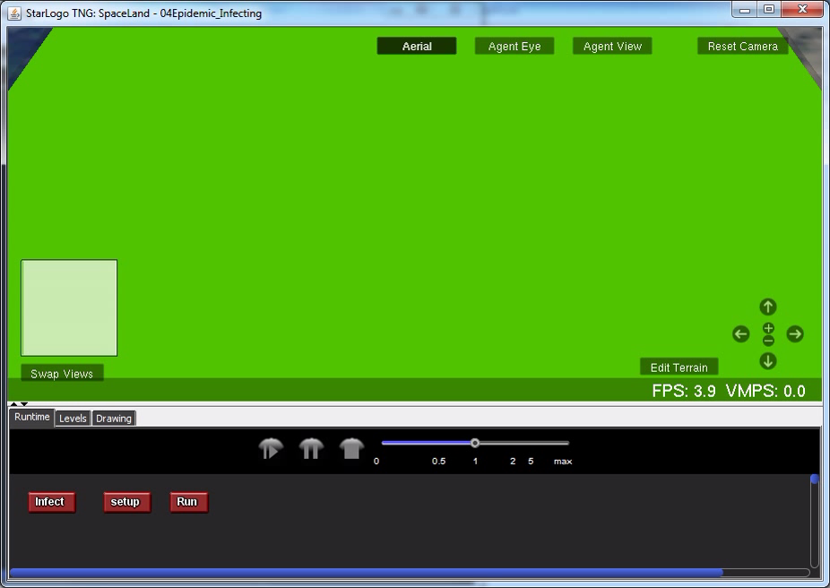
Notes:
What is wrong?
You may get a variety of answers – nobody dies for example, or sick people should stop moving and go to bed.
These are likely to be valid points and a list could be made.
Consideration could then be given to which are most important in an ‘ideas’ model that tries to represent the spread of infection.
The key flaw: without a way to recover, sooner or later everybody is infected. This is unrealistic.

Slide 9
Allowing Agents
To Recover
Set A Recovery Variable
Create A ‘Get Well’ Procedure
Call Procedure On Each Step
Notes:
Building recovery into our model is a three step process.

Slide 10
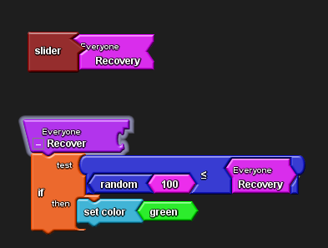
Set A Recovery Variable
Create A ‘Get Well’ Procedure
Notes:
In which space is the Recovery variable created?
It uses the Everyone space. We haven’t used this before.
We could have created it in the Turtle space.
By creating it for Everyone, if we add other breeds to our model they too can access the variable.
It acts as a ‘global’ rather than ‘local’ variable.
Note the slider block.
This is a built in ‘widget’. It is automatically added to SpaceLand, allowing us to set and vary the Recovery variable at runtime.
(click)
Can anyone explain how the Recover procedure works?
It uses the same technique used to seed the infection.
We generate a random number for an agent between 1 and 100.
If it is less than or equal to the Recovery variable, set by the slider, we set the agent green.

Slide 11
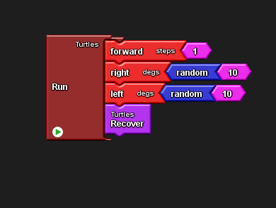
Call Procedure On Each Step
Notes:
Having defined the Recover procedure, we call it on each repetition of the forever loop that runs the program.
A good test of understanding might be to ask which Turtles it is applied to.
Every Turtle will generate a procedure call.
Since healthy agents are already green, it doesn’t matter if they aren’t set to green by the procedure.

Slide 12
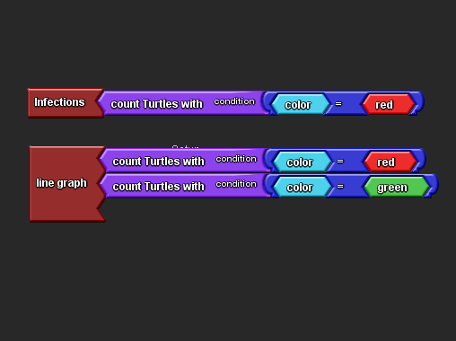
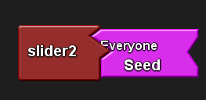
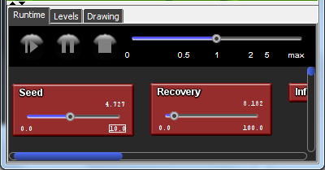
Gathering Statistics
02Epidemic_with_recovery_and_seed_slider.sltng
Notes:
Now that we have a basic model we might want to experiment by altering either the starting number infected, or the recovery rate.
Altering the recovery rate is achieved by moving the slider.
How would we change our seeding of the infection?
(click)
We would need to alter the number used in the Infect test.
To make that easier, we could make this a variable value, and attach a slider to it too.
This could set that as a practical challenge.
The slider widget is in the Setup and Run drawer.
The default range on the slider is 0 to 10.
Either parameter can be altered in SpaceLand
An example file is included: 02Epidemic_with_recovery_and_seed_slider

Slide 13
Gathering Statistics
Keeping Count of Infected Agents
Graphing Changes Over Time
02Epidemic_with_recovery_and_monitoring.sltng
Notes:
Sliders can be altered at runtime to observe the impact, but even so we have no accurate figures, just a visual sense of proportions.
Two ways we could improve this might be to keep a count of infected agents, and graph the changes over time.
Both are very simple to implement due to other widgets available in the Setup and Run drawer.
(click)
The line graph is particularly valuable in tracking how small local changes can impact on global values.
The video clip on the next slide demonstrates this.
As we alter the Recovery Rate during run time, we can see how the infected agents rises significantly in response to a small decrease in the Recovery, from 9/100 to 4/100.
An example file is included: 02Epidemic_with_recovery_and_monitoring. This has the Seed Slider removed to aid identification of the additional features.

Slide 14
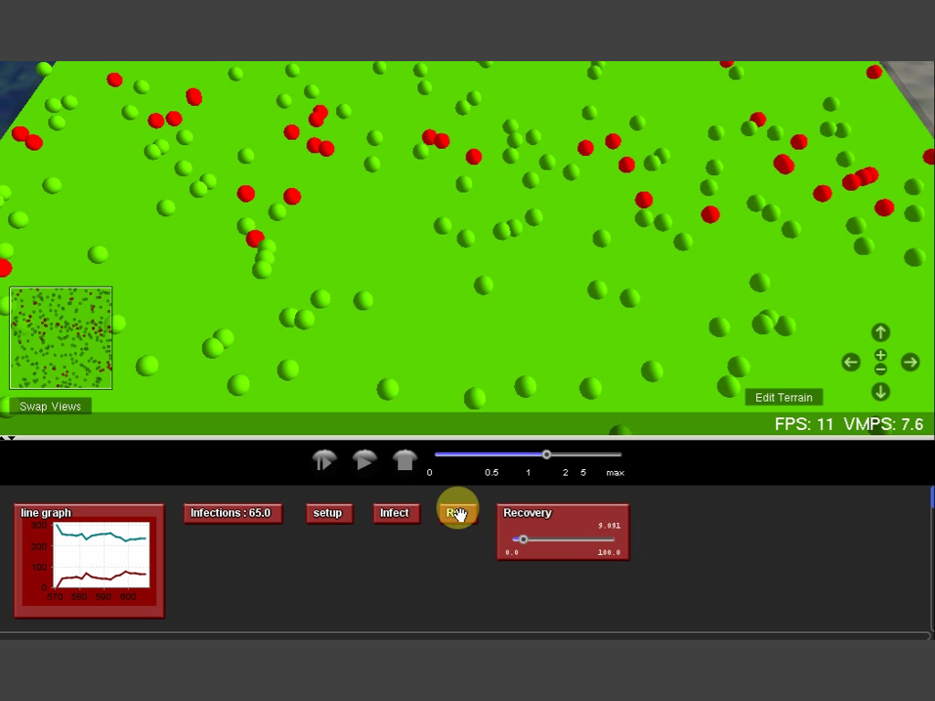
Notes:
If participants are investigating the model in this session, they can experiment on their own models and the video on the next slide can be removed.

Slide 15
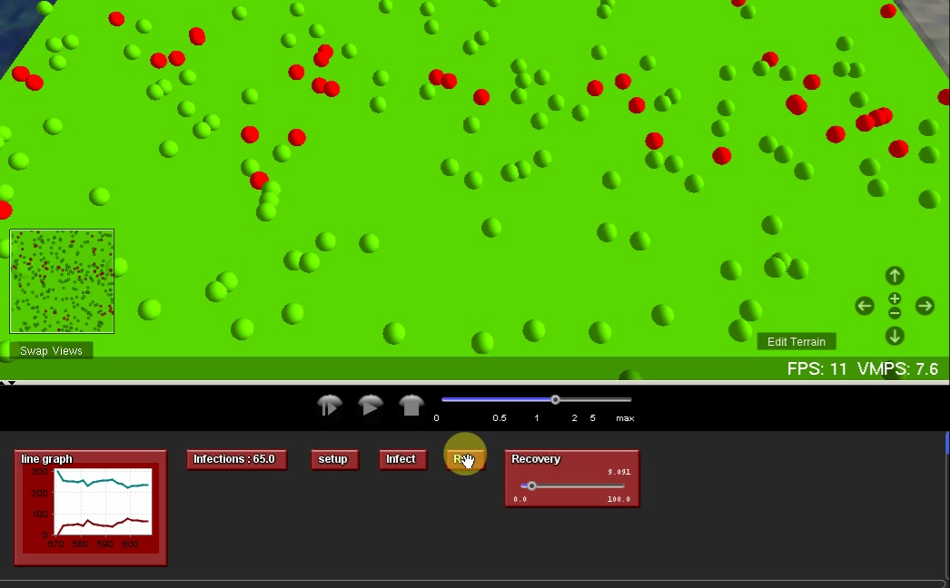
Notes:
The video will play automatically..

Slide 16
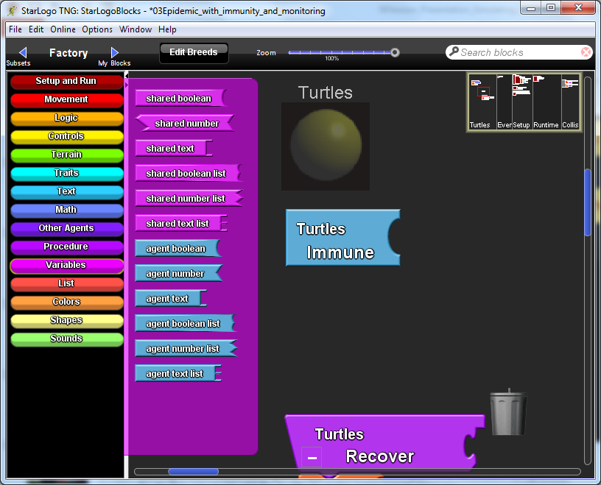
Refining our model
Making Agents Immune
Investigate The Impact
Notes:
Now that we can monitor impact, let’s add one further modification.
We might want students to get an appreciation of the impact of a vaccination programme.
To do this, we could add the facility to make some agents immune.
A local Boolean variable would suffice …

Slide 17
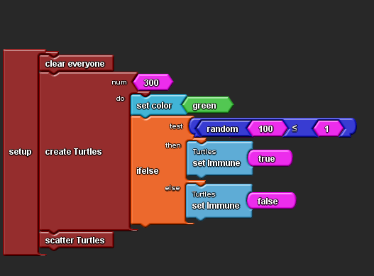
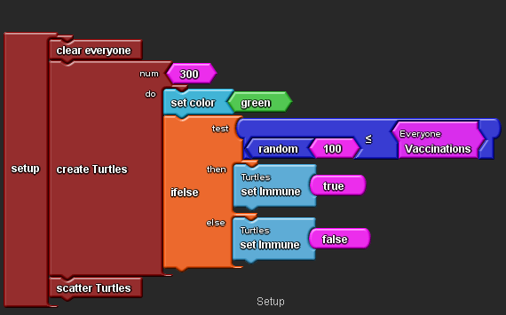
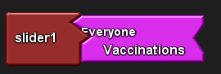
Refining our model
Making Agents Immune
03Epidemic_with_immunity_and_monitoring.sltng
Notes:
A local Boolean variable would suffice … which could be set when each agent is created.
Notice we use the same technique of assigning a random number and testing it against a threshold.
In this case, around 1% of the population are given immunity.
But we can do better than that.
(click)
By creating a ‘Vaccinations’ variable, attached to a slider like before
We can alter our level of vaccination at setup.

Slide 18
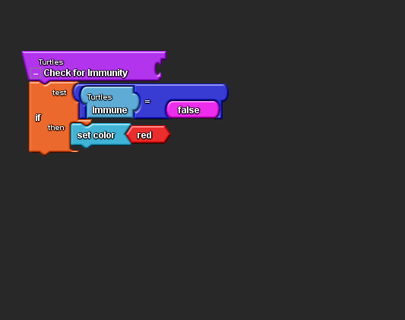
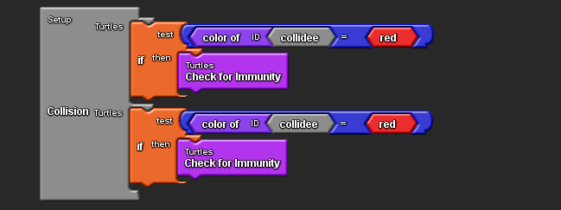
Refining our model
A check for immunity…
… called on collision
03Epidemic_with_immunity_and_monitoring.sltng
Notes:
Once an agent has an Immune attribute, a procedure is needed to check it.
The procedure is called when a collision occurs.
If the agent collides with an infected agent, the check is called.
Only if the agent is not immune, will they become infected.

Slide 19
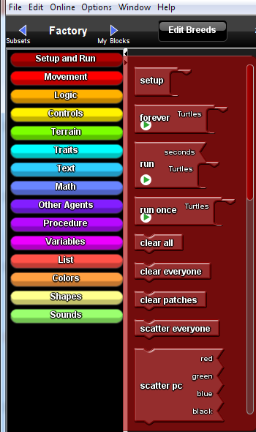
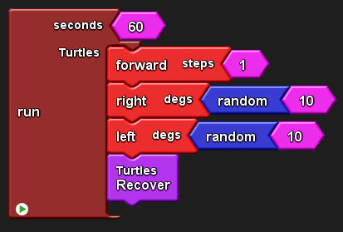
Refining our model
Setting the duration
03Epidemic_with_immunity_and_monitoring.sltng
Notes:
There is just one more refinement before we can run our model.
If we want to compare results we need to run simulations for the same length of time.
Notice here we have changed the Forever block for a Fixed Time of 60 seconds.
A final sample file is included, so attendees can experiment 03Epidemic_with_immunity_and_monitoring

Slide 20
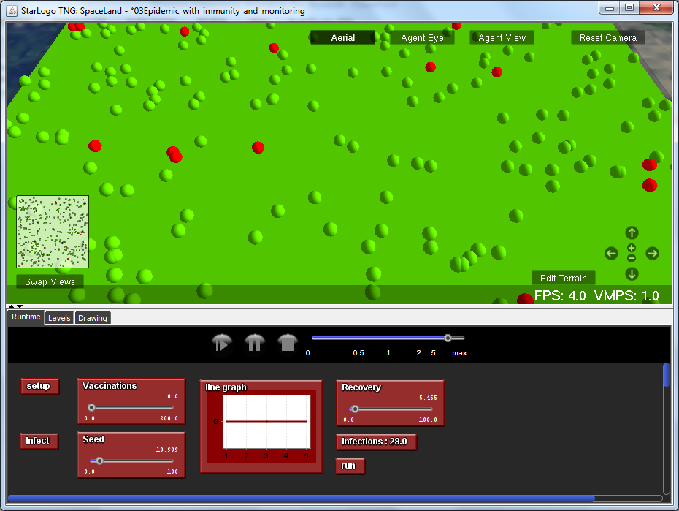
Pandemic panic!
Notes:
So here is our simulation, ready to run.
We have seeded the infection to around 10% of the population, have a recovery rate 5 and no vaccinations.
This sample code is available in the resources: 03Epidemic_with_immunity_and_monitoring.sltng
We have set it to graph infections only.

Slide 21
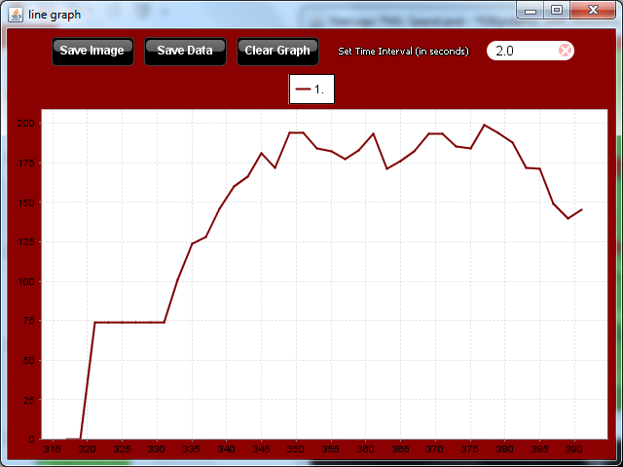
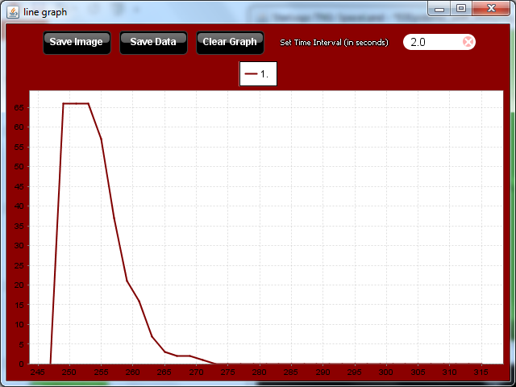
Pandemic panic!
Notes:
We can set the speed so it completes very quickly, and here is our result. Infections peaked at around 200 – that’s 2/3 of the 300 population we initially scattered.
If we now vaccinate 30% of the population and run the simulation again we can see a dramatic impact.
(click)
Not only has the infection died away quickly, if you look closely at the axis, it peaked at around 60. The graphs scale automatically as they are being created.
We have a clear visual representation of the potential impact of a vaccination programme …
… and hopefully stimulus to explore further.

Slide 22
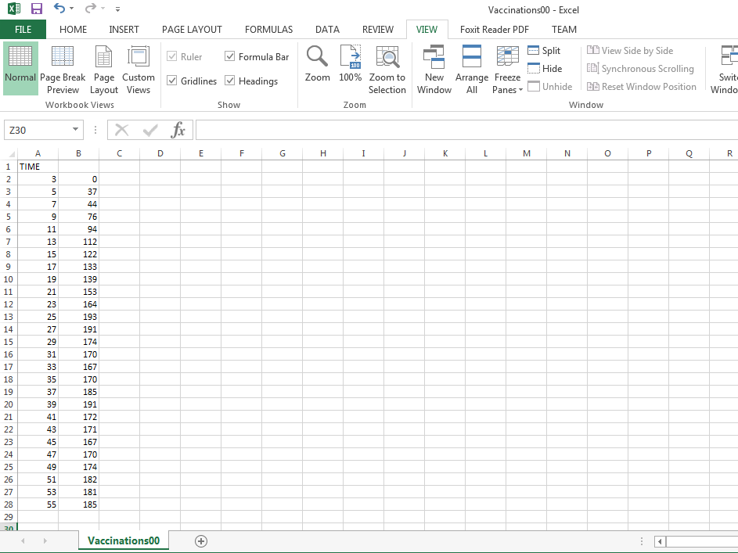
Pandemic panic!
Notes:
If we take a closer look at the graph widget, you’ll see an option to Save the Data.
This exports the data as a csv, which can be opened in Excel or a similar spreadsheet application.
Down the left hand column are the time values in 2 second increments – a parameter that can be set when capturing the data.
Although it would involve a degree of cutting and pasting, we have the basis for some simple analysis of the data captured.
Children can be encouraged to think how they might plot the impact on the spread of an epidemic of various levels of vaccination take up.

Slide 23
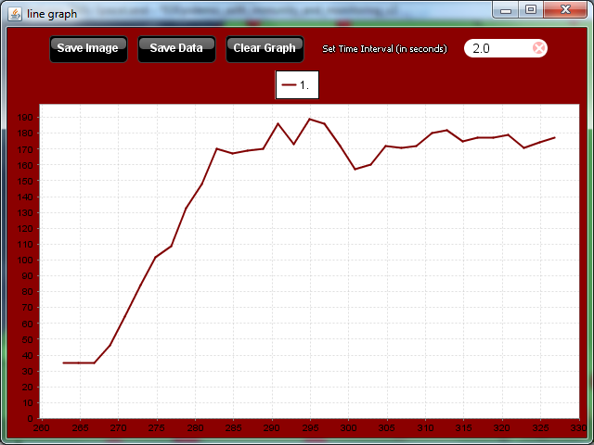
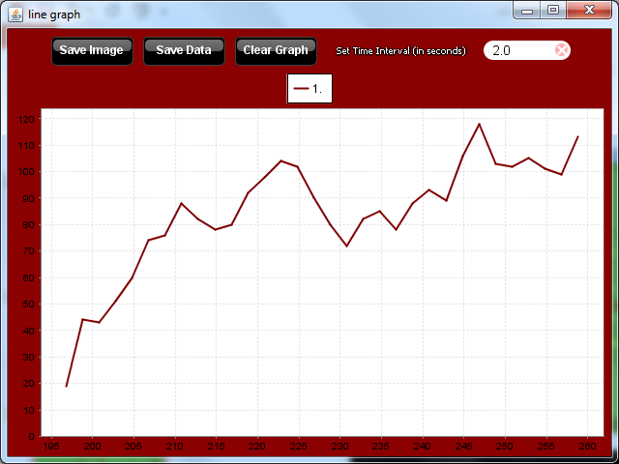

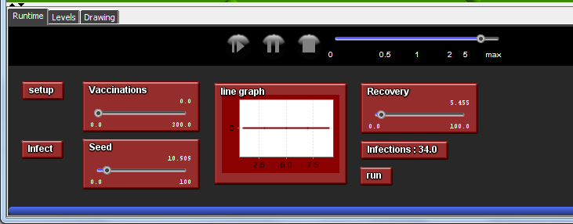

How scientific is our investigation?
34
28
46
Notes:
Let’s just consider our interface again for the moment.
Whilst running a simulation a few times with different vaccination rates might seem like a scientific experiment, we need children to embrace a few more ideas.
The question can be a good prompt for a class discussion.
Points to draw out are that our model is only as good as the assumptions it is based on.
Whilst we keep time constant, we also have 2 other variables to consider as well as the vaccinate rate.
The Recovery rate can represent the ‘health’ of the population – a well fed population is likely to recover quicker for example
So we have scope to investigate the impact of vaccination among populations of differing health.
We can also modify the Seed to reflect other social factors such as overcrowding.
A final crucial element is for children to reflect on the impact of random behaviour.
Although we can set a Seed variable, this only provides an upper boundary for generating a random number for each agent. As a result, the number of initial infections can vary significantly as can the subsequent behaviour of the model.
(click)
Setting up the same experiment can result in wildly different starting rates of infection.
And scattering the population results in a random distribution too.
Here 28 initial infections lead to this graph.
Recognising these factors should lead children to realise they need to carry out many runs of the same starting setup to derive an ‘average’ general view.
Scope here for group planning perhaps, with different groups initiating multiple runs on the same data.
Each group could have different parameters.
Once collated, spreadsheets from each group can be swapped and combined.

Slide 24
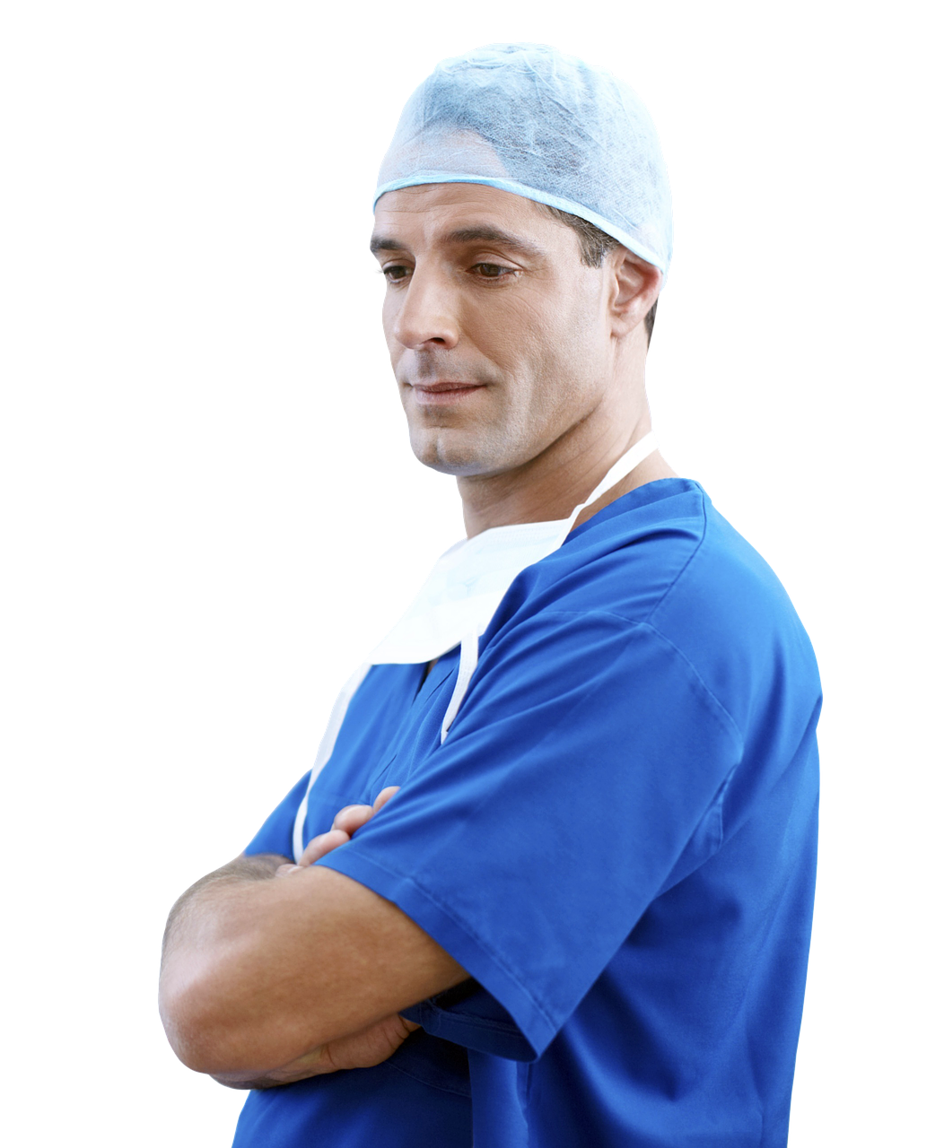
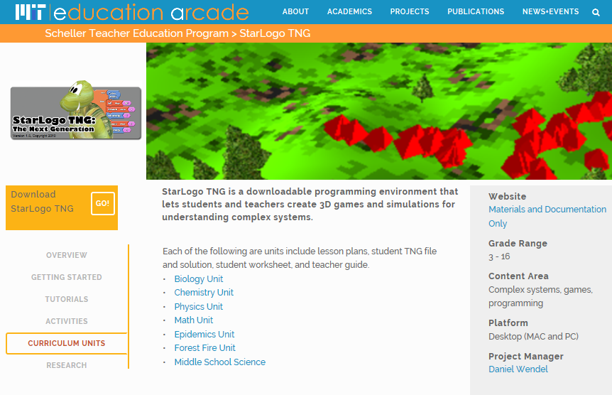
How can we improve the model?
http://education.mit.edu/portfolio_page/starlogo-tng/
Notes:
Before moving on, it’s worth considering ways to improve the model.
Children will come up with all sorts of ideas.
A key point to draw out is that ideas models are abstractions.
Extra detail isn’t always helpful so encourage pupils to focus on key ideas and simple ways to represent them.
An obvious one is to introduce doctors who heal people.
They can be implemented as blue agents, who heal infected agents when then collide.
Quarantine or hospitalisation might involve stopping the agent moving.
Death might be another ‘easy to implement’ development, and birth, so we begin to explore the idea of an population over time.
Passing on an infection at birth could also be considered.
Allowing children to develop their own improvements is often very rewarding. This is the constructionist pedagogy coming to the fore.
(click)
If you wish to develop a more structured investigation the Scheller Teacher Education Program hosts a series of curriculum units including one on epidemics.
This takes an investigation further, looking at the relative costs of different health interventions.
All materials are freely downloadable from their site:
http://education.mit.edu/portfolio_page/starlogo-tng/

Slide 25


Points to ponder
What cross-curriculum benefits are there from exploring and developing models in Computing?
Can model making support creativity in the Computing curriculum?
Notes:
A brief pause to encourage a short discussion whilst props are tidied up and the presenter gets ready for the next session.
It should be clear there is a lot of potential for cross curricular work involving modelling. Encourage a discussion around the potential for developing creative projects – you can pick up on the points raised after looking at another example exploration.

Slide 26
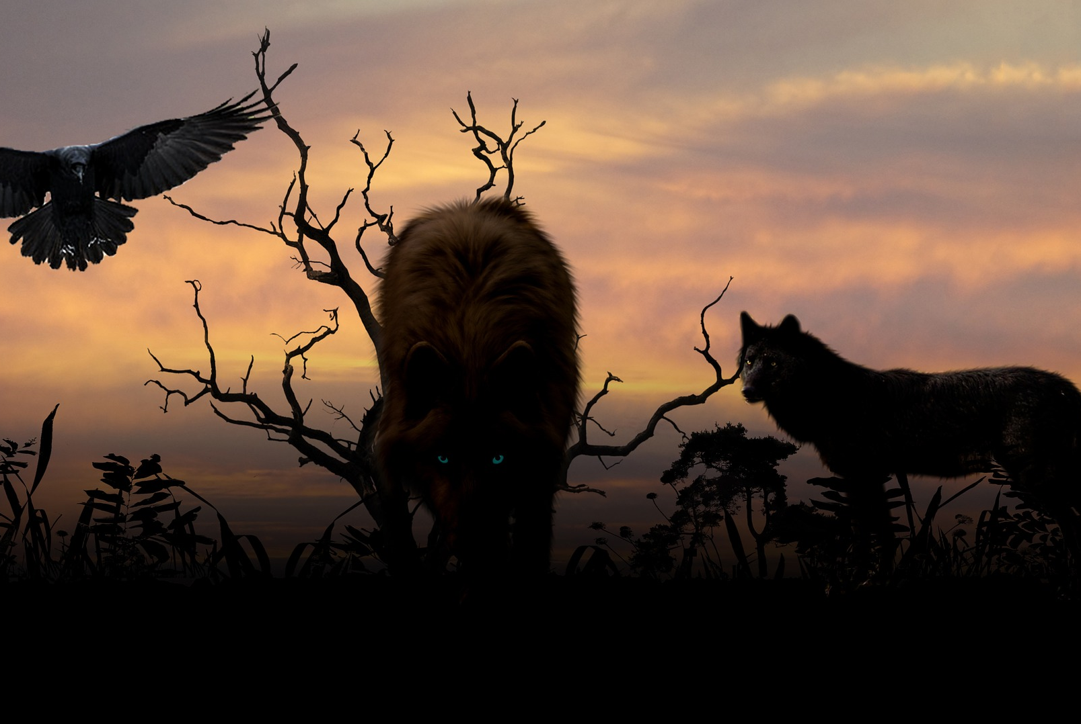
Predators and Prey
6
activity
Notes:
For our second exploration into ways to analyse data we’ll look at a model of a predator / prey environment.

Slide 27
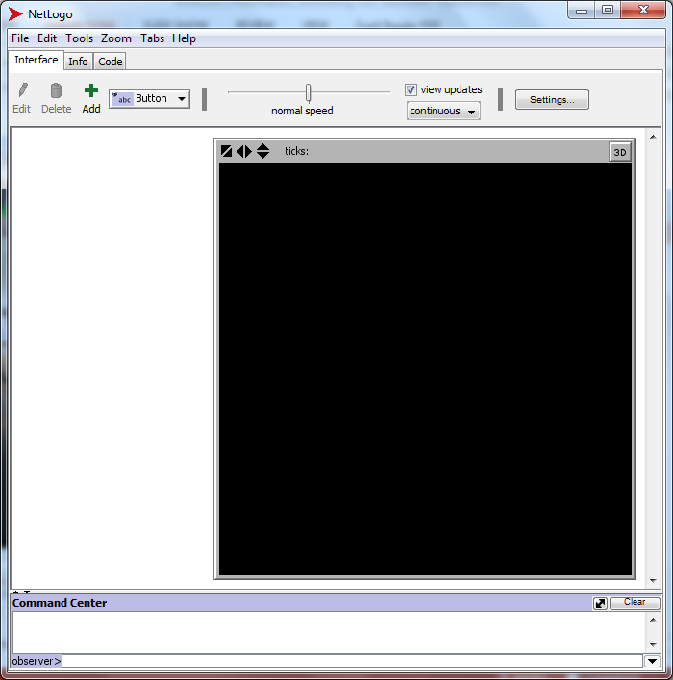
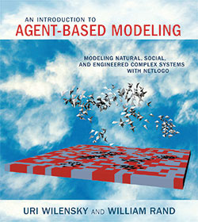
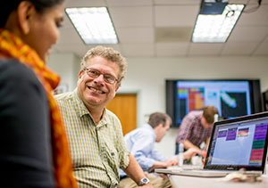
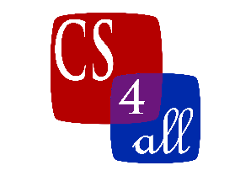
Predators and Prey
6
activity
http://ccl.northwestern.edu/netlogo/
csp-aims.appspot.com
Notes:
We’ll use a different modelling tool this time – NetLogo.
Another free download, it is widely used in academia.
It follows the same principles as StarLogoTNG:
Simple local rules applied to many agents from which the global behaviour emerges.
Developed by Uri Wilensky, co-author with Mitch Resnick of the paper outlining kinaesthetic activities earlier, he is another product of the MIT Media Lab, influenced by the educational ideas of Seymour Papert.
So NetLogo is another Logo descendant, and a text based modelling environment.
It is available for free download from the Centre for Connected Learning, which Wilensky directs.
It is based at Northwestern University on the edge of Lake Michigan, Illinois. http://ccl.northwestern.edu/netlogo/
Whilst we won’t have time to delve into NetLogo in any great depth, if modelling grabs you, this environment offers a natural progression from StarLogo.
Wilensky has written a comprehensive, if pricey book and the software is well supported and documented.
Our friends from Project GUTS at SantaFe Institute, through Computer Science 4 All have provided a structured online introductory course. This exercise is taken from that course.

Slide 28
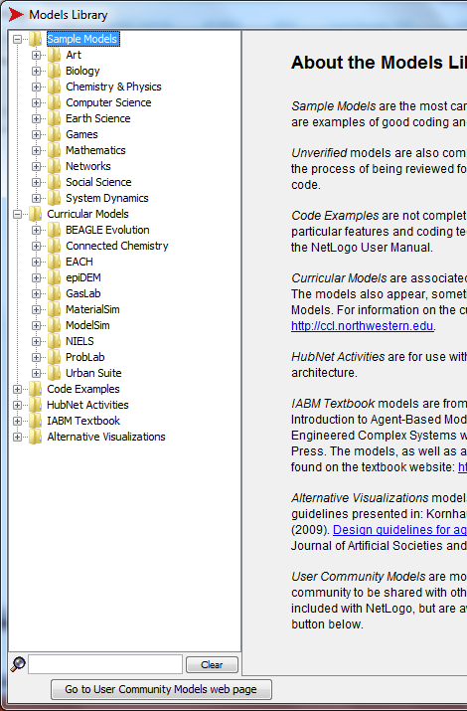
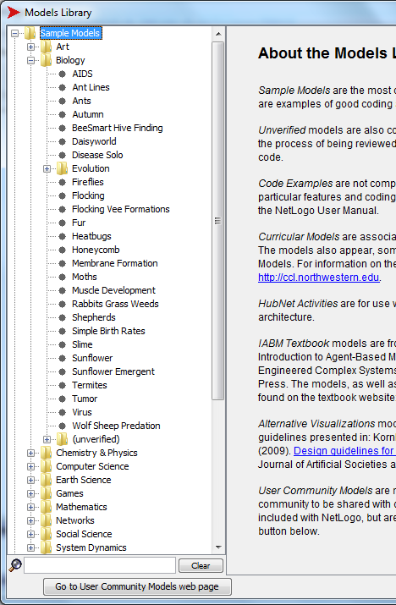
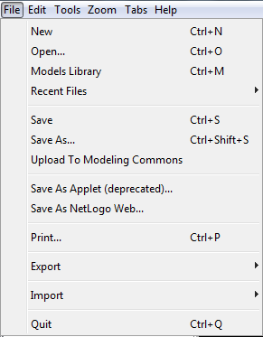
Predators and Prey
http://ccl.northwestern.edu/netlogo/
Notes:
One of NetLogo’s great strengths is the vast number of models in the Model Library.
This gives students plenty of opportunity to explore models, and engage in text based coding by making simple modifications.
(click)
Select the model library and you will see the many folders, each often containing many pre-built models. Expand the Sample models folder and locate the Biology folder.
(click)
Expand that and begin to appreciate the amount of resources available.
We will be working with the Wolf Sheep Predation model.
(click)
If there are problems accessing the file from the model library it is included in the resources.

Slide 29
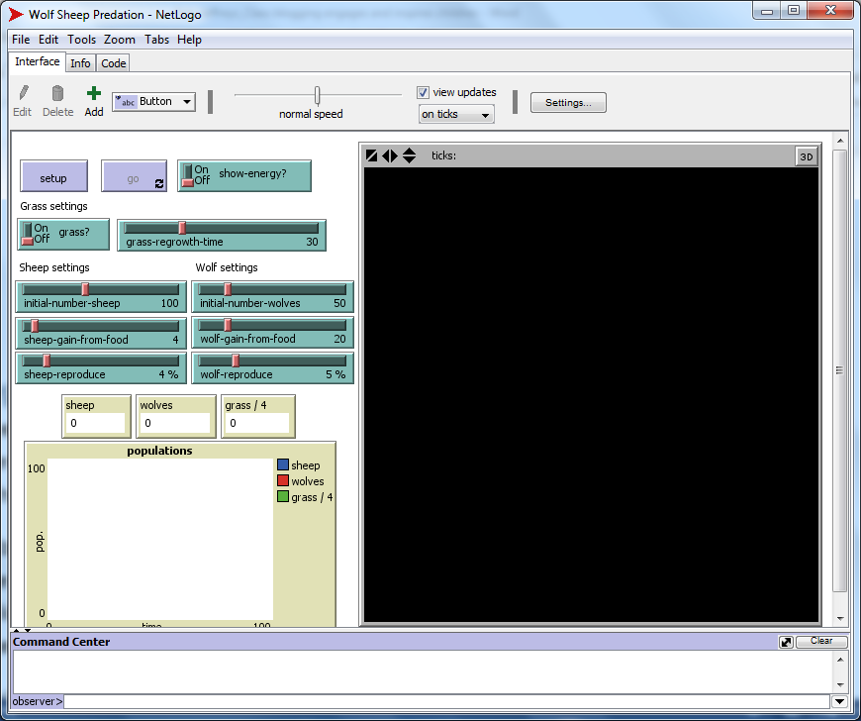
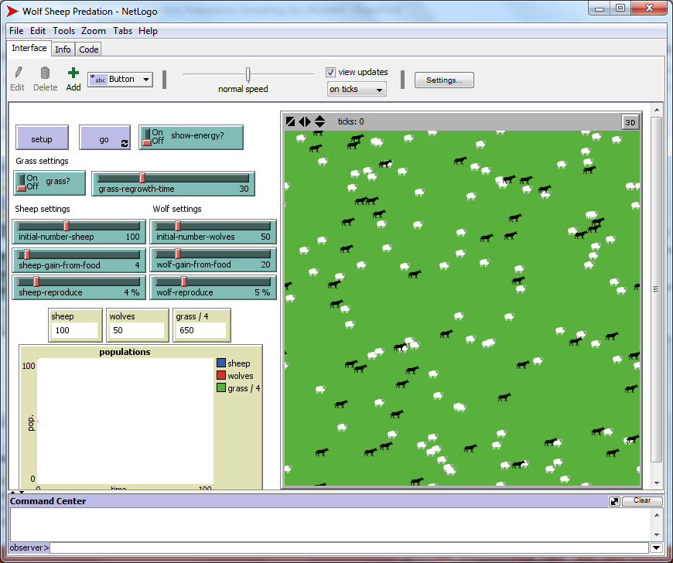
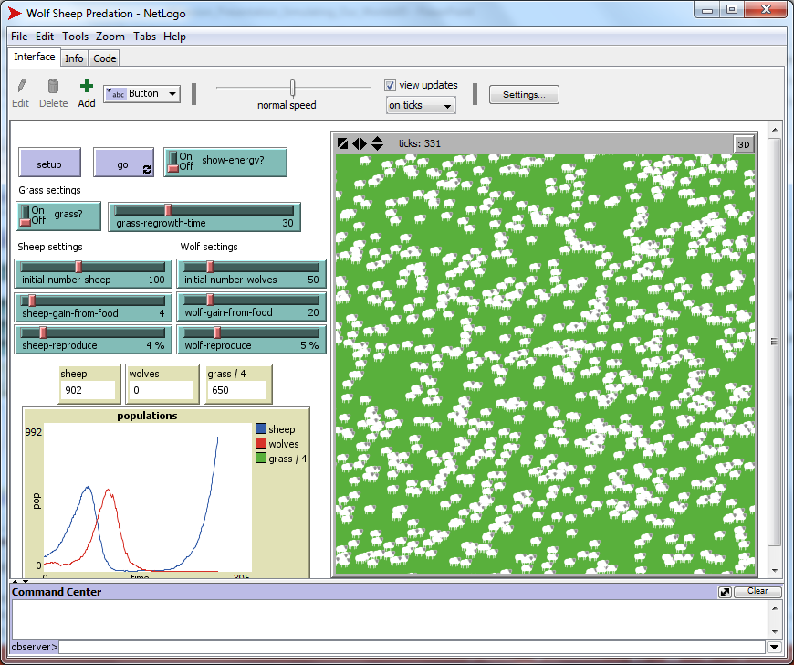
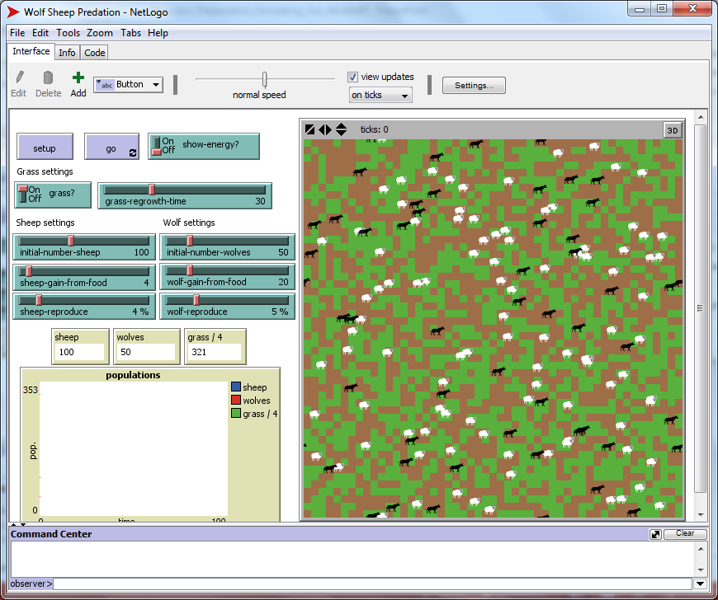
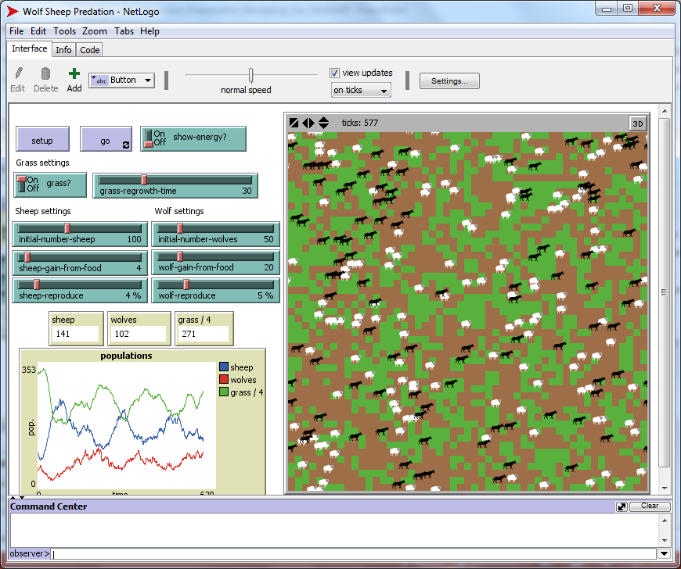
Notes:
As the introductory notes say, this is a model to explore the stability of a simple predator / prey model.
We’re familiar now with many of the elements for a decentralised model such as this.
There are 3 elements.
The observer (or user) instantiates the world through the Setup and Go buttons.
They can also change variable values via the sliders and settings to establish what is shown .
Let’s setup our world now, leaving all settings in their default state.
(click)
Our agents will follow simple rules as before.
How many different ‘agents’ have we in this model?
(Two, sheep and wolves.)
Let’s run the model to see what happens.
(click)
Everyone will get different results but you’ll notice we have similar graphing capabilities as we had in StarLogo.
Most will probably lead to extinction of one or the other species. In the example here, wolves have died out.
What happens if one species becomes extinct?
(If wolves die out, sheep population continues to expand. If sheep die down, wolves expand until they suddenly collapse). Either way, such a system is generally known as unstable.
(click)
Let’s make one alteration.
The third element in a model is the agents environment which is made up of patches.
Switch the Grass on, which introduces many more variants into the behaviour of the model.
Run the model and observe what happens.
(click)
Notice now how we have a stable eco-system.
As well as graphing sheep and wolves, we can monitor grass growth as well.
Notice the way the populations of all go up and down, and notice too how they relate to each other.
This is a familiar pattern in population dynamics which we will investigate in the final session.
First, let’s understand how this model works.

Slide 30
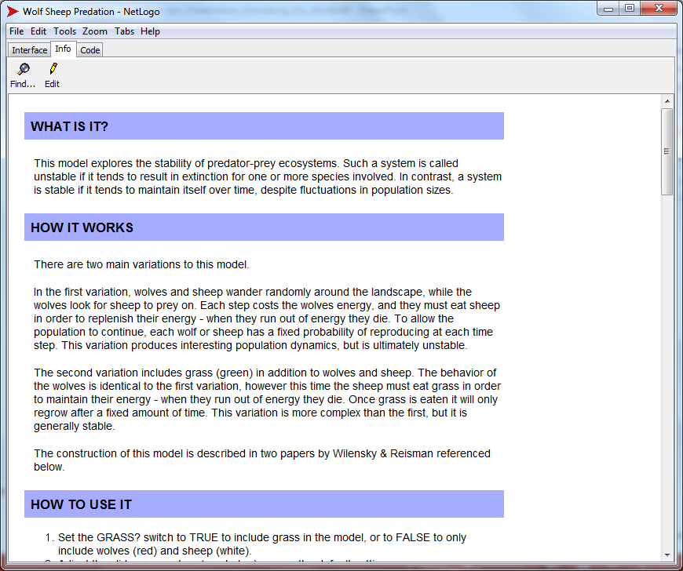
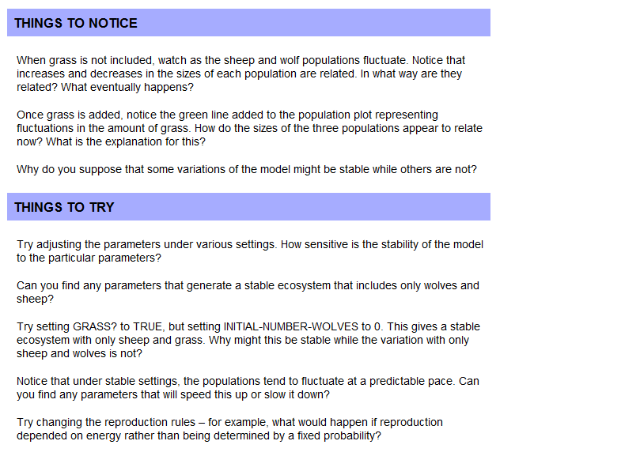
Notes:
Notice the tabs along the top.
Select the info tab.
Each model in the model library includes a comprehensive explanation.
Scroll down and read the ‘things to notice’ and ‘things to try’.
These are excellent resources for children to explore.

Slide 31
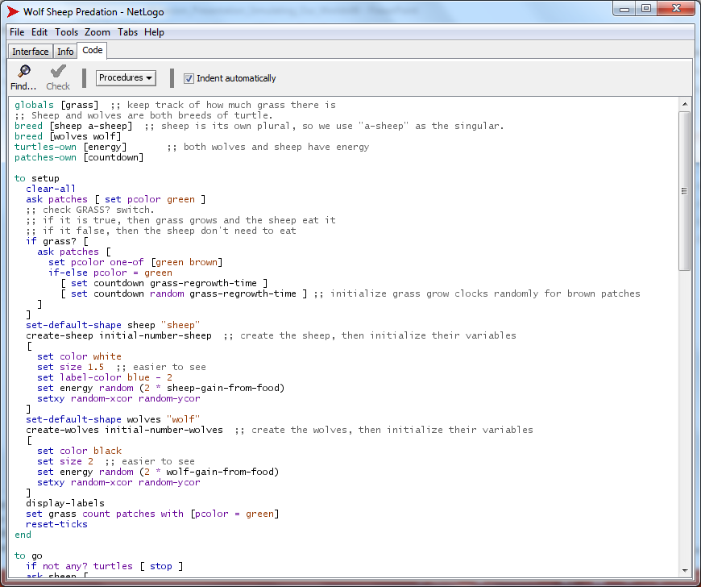
Notes:
Finally, take a look at the code.
It should be easy to identify the similarities with the sort of block based code we have used in our models.
(click)
We have two breeds, sheep and wolves. These are subsets of a turtle object, and both have a variable energy.
(click)
When we create our sheep, as part of the setup procedure, the energy value is assigned.
Can anyone explain how it is calculated?

Slide 32
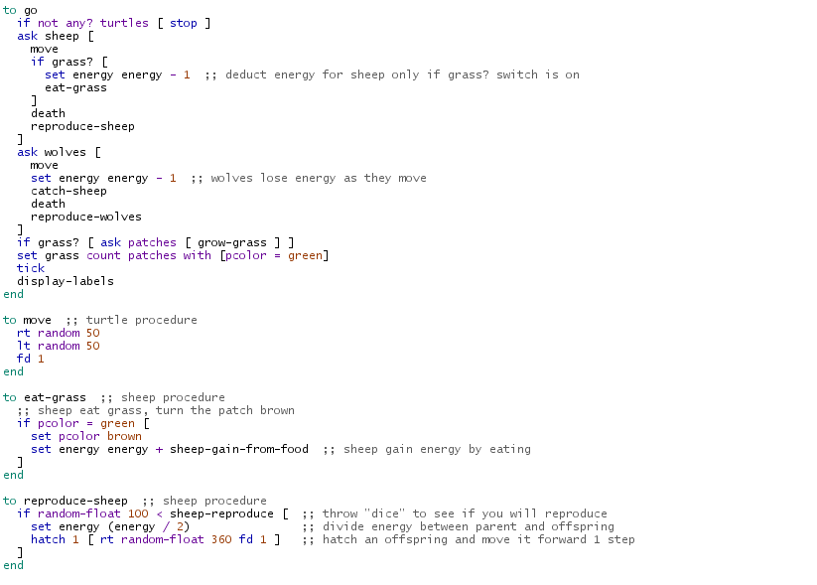
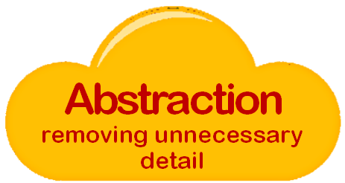

Notes:
Scrolling below the Setup procedure, you see the main Go procedure.
Again, you could use this as an exercise in reading code as a group.
Note how well commented and easy it is for children to understand, particularly if they have had experience with block based code.
Notice also, how ‘uncluttered’ the main procedure is – another example of procedural abstraction.
(click)
The main ‘Run’ loop calls a series of procedures which are defined below it.
Here the detail is spelt out, each action decomposing into a series of familiar steps.
Again, ideal for assessing students ability to understand and interpret code.

Slide 33


Perform a parameter sweep
For each set of parameters:
Run the model multiple times
Notes:
Remember our pedagogy model?
We’re still exploring models here, but by engaging with a text based equivalent model we’re deepening students understanding not only of how a model works, but how to analyse the simulation too.
NetLogo offers options for a more thorough exploration than those available in StarLogo.
How many parameters interact in this model?
There are 7 factors (or parameters) that can be altered to explore the behaviour of the simulation.
Like before, with the Bridge Design model, we might want to keep some factors constant whilst we sweep through a series of values for another factor.
(click)
So to analyse our model we need to perform a parameter sweep.
But for each group of settings, because this is a stochastic model involving randomness, we also need to run the model multiple times.
That is a lot of tests!
Like we suggested with StarLogo, we could approach this as a group task, but NetLogo has a wonderful tool to help us.
(click)
It’s called behaviour space, and is accessed from the Tools menu.
Instructions for setting up behaviour space and a sample spreadsheet output are also included in the resources.

Slide 34


Notes:
Select the new option and the dialogue window opens.

Slide 35
If grass grows faster, investigate the impact on the sheep population.
["grass?" true]
Notes:
Give your experiment a name, then look carefully at the variables list.
Let’s investigate the impact of faster grass growth on our sheep population.
To do that we will first need to turn the grass on, so set “grass?” to true
To do this we might want to run the model at various rates of growth.
Instead of a fixed rate of 30, lets try various rates. Replace 30 with the expression shown [0 20 100] (click).
Note the extra brackets and three numbers separated by spaces. (click)
These denote the lower and upper bounds and the increment.

Slide 36
If grass grows faster, investigate the impact on the sheep population.
["grass-regrowth-time" 30]
["grass-regrowth-time" [0 20 100]]
0
20
40
60
80
100
Initial value
Increments of 20
Final value
Notes:
Give your experiment a name, then look carefully at the variables list.
Let’s investigate the impact of faster grass growth on our sheep population.
To do this we might want to run the model at various rates of growth.
Instead of a fixed rate of 30, lets try various rates. Replace 30 with the expression shown [0 20 100] (click).
Note the extra brackets and three numbers separated by spaces. (click)
These denote the lower and upper bounds and the increment.

Slide 37

If grass grows faster, investigate the impact on the sheep population.
5
[“initial-number-sheep" 100]
[“initial-number-sheep" 50 100 150]
Notes:
Scroll down the variable list and locate “initial-number-sheep”.
This is currently set to 100.
(click)
Rather than a fixed population of sheep, we might want to investigate the impact of the grass change on several populations.
Here we have set it to try starting populations of 50, 100 and 150.
Note here that discrete values are simply separated by spaces, without any brackets.
So we now have 3 initial sheep populations, each being run in a simulation with 6 different rates of grass growth.
There is one other factor still to consider.
Because our model involves random elements we need to run each simulation several times.
Let’s change the ‘Repetitions’ to 5

Slide 38


If grass grows faster, investigate the impact on the sheep population.
count sheep
count wolves
Notes:
With the parameters for the simulations set, we can consider what we want reported.
(click)
The default is turtles, but we want the count of the sheep breed.
It is probably worthwhile to have a count of the wolves too.

Slide 39

If grass grows faster, investigate the impact on the sheep population.
not any? turtles
Notes:
The default setting for behaviour space is to measure runs at every step, rather than just at the end.
We’ll leave that so you can see the effect, but if you had long model runs or to simplify the volume of data you may wish to just report the values at the end.
Below this we can specify the procedures to call for setup, and run. In our case, the model uses just ‘setup’ and ‘go’.
The ’Stop condition’ allows us to run models until certain conditions are met.
In our case, we want to run each simulation for a certain amount of time, but if our breeds become extinct before that, there is little point continuing.
(click)
So to demonstrate this capability, let us put in the condition “not any? turtles”.
There is another option to specify any procedures to run after the simulation has finished – the Final commands.
We have no need for that.

Slide 40



If grass grows faster, investigate the impact on the sheep population.
1000
Notes:
Our final task is to specify how long we want the simulation to run for.
We’ll set it for 1000.
If you wish your simulation to run until a stop condition is met, this value can be left at 0.
However, even if you wish your simulation to be controlled by a condition, rather than a set time, if there is a chance it may never meet the condition, it is wise to specify a final time limit.
When we select OK, our Behavior Space window lists the experiment(s) we have configured and the number of runs required.

Slide 41



Notes:
When we hit Run, we are given the choice of output formats.
Selecting Spreadsheet allows the data to be saved as a comma separated by value file.
For efficiency and speed, several runs can be made in parallel – the default number being determined by the number of cores in the processor.
Finally decide where you wish to save the file, and add a .csv extension.
(click)
Behaviour Space will now run all the simulations automatically.
Note that you can increase the speed, as well as observe one of the runs currently taking place.
Observing the runs can stimulate discussion.
With a grass-regrowth-time of 0, this run has resulted in sheep dying out and the population of wolves is falling dramatically.
Why might that be the case?

Slide 42


Notes:
In this run, we seem to have a more stable eco-system.
You can see the settings – a grass-regrowth-time of 20.
(click)
With a longer regrowth time – 100 (this is run 85 of 90) we see a very different pattern.
This time the wolves have died out and the sheep population is oscillating.
So just the facility to run a series of simulations automatically can help stimulate further questions.
Hopefully students will be motivated to analyse the spreadsheet data more thoroughly.

Slide 43

Notes:
So here is the data captured in the csv file, opened in Excel.
The first thing you’ll notice about the spreadsheet is that it is huge!
Making sense of a large data set is part of the challenge for students.
Let’s spend a moment unpicking it.
(click)
The first six rows give details of the experiment: the model used, the date and the size of the world.
That’s what the min and max x and y co-ordinates indicate.
(click)
Rows 7 to 16 list the starting parameters for each run.
Check understanding by asking what the grass regrowth time is for run 3?
What is the initial number of wolves and sheep for the first runs?
(click)
Rows 17 to 22report the final results from each run for the things we specified – in this case number of sheep and wolves.
It also reports the minimum and maximum values achieved in each run and the mean.
Finally the number of steps the simulation took is recorded.
Question – we set our simulation to run for 1000 steps, why has this not happened in the runs displayed?
(click)
Finally, point out to students that there will be several columns recording data for each run.
Although the starting parameters are only stated once, there will be a column for each element we specified reporting on.

Slide 44

Notes:
If you scroll down, the count for each animal is recorded for every step of the simulation.
We could go on, but the point is to highlight the possibilities this offers for students to engage in systematic analysis.

Slide 45

Pupils should be taught to:
undertake creative projects
that involve selecting … multiple applications … to achieve
challenging goals, including
collecting and analysing data …
Notes:
We could go on, but the point is to highlight the possibilities this offers for students to engage in systematic analysis.
Once the data is in Excel, there are many more facilities for charting the data.
Running simulations in NetLogo, analysing the data in Excel and creating a summary report, whether written, oral or a multimedia report offers lots of scope for satisfying another element in the National Curriculum.
More importantly, given the wide variety of models available, there are lots of possibilities for tying this work to that done in other departments, principally science.

Slide 46
Pupils should be taught to:
undertake creative projects
that involve selecting … multiple applications … to achieve
challenging goals, including
collecting and analysing data …
Pupils should be taught to:
design, use and evaluate
computational abstractions
that model the state and
behaviour of real-world
problems and physical systems
Notes:
Back to our pedagogical framework.
We’ve spent a lot of time exploring ‘computational abstractions’ to get a good insight into what makes a model work.
We’ve introduced several models that simulate real world systems at an ‘ideas’ level.
Models such as these are ripe for evaluation and improvement.
But we should now be in a position to build a model almost from first principles.
That is the final focus of the session.
Before that though, let’s spend a moment considering the possibilities of action research.

Slide 47






Class based research
Why?
www.computingatschool.org.uk
Notes:
Before we embark on the last activity, use the following slides to prompt a discussion about the value of classroom research both to support continuing professional development and to inform the wider teaching community.
Use the terms “teacher enquiry”, “action research”, “reflective practitioner” and “practitioner research”.
Teaching computer programming is a relatively new activity.
Many teachers are experiencing it for the first time.
Those with experience can offer valuable support, advice and information to other colleagues.
There are lots of opportunities for colleagues, old and new to contribute to an emerging pedagogy.
(click)
Inform them of the Teacher Enquiry in Computing Education project. It provides a forum and focus for research in the field of computing.
It can be accessed from the home page of the CAS website, under the link to projects: http://www.computingatschool.org.uk/

Slide 48
Class based research
What?
Find out
from your colleagues in geography and science which aspects of this topic would support the pupils’ understanding in geography and science.
Notes:
Research an area in which you have ready access to the data but be aware of researcher bias and local ethical considerations.
Don’t try to prove something you believe – always think that you are “bringing a better understanding” of the situation – it helps avoid bias.
Emphasise the key words such as “find out”, “evaluate” and “compare” to spark ideas
Each of the following slides gives an example of a possible focus for research.

Slide 49
Class based research
What?
Evaluate
the use of a particular software package to effectively explain the principles and concepts of computer modelling.
Notes:
Focus your research on something you are trying out. Start by creating a question. Develop sub-questions that bring more detail or further focus your research.

Slide 50
Class based research
What?
Compare
school data of the pupils’ science performance and how well they succeed in creating a scientific model.
Notes:
There is a lot of data in school; devise an analysis that will enhance your job and provide interesting perspectives.

Slide 51
Class based research
What?
Design, implement and evaluate
a particular sequence of activities that introduce computer modelling to pupils.
Notes:
Evaluating a unit of work you develop has obvious practical benefits.

Slide 52


Class based research
How?
Notes:
Briefly tell the audience of different methods. Choose one of the examples from the previous slide and discuss which methods might be used:
Questionnaire (including online) and Survey
Interview
Focus group (and online forum, wiki)
Scrutiny of documents including pupils’ work and blogs
Scrutiny of numerical data
Observation
Less common but very effective:
Analysis of professional conversations (in meetings, by email, through forum)
Analysis of pupil interactions/engagement in VLEs, forum, etc.
Discourse analysis
Content analysis
(click)
Remember – all research has ethical considerations
Remind them of the school’s requirement/permissions/information to pupils and parents – the idea of informed consent and freedom to withdraw their data from the research process.
If working on a University course then you will be governed by their ethics policy.
If completing the BCS Certificate then there is an explicit ethical requirement.

Slide 53


Class based research
Qualifications and Certifications
www.computingatschool.org.uk/certificate
Notes:
End with a reminder of the BCS Certificate in Computer Science Teaching – there are A5 hand-outs. One part of the evidence for the award is classroom research undertaken by the teacher.
(click)
The other two areas involve attending CPD – like today!
(click)
And completing a manageable programming project.
If that sounds a little daunting, remember you can opt for either an independent or guided route.
The latter means you’re supported by a mentor who can help guide you through.
It is a valued award, giving professional recognition accredited by the BCS, The Chartered Institute for IT.
More importantly, it’s designed to help you in the work you’re developing in school.
See the link for more information: http://www.computingatschool.org.uk/certificate

Slide 54


Simulating Our World
Building
Models
Notes:
Our final set of activities look at building a model eco-system.
It starts with another kinaesthetic activity from ‘Adventures in Modeling’, designed to illustrate the cyclical nature of stable eco-systems.
We’ll then consider ways to set a final model building challenge.

Slide 55





https://youtu.be/Fywq_jKCDpY
Notes:
The relevant chapter from the book is included in the resources.
This 3 minute video from Project GUTS explains the idea well: https://youtu.be/Fywq_jKCDpY
You will require lots of sheets of paper to crumple, a large newspaper and some method for recording results.
It is a fun activity, preferably done out of doors.
Over 3 rounds, students are introduced to the idea of negative feedback loops which impact on population dynamics.
Apart from co-ordinating the activity, the key input from the teacher is to make explicit the link between the newspaper participants stand on, which is analogous to a finite food supply.
Recording results, students will observe the cyclical fluctuations in the population that we observed in our predator – prey model in the last exercise.

Slide 56

The Undersea World
7
✓
activity
Notes:
Our final activity is based on another project introduced by Project GUTS.
Students will build a marine eco-system.
It is tackled in two parts.
The first stage is scaffolded, so the students don’t start with a blank model.
The second allows them to develop the model in various ways.

Slide 57

7
Stage 1: Intended Outcome
activity
Notes:
The video that follows shows the intended outcome from the first stage of the project.
We’re using StarLogo.
We have a model with our familiar two buttons.
The undersea world has already been setup.
There are a variety of species of fish, represented by the different colours.
Their food source, plankton, are represented by the green balls.

Slide 58

Stage 1: Intended Outcome
Notes:
As the simulation runs we can see the familiar pattern of negative feedback in population dynamics.
The food is eaten, it becomes scarce, the population falls.
The food regenerates.
Once it is abundant the fish population similarly increases.
Let’s investigate what we give students as a starting point.

Slide 59


Stage 1: Starting Point
Notes:
Open the model 01Undersea_World_Stage1.sltng.
(click)
If SpaceLand isn’t empty, temporarily disconnect the actions in the Setup procedure, then run it so it clears the world as shown.

Slide 60



Notes:
Zoom in a little and you’ll notice the sea bed is uneven.
(click)
If you select the Edit Terrain option, the relief is clearer to see.
(click)
You can alter the terrain by selecting a range of patches and pulling them up or pushing them down, using the options available.

Slide 61

Notes:
Reconnect your Setup procedure if needed and run it.
Our marine world is populated as shown.
We have two ‘breeds’ on our world.
Select Edit Breeds to investigate them further.

Slide 62

Notes:
Our two breeds are shown.
Later, if we wish to add another agent, we would do so here. There is a wide range of sprites we can use.
(click)
Note that the Fish object has no ‘skin’.
Skinless objects are very useful as their colour can be set in our model.
This is how we create different species of fish.
Let’s investigate the Setup procedure.

Slide 63

Notes:
Most of the commands here will be familiar.
It could be used as an exercise in reading code.
Three small points to note.
What does ‘Set altitude’ do? Hovering over the block gives a description.
Each fish is set at a random altitude between 1 and 30, above the terrain.
You’ll find altitude in the ‘Traits’ drawer.
We’ll use it to make the fish movement more realistic when we run the simulation
(click)
Note that we set the colour trait of the Plankton to green.
But we don’t set a colour for the Fish.
When a skinless object is created, it is given a random colour.
This creates the impression of different species in our simulation.
(click)
The small ‘?’ indicates a comment.
You can add comments to any block in your code, either as explanations or prompts for class discussion.

Slide 64


Notes:
Notice again, how our ‘forever’ procedure is easy to comprehend because of our procedural abstraction.
(click)
Activate the ‘forever’ button in Spaceland.
What happens?
(The fish and plankton bob up and down but nothing else)
Let’s investigate the ‘up and down’ procedure before we explore why the others do nothing.

Slide 65

Notes:
The Up and Down procedure is in the ‘’Everyone’ panel.
This means it can be called by any breed.
Can anyone decompose the procedure and explain how it works?
Try to focus on the precision of the answer students give.
It isn’t easy to articulate, and working at precision aids students understanding and ability to express their own code.
The number of up steps is determined by a calculation.
The calculation subtracts 2 from a random number between 1 and 3.
This will give a value of either -1, 0 or 1.
IF the altitude of the agent is less than 1, the altitude is set to 1.
IF it is greater than 30, the altitude is set to 30.
If neither condition is met, the agent is moved up or down to the new altitude.
The effect is to keep all agents within the altitude bounds of 1 and 30.
In the example shown, there are comments to explain this, but the same file has been provided without comments for use with students.

Slide 66

Notes:
Plankton behaviour is governed by two further procedures.
If you observed closely when you ran the simulation you would notice that the Plankton are actually moving.
The move Plankton procedure should be familiar – it’s our wiggle walk, but the steps are tiny.
(click)
The reproduce procedure has been left incomplete – an easy first step for pupils to ensure they can make changes and test their model.

Slide 67


Notes:
The three remaining Fish procedures and the actions required on a collision are left as the initial challenge for the students.
(click)
An activity sheet, which gives a summary of the actions required for each procedure is included.

Slide 68


Stage 2: Extending Your Model
Notes:
More able students should be able to manage these tasks without the prompts, so a slimmed down version is also included.
Both ask for students to paste screengrabs of their procedures and explain how they work so the teacher can assess progress.
A completed version of the model is included in the resources.
Stage 2 involves students extending the model.
Like previous exercises there are lots of possibilities.
Teachers can exercise judgement about how best to proceed.
The suggestions on the activity sheet provide a structured extension.
All the required skills have been covered in this session.
However, this could be an ideal time for students to evaluate their own model and identify ways to improve it…
… or possibly embark on their own project.
Constructionism, as a theory of learning, holds that childrens knowledge develops when building their own creations.
StarLogo provides an environment that makes student experimentation possible.

Slide 69


Thinking about thinking
Learning to learn
Notes:
Nicholas Negroponte once described creating computer programs in these terms:
'Children need to learn learning, which is primarily acquired through the passion that comes from access, the ability to make things, to communicate and to express. Writing a computer program, while seemingly esoteric, is in fact the closest a child can come to thinking about thinking. Likewise, debugging a program is the closest one can come to learning learning.‘

Slide 70

Thinking about thinking
Points to Ponder
To what extent is there generic educational value in model building?
Notes:
Creating models, such as the ones we have looked at give children a chance to build a genuine ‘computational abstraction’.
To what extent do you think there is a more generic educational value?

Slide 71


Summary
youtu.be/Nu7Zcj8HGUk
Notes:
The scientific importance of emergent behaviour is well summarised in a 12 minute video, taken from the popular American channel NOVA Science Now.
First aired in 2012, it is worth showing, despite the low resolution: https://youtu.be/Nu7Zcj8HGUk
It makes explicit the interconnected nature of many of the ideas we have touched on and is particularly pertinent as an introduction to Artificial Intelligence.
The full documentary (25 mins) is currently available at https://youtu.be/qPP9XemRzkA

Slide 72
Summary
Dynamic decentralised systems are
everywhere!
Notes:
In summary, complex adaptive systems are widespread in the natural sciences.
There are many examples in political, economic and other social sciences too.

Slide 73
Summary
Dynamic decentralised systems are
many agents interacting
following simple rules …
… from which behaviour emerges
Notes:
They all share the same basic ideas.
So modelling techniques can transfer from one context to another.

Slide 74
Summary
Dynamic decentralised systems are
unpredictable
motivational
easy to model
Notes:
They are ideal for Key Stage 3.

Slide 75
Summary
Dynamic decentralised systems are
unpredictable
motivational
easy to model
a stimulating environment to learn how to think like a computer scientist
Notes:
They are an obvious arena to develop ‘computational abstractions’,
To engage in the wider problem solving involved in building something tangible.

Slide 76
Summary
Computing is about
much more than
programming
Notes:
We can summarise by saying these 3 things.

Slide 77
Summary
Computing is about
much more than
programming
Computing is about a
way of thinking
Notes:
We can summarise by saying these 3 things.

Slide 78
Summary
Computing is about
much more than
programming
Computing is about a
way of thinking
Concepts are transferable to other problem solving contexts
Notes:
We can summarise by saying these 3 things.

Slide 79


Computational
Thinking
A special way of looking at the world
Notes:
Throughout the activities, the emphasis has been on computational thinking.
Computational thinking involves a number of key concepts that occur again and again. These inform the way we look at the world. Make sure you have the Tenderfoot posters displayed in your classroom, so you can continually make reference to the concepts when they arise.

Slide 80



Join CAS
Not a member?
Thanks
Notes:
Promote CAS at end.

