Slide 1

Developing a new generation of
Curriculum Leaders
Notes:
A brief introduction outlining the purpose of the Tenderfoot project.

Slide 2

Why
What
When
How
Notes:
A chance to explain what the Tenderfoot project entails – hide if not required.
Why? The need to develop a deeper appreciation of Computer Science amongst non-specialists secondary teachers.
What? Currently seven full Units are completed, packaged as 30+ separate sessions to support Master Teachers and others hosting local CPD. Four further Units are scoped and awaiting further development.
When? The seven completed Units will be online by the start of the academic year 2017 – 18.
How? The CAS model is that of local face to face sessions through which we build trust and a genuine community of practice. Some may develop the material into online delivery but the key aim is to help sustain the fabric of the CAS Community, developing through the Regional Centre initiatives.

Slide 3
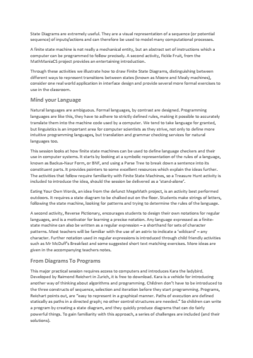
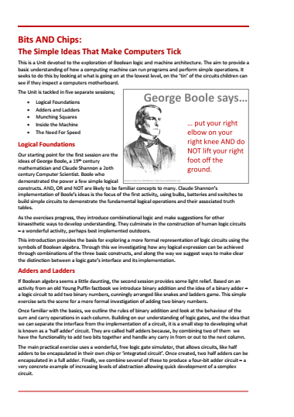
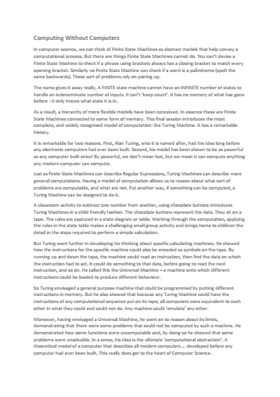
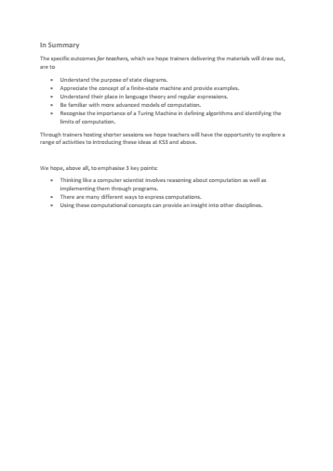
Each
Unit
Notes:
It is important that attendees understand the structure of the supporting resources and their target audience.
A short summary of the content of each Unit can be downloaded and distributed in advance.
A full day Unit is fast paced, aimed at experienced curriculum leaders and potential Tenderfoot trainers.

Slide 4

Each
Unit
Notes:
Each Unit includes a full Trainer Presentation, which follows these introductory slides.

Slide 5
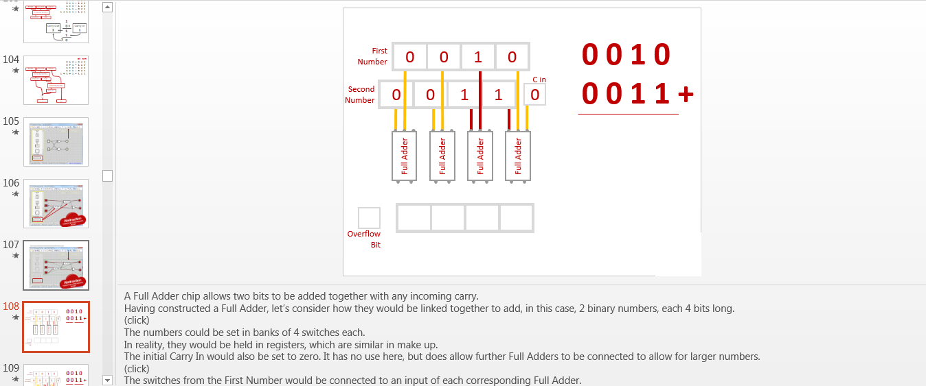
Notes:
The slides include very detailed notes outlining the supporting narrative. Please read them carefully if preparing a presentation.

Slide 6

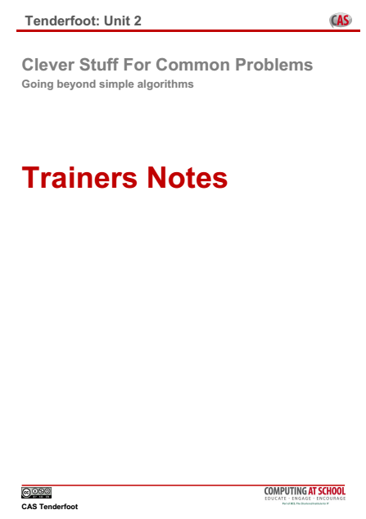
Each
Unit
Notes:
Trainer Notes are provided to help with advanced preparation.
These can be distributed at the start of a full day session.
The contents are explained in the following slides.

Slide 7
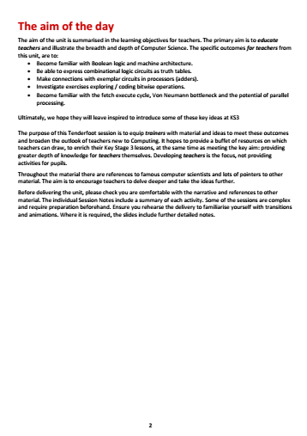

Notes:
The first page sets the subject matter in context, outlines the ‘big picture’ and identifies the learning objectives for teachers new to Computing.
It is worth emphasizing that the purpose of the material is to raise the awareness of teachers to the breadth and depth of the subject, not simply to provide another source of fun activities for classroom use.

Slide 8
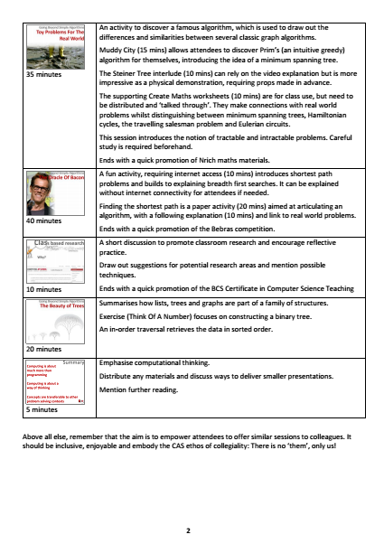
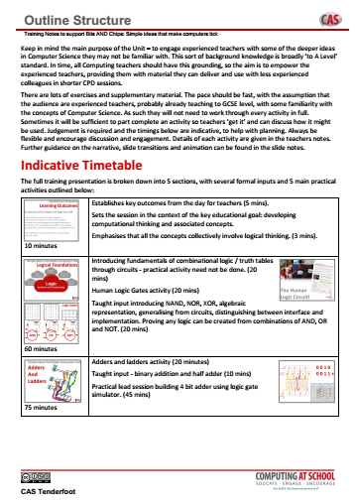
Notes:
An indicative timetable for a full day Unit is included.
A lot of ground is covered, so keeping to time can be challenging!

Slide 9

Notes:
Pointers are provided to good CPD practice. Making contact and establishing a dialogue prior to the event is important. Suggesting simple reading or watching a video allows the opportunity to follow up with a reminder.
The ultimate aim is to encourage teachers to dig deeper, so suggested further reading is also included.

Slide 10
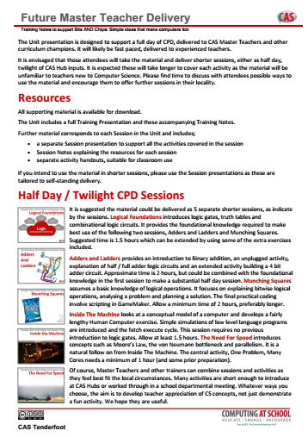
Notes:
The Unit is subdivided into sessions. This allows you to take the material and offer shorter sessions to fit local circumstances.
A summary of the sessions and indicative timings is included to facilitate planning.

Slide 11
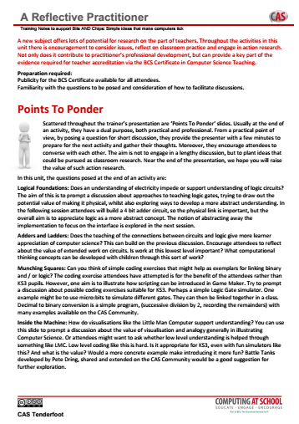

Notes:
Finally, there is a summary of the key points in the presentation where we hope Trainers will facilitate discussion and debate.
A key element in the CPD is to encourage reflective practice, promote action research and encourage teachers to consider the BCS Certificate in CS Teaching.

Slide 12
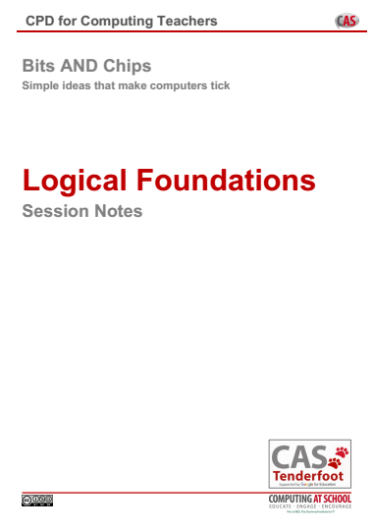

Each
Session
Notes:
Detailed notes are then included for each session, along with any photocopiable resources.
This allows each session to be delivered as a stand alone input to best fit local circumstances.

Slide 13



Bits AND Chips
Simple Ideas That Make Computers Tick
Notes:
Introductory slides that establish a common format to the start of a Master Teacher session. Please do stress the ethos at the start: there is no them – only us! If our subject is to develop all practising teachers have valuable contributions to make, regardless of prior experience. The CAS model recognises that good pedagogy is a process of discussion and development, facilitated through our Community of Practice.

Slide 14
Bits AND Chips
Simple Ideas That Make Computers Tick
Insert any specific notes
Start / End time
Toilets
Fire Drill / Exits
Notes:
Reminder to go through formalities at start. Placeholders for specific details

Slide 15
Bits AND Chips
Learning Outcomes
By the end of the session we hope you will:
Be familiar with Boolean logic and machine architecture.
Be able to express combinational logic circuits as truth tables.
Make connections with circuits in processors.
Investigate exercises exploring / coding bitwise operations.
Become familiar with the fetch execute cycle, von Neumann bottleneck and the potential of parallel processing.
Be inspired to introduce some of these key ideas at KS3.
Notes:
It is important to be explicit about the intended outcomes of the day for attendees.
Do not assume they will be aware of the purpose or target audience of the materials.
By stating the intentions, it helps avoid getting sidetracked into discussing the detail of individual classroom activities.
The primary aim is to educate teachers and illustrate the breadth and depth of Computer Science. The specific outcomes for teachers from this unit, are:
Be familiar with Boolean logic and machine architecture.
Be able to express combinational logic circuits as truth tables.
Make connections with circuits in processors.
Investigate exercises exploring / coding bitwise operations.
Become familiar with the fetch execute cycle, Von Neumann bottleneck and the potential of parallel processing.
And leave inspired to introducing these key ideas at KS3.
The purpose of Tenderfoot is to equip trainers with material and ideas to meet these outcomes and broaden the outlook of teachers new to Computing.
It hopes to provide a buffet of resources on which teachers can draw, to enrich their Key Stage 3 lessons, at the same time as meeting the key aim: providing greater depth of knowledge for teachers themselves.
Developing teachers is the focus, not providing activities for pupils.

Slide 16
The Big Picture
Logical Foundations
Adders And Ladders
Munching Squares
Inside The Machine
The Need For Speed
Notes:
Outline of the day.
We’ll start with an introduction to logic, highlighting the work of two people in particular, George Boole and Claude Shannon. (click)
This leads into a nice, if challenging programming activity.
The second half of the day gets under the hood of a computer, looking at how they actually run a program.
Finally, we consider a problem in computer architecture and the modern way to overcome it.

Slide 17
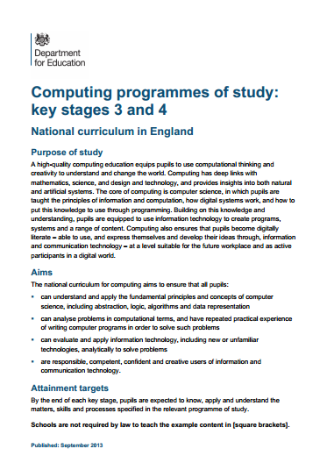
The Big Picture
Logical Foundations
Adders And Ladders
Munching Squares
Inside The Machine
The Need For Speed
Notes:
So lets start by setting the day in the context of new national curriculum

Slide 18
The Big Picture
Pupils should be taught to:
understand simple Boolean
Logic [for example, AND, OR and
NOT] and some of its uses in
circuits and programming
understand the hardware
and software components that
make up computer systems…
understand how instructions are stored
and executed within a computer system
Notes:
There is little in the primary school curriculum in this area, but at Key Stage 3 things are quite explicit.
Each subsequent slide highlights the next phrase (click).

Slide 19
The Big Picture
Pupils should be taught to:
understand simple Boolean
Logic [for example, AND, OR and
NOT] and some of its uses in
circuits and programming
understand the hardware
and software components that
make up computer systems…
understand how instructions are stored
and executed within a computer system
Notes:
Each subsequent slide highlights the next phrase (click).

Slide 20
The Big Picture
Pupils should be taught to:
understand simple Boolean
Logic [for example, AND, OR and
NOT] and some of its uses in
circuits and programming
understand the hardware
and software components that
make up computer systems…
understand how instructions are stored
and executed within a computer system
Notes:
There are other elements too, that tie some of these very explicit requirements to other areas of the curriculum, such as manipulating binary numbers, and we will address those during the session but there are two main points to be made here.
Firstly, children will have little or no experience of these ideas from primary school and
Secondly, these should not been seen as a body of facts the children have to learn.

Slide 21

✗
✗
Computational
Thinking
Notes:
The factual requirements are a skeleton at best.
Teachers teach what their knowledge, creativity and ambition allow.
Our job is to find ways to develop children’s capacity to think like computer scientists.
We call this Computational Thinking.
It lies at the heart of the National Curriculum.
Once you start to slice and dice a curriculum, it is very easy to focus on the trees, and lose sight of the wood, the big picture.

Slide 22
Computational
Thinking
A high-quality computing education equips pupils to use computational thinking and creativity to understand
and change the world…
Notes:
Regardless of the detail, our over-arching aim is: “A high-quality computing education equips pupils to use computational thinking and creativity to understand and change the world.”

Slide 23
Computing is much more
than learning facts
Notes:
We can summarise by saying these 3 things.

Slide 24
Computing is much more
than learning facts
Computing develops a
way of thinking
Notes:
We can summarise by saying these 3 things.

Slide 25
Computing is much more
than learning facts
Computing develops a
way of thinking
Computing concepts are transferable to other problem solving contexts
Notes:
We can summarise by saying these 3 things.

Slide 26
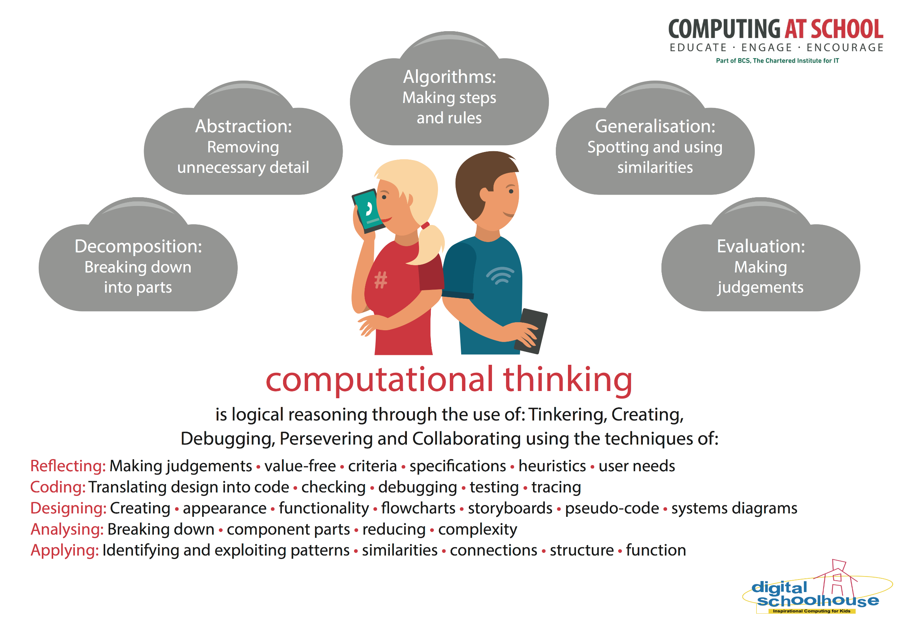
Computing concepts are transferable to other problem solving contexts
Notes:
CAS have produced a poster that highlights these concepts – great for the classroom wall, so you can keep referring to them whenever the opportunity arises. We’ll be doing this throughout these sessions. They are … each will be revealed on a click.

Slide 27

Simple Ideas That Make Computers Tick
Logical Foundations
Notes:
Collectively the concepts we identify as key to Computational Thinking, can all be thought of as part of the skills of logical analysis and reasoning, so what better place to start than by looking at the foundations of logic.

Slide 28
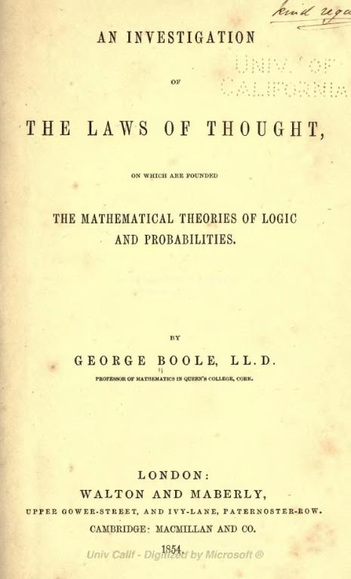
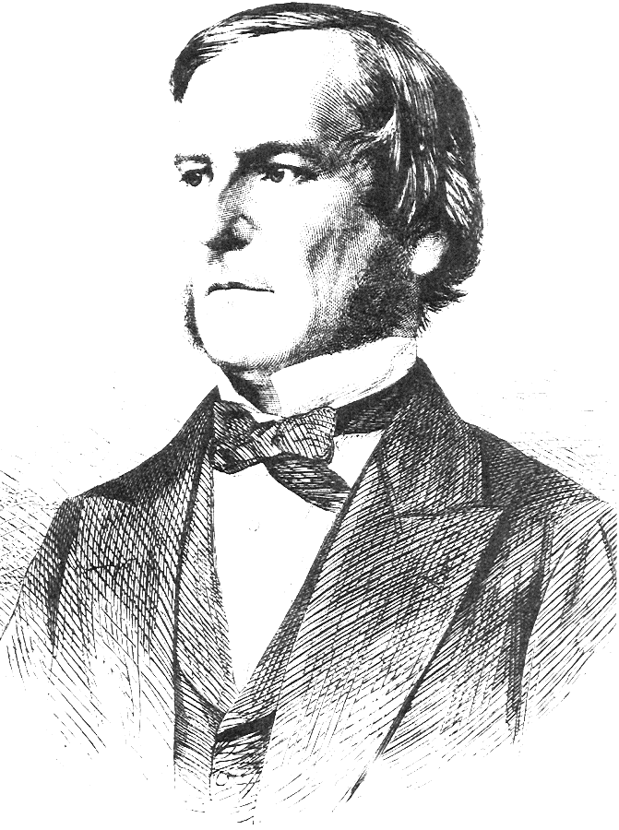
Simple Ideas That Make Computers Tick
Logical Foundations
“... no general method for the solution of questions … can be established which does not explicitly recognise ... those universal laws of thought which are the basis of all reasoning ...”
1815-1864
Notes:
Our starting point is a mathematician, George Boole, who was born just over 200 years ago.
(click)
In 1854 he published a very influential book “An Investigation Into the Laws of Thought” which continued “on which are founded the mathematical theories of logic and probability”.

Slide 29
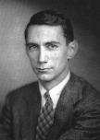
Simple Ideas That Make Computers Tick
Logical Foundations
Claude Shannon
1916-2001
Demonstrated the power of simple logical operations
1815-1864
Notes:
The book demonstrated the power of a few simple logical operations.
Their application to computing became apparent through the work of this man (click)
Claude Shannon nearly a hundred years later.
In 1938 his Masters thesis from MIT formed the basis for “A Symbolic Analysis of Relay and Switching Circuits”. In it, he demonstrated that you could construct electrical circuits to represent Boole’s logical operations.

Slide 30
Logic Gates
One output
One or more inputs
Class Activity
Can be made out of anything!
Mechanical, electrical or electronic components.
Notes:
Boole’s logical constructs can be represented in things called logic gates.
A logic gates has one or more inputs, and one output.
They can be made out of anything, but in this class activity, we can use basic electrical components, batteries, bulbs and switches, which are common in school science labs.
This makes a good group activity, with pupils working in pairs initially (if equipment makes that possible), then combining as the larger circuits require groups to share equipment.

Slide 31



A Simple Switched Circuit
Input | Output
0 | 0
1 | 1
Notes:
Consider a very simple electrical circuit. The battery is connected to a switch, which connects to a bulb. The bulb connects back to the battery to form a circuit.
The behaviour of the bulb is controlled by the switch.
When the switch is off, the lightbulb doesn’t illuminate. (click)
We can say when the input (switch) is 0 (off), the output (bulb) is 0 (off).

Slide 32


A Simple Switched Circuit
Truth Table
Input | Output
0 | 0
1 | 1
Notes:
And when the switch is on (1), the bulb lights up (1). (click)
Expressing the behaviour of the circuit in this fashion, is known as a truth table.

Slide 33
Two Switches Connected In Series
Switch A
Switch B
A | B | Light Q
Notes:
Now connect two switches ‘in series’, that is daisy chained together.
We want to develop a truth table for this circuit. Traditionally we refer to the output as Q.
We need to make sure we test every combination of switch settings.
What combinations of ‘on’ and ‘off’ for switches A and B do we need to consider?
(click) Ask a pupil to write them in the truth table.

Slide 34
Two Switches Connected In Series
Switch A
Switch B
A | B | Light Q
0 | 0
0 | 1
1 | 0
1 | 1
Notes:
Always fill in all the combinations of inputs before trying to complete a truth table.
The best way to ensure students don’t miss any is to fill the input columns, as if you were counting in binary. No matter how many inputs, you will always start with all zero’s, and your final entry will be all 1’s.
If the students don’t make that connection, point the pattern out.
(click)
Now ask the students to complete the output column (Q).
Answer on the next slide.

Slide 35
Two Switches Connected In Series
Switch A
Switch B
A | B | Light Q
0 | 0 | 0
0 | 1 | 0
1 | 0 | 0
1 | 1 | 1
Notes:
Ask the students to try to explain, in their own words what the truth table shows.
We are looking for answers that articulate that both Switch A AND Switch B need to be on before the light bulb illuminates.

Slide 36
Two Switches Connected In Parallel
Switch A
Switch B
A | B | Light Q
0 | 0 | 0
0 | 1 | 1
1 | 0 | 1
1 | 1 | 1
Notes:
Pupils should now rearrange their circuits, so the switches are connected ‘in parallel’.
Ask the pupils to develop a new truth table.
Point out that it still has two input switches, so the same combinations in the truth table need to be tested, but the output will be different.
A click will reveal the answer.
As before, ask the students to articulate the behaviour. We are looking for comments that say something like either Switch A OR Switch B, OR both need to be on for the bulb to light.

Slide 37
A Curious Arrangement
Switch A
A | Light Q
0 | 1
1 | 0
Notes:
Now consider this curious arrangement. It is unlikely the pupils will be able to create this, but they can imagine the scenario.
Two switches are connected by a pivot, so when one switch slides on, the other will slide off.
As the switches are connected there is only one switch, Switch A that we can operate.
(click)
The truth table therefore only has one input, in two states – on and off.
Ask the pupils what the output will be.
A click reveals the answer.
When articulating this behaviour, encourage answers along the lines of ‘when the switch is on, the bulb is NOT.

Slide 38
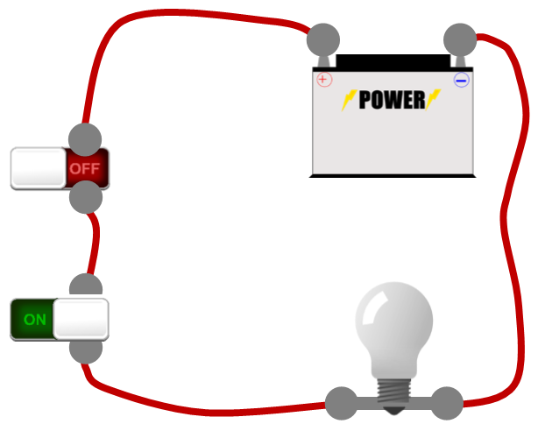
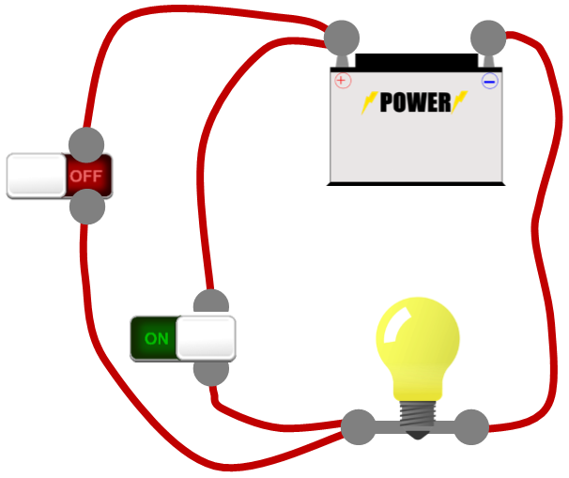
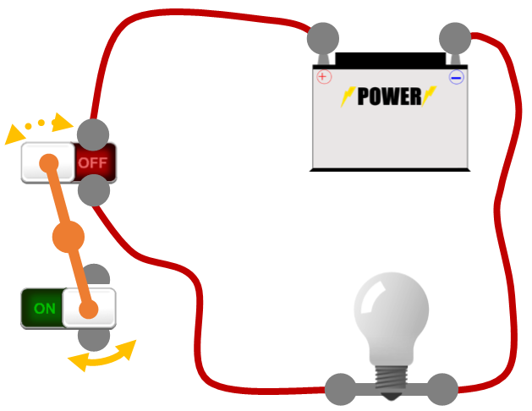
Logic Gates
A | B | Q
0 | 0 | 0
0 | 1 | 0
1 | 0 | 0
1 | 1 | 1
A | B | Q
0 | 0 | 0
0 | 1 | 1
1 | 0 | 1
1 | 1 | 1
A | Q
0 | 1
1 | 0
AND
OR
NOT
Notes:
To recap, we have developed truth tables for three different circuits.
These circuits provides a way of controlling output (lighting a bulb) by altering one or more inputs.
They are known as the three fundamental logic gates (click)
AND: both inputs must be true (on) for the output to be true (on)
OR: either input (or both) being true (on) means the output will be true (on) and
NOT: the output is the opposite of the input.
AND, OR and NOT are also the three constructs identified by George Boole as the foundation for all logical thought. Any complex logical statement can be expressed by combinations of these constructs.

Slide 39
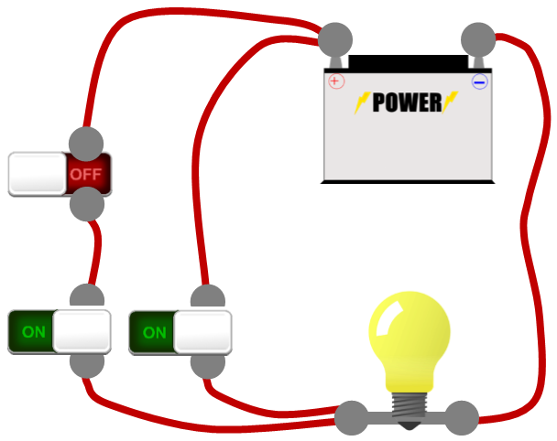
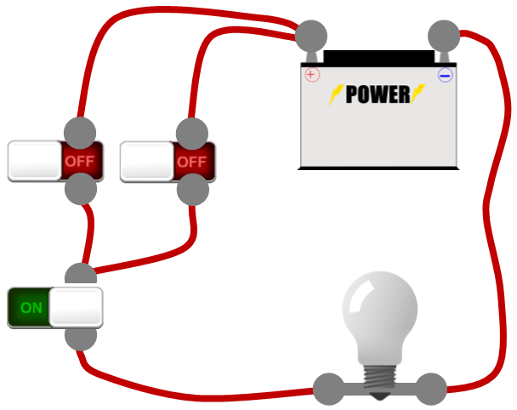
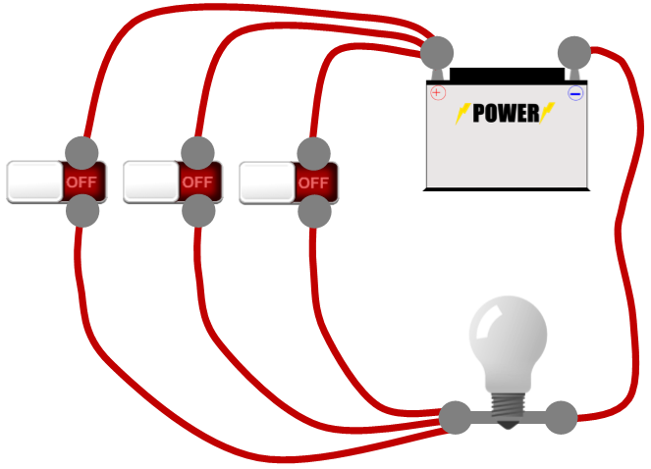
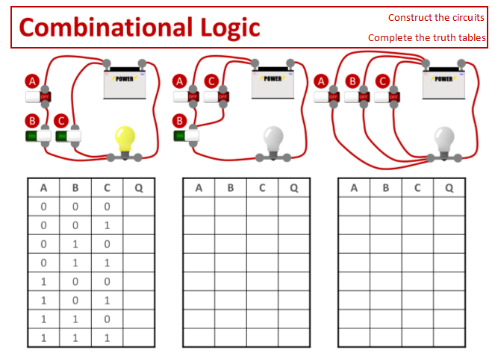
Combinational Logic
A
A
C
A
B
C
B
C
B
A | B | C | Q
0 | 0 | 0 | 0
0 | 0 | 1 | 1
0 | 1 | 0 | 0
0 | 1 | 1 | 1
1 | 0 | 0 | 0
1 | 0 | 1 | 1
1 | 1 | 0 | 1
1 | 1 | 1 | 1
A | B | C | Q
0 | 0 | 0
0 | 0 | 1
0 | 1 | 0
0 | 1 | 1
1 | 0 | 0
1 | 0 | 1
1 | 1 | 0
1 | 1 | 1
A | B | C | Q
0 | 0 | 0 | 0
0 | 0 | 1 | 0
0 | 1 | 0 | 0
0 | 1 | 1 | 1
1 | 0 | 0 | 0
1 | 0 | 1 | 0
1 | 1 | 0 | 1
1 | 1 | 1 | 1
A | B | C | Q
0 | 0 | 0 | 0
0 | 0 | 1 | 1
0 | 1 | 0 | 1
0 | 1 | 1 | 1
1 | 0 | 0 | 1
1 | 0 | 1 | 1
1 | 1 | 0 | 1
1 | 1 | 1 | 1
Notes:
How would we develop a truth table for circuits with 3 switches?
Exactly the same way as we did before. Put all the input headings in a line, then count fill in the table with incrementing binary numbers (click)
So with 3 inputs there are 8 possible combinations to check (binary 000 to 111).
Give out the activity sheet and let the children construct the circuits and complete the truth tables.
When they have the outputs, a sequence of clicks will reveal the answers.

Slide 40
Combinational Logic
Inputs |  |  | D | E | Q
A | B | C | NOT A | B OR C | D AND E
Inputs |  |  | D | E | Q
A | B | C | NOT A | B OR C | D AND E
0 | 0 | 0
0 | 0 | 1
0 | 1 | 0
0 | 1 | 1
1 | 0 | 0
1 | 0 | 1
1 | 1 | 0
1 | 1 | 1
Inputs |  |  | D | E | Q
A | B | C | NOT A | B OR C | D AND E
0 | 0 | 0 | 1
0 | 0 | 1 | 1
0 | 1 | 0 | 1
0 | 1 | 1 | 1
1 | 0 | 0 | 0
1 | 0 | 1 | 0
1 | 1 | 0 | 0
1 | 1 | 1 | 0
NOT
A
0
1
1
1
0
1
1
1
0
1
1
1
0
0
0
0
D
AND
Q
B
OR
E
C
Notes:
How do we work out the result of combining several logic gates in more complex circuits? (click)
The first step is to label all the inputs, the final output AND any interim outputs, that feed into the next logic gate.
Being systematic in this way avoids making silly errors.
We can now create a truth table as before, and fill in all the input combinations: A, B and C. (click)
Each interim value can now be calculated. Ask a student to fill in D, before revealing the answer (click)
Similarly, ask students to complete E and the final output Q. Clicks will reveal each correct answer in turn.

Slide 41
George Boole says…
… put your right elbow on your right knee AND do NOT lift your right foot off the ground.
… put your left hand on your head OR put your big toe in your mouth.
Based on ideas from MathManiacs: http://www.mathmaniacs.org
Notes:
There are many fun ways to reinforce basic understanding of the logical constructs.
George Boole says… is played in the same manner as Simon says, but with an emphasis on using statements that include AND, OR and NOT. (click)
Here are a couple of ideas to get you started. (click)

Slide 42
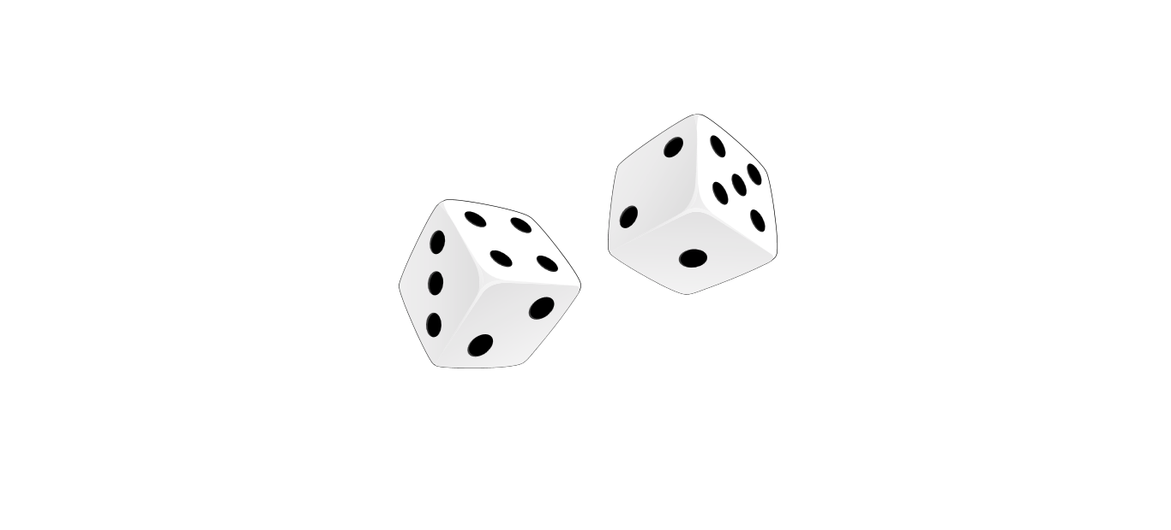
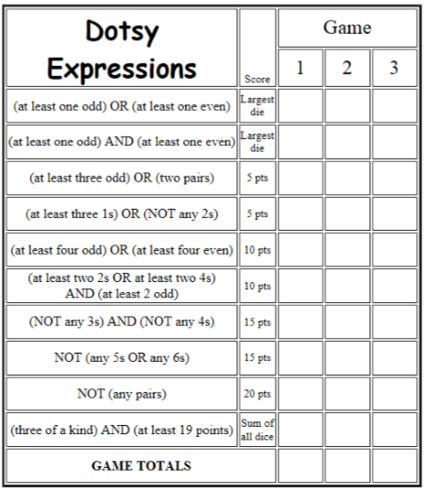
Let’s play Dotsy
Based on ideas from MathManiacs: http://www.mathmaniacs.org
Notes:
Another simple reinforcement game, that focuses on interpreting logical expressions is a simple ‘poker’ dice based game, where each player has 3 rolls of 5 dice, and can set aside any on each roll.
At the end of the 3 rolls the player scores points, based on the criteria shown.
Although any number can participate, it works best for groups of between 2 and 4 players, depending on how many dice are available, or seating arrangements.
If larger groups are required, splitting into two teams so players collaborate can also generate good discussion.

Slide 43
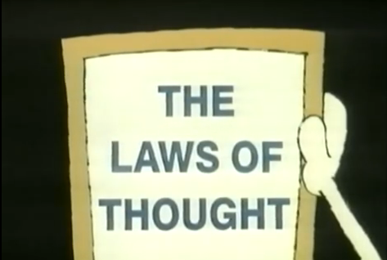
https://youtu.be/6wU2NoAtWKM
Notes:
As George Boole articulated all those years ago, logic gates can be used to frame human statements.
A short two minute clip from an old Canadian television series, The Essence of the Computer, broadcast in 1983 makes the point well and provides a good link for students between circuits and logical expressions.

Slide 44
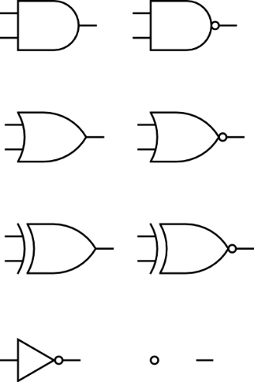
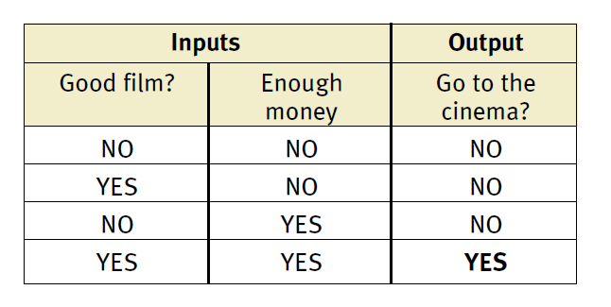
Logic Gates can provide answers to human questions
“Jane will only go to the cinema tonight if a good film is on AND she has enough money.”
Notes:
How could we express this statement in a truth table? What would be the two inputs?
(answer on click)
Here the inputs (conditions) are a good film and enough money. The output will only be yes (true) IF both conditions are true.
The truth table is that for an AND gate. (click)
Rather than just using circles to represent gates, each type of logic gate has its own symbol.

Slide 45
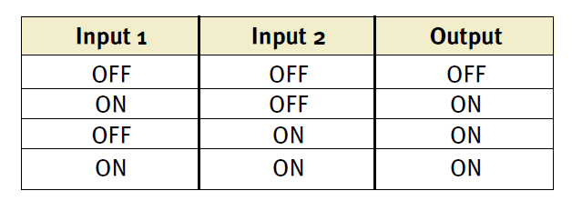
Logic Gates can provide answers to human questions
“Stuart will only go to the birthday party on Sunday if Katie OR Sammy is going too.”
Notes:
What would be the inputs to this truth table?
Katie going? and Sammy going? (click)
Here is the truth table, and the correct symbol for an OR gate.

Slide 46
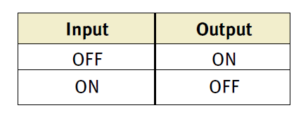
Logic Gates can provide answers to human questions
“Zoe will have a dessert if the main course does NOT fill her up (and vice versa).”
Notes:
What gate would represent this statement? (click)
Here’s the truth table and symbol for a NOT gate.

Slide 47
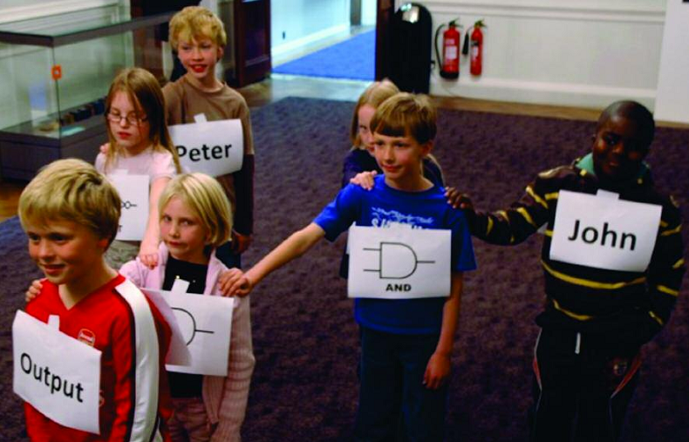
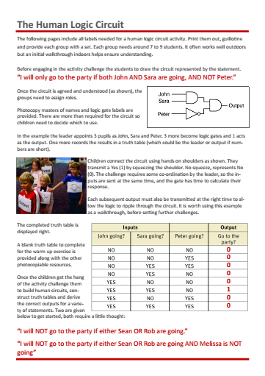
1
The Human Logic Circuit!
activity
Notes:
Human logic circuits are a great way to develop an understanding of combinational logic. Supporting material, based on activities from the Royal Institution Christmas Lectures 2008 are included in the resources.

Slide 48
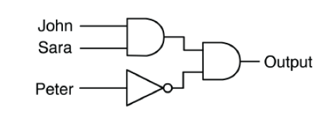
“I will only go to the party if both John AND Sara are going, AND NOT Peter.”
Can you draw the circuit?
Teams of 7 to 9
Leader appoints 3 as John, Sara and Peter
3 become logic gates
1 is the output
One records the output in a truth table
The Human Logic Circuit!
Notes:
Human logic circuits are a great way to develop an understanding of combinational logic.
This is a group activity, requiring groups of around 7 to 9 students.
It often works well outdoors but an initial walkthrough indoors helps ensure understanding.
Before engaging in the activity challenge the students to draw the circuit represented by the statement. (click)
Once the circuit is agreed and understood, the groups need to assign roles.
Photocopy masters of names and gates are provided.
Children connect the circuit using hands on shoulders as shown.
They transmit a Yes (1) by squeezing the shoulder. No squeeze, represents No (0).
The challenge requires some co-ordination by the leader, so the inputs are sent at the same time, and the gate has time to calculate their response.
Each subsequent output must also be transmitted at the right time to allow the logic to ripple through the circuit.
It is worth using this example as a walkthrough, before setting further challenges.
The next slide displays the truth table to complete.

Slide 49
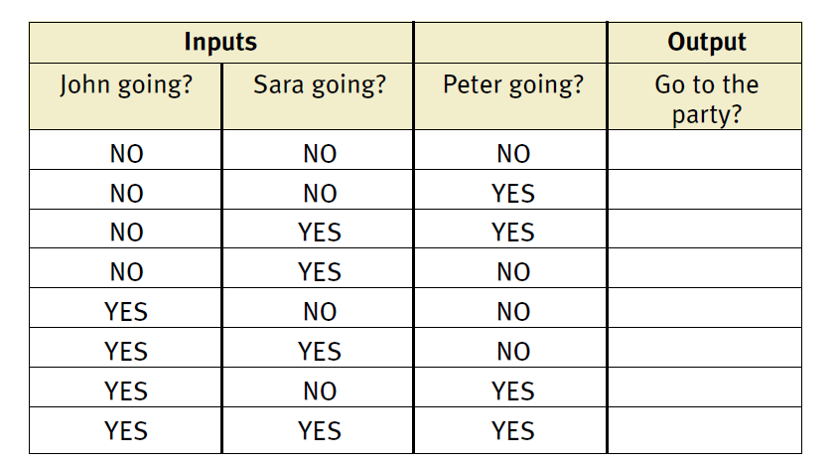
“I will only go to the party if both John AND Sara are going, AND NOT Peter.”
0
0
0
0
0
1
0
0
Notes:
Note the layout of the input combinations. Check understanding by asking which answer could be represented by a 1 (yes) and a zero (no).
A click will reveal the correct answer.

Slide 50
Challenge
In groups construct truth
tables, build human circuit
and work out results for
these scenarios.
“I will NOT go to the party if
either Sean OR Rob are going.”
“I will NOT go to the party if either Sean OR Rob are going AND Melissa is NOT going”
Notes:
Photocopiable masters are available to support these activities in the resources distributed with the unit.

Slide 51
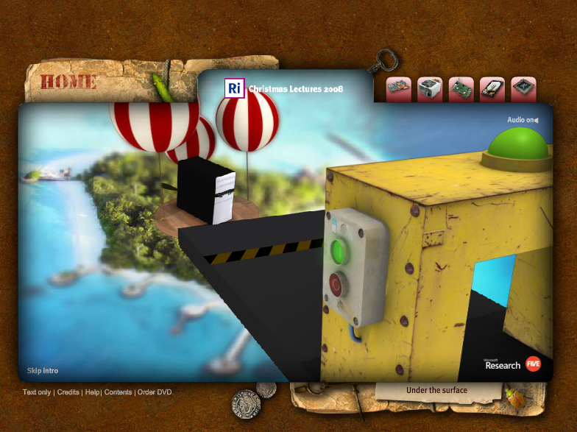
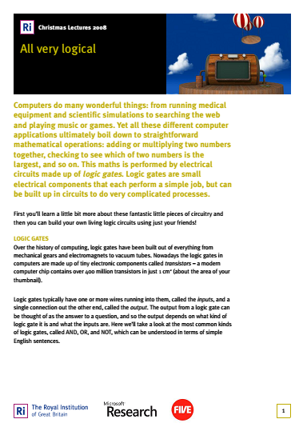
http://www.rigb.org/christmaslectures08/
http://goo.gl/FQCjH4
Notes:
The Human Logic Gates activity comes from the website that supports the Royal Institution Christmas Lectures 2008, presented by Chris Bishop.
It has several simple activities for children, and other resources and the lecture transcripts accessed via ‘Under the surface’.
Each of the five lectures is well worth viewing for ideas about how to present many of the fundamental aspects of computing. Lecture 2 ‘Chips With Everything’ looks at the development of several recent technologies and is particularly pertinent as a follow up to this unit.
They can be viewed from the RI website – each one is around 40 minutes.

Slide 52

Logic Gates Recap
One output
One or more inputs
Notes:
Let’s just recap the ideas behind logic gates.
Each gate takes one or more inputs, and generates one output, depending on the logical combination.
This is an abstract representation of the gate – hiding the particulars of what it is constructed from, and concentrating on its behaviour.

Slide 53
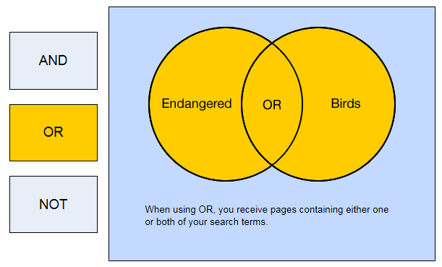
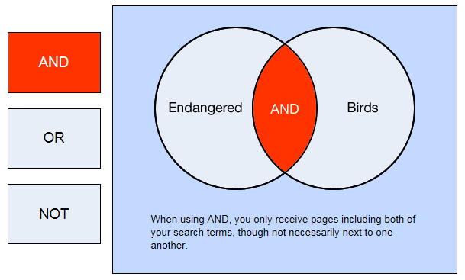
Logic Gates Recap
Notes:
Logical constructs can be visualised using Venn diagrams.
By making links to set theory, work in this area can be linked to, for example, exercises developing smart search techniques.
This can be helpful for some students, particularly to illustrate how an AND restricts output, which can be a common misunderstanding.

Slide 54
Logic Gates Recap
Notes:
An OR will return elements from both sets.

Slide 55
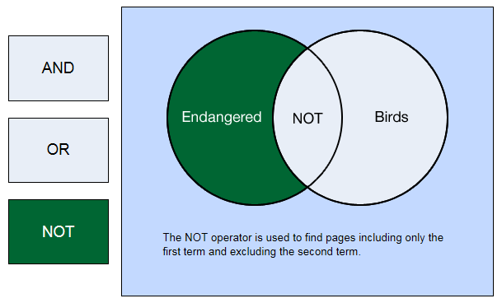
Logic Gates Recap
Can be made out of anything!
Mechanical, electrical or electronic components.
Notes:
And a NOT will restrict to a given attribute, removing the intersecting cohort.
We also noted that gates can be made from anything.

Slide 56
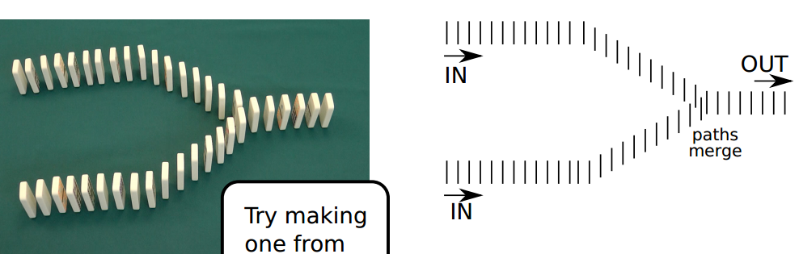
Logic Gates Recap
Try making one from dominoes!
Can be made out of anything!
Mechanical, electrical or electronic components.
Notes:
We also noted that gates can be made from anything.
We have used switches and light bulbs (and humans), but the same behaviour can be built from a wide variety of components.
Here is an example of an OR gate constructed from dominoes.

Slide 57
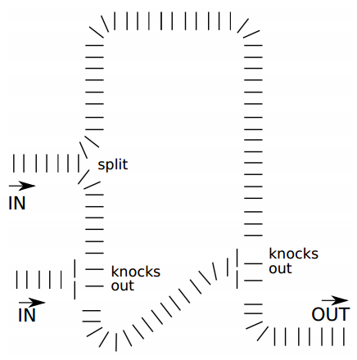
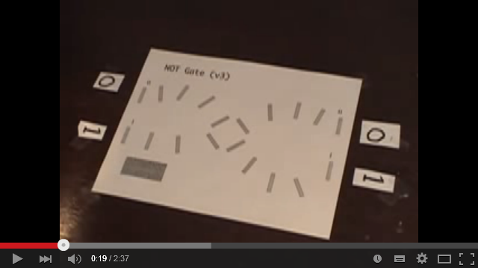
Logic Gates Recap
https://youtu.be/H-53TVR9EOw
Can be made out of anything!
Mechanical, electrical or electronic components.
Notes:
This circuit is a little harder to construct, but might provide a good activity if children can’t work out what it does.
(click)
A slightly different approach, using two lines of dominoes to represent 0 or 1, allows creation of NOT gates. The video link explain, and also provides an example using marble runs. https://youtu.be/H-53TVR9EOw

Slide 58
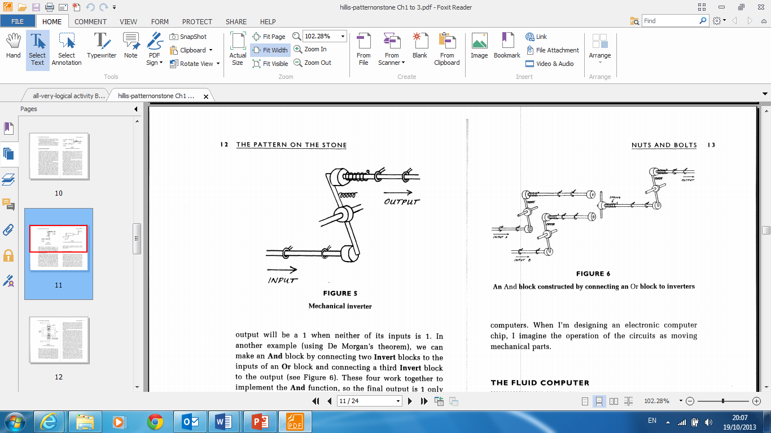
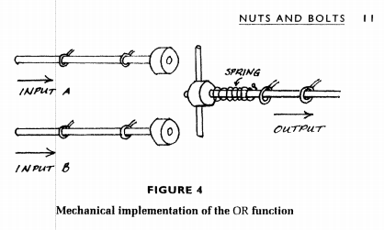

Logic Gates Recap
Can be made out of anything!
Mechanical, electrical or electronic components.
Notes:
These two diagrams demonstrate how we could fashion an OR and a NOT function using simple mechanical components.
The diagrams come from a wonderful book “The Pattern On The Stone” by Danny Hillis. Chapter 3 provides a good introduction to the ideas that lie behind this introduction.

Slide 59
Logic Gates Recap
Can be made out of anything!
Mechanical, electrical or electronic components.
Key idea: Every possible Boolean function can
be constructed using AND, OR and NOT
Notes:
Here’s a combinational logic circuit, constructed from 3 NOT gates and an OR gate.
As a challenge you could ask students to develop the truth table for this.
If you are pushed for time, point out that it performs as an AND gate. Only when both inputs are pushed (on), will the output also move forward.
(click)
The key point to draw from this, is that the behaviour of one logic gate can be reproduced by combining other logic gates. This is a key idea that underpins an understanding of how complex logical circuits can be constructed.
We’ll use this to introduce three new logic gates, and the idea of boolean algebra.

Slide 60
Boolean Algebra
A·B
A+B
A
A | B | Q
0 | 0 | 0
0 | 1 | 0
1 | 0 | 0
1 | 1 | 1
A | B | Q
0 | 0 | 0
0 | 1 | 1
1 | 0 | 1
1 | 1 | 1
A | Q
0 | 1
1 | 0
AND
OR
NOT
Key idea: Every possible Boolean function can
be constructed using AND, OR and NOT
Notes:
We are now familiar with the 3 core Boolean functions, AND, OR and NOT.
Here are their symbols and truth tables. (click)
We can also use algebraic expressions to indicate the same function. An AND is represented as shown.
(click)
An OR, somewhat confusingly is expressed with a ‘plus’ sign, and (click)
A NOT is written with a line above, to indicate inversion.

Slide 61
Boolean Algebra
A·B
A+B
A + B
A | B | Q
0 | 0 | 1
0 | 1 | 1
1 | 0 | 1
1 | 1 | 0
A | B | Q
0 | 0 | 1
0 | 1 | 0
1 | 0 | 0
1 | 1 | 0
A | B | Q
0 | 0 | 0
0 | 1 | 1
1 | 0 | 1
1 | 1 | 0
NAND
NOR
XOR
Key idea: Every possible Boolean function can
be constructed using AND, OR and NOT
Notes:
Here is another truth table. Does anyone notice anything about the behaviour it represents? (click)
It is the opposite of an AND and is known as a NAND (click). Its symbol is shown.
(click)
This is the negation of an OR, known as a NOR.
(click)
The sixth symbol we encounter is known as a XOR. Can anyone see why?
It is short for an exclusive OR; this is one OR the other, but not both.
(click)
Each expression can also be written in algebraic form.

Slide 62
Boolean Algebra
A·B
A+B
A + B
?
A | B | Q
0 | 0 | 1
0 | 1 | 0
1 | 0 | 0
1 | 1 | 0
A | B | Q
0 | 0 | 0
0 | 1 | 1
1 | 0 | 1
1 | 1 | 0
NAND
NOR
XOR
Key idea: Every possible Boolean function can
be constructed using AND, OR and NOT
Notes:
Remember the key idea: Every possible Boolean function can be constructed using combinations of AND, OR and NOT.
This is easy to see with a NAND. It is simply the inversion of AND, which could be also accomplished by connecting the output from an AND gate through a NOT gate, as shown. You can see in the symbol, how the ‘bobble’ serves a shorthand for a negation, and in the algebraic expression, where the negation line sits over the AND.
(click)
It’s the same with a NOR, which is the negation of an OR gate (click)
But what about the ‘exclusive OR’? It’s not at all clear, either from the symbol, or the algebraic expression how this could be constructed.

Slide 63
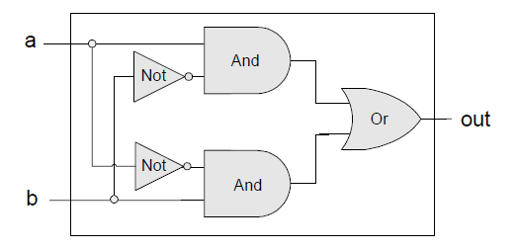
Interface and Implementation
Every combination of gates, up to the most complex chips, can be described by its interface.
A | B | Q
0 | 0 | 0
0 | 1 | 1
1 | 0 | 1
1 | 1 | 0
Key idea: Every possible Boolean function can
be constructed using AND, OR and NOT
Notes:
Every logical behaviour, beyond a simple AND, OR or NOT, can be described by its interface, that is the inputs it takes, and the corresponding outputs.
The XOR interface is described in the truth table. (click)
How it could be implemented is shown, using 2 AND, an OR and 2 NOT gates.
But once it is implemented, we can forget about the detail, and consider only the interface when designing more complex circuits.

Slide 64

Interface and Implementation
Every combination of gates, up to the most complex chips, can be described by its interface.
Complex chips combine smaller chips which …
… are designed by combining smaller chips …
… are designed by combining smaller chips …
… all the way down to individual combinations of gates.
Notes:
Complex circuits are built from less complex chips, but the design is based on the interface, rather than worrying about implementation. (click)
Any chip can be decomposed down to individual AND, OR and NOT components.
(click)
There is no better example of the relationship between decomposition and abstraction than chip design.
Once constructed, the detail of the implementation can be abstracted away.
The circuit designers can focus on connecting interfaces, without worrying about the detail of implementation.

Slide 65
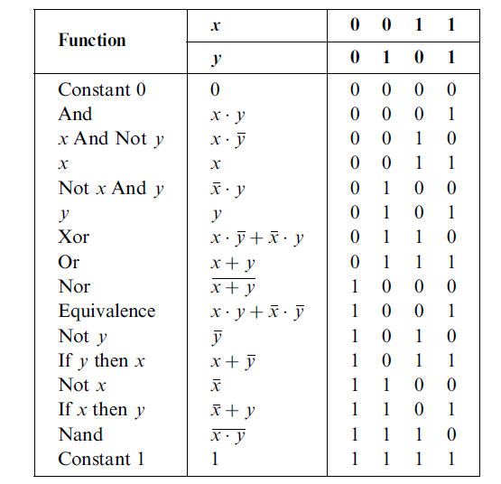
Interface
Notes:
To prove that this is possible we can take every possible permutation of output, for the combination of two inputs.
This will be created in the table shown.
It has 4 columns (highlighted), one for the output for each combination of input 00,01,10,11, like our truth tables, but arranged as columns rather than rows.
In the column underneath, we can construct each truth table output. The first two are shown, representing a constant zero output and the output derived from an AND gate.
We can ensure we consider every possible permutation of output, in the same way as we construct a truth table: we simply list the binary combinations from 0000 to 1111. (click)
We now have every possible interface for two inputs.
Each row represents a named function: for example we can see the interface for AND in the second row down.
(click)
All the others are listed below in the first column.
(click)
Finally, the second column expresses the implementation in algebraic form.
If this seems a little complicated take one row and investigate it.
(click)
You can see, for example how the table lists the interface, and implementation for the XOR we used as a demonstration.
You may wonder why we bother with an algebraic representation.
When logic circuits are combined, it is often the case that some gates will be redundant, or the circuit could be simplified to use less gates, whilst keeping the interface the same.
Boolean algebra makes such simplification easier, as the algebraic expressions can be simplified in much the same way as mathematical equations can also be simplified.
This isn’t of interest at KS3, but it does feature on courses at A Level.

Slide 66


Points to ponder
Does an understanding of electricity impede or support understanding of logic circuits?
Notes:
A brief pause to encourage a short discussion whilst props are tidied up and the presenter gets ready for the next session.
Use this slide to prompt a discussion about approaches to teaching logic gates, trying to draw out the potential value of making it physical, whilst also exploring ways to develop a more abstract understanding.

Slide 67
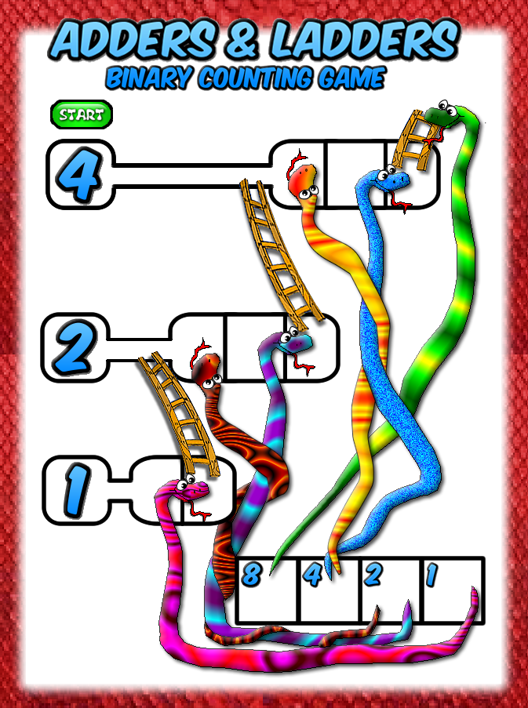
Simple Ideas That Make Computers Tick
Adders
And
Ladders
Claude Shannon
2
1916-2001
activity
Notes:
If delving into Boolean algebra is a little daunting, the next exercise should provide some light relief.
If we can demonstrate how a computer can use a logic circuit to do some simple maths, we have gone a long way to proving that all computation in a computer is performed in such a manner.
A standard example is to look at how a computer adds two binary numbers.
Before we look at a circuit to do this, the following exercise ensures children have an introduction to binary addition.

Slide 68
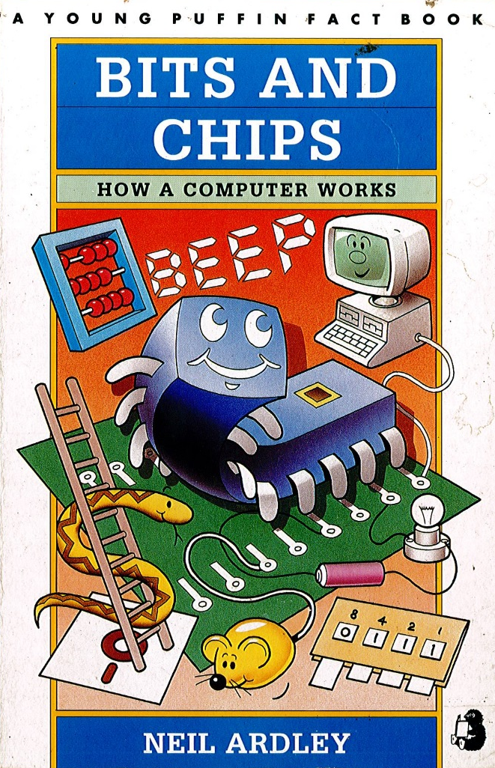
Adders And Ladders
Developed by Emma Partridge from an
idea in Bits and Chips, Neil Ardley, 1991
Notes:
It is based on an idea from Neil Ardley’s wonderful Young Puffin Fact Book, Bits And Chips. Published in 1991, you still find them available on Amazon secondhand – do try to get hold of a copy.
It uses a ‘Snakes and Ladders’ type board for children to explore binary addition. The resources were developed by Emma Partridge, and shared on the CAS Community.
Students will need up to six counters and a board. The following slides provide a walk through of how to add two binary numbers.

Slide 69
Adders And Ladders
Let’s try 5 + 7
Input 5 (101) by adding a counter at 4 and 1
Notes:
The binary value for the first number 101 (5) is placed in the relevant containers, below the start button.
Successive clicks will reveal the sequence of events.

Slide 70
Adders And Ladders
Let’s try 5 + 7
Move the 2 counters as far across as they will go

Slide 71
Adders And Ladders
Let’s try 5 + 7
Input 7 (111) by adding a counter at 1, 2 and 4

Slide 72
Adders And Ladders
Let’s try 5 + 7
Again, slide as far as possible to the right

Slide 73
Adders And Ladders
Let’s try 5 + 7
Working from the bottom up, (level 1, 2 then 4) counters go down the snake or up the ladder

Slide 74
Adders And Ladders
Let’s try 5 + 7
The yellow counter on level 1 can’t go down the snake as the red counter blocks it…

Slide 75
Adders And Ladders
Let’s try 5 + 7
…so it goes up the ladder and slides right as far as possible

Slide 76
Adders And Ladders
Let’s try 5 + 7
…so it goes up the ladder and slides right as far as possible

Slide 77
Adders And Ladders
Let’s try 5 + 7
The red counter on level 2 cannot go down the snake as the yellow counter now blocks it…

Slide 78
Adders And Ladders
Let’s try 5 + 7
… so it goes up the ladder and to the right as far as possible

Slide 79
Adders And Ladders
Let’s try 5 + 7
… so it goes up the ladder and to the right as far as possible

Slide 80
Adders And Ladders
Let’s try 5 + 7
The yellow counter on the top level is blocked so goes up the ladder…

Slide 81
Adders And Ladders
Let’s try 5 + 7
… and down the snake!

Slide 82
Adders And Ladders
Let’s try 5 + 7
All the other counters are also checked.

Slide 83
Adders And Ladders
Let’s try 5 + 7
The next red is not on the head of a snake, or ladder, so stays where it is.

Slide 84
Adders And Ladders
Let’s try 5 + 7
The top level counter on the left is on a snake, so down it goes!

Slide 85
Adders And Ladders
Let’s try 5 + 7
Neither of the other two counters are on either a snake or a ladder, so they don’t move…

Slide 86
Adders And Ladders
Let’s try 5 + 7
… leaving a counter in the 8 and 4 positions in the ‘tray’
1100₂ = 12₁₀
1 1 0 0
Notes:
If the sequence is followed correctly, the counters in the tray will give the answer to the addition in binary.
Note the use of the subscript in the presentation to indicate the base of a number.

Slide 87
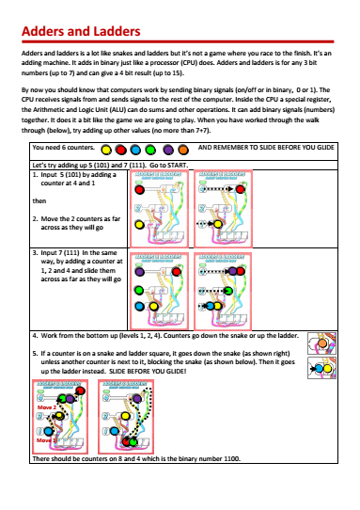
Adders And Ladders
Try any two 3 bit numbers yourself.
Read the instructions carefully.
Remember,
slide before
you glide.
Notes:
There is a prompt sheet for children to follow. Let them try several additions of two numbers between 0 and 7.
It is important they are comfortable about basic binary representation before embarking on the next task.
If they struggle to get the right answer, the major pitfall is usually forgetting to go down a snake where there is a choice between both a snake and a ladder (as there is on each rightmost square on each level).
They always ‘slide’ down unless a counter is in the next square to block it, in which case they ‘glide’ up the ladder. ‘Slide before you glide’.

Slide 88
Adders And Ladders
SUM CARRY
0 + 0 = 0 & 0
0 + 1 = 1 & 0
1 + 0 = 1 & 0
1 + 1 = 0 & 1
0 1 0 1
0 1 1 0 +
1 0 1 1
1
Notes:
Let’s now try to formalise the rules of adding two binary numbers.
Adding in binary is just like any other addition.
Lay the two numbers out, one below the other and add each column in turn, working from the right.
(click) 1+ 0 = 1
(click) 0 + 1 = 1
(click) But what happens with 1 + 1? Exactly the same rules apply when adding in decimal. If you run out of digits, you carry 1 to the next column. 2 in binary is one-zero (10).
(click) So 1 + 1 = 0 and carry 1
(click) So the final column is 0 + 0 + 1 = 1
It’s actually very easy to add in binary, because there are only 4 possible rules for adding two bits together. (click)
We can summarise them in a table. Ask the pupils t predict the answer to each rule before revealing it with a click.

Slide 89

Adders And Ladders
SUM CARRY
0 + 0 = 0 & 0
0 + 1 = 1 & 0
1 + 0 = 1 & 0
1 + 1 = 0 & 1
Notes:
We talked about interfaces and implementation earlier.
If we consider an adding machine as a black box, the interface is as shown.
It has two inputs, A and B, each of which can be 1 or 0.
It has two outputs, S for Sum, and C for Carry. (click)
Ask students if they know any logic gates that behave in the way described in the Sum column? (It is a XOR)

Slide 90
Adders And Ladders
SUM CARRY
0 + 0 = 0 & 0
0 + 1 = 1 & 0
1 + 0 = 1 & 0
1 + 1 = 0 & 1
Notes:
Similarly, we can think of the Carry as another logic circuit.
Ask if anyone recognises the truth table this time?

Slide 91
Adders And Ladders
SUM CARRY
0 + 0 = 0 & 0
0 + 1 = 1 & 0
1 + 0 = 1 & 0
1 + 1 = 0 & 1
Notes:
So a simple adding circuit can be implemented by using two logic gates, connecting the inputs to both an AND and a XOR.

Slide 92


Adders And Ladders
SUM CARRY
0 + 0 = 0 & 0
0 + 1 = 1 & 0
1 + 0 = 1 & 0
1 + 1 = 0 & 1
http://www.kolls.net/gatesim
Notes:
Armed with this knowledge, students can now build the logic circuit using a simulator.
There are several simulators available, but the one suggested is free, requires no installation and has several benefits over some of the alternatives, which will become apparent shortly.
It is available in the resources for this unit, or can be downloaded from the link shown. http://www.kolls.net/gatesim
(click)
Included in the resources are the sample circuits we are going to build using this simulator, so do remove those before making it available to students. A folder on a shared network drive is all that is required for students to use the simulator; it loads by clicking GatesWpf.exe.
Also included is a pdf of Steve Kollmansberger’s book on Computer Maths and Logic, released under Creative Commons. For those who want to study this in depth (to first year undergraduate level) it is an excellent resource.

Slide 93

Adders And Ladders
SUM CARRY
0 + 0 = 0 & 0
0 + 1 = 1 & 0
1 + 0 = 1 & 0
1 + 1 = 0 & 1
Notes:
The simulator is very intuitive, the only help students are likely to require is finding the correct components.
Switches are found in the I/O Gates palette. AND, OR and NOT gates are in the Basic Gates set, whilst NAND, NOR and XOR will be found in the Compound Gates set.
Components are connected by dragging (a wire) between connections. Inputs and Outputs can be labelled, components moved and rotated.
Once complete, students can test the logic by clicking on the inputs to toggle their value.
Once they are familiar with the basic operations, ensure they save their simple adder circuit.
Suggest they use the name ‘Half Adder’, for reasons that will become clear.

Slide 94
SUM CARRY
0 + 0 = 0 & 0
0 + 1 = 1 & 0
1 + 0 = 1 & 0
1 + 1 = 0 & 1
1 + 1 + 1 = 1 & 1
0 1 1 1
0 1 1 0 +
1 1 0 1
1
1
Notes:
There is one further addition rule we haven’t yet considered.
As a class, consider the sum above.
A series of clicks will allow you to work through it, but encourage students to come forward, write the answer in a column and articulate which rule they used.
It should become apparent that the third column has an extra ‘one’. How do we handle that?
1 + 1 + 1 = 3, which in binary is 1, carry 1 (11).
We can add this to our table of rules (click).

Slide 95
SUM CARRY
0 + 0 = 0 & 0
0 + 1 = 1 & 0
1 + 0 = 1 & 0
1 + 1 = 0 & 1
1 + 1 + 1 = 1 & 1
First bit
Second bit
Carry in
Half Adding Machine
Full Adding Machine
Carry out
Sum
Notes:
Our half adding machine is currently only designed to take two inputs.
What modification do we need to make to the diagram on the slide, to accommodate this new rule? (click)
We need to add a third input, to cope with a carry in from the previous column.

Slide 96
SUM CARRY
0 + 0 = 0 & 0
0 + 1 = 1 & 0
1 + 0 = 1 & 0
1 + 1 = 0 & 1
1 + 1 + 1 = 1 & 1
First bit
Second bit
Carry in
Half Adding Machine
Full Adding Machine
Carry out
Sum
1
1 +
0
1
1
Carry Out
1
Carry In
1
Notes:
Do we need to redesign our circuit to accommodate this change?
Yes and no. Clearly we need to add the extra capability, but we can do it by thinking of a 3 bit addition as two, two bit additions …
… and we have a machine already designed to handle that.
Consider these possible additions.
1 + 1 will give a sum of 0, and a carry out of 1
(click)
We can then add any carry in, to the sum of the first addition.
This gives us a sum of 1 and carry of 1.

Slide 97
SUM CARRY
0 + 0 = 0 & 0
0 + 1 = 1 & 0
1 + 0 = 1 & 0
1 + 1 = 0 & 1
1 + 1 + 1 = 1 & 1
First bit
Second bit
Carry in
Half Adding Machine
Full Adding Machine
Carry out
Sum
1
0 +
1
0
1
Carry Out
0
Carry In
0
Notes:
Now consider this sum.
1 + 0 will give a sum of 1, and a carry out of 0
(click)
We can then add any carry in, to the sum of the first addition.
As there isn’t one, the sum of 1 remains.
Again, the two stage adding gives the correct result

Slide 98
SUM CARRY
0 + 0 = 0 & 0
0 + 1 = 1 & 0
1 + 0 = 1 & 0
1 + 1 = 0 & 1
1 + 1 + 1 = 1 & 1
First bit
Second bit
Carry in
Half Adding Machine
Full Adding Machine
Carry out
Sum
0
0 +
0
1
1
Carry Out
0
Carry In
1
0
1
Notes:
Here 0 + 0 will give a sum of 0, and a carry out of 0
(click)
If we add a carry in to the sum of the first addition it gives us a sum of 1.
Again, the two stage adding gives the correct result.

Slide 99
SUM CARRY
0 + 0 = 0 & 0
0 + 1 = 1 & 0
1 + 0 = 1 & 0
1 + 1 = 0 & 1
1 + 1 + 1 = 1 & 1
First bit
Second bit
Carry in
Half Adding Machine
Full Adding Machine
Carry out
Sum
1
0 +
1
1
0
Carry Out
0
Carry In
1
1
1
Notes:
But now consider 1 + 0 which will give a sum of 1, and a carry out of 0
(click)
If we add a carry in to the sum of the first addition it gives us a sum of 0 and we need to change the carry out to 1.
The key point from this is that we can use two of our half adders to do the two stage addition, but the carry out from EITHER circuit must be allowed to set the value of the final carry out.

Slide 100
SUM CARRY
0 + 0 = 0 & 0
0 + 1 = 1 & 0
1 + 0 = 1 & 0
1 + 1 = 0 & 1
1 + 1 + 1 = 1 & 1
First bit
Second bit
Carry in
Half Adding Machine
Carry out
Sum
Half Adding Machine
Carry out
Final carry out
Sum
Notes:
Armed with this knowledge of the two stage addition, let’s build the circuit.
We can start with our Half Adder as shown.
(click)
We can add a second Half Adder, using the Sum from the first machine, and the Carry In as inputs.
(click)
The Sum from this second machine will be our final output, but what about the two Carry Out’s from each machine?
(click)
As EITHER carry out is valid, we can connect the two through an OR gate, to give a final carry.

Slide 101

Notes:
Creating this more complex circuit would be challenging, were it not for the fact that we can encapsulate the behaviour of the Half Adder in it’s own chip.
This is the real strength of this simulator.
With the Half Adder circuit open, select the ‘Create IC’ tool (click)
This allows you to create your own Half Adder chip.
In this way we can abstract away the detail of the circuits implementation.

Slide 102

Notes:
We can now use the new ‘chip’ to make a Full Adder circuit both easier to build and to comprehend.

Slide 103

http://www.kolls.net/gatesim/gatesim%20demo.swf
Notes:
By the same approach, we can now encapsulate a Full Adder circuit in its own chip, and so on.
You’ll find a very good, 2 minute walkthrough for building a full adder on Steve Kollmansberg’s website. Link shown on the slide.

Slide 104
0 0 1 0
0 0 1 1 +
0 1 0 1
First Number
0
0
1
0
C in
Second Number
0
0
1
1
0
0
1
0
Full Adder
Full Adder
Full Adder
Full Adder
Overflow Bit
Notes:
A Full Adder chip allows two bits to be added together with any incoming carry.
Having constructed a Full Adder, let’s consider how they would be linked together to add, in this case, 2 binary numbers, each 4 bits long.
(click)
The numbers could be set in banks of 4 switches each.
In reality, they would be held in registers, which are similar in make up.
The initial Carry In would also be set to zero. It has no use here, but does allow further Full Adders to be connected to allow for larger numbers.
(click)
The switches from the First Number would be connected to an input of each corresponding Full Adder.
Red lines indicate a 1, whilst yellow indicate zero.
(click)
The same would happen for the Second Number and the initial Carry In.

Slide 105

0 0 1 0
0 0 1 1 +
0 1 0 1
First Number
0
0
1
0
C in
Second Number
0
0
1
1
0
0
1
0
Full Adder
Full Adder
Full Adder
Full Adder
0
0
1
0
1
Overflow Bit
Notes:
We can now complete the addition.
(click)
Looking at the sum on the right: in the rightmost column, 0 + 1 will give an output of 1 carry 0.
(click)
In the circuit the output and carry lines are enabled as shown.
Notice how the Carry Out is linked to the Carry In input for the next Full Adder.
This completes the inputs for the next chip.
What output would you expect from this?
(click)
1 + 1 + 0 gives a Sum of 0 and a Carry of 1.
What would you expect to happen in the simulation?
(click)
The lines in the circuit are enabled: yellow to output 0, and red to pass a carry out of 1, into the next Full Adder.
(click)
The same thing happens with the next addition. 0 + 0 + 1, outputs 1 and sets the carry to zero.
(click)
The final calculation outputs 0. Notice that the final Carry Out is connected to an Overflow Bit.
If the addition had generated a number larger than 15, this would have ‘overflowed’ the number of bits allocated for the addition.
The computer would check this value and generate an error message if it held a value of 1.
(click)
Now that you understand the principle of an adding circuit, all that remains is to build one!
Notice how, by encapsulating circuits it is a relatively simple thing to do.

Slide 106






Simple Circuit Challenges
Light switches on a staircase.
Notes:
Building a full adding circuit may well be beyond Key Stage Three students, but there are many simple logic circuit challenges you could give to them.
This idea was shared by Phil Gardner, a CAS member from Devon and the activity cards (click) developed by Mark Clarkson. These make excellent challenges that build up to half and full adder challenges. These are included in the resources for the unit: 02Logic_Circuit_Challenges.

Slide 107


http://www.kongregate.com/games/scriptwelder/gates-of-logic
Notes:
Finally, students may like to try ‘Gates Of Logic’, a free online game that gets quite challenging!
http://www.kongregate.com/games/scriptwelder/gates-of-logic

Slide 108
Points to ponder
Does the teaching of the connections between circuits and logic give more learner appreciation of computer science?
Notes:
A brief pause to encourage a short discussion whilst props are tidied up and the presenter gets ready for the next session.
Use this slide to prompt a discussion about the value of extended work on circuits.

Slide 109

Simple Ideas That Make Computers Tick
Munching Squares
Claude Shannon
3
1916-2001
activity
Notes:
This is a practical coding activity designed to reinforce the ideas of basic logic. It has nothing to do with crisps!

Slide 110


Simple Ideas That Make Computers Tick
Munching Squares
Claude Shannon
3
1916-2001
activity
Notes:
It is a famous ‘display hack’.
Display hacks originated as simple code designed to manipulate pixels on computer screens to produce pretty patterns. They developed into a genre of ‘computer demo’s’, many becoming famous screensavers.
Often these were kaleidoscopic in effect (click).
For instance, this is a famous early display hack known as ‘smoking clover’.

Slide 111

Simple Ideas That Make Computers Tick
Munching Squares
Claude Shannon
A plot of the cells on a grid satisfying bitwise XOR (x, y) < n for consecutive values of n
n = 1, 2, .... grid size
Discovered by Jackson Wright
on the PDP-1 around 1962
Notes:
Munching Squares is thought to have been discovered by Jackson Wright on the PDP-1 (shown) around 1962. (click)
The formal definition is shown. The term n, refers to a threshold value that will increase by 1, up to the size of the grid.
The definition may not make much sense yet, but we’ll unpick it in the following slides.

Slide 112
The colour of each pixel is determined by comparing the bitwise XOR of row and column position with threshold (n)
7
6
5
4
3
2
1
0
 | 0 | 1 | 2 | 3 | 4 | 5 | 6 | 7
Notes:
Here we have a grid 8 squares wide and 8 high.
The cells are identified by their row and column position, labelled from the bottom left, starting from 0.

Slide 113
The colour of each pixel is determined by comparing the bitwise XOR of row and column position with threshold (n)
000 XOR
000
000
Is 0 < 1?
111
110
101
100
011
010
001
000
 | 000 | 001 | 010 | 011 | 100 | 101 | 110 | 111
Convert cell indices to binary
Set n = 1
Notes:
A ‘bitwise XOR’ requires the cell indices to be converted to binary first. So here the positions are given in their binary equivalent.
(click)
Let’s now consider the first cell; position 000, 000
Each of these bits are considered as input to an XOR in turn, starting with the least significant bit.
0 XOR 0 gives an output of 0 so (click)
In this case the output of each bitwise operation is 0
(click)
Finally we consider the binary number generated and ask if it is less than the threshold value, which we have set to 1 initially.
Because it is true (000 is less than 1) we leave the cell white.

Slide 114
The colour of each pixel is determined by comparing the bitwise XOR of row and column position with threshold (n)
000 XOR
001
001
Is 1 < 1?
111
110
101
100
011
010
001
000
 | 000 | 001 | 010 | 011 | 100 | 101 | 110 | 111
Convert cell indices to binary
Set n = 1
Notes:
We now move up one cell and XOR 000 with 001. (click)
Work through the bitwise operation with students.
(click)
In this case the output is 001 (click)
This isn’t less than 1, so we will colour the cell black.

Slide 115
The colour of each pixel is determined by comparing the bitwise XOR of row and column position with threshold (n)
000 XOR
010
010
Is 2 < 1?
111
110
101
100
011
010
001
000
 | 000 | 001 | 010 | 011 | 100 | 101 | 110 | 111
Convert cell indices to binary
Set n = 1
Notes:
You could ask students what values are compared next. (click)
What does the bitwise XOR of 000 and 010 give?
(click)
In this case the answer is 010, which is 2 in base 10.
(click)
Is 2 < 1?
(click)
Clearly not, so the cell is filled black.

Slide 116
The colour of each pixel is determined by comparing the bitwise XOR of row and column position with threshold (n)
111
110
101
100
011
010
001
000
 | 000 | 001 | 010 | 011 | 100 | 101 | 110 | 111
Convert cell indices to binary
Set n = 1
Notes:
We continue up the column doing a similar bitwise comparison.
Students can be challenged at this stage to work out what colour each of the cells in that column will be.
(click)
Every further cell will be black.

Slide 117
The colour of each pixel is determined by comparing the bitwise XOR of row and column position with threshold (n)
001 XOR
000
001
Is 1 < 1?
111
110
101
100
011
010
001
000
 | 000 | 001 | 010 | 011 | 100 | 101 | 110 | 111
Convert cell indices to binary
Set n = 1
Notes:
We continue the comparisons into the next column.
A sequence of clicks walks through the calculation for the next cell.

Slide 118
The colour of each pixel is determined by comparing the bitwise XOR of row and column position with threshold (n)
001 XOR
001
000
Is 0 < 1?
111
110
101
100
011
010
001
000
 | 000 | 001 | 010 | 011 | 100 | 101 | 110 | 111
Convert cell indices to binary
Set n = 1
Notes:
There is a similar sequence of clicks for the next square.
It’s worth seeing if the students can do the process without any prompts.

Slide 119
The colour of each pixel is determined by comparing the bitwise XOR of row and column position with threshold (n)
111
110
101
100
011
010
001
000
 | 000 | 001 | 010 | 011 | 100 | 101 | 110 | 111
n = 1
Set n = 2
Notes:
By now, they may be able to spot a pattern developing.
Ask them to predict what the completed grid will look like, before revealing it. (click)
Point out that this is the pattern when the threshold value (n) is set to 1.
(click)
Once complete we increment the threshold value and start again.

Slide 120
The colour of each pixel is determined by comparing the bitwise XOR of row and column position with threshold (n)
111
110
101
100
011
010
001
000
 | 000 | 001 | 010 | 011 | 100 | 101 | 110 | 111
n = 2
Notes:
This might be a good time to get students to try to work out the pattern when the threshold is set to 2.
The first column is completed to help get them going.
The answer might surprise them, and will be revealed on click.
It may be helpful to take particular squares and work through the calculation so students see how the pattern is derived.

Slide 121


The colour of each pixel is determined by comparing the bitwise XOR of row and column position with threshold (n)
111
110
101
100
011
010
001
000
 | 000 | 001 | 010 | 011 | 100 | 101 | 110 | 111
n = 3
Notes:
Again, we increment the threshold value.
Students can either calculate the new values or try to predict the pattern.
If predicting, the result may well surprise them again. Again a click will reveal it.
A group activity might be to work out the rest of the sequence, with each child in a group taking a different threshold value. There are templates provided in the resources to allow students to calculate the values themselves.
An 8 by 8 grid makes a good group activity, with a lot of individual calculations (64 per threshold value). A smaller 4 by 4 grid is also provided which could be used as a (homework) exercise to establish understanding.
If an 8 by 8 grid is too hard, a 4 by 4 template is also included.

Slide 122

Notes:
The process can be applied to any sized grid, but numbers divisible by 4 give a nice regular pattern.
This shows the sequence of patterns generated by a 16 by 16 grid.

Slide 123

Notes:
The beauty of the pattern becomes more apparent when you cycle through the threshold values, creating an animation. This animation came from Wolfram MathWorld.
http://mathworld.wolfram.com/MunchingSquares.html
If you use the group activity to calculate the pattern for each threshold value, the individual patterns can be competed on the ‘master templates’ provided for each threshold value. By reproducing the ‘master templates’ on card and cutting them out students can see the animation effect by creating a ‘flick book’ of their answers
Our task is to try to code an application to do something similar.
(click)
Before we worry about the language we will use, let’s try to decompose the problem.
(click)

Slide 124



Inputss
Outputss
The height and width of the grid
Starting threshold value
For each threshold value:
Display a grid showing every squares value
Processs
Storages
For each threshold value:
Calculate each squares
value
A way to hold and change each squares value
The threshold
value
Notes:
Discuss with the group the steps required to develop a solution.
A good starting point can be to identify answers to the 4 areas outlined. (click) which are based on a basic model of a computer.
The best starting point is usually to consider the output first. This often informs what data needs to be input.
A series of two clicks will reveal suggestions for Output and Inputs.
From this we can usually get some idea of what needs to be stored and the processes involved (click)
The latter two boxes equate roughly to the algorithms and data structures required in our program.

Slide 125


Storages
A way to hold and change each squares value
The threshold
value
Notes:
Lets now consider the data structures in more detail.
(click)
The threshold value is a single entity, so a single variable will be fine, but what about a structure to hold the value for each square. What data structure do we know that can store lots of similar items? (click)
A list of course (sometimes called an array).

Slide 126
0 1 2 3 4 5 6 7 54 55 56 57 58 59 60 61 62 63
0,0,0,0,0,0,0,0 .... 0,0,0,0,0,0,0,0,0,0
0,0,0,0,0,0,0,0
0,0,0,0,0,0,0,0
0,0,0,0,0,0,0,0
0,0,0,0,0,0,0,0
0,0,0,0,0,0,0,0
0,0,0,0,0,0,0,0
0,0,0,0,0,0,0,0
0,0,0,0,0,0,0,0
Notes:
Each square will hold a value of True or False. This will be the result of evaluating whether the result of the bitwise XOR is less than the threshold value, but we can start with them all holding nothing (or zero).
(click)
We could hold all these in a long list of 64 values but we would have to keep working out which position in the list corresponded to which square in the grid.
A much neater way of storing the values is to think of each row as a separate list (click)
We could then store these lists in a big ‘list of the lists’.

Slide 127
0 1 2 3 4 5 6 7
01234567
0,0,0,0,0,0,0,0
0,0,0,0,0,0,0,0
0,0,0,0,0,0,0,0
0,0,0,0,0,0,0,0
0,0,0,0,0,0,0,0
0,0,0,0,0,0,0,0
0,0,0,0,0,0,0,0
0,0,0,0,0,0,0,0
Notes:
Such a structure is sometimes known as a two dimensional list or array.
Each list still has 8 index positions (0 to 7).
(click)
But we now put those into a big list so each small list also has an index position.

Slide 128
Which index position in the small list?
squaresList
0
, 1
0 1 2 3 4 5 6 7
01234567
0,0,0,0,0,0,0,0
Which small list is the square in?
0,0,0,0,0,0,0,0
0,0,0,0,0,0,0,0
0,0,0,0,0,0,0,0
0,0,0,0,0,0,0,0
0,0,0,0,0,0,0,0
0,0,0,0,0,0,0,0
0,0,0,0,0,0,0,0
Notes:
Let’s call our large list squaresList. (click)
Any individualsquare can now be referred to by (click)
Which small list it is in (click)
Which becomes the first index inside the brackets. (click)
And then by which position in that list (click)
Which becomes a second index.

Slide 129
Which index position in the small list?
squaresList
4
, 3
0 1 2 3 4 5 6 7
01234567
0,0,0,0,0,0,0,0
Which small list is the square in?
0,0,0,0,0,0,0,0
0,0,0,0,0,0,0,0
0,0,0,0,0,0,0,0
0,0,0,0,0,0,0,0
0,0,0,0,0,0,0,0
0,0,0,0,0,0,0,0
0,0,0,0,0,0,0,0
Notes:
Just to ensure that is clear, here is another example:

Slide 130
Which index position in the small list?
squaresList
6
, 5
0 1 2 3 4 5 6 7
01234567
0,0,0,0,0,0,0,0
Which small list is the square in?
0,0,0,0,0,0,0,0
0,0,0,0,0,0,0,0
0,0,0,0,0,0,0,0
0,0,0,0,0,0,0,0
0,0,0,0,0,0,0,0
0,0,0,0,0,0,0,0
0,0,0,0,0,0,0,0
Notes:
And one with less prompts.

Slide 131

0,0
squaresList
7
, 2
0 1 2 3 4 5 6 7
01234567
0,0,0,0,0,0,0,0
0,0,0,0,0,0,0,0
0,0,0,0,0,0,0,0
0,0,0,0,0,0,0,0
0,0,0,0,0,0,0,0
0,0,0,0,0,0,0,0
0,0,0,0,0,0,0,0
0,0,0,0,0,0,0,0
Notes:
Finally one with no prompts.
Further questions can be asked if needed, but note one thing (click)
We’ve flipped our grid, so the position 0,0 is now the top left, rather than the bottom left of the grid.
This reflects the fact that computer screens and graphic windows usually reference the location of a pixel from the top left.

Slide 132
Inputss
Outputss
The height and width of the grid
Starting threshold value
For each threshold value:
Display a grid showing every squares value
Processs
Storages
For each threshold value:
Calculate each squares
value
A way to hold and change each squares value
The threshold
value
Notes:
We’ve considered the data structures needed in our program.
Now let’s consider the algorithm.

Slide 133
Processs
For each threshold value:
Calculate each squares value
Notes:
Again, we can decompose the idea further.
First, lets consider how we might implement the second statement: calculating each squares value.
We can break this down into a sequence of steps (click)

Slide 134
Processs
For each threshold value:
Calculate each squares value
Convert the two index values to binary
Perform a bitwise XOR
Convert the result back
Compare with threshold
Notes:
Again, we can decompose the idea further.
First, lets consider how we might implement the second statement: calculating each squares value.
We can break this down into a sequence of steps. Let’s consider just one square to start with.
A sequence of clicks illustrates the steps.
Implementing this might be very easy, or very hard!
Many programming languages have built in support for converting numbers to binary.
Many have built in functions for doing bitwise operations, as this is a common task in computing.
Let’s not worry about this for the moment, just assume we can do it, abstract away the detail and call it compute value.

Slide 135


Processs
For each threshold value:
Calculate each squares value
For each threshold value
For each row
For each square in row
Next square
Next row
Next threshold
compute value
Notes:
Once we can compute the value for one square what do we need to do?
We need to do the same thing for the next one, and the next one, and so on.
There are only 3 constructs in algorithms: Sequence, selection and repetition. Which would we use for this?
(click)
Repetition.
Specifically, a counter controlled loop will allow us to move along the row.
(click)

Slide 136
Processs
For each threshold value:
Calculate each squares value
0,0,0,0,0,0,0,0
0,0,0,0,0,0,0,0
0,0,0,0,0,0,0,0
For each threshold value
For each row
For each square in row
Next square
Next row
Next threshold
0,0,0,0,0,0,0,0
0,0,0,0,0,0,0,0
0,0,0,0,0,0,0,0
compute value
0,0,0,0,0,0,0,0
0,0,0,0,0,0,0,0
Notes:
Remember, the row is really the first small list in our 2D ‘list of lists’.

Slide 137
Processs
For each threshold value:
Calculate each squares value
0,0,0,0,0,0,0,0
0,0,0,0,0,0,0,0
0,0,0,0,0,0,0,0
For each threshold value
For each row
For each square in row
Next square
Next row
Next threshold
0,0,0,0,0,0,0,0
0,0,0,0,0,0,0,0
0,0,0,0,0,0,0,0
compute value
0,0,0,0,0,0,0,0
0,0,0,0,0,0,0,0
Notes:
We’ve now computed the value in the first row.
What next?
(click)
We need to do the same thing for every row (or small list)
(click)
Notice again that we will use a counter controlled loop to do this.

Slide 138
Processs
For each threshold value:
Calculate each squares value
Threshold
1
t,f,f,f,f,f,f,f
0,0,0,0,0,0,0,0
f,t,f,f,f,f,f,f
0,0,0,0,0,0,0,0
f,f,t,f,f,f,f,f
0,0,0,0,0,0,0,0
For each threshold value
For each row
For each square in row
Next square
Next row
Next threshold
f,f,f,t,f,f,f,f
0,0,0,0,0,0,0,0
f,f,f,f,t,f,f,f
0,0,0,0,0,0,0,0
f,f,f,f,f,t,f,f
0,0,0,0,0,0,0,0
f,f,f,f,f,f,t,f
compute value
0,0,0,0,0,0,0,0
f,f,f,f,f,f,f,t
0,0,0,0,0,0,0,0
Notes:
We can now see what will happen as this is executed when the threshold value is 1. (click)
Each squares value is computed in turn, and true or false replaces the 0 in each position.

Slide 139
Processs
For each threshold value:
Calculate each squares value
Threshold
?
1
t,f,f,f,f,f,f,f
0,0,0,0,0,0,0,0
f,t,f,f,f,f,f,f
0,0,0,0,0,0,0,0
f,f,t,f,f,f,f,f
0,0,0,0,0,0,0,0
For each threshold value
For each row
For each square in row
Next square
Next row
Next threshold
f,f,f,t,f,f,f,f
0,0,0,0,0,0,0,0
f,f,f,f,t,f,f,f
0,0,0,0,0,0,0,0
f,f,f,f,f,t,f,f
0,0,0,0,0,0,0,0
f,f,f,f,f,f,t,f
compute value
0,0,0,0,0,0,0,0
f,f,f,f,f,f,f,t
0,0,0,0,0,0,0,0
Notes:
We now need to consider how to iterate through each threshold value up to the size of the grid.
Remember we want our animation to continue to repeat, like that shown (click)
How can we do this? Will a counter controlled loop work in this case?

Slide 140

Threshold
?
t,f,f,f,f,f,f,f
0,0,0,0,0,0,0,0
Set threshold to 0
Repeat
f,t,f,f,f,f,f,f
0,0,0,0,0,0,0,0
f,f,t,f,f,f,f,f
0,0,0,0,0,0,0,0
Add 1 to threshold
For each row
For each square in row
Next square
Next row
If threshold = gridSize, set it back to 0
f,f,f,t,f,f,f,f
0,0,0,0,0,0,0,0
f,f,f,f,t,f,f,f
0,0,0,0,0,0,0,0
f,f,f,f,f,t,f,f
0,0,0,0,0,0,0,0
f,f,f,f,f,f,t,f
compute value
0,0,0,0,0,0,0,0
f,f,f,f,f,f,f,t
0,0,0,0,0,0,0,0
Notes:
If we start with the threshold set to 0, what needs to be done once we enter the main loop? (click)
Add 1 to the threshold to get our starting value.
What needs to be done at the end, before repeating? (click)
We need to check if it has reached the size of the grid, and if so, set it back to zero.
There are 3 constructs in algorithms: sequence, selection amd repetition. What is the last line an example of?
(click)
It’s a selection structure: If

Slide 141

t,f,f,f,f,f,f,f
0,0,0,0,0,0,0,0
Set threshold to 0
Repeat
f,t,f,f,f,f,f,f
0,0,0,0,0,0,0,0
f,f,t,f,f,f,f,f
0,0,0,0,0,0,0,0
Add 1 to threshold
For each row
For each square in row
Next square
Next row
If threshold = gridSize, set it back to 0
f,f,f,t,f,f,f,f
0,0,0,0,0,0,0,0
f,f,f,f,t,f,f,f
0,0,0,0,0,0,0,0
f,f,f,f,f,t,f,f
0,0,0,0,0,0,0,0
f,f,f,f,f,f,t,f
compute value
0,0,0,0,0,0,0,0
f,f,f,f,f,f,f,t
0,0,0,0,0,0,0,0
Notes:
The algorithm will loop back and cycle through the threshold values.
What sort of repetition is this an example of?
There are two types of loops, counter controlled and condition controlled. (click)
This time we need a condition controlled loop, but what is the condition that will stop it?
That can be discussed – maybe a key press can stop the algorithm?
As an aside, there are two ways of phrasing a condition controlled loop, either repeating until a condition stops the loop (as in this case), or repeating while a condition remains true. We could use either.

Slide 142

Set threshold to 0
Repeat
Add 1 to threshold
For each row
For each square in row
Next square
Next row
If threshold = gridSize, set it back to 0
Compute All Squares
compute value
Notes:
Now that we have an understanding of the key process, let’s not worry too much about how we implement it.
Instead, lets abstract away the detail and just call it ‘compute all squares’.
Until we come to implement this, we want to work at a higher level of abstraction, so we can plan and understand the structure of our program.

Slide 143
Inputss
Outputss
The height and width of the grid
Starting threshold value
For each threshold value:
Display a grid showing every squares value
✓
Processess
✓
✓
Storages
For each threshold value:
Calculate each squares
value
A way to hold and change each squares value
The threshold
value
Notes:
Lets take stock again, in our planning.
We’ve considered what inputs we need, and how to store any data.
We’ve also considered the process to work out the values of the squares.
All that remains is to consider how the result will be displayed.

Slide 144
Outputss
For each threshold value:
Display a grid showing every squares value
t,f,f,f,f,f,f,f
0,0,0,0,0,0,0,0
f,t,f,f,f,f,f,f
0,0,0,0,0,0,0,0
f,f,t,f,f,f,f,f
0,0,0,0,0,0,0,0
For each value in list
If value is true:
Then draw a white square
Else draw a black square
Next value in list
f,f,f,t,f,f,f,f
0,0,0,0,0,0,0,0
f,f,f,f,t,f,f,f
0,0,0,0,0,0,0,0
f,f,f,f,f,t,f,f
0,0,0,0,0,0,0,0
f,f,f,f,f,f,t,f
0,0,0,0,0,0,0,0
f,f,f,f,f,f,f,t
0,0,0,0,0,0,0,0
Notes:
Again, we can decompose the idea further. (click)
We already know how to get the value of each square, all we need to do is consider how to draw it.
(click)
Ask the students what steps are required for each value. Clicks reveal the answer.

Slide 145


0 1 2 3 4 5 6 7 8 9 10 11 12
0 1 2 3 4 5 6 7 8 9
s
t,f,f,f,f,f,f,f
0,0,0,0,0,0,0,0
f,t,f,f,f,f,f,f
0,0,0,0,0,0,0,0
f,f,t,f,f,f,f,f
0,0,0,0,0,0,0,0
f,f,f,t,f,f,f,f
0,0 0,1 0,2 ….. 1,0 1,1 1,2
0,0,0,0,0,0,0,0
f,f,f,f,t,f,f,f
0,0,0,0,0,0,0,0
Start X
Start Y
End X
End Y
0 4 8
0 0 0
4 8 12
4 4 4
0 4 8
0 0 0
4 8 12
4 4 4
f,f,f,f,f,t,f,f
0,0,0,0,0,0,0,0
f,f,f,f,f,f,t,f
0,0,0,0,0,0,0,0
f,f,f,f,f,f,f,t
0,0,0,0,0,0,0,0
Notes:
Let’s now consider how to draw a square.
We’ll assume we want to draw from the top left corner of a screen or window and we want each square to be 4 pixels high / wide.
A chart has been started for the first square in our list [0,0] listing the starting and ending pixel values on both the X and Y axis.
As a class complete the values for the next two square [0,1] (click)
… and [0,2] (click)
Another click reveals the co-ordinates for [0,2].
These would continue along the top row.
Encourage students to see if they can spot a pattern in the way the start and end co-ordinates advance.
Pattern recognition is an important part of computational thinking.
It allows us to generalise a sequence, so we should be able to code it for any number of squares (or size of square)

Slide 146
0 1 2 3 4 5 6 7 8 9 10 11 12
0 1 2 3 4 5 6 7 8 9
s
t,f,f,f,f,f,f,f
0,0,0,0,0,0,0,0
f,t,f,f,f,f,f,f
0,0,0,0,0,0,0,0
f,f,t,f,f,f,f,f
0,0,0,0,0,0,0,0
f,f,f,t,f,f,f,f
0,0 0,1 0,2 ….. 1,0 1,1 1,2
0,0,0,0,0,0,0,0
f,f,f,f,t,f,f,f
0,0,0,0,0,0,0,0
Start X
Start Y
End X
End Y
0 4 8
0 0 0
4 8 12
4 4 4
0 4 8
4 4 4
4 8 12
8 8 8
f,f,f,f,f,t,f,f
0,0,0,0,0,0,0,0
f,f,f,f,f,f,t,f
0,0,0,0,0,0,0,0
f,f,f,f,f,f,f,t
0,0,0,0,0,0,0,0
Notes:
If students only come up with fixed relationships ie that X always increases by 4 and Y remains the same, encourage them to see how these values relate to the index positions of the value in the list.
The starting X co-ordinate is given by multiplying the second index position by 4.
The finishing X co-ordinate is the starting X co-ordinate plus 4.
Similarly, the starting Y co-ordinate is derived by multiplying the first index position by 4, and the end co-ordinate calculated by adding 4 to that value.
We can show this more clearly by considering values in the second row. (click)

Slide 147


Storage
Create variables and data structures
Inputs
Size of grid
and initial threshold
Process
Compute all squares for threshold
Increment threshold (or reset to zero)s
Output
Draw squares at calculated position
Notes:
Having decomposed the problem, and armed with the analysis as a result, we can now state the problem as a sequence of higher level abstractions. (click)
First we’ll create the data structures required and allow a user to input the variables required. (click)
Secondly we’ll implement the algorithms required to process the data and output it.
Remember, we need to keep looping round and performing the algorithms over and over again. (click)
Hopefully that has gone some way to illuminating the idea that programs are just ways of combining algorithms (a sequence of steps) with data structures (ways to hold the values).
Moreover, the two essential techniques we use over and over again to design programs are decomposition (breaking problems into smaller parts) and abstraction (allowing us to see the wood from the trees).

Slide 148

Storage
Create variables and data structures
Inputs
Size of grid
and initial threshold
Programming Language Criteria
1 | Drawing capabilities
2 | Support bitwise operations
Desirable
 | Pupil / staff familiarity
 | Simple interface
 | Good help
Process
Compute all squares for threshold
Increment threshold (or reset to zero)s
Output
Draw squares at calculated position
Notes:
Notice that up to now we haven’t considered what programming language to use.
Our program can be described independently of any language.
Nonetheless, the final challenge is to implement it so we do need to evaluate possible options.
Lets discuss possible criteria for selecting a language. (click)
The criteria table suggests two essential elements.
Direct a discussion towards identifying these, whilst building a list of other desirable factors.
(clicks will reveal the essential functionality)
There may be many more desirable elements – these are just some to facilitate debate.
Notice there are few of the sort of factors that often pepper the ‘language wars’ often seen on forums.

Slide 149


http://rosettacode.org/wiki/Munching_squares
http://www.yoyogames.com/studio
Notes:
Python is a possible contender, as is Greenfoot (Java).
Wolfram Mathematica might be a good choice.
You’ll find implementations in many languages at the Rosetta Code link displayed.
We’ll use Game Maker, from YoYo Games to develop our solution.
The choice may surprise you but it is an ideal environment.
The ‘Lite’ version is free, and is widely used in schools, so children may already be familiar with it.
It was developed by Mark Overmaars at Utrecht University to teach game design and programming.
Behind the Graphical User Interface is a powerful programming language.
Moreover, it satisfies both of our essential criteria:
The language supports bitwise operations and it has drawing capabilities.
By familiarising yourselves with this scripting capability, you may be able to introduce simple coding into more traditional ‘game design’ projects.
(click)
For those not familiar with the interface, a Game maker project is made up of a variety of resources. These are organised in the folders down the left hand side. New resources can be added from the drop down menu, as shown. Notice that one of the resources we can add is Scripts. We’ll be adding some Scripts soon.
A game takes place in one or more rooms. We will therefore need a room (as shown). We don’t need to worry about any of the detailed properties – we just need somewhere for the action to happen.

Slide 150


Notes:
Inside a room, one or more objects can be placed.
An object has many properties: what it looks like, it’s size and so forth.
An object can be defined to respond to various Events, such as keypresses, collisions etc.
Students normally program the behaviour of an object by dragging a sequence of Actions that would be triggered by a particular Event.
In a normal Game Design scenario, children would identify the objects required for their game, and the behaviours they wished to associate with the responses to identified Events.
In our project, we are simply using the room as a canvas (with a helpful grid structure), and we will need one object to control the start of the script. It is unseen, so no visible appearance is needed.
(click)
Once the object is created, normally called objController, we drag an instance of it into our room, as shown.
(click)
In the Room Properties, under the objects tab, we have selected our object, and clicked the top left square to place an instance in the room.

Slide 151


Notes:
With the Controller object properties dialogue open, select Add Event (click).
We are going to add 4 Events, which correspond to our program outline. (click)
The Create event will be used to set up the data structures.
The Step event will execute the algorithms to calculate each value in the list.
The Draw event will draw the output, using the room as a canvas grid.
(click)
Finally the Key_Press event is set to a key of your choice (R is used here). When this is presses it invokes the Action from the Main1 tab, to Restart the Current Room.

Slide 152


Notes:
Each of the first 3 Events simply executes a piece of code.
When you drag the Code icon from the Control tab into the Actions area, it opens a code editor. (click)
This is where you will prepare each of your 3 scripts.
You can save them as text files whilst you are working on them, but the Code Editor provides simple syntax checking.
That’s the challenge. The next slide outlines how you might find out more about the syntax of the Game Maker language.

Slide 153


Notes:
Help is available from the menu, or the F1 shortcut. (click)
There is a whole section on the Game Maker Language.
As shown, under the GML Overview, the documented Expressions include bitwise OR, AND and XOR.

Slide 154

Notes:
Another way to navigate Help might be through the search facility.
Here, a search using ‘draw’ returns a Drawing Shapes topic, which includes details of the command to draw a rectangle.
The next slide outlines the pseudocode for the core algorithm, and can be left on display for reference (or handed out as a prompt sheet). It is strongly recommended you try to solve this yourself, before setting it as a challenge.
Warning: the slide after that contains a solution.

Slide 155

Storage
Create variables and data structures
Inputs
Size of grid
and initial threshold
Process
Compute all squares for threshold
Increment threshold (or reset to zero)s
Output
Draw squares at calculated position
Notes:
This slide can be kept on screen as a guide for students.
Note that the loop doesn’t have to be stated explicitly.
The Step event is code that continually executes on each ‘step’ of the game animation.
Warning: A coded solution is given on the next slide.

Slide 156





Notes:
The solution should demonstrate how simple the required code is.
The key is mastering a nested loop for iterating through the array.

Slide 157

Experiment
^ for bitwise XOR
| for bitwise OR
& for bitwise AND
~ for NOT
Experiment with >, < and ==
Explore div and mod
(floor division and remainder) too
Notes:
Once coded, there are several logical and bitwise operations you can experiment with.
Game Maker uses | for a bitwise OR and & for bitwise AND
A ~ is used for NOT
You can experiment with >, < and ==
Explore div and mod (floor division and remainder) too.
All sorts of patterns are possible and often come as a surprise. Several suggestions are given in the Step event code comments.

Slide 158
Points to ponder
Can you think of simple coding exercises that might help as exemplars for linking binary and / or logic?
Notes:
A brief pause to encourage a short discussion whilst props are tidied up and the presenter gets ready for the next session.
Use this slide to prompt a discussion about possible coding exercises suitable for KS3.

Slide 159

Simple Ideas That Make Computers Tick
Inside the Machine
Notes:
So how does a computer actually work?
Lifting the bonnet of a desktop computer can be an interesting, hands-on classroom experience for children, but it tells them very little about the principles on which they operate.

Slide 160
A
Conceptual
Model
Backing Storage
Process
Memory
Input
Unit
CPU
Output
Unit
Notes:
Before getting out some old computers and the screwdrivers, it helps to have a conceptual model from which to identify the components. We need to abstract away the technical detail and focus on the concept of a computational machine.
Our starting point is the same as we used when considering a program.
We can think in terms of a computer as a means to Input data – Process it – Output data
(click)
To that, we ought to add the ability to store (and retrieve) data too.
(click)
When we begin to look ‘under the hood’, and ask how a computer processes information we can identify two key components: the CPU and Memory.
Again, data flows between the two components.

Slide 161

A
Conceptual
Model
https://youtu.be/C3dLwtwdEjM?list=PLC4820150EF5C2DC7
Backing Storage
Buses
RAM
ROM
https://youtu.be/C3dLwtwdEjM
Buses
Input
Unit
CPU
Output
Unit
Buses
Buses
Notes:
The data is passed between components using buses.
(click)
We can further subdivide memory into RAM (Random Access Memory) and the much smaller ROM (Read Only Memory).
As the name implies, Read Only Memory can’t be altered, so the data flow is one way, rather than two.
In simple terms, the ROM stores the instructions that allow a computer to start and check that it can receive and send data to the peripherals (input / output / storage).
Programs and any data they use are loaded into RAM so they can be run. When the computer is turned off, they disappear, so we save any data or programs as files on the backing storage (often a hard drive).
(click)
A nice but old 3 minute video (link on slide) provides a simple introduction for children, making an analogy between the CPU and an untelligent filing clerk. It also introduces the idea that a program is executed by fetching, decoding and executing each instruction in turn.

Slide 162

A
Conceptual
Model
Backing Storage
Buses
RAM
ROM
Buses
Input
Unit
CPU
Output
Unit
Arithmetic &
Logic Unit
Control Unit
Buses
Buses
Notes:
If we lift the lid on the CPU, we can identify another two key components: the Control Unit, which decodes the instructions it receives, and the Arithmetic and Logic Unit which performs any manipulation and calculation.
Again, buses link the components together, allowing data to be transferred around the different components.
Buses inside the chip tend to be referred to as internal, rather than external buses.
The processor is the chip that lies at the heart of a computer. If we lift the lid on a desktop pc, they often look like this. (click)

Slide 163


Notes:
The chip itself is a tiny piece of silicon sitting inside this housing. You can get a feel for the size from this photo which compares it to a grain of rice.
(click)
The chip is wired to the pins of the housing as shown.
The chip is really just a lot of switches, connected to create the sort of logic gates we saw earlier.

Slide 164

https://youtu.be/d9SWNLZvA8g
Notes:
Chips are made from silicon, which is a key component of sand.
Many chips are produced on a single wafer.
The link (https://youtu.be/d9SWNLZvA8g) is a 2 minute Intel video showing the process.

Slide 165


https://youtu.be/YIkMaQJSyP8
http://www.visual6502.org/
Notes:
It’s difficult for children to make the link between the sort of switches they used to make logic gates, and the semi conductor transistors etched onto a wafer.
This picture shows the actual connections on a wafer. There are three layers. The depth is 22nanometres.
The link (https://youtu.be/YIkMaQJSyP8) is a 4 minute Intel video which gives children a sense of the scale involved.
(click)
To get a sense of the millions of circuit switches involved in running a program, this wonderful website shows the state changes involved in an ARM chip as it executes a simple program.
Designing a chip can be likened to designing a road map for the entire planet, including footpaths!

Slide 166


50 Years Of Progress
Manchester Baby (1948):
filled a medium-sized room
used 3.5 kW of electrical power
700 instructions per second
5 joules per instruction
ARM9 chip (1998):
fills around 1mm² of silicon
uses 20 mW of electrical power
200,000,000 instructions p/second
0.000 000 000 1 Joules p/instruction
50 000 000 000 times better!
Notes:
The point of this unit is not to get obsessed about the technology, but it is worth pausing and reflecting on what 50 years of technological progress has delivered.
The Manchester baby was one of the first computers built in the UK. Some key metrics are listed.
(click)
Compare that with the ARM9 family of chips, used in many embedded computers, as an example.
Each comparable metric revealed on clicks.
It is an improvement by a factor of 50 billion!

Slide 167

50 Years Of Progress
50 000 000 000 times better!
"If GM had kept up with the technology like the computer industry has, we would all be driving $25.00 cars that got 1,000 miles to the gallon."
Notes:
The quote from Bill Gates puts it in perspective.

Slide 168
But How
Does It
Work?
Backing Storage
Buses
RAM
ROM
Buses
Input
Unit
CPU
Output
Unit
Clock
Arithmetic &
Logic Unit
Control Unit
Buses
Buses
Notes:
It’s one thing to marvel at technological progress, but it doesn’t get us any closer to understanding how a computer actually works.
Let’s just recap our conceptual model. We’ve added one extra component to complete the picture – the clock.
It is the clock that regulates all the switching on/off that happens billions of times per second.

Slide 169

But How
Does It
Work?
The Human
Computer
What Parts Do We Need?
A user
A keyboard
A screen / printer
Memory
ALU
Control Unit (Instruction Decoder)
Buses (carry data)
4
activity
https://goo.gl/Hnc8VE
Notes:
Welcome to the Human Computer group activity. As a group, children will act out the roles in a computer.
The activity can work well out of doors.
The idea and materials comes from Steve Baker (link on slide to explanatory wiki) (click)
We have our conceptual model, so what parts do we need for our human computer?
Discuss this before revealing the minimal list of roles we will use.
Each role equates to part of our model.
Programs are already loaded into memory, so we have no need for backing storage.
Our computer is very slow, so we can dispense with the clock.
ROM is optional.
This makes a good group activity for between 7 and 10 children.
It may be worth spending the latter half of a lesson allocating children to groups, assigning roles and ensuring they understand what is involved.
That allows the following full lesson be given over to executing programs.

Slide 170















The Human
Computer
Control Unit
Display
Keyboard
ALU
Buses
Technician
User
Memory
Notes:
Our computer is called SPARK (Small Programs and Real Kids).
Some components are essential, whilst others allow flexibility to accommodate varying numbers.
(click)
The Control Unit is the key role. They hold the program instructions, should read each out in turn and direct operations. Stay close, or have two children working together in this role.
(click)
One child needs to act as the ALU. They could have a calculator or mini white board in case basic calculations need to be performed.
(click)
You will need a child as an input unit. They could hold a strip of post-it notes with letters on, to represent keys on a keyboard (or a real keyboard).
(click)
An child with a cardboard box on their head (with the screen cut out) would work for an output unit. Or write on a paper to represent a printer.
(click)
A child with several pigeonholes (or small boxes) labelled with A, B, C, D etc can represent memory (RAM).
(click)
Energetic pupils can act as buses, running data according to instructions given by the Control Unit. Again, with surplus children, this role can double up.
(click)
Finally a user must be identified. Not strictly part of the computer but performs the role of operating the keyboard, or reading from the screen.
If you have a child who requires firm control, an extra memory component, ROM can be included. Their job is simply to run around at the start putting the correct labels on the other pupils (booting up). Beyond that, they stay still.
(click)
Finally, the teacher (or able pupil) can play the role of technician, fixing things if the activity breaks down!
Once roles are allocated, give out the role descriptions and ensure the children read them carefully.
A list of equipment and setup instructions is provided.
Between runs of programs, roles can be changed, or children can double up.

Slide 171

The Human
Computer
1: Show this to SCREEN: "The smallest number of coins for"
2: Tell MEMORY to show the slip in box 'A' to SCREEN
3: Show this to SCREEN: "pence is:"
4: Tell MEMORY to write '0' on a paper slip and put it into box 'C'.
5: Fifty Pence!
(Go to the next card)
Notes:
SPARK runs programs written in the computer language HICCUP.
You will require a plentiful supply of blank paper squares and marker pens.
Ensure the memory locations are labelled A to F.
Two programs are provided to get started. They are best printed out on card and put in a ring binder.
The first program calculates currency required for change.
It does not need a User or keyboard.
It does needs a value in memory location A.
Write 67 on a slip of paper and put it there before you start.
(click)
Each instruction is on a separate card.
The first five instructions are shown.
1: The Control Unit writes the message on a slip of paper, gives it to the buses, who show it to the screen.
The screen writes it on a display.
2: The Control Unit tells Memory to write the value in Box A (67) on a slip of paper, give it to the buses, who show it to the screen, who adds it to the display.
You will notice that it takes 3 instructions just to get a message on the screen.
Each instruction is executed in sequence,.
Note instruction 5: Here nothing is done, This is a label or placeholder. It will be used later when a jump is required to return to this place in the program. They are used to control program flow, implementing selection statements and loops.
It is therefore very important to keep the cards in order (a ring binder works best).
Children will probably be surprised at how long it takes to work through the program, but if successful the output should say how many of each coin is required to make 67 pence.

Slide 172

The Human
Computer
Notes:
After running it, encourage pupils to make simple modifications to test understanding. You can display the code listing on the board or hand it out to aid this.
How would we modify the code to calculate the change for 85 pence?
How could we have a User input the amount?

Slide 173
The Human
Computer
1: Tell MEMORY to write '30' on a paper slip and put it into box 'B'.
2:Tell MEMORY to write '1' on a paper slip and put it into box 'C'.
3: Show this to SCREEN: "Think of a number bigger than 0 and smaller than"
4: Tell MEMORY to show the slip in box 'B' to SCREEN
5: Hello!
(Go to the next card)
Notes:
Here’s the start of the second program; A High / Low guessing game.
This introduces user input, so needs the extra role and that of a keyboard.
The keys required would be <, > and =, but a later extension might require digit keys too.
Note also that this program uses floor division (ignoring remainders)
Again, the key to execution is mastering the jumps back to labelled cards, such as card 5.

Slide 174

The Human
Computer
Notes:
Again, after running it, encourage pupils to make simple modifications to test understanding. You can display the code listing on the board or hand it out to aid this.
How could we modify the program so the user thinks of a number between 1 and 100?
If pupils have studied search algorithms they should be able to recognise this as a divide and conquer routine.
An interesting extension would be to get the pupils to consider how we might alter the language so we can have a different output device, such as a simple robot or floor turtle, like in Logo.
This would make a good group planning homework, which could be tested in the following lesson.

Slide 175

What have we learnt?
The Human
Computer
http://goo.gl/uOqhI1
Notes:
It is worth drawing out of a discussion what insights the pupils have gained about how a computer works.
The most obvious is how small each of the instructions is, in order to do anything, even simple things.
The ‘low level’ instructions computers work with are very limited in what they can do.
(click)
If children considered developing instructions for a turtle output, you may want to get them to consider what is required to use a mouse as input.
TED Ed have a very good 4 minute video that traces the journey of a mouse click, and introduces a sense of the complexity involved in todays multitasking systems.
The sample chapter from Brown Dogs and Barbers, included in the resources (mentioned at the end) explains the same process.

Slide 176
How does it differ from a real computer?
The Human
Computer
Some points to note
In a ‘real’ computer:
Instructions are coded as numbers.
Program instructions are stored in Memory, not a file.
Each instruction has to be fetched before it can be read.
Before reading, must be decoded.
Notes:
Try to draw out from a discussion how our Human Computer differs from a ‘real’ computer.
The four key points are revealed on separate clicks.

Slide 177

The Little
Man
Computer
Some points to note
In a ‘real’ computer:
Instructions are coded as numbers.
Program instructions are stored in Memory, not a file.
Each instruction has to be fetched before it can be read.
Before reading, must be decoded.
Fetch - Decode - Execute
Notes:
Welcome to the Little Man Computer!
This simulation takes our understanding of how a computer works one step further.
Our Control Unit is no longer a Human, but a little character with a crazy hairstyle!
The process of getting each instruction from memory, before decoding and running is illustrated by the next activity.

Slide 178
Little
Man
Computer
Backing Storage
Buses
RAM
ROM
Buses
Input
Unit
CPU
Output
Unit
Clock
Counter
Arithmetic &
Logic Unit
Control Unit
Buses
Buses
Notes:
Before we start, let’s review our conceptual model.
The Little Man has the same components as before.
(click)
As before we don’t need to worry about Backing Storage as our program will be in memory (RAM).
(click)
The computer is ready to go, so no need to think about the role of ROM.
The pupil will be the clock, advancing the sequence by clicking the mouse.
(click)
But there is one more component we need, and that is known as the Program Counter.

Slide 179


Notes:
Here is the opening screen, when the application loads.
(click)
The buttons in the bottom right allow you to set whether you watch an animation, or whether the pupil has to provide directions for the little man.
It is set initially for the Little Man to provide the student with a commentary.
(click)
A sample program is already loaded into memory.
(click)
We don’t know what it means unless we have a copy of the instruction set.
Hand these out to students.
The next slide talks through how to decode the program.

Slide 180
LMC Instruction Set
Address | Content
00 | 500
01 | 299
02 | 500
03 | 399
04 | 600
05 | 700
Notes:
Here’s the program listed when LMC launches.
The address column refers to the memory location for each instruction. LMC refers to these as ‘mailboxes’.
It has 100 mailboxes, from address 00 to 99.
(click) The instruction in memory location 00 is 500.
What does that translate to?
Input a value to the calculator. LMC uses calculator to refer to the ALU.

Slide 181
LMC Instruction Set
Address | Content
 | Opcode | Operand
01 | 2 | 99
Address | Content
00 | 500
01 | 299
02 | 500
03 | 399
04 | 600
05 | 700
Notes:
The second instruction isn’t quite as straightforward.
It’s reproduced at the top of the slide.
The content can be split into two part: the Opcode and the Operand.
The Opcode is in the Instructions Set.
What does it mean?
Store the contents of the calculator (ALU) into a mailbox.
But which mailbox?
(click)
The XX in the Instruction Set means any given in the operand.
(click)
Armed with this knowledge, can the students translate the remaining program and state what it does?
Work through as a class, line by line.

Slide 182
Notes:
The play button allows us to see the Little Man in operation.
Before you do so, turn the speed down a touch.

Slide 183

Notes:
Here is the Little Man ready to go.
The program is listed over on the right, but is loaded into the Memory chip.
The ALU is represented by the calculator, input and output trays over to the left.
(click)
We are at the start of a fetch cycle.
The instruction must be fetched from memory before the Little Man can decode it.
But how does he know which instructions to fetch?
(click)
He will look at the value in the Program Counter at the front.
As soon as he knows the value, it is increased by 1, so it is ready for the next Fetch cycle.
Click the mouse to watch Little Man talk you through what he is doing.
If it is too fast to read, the Escape button takes you back to the opening screen where you can alter the speed.

Slide 184

Notes:
Once the Little Man has fetched the required instruction we enter the Execute Cycle.
Notice that the instruction has been decoded by the Little Man in the lower right.
The numbers the Little Man Computer can handle are integers up to 999.
You cannot input a negative number, but it will handle negative values produced by calculations in the ALU.

Slide 185



Notes:
To reinforce understanding, pupils can see whether they can give directions to the Little Man.
(click)
They may find this surprisingly difficult!
(click)
A series of programming challenges are in the resources. Apart from the first two, these are probably far too challenging for KS3, but included to allow teachers to practice.

Slide 186
The Fetch – Decode – Execute Cycle
A culinary analogy
Ideas and graphics from Manique Wilson
Notes:
CAS member Manique Wilson offers a nice analogy for explaining the Fetch Execute Cycle to children.
You can find the original powerpoint on the CAS Community: http://community.computingatschool.org.uk/resources/1766
We can think of a computer as having 3 key components: The Control Unit, Memory and ALU which processes the data.
(click)
An anaology with cooking might be the cook (Control Unit), cookbook (instructions) and ingredients (data) in memory, and mixing the ingredients as the processing.
The final output being the cake of course!

Slide 187

The Fetch – Decode – Execute Cycle
A culinary analogy
Ideas and graphics from Manique Wilson
Notes:
Notice the example makes a distinction between the Instruction Memory and Data Memory.
This is an example of a different architecture.
When data and instructions are stored in the same memory space (as in most PC’s), we talk of Von Neumann architecture., designed initially by John Von Neumann.
When two separate memory spaces are used (as in most mobile phones) we talk of Harvard architecture.
Either way, the same Fetch – Decode – Execute cycle is followed.

Slide 188
The Fetch – Decode – Execute Cycle
Fetch : find next instruction from cook book
A culinary analogy
Ideas and graphics from Manique Wilson
Notes:
Here the fetch finds the next instruction.

Slide 189
The Fetch – Decode – Execute Cycle
Decode : read instruction and get ingredients from store
culinary analogy
Ideas and graphics from Manique Wilson
Notes:
The instructions is read and understood (decoded) and the data required is found.

Slide 190
The Fetch – Decode – Execute Cycle
Execute : crack egg into bowl
A culinary analogy
Ideas and graphics from Manique Wilson
Notes:
Finally it is processed.

Slide 191



Richard Feynman
https://youtu.be/EKWGGDXe5MA
http://www.cs4fn.org/compilers/sorrytobugyou.php
Notes:
Finally, to round this section off, you may wish to watch an old lecture by Richard Feynman, the noted physicist.
Mentioned earlier, and the basis for many of the metaphors about ‘little men’, this Feynman lecture explains how computers work from the inside out, using a file clerk as his analogy.
(click)
We’ve noted that computers use a very small number of ‘low level’ commands. Programming in ‘low level’ languages is difficult and soon after the first computers were developed, ‘high level’ languages also developed. These grouped lots of low level commands together, making it easier for programmers to express their solutions.
The programming languages we use today are high level languages, and we will look at how they are translated into machine code in another module.
But a short, interesting article on the cs4fn website notes that Grace Hopper, the programmer who popularised the term ‘bug’, also developed the first translator for a high level language, Cobol.

Slide 192
Points to ponder
How do visualisations like the Little Man Computer support understanding?
Notes:
A brief pause to encourage a short discussion whilst props are tidied up and the presenter gets ready for the next session.
Use this slide to prompt a discussion about the value of visualisation and analogy.

Slide 193

Simple Ideas That Make Computers Tick
The Need For Speed
Claude Shannon

Slide 194


Moore’s Law
Notes:
Does anyone know who this is?
(click)
Gordon Moore, co-founder of Intel (1968).
Three years earlier, whilst working for Fairchild Semiconductors, he had noted a tendency for the number of transistors packed into a chip had doubled every 18 months or so.
He speculated the trend would continue for at least another ten years.
This became known as Moores Law.

Slide 195
100
Pentium 4
Pentium III
10
Pentium
Pentium II
486
1
386
Millions of transistors per chip
286
0.1
8086
0.01
4004
8080
8008
0.001
1970
1975
1980
1985
1990
1995
2000
Moore’s Law
Notes:
As you can see from the graph, which plots the number of transistors in Intel chips, Moore’s Law held true for far longer than 10 years.
Look carefully at the scale in the left.
This is not a linear progression, but an exponential one.
In 1974, the Intel 8080 chip had under 5,000 transistors etched into it.
In 1984, the 386 had about 300,000 and by 1994, the first Pentium processors had over 3 million.

Slide 196


https://youtu.be/x_DqMUkZHn0
Moore’s Law
Notes:
When most people talk about Moore’s Law they don’t talk about transistor count, but about processing power.
That’s because the two are related.
By squeezing more transistors, particularly those for caches onto a chip, they can reduce the fetch time for data.
And because the fetch time decreases, they can increase the clock speed.
So computers have got faster and faster, meaning they can do more and more things.
(click)
It’s very difficult for children to appreciate what these clock speeds mean in real time.
Another 3 minute video from the marvellous old Canadian TV series, Bits and Bytes makes the point well.

Slide 197
Moore’s Law
Notes:
Ask children if they know what MHz stands for.
Hertz are cycles per second, megahertz millions of cycles per second.
What sort of clock speeds had been achieved by the turn of the new century?
Around 2 billion cycles per second or 2GigaHertz
Note the same logarithmic scale on the axis as the transistor chart.
A similar exponential growth can be seen in clock speeds.
(click)
But notice too what has happened since the start of the new millenium.
The rate of growth slowed and clock speeds have reached their peak.

Slide 198


http://goo.gl/HJyCDg
Notes:
The reason for this is heat.
Transistors are so closely packed that they generate a huge amount of heat.
Dissipating this has meant ever larger heat sinks, sitting on top of processors.
Children will see these if they take a pc apart.
In the first of The Royal Institution Christmas Lectures from 2008, Chris Bishop explains the challenges well.
Around 40 minutes long, this would make a good ‘flipped classroom’ activity.
Included in the resources, is a simple question / answer sheet to support the video and encouragement to do a little research to find the specification of a pc / phone.

Slide 199
Moore’s Law
Notes:
Back to our clock speed chart.
Notice the name of the Intel processor that appeared in 2006.
The development of multi-core processors started around 2003.
By 2007, 8 cores were being packed on a chip.
2009 saw 16 cores and by 2013, 64 core chips were being produced.
At the time of writing (2015), 8 core processors are appearing in home computers.
And the major chip manufacturers have all developed processors with 128 or more cores for use in more industrial settings.
What we are witnessing is the start of a new exponential!
This is one of the exciting trends in computer science that will define the coming era.
Welcome to the era of massive parallelism!

Slide 200

http://www.cs4fn.org/vlsi/multicore.php
http://www.cs4fn.org/parallelcomputing/parallelrats.php
Notes:
Two articles on the cs4fn website provide great introductory reading about Moore’s Law and the challenges posed by the new era of parallelism.
Good homework reading.
Has parallelism solved everything?
No – it’s just passed the buck to the programmers, who need to write programs that make use of the new architecture.
Challenge the pupils to think of everyday activities that would benefit from being carried out ‘in parallel’ …
…and others that couldn’t be.
Suggestions in the notes to the next slide.

Slide 201


One Problem
Many Cores
5
activity
Notes:
Many human tasks can be broken down into individual parts.
Some of those can then be performed simultaneously.
An orchestra might be a good example.
Other, more mundane tasks might include:
Giving out exercise books or worksheets.
Carrying heavy loads in multiple bags, made easier by spreading amongst several people.
Planting or picking crops.
Using Bit-torrent to download a file.
Draw up a list of examples on the board.

Slide 202


One Problem
Many Cores
4 x d x ( ( a + 1 ) x ( b + 2 ) + ( 2 x ( 3 + c ) ) )
Notes:
But there is a key challenge with any parallel activity, as the orchestra analogy suggests.
Co-ordination is key.
We’re going to try a class activity where we collectively solve a long mathematical equation.
The task was devised by Quintin Cutts and Margaret Brown as part of the CS Inside outreach project.
It is just the sort of task that lends itself to ’distributed computing’ – sharing out parts of the task to individual processors.
In fact, some of the earliest examples of extra processors in computers, were ‘maths co-processors’ which aimed to take the load of the central processor.
When long, heavy calculations needed doing these were hived off to the maths co-processor so the CPU could get on with another task.
You see the same thing at work with graphics cards which take the long task of rendering 3D images in games, so the CPU can handle other elements.

Slide 203
4 x d x ( ( a + 1 ) x ( b + 2 ) + ( 2 x ( 3 + c ) ) )
What is the result when
a = 1, b = 2, c = 3 and d = 4?
Make a note of your answer.
What different types of operation are needed?
Some values have to be added together.
Some need to be multiplied.
The values of a, b, c and d need to be obtained
Notes:
So let’s consider the long equation.
Before doing the simulation, ask pupils to individually calculate the answer when a=1, b=2, c=3 and d=4 and make a note of their answer.
(click)
If we want to break this calculation up and distribute the processing we need to start by identifying the different types of operations required.
Discuss this with the class then reveal the 3 key operations.

Slide 204
4 x d x ( ( a + 1 ) x ( b + 2 ) + ( 2 x ( 3 + c ) ) )
Input data
Result
Values
Add (+)
Multiply (x)
Notes:
Each of the three operations can be given to a dedicated processor.
One to handle values, another to Add, another to Multiply.
(click)
Once we start and input data, the processors will pass values back and forth, before the result is obtained.

Slide 205
A Three Core Machine: Layout
C
F
A
B
Add (+) Core
Multiply (x) Core
G
H
D
E
Inbox
Outbox
Inbox
Outbox
Inbox
Outbox
a
b
Value / Result Core
c
d
r
Notes:
Each three core machine will require 3 separate desks, labelled with their function.
Each desk will have an inbox and outbox tray.
Onto each desk are placed the ‘calculation cards’ shown. Each is identified by a letter and need to be photocopied in advance.
Post-It notes, with incomplete values will need to be stuck onto the cards before they are laid out.
More about these in a minute.

Slide 206


A Three Core Machine: Calculation Cards
Notes:
There are 13 ‘Calculation Cards’ in total.
Each is identified by a letter, and the Core.

Slide 207

A Three Core Machine: Calculation Cards
Notes:
Some cards may already have a value filled in, others will be blank.
The respective Post-It Value notes should be placed on the cards before they are given out..
There are instructions on each card at the top.
WAIT until someone requests the result of your card.
This will come as a Post-It note.
If you cannot calculate the result, you also must request a value via a Post-It note placed in your outbox.
When you receive the value, complete the calculation, write the result on a Post-It and place in your outbox.
If that sounds complicated, the following slide provides a walkthrough

Slide 208

A Three Core Machine: Post-It Values
Shows the calculation card that generates this value
Get result from:
D(x)
Shows where to place the Post-It initially, and where the result is sent back to
The value from the calculation card is written here
Return to:
Value 1: C(+)
Notes:
The values generated by the processes are passed around on post-it notes.
Labels are included in the resources which can be printed out and stuck directly onto post-it notes. The values can then be filled in on the label.
The incomplete Post-It’s should be stuck onto the calculation cards before the simulation begins.

Slide 209
Now place the results back in the value spaces. You can tell which Calculation card it should go on from the Return to section.
This is the starting position. Wait until a request appears in your Inbox - do nothing yet.
A post it has appeared in your Inbox. Look at which Calculation Card it applies to...
The post-it is looking to get a value from this Calculation Card - so put it onto the Result box.
No? Put the value requests into your outbox and they will be taken by the network to be calculated
Can you do the calculation?
Now you can perform the calculation…
Now put the result in your outbox for others to use
You have to wait until you receive the results back…
Value 1
+
Value 2
=
Result
Get result from:
D(x)
7
12
Return to Value1: C(+)
C Add (+) Core
INBOX
OUTBOX
Get value from:
D(x)
5
Get result from:
C (+)
Return to Value 1: E(x)
Return to Value1: C(+)
Notes:
A series of clicks will walk through a sample calculation.
The+ and x cores have parts of the calculation
Their results will need to be passed around the network to others
A core might need to request results from other cores BEFORE they can calculate their own!
It is very important to stress that they must WAIT for a request for their calculation, BEFORE they request values for themselves.

Slide 210



A Three Core Machine: Value/Result Core
4 x d x ( ( a + 1 ) x ( b + 2 ) + ( 2 x ( 3 + c ) ) )
Notes:
The equation we will solve requires four values (a, b, c and d).
Two sets of value cards are supplied – one with low values 1, 2, 3 and 4
.The other with higher values 5, 6, 7 and 8, but you can always create more.
These remain on the Value / Result Core table until requested by one of the other cores.
(click)
The processors have completed their work when the final value can be posted onto the Result card.

Slide 211

A Three Core Machine: Setting Up
Create teams of
11 or so
Each team is a
‘3 core machine‘
4 pupils are the Addition Core
4 pupils are the Multiplication Core
1 pupil to be the Value/Result Core
2 pupils act as Internal Buses
Notes:
Teams can be varied sizes depending on class size, but you will need at least 2 pupils for the Multiplication and Addition Cores. Between 7 and 11 in a team works best.

Slide 212

A Three Core Machine: What To Do
Internal Buses:
Continually check outboxes
for messages to deliver
Deliver messages to
correct inbox
Calculation Cores:
WAIT until someone requests
one of your results BEFORE
requesting any values
Value / Results Core:
Start the processors running
by putting your Result Post-It
into your Outbox
Notes:
Once each ‘multi-core team’ are in place the final instructions can be read to the class.
Each group needs to listen carefully to the role. Clicks reveal each of the 3 roles.
Stress that Calculation Cores MUST WAIT for a request for their value before trying to retrieve any values themselves.

Slide 213
A Three Core Machine: Conclusion
Did you get the same answer as your initial calculation?
Did it take more or less ‘brain power’ doing it as a group?
Do you think doing it as a group was a good way to calculate the result?
What made it a good/ bad approach?
Would it be more helpful if a larger/ more complicated equation was used?
Advantages?
Disadvantages?
Notes:
Several runs of the calculation can be made.
After a couple of attempts, the teams should get the hang of parallel calculations.
It might be worth having one group observe another.
(click)
Afterwards try to draw out the advantages and disadvantages of solving a long calculation in this way.
Some simple tasks may lend themselves to easy distribution, but more complex tasks require careful planning.
The challenge of harnessing the potential of massive, multi-core processors is a hot topic in Computer Science.
And it’s not just paralle programming in one machine.
Distributed computing lies behind many network services – in fact, modern web services are a very good example of distributed tasks.

Slide 214



Notes:
We look at network sorting algorithms in another module, but the Network Sort activity devised by CS unplugged is another excellent activity to demonstrate the power of parallel processing.
(click)
Developments in parallel processing are just the latest example in the explosive development of computing technology. Along the way, computer scientists have had to grapple with many problems.
This fascinating story, and the way key ideas such as abstraction, algorithms and decomposition lay at the heart of solving every problem is well told in this book: Brown Dogs and Barbers.
Each chapter is less than 4 pages – ideal for a busy teacher.
The introductory chapter is included in the resources.

Slide 215






Class based research
Why?
www.computingatschool.org.uk
Notes:
Before we embark on the last activity, use the following slides to prompt a discussion about the value of classroom research both to support continuing professional development and to inform the wider teaching community.
Use the terms “teacher enquiry”, “action research”, “reflective practitioner” and “practitioner research”.
Teaching computer programming is a relatively new activity.
Many teachers are experiencing it for the first time.
Those with experience can offer valuable support, advice and information to other colleagues.
There are lots of opportunities for colleagues, old and new to contribute to an emerging pedagogy.
(click)
Inform them of the Teacher Enquiry in Computing Education project. It provides a forum and focus for research in the field of computing.
It can be accessed from the home page of the CAS website, under the link to projects: http://www.computingatschool.org.uk/

Slide 216
Class based research
What?
Find out
from your colleagues in mathematics which aspects of this topic would support the pupils’ mathematical development.
Notes:
Research an area in which you have ready access to the data but be aware of researcher bias and local ethical considerations.
Don’t try to prove something you believe – always think that you are “bringing a better understanding” of the situation – it helps avoid bias.
Emphasise the key words such as “find out”, “evaluate” and “compare” to spark ideas
Each of the following slides gives an example of a possible focus for research.

Slide 217
Class based research
What?
Evaluate
the use of particular metaphors to support understanding of logic paths (pipes, dominoes, electricity).
Notes:
Focus your research on something you are trying out. Start by creating a question. Develop sub-questions that bring more detail or further focus your research.

Slide 218
Class based research
What?
Compare
school data of the pupils’ cognitive performance and how well they succeed with this topic.
Notes:
There is a lot of data in school; devise an analysis that will enhance your job and provide interesting perspectives.
Maybe the Bebras competition and performance on particular questions could provide an interesting comparison here?

Slide 219
Class based research
What?
Design, implement and evaluate
a particular metaphor used to explain logic AND, OR and NOT.
Notes:
Evaluating a unit of work you develop has obvious practical benefits.

Slide 220


Class based research
How?
Notes:
Briefly tell the audience of different methods. Choose one of the examples from the previous slide and discuss which methods might be used:
Questionnaire (including online) and Survey
Interview
Focus group (and online forum, wiki)
Scrutiny of documents including pupils’ work and blogs
Scrutiny of numerical data
Observation
Less common but very effective:
Analysis of professional conversations (in meetings, by email, through forum)
Analysis of pupil interactions/engagement in VLEs, forum, etc.
Discourse analysis
Content analysis
(click)
Remember – all research has ethical considerations
Remind them of the school’s requirement/permissions/information to pupils and parents – the idea of informed consent and freedom to withdraw their data from the research process.
If working on a University course then you will be governed by their ethics policy.
If completing the BCS Certificate then there is an explicit ethical requirement.

Slide 221


Class based research
Qualifications and Certifications
www.computingatschool.org.uk/certificate
Notes:
End with a reminder of the BCS Certificate in Computer Science Teaching – there are A5 hand-outs. One part of the evidence for the award is classroom research undertaken by the teacher.
(click)
The other two areas involve attending CPD – like today!
(click)
And completing a manageable programming project.
If that sounds a little daunting, remember you can opt for either an independent or guided route.
The latter means you’re supported by a mentor who can help guide you through.
It is a valued award, giving professional recognition accredited by the BCS, The Chartered Institute for IT.
More importantly, it’s designed to help you in the work you’re developing in school.
See the link for more information: http://www.computingatschool.org.uk/certificate

Slide 222
Summary
Microprocessors are
the discovery of the modern world
Complex technology is based on simple concepts
Computing concepts are the key to solving technical problems
Notes:
That concludes the activities for this Unit.
The purpose was to introduce the foundations of Boolean logic and demonstrate how they lie at the heart of explaining how a computer does stuff.
Some activities, such as Munching Squares are challenging, and perhaps more suited to KS4 or 5, but were included to illustrate the connection between concepts and code.
We then went on to look inside the computer, more in a conceptual, rather than technical sense, to investigate how a program runs.
Finally we looked at the physical limits of computer architecture and some of the exciting developments in modern computer science.
We can summarise by saying these 3 things.

Slide 223
Summary
Microprocessors are
the discovery of the modern world
Complex technology is based on simple concepts
Computing concepts are the key to solving technical problems
Notes:
We can summarise by saying these 3 things.

Slide 224
Summary
Microprocessors are
the discovery of the modern world
Complex technology is based on simple concepts
Computational concepts are the key to solving technical problems
Notes:
We can summarise by saying these 3 things.

Slide 225

Computational
Thinking
A special way of looking at the world
Notes:
Throughout the activities, the emphasis has been on computational thinking.
Computational thinking involves a number of key concepts that occur again and again. These inform the way we look at the world. Make sure you have the Tenderfoot posters displayed in your classroom, so you can continually make reference to the concepts when they arise.

Slide 226
Join CAS
Not a member?
Thanks
Notes:
Promote CAS at end.

