Slide 1
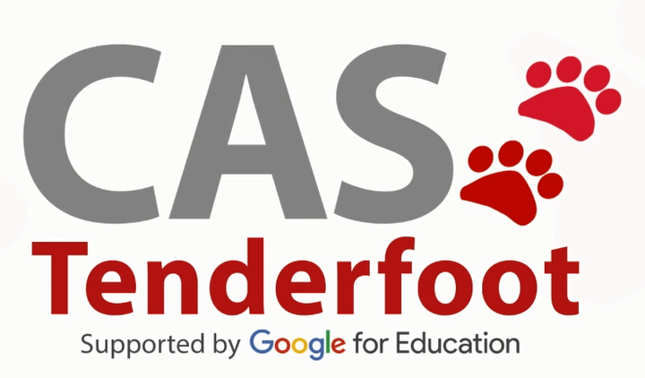
Developing a new generation of
Curriculum Leaders
Notes:
A brief introduction outlining the purpose of the Tenderfoot project.

Slide 2

Why
What
When
How
Notes:
A chance to explain what the Tenderfoot project entails – hide if not required.
Why? The need to develop a deeper appreciation of Computer Science amongst non-specialists secondary teachers.
What? Currently seven full Units are completed, packaged as 30+ separate sessions to support Master Teachers and others hosting local CPD. Four further Units are scoped and awaiting further development.
When? The seven completed Units will be online by the start of the academic year 2017 – 18.
How? The CAS model is that of local face to face sessions through which we build trust and a genuine community of practice. Some may develop the material into online delivery but the key aim is to help sustain the fabric of the CAS Community, developing through the Regional Centre initiatives.

Slide 3
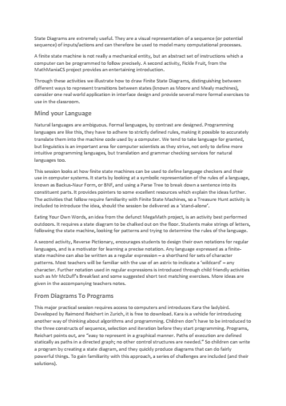
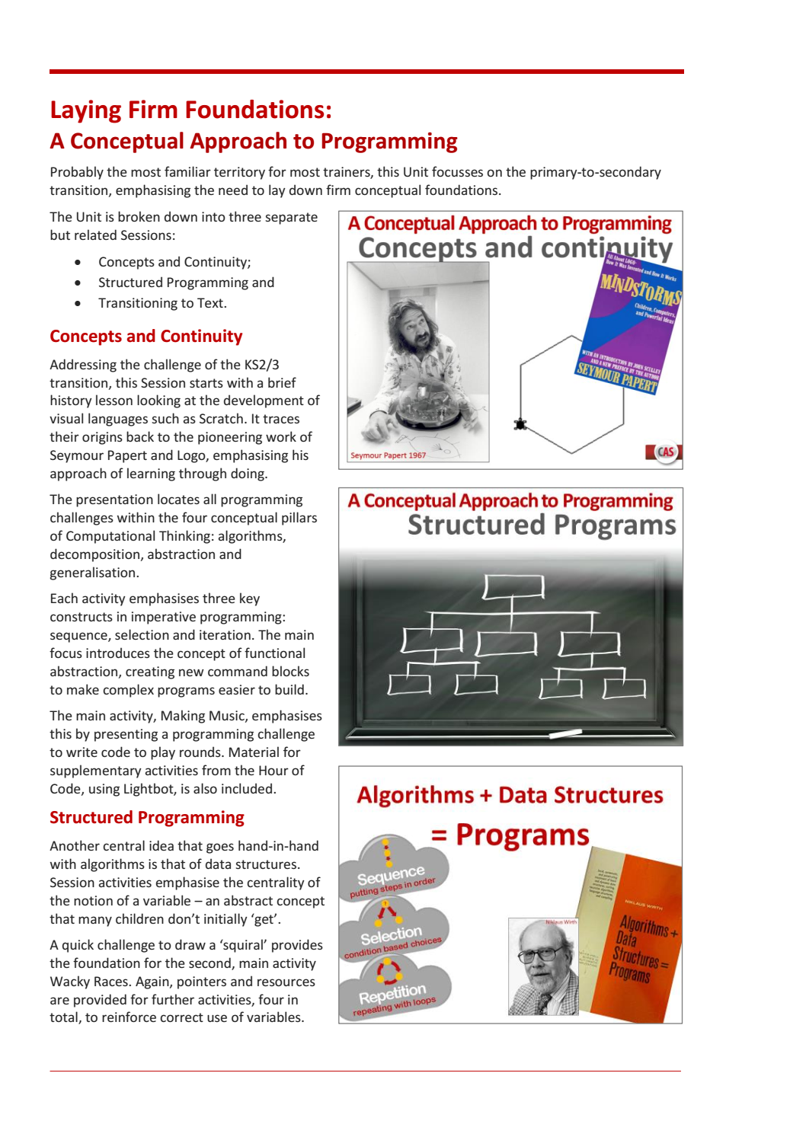
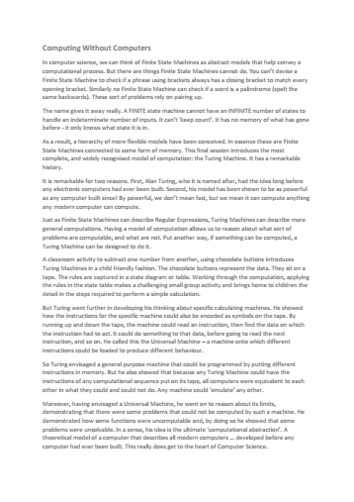
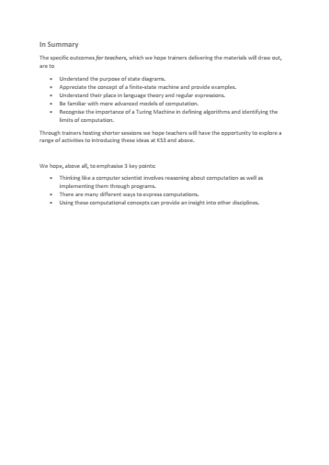
Each
Unit
Notes:
It is important that attendees understand the structure of the supporting resources and their target audience.
A short summary of the content of each Unit can be downloaded and distributed in advance.
A full day Unit is fast paced, aimed at experienced curriculum leaders and potential Tenderfoot trainers.

Slide 4

Each
Unit
Notes:
Each Unit includes a full Trainer Presentation, which follows these introductory slides.

Slide 5
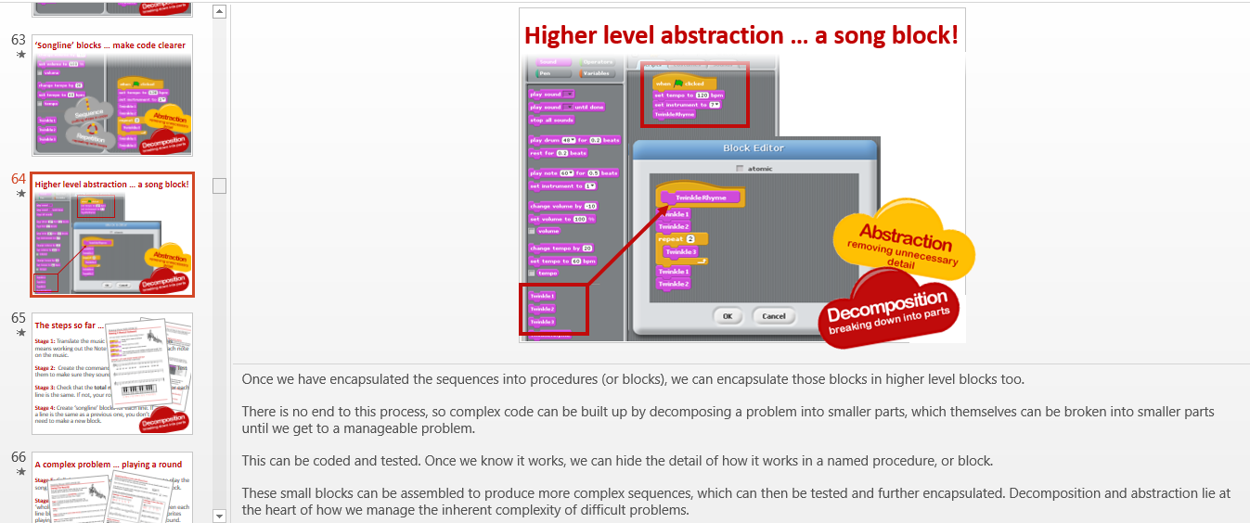
Notes:
The slides include very detailed notes outlining the supporting narrative. Please read them carefully if preparing a presentation.

Slide 6
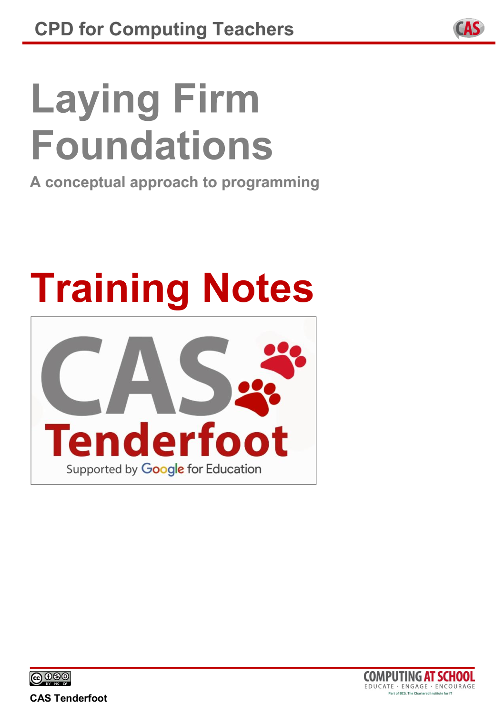
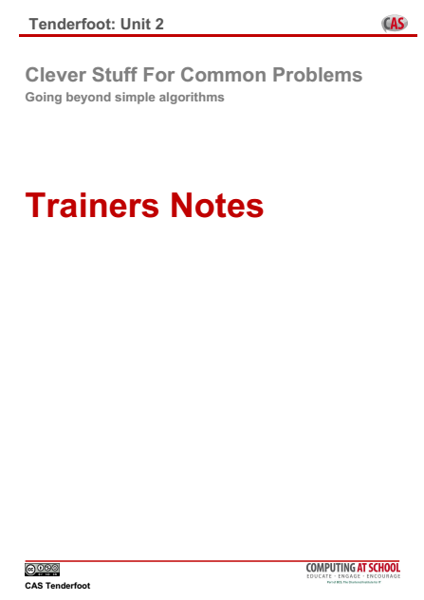
Each
Unit
Notes:
Training Notes are provided to help with advanced preparation.
These can be distributed at the start of a full day session.
The contents are explained in the following slides.

Slide 7
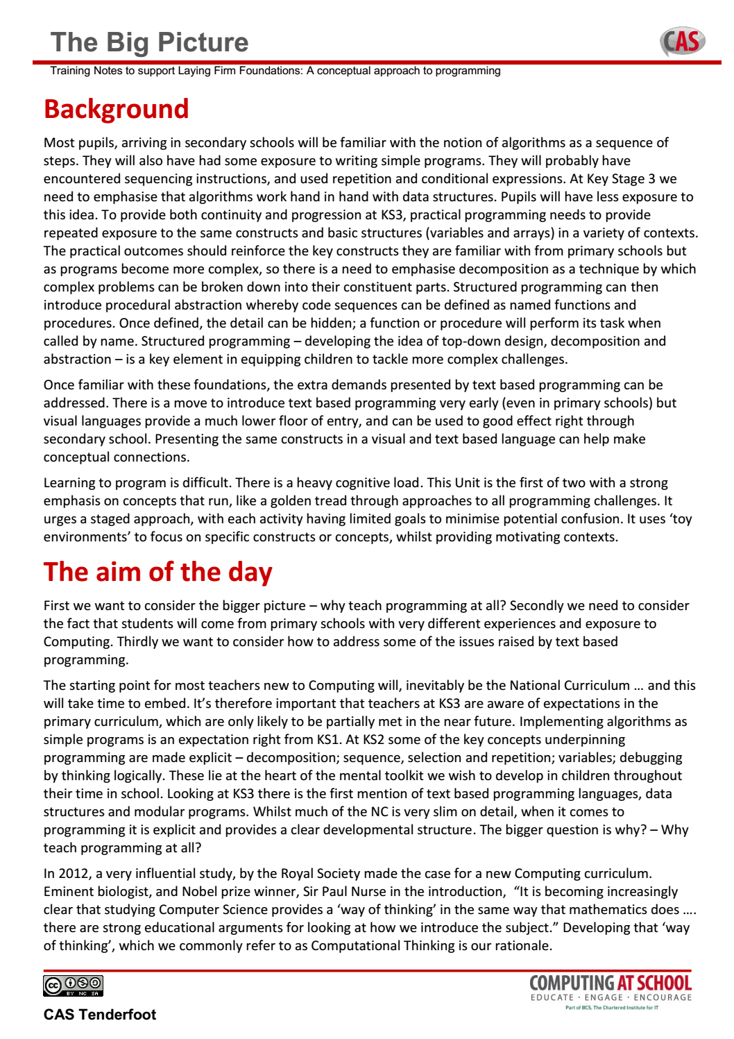
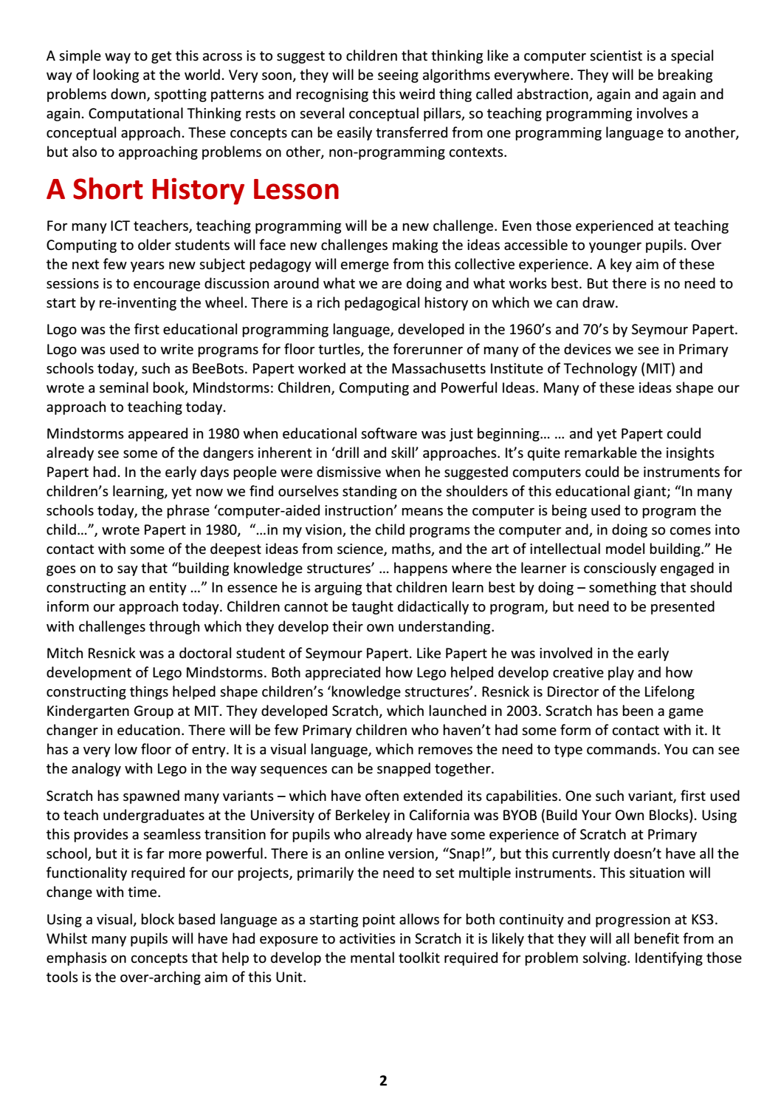
Notes:
The first page sets the subject matter in context, outlines the ‘big picture’ and identifies the learning objectives for teachers new to Computing.
It is worth emphasizing that the purpose of the material is to raise the awareness of teachers to the breadth and depth of the subject, not simply to provide another source of fun activities for classroom use.

Slide 8
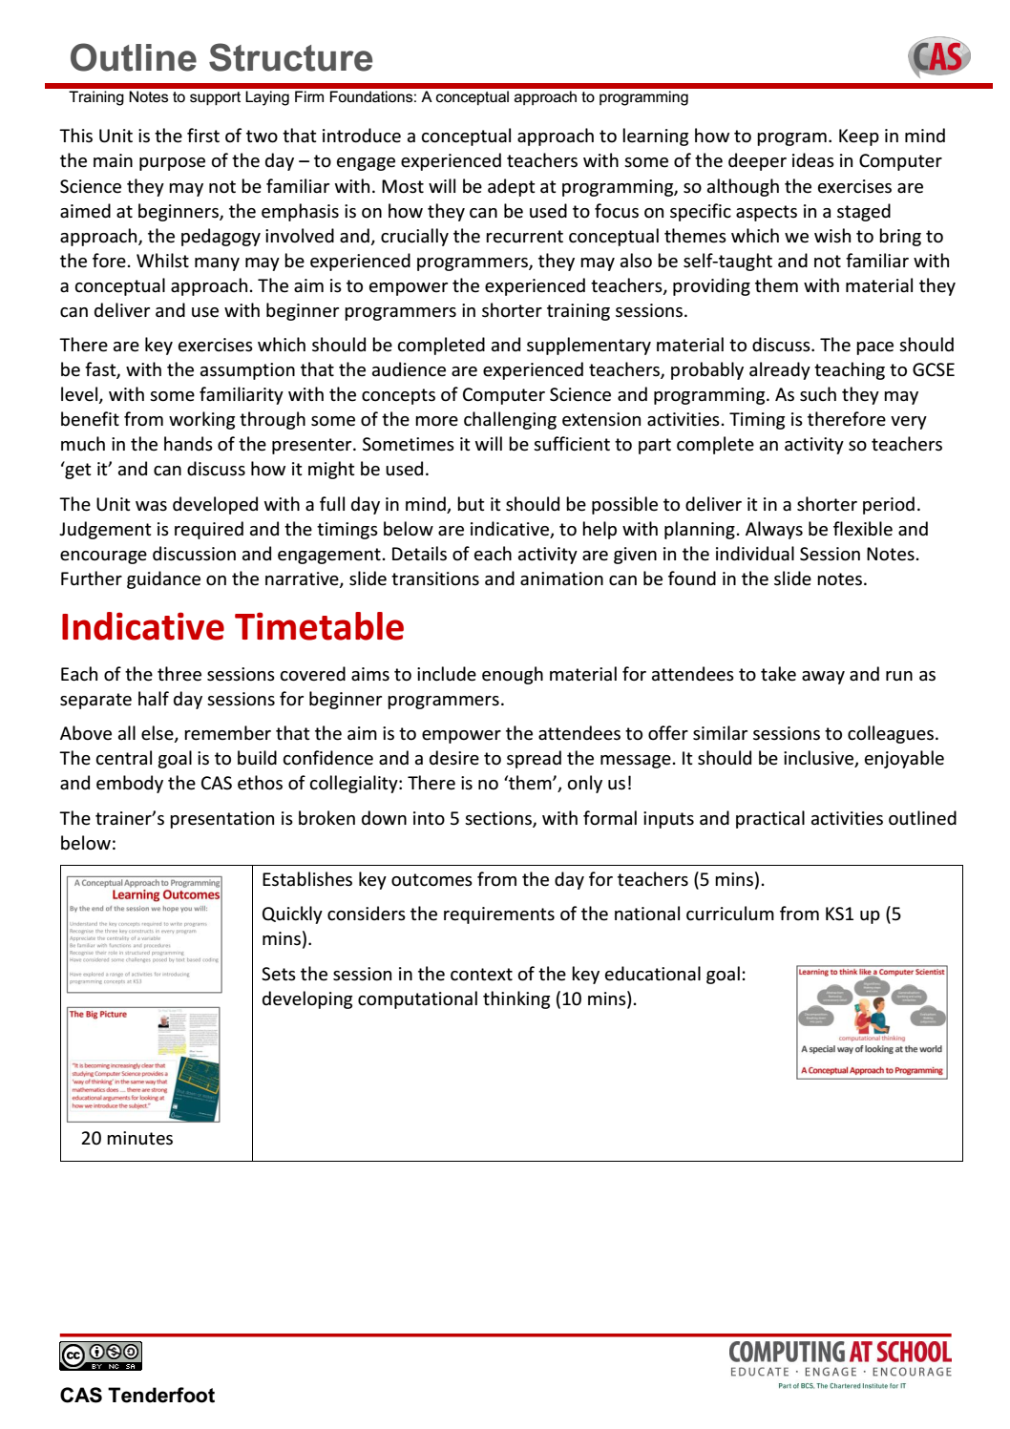
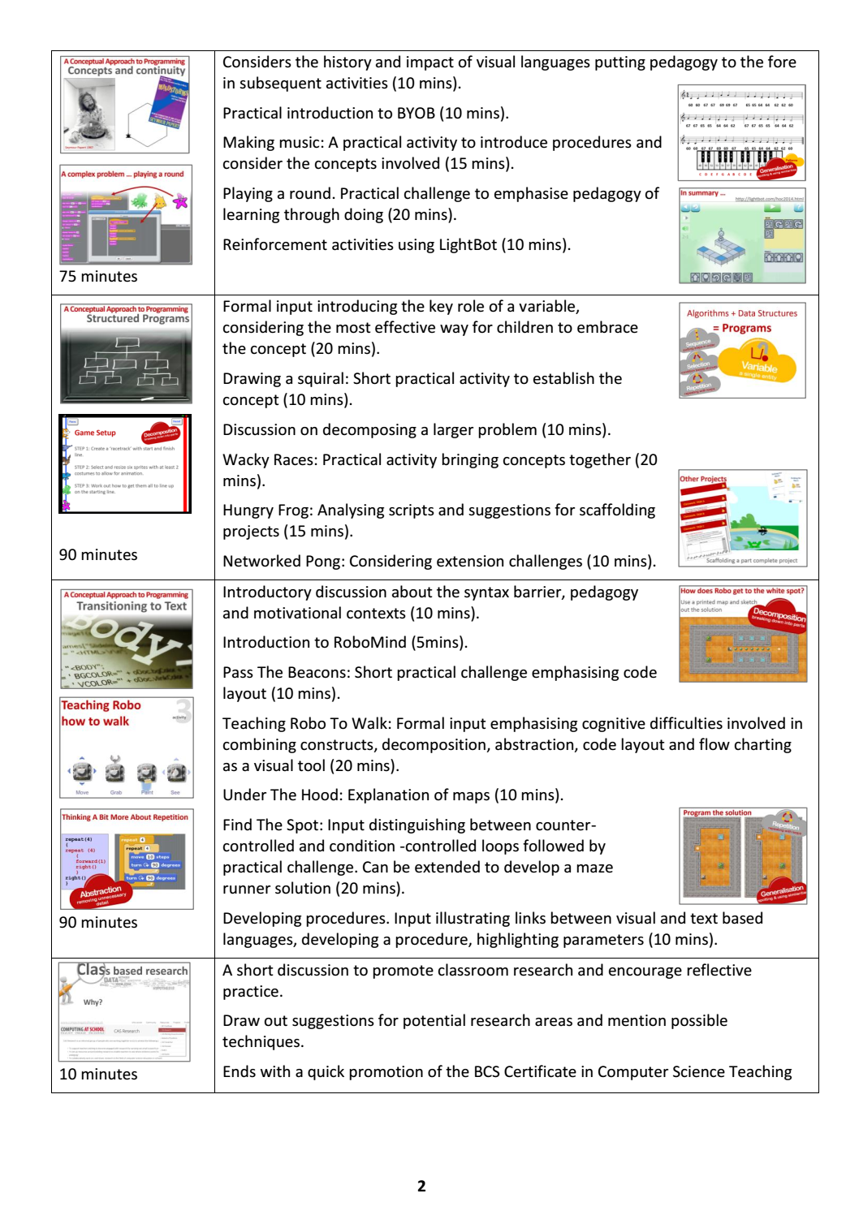
Notes:
An indicative timetable for a full day Unit is included.
A lot of ground is covered, so keeping to time can be challenging!

Slide 9
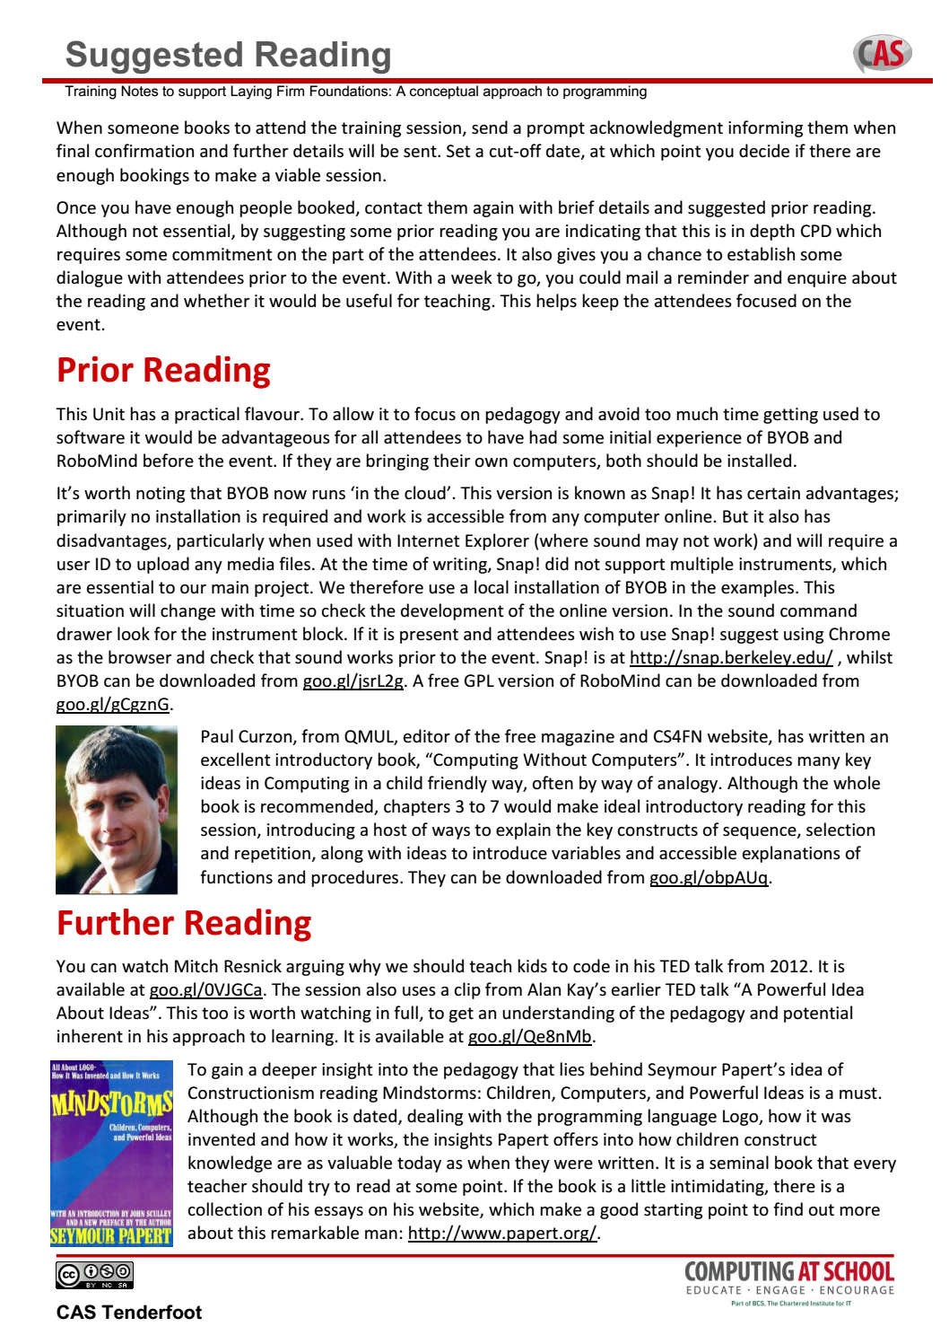
Notes:
Pointers are provided to good CPD practice. Making contact and establishing a dialogue prior to the event is important. Suggesting simple reading or watching a video allows the opportunity to follow up with a reminder.
The ultimate aim is to encourage teachers to dig deeper, so suggested further reading is also included.

Slide 10
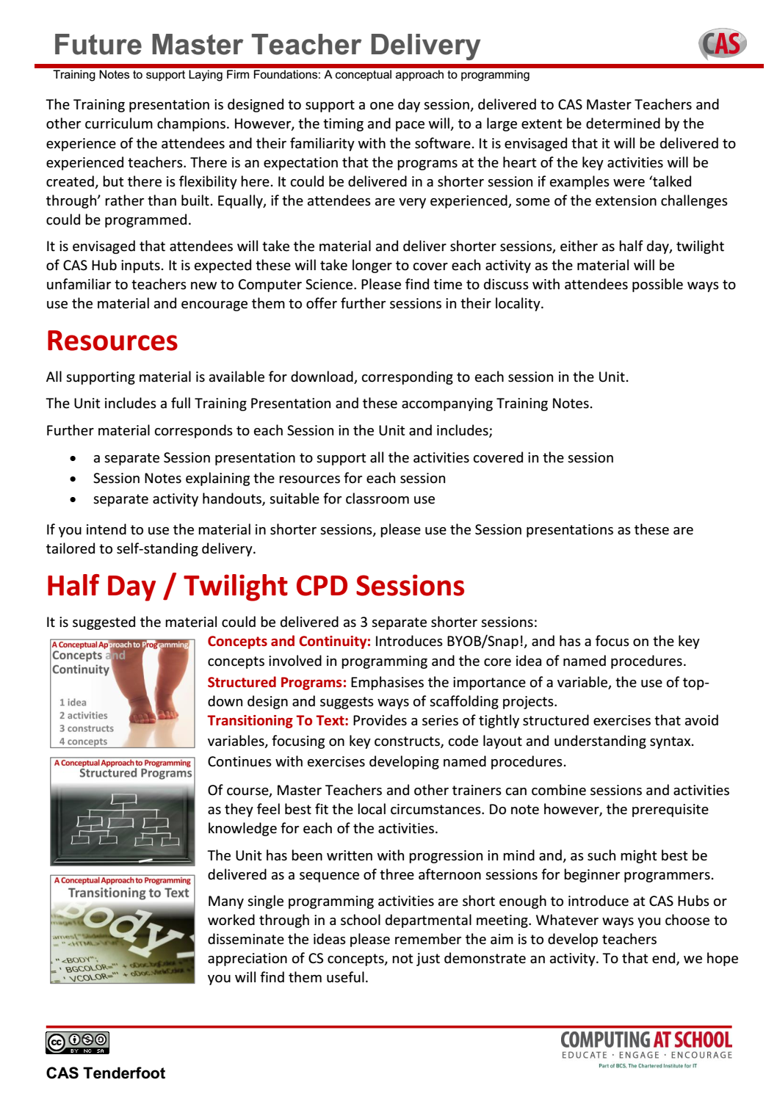
Notes:
The Unit is subdivided into sessions. This allows you to take the material and offer shorter sessions to fit local circumstances.
A summary of the sessions and indicative timings is included to facilitate planning.

Slide 11
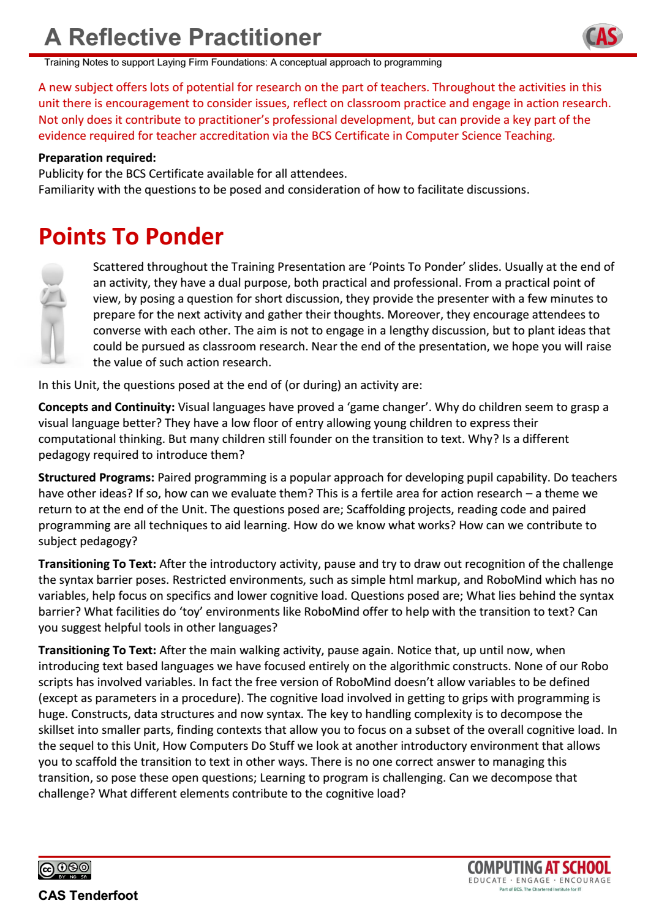
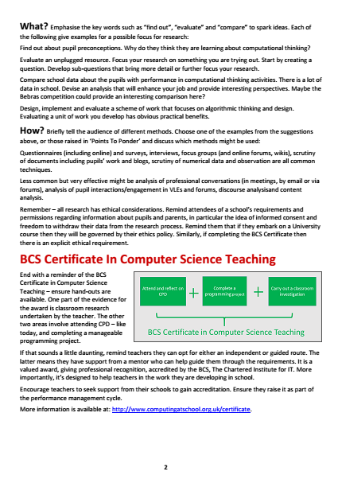
Notes:
Finally, there is a summary of the key points in the presentation where we hope Trainers will facilitate discussion and debate.
A key element in the CPD is to encourage reflective practice, promote action research and encourage teachers to consider the BCS Certificate in CS Teaching.

Slide 12
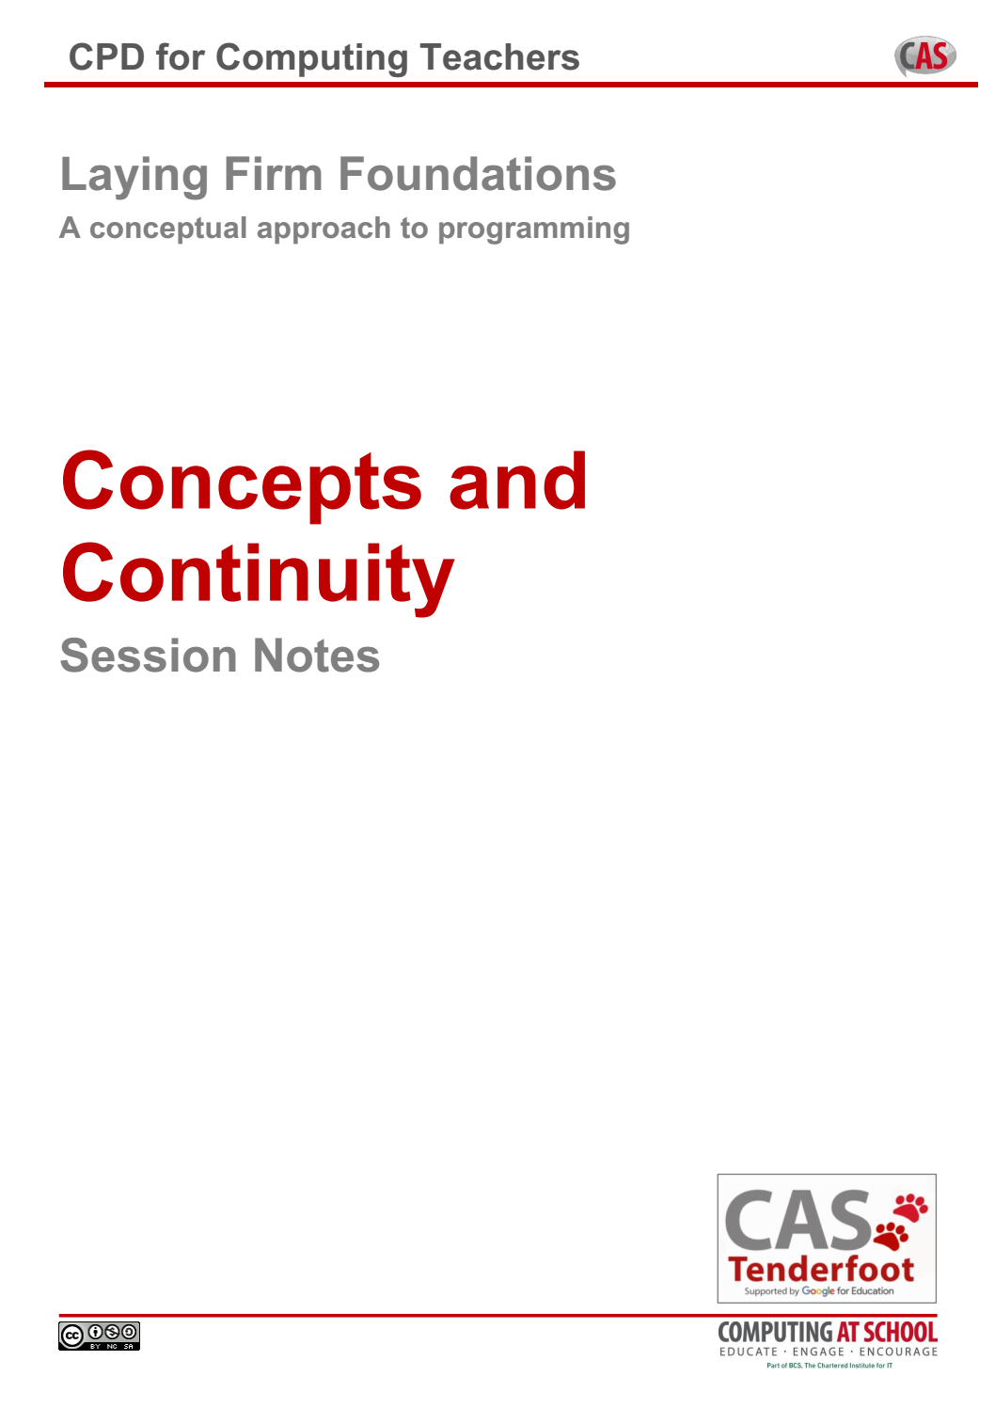
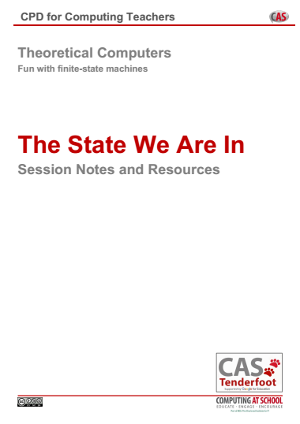
Each
Session

Slide 13


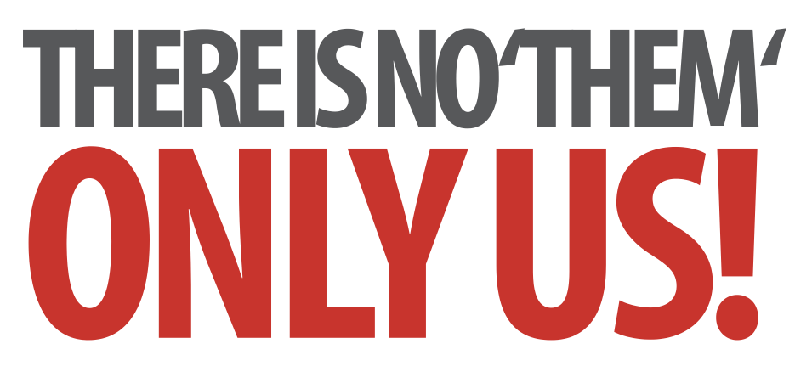
Laying Firm Foundations
A Conceptual Approach to Programming
Notes:
Introductory slides that establish a common format to the start of a Master Teacher session. Please do stress the ethos at the start: there is no them – only us! If our subject is to develop all practising teachers have valuable contributions to make, regardless of prior experience. The CAS model recognises that good pedagogy is a process of discussion and development, facilitated through our Community of Practice.

Slide 14
Laying Firm Foundations
A Conceptual Approach to Programming
Insert any specific notes
Start / End time
Toilets
Fire Drill / Exits
Notes:
Reminder to go through formalities at start. Placeholders for specific details

Slide 15
A Conceptual Approach to Programming
Learning Outcomes
By the end of the session we hope you will:
Understand the key concepts required to write programs
Recognise the three key constructs in every program
Appreciate the centrality of a variable
Be familiar with functions and procedures
Recognise their role in structured programming
Have considered some challenges posed by text based coding
Have explored a range of activities for introducing programming concepts at KS3
Notes:
It is important to be explicit about the intended outcomes of the day for attendees.
Do not assume they will be aware of the purpose or target audience of the materials.
By stating the intentions, it helps avoid getting sidetracked into discussing the detail of individual classroom activities.
The primary aim is to educate teachers and illustrate the breadth and depth of Computer Science. The specific outcomes for teachers from this unit, are
Understand the key concepts required to write programs
Recognise the three key constructs in every program
Appreciate the centrality of a variable
Become familiar with functions and procedures
Recognise their role in structured programming
Have considered some challenges posed by text based coding
The purpose of Tenderfoot is to equip trainers with material and ideas to meet these outcomes and broaden the outlook of teachers new to Computing.
It hopes to provide a buffet of resources on which teachers can draw, to enrich their Key Stage 3 lessons, at the same time as meeting the key aim: providing greater depth of knowledge for teachers themselves.
Developing teachers is the focus, not providing activities for pupils.

Slide 16
The Big Picture
Concepts and Continuity
Structured Programming
Transitioning To Text
Notes:
Here’s the outline of the day: First we want to consider the bigger picture – why teach programming at all? Secondly we need to consider the fact that students will come from primary schools with very different experiences and exposure to Computing. Thirdly we want to consider how to address some of the issues raised by text based programming, before offering some practical challenges that get children using ‘real’ programming environments.

Slide 17
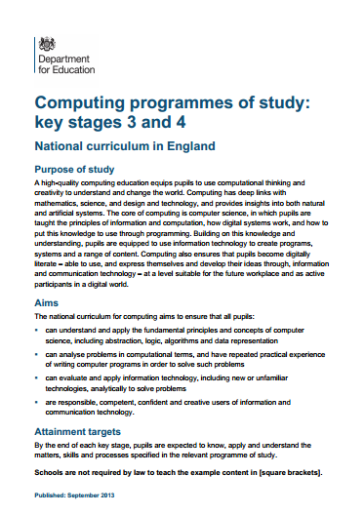
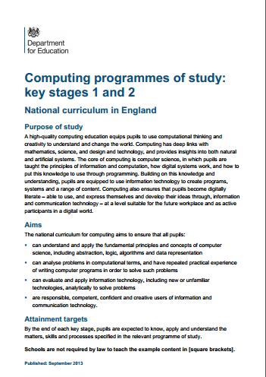
The Big Picture
Concepts and Continuity
Structured Programming
Transitioning To Text
Notes:
So lets start with the big picture. The starting point for most teachers new to Computing will, inevitably be the National Curriculum … and secondary teachers need to be aware that this will take time to embed. It’s therefore important that they are aware of expectations in the primary curriculum, which are only likely to be partially met in the near future.

Slide 18
The Big Picture
Key Stage 1
Pupils should be taught to:
understand what algorithms are;
how they are implemented as
programs on digital devices; and
that programs execute by following
precise and unambiguous instructions
create and debug simple programs
use logical reasoning to predict the behaviour of simple programs
Notes:
So starting with primary schools, it is clear that implementing algorithms as simple programs is an expectation right from KS1. Notice the third statement – using reasoning to predict the behaviour of programs. Even at this early age there is an indication about the pedagogy

Slide 19
The Big Picture
Key Stage 2
Pupils should be taught to:
design, write and debug
programs …
solve problems by decomposing
them into smaller parts
use sequence, selection, and
repetition in programs
work with variables …
use logical reasoning … to detect and correct errors in algorithms and programs
Notes:
At KS2 some of the key concepts underpinning programming are made explicit – decomposition; sequence, selection and iteration; variables; debugging by thinking logically. These lie at the heart of the mental toolkit we wish to develop in children throughout their time in school.

Slide 20
The Big Picture
WHY?
Key Stage 3
Pupils should be taught to:
use two or more programming
languages, at least one of which is
textual, to solve a variety of
computational problems
make appropriate use of data
structures [e.g lists, tables or arrays]
design and develop modular programs that use
procedures or functions
Notes:
And so on to KS3 where there is the first mention of text based programming languages, data structures and modular programs.
Whilst much of the NC is very slim on detail, when it comes to programming it is explicit and provides a clear developmental structure. That’s very good for us, and something that will shape the activities to come but before we do that we need to take a step back, appreciate the bigger picture and try to distinguish the wood from the trees.
(click)
The bigger question must surely be WHY? – why teach programming at all?

Slide 21
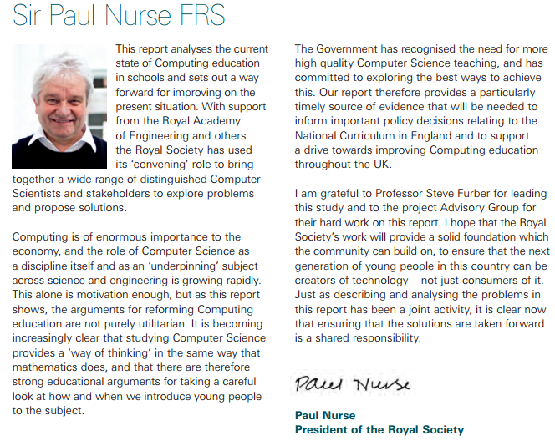
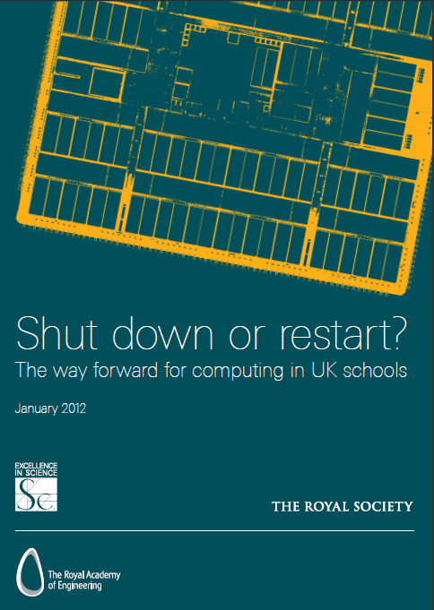
The Big Picture
“It is becoming increasingly clear that studying Computer Science provides a ‘way of thinking’ in the same way that mathematics does …. there are strong educational arguments for looking at how we introduce the subject.”
Notes:
In 2012, a very influential study, by the Royal Society made the case for a new Computing curriculum. Eminent biologist, and nobel prize winner, Sir Paul Nurse wrote the introduction and in it he said …

Slide 22

Learning to think like a Computer Scientist
“It is becoming increasingly clear that studying Computer Science provides a ‘way of thinking’ in the same way that mathematics does …. there are strong educational arguments for looking at how we introduce the subject.”
Notes:
Developing that ‘way of thinking’, which we commonly refer to as Computational Thinking is our rationale.

Slide 23
Learning to think like a Computer Scientist
Purpose Of Study
A high-quality computing education
equips pupils to use computational
thinking and creativity to
understand and change the world.
Notes:
Computational Thinking is made explicit in the Purpose of Study that introduces both the primary and secondary programmes of study …

Slide 24
Learning to think like a Computer Scientist
Purpose Of Study
A high-quality computing education
equips pupils to use computational
thinking and creativity to
understand and change the world.
The core of computing is computer
science, in which pupils are taught
the principles of information and
computation, how digital systems work, and how to put this knowledge to use through programming.
Notes:
It goes on to say how this can be applied through programming.

Slide 25
Computing is about
much more than
programming
Notes:
We can summarise by saying these 3 things.

Slide 26
Computing is about
much more than
programming
Computing is about a
way of thinking
Notes:
We can summarise by saying these 3 things.

Slide 27
Computing is about
much more than
programming
Computing is about a
way of thinking
Computational thinking is developed through computational doing
Notes:
We can summarise by saying these 3 things.

Slide 28
Teaching children to
program is about
applying key concepts
from Computational
Thinking
Concepts are transferable to other problem solving contexts
Notes:
So teaching programming involves a conceptual approach. These concepts can be easily transferred from one programming language to another, but also to approaching problems on other, non programming contexts.

Slide 29
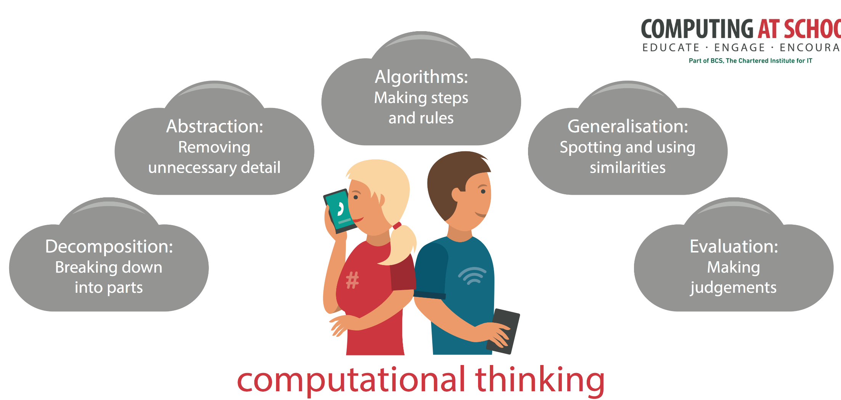
Teaching children to
program is about
applying key concepts
from Computational
Thinking
Concepts are transferable to other problem solving contexts
Notes:
CAS have produced a poster that highlights these concepts – great for the classroom wall, so you can keep referring to them whenever the opportunity arises. We’ll be doing this throughout these sessions. They are … each will be revealed on a click.

Slide 30
Learning to think like a Computer Scientist
A special way of looking at the world
A Conceptual Approach to Programming
Notes:
A simple way to get this across is to suggest to children that thinking like a computer scientist is a special way of looking at the world. Very soon, they will be seeing algorithms everywhere. They will be breaking problems down, spotting patterns and recognising this weird thing called abstraction, again and again and again.
Many CAS members offer CPD in particular programming languages. Regardless of the language, the concepts should be the same. The language is secondary, the concepts are key – hence the name of this session (title appears on click).

Slide 31
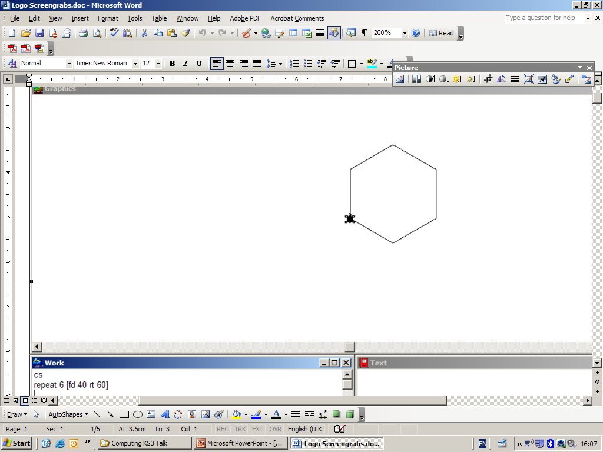
Concepts and continuity
A Conceptual Approach to Programming
The big picture
Concepts and continuity
Structured programming
Transitioning to text
Notes:
So let’s start by outlining the key concepts and looking at how we can ensure continuity from primary.

Slide 32
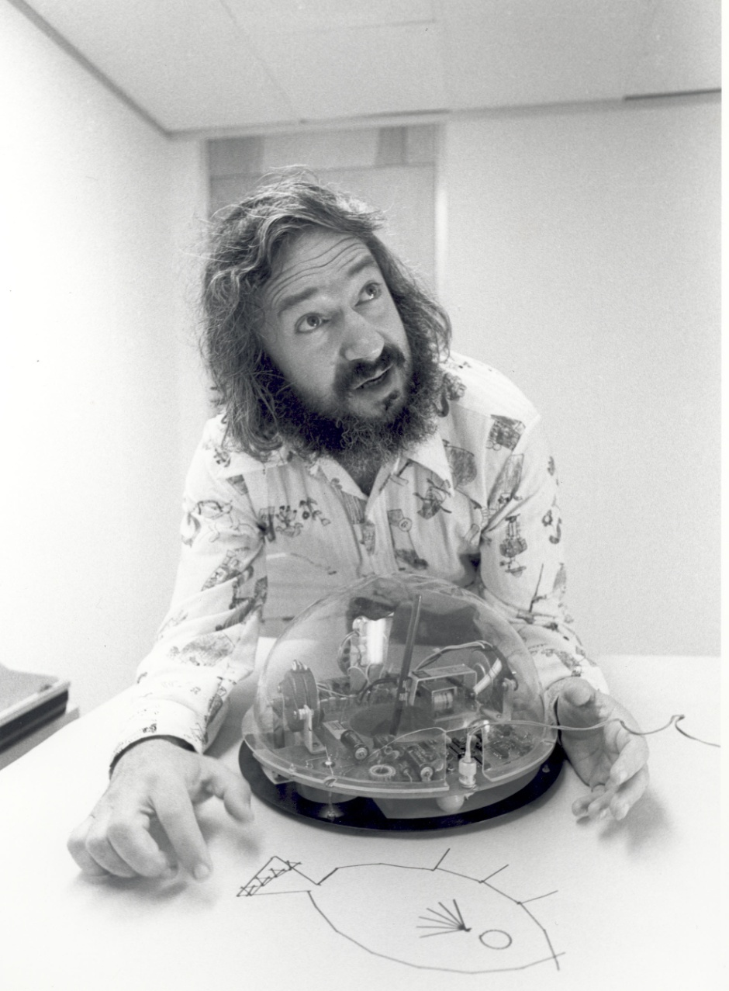
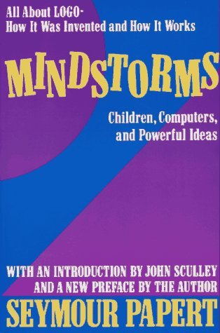
History lesson
Seymour Papert 1967
Notes:
We’ll start with a quick history lesson. What do you think of when you see this image? If your answer wasn’t LOGO, you’re clearly not from a certain generation. Logo was the first educational programming language, developed in the 1960’s and 70’s by this man (click), Seymour Papert. Logo was used to write programs for floor turtles, like the one shown. It was the forerunner of many of the devices we see in Primary schools today, such as BeeBots.
Papert worked at the Massechusettes Institute of Technology (MIT) and wrote a seminal book (click), Mindstorms: Children, Computing and Powerful Ideas. Many of these ideas shape our approach to teaching today.

Slide 33

Seymour Papert 1967
Notes:
The name Mindstorms might be familiar from the programmable Lego kits. Seymour Papert was involved in the early development of these. Mindstorms (the book) appeared in 1980 when educational software was just beginning… … and yet Papert could already see some of the dangers inherent in ‘drill and skill’ approaches.

Slide 34
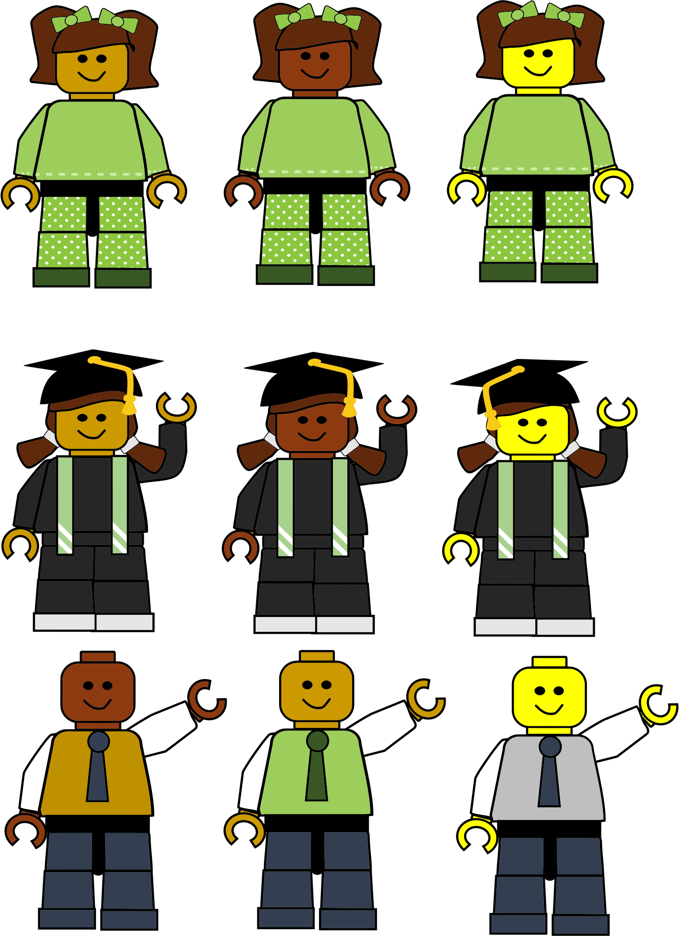
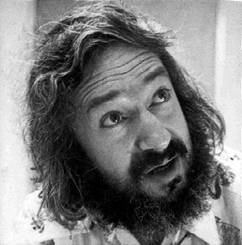
“In many schools today, the phrase ‘computer-aided instruction’ means the computer is being used to program the child....
Notes:
It’s quite remarkable the insights Papert had. In the 1960’s people laughed when he suggested computers could be instruments for children’s learning, yet now we find ourselves standing on the shoulders of this educational giant. Quote extends over 2 slides.

Slide 35
…in my vision, the child programs the computer and, in doing so
comes into contact with some of the deepest ideas from science, maths, and the art of intellectual
model building.”

Slide 36
“building knowledge structures’ … happens where the learner is
consciously engaged
in constructing
an entity …”
Learning through ‘doing’
Notes:
He goes on to say (quote again). In essence what he is arguing is (click) that children learn by doing – something that should inform our approach today. Children cannot be taught didactically to program, but need to be presented with challenges through which they develop their own understanding.

Slide 37
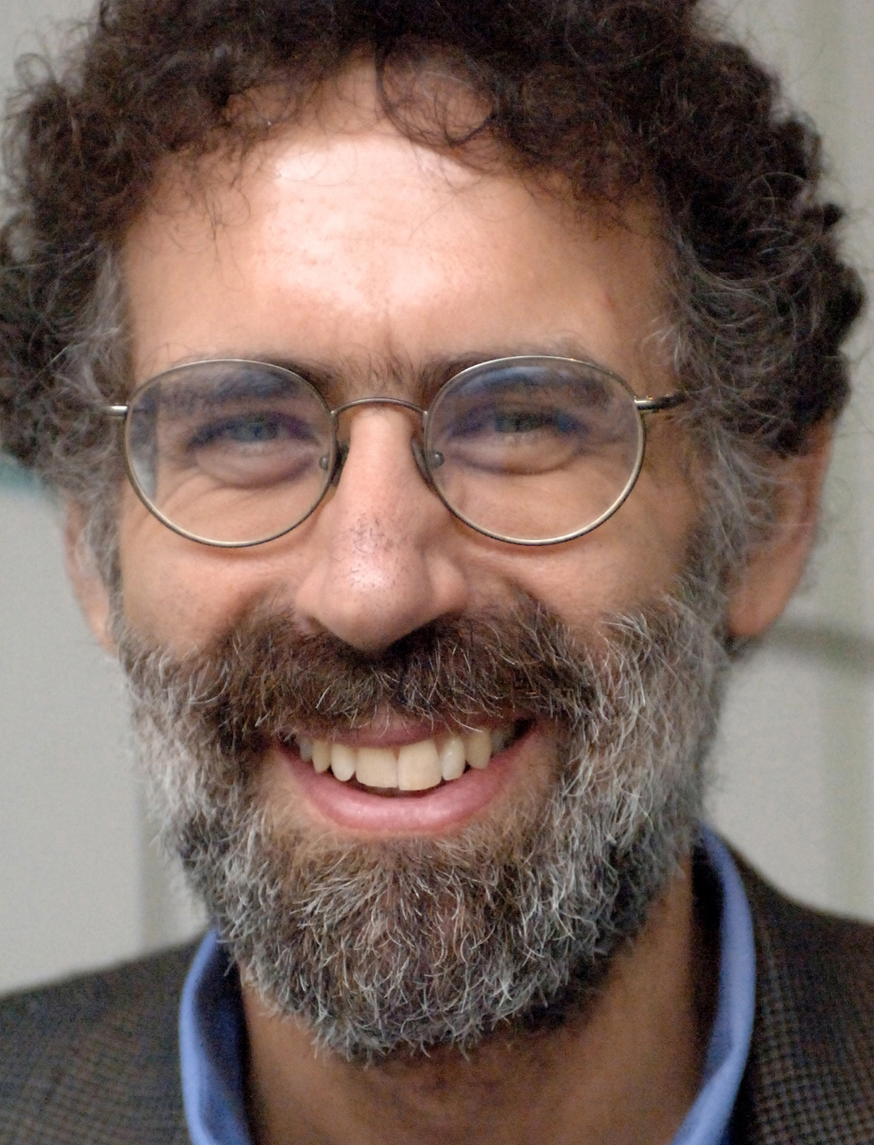
Learning through ‘doing’
Notes:
This man was a doctoral student of Seymour Papert’s. He too was involved in the development of Lego Mindstorms (click). Both appreciated how Lego helped develop creative play and how constructing things helped shape children’s ‘knowledge structures’. Does anyone know who he is and what he is famous for today? (Answer: Mitch Resnick created Scratch)

Slide 38
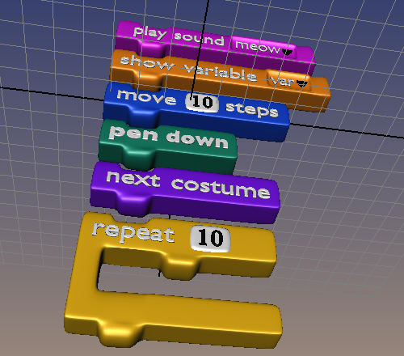
Learning through ‘doing’
Notes:
Mitch Resnick, ‘Papert Professor of Learning Research’ and Director of the Lifelong Kindergarten Group at MIT developed Scratch, launched in 2003. Next slide has a video (1min 20secs) explaining why.

Slide 39
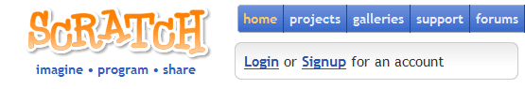

Notes:
Scratch has been a game changer in education. There will be few Primary children who haven’t had some form of contact with it. It has a very low floor of entry. It is a visual language, which removes the need to type commands. You can see the analogy with Lego in the way sequences can be snapped together.

Slide 40




http://byob.berkeley.edu/
Visual languages are educational tools
Notes:
Scratch has spawned many variants – which have often extended it’s capabilities. One such variant (click), used to teach undergraduates at the University of Berkeley in California was BYOB (Build Your Own Blocks). This provides a seamless transition for pupils who already have some experience of Scratch, but is far more powerful.
(click) Don’t dismiss visual languages as ‘toy’ languages. They have a long history of pedagogical development and are the starting point for grasping computational concepts. Once grasped, they make the transition to text based coding much easier.
Its worth noting that both Scratch and BYOB now run ‘in the cloud’. These versions are Scratch 2 and Snap! (click). This has certain advantages, primarily no installation and being accessible from any computer online. But they also have disadvantages for schools with unreliable or limited connectivity. It is also another User ID for students to remember and any media they wish to use has to be uploaded to the cloud first.
At the time of writing, Snap! didn’t support multiple instruments which is essential for an upcoming project. We’ll therefore be using a local installation of BYOB in these examples. This situation will change with time and you may wish to use the online versions. Both are freely available from the URL (click) http://byob.berkeley.edu

Slide 41
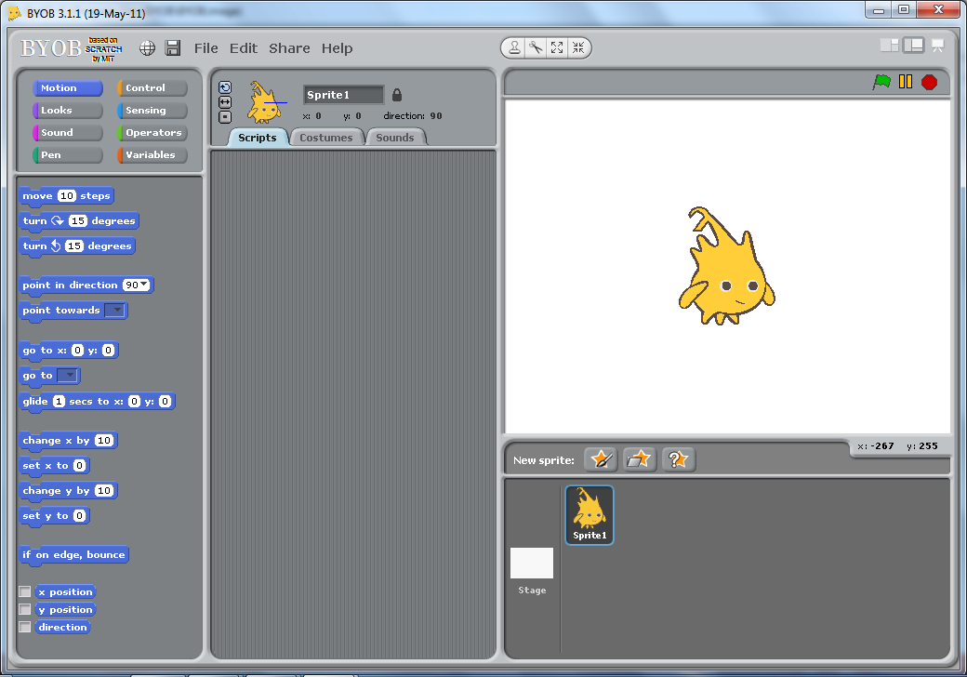
The BYOB ‘IDE’
Integrated Development Environment
Notes:
Before we start, ensure everyone can open BYOB. Use this to to stress the similarity with Scratch – 3 slides simply show different drawers of commands which are just the same as Scratch.

Slide 42
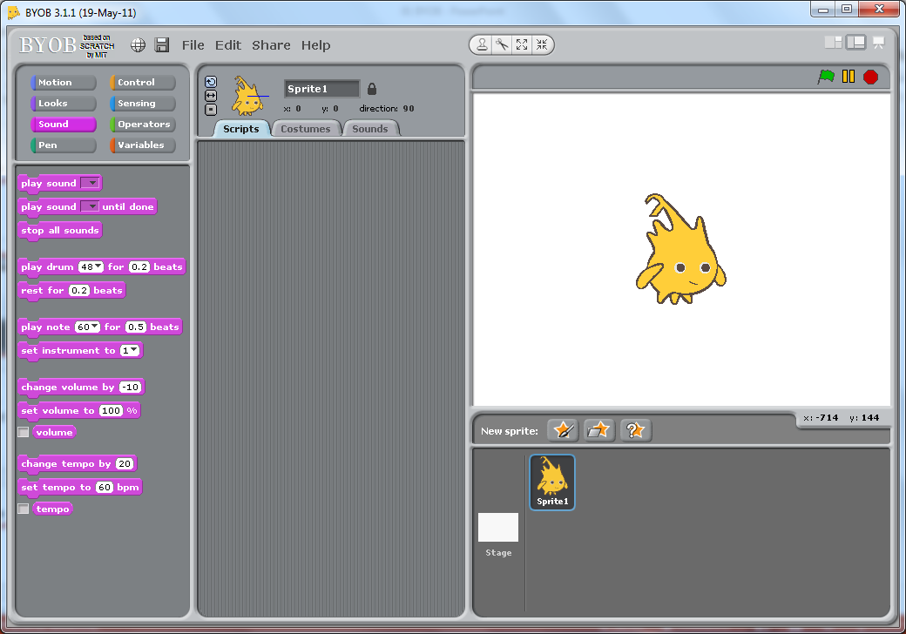
The BYOB ‘IDE’
Integrated Development Environment

Slide 43
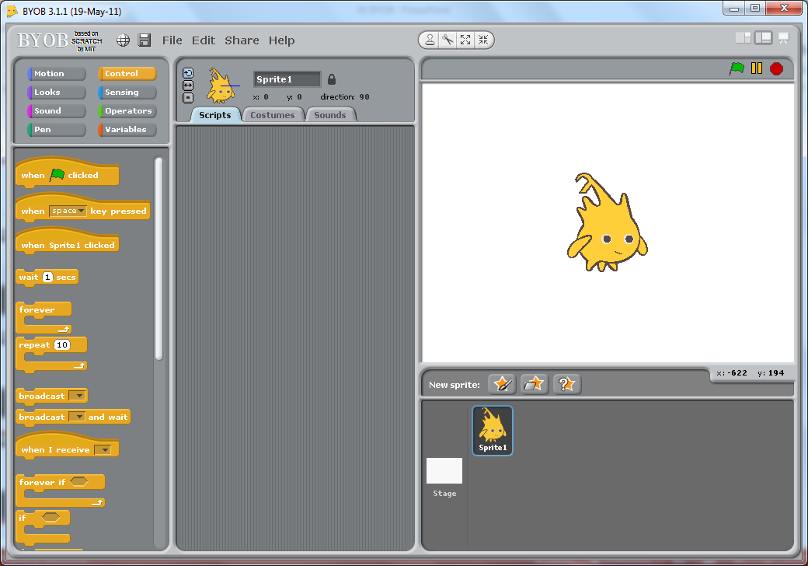
The BYOB ‘IDE’
Integrated Development Environment

Slide 44
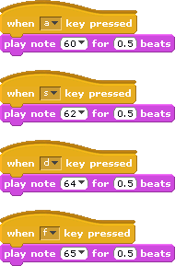
Lets make some music!
Notes:
Ensure your audience are familiar with dragging blocks to create scripts. Point out the ‘hat’ blocks which sit on top of scripts and act as the trigger to execute the commands. Here we program different keys on the keyboard to act as triggers to play notes.

Slide 45

A Conceptual Approach to Programming
Concepts and
Continuity
1 idea
2 activities
3 constructs
4 concepts
Notes:
We’ve talked a lot in the introduction. The focus of this session is concepts and continuity. What we want to do is constantly reinforce 1 big idea – that this is about developing Computational Thinking (click).
We’ll suggest two activities, involving 3 key constructs to illustrate 4 central concepts.

Slide 46
Learning through ‘doing’
Paired programming?
Notes:
One final point - just like children learning to walk, you, or your audience will learn through doing. Nobody can ‘tell’ a child how to walk – they learn by falling over … again and again and again.
So it is with programming, but a challenge facing teachers is managing that within a class. A parent may pick a child up, but you can’t be picking 30 children up all the time. There are many ideas being shared by teachers in this regard – one very effective method is to develop paired programming. Working in pairs allows discussion and develops the ability to articulate your thoughts. So one person constructs the program from the instructions of another.

Slide 47
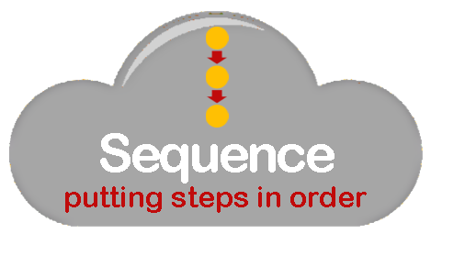


The ‘Big Three’
Notes:
We’re going to give children a couple of programming projects. Programming need not be intimidating- on fact it is based on just three simple ideas, or constructs. We could call them the ‘big 3’:
(click)
Sequence – the challenge of arranging instructions into the correct order.
Selection – allowing a program to branch down a different route IF a certain condition is met and
Repetition –sometimes referred to as Iteration Allowing us to repeat sequences of commands by looping back.
It’s useful to repeat these constructs regularly and often. Perhaps get the children to chant them back in response to a prompt; “There are only 3 constructs in programming. They are?” Response in a loud voice, all together; “Sequence, Selection and Repetition” It’s worth noting too, that when introducing programming this probably represents the order of complexity of the constructs. Children generally find conditional IF statements easier than loops.
Throughout any coding project, take the opportunity to highlight code and ask what construct(s) are exemplified.

Slide 48





Notes:
We’ve mentioned the focus on concepts, so lets get them upfront right from the start. Obviously there will be a focus on algorithms as a sequence of instructions, but we also want to highlight (click) the idea of decomposition, breaking a complex problem into smaller parts as a way of managing complexity. Generalisation (click) may be a new term for many, but in many computing contexts for young children, this amounts to trying to spot patterns. Finally (click), at the heart of Computational Thinking is the notion of Abstraction, which we’ll highlight as it arises.
Throughout the projects we want to take every opportunity to highlight examples of both the key constructs and the core concepts.

Slide 49

Making Music
1
activity
with BYOB
Notes:
With all that said, lets look at making some music with BYOB.

Slide 50
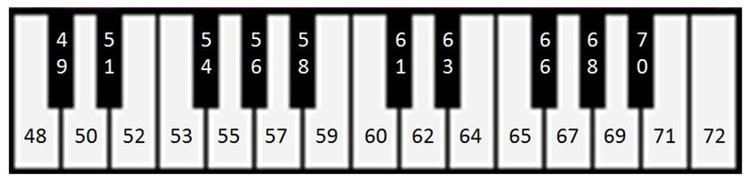
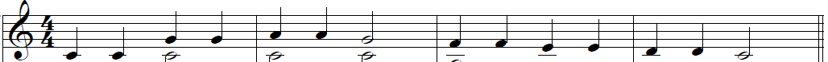
Understanding notes
C D E F G A B C D E F G A B C
67 67 69 69 67 65 65 64 64 62 62 60
60 60
C C G G A A G F F E E D D C
Notes:
Children don’t need to understand musical notation to do these activities. In fact, learning to read music is an exercise in pattern recognition itself. We do need to start by explaining notes. Start by making a link to keys on a piano. The numbers on the piano keys equate to the BYOB pitch number. (click) The letters of the notes appear below the piano keys
The numbers in a BYOB ‘play’ command indicate the key or pitch to play. The default number (60) represents the middle key on the piano. White piano keys are represented by the letters A to G, which repeat in sets of 8 (or octaves). We wont be worrying about the black notes at the moment. (click)
The musical score is a way of writing instructions to play a sequence of notes. Each line and each space between the lines indicates a different white piano key. If we tell pupils that the first note represents middle C, we can work out the letter of each further note. (click removes the arrow) Go through this on the screen, counting up each space and line to the G, then the A to make this clear.
Finally, having worked out the notes, we can convert these to the pitches (numbers) used in the ‘Play Note’ command in BYOB. (click illustrates first two notes) Having been given the first two 60’s, work through the rest with the group to ensure they understand how to convert. The higher up the score the notes are, the higher the number. (click to reveal answer)
(click brings concept graphic) In essence what we are doing is translating one language (a musical score) to a sequence of instructions for the computer. The rules for converting one to another have to be expressed unambiguously (an example of an algorithm).
The musical score itself can itself be seen as an algorithm – an unambiguous sequence of steps to produce a tune.

Slide 51
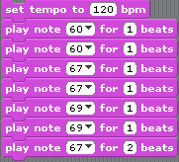
Save as LittleStar01
Too slow?
Change tempo
60 60 67 67 69 69 67 65 65 64 64 62 62 60
Notes:
Having translated the score to numeric notes, we can implement the algorithms in BYOB, using a sequence of play note commands. The first seven notes are given on the screen. At this point we can point out that the different look of a musical note indicates the length of time to play it for (click). In this case all the notes are 1 beat (a crotchet) apart from notes 7 and 14 which are two beats (a minim).
If it sounds too slow, do not change the number of beats for a note, but change the tempo of the beats (click).
Aremed with this knowledge, pupils can finish creating the script for the whole line. (click) A clear example of Sequencing.
(click) At this point it’s worth ensuring pupils can save their script, locate it and reload it into BYOB. They will probably recognise the tune so suggest a naming convention that allows for versions eg LittleStar01

Slide 52
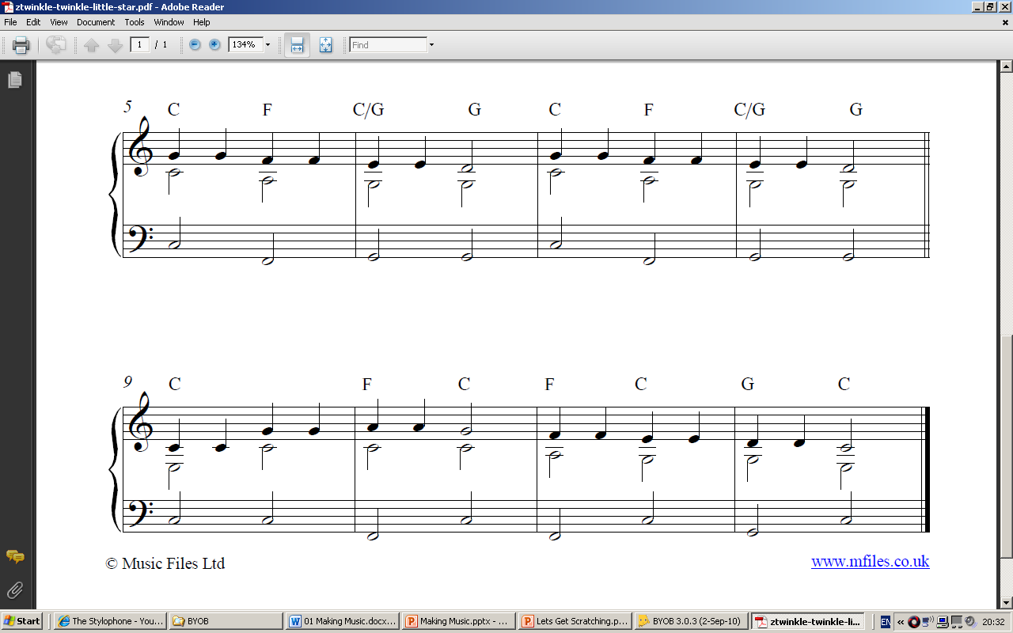
60 60 67 67 69 69 67 65 65 64 64 62 62 60
C D E F G A B C D E F G A B C
Notes:
With the remainder of the score on the screen, the challenge is to continue with the translation and scripting of the sequence.

Slide 53
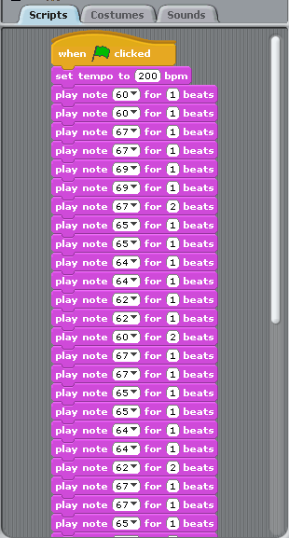
LittleStar01
60 60 67 67 69 69 67 65 65 64 64 62 62 60
C D E F G A B C D E F G A B C
Notes:
The start of the long sequence can be illustrated on screen if they are struggling.

Slide 54
Can we spot a repeating pattern?
Twinkle twinkle little star
how I wonder what you are
Up above the earth so high
like a diamond in the sky
Twinkle twinkle little star
how I wonder what you are
Notes:
The words of the rhyme should make it obvious to all that part of it is repeated (click)

Slide 55
60 60 67 67 69 69 67 65 65 64 64 62 62 60
67 67 65 65 64 64 62 67 67 65 65 64 64 62
60 60 67 67 69 69 67 65 65 64 64 62 62 60
C D E F G A B C D E F G A B C
Notes:
With the fully translated score, can the pupils spot the repeating musical sequence displayed?
The last line is the same as the first, just as the words are. If they don’t see this initially, perhaps ask them to listen to the tune and see if they can spot the pattern.

Slide 56
60 60 67 67 69 69 67 65 65 64 64 62 62 60
67 67 65 65 64 64 62 67 67 65 65 64 64 62
60 60 67 67 69 69 67 65 65 64 64 62 62 60
C D E F G A B C D E F G A B C
Notes:
This is a good example of the concept of pattern recognition. If we can spot this, we can reuse the original sequence (initially just by copying it), rather than creating it all again. Later we can look at better ways to reuse the code, but worth highlighting the concept now.

Slide 57
Can we spot another repeating tune?
Twinkle twinkle little star
how I wonder what you are
Up above the earth so high
like a diamond in the sky
Twinkle twinkle little star
how I wonder what you are
67 67 65 65 64 64 62 67 67 65 65 64 64 62
Notes:
If they haven’t noticed already, see if they can spot another part of the tune that repeats. (click)
It is worth pointing this out: the tune repeats, even if the words are different. (click reveals the score)

Slide 58
The trouble with a long script?
Twinkle twinkle little star
how I wonder what you are
Up above the earth so high
like a diamond in the sky
Twinkle twinkle little star
how I wonder what you are
Notes:
As pupils code their tune, it should become obvious that a long script (spaghetti code) makes it very difficult to spot mistakes.
Far better to break the song down into smaller sections and test each as it is developed.
This is, of course, and example of decomposition (click).

Slide 59
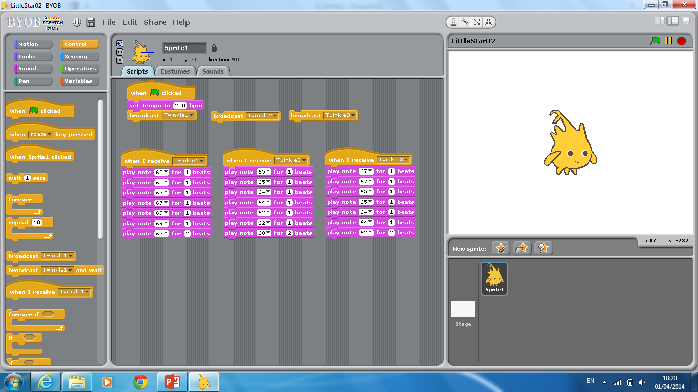
The trouble with a long script?
Refactor your composition
and save as LittleStar02
Twinkle twinkle little star
how I wonder what you are
Up above the earth so high
like a diamond in the sky
Twinkle twinkle little star
how I wonder what you are
Notes:
The rhyme can be coded using just these 3 sequences of seven commands. Highlight the use of message broadcasts to control program flow. This will be essential later on.
Discuss the benefits of this approach with students: Easier to test and debug, easier to check each section has the same number of beats etc.
Students should refactor their TwinkleStar code to ensure familiarity with the use of broadcasts and save it as, perhaps LittleStar02.

Slide 60
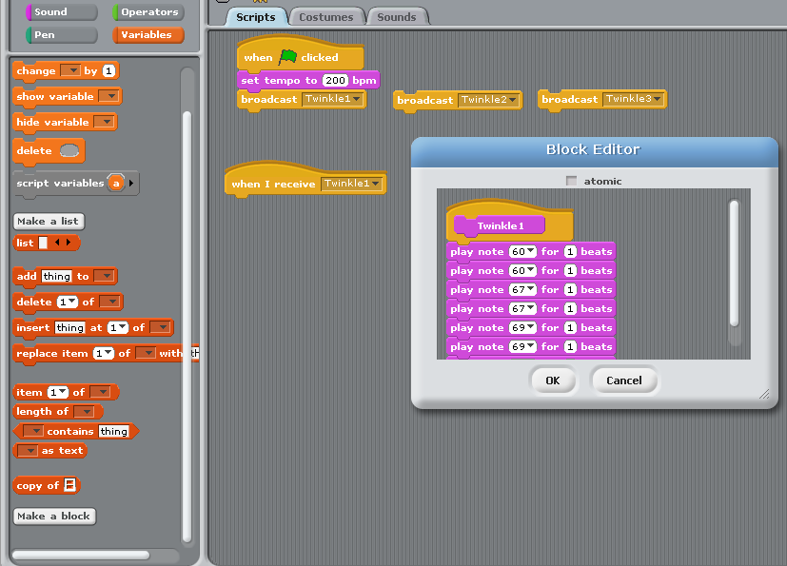
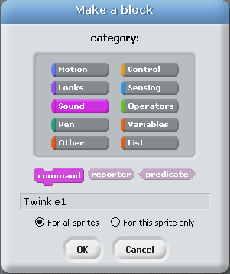
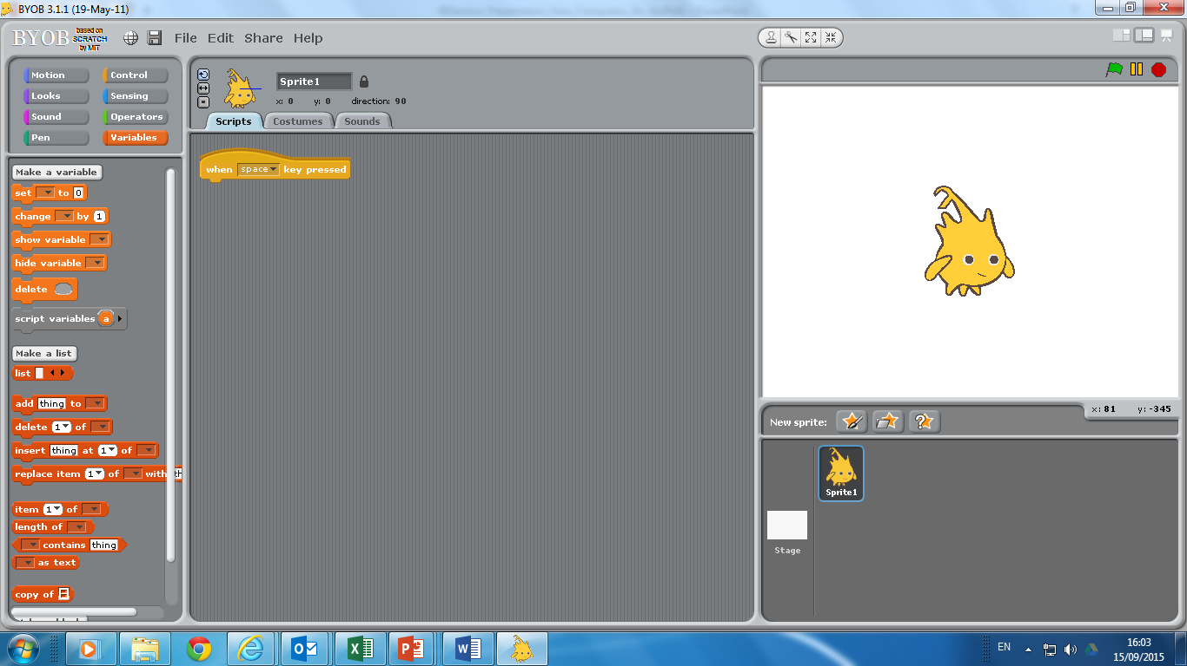
‘Songline’ blocks …
Notes:
Having refactored their code into manageable chunks, it is only a small conceptual step to encapsulate that code in a block of its own. We’ll call them songline blocks. The animation demonstrates how to define and name a new command block, ensuring it is placed in the correct category drawer (Sound).

Slide 61
‘Songline’ blocks …
Notes:
Once defined, we can drag the relevant code from the script window (click).

Slide 62
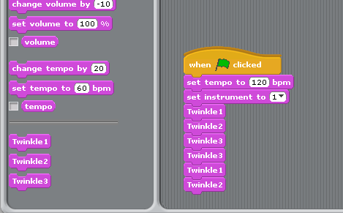

‘Songline’ blocks … make code clearer
Notes:
The rhyme can now be built from a higher level sequence of 3 songline blocks.
Hiding the detail of each songline within a named procedure is a good example of abstraction: the complexity of the song detail is hidden, making the code clearer.
In this sense procedural abstraction and decomposition can be viewed as two sides of the same coin.

Slide 63
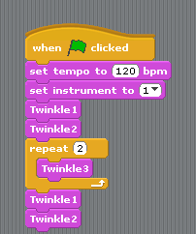
‘Songline’ blocks … make code clearer
Notes:
We can, of course, improve this sequence slightly by recognising the repetition of Twinkle3! (click)

Slide 64
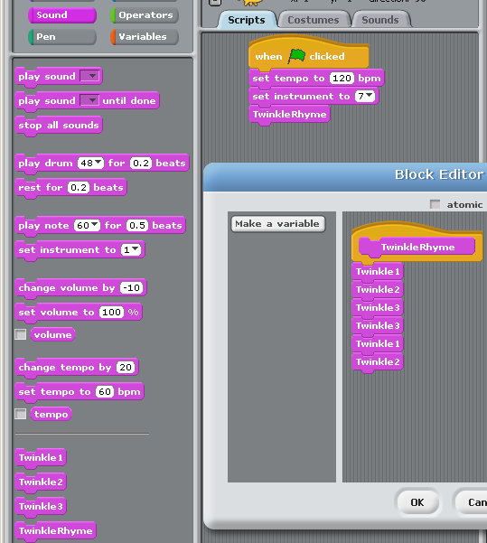
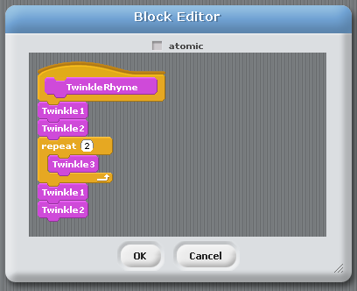
Higher level abstraction … a song block!
Notes:
Once we have encapsulated the sequences into procedures (or blocks), we can encapsulate those blocks in higher level blocks too.
There is no end to this process, so complex code can be built up by decomposing a problem into smaller parts, which themselves can be broken into smaller parts until we get to a manageable problem.
This can be coded and tested. Once we know it works, we can hide the detail of how it works in a named procedure, or block.
These small blocks can be assembled to produce more complex sequences, which can then be tested and further encapsulated. Decomposition and abstraction lie at the heart of how we manage the inherent complexity of difficult problems.
To play our tune, we now only need to ‘call’ or use one block, ‘TwinkleRhyme’.
But what’s the point of developing such a high level block?

Slide 65


The steps so far …
Stage 1: Translate the music into BYOB commands. This means working out the Note Number and Beats for each note on the music.
Stage 2: Create the commands for each line of the song. Test them to make sure they sound correct.
Stage 3: Check that the total number of beats played for each line is the same. If not, your round won’t work.
Stage 4: Create ‘songline’ blocks for each line. If
a line is the same as a previous one, you don’t
need to make a new block.
Notes:
With a high level block like TwinkleRhyme, we can tackle more complex problems, such as playing a round. There is an activity sheet for children and it is best to set this as a challenge to grapple with.
This slide outline the steps so far (click for each step). The following slide outlines the further steps required. Although they are summarised here, decomposing the problem would make a good class discussion.

Slide 66


A complex problem … playing a round
Stage 5: Call the ‘songline’ blocks in the right order to play the song. If it works, put them together in a ‘wholesong’ block.
Stage 6: Make a ‘leader’ block. This is the same as the ‘wholesong’ block, but has messages broadcast between each line block. These are used to start each of the other sprites playing at the correct time when you start playing a round.
Stage 7: Create several sprites. For each, set a different instrument. When they receive the right message they call the ‘wholesong’ block.
Notes:
With a high level block like TwinkleRhyme, we can tackle more complex problems, such as playing a round.
This slide outlines the further steps required to create a round. In order to hear the round it is essential to have different instruments for each sprite.
Once successful, a follow up activity sheet introduces 4 other more challenging rounds to create.
For those who struggle, the key technique is outlined on the next couple of slides.

Slide 67

A complex problem … playing a round
Notes:
The Leader block includes message broadcasts.

Slide 68
A complex problem … playing a round
Notes:
The angler fish sprite is the leader. After two lines of Twinkle Twinkle it broadcasts a message.
The starfish sprite is scripted to call the whole song block on receiving this message, so starts playing (with a different instrument) as the leader starts the third line.

Slide 69
In summary …
To tackle complex problems we DECOMPOSE them into smaller steps.
Each small challenge can be defined as a block and tested.
Once working we can ABSTRACT away the detail. We just use the block without having to worry about
how it works.
This makes DEBUGGING much easier.

Slide 70

In summary …
http://armorgames.com/play/2205/light-bot
Notes:
Before moving on, it’s worth mentioning light-Bot. This is a wonderful game that helps reinforce the idea of defining functions and calling them multiple times. It is available to play free online via Armor Games, including the very challenging light-Bot 2. or… (click)

Slide 71

In summary …
http://lightbot.com/hoc2014.html
Notes:
The Hour of Code initiative has a set of problems available as a free app, or online flash game.

Slide 72

In summary …
http://lightbot.com/hoc2014.html
Notes:
It has simple challenges to allow children to build basic sequences from 5 command blocks. (The last is a jump command)

Slide 73

In summary …
http://lightbot.com/hoc2014.html
Notes:
Very quickly, the number of spaces in the Main program are not enough to solve the challenge, and a procedure call is introduced.

Slide 74

In summary …
http://lightbot.com/hoc2014.html
Notes:
Here’s the first simple example, involving 3 calls of the procedure. Talk through it.
It does get more challenging, but one word of warning. At the higher level, procedure calls are used recursively. What that means is a procedure can include a call to itself in the definition, in order to create loops. There is an example here (click for next slide).

Slide 75





In summary …
http://lightbot.com/hoc2014.html
Notes:
Notice the procedure includes a call to itself in the definition. The result of this would be an infinite loop. (click)
Here you’ll see that the procedure is called. The last step of its execution is to call itself again… and again … and again.
When to introduce recursion in teaching programming is a subject of much debate and for young children can become a source of confusion. Can you see a simpler way to solve this level?
To avoid this potential confusion it may be best to stick to Levels 1 and 2 in the Hour of Code material. (click)
If you are pressed for time, we’ve included the solutions in the resources.

Slide 76


Points to ponder
Visual languages have proved a ‘game changer’.
Why do children seem to grasp a visual language better?
Is a different pedagogy required to introduce them?
Notes:
A brief pause to encourage a short discussion whilst props are tidied up and the presenter gets ready for the next session.
Use this slide to prompt a discussion about approaches to teaching programming.
Visual languages, in particular Scratch, have become game changers. They have a low floor of entry allowing young children to express their computational thinking. But many children still founder on the transition to text. Why?

Slide 77

Structured Programs
A Conceptual Approach to Programming
Notes:
In this second session we want to take the ideas of structured programming further.

Slide 78

Structured Programs
A Conceptual Approach to Programming
1 idea
2 activities
3 constructs
4 concepts
Notes:
Let’s just recap. The focus of the first session was concepts and continuity. What we want to do is constantly reinforce 1 big idea – that this is about developing Computational Thinking (click). We’ve developed one programming activity so far, involving only simple sequencing to illustrate the 4 central concepts.
Before we look at a second activity, lets consider the 3 constructs for creating algorithms, and another central idea that goes hand in hand with algorithms, that of data structures.

Slide 79


= Programs
Algorithms + Data Structures
Niklaus Wirth
Notes:
Algorithms + Data Structures = Programs is an old, but well known book written by Computer Scientist Nicklaus Wirth.
Amongst many other achievements, Wirth developed the programming language Pascal.
The title summarises the challenge facing programmers. They need to develop algorithms which manipulate data.
We’ve mentioned the 3 key constructs for building algorithms. What are they? (click for reminder of sequence, selection and iteration)
So far we haven’t considered how data is held in a program, that is, the Data Structures in Nicklaus Wirths equation.

Slide 80

= Programs
Algorithms + Data Structures
Notes:
We’ll start with a simple, but absolutely key concept: the notion of a variable. This is the idea that any data we wish to hold in a program must be put into a named ‘container’. This is the simplest data structure, on which many more can be built. It is therefore a key idea for students to grasp.
Children don’t intuitively ‘get this’ – it is an abstract concept, and how we introduce it can have a huge bearing on children’s understand.

Slide 81

= Programs
https://www.ted.com/talks/alan_kay_shares_a_powerful_idea_about_ideas
Algorithms + Data Structures
Notes:
Here’s a clip of Alan Kay (pioneer of the early laptops, developer of object oriented programming, designer of Squeak, a visual language and much much more) speaking at a TED Conference in 2007.
If you want to watch the whole talk, about the power of programming to inspire thinking and foster curiosity, you can find it at the link at the top (click) https://www.ted.com/talks/alan_kay_shares_a_powerful_idea_about_ideas

Slide 82


What will the cat say?
Notes:
So we want children to discover the properties of variables through practical challenges. They will learn by doing. By doing and observing they will build up their own mental model of how variables work. But before doing so it is worth introducing the name of the concept and pointing out the drawer in BYOB or Scratch that allows variables to be created.
Ask students to predict what the Cat will say. Some may expect it to say ‘counter’ if they have never come across the notion of a variable. Others may intuitively see what will happen but not have the language to explain. Introduce the term variable to them.
Ask the students to read the code on the screen line by line. If the answers are imprecise, model the language required eg ‘A value of 1 is assigned to the variable called counter’, ‘The contents of the variable called counter (which is currently 1) are displayed in the speech bubble for 1 second.’ etc
The following animation makes the behaviour clear (click)

Slide 83

Key Concept: Variable
Notes:
Before we animate the code, point out how a variable can be created and named in BYOB or Scratch, and once created, where they appear..

Slide 84

Variables
VALUE
NAME
Notes:
Conceptually, it is useful to thing of a variable as a container, with a label, into which a value can be placed. The value can change, as we will see, but the container will only ever contain one entity.

Slide 85
Variables
1
COUNTER
Notes:
So let’s step through the code.
The container is labelled (named) as counter. (click)
The value 1 is placed in it.

Slide 86

Variables
1
COUNTER
Notes:
The value inside the container is inspected and ‘spoken’ for 1 second.
The program then waits for 1 second.

Slide 87
Variables
1
2
COUNTER
Notes:
The value in counter is incremented by 1, so it now contains the value 2.
The animation takes the value out and changes it to emphasise that it is only 1 held in the box.

Slide 88
Variables
2
3
2
COUNTER
Notes:
The program loops round and repeats the sequence, saying the value 2, waiting, incrementing counter to the value 3.

Slide 89
Variables
3
4
3
COUNTER
Notes:
The same sequence, this time saying 3 and incrementing to 4.
It can be useful to have a couple of childen acting this out in front of the class with a box and a mini whiteboard slate, on which they can rub out the old and write the new values on, before putting it back in the box.

Slide 90
Variables
4
5
4
COUNTER
Notes:
The same sequence again. If the children think they have ‘got it’ ask them to chant the steps, before enacting in the animation. It is surprising how often they get it wrong!

Slide 91


Variable Challenge
Draw a squiral
Extra challenge!
Can you use another VARIABLE so the colour of the sides changes on every turn
Notes:
Some children will get this very quickly, but for many, repeated exposure to the concept is needed. Drawing a Squiral provides a good lesson to practise applying the concept – with plenty of extension challenge for those who grasp the concept, along with some powerful visuals.
Start by discussing how it might be drawn (from the centre outwards, using a similar loop and variable as we did in the counter example).

Slide 92
Investigation
If that was easy:
Stop the squiral when the sprite touches the edge.
Amend the code so the sprite comes back, drawing a second squiral inside the first one.
Can you generalise your code so the ‘gap’ between the lines in the
squiral can be varied.
Notes:
For the more able, start by asking pupils to investigate the impact of changing the amount the variable is incremented on each step. They can then control the ‘gap between the lines.
Returning within the squiral involves recognising how far to move, before redrawing a decrementing squiral.
The final challenge involves creating a gap variable, and refactoring the move at the edge, to reflect half the value of the gap. This is a good example of how code can be refactored, spotting the pattern between the gap and the move, to make it more general.

Slide 93

Structured Programs
A Conceptual Approach to Programming
1 idea
2 programs
3 constructs
4 concepts
Notes:
Let’s just recap again. The focus of this session is concepts and continuity. Many of the tools and techniques introduced wont be new to pupils, but once in secondary school we need to put what they know already into the context of our 4 key concepts and constantly reinforce that these are at the heart of developing Computational Thinking (click).
We know that programs are built up of algorithms acting on data structures. (click)
We know the key to handling complexity lies in decomposing big problems into smaller ones, and that once a small program is created, the detail can be abstracted away by developing functions or procedures.
So complex programs are built by assembling smaller blocks of code.
Let’s now look at a more challenging activity to illustrate these key concepts and build on the ideas of decomposition and abstraction.
(click) Welcome to Wacky Races!

Slide 94

2
activity
© Hanna Barbera Productions
Notes:
Welcome to Wacky Races!
The next slide shows a finished program running. As it runs, point out the start and finish line, and how the six sprites line up to start when the Reset button is pressed.
The race is random and the outcome will differ each time.

Slide 95

Notes:
The video should start automatically.

Slide 96

Notes:
Discuss how we might break down the task.
The aim would be to draw out 3 or 4 distinct areas that could be developed independently eg Race Setup, Actual Race and the Finish.
Each can then be further decomposed. Consider each in turn.

Slide 97
Game Setup
STEP 1: Create a ‘racetrack’ with start and finish line.
STEP 2: Select and resize six sprites with at least 2 costumes to allow for animation.
STEP 3: Work out how to get them all to line up on the starting line.

Slide 98

The Scratch/BYOB Screen
Notes:
It’s worth noting the co-ordinates used on the screen, so the six sprites can be spaced equidistant.

Slide 99
Main Race
STEP 4: Get one sprite to race across the screen
STEP 4a: And stop on the finish line.
STEP 5: Apply to all six sprites - but they must race at a random speed.
STEP 6: Work out how to get them all to start racing together.
What constructs might we use here?
Notes:
Again we can decompose the Main Race. We can consider using a loop to repeat a move command, changing the costume each time to create the animation, and a selection statement (IF touching) to stop when it touches the red line.

Slide 100
Finishing Touches
STEP 7: Get the sprites to announce their position on the finish line.
STEP 8: Work out how to reset the game so that, when you click a reset button, all the sprites line up on the start line ready to race again.
How might we keep track of the position?
Notes:
Some form of counter variable would help keep track of position, incrementing by 1 each time a sprite finishes.

Slide 101
Code Management
LineUp
Race
Extensions
Notes:
Now that we have decomposed the problem, we can think about naming our own procedures to encapsulate the code. The race breaks down neatly into the commands to Line Up, which can be called by clicking on the Reset Button, and the commands to Race.
If we want to extend the functionality, we can develop new procedures to accomplish particular tasks.

Slide 102
Extensions
Award points to each racer. 6 points for a win, down to 1 for last place.
Keep a record of Total Points for each racer, so we can run several races.
Add a third button, Final Score. When clicked it will display the total score for each sprite …
… and announce the winner!
Notes:
Three possible extensions are suggested, for those who make quick progress. The last one is challenging but doesn’t require any more knowledge of structures than we have covered.

Slide 103


A step too far?
Scaffolding a part complete project
Notes:
There is an Activity handout for reference, to help tackle the challenges.
However, it is often difficult for children to code from a blank canvas. If you feel creating Wacky Races from scratch would be a ‘step too far’ you could provide a partial implementation and set challenges to modify the existing code. Several incomplete versions of the program are included in the resources.
Race01: provides the background start / finish lines and has sprites in place so pupils can investigate their starting position, prior to writing the code to line them up.
Race02: models the code to return a sprite to the start, and displays the co-ordinates to make it clearer.
Race03: develops the code for one sprite to race.
Race04: models the encapsulation of the race sequence into a block
Race05: displays the use of a position variable to allow the sprite to announce its place at the end of a race.
Race06: introduces buttons and broadcasts

Slide 104




Other Projects
goo.gl/XCQARR
Scaffolding a part complete project
Notes:
There are lots of excellent resources to support the development of programming using Scratch / BYOB.
The best, with comprehensive notes for students and tutors, supported by screencasts, and supporting programs is probably Jeremy Scott’s material. Starting From Scratch provides an introduction for absolute beginners. (click)
The material in Itching For More is best pitched for KS3 pupils developing the ideas and concepts we’ve outlined here.
Produced for The Royal Society in Edinburgh, the material is part of a bigger resource that also includes material for developing projects in App Inventor. All resources can be obtained from https://goo.gl/XCQARR

Slide 105





Other Projects
Scaffolding a part complete project
Notes:
Included in the resources are some ready to go classroom materials based around one of the projects in ‘Itching For More’: The Hungry Frog
This project requires some media files (included).
The activity focuses on students investigating a working game and answering a series of structured questions. (Task A)
It then involves students analysing a part working game and comparing it to the previous example to identify the errors.
The focus is on observing behaviour, then reading the code.
Finally, Task C plans how to fix it. It includes a teacher presentation, two activity sheets and a homework.

Slide 106


Other Projects
To engage the very able, without introducing new concepts
A simple game with a twist
Notes:
Finally, there are instructions and scripts included to demonstrate how to play the classic game, Pong across two machines.
One big challenge for Computing teachers is providing challenges for able students that don’t require extra support. This is an excellent project to get able students thinking, and having a sense of doing something special…
… and it doesn’t involve any extra knowledge, apart from how to enable the sharing of sprites across machines.

Slide 107
Teaching children to program is about
applying key concepts from Computational Thinking
Concepts are transferable to other problem solving contexts
Notes:
We started by emphasising that teaching programming requires a conceptual approach. These concepts can be easily transferred from one programming language to another.
Let’s quickly recap what is in our intellectual toolkit

Slide 108
Teaching children to
program is about
applying key concepts
from Computational
Thinking
Concepts are transferable to other problem solving contexts
Notes:
The programming language we use is secondary, the concepts are key. They give us a special way of looking at problems. If you can think like a Computer Scientist you have an approach that allows transition to more complex programming environments.

Slide 109
Points to ponder
Scaffolding projects, reading code and paired programming are all techniques to aid learning.
How do we know what works?
How can we contribute to subject pedagogy?
Notes:
Again, a brief pause to encourage a short discussion whilst props are tidied up and the presenter gets ready for the next session.
Use this slide to prompt a discussion about approaches to teaching programming.
Paired programming is a popular approach for developing pupil capability. Do teachers have other ideas? If so, how can we evaluate them? This is a fertile area for action research – a theme we return to at the end of the Unit.

Slide 110

A Conceptual Approach to Programming
Transitioning to Text
Notes:
Once all students have some grounding in the concepts we can consider some of the barriers involved in transitioning to text based programming.
As before, we’ll try to emphasise 1 big idea, use practical activities to illustrate the 3 constructs and 4 concepts we want to bring out from all the activities, but text based programming offers up many potential pitfalls.
A staged approach can help avoid them … or at least help children over the biggest hurdle of all, commonly known as the ‘syntax barrier’.
First and foremost, the biggest barrier for most children is their inability to write / type accurately. Program environments are unforgiving. It must be one hundred percent accurate or it wont run. Different environments have different facilities to help with this, but an emphasis, right from the start on accuracy and attention to detail is essential.

Slide 111
A staged approach
Notes:
Many pupils will have some experience of creating html code. Exercises creating simple web pages in Notepad or Notepad++ can help instil the importance of syntactic accuracy.
Because html is a markup language, pupils will get immediate feedback on the accuracy of their code. It either displays as expected, or it doesn’t.
Moreover, there is no extra cognitive load involved in trying to think through the logic of algorithms involving our selection and iteration constructs. A simple html document is merely a set of display commands, executed sequentially.
Given the motivational context and the ease of creation in a plain text editor, they provide an ideal introduction to the rigour of text based coding. Simple html exercises will be included in a different Tenderfoot module.

Slide 112

Learning by doing
Motivational contexts
General Public License (GPL) version available from
http://robomind.en.softonic.com/
Free
http://www.robomind.net/
Notes:
Given the extra cognitive demands raised by text based programs, finding motivational contexts is important.
Real robotics provides one example. Thanks to the Raspberry Pi legacy, there are now lots of cheap devices available on which to develop simple programs. If you have any Lego NXT Mindstorms kits at school, Enchanting (free http://enchanting.robotclub.ab.ca/About) allows you to program them via a Scratch interface, allowing an easy way in.
There is scope for a discussion hear to see what devices different schools use. There are no shortage of offerings that allow simple text programs to be written in a variety of languages, but few match the robustness (or cost!) of Lego Mindstorms.
Whatever robotics kit schools use (if any), the point is to highlight this area as highly motivational and point out that the exercises that follow using a simple simulator can provide good grounding to developing more complex work with real hardware..
RoboMind is a commercial offering. Earlier versions, with more limited functionality are available on a GPL license, eg free to download and use.
Developed at Amsterdam University, purpose built for education, version 2.6 can be downloaded from http://robomind.en.softonic.com/. A simple robot simulation, it provides an excellent way to transition to text based programming, and paves the way to further robotics exploration using industry standard languages.
The later commercial version also connects to Lego NXT.
We’ll use this for our activities.

Slide 113




https://www.youtube.com/watch?v=mThf1LjWo1c
Notes:
Looking at robots in the real world can provide a good introduction to the topic.
iRobot are a company producing robotic devices ranging from hoovering (right) to military robots for tasks such as bomb disposal (left).
(click) The iRobot advertising campaign (2013) for the Roomba vacuum provides a good introductory video to engage interest. Several exist on YouTube, the link is to one of them. (click)

Slide 114

https://www.amazonrobotics.com/#/vision
Notes:
The Amazon Robotics website has a very good video about the people working there. Useful for demonstrating the type of careers Computing may lead to. Later we’ll see a video of their warehouse in action.

Slide 115

A Robot’s World
Move
Grab
Notes:
Robo is a small robot simulation. It can move forward, back, left and right. It has the facility to ‘see’, pick things up and paint lines.

Slide 116

Notes:
With students at the computer we can explain the environment it operates in. It moves from tile to tile in it’s world – the highlighted area shows an overall map view of that world. (click)

Slide 117


Notes:
From the View menu we can zoom in and out (click)

Slide 118

Notes:
From the Run menu, we have a Remote Control option. This is rather like a toy and it is useful for children to experiment with this to see how Robo moves and how their clicks are translated into text based commands.

Slide 119

Quick Challenge
Using the Remote Control to pick up the 2 objects and place at either end of the line.

Slide 120


Copy and Paste your
code into the Editor.

Slide 121
Tidy up the code and
save it with a sensible filename.
Notes:
The Remote Control will generate a command for each step. We can tidy these up to, for example, backward (2)

Slide 122

Restart RoboMind.
Open your file.
Run it.
Notes:
This ensures children can save and open files before embarking on a full program.

Slide 123

Writing Instructions
Each instruction on a separate line:
forward(1)
left()
forward(1)
right()
1. Write instructions
2. Click execute
3. See the result
Notes:
Click to illustrate sequence.

Slide 124

Efficiency Matters
forward(1)
right()
forward(1)
right()
forward(1)
right()
forward(1)
right()
Notes:
What can we say about the sequence of commands in the box (click) The two command sequence is repeatedly written 4 times. (click) This is an example where iteration would come in handy.

Slide 125
Efficiency Matters
Syntax:
repeat(number){Instructions}
forward(1)
right()
forward(1)
right()
forward(1)
right()
forward(1)
right()
repeat(4)
{
forward(1)
right()
}
Same square,
less work
Notes:
Syntax may be a new term – ensure they understand what it means.
We need to be absolutely clear about the ‘syntax’ for a repeat command (click). Emphasise the command and parameter( click), then the sequence of instructions to repeat within braces (click)
So this can be written (click) as shown. Notice how the braces are put on separate lines. Insisting on this layout is a key point to emphasise. It makes the code easier to read and debug.
There are 3 constructs in computer programs – this is an example of which? (click)

Slide 126

How does Robo get to the white spot?
Use a printed map and sketch
out the solution
Notes:
Print out the map and provide small wooden blocks for pupils to simulate Robo. (They may want to draw front /back/ left and right sides to remind them). Ask them to write down their solution.
(click) This is an exercise in decomposition. Work out a way to move one of the objects out of the way first. Jot the commands down.
Then do a similar thing for the second object, in a different column.
As they work through the actions they should become aware of a repeating sequence.

Slide 127

Repetition Practice
Load the Map – PassBeacons.map
Notes:
There are various ‘worlds’ included with the default installation of RoboMind. You can change Robo’s world by loading a different map file.

Slide 128
Repetition Practice
Write the program so Robo
stops on the white spot
Extension:
Modify your program to put
the beacons back before
you finish on the spot
Notes:
With the correct map and a solution already sketched out we can try the practical challenge.
The purpose is to establish that children can recognise and lay out a loop correctly. It is often good to be explicit about the purpose of the exercise. (click) Finding repeating patterns is an example of generalisation or pattern recognition.
(click) The extension is challenging but if they focus on trying to spot repeating patterns they may manage it!
A solution is included.

Slide 129
Points to ponder
What lies behind the syntax barrier? What facilities do ‘toy’ environments like RoboMind offer to help with the transition to text.
Can you suggest helpful tools in other languages?
Notes:
Again, a brief pause to encourage a short discussion whilst props are tidied up and the presenter gets ready for the next session.
Use this slide to prompt a discussion about approaches to teaching programming.
Try to draw out recognition of the challenge the syntax barrier poses.
Restricted environments, such as simple html markup, and RoboMind which has no variables, help focus on specifics and lower cognitive load.

Slide 130
Learning To Program
Don’t run before you can walk
Notes:
There are only three constructs for building programs. In the surface that seems simple. But the real power of programs comes once constructs are combined together or nested within each other.
Once we start combining constructs many children will struggle to appreciate what is happening, and even those who do, may struggle to articulate it. (click)
Don’t try to get children to run, before they can walk. Good programming requires a very solid grasp of these basic constructs. Children need endless exposure to the simple, ‘one level’ constructs before they are firmly embedded. Don’t move on to more complex challenges unless you are confident this is the case. Even if children create code that works, asking them to explain it will reveal the true thought processes involved.
Reading code snippets, saying it aloud is a good precursor to writing code. Explaining why code doesn’t work is a good measure of the ability to articulate their logical processes. Asking children to read code examples and predict what will happen gives teachers an immediate measure of understanding.
Much scaffolding is required when introducing compound constructs, and establishing careful ways to lay code out helps enormously.
We’ll model this by considering how to get Robo to walk, introducing flowcharts as a way to visualise program flow.

Slide 131
3
Teaching Robo
how to walk
activity
Move
Grab
Paint
See
Notes:
Let’s teach Robo how to walk, paying particular attention to the structure of the code we build.
As well as moving and picking up/putting down, Robo can paint lines and also has some simple facilities to sense it’s surroundings – in other words to see. We’ll use both in the coming activities, but we’ll start by considering how it ‘sees’.

Slide 132

Notes:
Robo can see if the front, right or left is clear, white, black or contains an obstacle.
Notice we can list (and insert) all the commands Robo uses from the Insert menu. Encouraging the use of insert helps pupils avoid many of the syntax errors they would otherwise encounter.
By then editing and indenting, it helps them focus on structure, rather than syntax.
Teaching Robo to walk provides a simple context for introducing selection constructs. (click) Selection allows a program to do different things depending on the condition. Notice the Conditions sublist, also part of the Insert menu (click)

Slide 133

Notes:
There are 4 choices, for framing questions on which a decision can be made. We’ll start by considering how Robo might try to avoid an obstacle, using an IF – ELSE construct.
Can anyone suggest a way of combining a ‘see’ command, with the selection construct? (click

Slide 134


if( frontIsClear() )
{
forward(1)
}
else
{
right()
}
Notes:
When we insert the IF statement, there are a lot of brackets and braces which can cause confusion. Take some time explaining how to arrange this statement over more separate lines, to make it easier to comprehend.
The IF statement goes on the first line (click), and the condition (question) goes inside the brackets.
The braces (click) are arranged on separate lines.
This makes clear that the actions associated with each condition can be inserted between the pairs of braces. (click)
Insisting on this sort of detail in layout is the key to clear comprehension of code.

Slide 135

repeat()
{
if( frontIsClear() )
{
forward(1)
}
else
{
right()
}
}
What will happen
when this code runs?
Have a go!
How can we turn this
into a walk?
Notes:
Before anyone creates the code, ask them to predict what will happen.
Building a mental model of what to expect is an essential part of understanding code.
Reading comes before writing.
When the code is run, real learning starts to happen if the observed behavior contradicts the expectation.
At that point, the student has to reach into their mental toolkit and reason about what they are observing.
Take time to explain this rationale – you are equipping children to learn how to learn (click)
The code will move Robo 1 step forward if the way ahead is clear, otherwise turn right. It does not repeat. (click)
Combining constructs is challenging for children, but building a more complex structure in this way makes it easier to comprehend. We now need to repeat the whole ‘one step’ process by putting it inside a loop construct. (click) Which one?

Slide 136

Start
Go forward
one step
repeat()
{
if( frontIsClear() )
{
forward(1)
}
else
{
right()
}
}
Is front
clear
?
Yes
No
Turn right
Notes:
If students struggle to grasp what is going on, another useful technique might be to develop a flow chart alongside reading the code, line by line from the screen.
A series of clicks takes you through the animation. Pause on click three, to emphasise that the step forward repeats many times until the way forward is no longer clear..

Slide 137
Decomposition Rules!
Key rule 1:
Put separate steps
on different lines.
Key rule 2:
Put brackets on separate lines and check they are in pairs.
Key rule 3:
Indent chunks of code for clarity.
Notes:
Decomposition applies at many levels.
Insist on children decomposing selection and iteration structures into separate parts. (click)
Then further decomposing to lay the brackets out on separate lines. (click)
Finally, use indentation to make the layout as clear as possible. This is particularly important when developing constructs that are nested within each other.

Slide 138

……paint a trail as you go
Let’s go walkabout
Notes:
Armed with the knowledge built so far, lets code Robo to go walkabout and paint a trail as it goes. Once implemented, another problem should become obvious … (click)

Slide 139

There was no ‘end’ to our flowchart
Start
Go forward
one step
Is front
clear
?
Yes
No
Turn right
Now what’s the problem?
Notes:
Clearly Robo will continue forever.
(click) Encourage students to study the flowchart
(click) There is no obvious end, or termination

Slide 140
Can you make Robo halt here?
Start
Go forward
one step
Is front
clear
?
Yes
No
Turn right
??
Notes:
Set an extra challenge to stop Robo in the top right corner
Ask what and where we might insert further commands into the flowchart. If the students are struggling (click) give a hint to indicate the position.
If they are still struggling, further hints and solution on the next slide.

Slide 141
What condition could we set here?
Start
Go forward
one step
Is front
clear
?
Yes
No
Turn right
No
Is front white?
Yes
End
Notes:
What condition could we set in the new decision box?
(click) adds the condition and end
(click) adds the iteration

Slide 142
What if we wanted to stop here?
Start
Go forward
one step
Is front
clear
?
Yes
No
Turn right
Where would the conditional go now?
Notes:
A good test of understanding might be to do class activities from the front asking what the impact would be of moving the conditional. Often the answers will reveal how little understanding children gain ‘first time round’.
Answer on next slide.

Slide 143
What if we wanted to stop here?
Start
Yes
Is front white?
End
Go forward
one step
No
Is front
clear
?
Yes
No
Turn right
Where would the conditional go now?
Notes:
In this case, we would want Robo to stop as soon as it senses white, so a check at the start of each iteration would make sense.
(click) reveals the position.
(click) adds the termination.

Slide 144
Challenge 1
1
2
3
4
5
6
7
8
9
10
11
12
13
14
15
16
17
paintWhite()
repeat()
{
if()
{
}
if(frontIsClear())
{
forward(1)
}
else
{
right()
}
}
IF what?
if()
{
}
Notes:
Even with a grasp of the logic behind the program flow, the challenge still remains to translate that logic into code.
Having correctly placed the selection construct, the condition must be determined. Again, ask the class (click)

Slide 145
Challenge 1
1
2
3
4
5
6
7
8
9
10
11
12
13
14
15
16
17
paintWhite()
repeat()
{
if(frontIsWhite())
{
}
if(frontIsClear())
{
forward(1)
}
else
{
right()
}
}
frontIsWhite()
Is anything missing?
Notes:
And again we can build up the code gradually. (click) shows correct placement.
(click) asks what remains to be done.

Slide 146
Challenge 1
1
2
3
4
5
6
7
8
9
10
11
12
13
14
15
16
17
paintWhite()
repeat()
{
if(frontIsWhite())
{
end
}
if(frontIsClear())
{
forward(1)
}
else
{
right()
}
}
end
Is anything missing?
Notes:
(click) gives answer and further (click) inserts in correct place.

Slide 147
Can you code both examples…
Start
Start
Yes
Is front white?
Go forward
one step
End
Go forward
one step
Is front
clear
?
No
Yes
Is front
clear
?
Yes
No
Turn right
No
Turn right
No
Is front white?
Yes
…to see the difference
End
Notes:
In this case, we would want Robo to stop as soon as it senses white, so a check at the start of each iteration would make sense.
(click) reveals the position.
(click) adds the termination.

Slide 148

Robo’s World
Under the hood
An interlude for able students
Notes:
A repeating theme of this presentation is that it takes time, often a long time for children to recognise and apply basic constructs in their programs. But some ‘get it’ quickly. Having other ‘low maintenance’ challenges and tasks on hand for these students is an essential part of differentiation.
Investigating how Robo’s maps are constructed is itself a good exercise in computational thinking.

Slide 149

0 1 2 3 4 5 6 7 8 9
1
2
3
4
5
6
7
8
9
Notes:
We’ve taken the map file for granted. Load a map file and it displays a new world. But how does it do it?
We can get ‘under the hood’ of the file by opening it in Notepad. (click)
Here is a description of the world in another language. Let able students study it without any prompts.
Some elements are intuitive, but it will take systematic investigation to identify all the elements involved.
In particular, the syntax involving for adding paint strokes (click) requires them to understand how the x and y co-ordinates are specified.
These are numbered from zero from the top left (click)

Slide 150



findSpot1
findSpot2
Notes:
The map shown is included in the RoboMind installation: FindSpot1. (click) There is a second similar map which we shall use in the next exercise: FindSpot2
As a challenge, students could study the maps and create two new variations (findSpot3 and 4) as shown.
Both are included in the resources as they will be used in the next exercise. Note the greater depth in the wall containing the spot.

Slide 151

Challenge: Flowchart the solution
Notes:
As a group, you can challenge the students to flowchart the sequence for Robo to find and move onto the spot.
They may come up with a fixed set of commands (eg forward(5)), so emphasise the fact that we want to use something similar to the walkabout code, which used selection and iteration. (click).
That way we can generalise our code to find the spot wherever it is. As a challenge, Robo should find the spot, regardless of which map (findSpot1 or findSpot2) is used.
The following slide builds up the flowchart.

Slide 152





Repetition Again!
Start
Is left wall?
Yes
Go forward
one step
No
Turn left
Go forward
one step
End
Notes:
Use this to talk through the sequence of events. On the following slide we consider the loop in more detail.

Slide 153

Repetition Again!
Let’s program this first section.
What do we need?
A Loop!
But what else?
A Condition
So what instruction should we use?
Start
Is left wall?
Yes
Go forward
one step
Notes:
This is the first time we have formally introduced a different kind of loop. Up to now, the loops have been counter controlled loops, that is ‘For’ loops, or ‘Forever’ loops (in the absence of a number). This time we will use a ‘While’ loop; iterating whilst a condition remains true.

Slide 154
Repetition Again!
Condition controlled
loops
Syntax:
repeatWhile(condition)
{
Instructions
}
Start
Is left wall?
Yes
Go forward
one step
Notes:
Finally, we can highlight the syntax and layout we require in the code.

Slide 155


Two Types of Loop
Condition controlled
loops
Counter controlled
loops
Notes:
It’s worth emphasising the two types of loop. Another little chant for the class. ‘There are 2 kinds of loop – what are they?’ (click) ‘Counter controlled and condition controlled’ comes back the reply.
But it can still be a source of confusion.
Students may have used a Repeat – Until, or Forever – If in Wacky Races, and it is worth highlighting these constructs. Neither uses ‘while’ but both use a condition to control the number of iterations.

Slide 156
Program the solution
Notes:
The students can now program the solution …

Slide 157


Program the solution
findSpot3
findSpot4
findSpot5
Notes:
… and once they succeed, get them to consider further generalising the code so it will work on the map findSpot3.
A further test would be to use findSpot4 (click) which should require no modification …
… and finally findSpot5 which requires considering a different starting position. This is quite tricky and should provoke a lot of thought and discussion.
The obvious solution is to program a starting routine that takes Robo forward until it reaches a wall, at which point it turns right, putting the wall on its left. The wall following routine can then be invoked. If this is the solution children find, consider findSpot6, which should get them to consider an obvious problem with wall following.

Slide 158


Two Big Challenges (1)
Walking a maze
Notes:
If the maze is simply connected (ie has no loops or inaccessible areas) your wall following algorithm can provide the basis for solving the maze. This is a ‘classic’ challenge and one that can leave a lasting impression on students. Unfortunately, too often, it is introduced without the necessary scaffolding. If your students have had the grounding we have just introduced, it shouldn’t present too much of a challenge.
The good folk at RoboMind have produced a nice handout about Maze Solving which you could use to encourage further research into maze solving algorithms (and types of mazes). For more able students, implementing Tremaux’s Algorithm would be a good challenge.

Slide 159



https://www.youtube.com/watch?v=6KRjuuEVEZs
Notes:
As mentioned earlier Amazon acquired the robotics company Kiva Systems, this year (2015). They produce the robots that are used in the automated warehouses.
Instead of the packers going to the shelves, the shelves come to the packers. The photo gives a sense of the scale involved. The Business Week video (3.30 mins) is well worth watching to give children a sense of how robots are used in the ‘real world’. They also look rather like the Robo!
After the video, ask pupils how the robots find their way around the warehouse. The complex software is obviously important, but the physical steering is accomplished by ‘line following’. You can see the tracks on the warehouse floor.

Slide 160


Two Big Challenges (2)
Walking the line
Notes:
The good folk at RoboMind have also produced a very good handout about Line Following. This includes a series of increasingly difficult challenges, from a simple line follower, to considering avoiding debris and walking grids.
To tackle the later challenges you would probably need to introduce procedures, like we used in BYOB. A brief introduction, using our square example from before follows.

Slide 161
Points to ponder
Learning to program is challenging.
Can we decompose that challenge?
What different elements contribute to the cognitive load?
Notes:
Again, a brief pause to encourage a short discussion whilst props are tidied up and the presenter gets ready for the next session. Use this slide to prompt a discussion about approaches to teaching programming.
Notice that, up until now, when introducing text based languages we have focused entirely on the algorithmic constructs.
None of our Robo scripts has involved variables. In fact the free version of RoboMind doesn’t allow variables to be defined (except as parameters in a procedure).
The cognitive load involved in getting to grips with programming is huge. Constructs, data structures and now syntax.
The key to handling complexity is to decompose the skillset into smaller parts, finding contexts that allow you to focus on a subset of the overall cognitive load.
In Part 2 of this Unit we’ll look at another introductory environment that allows you to scaffold the transition to text in other ways.

Slide 162


Seymour Papert
Notes:
In drawing simple shapes we are taking directly from the ideas of Seymour Papert and the sort of exploratory Logo activities he advocated in his book Mindstorms.
Drawing patterns and shapes is a very rich environment for early programming. The output is visual and the child can immediately see if their program works correctly. But it is not just the medium that is important, but the pedagogy too. You can get a flavour of this from this wonderful archive footage (click) starts video (2mins)

Slide 163
Thinking About Repetition
How might Robo
draw a window
like this?
Have a go!
Use the openArea map
Notes:
Asking how Robo might create a window like this, with 4 quadrants should provoke some discussion amongst those new to programming. If they are struggling encourage them to decompose, or subdivide the problem.
As Seymour Papert says though, students will learn best through doing. Encourage people to try, then discuss the solution on the next slide.

Slide 164
Thinking About Repetition
repeat(4)
{
repeat (4)
{
forward(1)
right()
}
}
What’s wrong?
Notes:
Many students will recognise that this is a repeat of a square.
Using the example above, point out the potential for confusion unless ‘nested loops’ are indented.
To reiterate - laying code out well is important for debugging.
(click)
What is wrong with this code? (click) for answer

Slide 165
Thinking About Repetition
repeat(4)
{
repeat (4)
{
forward(1)
right()
}
right()
}

Slide 166
Thinking A Bit More About Repetition
repeat(4)
{
repeat (4)
{
forward(1)
right()
}
right()
}
Notes:
It is best to avoid the complexity of nested iteration in early programming.
However encapsulating nested code in procedures makes it much easier to comprehend, since we can abstract away the unnecessary detail – in this case, by creating a procedure to draw a square, to remove the detail of the inner loop.

Slide 167

Thinking A Bit More About Repetition
repeat(4)
{
repeat (4)
{
forward(1)
right()
}
right()
}
Notes:
We can make a link with previous work in BYOB, which can help students understand a procedure definition.

Slide 168

Notes:
In BYOB, we encapsulated the code to draw one square in it’s own block

Slide 169

Thinking A Bit More About Repetition
repeat(4)
{
repeat (4)
{
forward(1)
right()
}
right()
}
square()
Notes:
By doing so, we made the code much easier to understand (click). We want to do the same thing in Robo’s code.

Slide 170
Two Stages
Define the procedure
Call it in your script
Notes:
As with BYOB, there are two stages, procedure definition, and once defined procedure calls

Slide 171

Two Stages
Define the procedure
procedure name( )
{
...instructions...
}
syntax: procedure p( ){ }
Notes:
To define can use the insert options to avoid syntax errors, but as before, we want to lay the code out on separate lines to make the structure more obvious (click).

Slide 172
Two Stages
Define the procedure
procedure square( )
{
repeat(4)
{
forward(1)
right()
}
}
Notes:
So here is the procedure definition

Slide 173
Two Stages
Define the procedure
Call it in your script
repeat(4)
{
square
right()
}
Notes:
To call the procedure we simply insert in our code, (click) just like in BYOB

Slide 174

A Quick Challenge
We can save lines of
repetitive code by creating procedures and calling them many times.
Use 4 calls
of ‘square’
so Robo
produces this.
Notes:
The procedure we have defined draws a fixed size square, (click) but we can generalize the definition so it can be called with different values.
All squares have a similar set of commands, the only thing that differs is the length of the side.

Slide 175
A Quick Challenge
procedure square(width)
{
repeat(4)
{
forward(width)
right()
}
}
parameter
Notes:
Here’s the more general procedure definition. Notice the parameter included in the procedure header, and referenced in the body.
We can now call the procedure with different values as the parameter.

Slide 176

A Quick Challenge
procedure square(width)
{
repeat(4)
{
forward(width)
right()
}
}
parameter
VALUE
WIDTH
Notes:
A parameter is another new technical term. We can think of parameters as variables local to a procedure.
A box, named in the definition, into which we can put different values, when we call the procedure.

Slide 177






Class based research
Why?
www.computingatschool.org.uk
Notes:
Before we embark on the last activity, use the following slides to prompt a discussion about the value of classroom research both to support continuing professional development and to inform the wider teaching community.
Use the terms “teacher enquiry”, “action research”, “reflective practitioner” and “practitioner research”.
Teaching computer programming is a relatively new activity.
Many teachers are experiencing it for the first time.
Those with experience can offer valuable support, advice and information to other colleagues.
There are lots of opportunities for colleagues, old and new to contribute to an emerging pedagogy.
(click)
Inform them of the Teacher Enquiry in Computing Education project. It provides a forum and focus for research in the field of computing.
It can be accessed from the home page of the CAS website, under the link to projects: http://www.computingatschool.org.uk/

Slide 178
Class based research
What?
Find out
about pupils preconceptions of why they are learning computer programming
Notes:
Research an area in which you have ready access to the data but be aware of researcher bias and local ethical considerations.
Don’t try to prove something you believe – always think that you are “bringing a better understanding” of the situation – it helps avoid bias.
Emphasise the key words such as “find out”, “evaluate” and “compare” to spark ideas
Each of the following slides gives an example of a possible focus for research.

Slide 179
Class based research
What?
Evaluate
the use of a regular starter based on tracing (dry running) or reading code.
Notes:
Focus your research on something you are trying out. Start by creating a question. Develop sub-questions that bring more detail or further focus your research.

Slide 180
Class based research
What?
Compare
school data about the pupils with their performance in programming sessions.
Notes:
There is a lot of data in school; devise an analysis that will enhance your job and provide interesting perspectives.

Slide 181
Class based research
What?
Design, implement and evaluate
a module to support primary transition.
Notes:
Evaluating a unit of work you develop has obvious practical benefits.

Slide 182


Class based research
How?
Notes:
Briefly tell the audience of different methods. Choose one of the examples from the previous slide and discuss which methods might be used:
Questionnaire (including online) and Survey
Interview
Focus group (and online forum, wiki)
Scrutiny of documents including pupils’ work and blogs
Scrutiny of numerical data
Observation
Less common but very effective:
Analysis of professional conversations (in meetings, by email, through forum)
Analysis of pupil interactions/engagement in VLEs, forum, etc.
Discourse analysis
Content analysis
(click)
Remember – all research has ethical considerations
Remind them of the school’s requirement/permissions/information to pupils and parents – the idea of informed consent and freedom to withdraw their data from the research process.
If working on a University course then you will be governed by their ethics policy.
If completing the BCS Certificate then there is an explicit ethical requirement.

Slide 183


Class based research
Qualifications and Certifications
www.computingatschool.org.uk/certificate
Notes:
End with a reminder of the BCS Certificate in Computer Science Teaching – there are A5 hand-outs. One part of the evidence for the award is classroom research undertaken by the teacher.
(click)
The other two areas involve attending CPD – like today!
(click)
And completing a manageable programming project.
If that sounds a little daunting, remember you can opt for either an independent or guided route.
The latter means you’re supported by a mentor who can help guide you through.
It is a valued award, giving professional recognition accredited by the BCS, The Chartered Institute for IT.
More importantly, it’s designed to help you in the work you’re developing in school.
See the link for more information: http://www.computingatschool.org.uk/certificate

Slide 184


Computational
Thinking
A special way of looking at the world
Notes:
Computational thinking involves a number of key concepts that occur again and again. These inform the way we look at the world. Make sure you have the Tenderfoot posters displayed in your classroom, so you can continually make reference to the concepts when they arise.

Slide 185
Computing is about
much more than
programming
Notes:
We can summarise by saying these 3 things.

Slide 186
Computing is about
much more than
programming
Computing is about developing a
way of thinking
Notes:
We can summarise by saying these 3 things.

Slide 187
Computing is about
much more than
programming
Computing is about developing a
way of thinking
Computing concepts provide insight into many other contexts
Notes:
We can summarise by saying these 3 things.

Slide 188
Join CAS
Not a member?
Thanks
Notes:
Promote CAS at end.

